Slide 1
Hydrogen : Industry - Academia Research Opportunities
Prof. Brian Ó Gallachóir, MaREI Director
European Funding Opportunities for Hydrogen Projects on the Island of Ireland Workshop
February 25th, 2022

Slide 2
MaREI Strategy

Slide 3
MaREI Strategy

Slide 4
Peer review
A key impact is the contribution of the project to Ireland’s international reputation, namely through the outstanding number of scientific publications in very high-quality journals, co-authored by researchers from different institutions, and international collaboration towards achieving carbon neutrality, a key global policy objective. NSFC-SFI CHIMERA Project Scientific Review August 2021
MaREI has been able to integrate excellent scientists who are national leaders and with several of them having achieved very high international reputations SFI MaREI 8 Year Panel Review Report December 2021
‘the strategy for pursuing the impacts has been very effective across a variety of impact categories ... MaREI has especially contributed to the national policy on energy and climate, but also policy-making in Europe’ SFI MaREI 8 Year Panel Review Report December 2021
MaREI has developed a robust and impressive education and public engagement strategy … could take a lead role at the global level in demonstrating how to raise the profile of participation in public engagement activities. SFI MaREI 8 Year Panel Review Report December 2021
MaREI is ‘performing outstandingly’, a ‘truly national Centre’ is an ‘excellent ecosystem for establishing and supervising PhD-projects and training’ that has ‘become a reference Centre in its field of expertise for decision making in Ireland.’ SFI MaREI 8 Year Panel Review Report December 2021

Slide 5

Research programme
Offshore Renewables
Offshore Engineering
Renewable Fuels
Blue Economy
Energy Transition
Intelligent Efficiency
Marine Governance
Climate Mitigation
Climate Adaptation
Climate Science
Climate Action

Slide 6

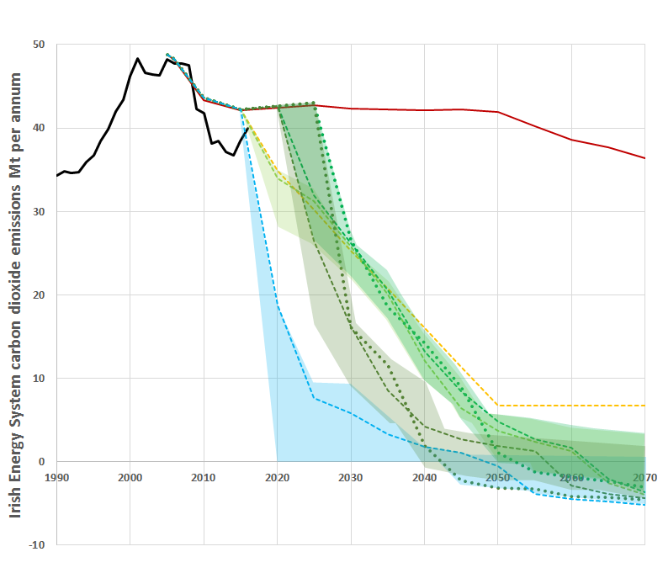
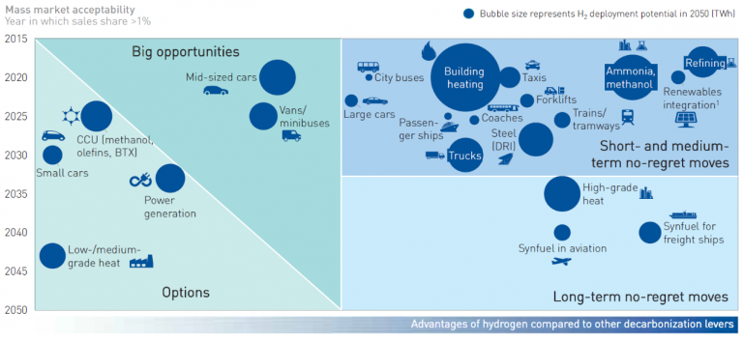
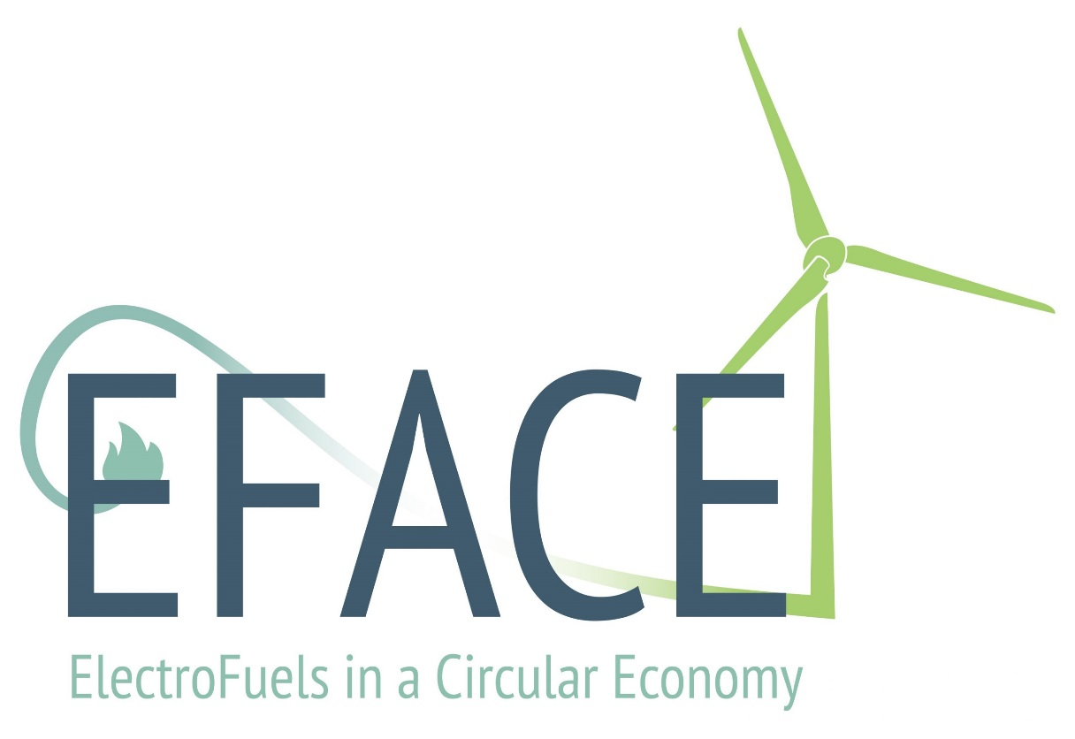
MaREI Hydrogen Research
Ireland’s Future Energy System
H-WIND Hydrogen from Offshore Wind
HyLIGHT - Hydrogen Roadmaps to Support Ireland’s Decarbonisation by 2050

Slide 7
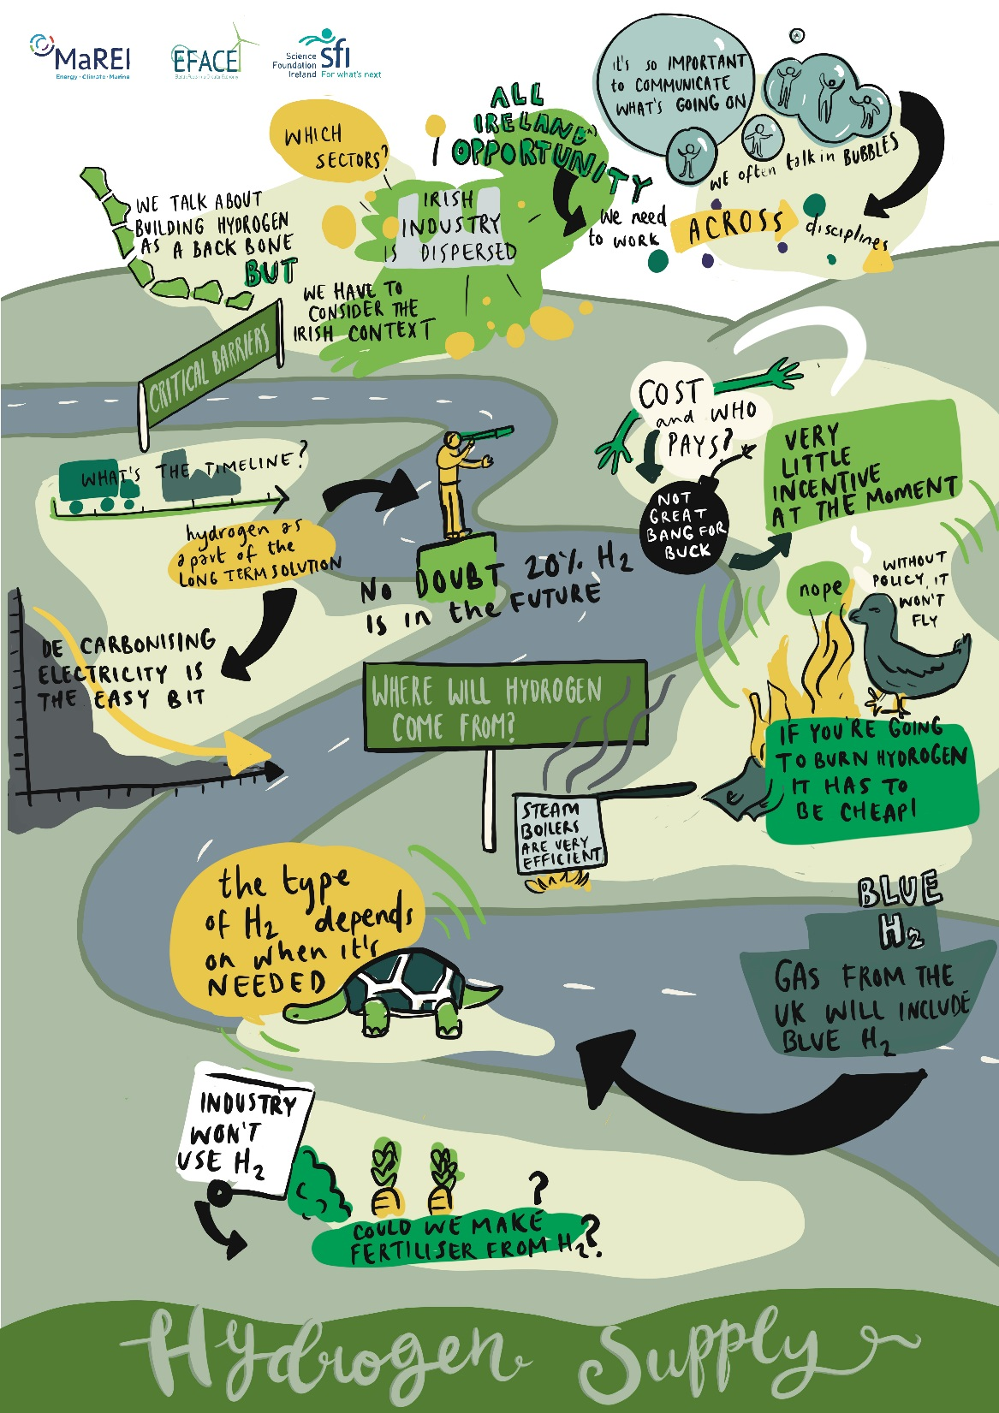
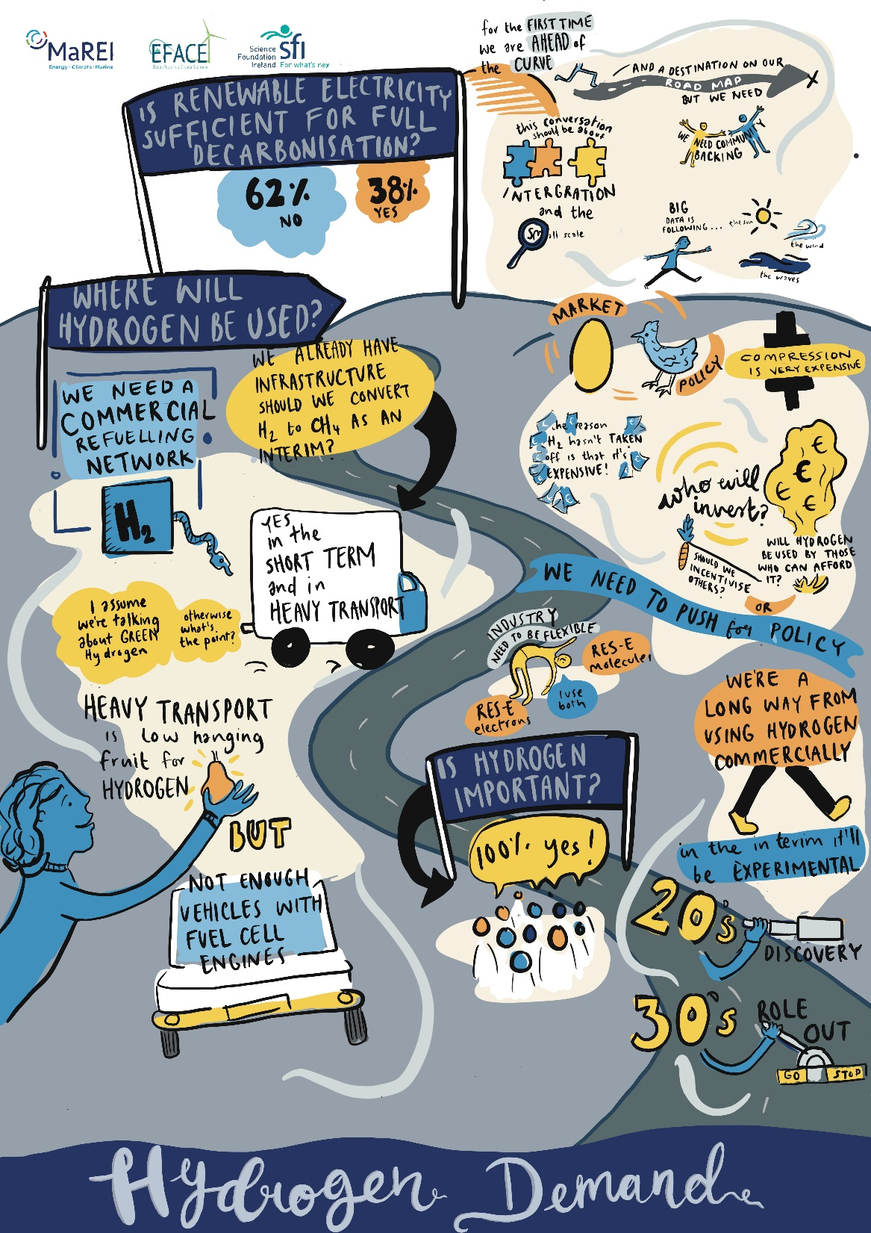
Hydrogen Supply and Demand

Slide 8
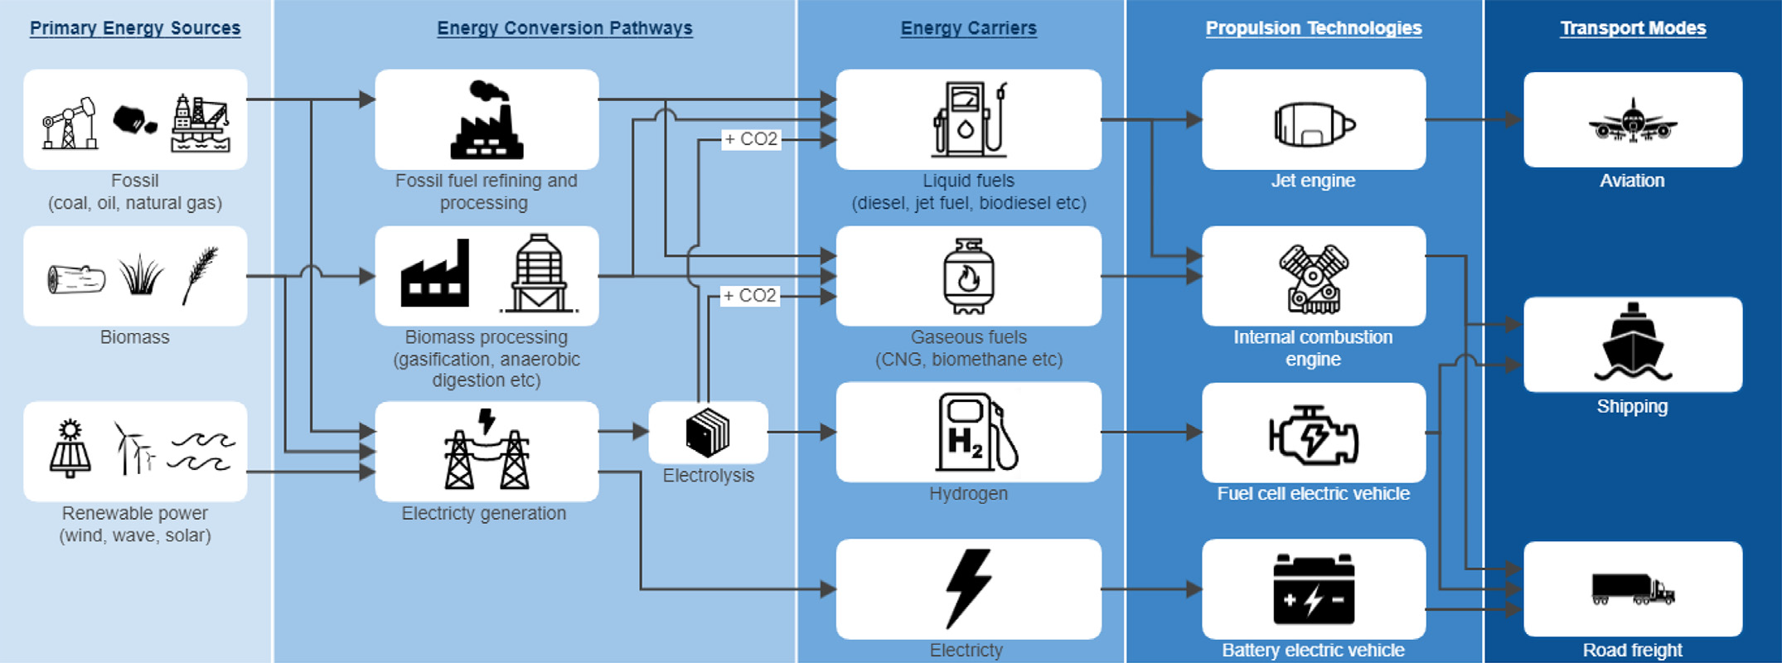
Which sectors?
Nathan Gray N., McDonagh S. O’Shea R., Smyth B., Murphy J.D 2021 Decarbonising ships, planes and trucks: An analysis of suitable low-carbon fuels for the maritime, aviation and haulage sectors. Advances in Applied Energy 1 10008 Available here

Slide 9
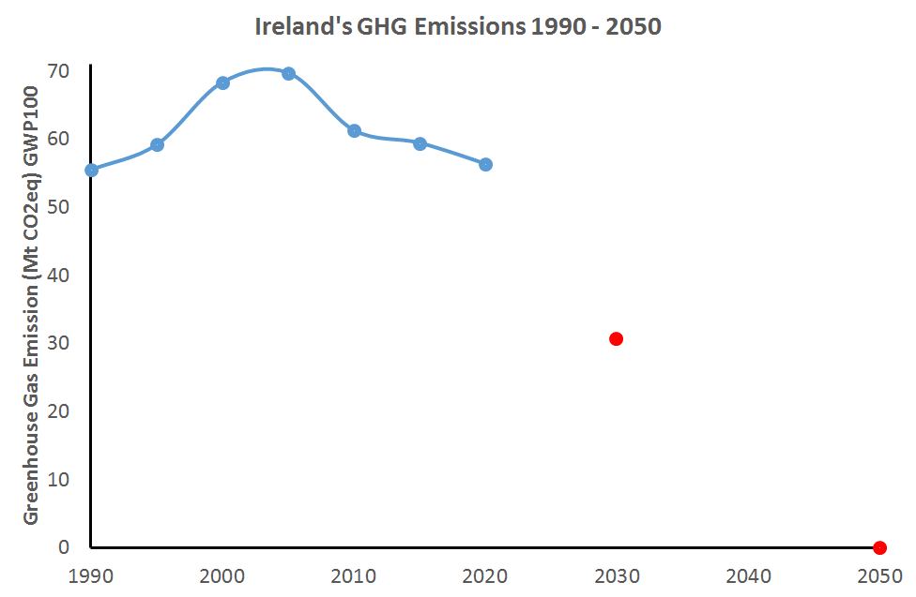
Climate Act 2021 – Climate neutral by 2050 and 51% reduction by 2030
What emissions pathway from now to 2030?

Slide 10
Climate Act 2022 – Climate neutral by 2050 and 51% reduction by 2030

Slide 11
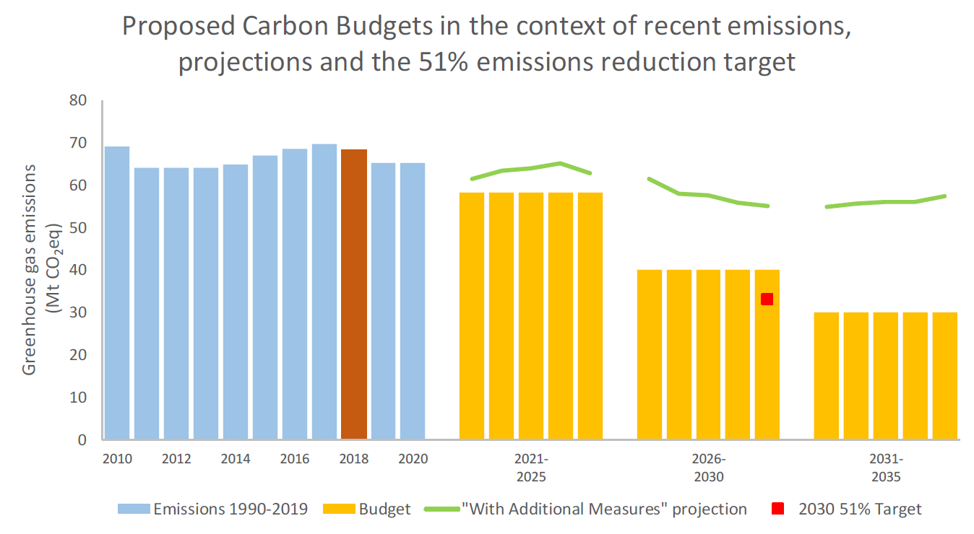
Carbon Budgets
The Climate Action and Low Carbon Development (Amendment) Act 2021 increased Ireland’s climate ambition (second in the world only to Denmark) and committed to reduce emissions by 51% by 2030 in addition to achieving net zero emissions by 2050.
Comment
This is an unprecedented level of decarbonisation across the full economy and achievability will be challenging.
Carbon budgets (left) will be influential in shaping the energy and agriculture landscape in Ireland and will pivot policy to ‘emissions reduction targets’
Sectoral emissions ceilings will be determined - lower emissions reduction potential in agriculture, will demand deeper decarbonisation of transport, heat and electricity (e.g. A33:E61)
-4.8%
-8.3%
  Climate Change Advisory Council 2021 Carbon Budget Technical Report

Slide 12
Ireland’s GHG Emissions 2005-2020
Brian Ó Gallachóir: How has Ireland reduced greenhouse gas emissions by 18% since 2005?

Slide 13
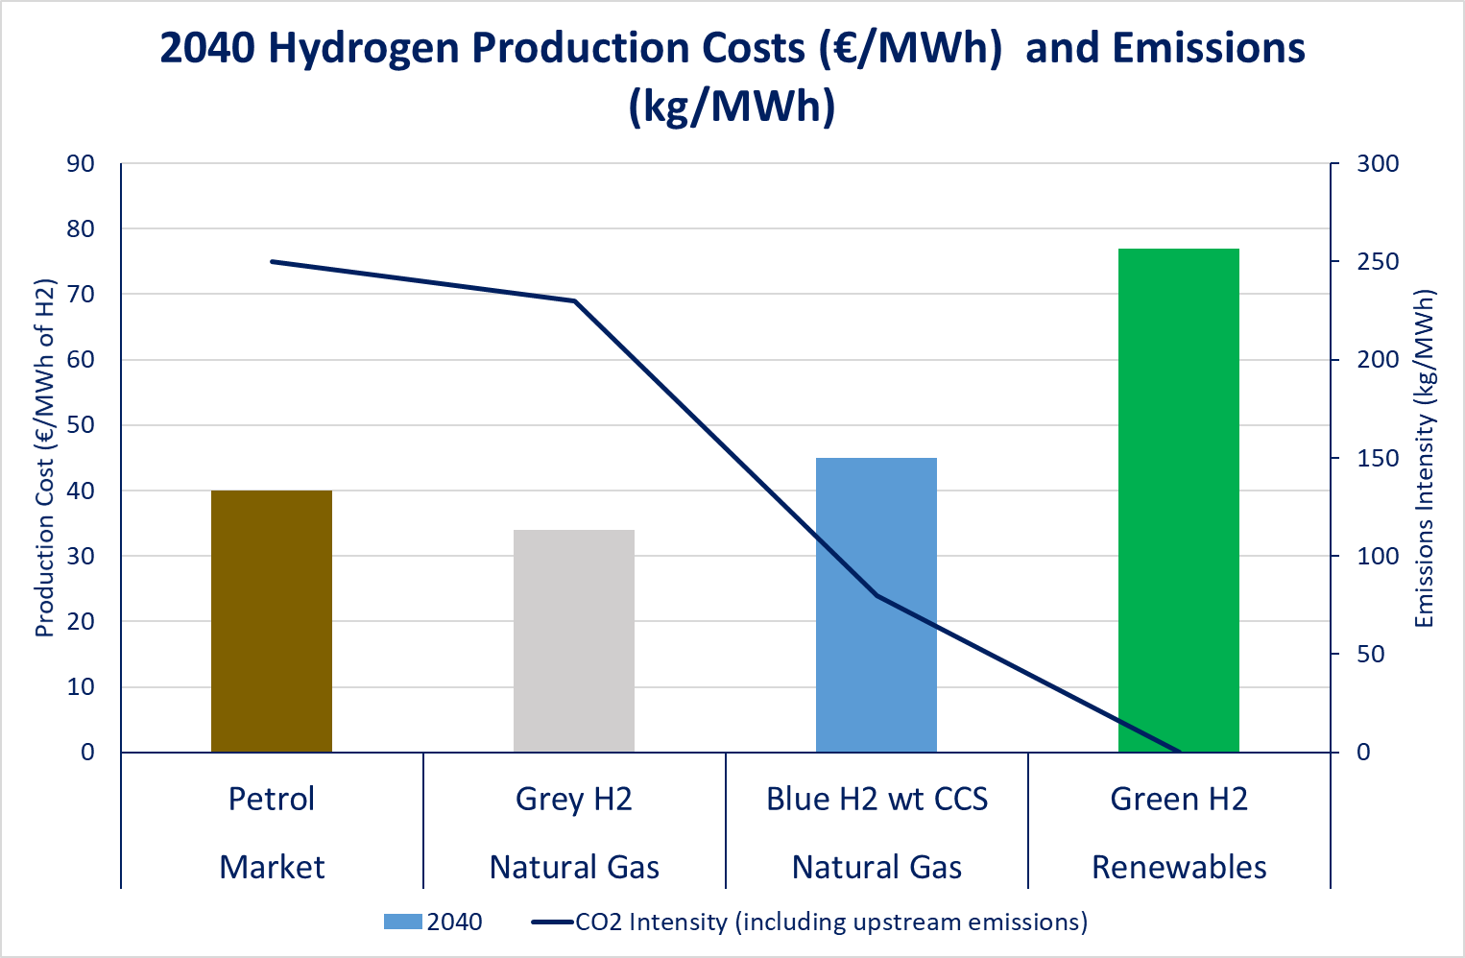
Hydrogen Costs (expected – according to UK CCC)
Source the CCC UK
https://www.theccc.org.uk/publication/hydrogen-in-a-low-carbon-economy/

Slide 14
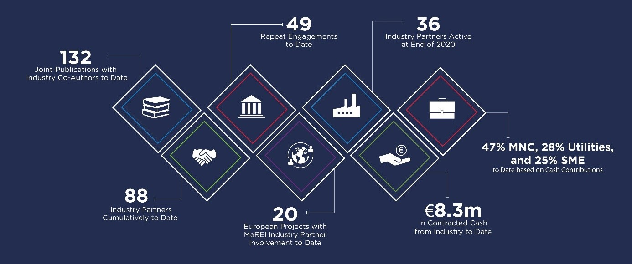
Industry collaboration

Slide 15
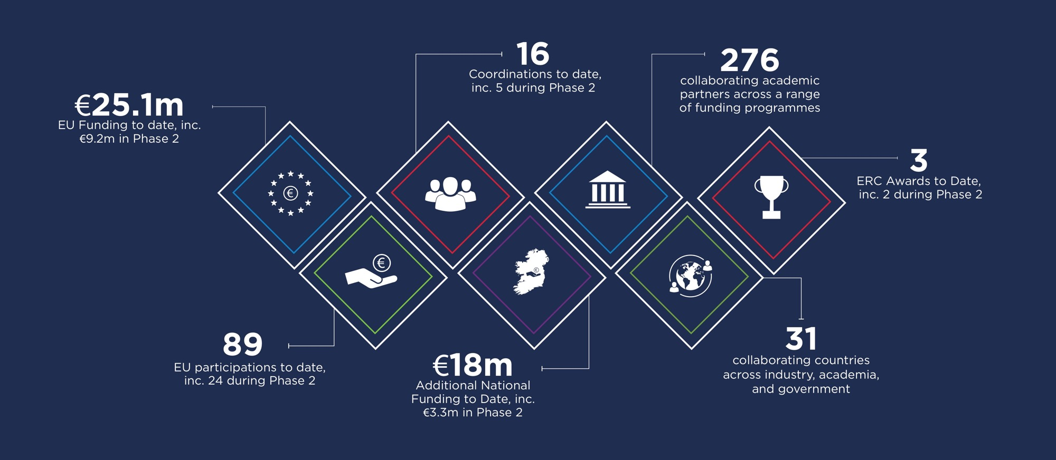
EU collaboration

