Slide 1
CEF Transport – Alternative Fuels Infrastructure Facility
Siobhán Kelly
25 February 2022

Slide 2
CEF and TEN-T
The Connecting Europe Facility (CEF) for transport is the EU funding instrument that supports the development of the Trans-European Transport Network (TEN-T).
The objectives, budget, and the rules for the current CEF programme are set out in Regulation (EU) 2021/1153 and, in more detail, in the CEF Multi-Annual Work Programme 2021-2027.
The TEN-T network is set out in Regulation (EU) No 1315/2013.

Slide 3
AFIF – what is it?
The Alternative Fuels Infrastructure Facility (AFIF) is the part of the CEF call that aims to support the deployment of alternative fuel supply infrastructure on the TEN-T network.
Projects in Ireland can apply for part of the €1.2bn funding made available under this call.
The AFIF is divided into three topics:
Recharging points for EVs and HDVs
Low-emission fuels
Zero-emission fuels (CEF-T-2021-AFIFGEN-WORKS-ZE)

Slide 4
AFIF – what support for hydrogen?
For hydrogen projects, CEF support for up to 30% of the project cost is available.
Support is available for the following types of project:
Publicly accessible refuelling stations for LDVs and/or long haul HDVs
Refuelling stations for public transport
Refuelling stations supplying railways
Refuelling facilities supplying port vehicles and equipment
Refuelling facilities supplying maritime vessels
Fitting or retrofitting the main propulsion systems of maritime vessels

Slide 5
AFIF – a blending call
Blending means the combination of EU grants with financial support from public and private financial institutions.
In order to be eligible for AFIF funding, applicants must secure the support of a financial institution for at least 10% of the overall project cost in advance of their application.
For the purpose of the call, these institutions are divided into two categories:
Implementing partners (the EIB)
Non-implementing partners (other public or private financial institutions)

Slide 6
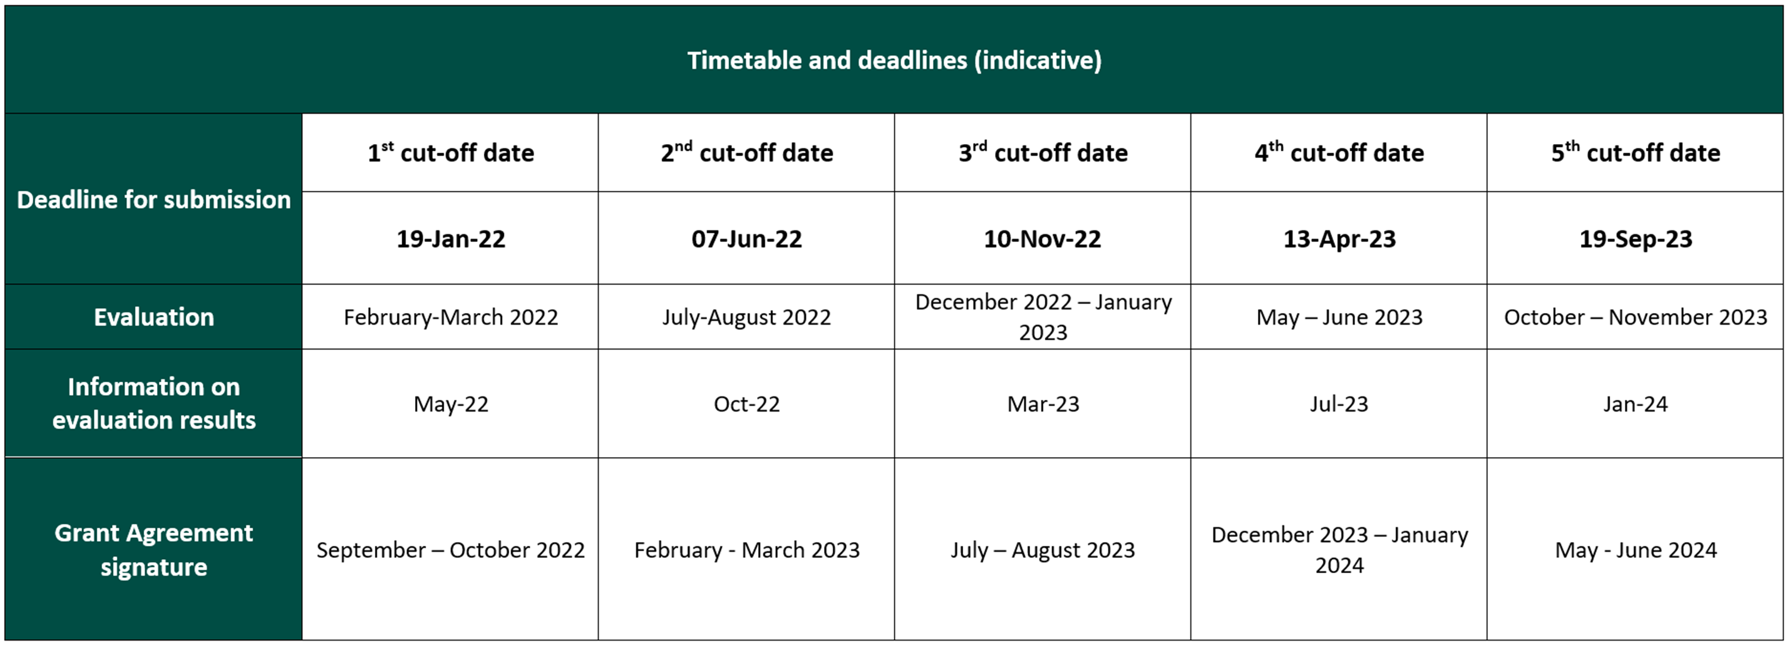
AFIF –deadlines
Send your draft applications to the Department of Transport at least two months before the EU deadline!

Slide 7
What next?
Watch the EU info day on the call: https://cinea.ec.europa.eu/events/virtual-info-day-cef-transport-call-alternative-fuels-infrastructure-facility-afif_en
Read the call document and the FAQ: https://ec.europa.eu/info/funding-tenders/opportunities/portal/screen/opportunities/topic-details/cef-t-2021-afifgen-works-ze
Arrange support from a financial institution
Contact us: EUCoordination@transport.gov.ie

