Slide 1
Promoting a green, smart and just transition in North-West Europe
Sarah Davoren
National Contact Point

Slide 2
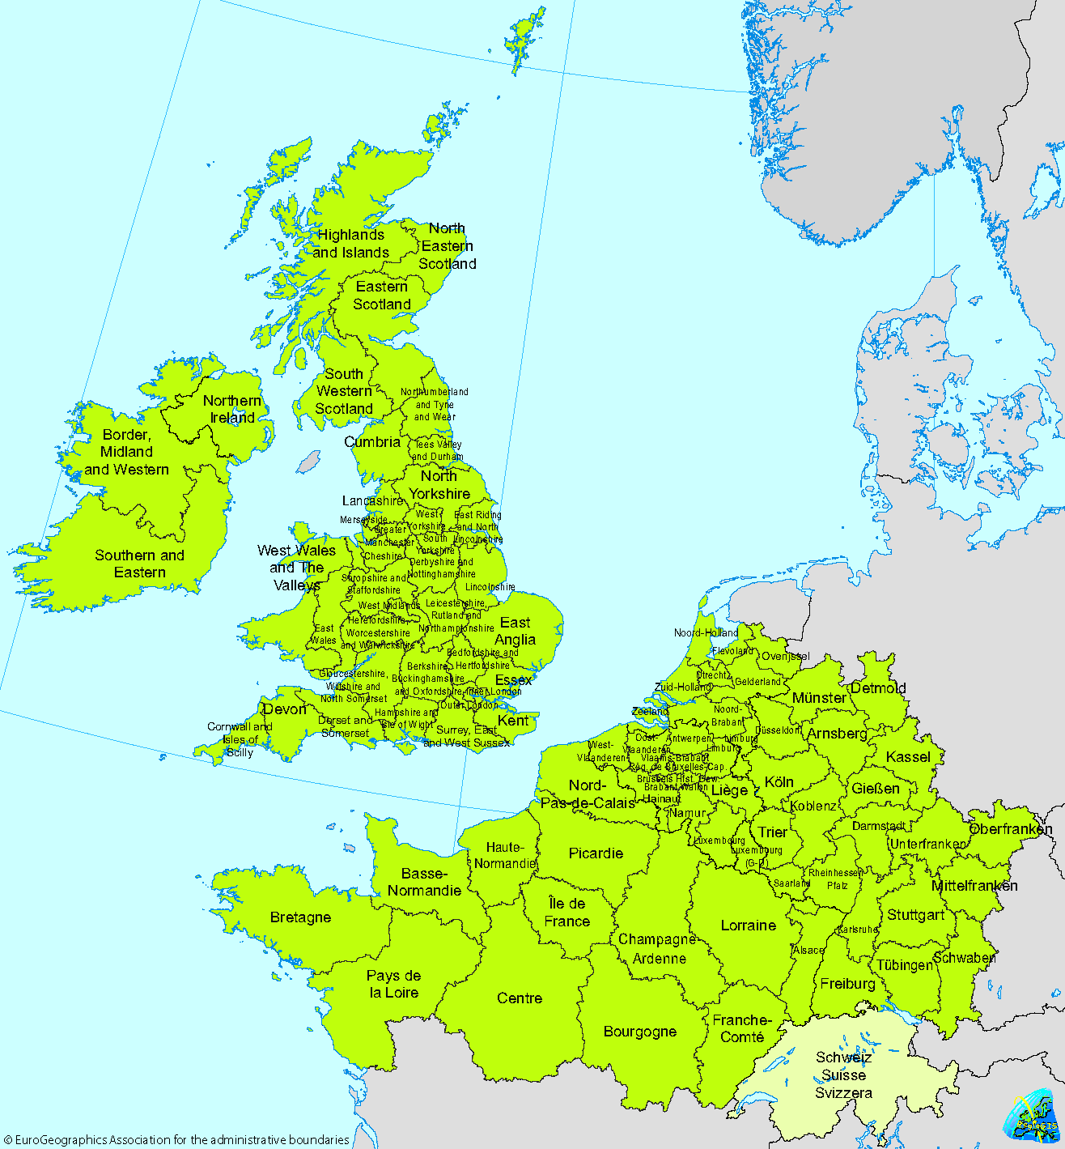
The NWE Programme 2014-2020
Across NWE
102 financed projects
1078 project partners
€378 million ERDF allocated
In Ireland
€60 million invested nationwide
€35 million directly to 137 Irish partners

Slide 3
The NWE Programme 2014-2020
Programme partner breakdown (all countries):
30% Higher education and research
24% SMEs/Enterprises
16% Public authorities (local, regional, national)
PUBLIC
50.5%
PRIVATE
49.5%
Type of partner breakdown (Ireland):
25% Higher education and research
32% SMEs, Private enterprises
31% Public authorities (local, regional, national)
11% Interest groups, NGOs, other

Slide 4
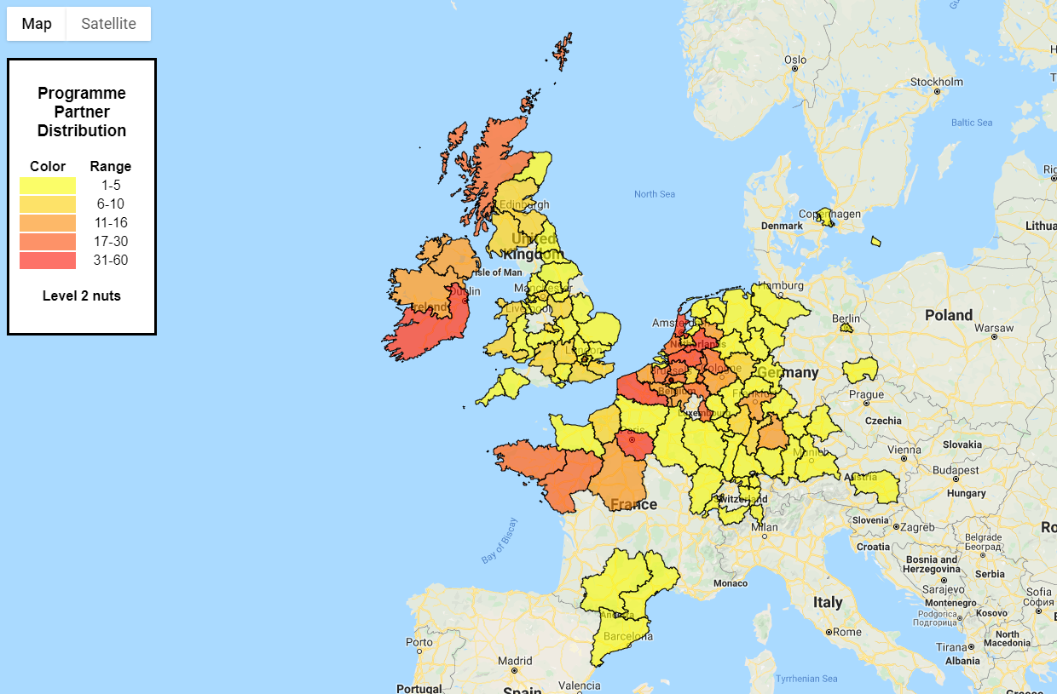
Partner distribution (2014-2020)
Priority 4
Improving territorial resilience in NWE through innovative and smart transformation
Priority 5
Inclusive NWE

Slide 5
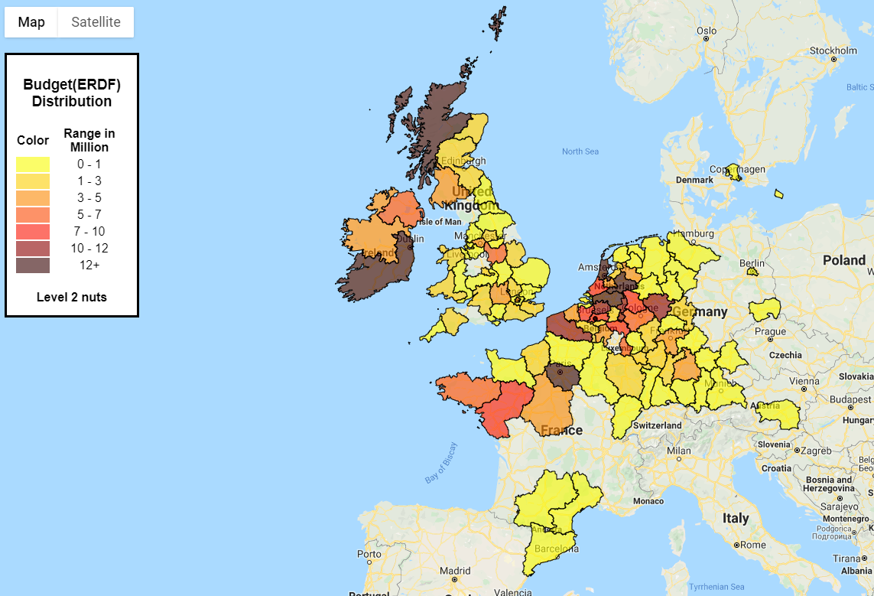
Distribution of funds (2014-2020)

Slide 6
NWE making an impact!
Expected results by 2023

Slide 7
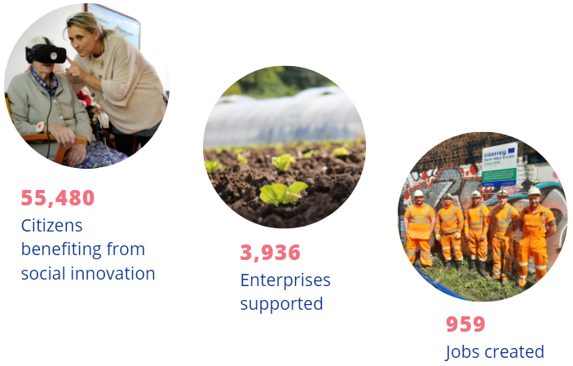
NWE making an impact!
Expected results by 2023

Slide 8
The NWE Programme 2021-2027
EU Area covered:
Belgium, France, Germany, Ireland, Luxembourg, the Netherlands and Switzerland
New regions:
Germany and NL
Irish area covered:
All counties are eligible

Slide 9
The NWE Programme 2021-2027
7 countries
Transnational cooperation:
Projects need at least 3 countries, of which 2 are from the NWE area
Overall budget:
€703 million
EU contribution:
€400 million (60%)
(40% co-funding required at project level.)

Slide 10
The NWE Programme 2021-2027

Slide 11
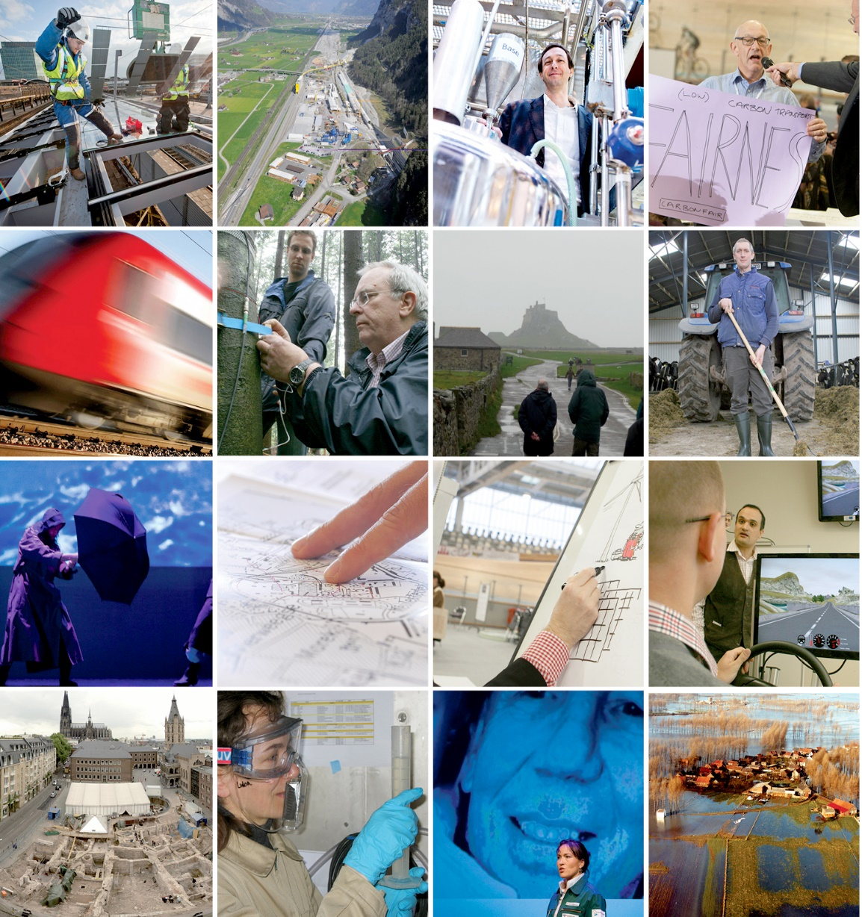
Thematic focus
2021-2027
Priority areas
1. Climate and environment
2. Energy transition
3. Circular Economy
4. Innovation and resilience
5. Inclusive society

Slide 12
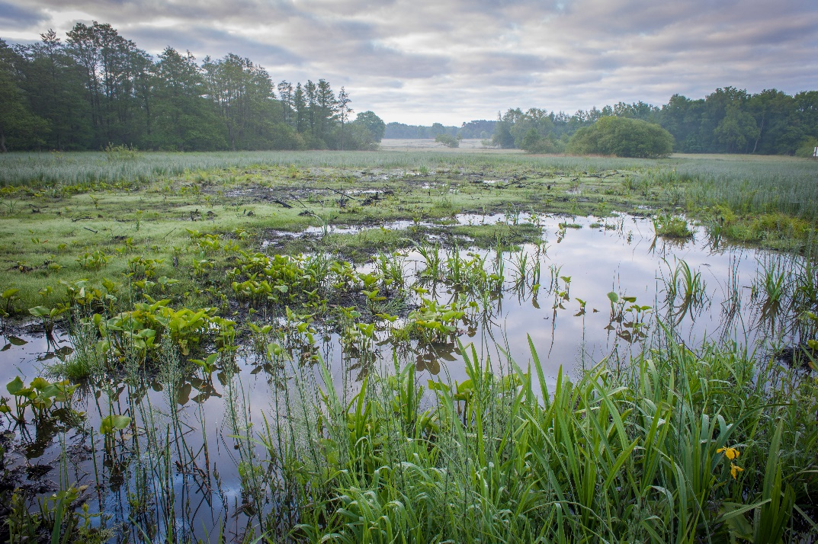
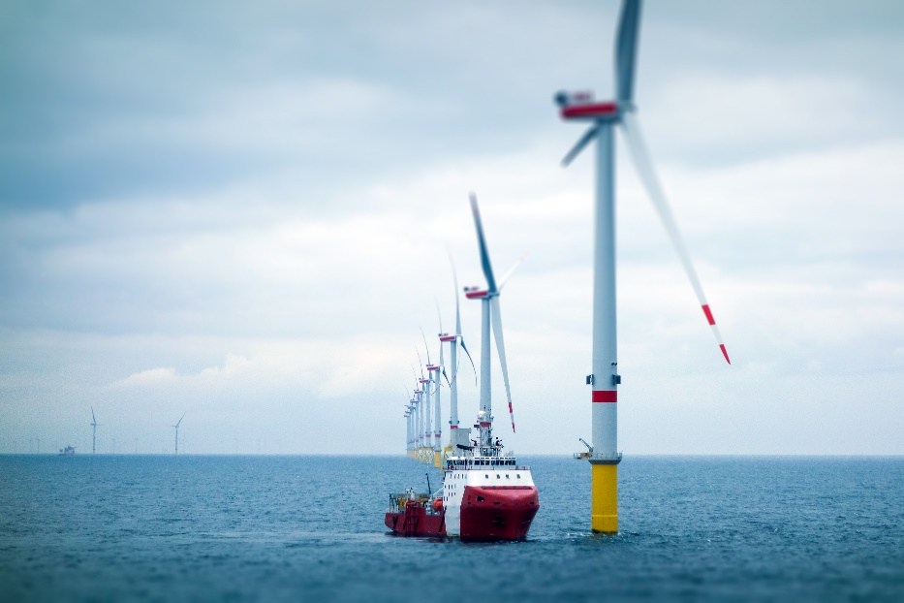
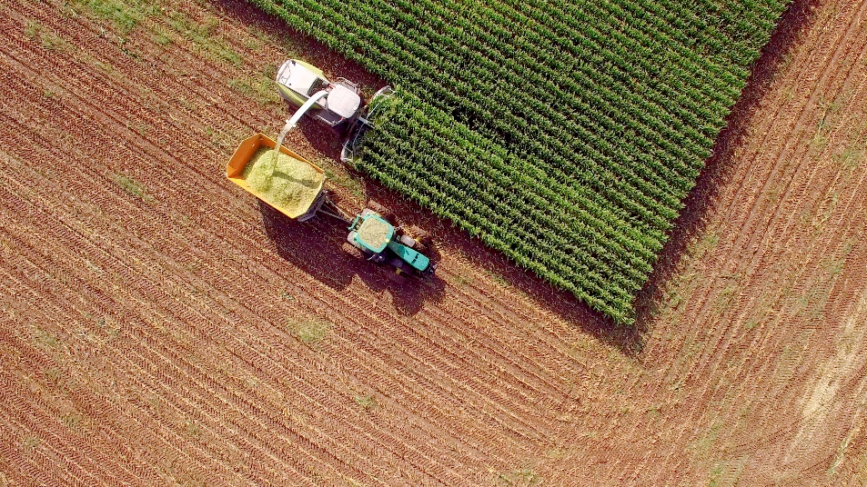
Thematic focus
2021-2027
Priority 1
Climate and Environment
Priority 2
Energy Transition
Priority 3
Circular Economy
SO 2.7
Enhancing nature protection, biodiversity and reducing all forms of pollution
SO 2.1
Promoting energy efficiency and reducing greenhouse gas emissions
SO 2.6
Promoting the transition to a circular and resource efficient economy
SO 2.4
Promoting climate change adaptation and disaster risk prevention resilience
SO 2.2
Promoting renewable energy

Slide 13
Thematic focus
2021-2027
Priority 4
Innovation and resilience
Priority 5
Inclusive society
SO 4.1
Enhancing the effectiveness and inclusiveness of labour markets and access to quality employment through developing social infrastructure and promoting social economy
SO 1.1
Developing and enhancing research and innovation capacities and the uptake of advanced technologies
SO 4.5
Ensuring equal access to healthcare through developing infrastructure, including primary care, and promoting the transition from institutional to family and community-based care
SO 4.6
Enhancing the role of culture and sustainable tourism in economic development, social inclusion and social innovation

Slide 14
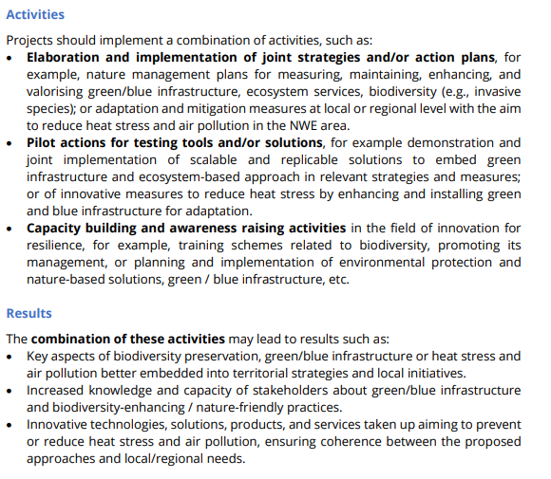
Factsheets
Available here for every SO: https://www.nweurope.eu/future-nwe-programme/call-1-support-documents/
Example

Slide 15
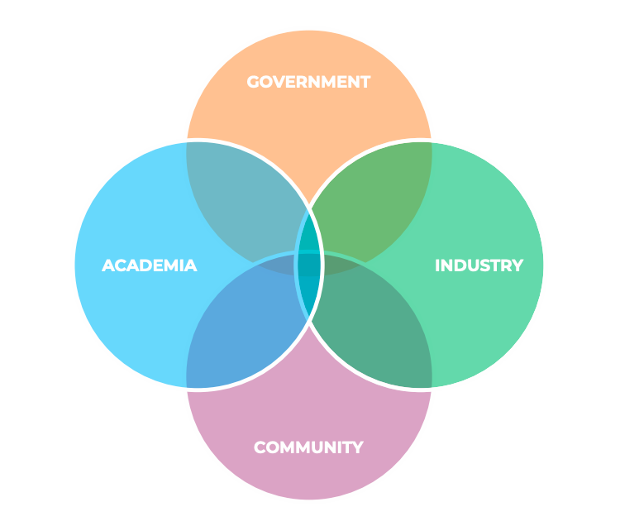
What makes a good project
Who are we looking for? (beneficiaries/project partners)
Public: Local/regional/national authorities, governmental agencies, public equivalent organisations
Private: SMEs and business support organisations
Academia: Universities, public research centres, private research units, schools and higher education, training centres
Civil Society: Sectoral associations, NGOs, lobby organisations, citizens groups
Priority 4
Improving territorial resilience in NWE through innovative and smart transformation
Priority 5
Inclusive NWE

Slide 16
What makes a good project
Type of projects:
Project dissemination / roll out / uptake throughout all NWE territories
Priority 5
Inclusive NWE
A combination of activities:
Elaboration and implementation of joint strategies or action plans
Pilot actions for testing tools / solutions upscaled and replicated
Capacity building and awareness raising activities

Slide 17
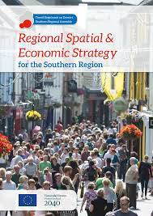
What makes a good project
Clearly defined needs and relevance
Specifies why it is needed.
What territorial challenges and opportunities it will address?
What change (project results) in NWE territories?
Identifies the profile of the territories it will intervene in (i.e., rural, peri-urban, urban…).
Embedded in an overall strategic framework.

Slide 18
What makes a good project
A balanced partnership and transnational approach
Involves the right types of organisations
Consider the quadruple helix
IP text defines target groups per SO.
Transnational nature

Slide 19
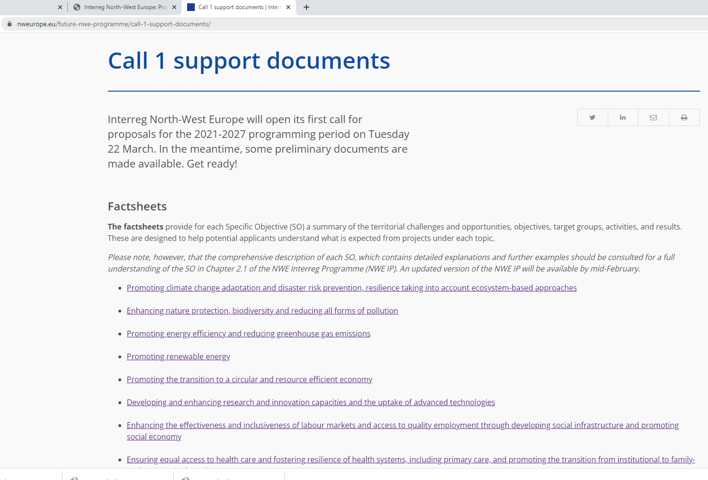
What makes a good project
Clear contribution to Interreg NWE objectives
Needs to contribute to one of the Programme SOs.
Clear objective that links to one SO – realistic and achievable.
Up to three project specific objectives (‘foreseen project specific objectives’ in Step 1).
Clearly defines and quantifies expected outputs and results.

Slide 20
What makes a good project
Builds on and goes beyond existing approaches
A good project does not reinvent the wheel.
Develop and test new approaches;
Adapt and implement existing approaches in different sectors/regions for further uptake (as defined in the NWE IP).
Long-term effects
Activities must be included in the Work Packages.
Clearly linked to activities and Work Package objectives.

Slide 21
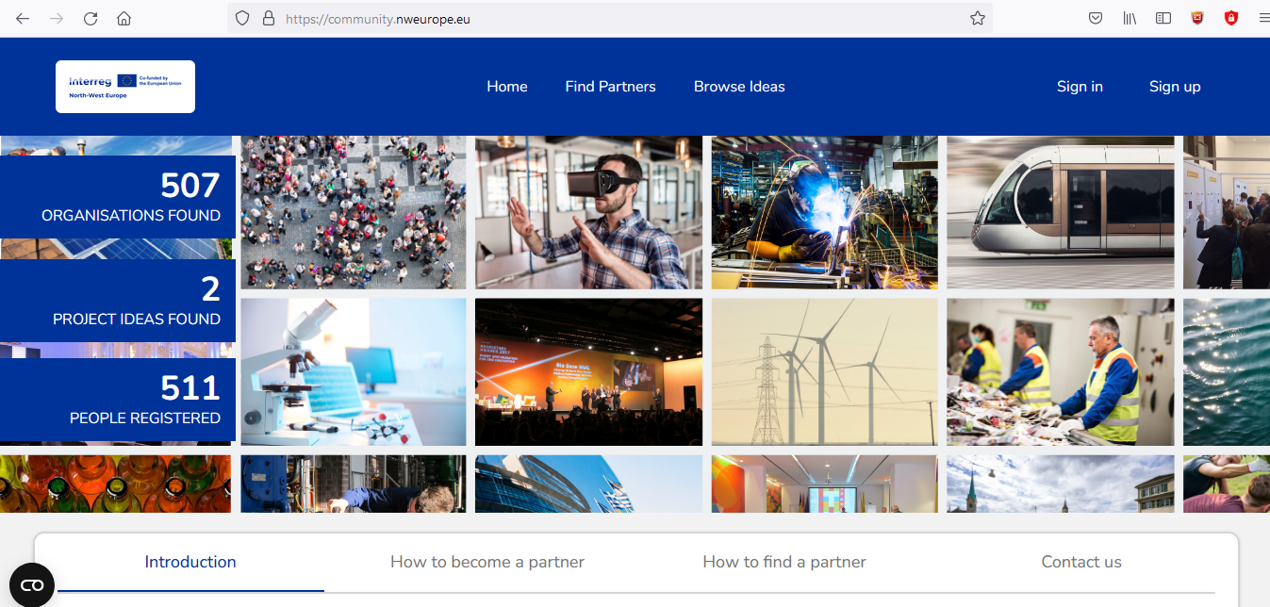
Online Applicant community
Find international partners
Float project ideas
Browse ideas in the pipeline
Centralised library of key call documents and guidance
Click here to Register: www.community.nweurope.eu

Slide 22
Prepare your application
Key documents (see website)
Word version of Step1 application form
Assessment Criteria
Eligibility Criteria
Advice, support, find partners, be informed
Get first advice and support from the NWE CPs
Use the « Applicant community platform »
Participate in programme launch event (31st March 2022)
Click here for Joint Secretariat mailing list
Click here for Irish partner mailing list

Slide 23
THANK YOU!
Email: sdavoren@southernassembly.ie

