Slide 1
European Funding Opportunities
Philip Cheasty Enterprise Ireland February 2022

Slide 2
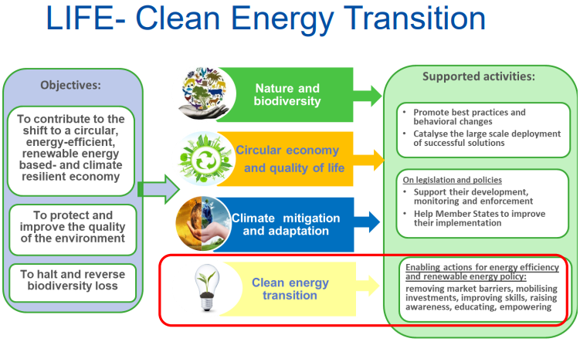
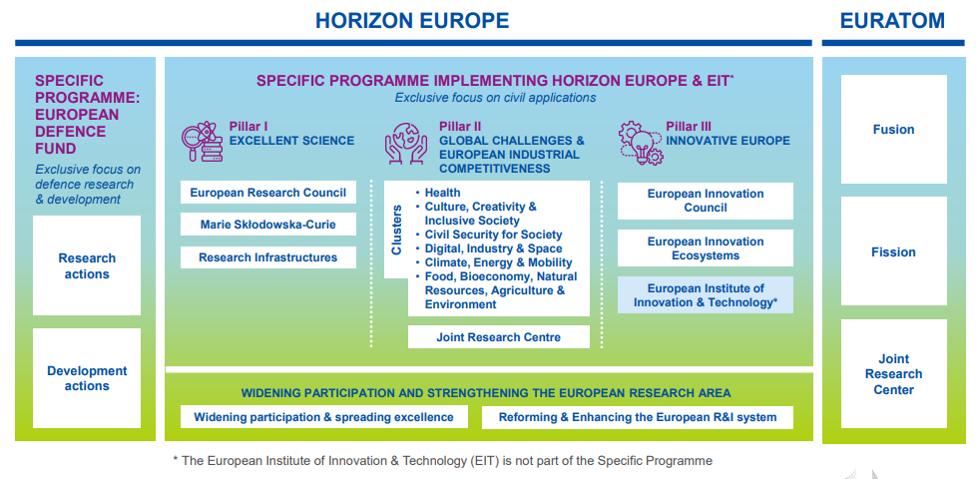
National Contact Point For
Horizon Europe Cluster 5 Climate, Energy and Mobility
LIFE - Clean Energy Transition subprogramme
H2020 Green Deal call. Projects such as GreenH2Atlantic – Pioneer -Tulips
Notes:
GREENH2ATLANTIC -a first-of-a-kind 100 MW alkaline electrolyser at TRL8,
Led by the Port of Antwerp PIONEERS project on clean energy production and supply, the deployment of electric, hydrogen and methanol vehicles, sustainable port design, modal shift and flows optimisation, and digital transformation through AI- and 5G-based digital platforms.
TULIPS project - reduced greenhouse gas emissions at airports.

Slide 3
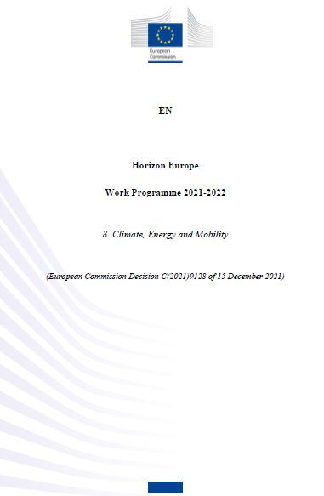
Current Horizon Europe Cluster 5 Climate, Energy and Mobility
workprogramme
HORIZON-CL5-2021-D2-01-09: Methane cracking to usable hydrogen and carbon
HORIZON-CL5-2021-D5-01-07: Enabling the safe and efficient on-board storage and integration within ships of large quantities of ammonia and hydrogen fuels (ZEWT Partnership)
Energy System topics see Hydrogen as an application.
HORIZON-CL5-2022-D3-01-13: Energy system modelling, optimisation and planning tools.

Slide 4
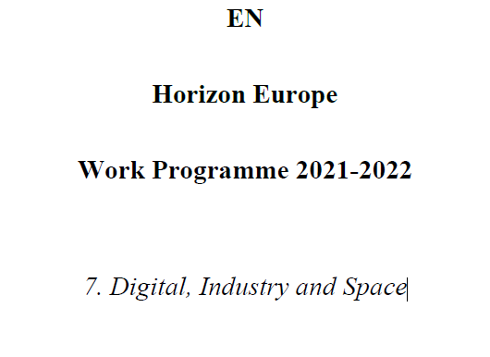
Current Horizon Europe Cluster 4 Digital, Industry and Space
workprogramme
HORIZON-CL4-2022-TWIN-TRANSITION-01-17: Integration of hydrogen for replacing fossil fuels in industrial applications (Processes4Planet Partnership) (IA)
HORIZON-CL4-2021-RESILIENCE-01-17: Advanced materials for hydrogen storage (RIA). closed

Slide 5
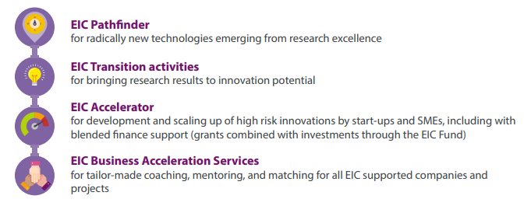
Horizon Europe Pillar III

Slide 6
Horizon Europe Pillar III
‘EIC Pathfinder Open’, open to proposals in any field of science, technology or application without predefined thematic priorities;
TRL1-4
Transformative positive effect to our economy and society.
science-towards-technology breakthrough
High-risk/high-gain research approach and methodology, with concrete and plausible objectives.
Collaborative research. at least three independent legal entities,
Up to €3m 100% funding Deadline 3 May 2022

Slide 7
Horizon Europe Pillar III
‘EIC Pathfinder Challenges’ to support proposals within a predefined thematic area and addressing specific objectives.
Challenge: Carbon dioxide and nitrogen management and valorisation
Challenge: Mid to long term and systems integrated energy storage
4 other Challenge in Health, ICT
TRL starting at 2 and reaching 3-4
Collaborative research Or from single legal entity
Up to €4m Deadline 19 October 2022
2021 EIC Pathfinder challenge: Novel routes to green hydrogen production. Results not out yet.

Slide 8
Horizon Europe Pillar III
EIC Transition Open which has no predefined thematic priorities and is open to proposals in any field of science, technology or application;
or
EIC Transition Challenges in predefined thematic areas of emerging and strategic technologies.
EIC Transition is restricted to proposals based on results generated by the following eligible projects: EIC Pathfinder projects, Horizon 2020 FET-Open, FET-Proactive) and FET Flagships calls (including ERANET calls under the FET Work Programme).
European Research Council Proof of Concept projects.
TRL starting at 2 and reaching 3-4: collaborative research (5 partners max) Or from single legal entity
Up to €2.5m Deadline 4 May 2022. 28 September 2022.
EIC Transition Challenge: Process and system integration of clean energy technologies.

Slide 9
Horizon Europe Pillar III
At least Technology Readiness Level 5/6 or higher
EUR 0.5 to EUR 17.5 million Blended finance – Grant Only or Grant first
Short proposals (result after 4 weeks)
If successful, you will be invited to prepare a full proposal, where you will have
access to support through the EIC artificial intelligence-based IT platform and
from EIC business coaches to develop a detailed business plan; 5/6 weeks
3. Full proposals will first be assessed remotely by EIC expert evaluators. If
successful, you will be invited to a face to face interview with an EIC jury as the
final step in the selection process;
23 March 2022 at 17h00 Brussels local time; 15 June 2022 at 17h00 Brussels local time;
5 October 2022 at 17h00 Brussels local time;
EIC Accelerator Challenge: Technologies for ‘Fit for 55’

Slide 10
Other Funding Mechanisms
Innovation Fund
Catalyst Fund initiative https://www.breakthroughenergy.org/catalyst-eu-rfp
ec_rtd_eu-catalyst-factsheet.pdf (europa.eu)
Start by focusing on four critical technologies for decarbonization:
Direct air capture (DAC)
Green hydrogen
Long-duration energy storage (LDS)
Sustainable aviation fuel (SAF

Slide 11
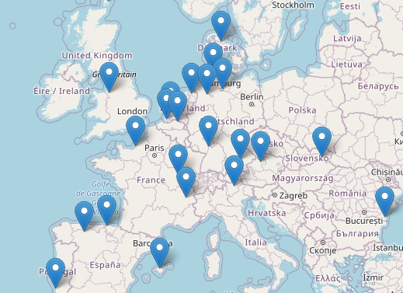
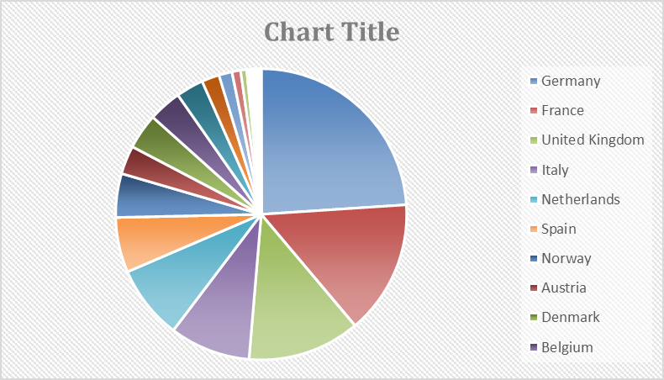
Clean Hydrogen JU
Pillar 1: Renewable Hydrogen Production
Pillar 2: Hydrogen storage and distribution
Pillar 3: Hydrogen end uses
Pillar 3.1: Transport applications
Pillar 3.2: Clean heat and power
Horizontal Activity 2: Hydrogen Valleys
ESB’s Green Atlantic at Moneypoint
ESB’s plans include investment in a green hydrogen production,
storage and generation facility at Moneypoint towards the
end of the decade. A clean, zero-carbon fuel, green hydrogen will be produced from renewable energy and used for power generation, heavy goods vehicles in the transport sector and to help decarbonise a wide range of industries such as pharmaceuticals, electronics and cement manufacturing.
€ 638,885,191

Slide 12
Clean Hydrogen JU
PILLAR 2: HYDROGEN STORAGE AND DISTRIBUTION
Pillar 1: Renewable Hydrogen Production
RIA | Compatibility of Transmission and Distribution gas grid steels with hydrogen and development of mitigation techniques
RIA | Compatibility of Distribution non-steel metallic gas grid materials with hydrogen
RIA | Hydrogen and H2/NG mixture leak detection system for continuous monitoring and safe operation of HRS and future hydrogen/H2NG networks
RIA | Validation of a high-performance hydrogen liquefier prototype
RIA | Ammonia to Renewable Hydrogen: efficient system for ammonia cracking for application to long distance transportations
RIA | Efficient system for dehydrogenation of liquid organic hydrogen carriers for application to long distance transportations
RIA | Development of large scale LH2 containment for shipping
RIA | Increased hydrogen capacity of GH2 road trailers
IA | Development of novel or hybrid concepts for reliable, high capacity and energy-efficient H2 compression systems at real-world scale
RIA | Sampling methodology and quality assessment of HRS
RIA | Implementing new/optimised refuelling protocols and components for high flow HRS
IA | Development and demonstration of mobile and stationary compressed hydrogen refuelling solutions for application in inland shipping and short-distance maritime operations
PILLAR 3.1: HYDROGEN END USES:
TRANSPORT APPLICATIONS
RIA | Addressing the sustainability and criticality of electrolyser and fuel cell materials
RIA | Development and validation of pressurised high temperature steam electrolysis stacks (SOEL)
RIA | Development and validation of pressurised high temperature steam electrolysis stacks (PCCEL)
RIA | Development of low temperature water electrolysers for highly pressurised hydrogen production
RIA | Design for advanced and scalable manufacturing of electrolysers
RIA | Scaling up of cells and stacks for large electrolysers
RIA | Efficiency boost of solar thermochemical water splitting
IA | Bringing renewable hydrogen MW scale off grid installations closer to technical and financial maturity
IA | Integration of multi MW electrolysers in industrial applications
RIA | Scaling up technologies for SOEL
IA | Demonstrating offshore production of renewable hydrogen
RIA | Development and optimisation of reliable and versatile PEMFC stacks for high power range applications
RIA | Innovative and optimised MEA components towards next generation of improved PEMFC stacks
IA | Large scale demonstration of European H2 Heavy Duty Vehicle along the Ten-T corridors
RIA | LH2 tanks for heavy-duty vehicles
IA | Large scale demonstration of hydrogen fuel cell propelled inland waterway vessels
RIA | Development and optimisation of a dedicated Fuel Cells for Aviation: from dedicated stack (100s kW) up to full system (MWs)
RIA | Development of specific aviation cryogenic storage system with a gauging, fuel metering, heat management and monitoring system

Slide 13
Clean Hydrogen JU
IA | Design and industrial deployment of innovative manufacturing processes for fuel cells and fuel cell components
RIA | Ammonia powered fuel cell system focusing on superior efficiency, durable operation and design optimisation
RIA | Reversible SOC system development, operation and energy system (grid) integration
RIA | Dry Low NOx combustion of hydrogen-enriched fuels at high-pressure conditions for gas turbine applications
CSA | Public understanding of hydrogen and fuel cell technologies
RIA | Safety of cryogenic hydrogen storage and transfer technologies in public areas and for mobile application
RIA | Safe hydrogen injection management at network-wide level: towards European gas sector transition
RIA | Development of validated test methods and requirements for measuring devices intended for measuring NG/H2 mixtures
IA | H2 Valley
CSA | Proposal l for Research & Innovation co-operation with Africa on hydrogen
PILLAR 3.2: HYDROGEN END USES: CLEAN HEAT AND POWER
HORIZONTAL 1:CROSS-CUTTING
HORIZONTAL 4: STRATEGIC RESEARCH CHALLENGES
HORIZONTAL 2: HYDROGEN VALLEYS

Slide 14
THANK YOU

