Slide 1
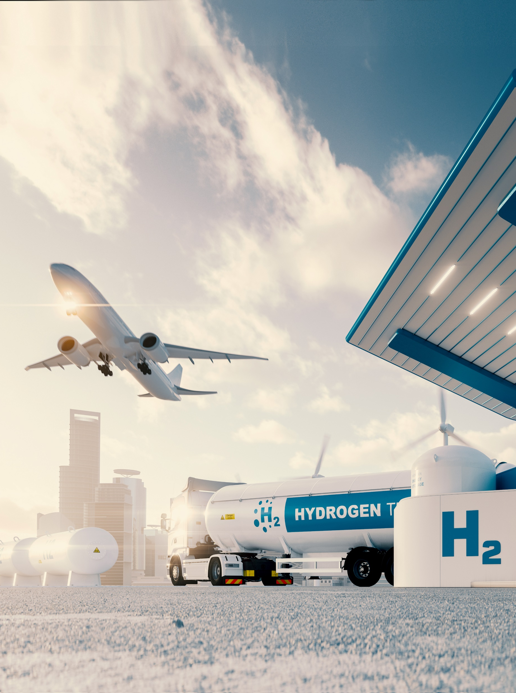

European Hydrogen Valleys
Bart Biebuyck
Executive Director
24-25 February 2022

Slide 2



Clean Hydrogen Joint Undertaking
EU Institutional Public-Private Partnership (IPPP)
Industry
More than 350 members
Research community
over 103 members
To facilitate the transition to a greener EU society through the development of hydrogen technologies

Slide 3





Clean Hydrogen JU Objectives
Support a sustainable hydrogen economy, contributing to EU’s climate goals
Contribute to the EU ambitious 2030 and 2050 climate ambition
Support the implementation of the Commission’s Hydrogen Strategy
Stimulate research and innovation on clean hydrogen production, distribution, storage and end use applications
Strengthen the competitiveness of the EU clean hydrogen value chain

Slide 4
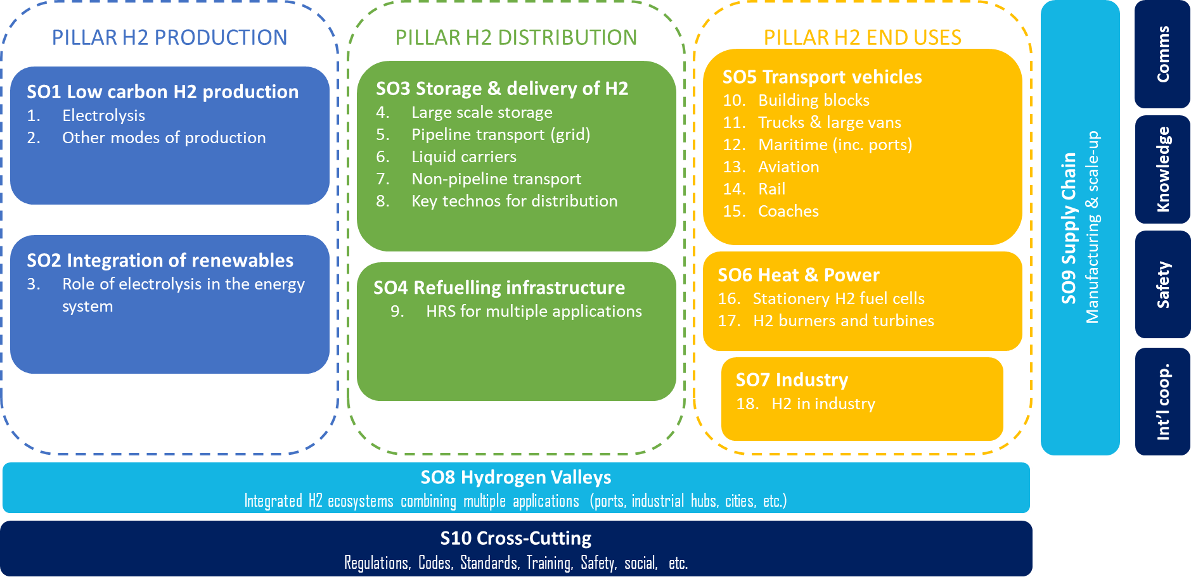

Research and Innovation priorities in Clean Hydrogen JU
Maintain and strengthen EU’s global leadership role through a € 2.0 bn research program

Slide 5
Clean Hydrogen JU Programme
H₂ Storage & Distribution
H₂ Valleys
22 Projects
€ 55.8 million
3 Projects
€ 35 million
287 projects supported for
€ 1.08 bn(*)
Cross-cutting
46 Projects
€ 65 million
H₂ End Uses
  Transport Applications
  Clean Heat and Power
    159 Projects
    € 739.6 million
H₂ Production
Electrolysis
Other routes
  57 Projects
  € 181 million
(*) Similar leverage of other sources of funding: € 1.08 bn

Slide 6

  Republic of Ireland
Clean H₂ Contribution: € 280k
2 Projects (H₂ Valleys)
  GREEN HYSLAND
  HEAVENN
3 Beneficiaries
Additional information
  20 planned m-CHP (PACE project)
  Other Projects *
SEAFUEL (Interreg)
GENCOMM (Interreg)
Hylantic (Interreg)
Various *
1 Trial Bus deployed (BOC)
Future goals: Ireland to become a major H₂ exporter
*Not directly related to Clean H₂ JU activities
Notes:
https://www.irishtimes.com/business/energy-and-resources/green-hydrogen-could-be-vital-to-decarbonising-ireland-report-1.4780540
https://hydrogenireland.org/
https://www.nweurope.eu/projects/project-search/gencomm-generating-energy-secure-communities/
http://www.seafuel.eu/
https://heavenn.org/
https://greenhysland.eu/

Slide 7


















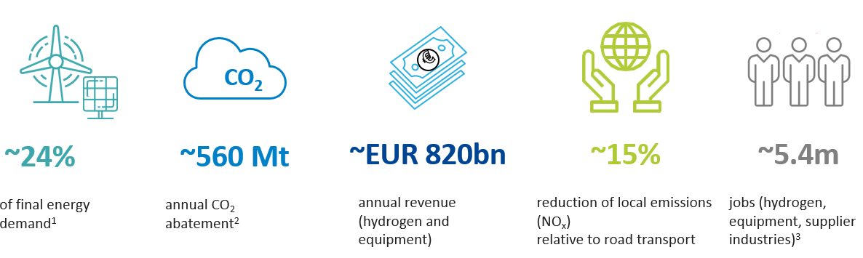
Besides CO₂ abatement, deployment of the hydrogen roadmap also cuts local emissions, creates new markets and secures sustainable employment in EU
2050 hydrogen vision

Slide 8
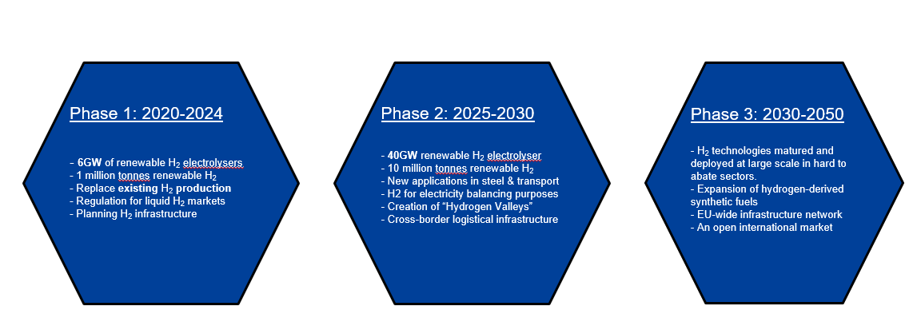
EU Hydrogen Strategy launched on 8th July 2020
Objectives in 3 phases with the Hydrogen Alliance to support the investment agenda
Clean Hydrogen Alliance to support the EU investment agenda

Slide 9
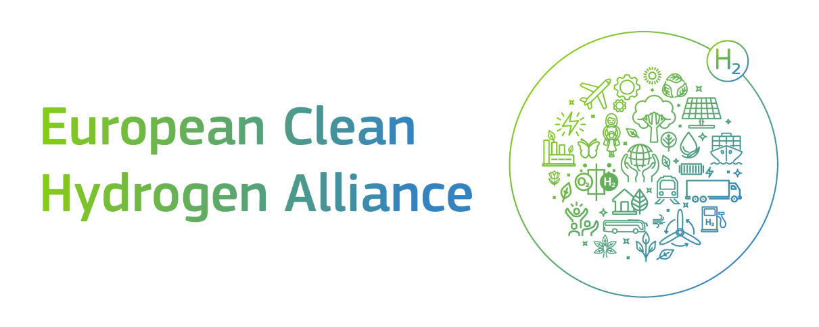
What is it?
Hydrogen Production
Launch on 8th July 2020
Mission to create a project pipeline for a massive role-out of EU Clean Hydrogen technology
Involving all active stakeholders in the clean hydrogen ecosystem, bringing together supply and demand
The blueprint estimates investments of
€430 billion by 2030
Transmission & Distribution
Mobility Applications
Industrial Applications
Energy Applications
Residential Applications

Slide 10
Hydrogen valleys

Slide 11
Definition of a Hydrogen Valley
Used in the call topics and the Mission Innovation platform
A Hydrogen Valley is a defined geographical area where hydrogen serves more than one end sector or application in mobility, industry and energy. They typically comprise a multi-million euro investment and cover all necessary steps in the hydrogen value chain, from production (and often even dedicated renewable electricity production) to subsequent storage and its transport & distribution to various off-takers.

Slide 12
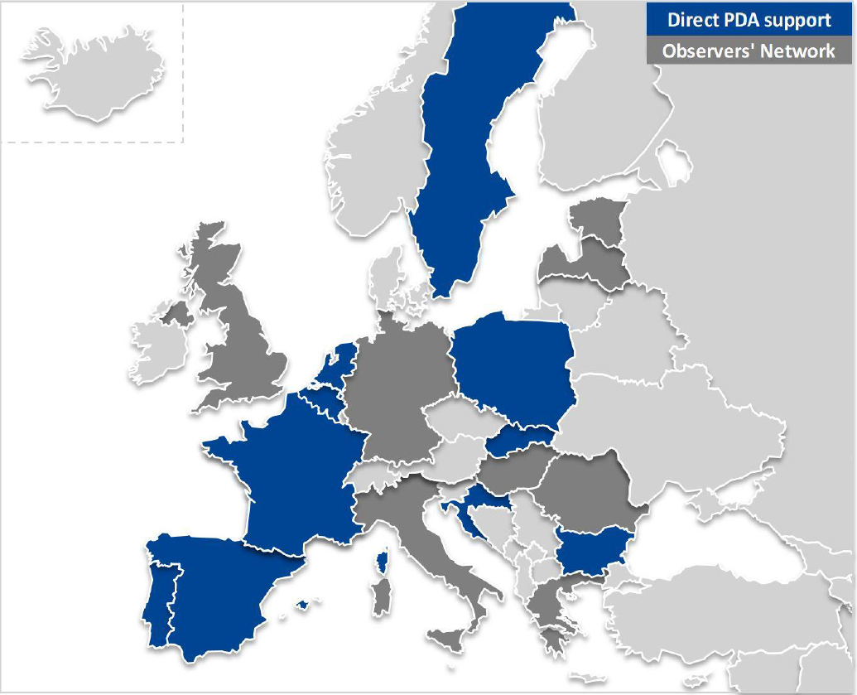
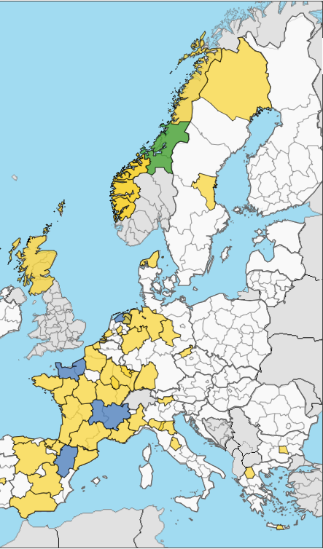


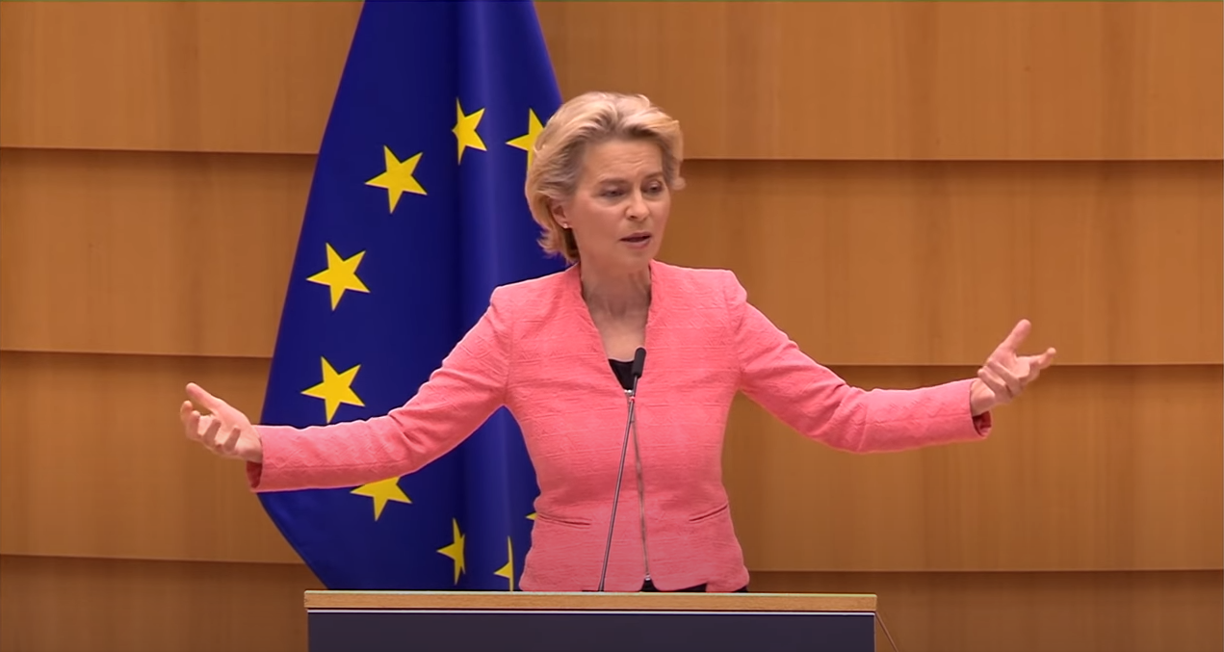
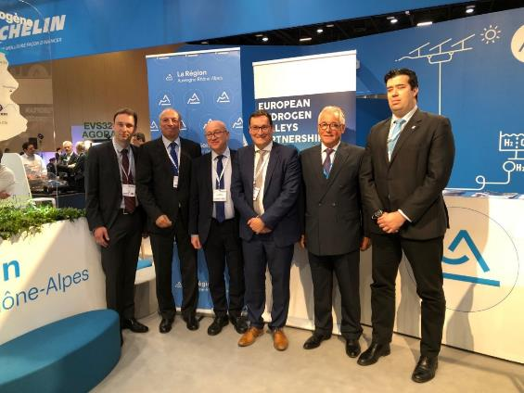
The region initiative was key to boost the H₂ awareness in EU
The 100 regions initiative led to the PDA, H₂ Valley partnership and funding of H₂ Valley
https://www.clean-hydrogen.europa.eu/get-involved/fch-regions-hub-0_en
(1) Project Development Assistance (PDA)
(2) EU H₂ Valleys Partnership
(3) Creation of H₂ valleys
“I want Next Generation EU to create new European Hydrogen Valleys to modernise our industries, power our vehicles and bring new life to rural areas.”
Great opportunity to bring on-board and share learnings with ‘less FCH ready’ but higly interested central and eastern European regions
Partnership led by:
North of Netherlands (NL)
Auvergne-Rhône Alpes (FR)
Le Normandy (FR)
Aragon (ES)
56 regions joined
Q2 2022 another PDA will be launched focus on central and eastern Europe
http://s3platform.jrc.ec.europa.eu/hydrogen-valleys

Slide 13

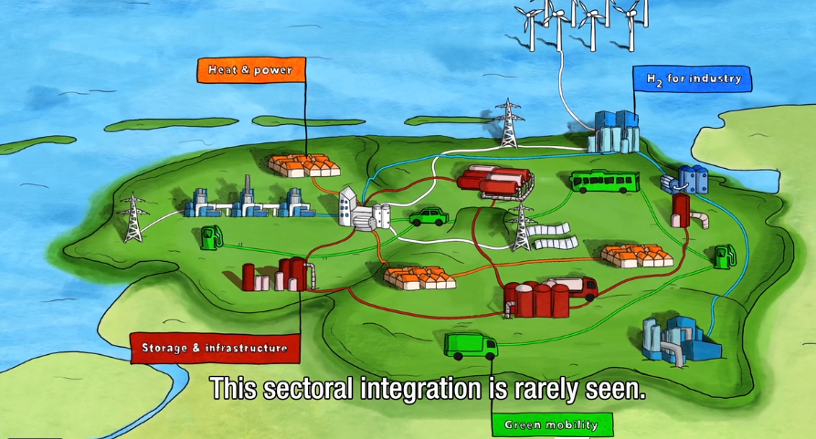
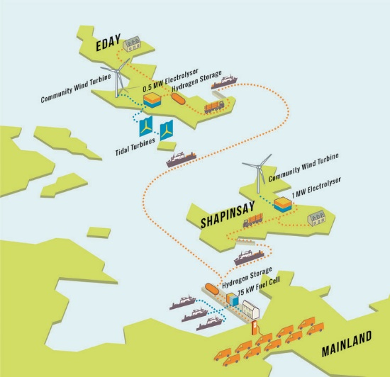
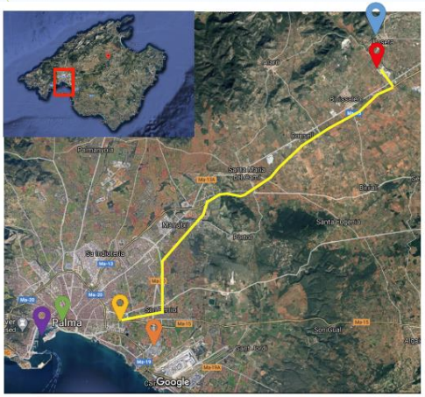

13
Clean Hydrogen Partnership funded Hydrogen Valleys
Three different projects were supported
1
2
3
  2015: Orkney’s Island (Scotland):
  H2 production by wind on Islands
  Storage & transportation by truck
  Use: heat (school), power (ferries) & mobility (municipality cars)
2019: North Netherlands (Groningen):
31 partners (public + private)
Electrolysis for green H2 production,
H2 Mobility: buses, passenger cars and trucks
H2 Refueling stations
E-Kerosene for aviation
H2 for an inland water transport barge
Domestic Heat applications
Underground H2 storage (Hystock)
2020: Hydrogen Island (Spain)
H2 production from solar
H2 injection in gas-grid
Use: heat (hotel, municipality buildings), power (port of Palma), mobility (buses)
    Future Possible (cross-border) H₂ valleys: Ports, Airports, Industrial hubs, Logistical hubs, A H2 city (or area)

Slide 14
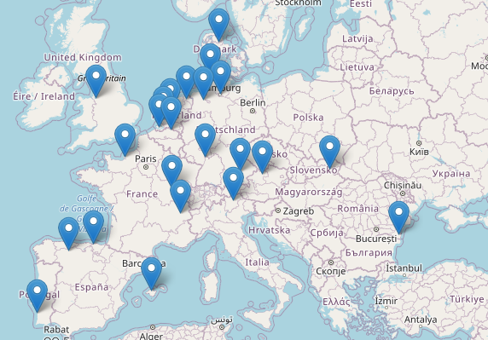











Hydrogen Valleys in Europe www.h2v.eu
23 Hydrogen valley’s identified in 10 EU countries + U.K.
1 in Denmark:
Hobro (Hybalance)
3 in The Netherlands:
North Netherland
Zuid Holland
Zeeland (H2 delta)
5 in Germany:
Munich (Hybayern)
Mannheim (H2rivers)
Heide (eFarm)
Hamburg (NDRL)
Oldenburg (HyWays)
2 in U.K.:
- North West England
- Orkney Islands
4 in France:
Rhone Alpes
Normandy
Bourgogne Franche Comté
French Guiana
1 in Slovakia:
Kosice (Black Horse)
1 in Romania:
Constanza (Blue Danube)
1 in Portugal:
Sines industrial hub
3 in Spain:
Island Mallorca
Basque (BH2C)
Green Crane
1 in Italy:
Bolzano
1 in Austria:
Linz (WIVA)

Slide 15
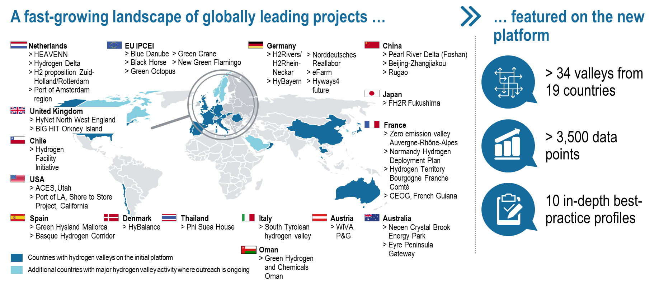
15
Hydrogen valleys have become a global theme
Integrated projects are emerging all around the world and sharing lessons learned to accelerate the energy transition
www.h2v.eu

Slide 16
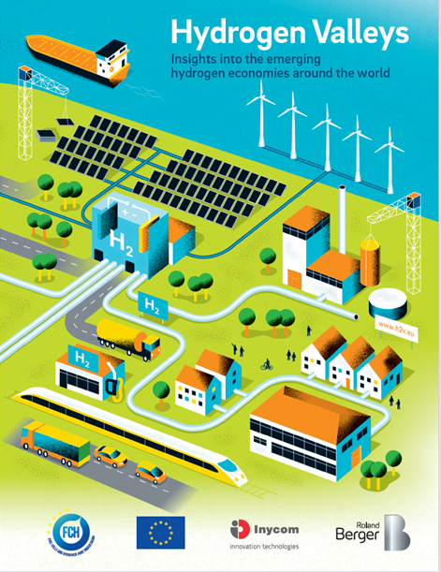
16
Hydrogen Valleys continue under Mission Innovation 2.0
Final report identified key barriers to be tackled under the next Hydrogen Mission
  MI 1.0 identified Key Remaining Barriers:
  Obtaining public funding support to close funding gaps
  Finding green hydrogen off-takers and signing long-term contracts
  Ensuring Clean Hydrogen applications Technology readiness
  Ensuring adequate legal regulatory support
  (carbon pricing, standardization, fast permitting…)
  Next steps under MI 2.0:
  Further development and enhancement of the MI Hydrogen Valley Platform.
  Target for 100 Hydrogen Valleys and minimum three in each member country.

Slide 17
Hydrogen Production

Slide 18
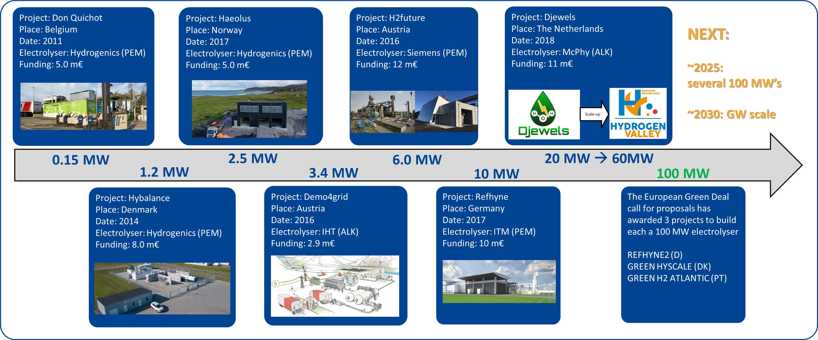
Electrolysis projects: increase capacity & lowering cost
Europe is world-leader in electrolysis systems
(EU has the most patents and publications vs other parts of the world)
Next: building standard modules (10~20MW), replacing materials, cost reduction

Slide 19
Transport

Slide 20
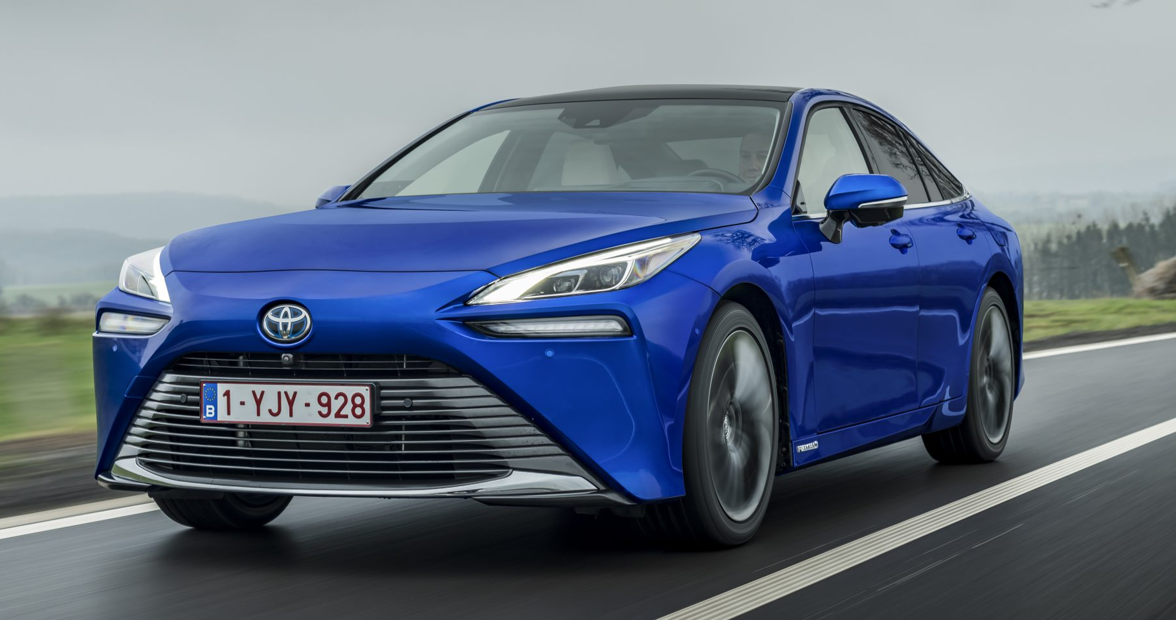
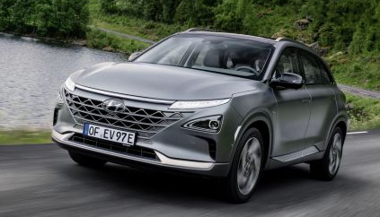
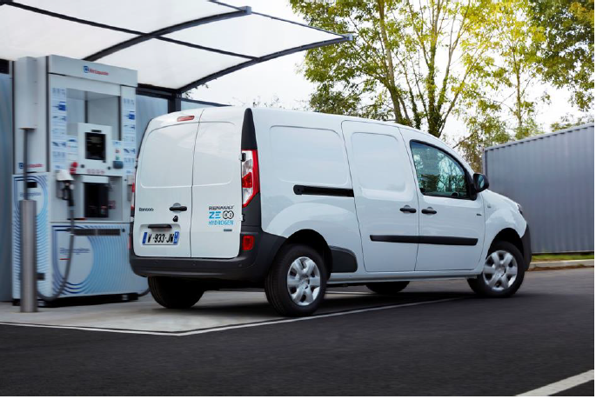
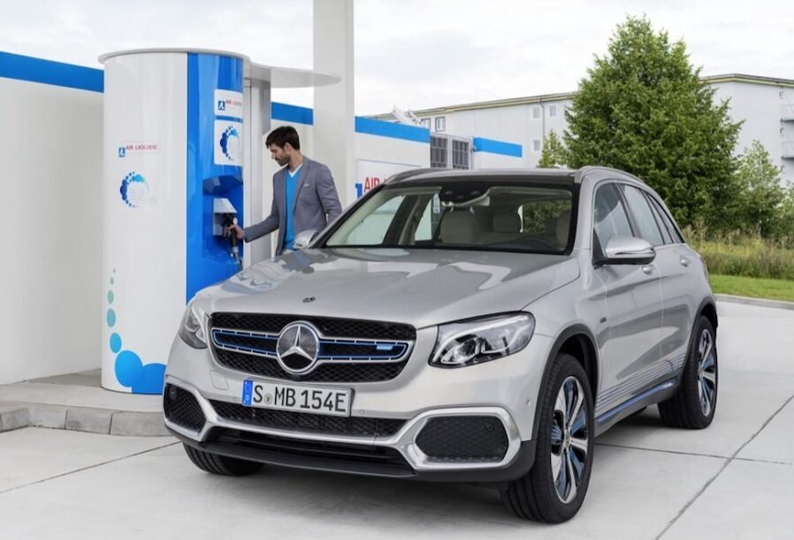
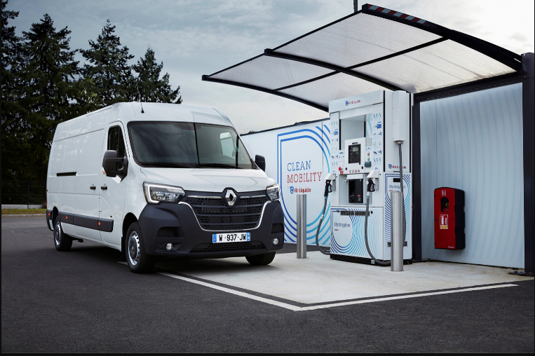
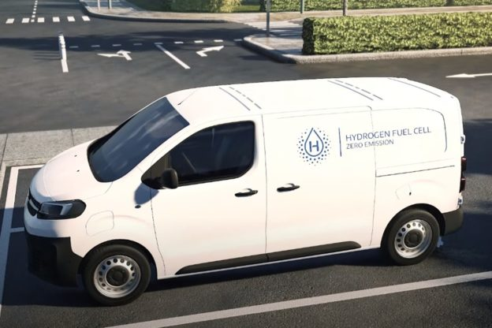
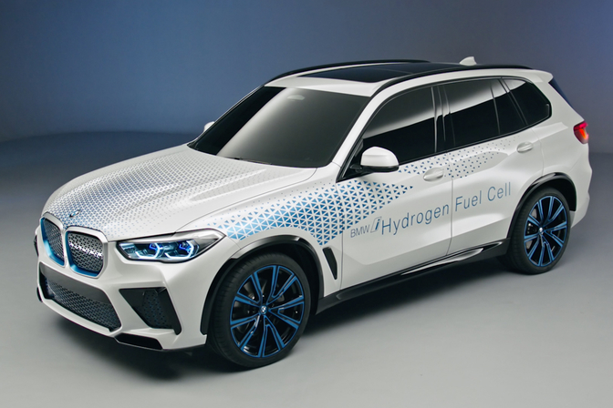
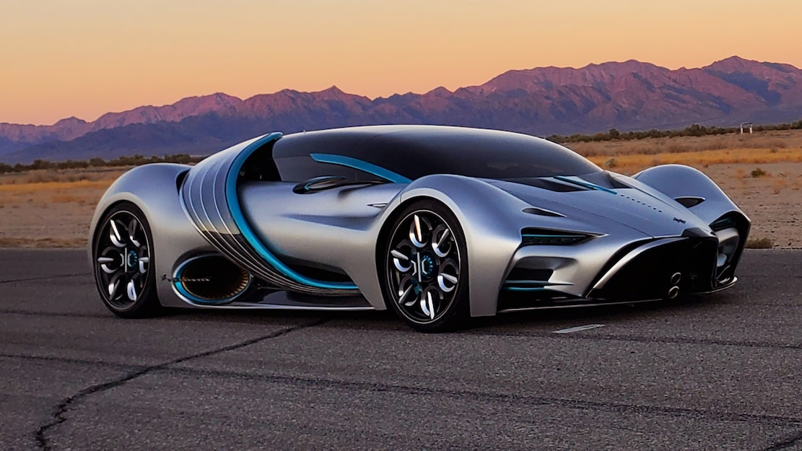
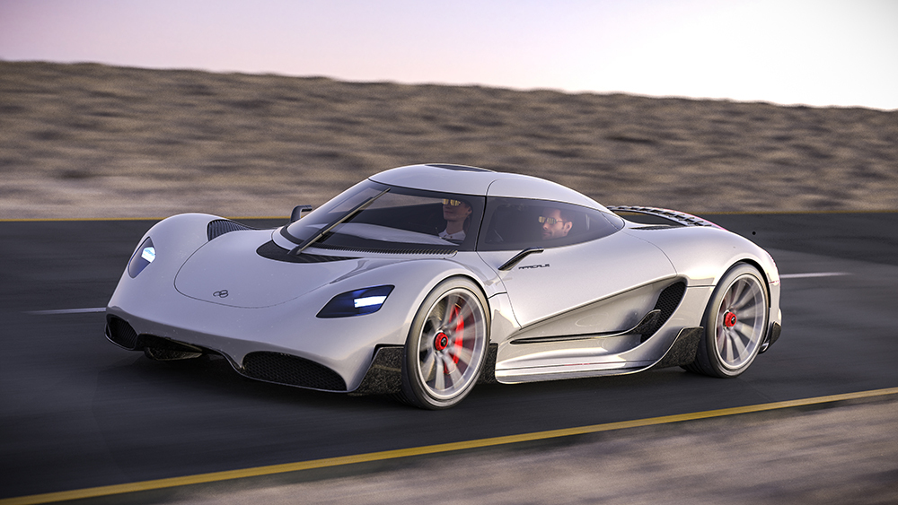
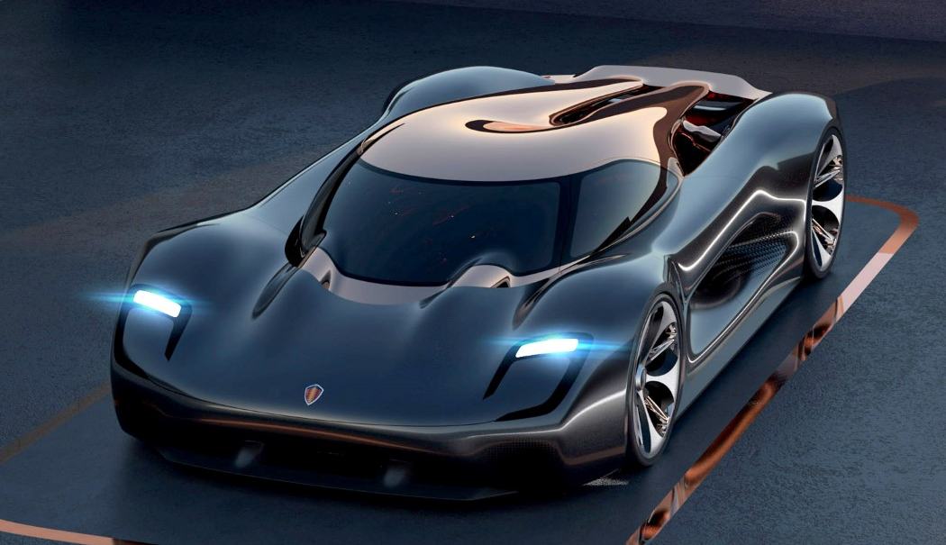
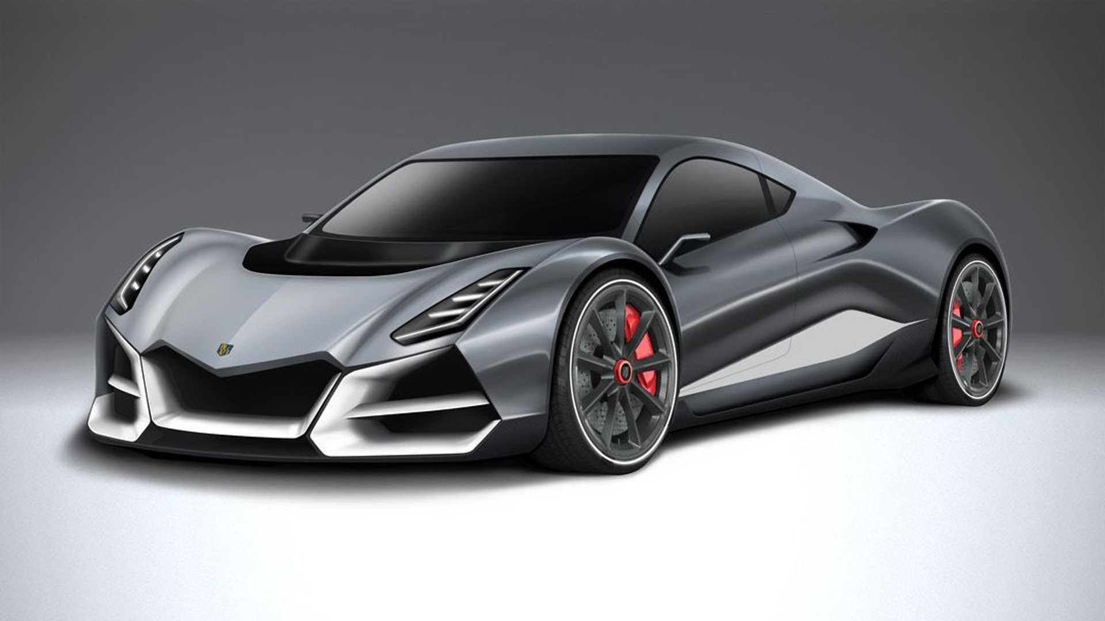
Hydrogen cars mainly for intensive use or high performance
What is the status and which technology is the future?
Mass production today
Mass production from 2022~
    H2 cars: refill in 3-5 min. driving distance up to 1000km.
    The market needs H2 cars due to specific needs
    (high intensive use cases)
Hypercars

Slide 21
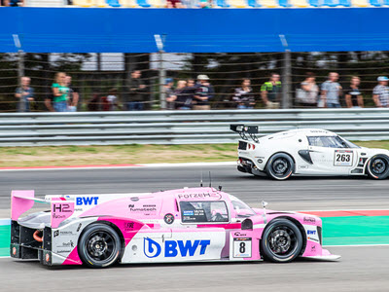
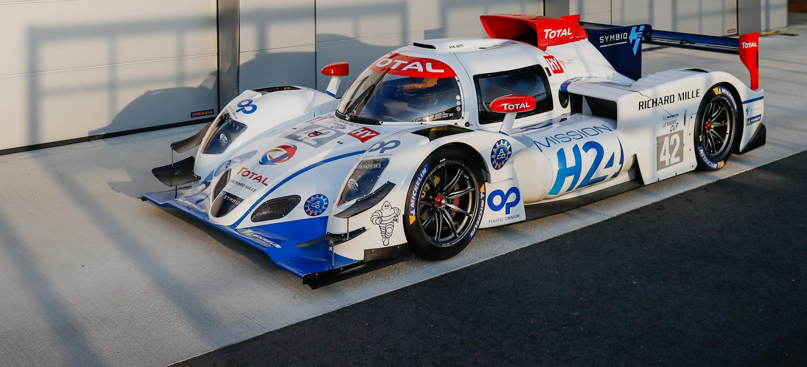
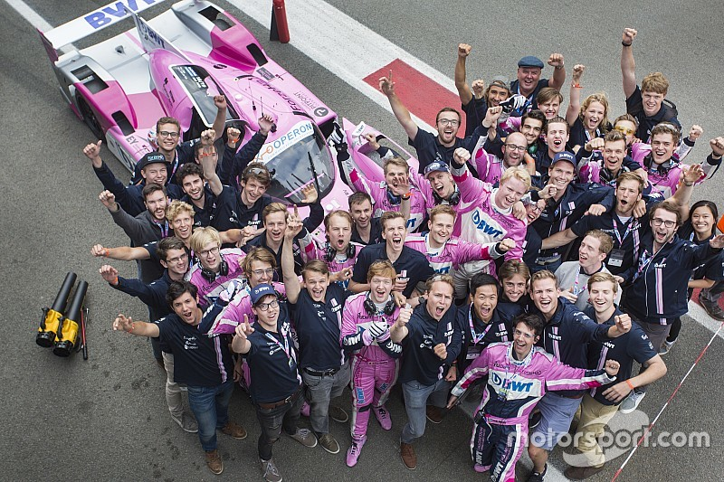
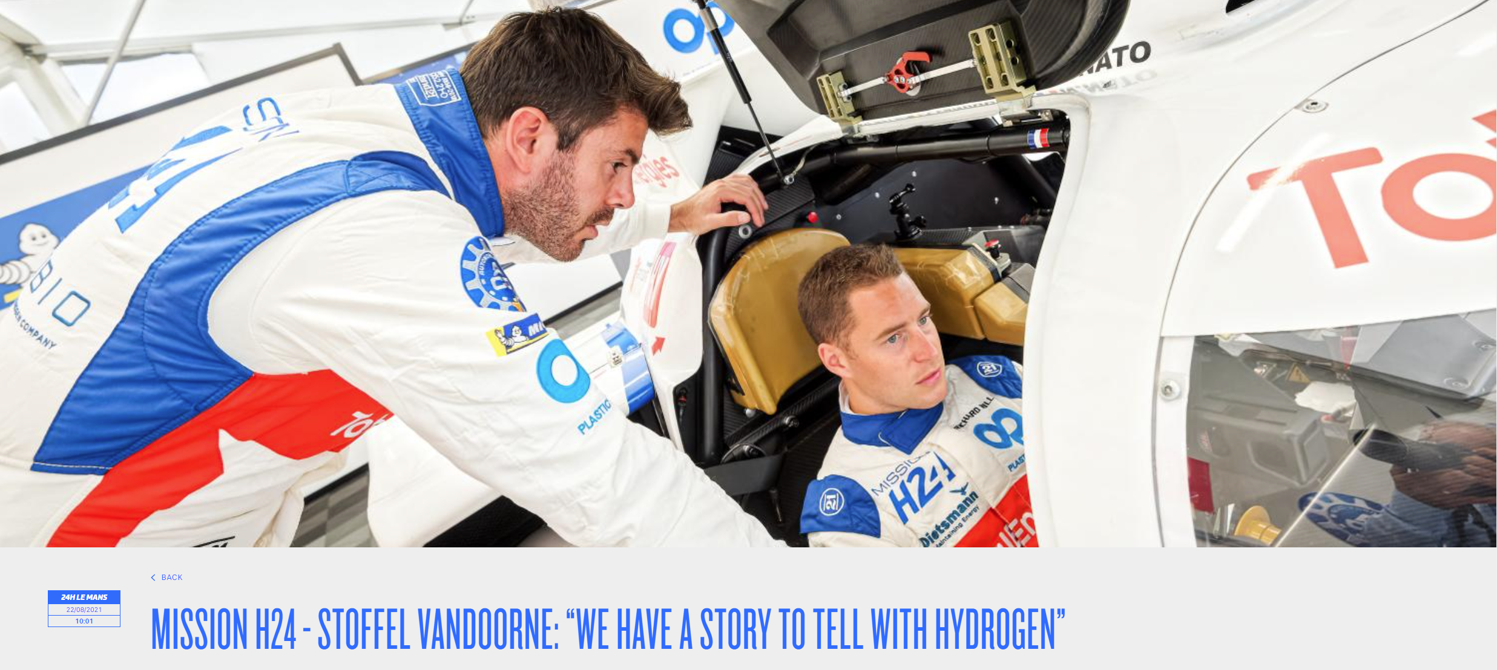
Hydrogen cars sees their entrance in racing
24Hrs of Le Mans is preparing for a switch to hydrogen
TU Delft students made a H2 racing car and won 2nd place in supercar challenge in Asse against gasoline cars
The 24 Hours of Le Mans will introduce a Hydrogen Class in 2025. In 2021 first test-drives took place

Slide 22
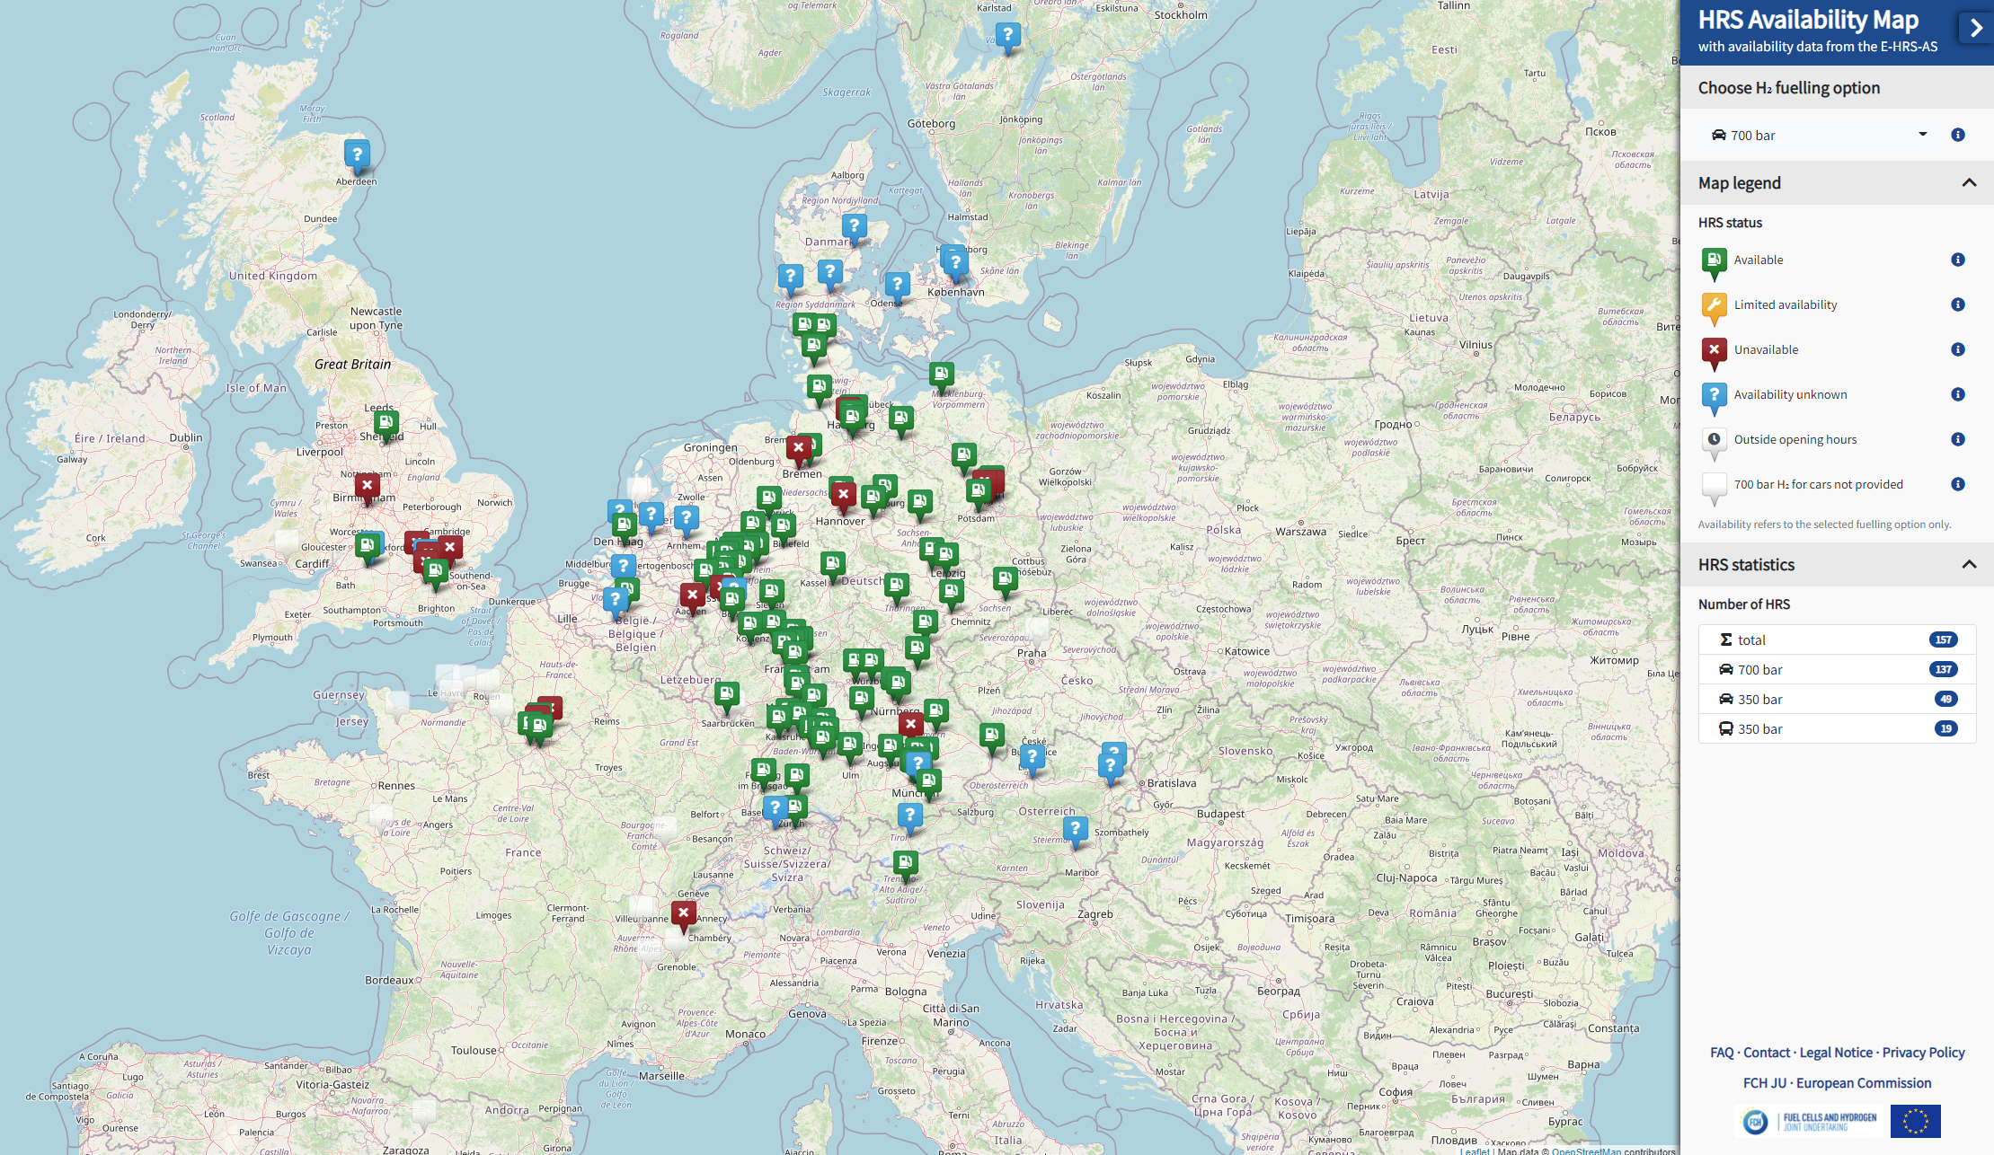
European H2 stations network
The Clean Hydrogen Partnership
Hydrogen Refuelling Station Availability system.
www.H2map.eu
Nearly all HRS in EU are connected to this tool and
gives every minute an update on its status
(open, closed, maintenance…)
The Alternative Fuel Infrastructure Regulation (AFIR)
is under discussion and proposal requests on
TEN-T & comprehensive networks by 2030
HRS (gas) every 150km and an HRS (liquid)
Refuelling capacity for HDV and LCV
Storage capacity of at least 1000kg H2
One payment system (with credit cards) across the EU

Slide 23
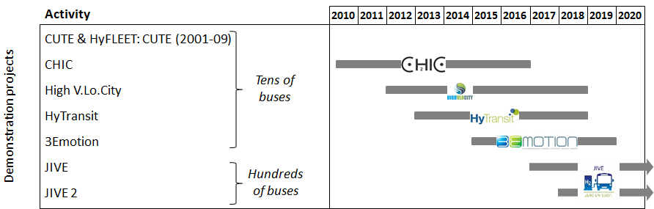
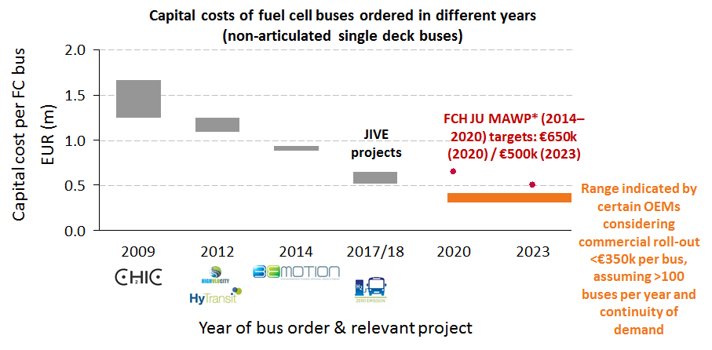
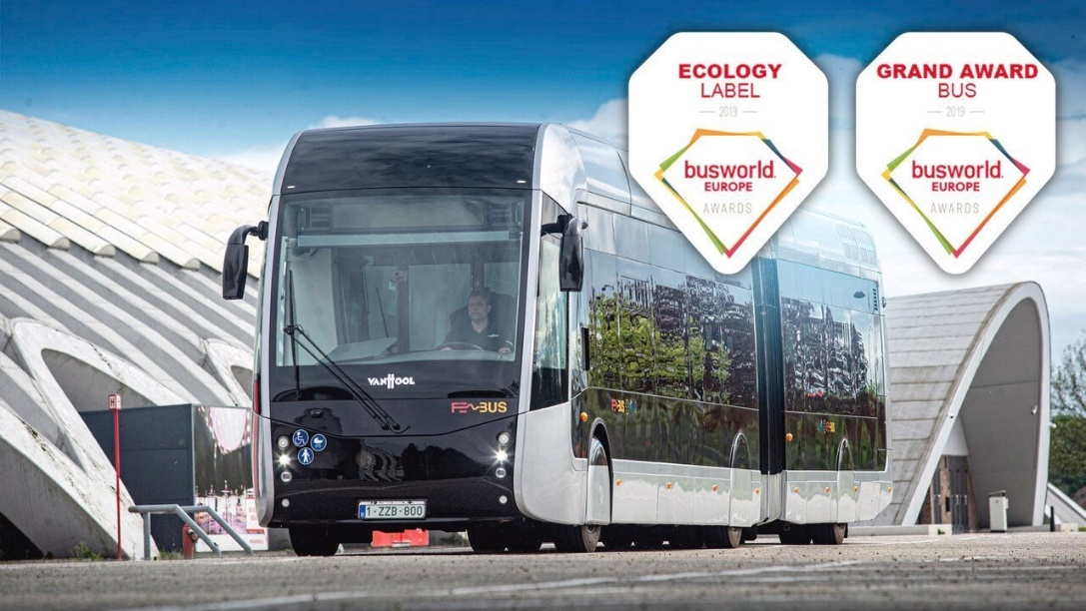
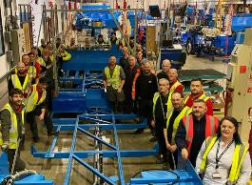
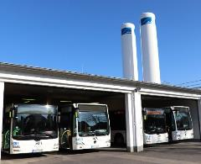
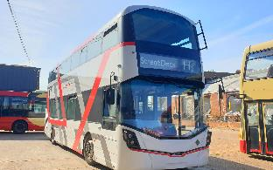
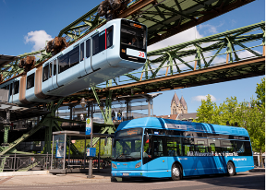
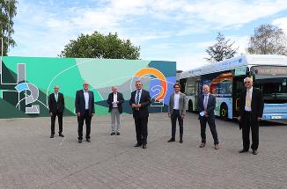
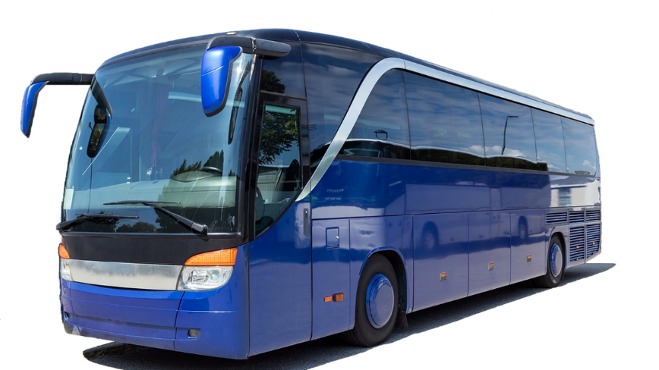
Clean Hydrogen JU funded FCB projects and studies since 2009
7 projects will put in total about 360 FCB’s on the road
Van Hool hydrogen bus for PAU (France) crowned as best bus of the world 2019!
NEXT:
City buses have advanced a lot, next is to work on coaches.
The project CoacHyfied will demonstrate
6 Fuel Cell Coaches in the two coach segments
(inter-city and long-distance passenger transport)
JIVE/JIVE2
Orders placed for 230/295 buses (78%) with 5 suppliers Van Hool (80), Solaris (57), Wrightbus (65), SAFRA (10), and Caetano (18).
Delivery of the first 50 buses in Cologne (35), Wuppertal (10), and Pau (5) and start of full route operation.
All buses on the road by end 2021
Increased interest from other European OEMs, with JIVE-compliant offers received from: Optare, Rampini, and SOL and continued interest from ADL, Daimler, VDL, and interest from 2 other major European OEMs.

Slide 24


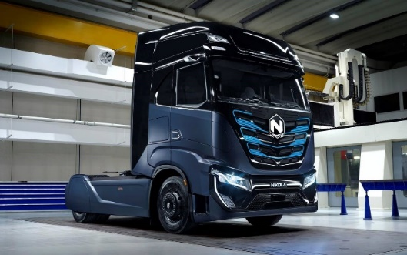
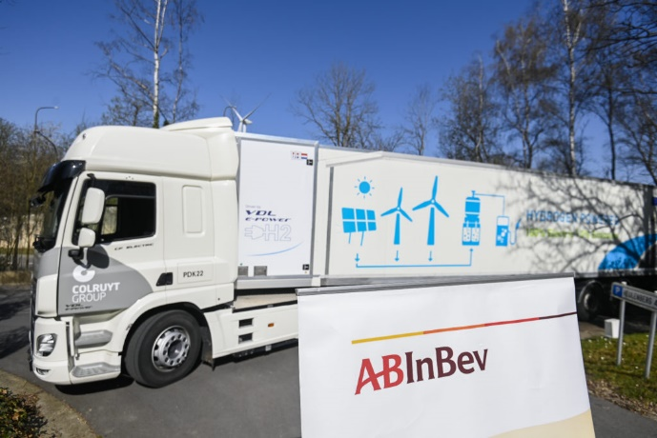
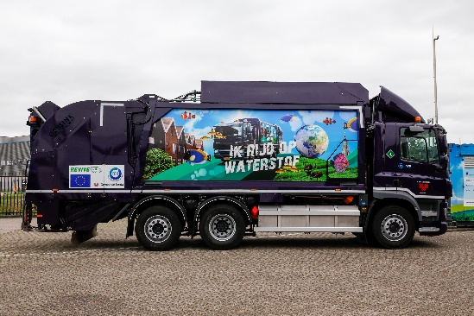


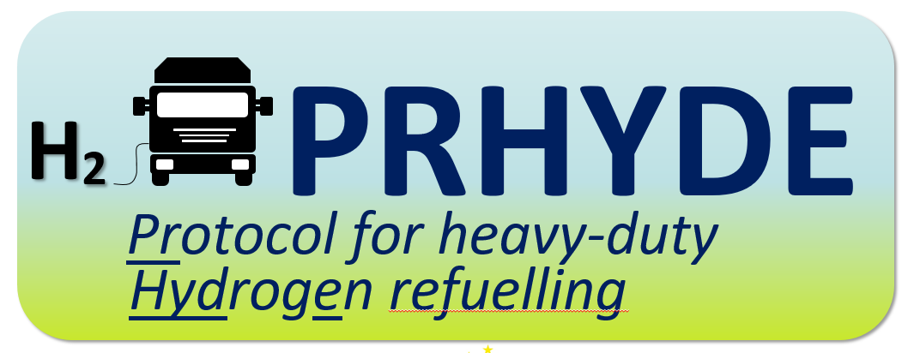
Heavy duty trucks demonstration projects to validate the technology
Long haul and urban applications, 30 trucks demonstrations in 13 sites and 7 countries
15 Refuse trucks
15 Long haul trucks
At least 400 km autonomy;
Tractor and rigid configurations;
Integration in the daily operations of end users with different operations
(Air Liquide, BMW, Carrefour, Colruyt)
2021/2022 deployment of the trucks;
Daily back-to-base missions;
Standardization of the design towards mass production;
Fleet operation: 120.000 hours;
First truck already deployed in Breda;
Antwerp will also deploy a refuse truck
    23/11/2020: Industry commitment for 100.000 trucks and 1500 HRS by 2030 in the EU
Iveco - Nicola
VDL (Colruyt, AbInBev)
Protocol for heavy-duty refueling using hydrogen
Develop refueling protocol(s) for vehicles with Compressed H2 Storage System >250L & >10kg;
Identify factors limiting the refueling rate (120g/s) and propose solutions for larger flow rates;
Findings and recommendations should be shared with relevant sectors and standardization committees;
International cooperation;

Slide 25
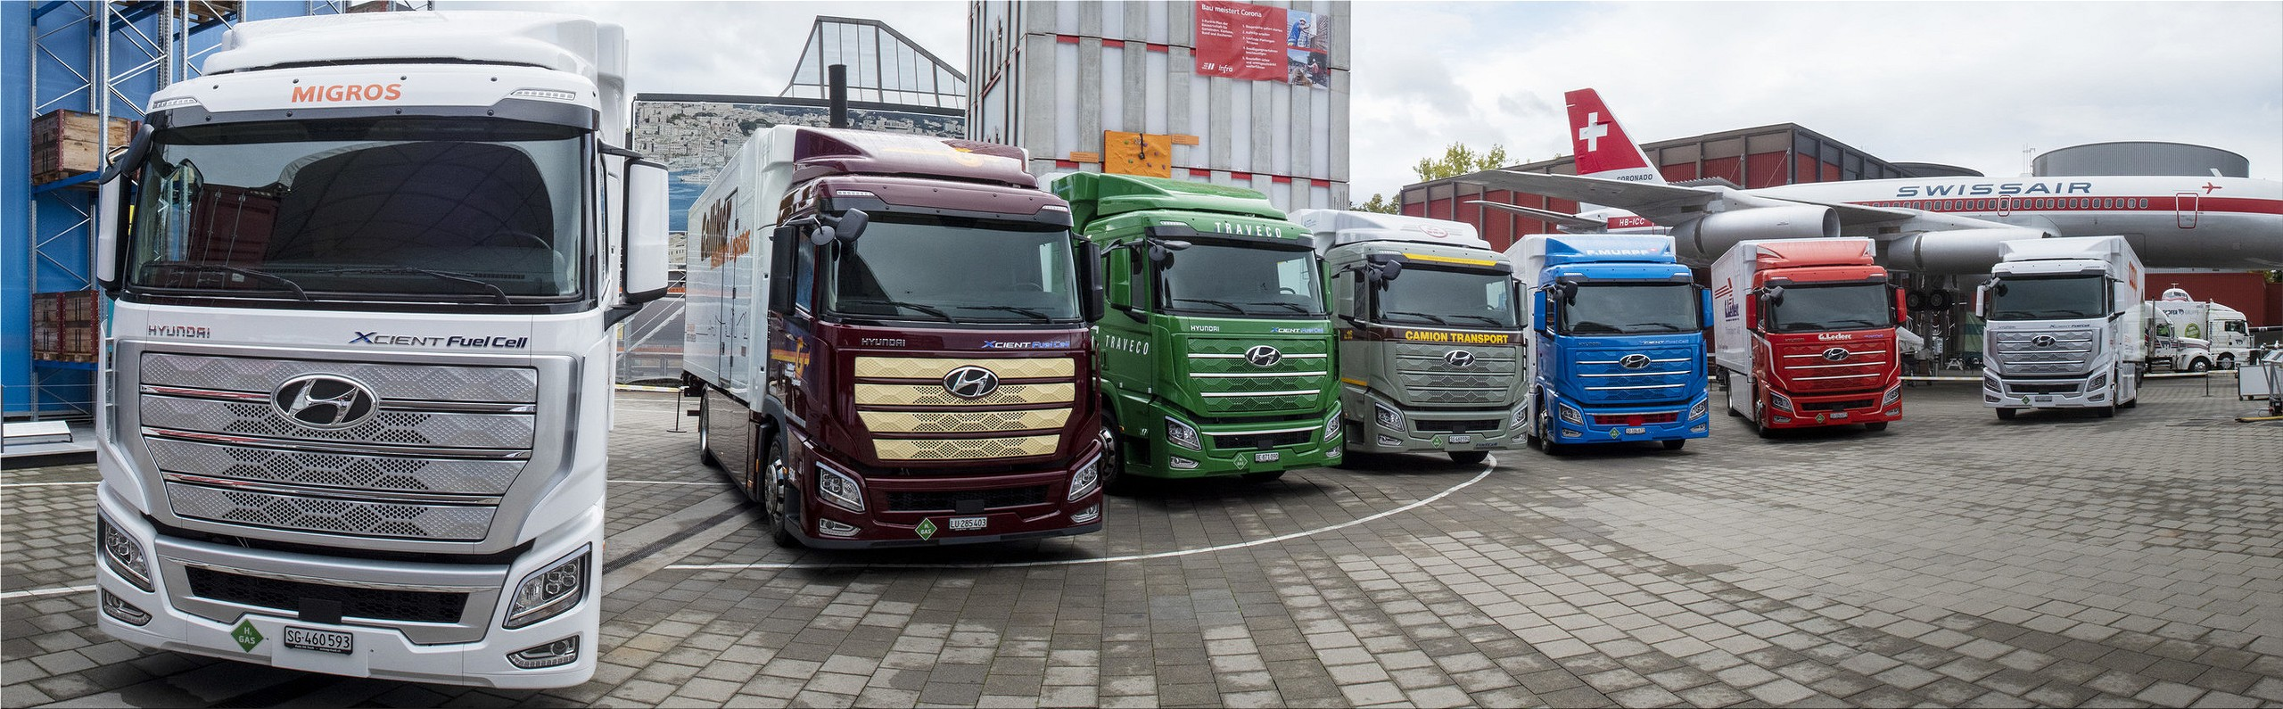
Heavy duty trucks fleets are commercial in Switzerland
Trucks and hydrogen refuelling stations are build by private industry
Switzerland has ordered 1600 Hydrogen Hyundai trucks, first deliveries happened. TCO is economical thanks to a favorable tax regime.

Slide 26
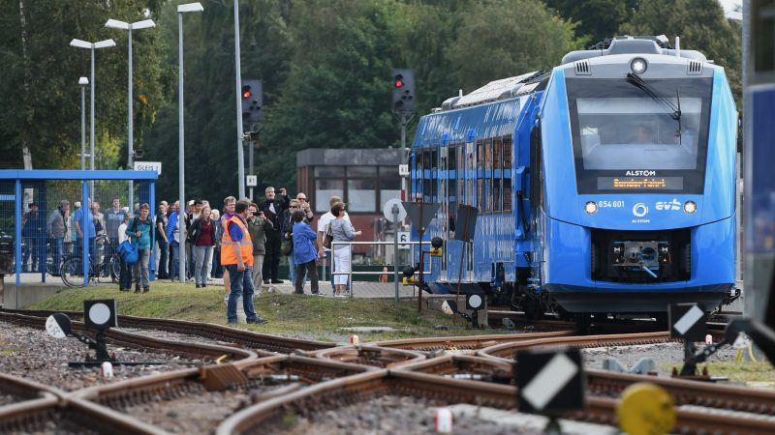

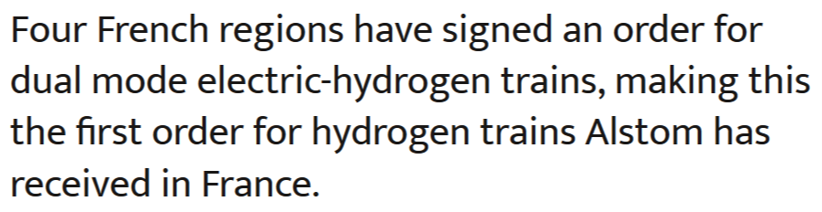
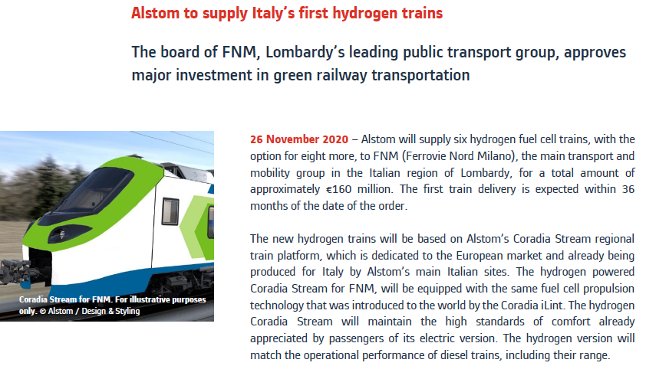
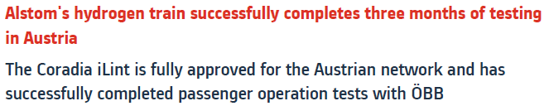







2018 German H₂ train
Hydrogen trains in Europe
Market demand is accelerating fast

Slide 27




Fuel Cell Hybrid PowerPack for Rail Applications
Demonstrate the system in a bi-mode train to be homologated in three MS
Start date: 01/01/2021
Total cost: 13,341,609.93 €
Grant amount: 10,000,000.00 €
Main objective:
  Develop, build, test, demonstrate and homologate a scalable, modular and multi-purpose Fuel Cell Hybrid PowerPack (FCHPP) applicable for different rail applications (multiple unit, mainline and shunting locomotives) also suitable to for retrofit existing electric and diesel trains, to reach TRL7.
  The train demonstrator tests to be carried out cross-border in Portugal and Spain and homologation to be sought for three EU countries.
Methodology

Slide 28








Clean Hydrogen JU support for FC and H2 in maritime applications
Moving towards larger sizes of vessels, no « size fits all »
  HySHIP
  Ships
3 MW
RoRo vessel, for coastal goods transport
3MW fuel cell system using LH2 (>5t storage)
Conceptual designs for a 20MW ship
Develop a standardised bunkering system
LH2 distributed to a series of maritime bases in a containerized system
  2020 – LH₂ vessel
  LH₂
  PEM
  2019 – sea-going
  vessel
2 MW
  NH₃
  SOFC
  ShipFC
  2018 – ferry + barge pusher
1 MW
Platform support vessel in North Sea (Norway)
Length: 95m, Gross tonnage: 5073MT
Operation: 2024
Zero emission ammonia
  CH₂ PEM
  2017 – research
  vessel
0,16 MW
  CH₂ PEM
  2013 - APU for yachts
0,05 MW
  LPG
  HT PEM

Slide 29


Global Ports Hydrogen Coalition launched under the CEM.
H2Port project Valencia: First application of hydrogen technologies in port handling equipment in Europe.
CEM H2 Initiative:
Global Ports Hydrogen Coalition
Launched on 1st of June
Co-Led by IEA H2I & DG ENER – Support by FCH-JU
Out of 25 ports, 12 European Ports participate
(Norway:4, Germany:3, Spain:1, Sweden:1, The Netherlands:1, Belgium 1, Portugal)
Brunsbüttel Ports (Germany)
Flam Port (Norway)
North Queensland Bulk Ports (Australia)
Pecém Port Complex (Brazil)
Port of Auckland (New Zealand)
Port of Bahia Blanca (Argentinia)
Port of Berlevåg (Norway)
Port of Brisbane (Australia)
Port of Duqm (Oman)
Port of Farsund (Norway)
Port of Grenland (Norway)
Port of Gothenburg (Sweden)
Port of Hamburg (Germany)
Port of Houston (USA)
Port of Mejillones (Chile)
Port of Rotterdam (The Netherlands)
Port of Valencia (Spain)
Port of Vancouver (Canada)
Portuguese Ports Association
Southern Ports (Australia)
Lehmann GmbH
Neltume Ports (Chile)
Woodside (Australia)
Free Hanseatic City of Bremen (Germany)
Hydrogen Council
International Association of Ports and Harbours Port of Antwerp
H2PORTS project in the port of Valencia
Reach stackers and yard tractors will be demonstrated in the port
A mobile hydrogen refueling station will be operated inside the port
DURATION: 2019-2022; project 4.1 M€ (4 M€ by FCH-JU)

Slide 30









Hydrogen powered Aviation study (joint study with Clean Sky2 JU)
Hydrogen propulsion has significant potential
Zeroavia: UK
    Key takeaways:
    - Hydrogen is feasible to power aircraft with entry into service between 2030-2035 for short-range segments.
    - Less than 17€ per PAX additional cost on a short range flight.
    - Zero CO2 and 70% reduction of climate impact.
    - First prototype by 2028, need for large R&D investments
    - 40% of the fleet by 2050 on LH2 for short and partly medium range, others by SAF (eg. methanol)
Airbus presented 3 models on Liquid Hydrogen targeting 2035 to enter service
H2fly: HY4 Germany
SKAI: passenger drone
https://www.fch.europa.eu/news/new-study-hydrogen-powered-aviation-preparing-take

Slide 31








Other hydrogen applications
Off-road applications
    Snow groomers in Italy
    Ford New Holland hydrogen tractor
    JCB hydrogen excavator
    FCH-JU has supported hundreds of forklifts in Carrefour (Paris) and Colruyt (Halle)
    Snow scooters
    Autonomous hydrogen Valtra tractor
    Hydrogen bike Pragma industries

Slide 32
Heating and Cooling

Slide 33




Over 10000 fuel cell µCHP systems installed across EU
Track record of domestic heat and power systems created
1046 units deployed under ene.field project
Over 1 MWe capacity installed
>5 million operating hours
Additional >1,000 units deployed under German scheme
0 1000+

Slide 34




Medium size Fuel Cells first deployments
FCH-JU research projects demonstrates medium size Fuel cells potential in waste water treatment plants
175 kW SOFC in Collegno Waste Water Treatment Plant, Turin Itay area will guarantee the supply of around 30% of the site electrical consumption, and almost 100% of the thermal requirement.
DURATION: 2015-2020 with FCH JU Funding: ~4.5M€

Slide 35








MW fuel cells greening big industry by using waste hydrogen
FCH-JU research projects shows Fuel Cells can help to decarbonise industry like the Chlor-Alkali industry
1MW plant at Martinique, oversea territory of France
Demonstrate the deployment of a 1MW PEM Fuel Cell, developed and purpose-built for the EU market, running on waste hydrogen from a refinery plant (246 t/year flared)
DURATION: 2012-2020 with FCH JU Funding: ~4.6M€
2MW plant at Ynnovate, Yingkou, China
Design, build and operate a 2 MW power generator, with full integration of heat and power with an existing chlorine production plant. Fully automated way of operation and remote control
DURATION: 2015-2018 with FCH JU Funding: ~5.5M€

Slide 36
Cross cutting actions

Slide 37







Educational Activities – Overview
Preparing the European workforce is crucial for scaling up the industry.
Educational and training programs tailored to multiple target groups
Clean Hydrogen supports
European
Network of Universities
Post Graduates and Young
Professionals
E-Platform for connecting knowledge
Technical
Professionals
Regulators and
Public Safety Officials
Technician
and workers
First
Responders
  Multiple levels and types of education, learning formats, features…
Graduate
Undergraduate
…
In person training
…
Serious games
Mock-up installations
Vocational
Compulsory
…
blended
e-learning
…
Virtual reality

Slide 38

















Clean Hydrogen JU safety-related activities
European Hydrogen Safety Panel (EHSP) – Expert group supporting the Programme and beyond
Assuring that hydrogen safety is adequately managed
Promoting and disseminating a high-level hydrogen safety culture
  Project
  level
  Programme
  level
  Data
  Collection
  Public Outreach
Working groups
Notes:
TF1 - Ensuring that all FCH 2 JU funded projects address and incorporate the state-of-the-art in hydrogen safety appropriately
TF2 - Supporting the FCH 2 JU Programme in hydrogen safety-related matters
TF3- Increasing the number of events in HIAD 2.0 and providing lessons learnt
TF4 - Disseminating information about the EHSP and hydrogen safety, promoting a high-level hydrogen safety culture

Slide 39







Fuel Cells and Hydrogen Observatory (Launched 15 Sept ’20)
One stop shop to understand where the Clean Hydrogen sector is at and how it is evolving
Go to resource for all things on fuel cells and hydrogen
User friendly and reliable output
  charts, graphs and data downloads
  reports
It covers
  Technology & Market
  Policies & regulation
  Codes & Standards
  Patents & Publications
  Funding
  Education & Training
Global resource
www.fchobservatory.eu
Email: info@fchobservatory.eu
@FCHObservatory
Notes:
Project started Jan 2019 and it has a maximum duration of 40 months.
On 15.09.2020, the Fuel Cells and Hydrogen Observatory (FCHO) online launch event took place with around 1000 participants from European and national institutions, industry and associations from around the world.
The Fuel Cell Hydrogen Observatory (FCHO) provides data and up to date information about the entire hydrogen sector. It focuses on technology and market statistics, socio-economic indicators, policy and regulation, as well as financial support.
The FCHO project collects data from primary sources to the utmost and to present them in an accessible and practical way for the further use of a large audience. Data collected through the Observatory will be used to produce and disseminate on a regular basis digestible analytical reports to make annual comparisons assessing market progress and identify strengths and trends in the fuel cells and hydrogen sector.
Next release foreseen for November 2020 where we hope to have the module on Education and Training.
The FCHO has been commissioned for the Fuel Cells and Hydrogen Joint Undertaking (FCH 2 JU) under a public procurement contract. The FCHO consortium partners include the following organisations: e4Tech, Hydrogen Europe, HGF, NEN, Hydrogen Europe Research, Innovation Loop, and Inycom.
The Observatory is available at www.fchobservatory.eu and all FCHO related updates will be also shared via its Twitter and LinkedIn accounts.

Slide 40
Next steps
March 1st 2022: Launch of the call for proposals (indicative)
  Around 300m EUR call and 41 topics:
    Hydrogen production
    Hydrogen distribution
    Transport
    Heat and Power
    Cross-cutting
    Overarching
  Two cut-off dates: 31st May and 20th September
  Open to all, some topics will require a member of Hydrogen Europe in the consortium.
  At least 3 Member states should be represented by the consortia
March 15th 2022: Info day (online)

Slide 41
Topic: Large scale Hydrogen Valley (subject to final approval by Governing Board)
Building on the successful experience of previous years
Indicative Budget of Max. 25 million Euro ( proposal is ineligible if more is requested)
Submission by 20th September 2022
At start TRL 6 → 8 at the end of the project
At least one partner in the consortia must be a member of Hydrogen Europe or Hydrogen Europe Research
Seals of excellence will be rewarded to the ones passing the evaluation criteria but cannot be funded as there was a better project
Topic novelty is to make interlinkages of other places of H2 production and consumption outside its boundaries.
Proposals need to show how to contribute to the European Hydrogen Strategy and the European Green Deal
At least 2 years of demonstration to monitor at least the KPI’s that are mentioned in the SRIA of the Clean Hydrogen Partnership
Min 5000 tonnes/yr. renewable hydrogen production, different production sites are allowed
Covering at least 2 sectors (Industry, Energy or Transport)
Synergies with other funding programs are allowed and stimulated (eg CEF, innovation fund,…)
Evidence of he commitment and role of public authorities in the form of an LOI
GO’s should prove the renewable hydrogen (by M/S issuing body or eg Certifhy scheme)
Preliminary safety plan needs to be submitted with the proposal

Slide 42
Topic: Small scale Hydrogen Valley (subject to final approval by Governing Board)
Start building Hydrogen Valleys in area’s of Europe with no or limited presence of H2 valleys
Indicative Budget of Max. 8 million Euro ( proposal is ineligible if more is requested)
Submission by 20th September 2022
At start TRL 6 → 8 at the end of the project
At least one partner in the consortia must be a member of Hydrogen Europe or Hydrogen Europe Research
Seals of excellence will be rewarded to the ones passing the evaluation criteria but cannot be funded as there was a better project.
Topic calls for the deployment of a hydrogen valley in areas of Europe with no or limited presence of H2 valleys such as but not necessary limited to Central and Eastern Europe.
Proposals need to show how to contribute to the European Hydrogen Strategy and the European Green Deal
At least 2 years of demonstration to monitor at least the KPI’s that are mentioned in the SRIA of the Clean Hydrogen Partnership
Min 500 tonnes/yr. renewable hydrogen production, different production sites are allowed
Covering at least 2 sectors (Industry, Energy or Transport)
Synergies with other funding programs are allowed and stimulated (e.g. CEF, innovation fund,…)
Evidence of he commitment and role of public authorities in the form of an LOI
GO’s should prove the renewable hydrogen (by M/S issuing body or e.g. Certifhy scheme)
Preliminary safety plan needs to be submitted with the proposal

Slide 43

CEF (Connecting Europe Facility) funding opportunities
Synergies with other EU funding instruments are envisioned
    Consortia can consider to submit another proposal for Hydrogen Refueling stations to CEF

Slide 44

Many EU funding instruments are covering hydrogen
Launch of the call + info days
Synergies with other EU funding instruments are encouraged
Metrology

Slide 45




Bart Biebuyck
Executive Director
Bart.Biebuyck@clean-hydrogen.europa.eu
@bart.biebuyck
Bart Biebuyck
For further information
www.clean-hydrogen.europa.eu
www.hydrogeneurope.eu
www.hydrogeneurope.eu/research
Clean Hydrogen Partnership
@CleanHydrogenEU

Slide 46

46
Hydrogen Valleys
HEAVENN project - Hydrogen Energy to decarbonize an entire region in Northern Netherlands
    Integration of existing & planned project clusters across 6 locations
    Integration of RES (onshore and offshore)
    Deployment of key transport & distribution gas infrastructure
    Deployment of 11 HFC end-user applications across the project
    Part of the H2 to be injected up to 3% in NG prior to firing in Gas Turbine

Slide 47


47
Hydrogen Valleys
GreenHysland H₂ Valley: deployment of a H₂ Ecosystem on the Island of Mallorca
    Green Hydrogen production using RES (PV) , 300 tonnesH₂/year
    Injection of H2 into the local NG distribution grid
    HRS at bus depot in Palma
    H2 buses, Light vehicles
    Fuel Cells-based (CHP)
    (municipal building, hotels, port)
    2050 roadmap for long-term vision for the development of a H2 economy in Mallorca and the Balearic Region
    Replication experiences and business models are foreseen in five other EU island

