Slide 1
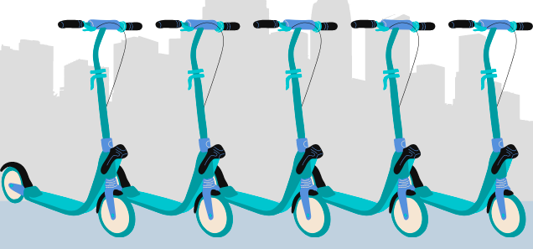
MObility DEcisions framework (MODE)
Joan Estrada
j.estrada@baxcompany.com
Notes:
Hi everyone,
My name is Albert Gragera and I am Innovation Consultant at Bax & Company
Where I am involved in helping mobility stakeholders assess the impact of different piloted solutions
And I am gonna present a new methodological framework we developed within the Interreg project MOBI-MIX

Slide 2
Why a new methodology to study shared mobility?
Cities can make or break shared mobility implementation
Companies often ask for favorable treatment
Many municipalities seem reluctant to jump on board
Private companies use public space
Lack of data & mixed/partial evidence
→ Social benefits of shared mobility are often still unclear
NEW METHOD
Evidence-based decision-making & policy formulation
Credible & robust impact evaluation (causal inference)

Slide 3
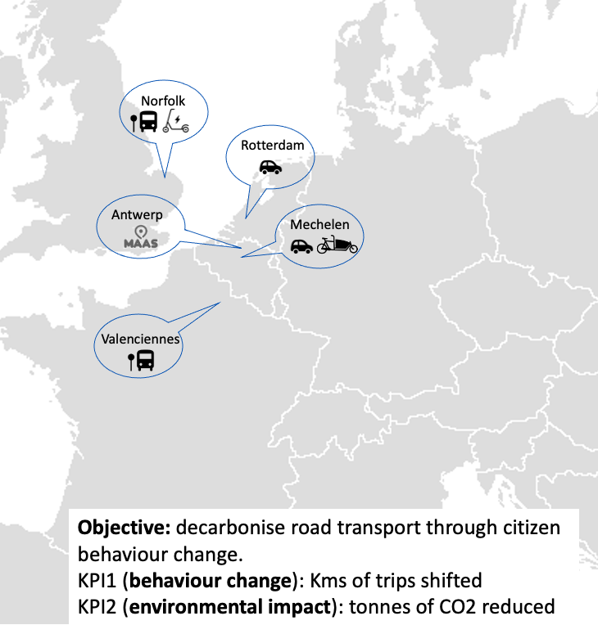
MOBI-MIX: exploring shared mobility & MaaS
2020 – 2022
5 cities
€3M
Solutions trialed
Shared e-scooters
Shared e-cargo bikes
Shared e-cars
MaaS
Mobility hubs
Universal basic mobility
Notes:
We apply this new method to the Interreg MOBI-MIX project
Where 5 cities are trialling different shared mobility solutions
Aiming at decarbonizing road transport through travel behaviour change
Specifically I will show you our preliminary results for the application of the ex-ante evaluation of Norfolks shared e-scooter pilot

Slide 4
Questions we can help answer
How many users will join a specific shared mobility service?
How many will shift from different transport modes?
Should we promote shared mobility? (social benefit)
Who should we target to achieve certain policy goals?
Notes:
You might wonder, WHICH TYPE OF QUESTIONS CAN WE HELP ANSWER?
It boils down to:
How many will join a given shared mobility service? (and who they are)
How much will they change their travel behaviour? (which transport mode they shift trips from)
And from that:
Assess the SOCIAL BENEFIT of such solution = justify its promotion and by how much
Who should we target to reach certain goals? (certain areas/users)

Slide 5
MObility DEcisions framework (MODE)
Step-wise approach to shared mobility impact assessment

Slide 6
MObility DEcisions framework (MODE)
How can we help cities along the pilot implementation decision process?
PROJECT PHASES:
Pilot test
Conception
Pre-design
Decision
Deployment
Assessment
Exploratory
evaluation
Ex-ante
evaluation
Ex-post
evaluation
Case studies
Impact repository
User profiling
Potential demand
Intended impact
User profiling
Demand
Causal impact
Bias correction
Update repository + robust selection
Notes:
GENERAL DESCRIPTION
We developed a sequential method → providing insights at each project phase
Adapting to the level of information/detail that arises at each step of the way
Going from conception & pre-design phase
To the actual deployment and assessment of trialled solutions
Or even changes introduced to current schemes (not just for greenfield projects)

Slide 7
MObility DEcisions framework (MODE)
How can we help cities along the pilot implementation decision process?
PROJECT PHASES:
Pilot test
Conception
Pre-design
Decision
Deployment
Assessment
Exploratory
evaluation
Ex-ante
evaluation
Ex-post
evaluation
Case studies
Impact repository
User profiling
Potential demand
Intended impact
User profiling
Demand
Causal impact
Bias correction
Update repository + robust selection
Notes:
EXPLORATORY ANALYSIS
Based on a “Case studies Impact repository”
In a sort of meta-regression fashion, we adapt available evidence to the city context and shored solution.
Not all studies are equally accurate and robust.
## Many simply:
Measure with descriptive survey to users
Naïve before-after comparison → where all change assigned to SM solution
Do not account for consumer self-selection into shared services
No control for confounding factors (neighborhood and attitudinal characteristics)

Slide 8
MObility DEcisions framework (MODE)
How can we help cities along the pilot implementation decision process?
PROJECT PHASES:
Pilot test
Conception
Pre-design
Decision
Deployment
Assessment
Exploratory
evaluation
Ex-ante
evaluation
Ex-post
evaluation
Case studies
Impact repository
User profiling
Potential demand
Intended impact
User profiling
Demand
Causal impact
Bias correction
Update repository + robust selection
Notes:
EX-ANTE EVALUATION
If we move one step closer to implementation
Now we do undertake a survey aiming to gather responses from both potential users and non-users
Getting potential users is easier if done in collaboration with the shared mobility provider

Slide 9
MObility DEcisions framework (MODE)
Socioeconomics
Vehicle ownership
Travel diary
Panel survey content
Attitudes
Post-Covid
Notes:
This panel survey quiestionnaire will include:
Socioeconomic characteristics
Vehicle ownership levels
Attitudes towards cars and shared mobility
Travel diary
In this exante stage this first round of the survey
Uniquely identify respondents = emails (anonymized) = track them into the 2nd round

Slide 10
CASE STUDY
Norfolk
Shared e-scooters

Slide 11
Norfolk: Who would join a shared e-Scooter service?
GENDER
AGE
26 – 40 y/o
41 – 65 y/o
66+ y/o
+17%
=
-15%
-42%
18 – 25 y/o
MOBILITY PATTERNS
PARKING AVAILABILITY
-18%
Employer paid parking
=
+13%
=
+9%
Veh-km travelled per week using each mode
(st.dev above mean)
Potential demand
13% pop.
No effect: Income, vehicle availability, attitudes towards cars
100k Users
Note: Estimated marginal effects (at mean values) on the probability to join based on a Logit model using 304 complete response and controlling for area-specific effects (postcodes).
Notes:
So far, we find that
The probability to join the shared e-Scooter service is:
17% for men
And citizens below 40 y/o, with a marked decrease in the chances of joining for older groups.
Those more prone to join are the ones more intensively using individual mobility modes
Enjoying free granted parking at work reduces the chances to join
Extrapolating the results of our model to the whole population of Norfolk,
We believe that the potential demand for the shared e-Scooter will lay somewhere around 100k users.

Slide 12
Norfolk: How much would it change travel behaviour?
Trips shifted to e-Scooter
+ 8.3%
-
+ 16.7%
+ 9%
Note: Only including respondents that would join the e-Scooter service
POTENTIAL
CARBON REDUCTION
- 0.2% /km
18 – 25 y/o
- 13%
- 1.2% /tpw
41 – 65 y/o
0,015 Tn/user
+ 15.3%
- 24%
66+ y/o
Notes:
When looking at how much respondents report to be willing to change their behaviour
We see that trips done by public transport are the ones more likely to be substituted by e-Scooters, with similar chances for walking and car use.
However, this is not that bad if we look at the average veh-km shifted (as you see in the sidebars on the right)
Other trip characteristics, like distance and frequency do negatively affect the chances for that trip to be substituted by e-Scooters.
Leisure trips are the one more likely to shift to this new solution.
Using previous figures, Norfolks’s e-Scooter service has a potential carbon reduction above 300 Tn/year

Slide 13
MObility DEcisions framework (MODE)
How can we help cities along the pilot implementation decision process?
PROJECT PHASES:
Pilot test
Conception
Pre-design
Decision
Deployment
Assessment
Exploratory
evaluation
Ex-ante
evaluation
Ex-post
evaluation
Case studies
Impact repository
User profiling
Potential demand
Intended impact
User profiling
Demand
Causal impact
Bias correction
Update repository + robust selection
Notes:
GENERAL DESCRIPTION

Slide 14
MObility DEcisions framework (MODE)
Intuition behind the ex-post evaluation
Population
ADVANTAGES:
Controls for simultaneous factors
Controls for unobserved time invariant factors
Identifying assumption: Parallel trends
= no self-selection
Control
KPI of interest
Users
Impact
Before
After
Time
Notes:
Compare pre/post-pilot surveys to assess differences in travel behaviour, vehicle ownership, awareness and attitudinal changes between users and ‘control group’.
ADVANTAGES:
Controls for simultaneous factors
Controls for unobserved time invariant factors
Identifying assumption: Parallel trends
= no self-selection
In deed,
This framework can be adapted to give you insights about any quantifiable metric, using either stated / revealed preferences or even transaction data.

Slide 15
Ex-post evaluation
DiD with matching
We now match each participant (treated) with her control group counterpart, based on the similarity of individuals following certain ‘criteria’:
Propensity score matching:
Probability to participate $P\left(T=1 | X\right)=Λ\left(X\right)$is used as a score to select individuals in each group
Almost users
Unfrequent users
Super users
Joined
Use frequency
Population
Participants
ADVANTAGES:
Allows to reduce self-selection issues
CAVEATS:
Need for common support (overlap)
$$P_{Y_{0t}}\left(T=1 | X\right)≅P_{Y_{it}}\left(T=1 | X\right)$$

Slide 16
Want to know more about the MODE framework?
Check it out here:
j.estrada@baxcompany.com
​

