Slide 1

eHUBS in Leuven
Hilke Evenepoel
3/5/22

Slide 2

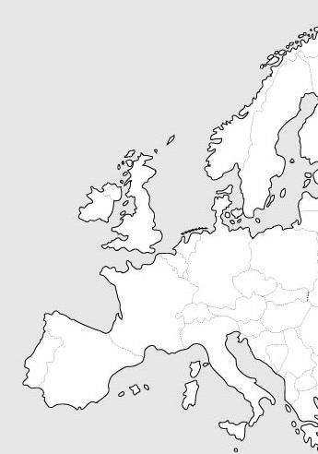
1. Context
Population:
+100.000 inhabitants
+ 65.000 students
+ increasing number of jobs
Area:
56 km²
Dynamic city:
20 km east of Brussels Capital
Fastest growing city in Belgium
Challenges on traffic congestion
Modal split
40% commuting/ school trips by bicycle
20% cycling in all trips
Vision and ambitions
LCN 2050
Leuven

Slide 3
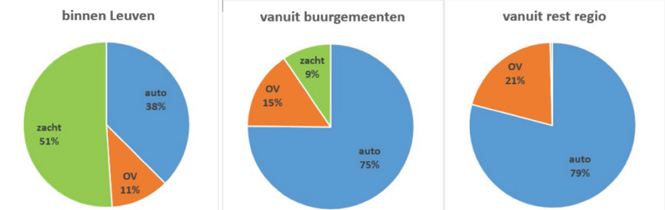
2. At the start
Car is king
Sharing systems:
  Leuven is carsharing city nr. 1 in Belgium →3 per 100 inhabitants is doing carsharing (yearly increase ca. 20%)
  Bike sharing at Leuven station
  Back-to-one/station based
Flanders: policy about mobipoints since 2017 (Hoppin)

Slide 4
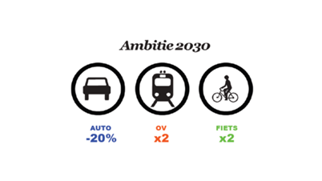
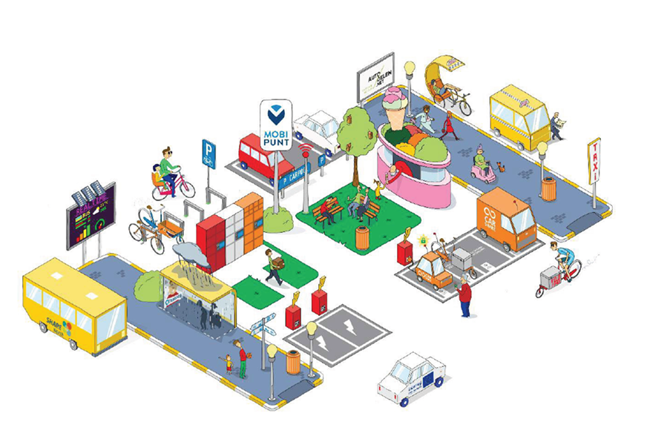
3. Driving forces
  Liveability
  Accessibility
  Equality
  Sustainability
  → eHUBs
  = More shared and clustered (e-)mobility services
    90 - 125 e-bikes
    30 e-cargobikes
    20 - 30 EV
    Network + proximity approach
Notes:
Leefbaarheid (lage impact op gedeelde ruimte, meer auto’s weg leidt tot meer ruimte in de stad, die op andere manieren benut kan worden)
Bereikbaarheid (stad bereikbaar ondanks toename mobiliteit)
Gelijkheid (alle bewoners toegang bieden tot anders onbetaalbaar elektrisch vervoer) – we zijn aan het uitzoeken om het kansentarief (UITpas) ook toe te kunnen passen voor deelmobiliteit – pilootfase met ev Urbee en Cargoroo
Duurzaamheid (schone mobiliteit)
Netwerklogica: Gebruik van VoM in combinatie met het openbaar vervoer of met de eigen wagen. Gebruikers leggen langere verplaatsingen af waar VoM een deel van de totale verplaatsing uitmaakt. VoM vergroot de invloedssfeer van het mobiliteitsknooppunt. Netwerklogica wordt aangeboden op locaties in de buurt van OV-knooppunten (mobipunten).
Nabijheidslogica: Gebruik is gericht op bewoners, zonder combinatie met andere vervoersmiddelen of ter vervanging van de eigen fiets (als mensen niet kunnen of willen fietsen) in voortransport. Gebruikers gebruiken VoM voor korte verplaatsingen in de stad/(deel)gemeente. Nabijheidslogica wordt aangeboden op locaties in de buurt van woonplekken en attractiepolen. Fijnmazigheid van het VoM-netwerk en densiteit van woningen en functies zijn belangrijk.
De keuze van locaties voor deelfietsstations bekijken we in eerste plaats vanuit de netwerklogica en de last-mile gedachte: waar kan een deelfiets ervoor zorgen dat specifieke attractiepolen, zoals bijvoorbeeld bedrijventerreinen, toch via het regulier openbaar vervoer bereikbaar zijn, zonder dat we dit openbaar vervoer moeten uitbreiden. Dit wil zeggen dat een persoon het regulier openbaar vervoer kan gebruiken tot een bepaalde halte, en daar met een deelfiets de laatste kilometers kan overbruggen tot zijn bestemming.

Slide 5
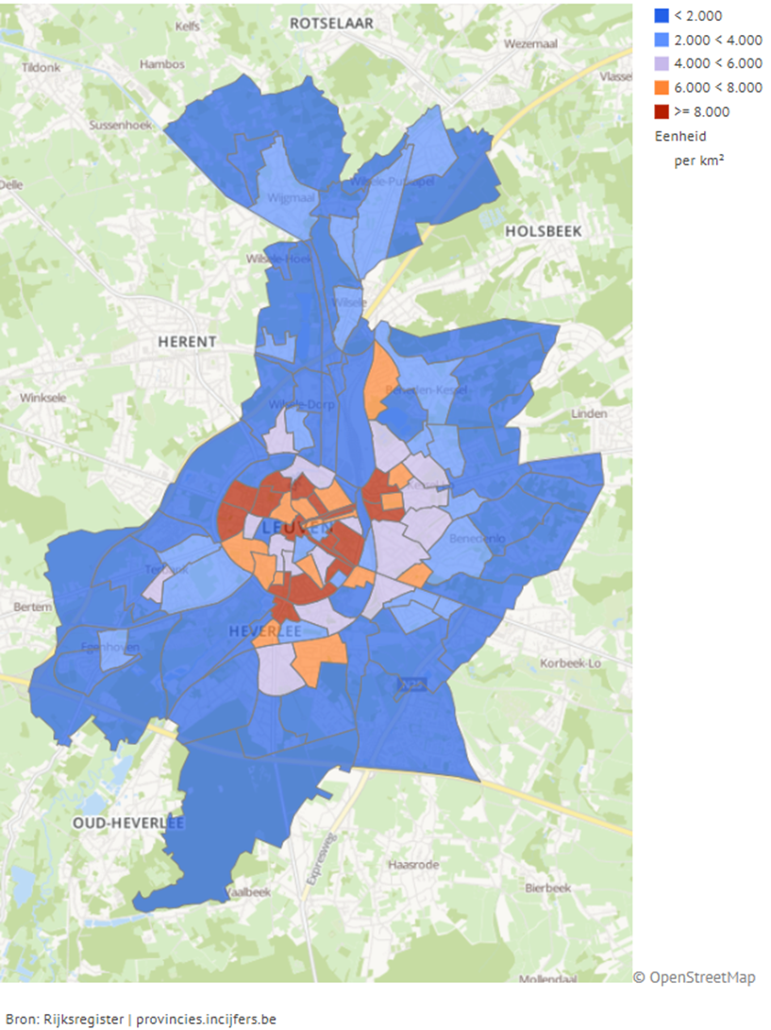
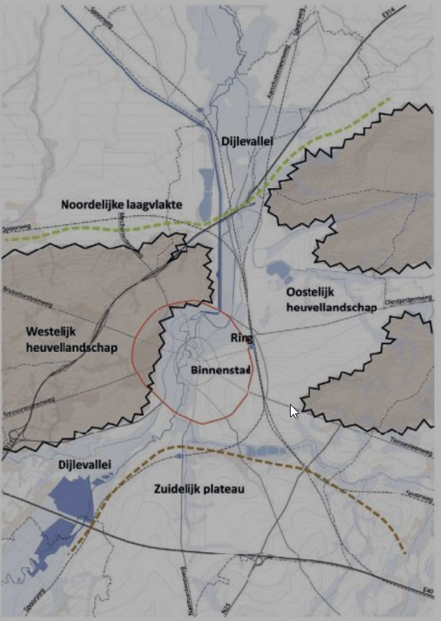
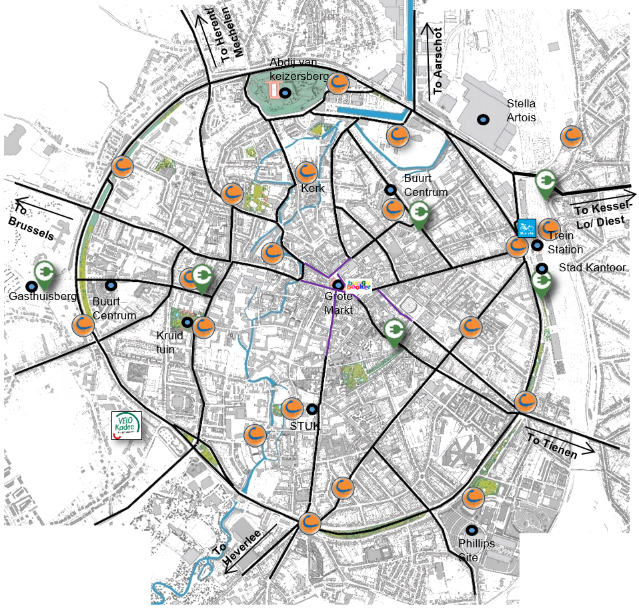
4. Location determination
Strategic (32/40)
Business and other activities (Old city centre, university, industry and research park, university hospital, …)
Area and population densities (>5K/km² in centre: 4 hubs/km²; elsewhere: 1 hub/2 km²) → 50 hubs
Circulation plan
Geomorphology
Existing shared mobility offer and public transportation network
Opinion of the shared mobility providers
Potential to expand
Charging infrastructure
No detailed analysis of grid
Notes:
Hier eerst een kaartje tonen van de strategische punten. Selecteren van Leuven site. En dan criteria één voor één overlopen met de illustratie..
Leuven is a combination of an old city centre and four sub municipalities surrounding it. The largest concentration of business activities is in the Leuven city centre with secondary centres in the four sub municipalities. Sixth and final pole worth mentioning is situated in the south east edge of the map: the business and industry centre of Haasrode.
Population of Leuven has increased strongly the last years and it does not look like this trend is about to stop. Leuven is about 57km², but with a population of over 100 000 inhabitant this leads to an average density of 1 773 inhabitant per km². The largest densities are found in Leuven centre with 5 531 inhabitants per km², not including the large student population. Sub municipalities Heverlee and Kessel-Lo have medium densities, and the lowest are found in Wilsele and Wijgmaal.
The city centre does not only have a large population density is also is a large cluster of activities: business, recreational, tourist etc. This translates to large pressure on the public domain and traffic congestion during rush hours. In 2016 the Leuven circulation plan was implemented. The city is divided in parts where automobile traffic cannot cross from one part to the other. To do a cross-over using a car, the ring-road needs to be utilized. City centre itself is a big car-shy zone (dark purple) and car free zone at the historical core (light purple).
Leuven centre: 6 km² and 4 points/km² for Leuven centre → 24 hubs (gerekend aan 1hub voor 1.250 mensen)
Rest: 51 km² and about 0.5/km² outside of it → 26 hubs

Slide 6

4. Location determination
Bottom up (4/40)
Phase 1: Submit a location
Phase 2: Create an extensive submission file
Phase 3: Neighbourhood meetings and swapping information
Phase 4: Implementation of the neighbourhood mobipoints

Slide 7
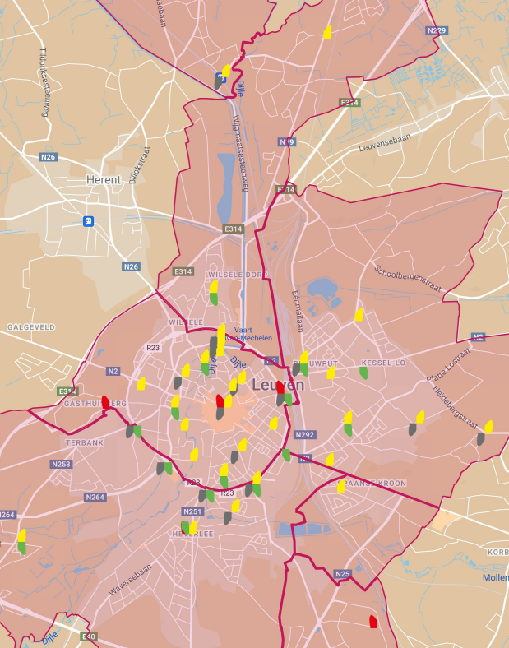
5. Status (1/5/22)
40 eHUBS
30 Cargoroos (30 stations)
40 Urbees (5+1 stations)
17 EVs (12 eHUBs)
Extra: parcel lockers added at 14 eHUBS (pilot project ecozone: emission-free post and parcel delivery)

Slide 8
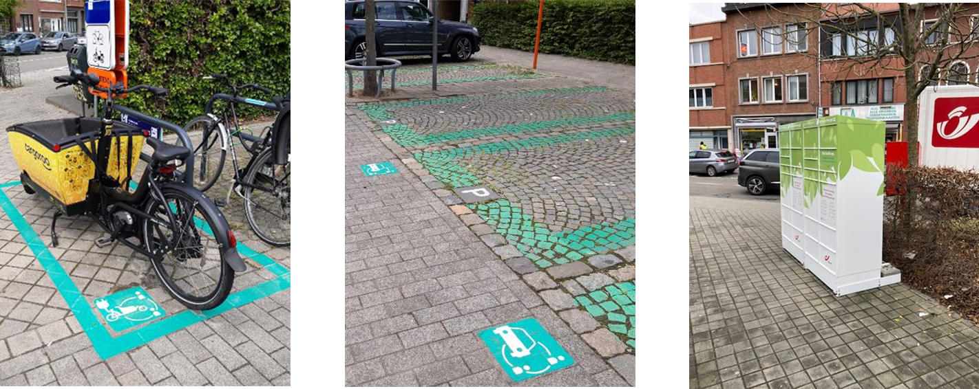
De Becker-Remy:
bus + e-cargo bike + EV + shared cars + parcel locker

Slide 9
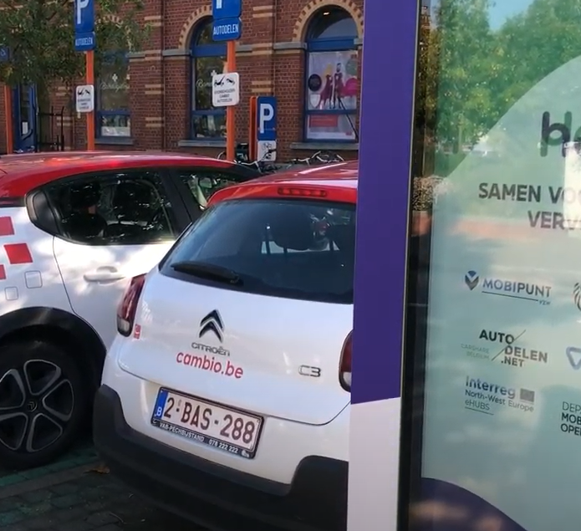
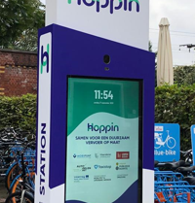
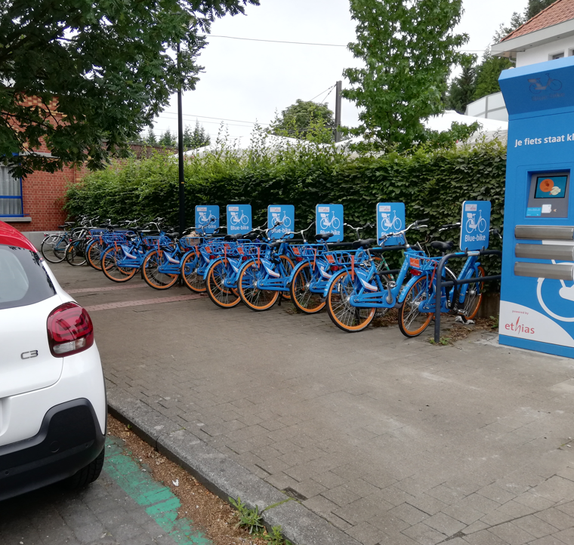
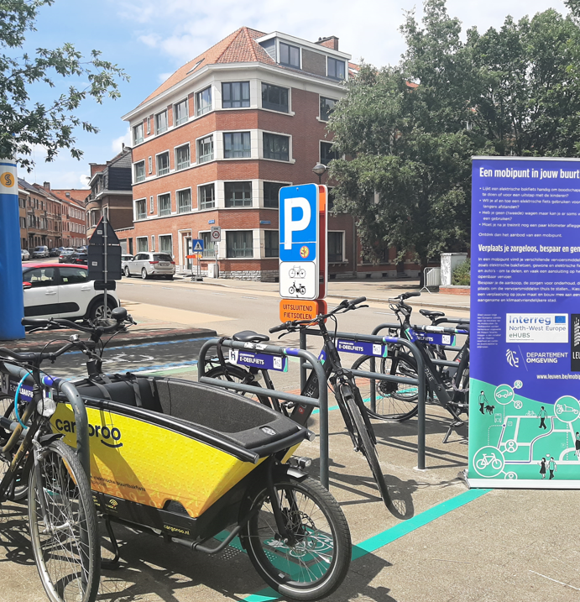
Heverlee Station: e-bikes, e-cargo bike, shared cars and bikes

Slide 10
6. Use of shared mobility
(1/3/22)
 | Fleet size | Rides per vehicle per day (indicative) | # active users (per month)
Urbee (sept-oct ’21) | 26 | 0,22 | Sept: 81 Oct: 57
Cargoroo (2021) | 30 | 0,48 | Oct: 168 Nov: 141
Blue-bike (2021) | 124 | 0,44 | From 1078 (feb) to 3049 (oct) users per month (2021)
Cambio (2021)* | 129 | 1,25 | 3393 (2021)
Partago (2020) | 5 | 0,52 | 64 (2021)
* About whole fleet: conventional + electric vehicles

Slide 11


Slide 12
Rentals
Notes:
IK weet niet of aantal ritten zo relevant is hier.
Total number of rides (9 bikes, jun ‘20 – jun ‘21) = 2034
Total number of rides (30 bikes, jul ‘21 – jan ‘22) = 2029

Slide 13

Average number of rides per bike per day = 0,19
Most of users only do 1 trip
More than 50% of trips are B2M
Notes:
Linear unique users per month
1 user approx 200
Lot of users one time

Slide 14
Rentals

Slide 15
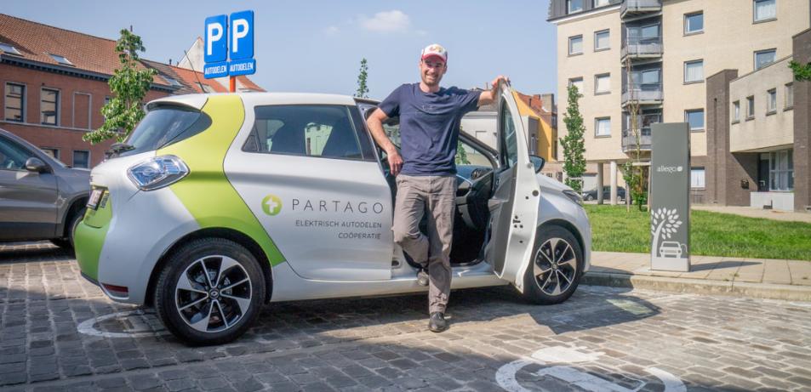
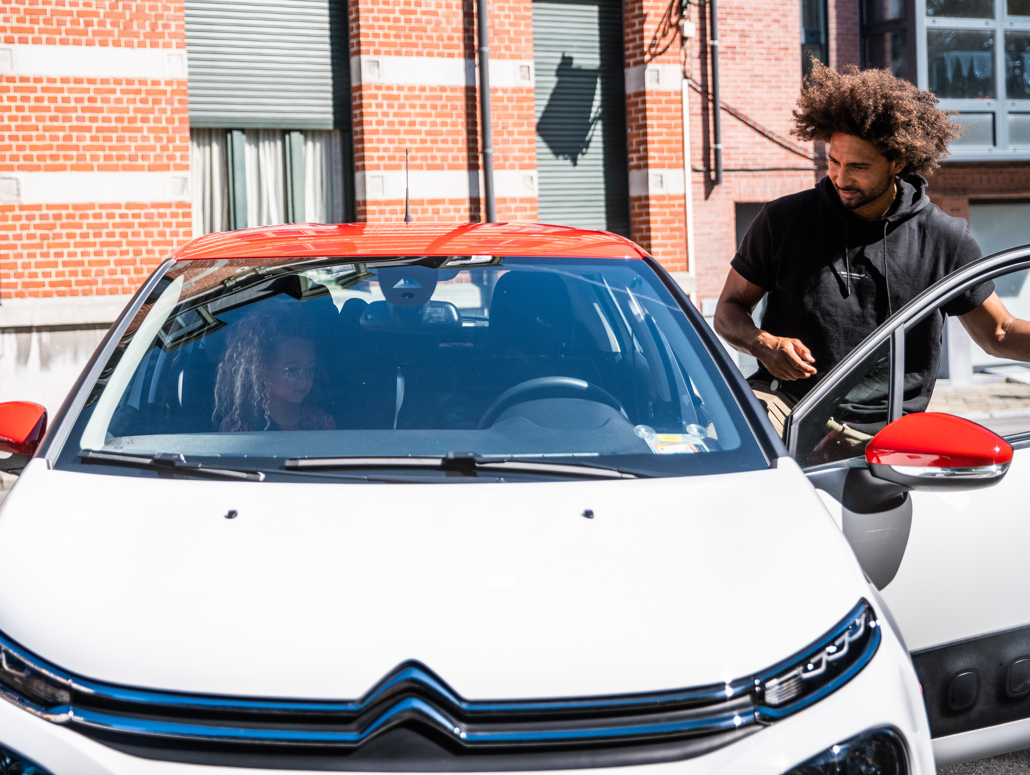
6.3. Shared e-cars
17 EVs on street (linked with eHUBS)
Not yet any specific user data

Slide 16
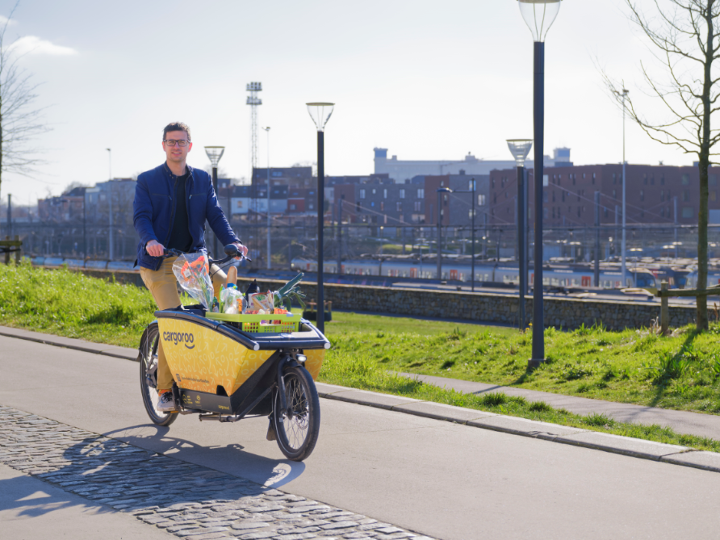
7. Plans
Objective nr 1: to increase uptake
Extension with Cargoroo till end of 2022 – now tendering for concession: 1/1/2023 →
More and better offer
  EVs and E-cargo bikes – testing smart subsidy scheme → transition
  E-bikes – testing in PPP
  More eHUBS on the longer term
More demand
  Nudging
    Look-and-feel of eHUBS → visibility
    Communication tools/campaigns
    Incentives
  MaaS
  Specific target groups – inclusiveness – pilots
  Extra services at eHUBS – pilots
Policy
  CDS-M → evidence-based policies
  More integration (e-mobility, shared
  and multi-modal mobility, urban
  logistics, smart city, public works) and
  focus
  Hoppin?
Notes:
Samenwerking met Duwtje
Pilootcampagne
Focus op e-deelbakfiets
Inspelen op welke motieven
Adhv verschillende technieken via folders
Timing
Verbeteren van zichtbaarheid
Plan op langere termijn

Slide 17
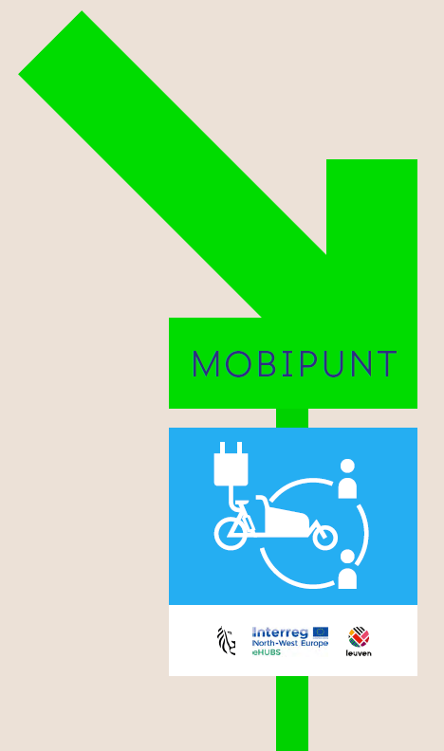
8. Tips and tricks
A strong, clear and flexible vision regarding mobility within the municipality is key to the success of getting started with eHUBS
Reflect about the specific target groups you are aiming at on the short, medium, and long term
Define well your role as local government and the role of the other stakeholders and make sure you are clear about it to the citizens.
Engage the relevant internal and external stakeholders from the start.
Involve the citizens in the planning of the eHUBS if the roll-out of the eHUBS is not so urgent, because this implies a better uptake.
Consider well the preconditions in order of effective implementation, such as electricity.
Be aware that the size, location and services of an eHUB are inseparable.
Be realistic in the business model of shared mobility and foresee a subsidy
Focus on the first and further use and on the visibility
of the eHUBS to promote the uptake of the eHUBS.

Slide 18
Thank you!

