Slide 1


eHUBs Webinar
03/05/2022
Sarah Kumeta
Notes:
TEMPLATE INTRO SLIDE

Slide 2
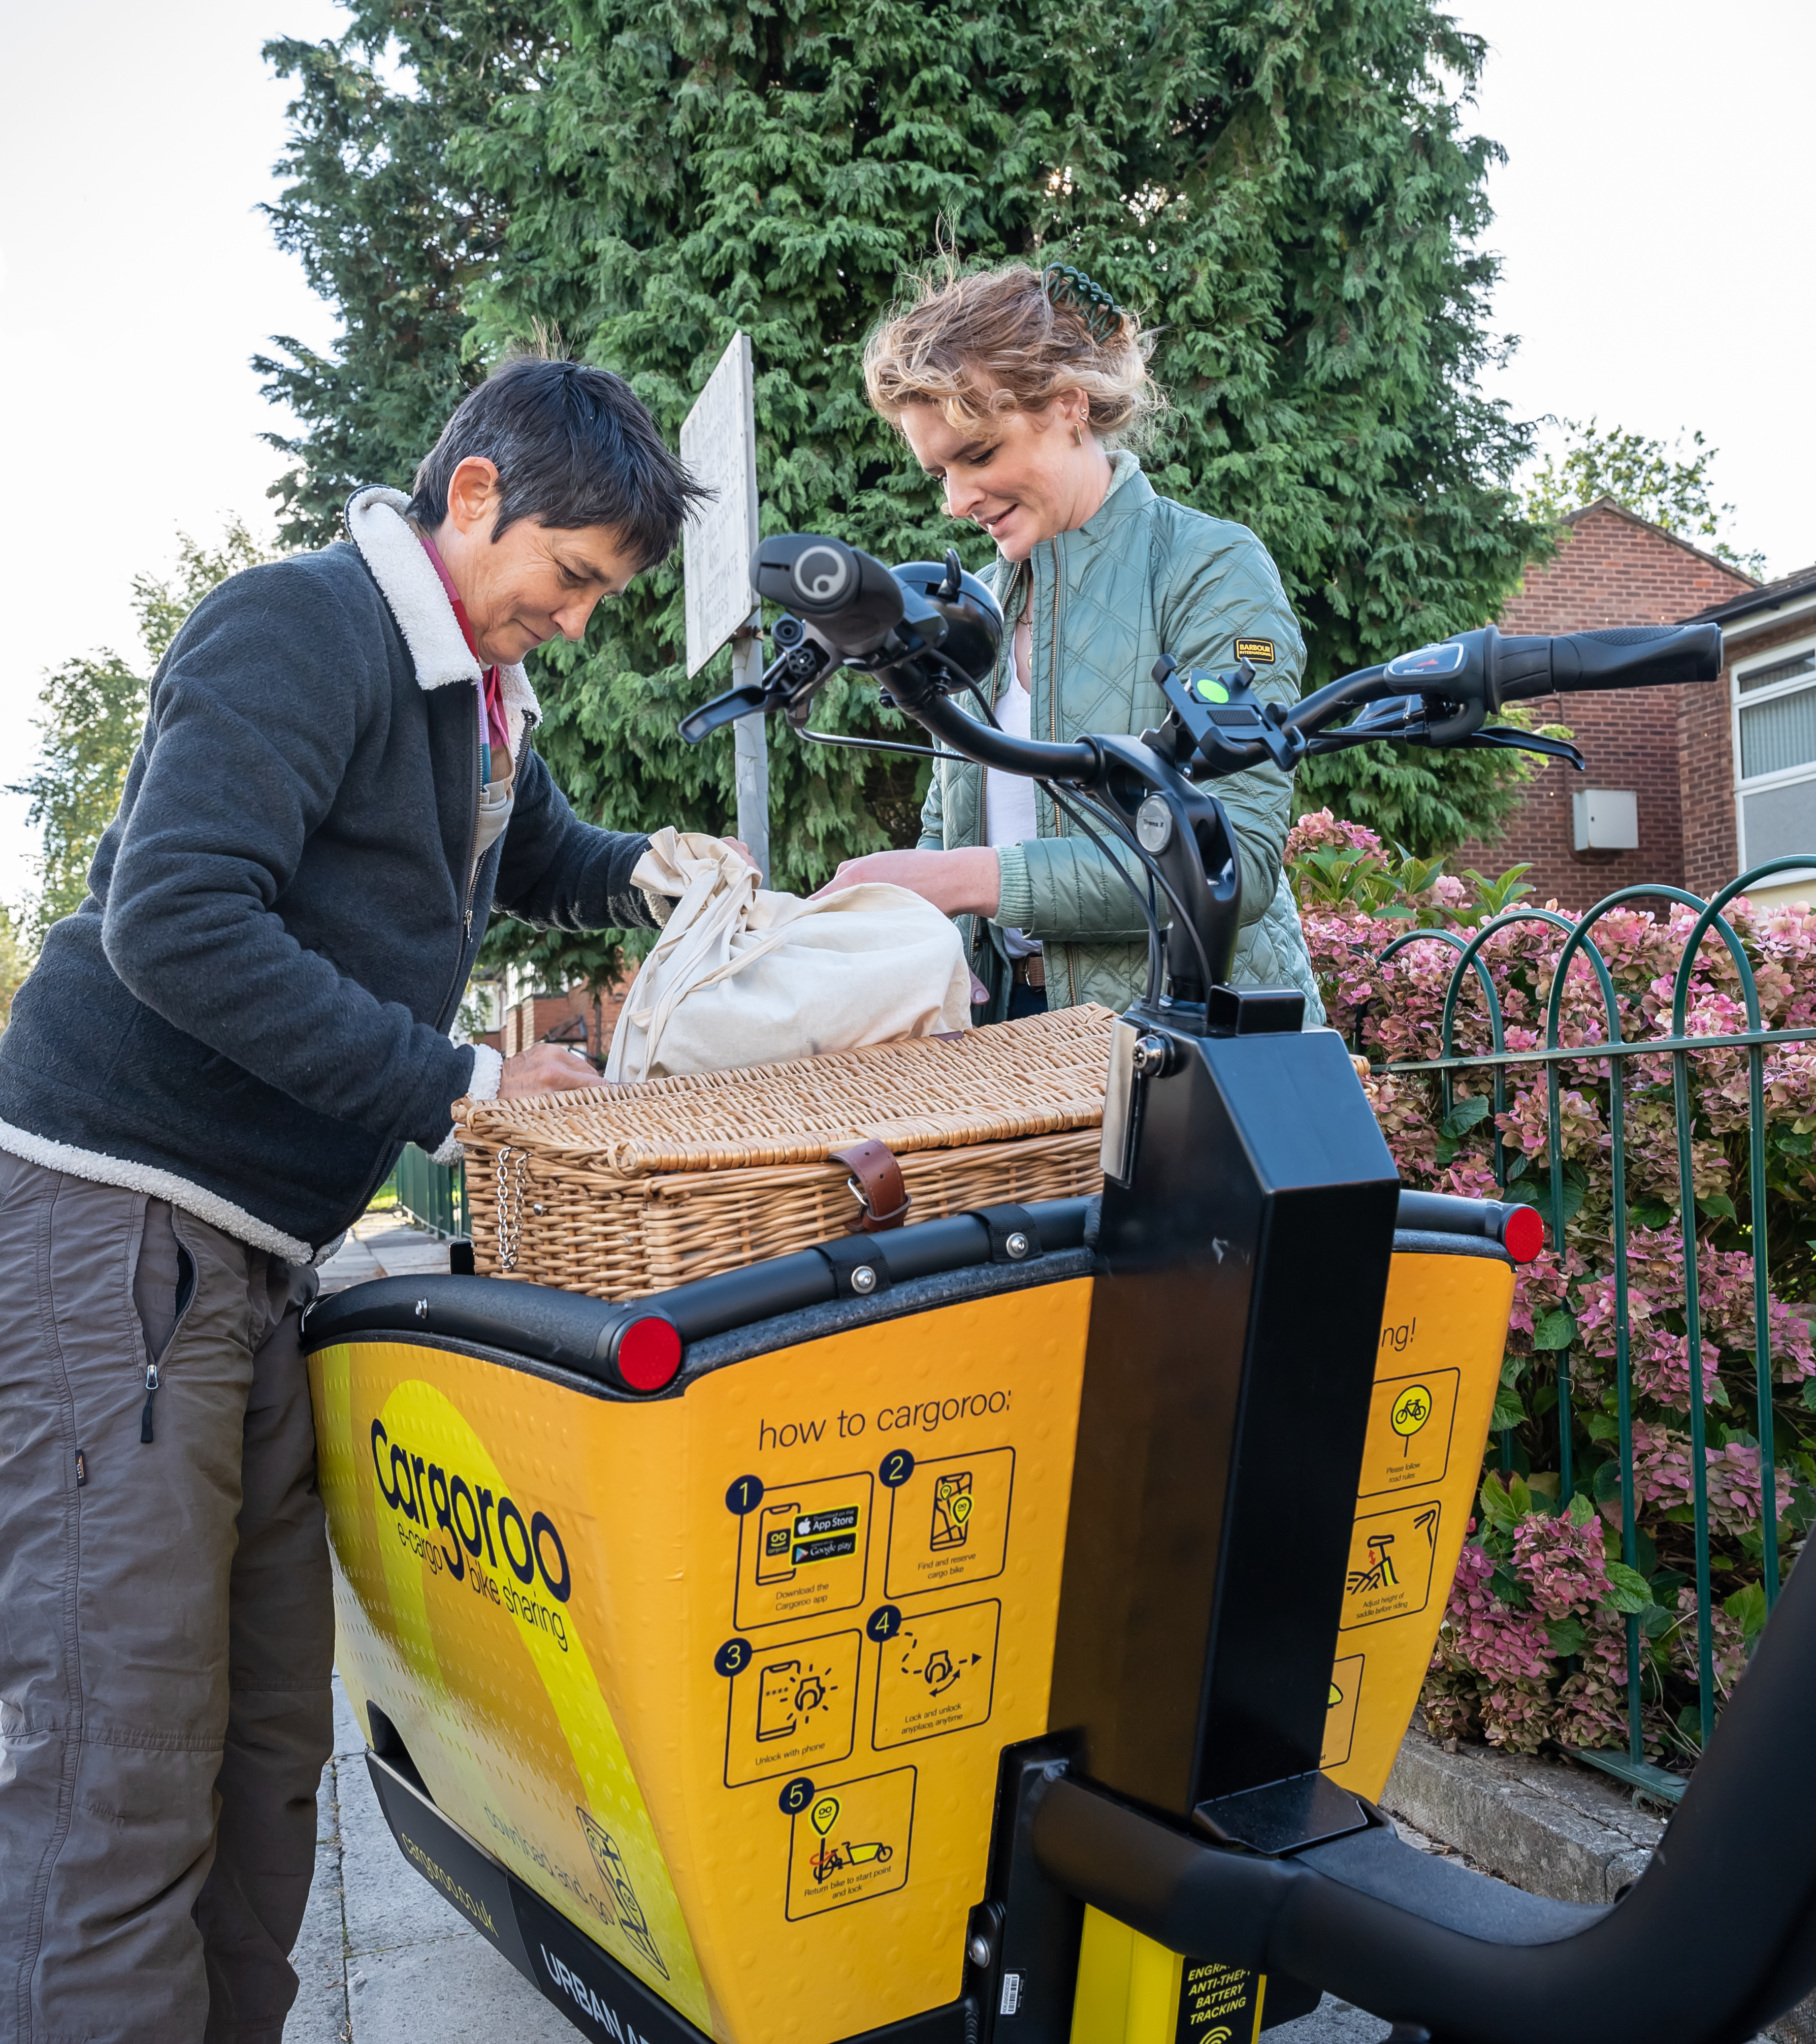

eHUBs – why?
Principle aim is to reduce CO2 emissions through:
  Increasing use and profile of e-shared mobility.
  Reducing private car ownership.
  Increasing active travel.
  Expediting transition to EVs.
  Enabling the development of Mobility Hubs in GM through the creation of a blueprint.
  TfGM keen to understand how people use shared mobility and develop a blueprint for establishing mobility hubs.
Notes:
TEMPLATE – IMAGE AND TEXT

Slide 3
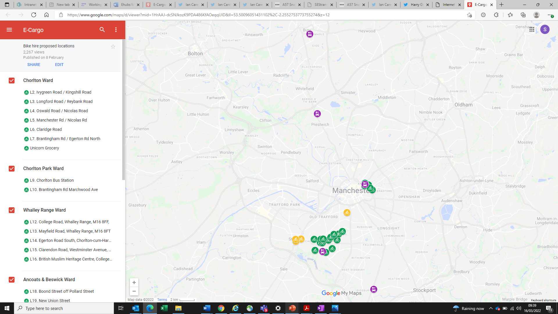

In GM we will deliver 25 e-cargobikes in Ancoats, Chorlton and Whalley Range and 12 Car Club BEVs in Ancoats, Chorlton, Whalley Range and Bury. Creating ten discrete hubs
Map of the locations here:
E-Cargo – Google My Maps
Locations were chosen based on analysis undertaken by University of Delft and work by TfGMs Strategic Planning team. These were consulted on with local authorities and ward members. Following this local residents with properties / shops adjacent to shops were consulted.
Notes:
TEMPLATE INTRO SLIDE

Slide 4
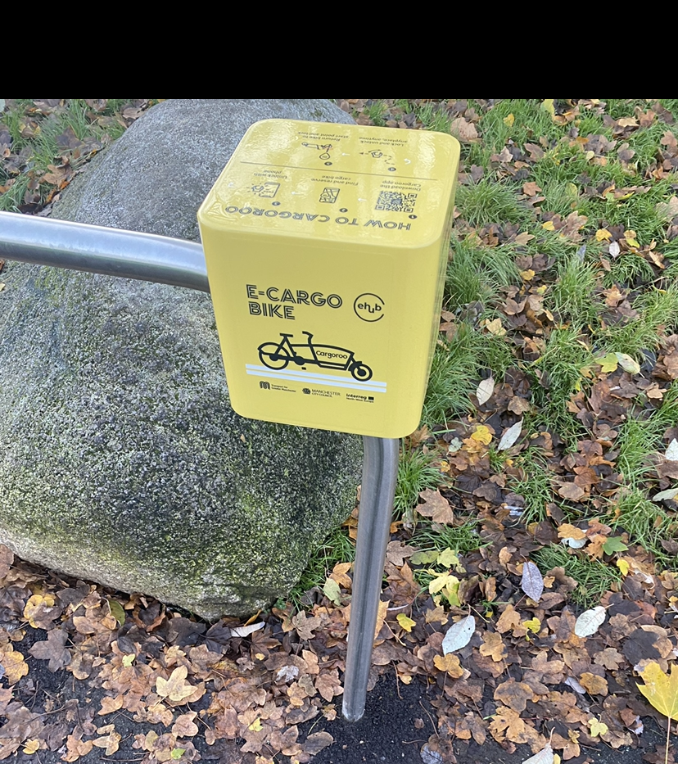
Status Update: E-cargo Bikes
A subset of the e-cargo bikes went live across Chorlton, Whalley Range and Ancoats on the 6th Dec 2021, with a phased roll-out of bikes. There are currently 21 bikes operational, the remaining 4 are awaiting sign off from the local authorities
The uptake has been promising, with 545 user registrations over this period
Dedicated e-cargo bike training launched on the TfGM cycle training webpage
Unique cube signage has been installed on the Sheffield stands, with bespoke yellow and black branding
Cargoroo have been accredited with CoMo UK. Collaborative Mobility UK is the national organisation dedicated to shared transport and an accrediting body of bikeshare and car club operators. The Cargoroo accreditation is the first of its type in the UK.
Manchester Bike Hire have been successfully undertaking the battery swap and maintenance element of the project, on Cargoroos behalf
Unfortunately, there have been some incident of anti-social behavior with 5 of the bike located in the city central locations. TfGM have been working with MBH, Cargoroo and GMP to work through alternative options.
Notes:
Ambassador scheme

Slide 5
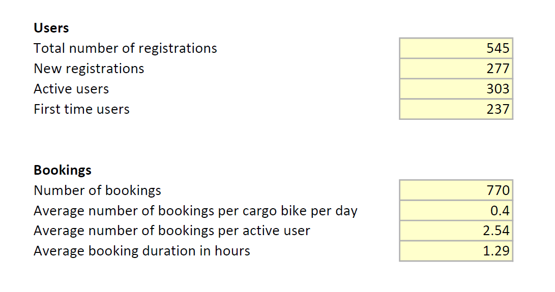
ECargo Bike Usage – 6th Dec –Feb 28th
(fleet gradually increased in size over period to 20 e-cargo bikes)
Booking duration: 54% ~ 1 hr / 30% 1-2hrs
Most popular day: Saturday
TfGM have noticed that the more residential locations have had a higher number of rentals compared to the city centre locations.
We have also trialled ‘destination’ based locations i.e. a bike at medium size ethical supermarket proving to be a popular location. Therefore we are looking to install a similar ‘destination’ based location at Stretford mall (a shopping centre with a supermarket and other shops.

Slide 6
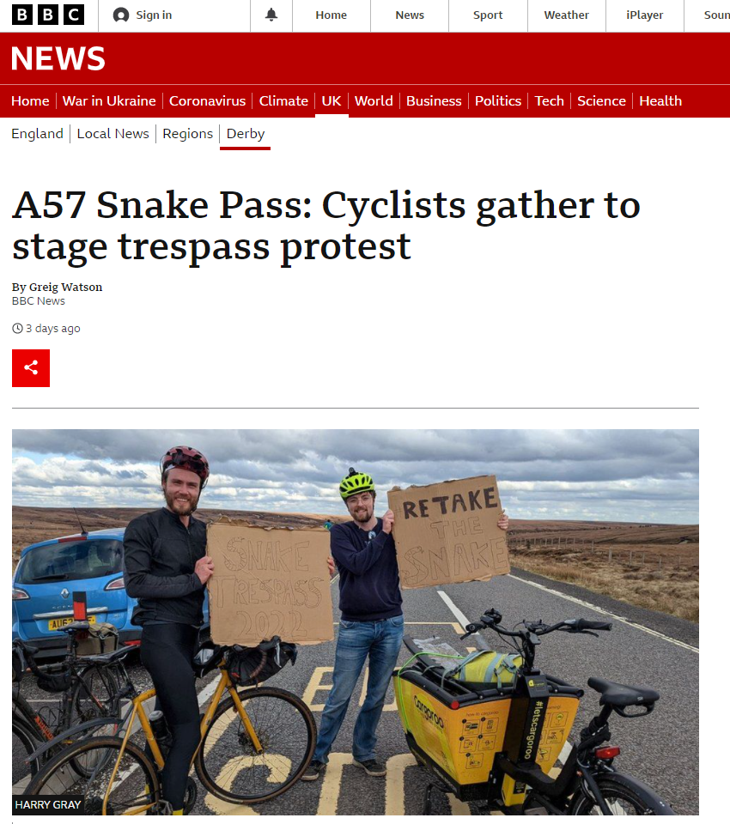
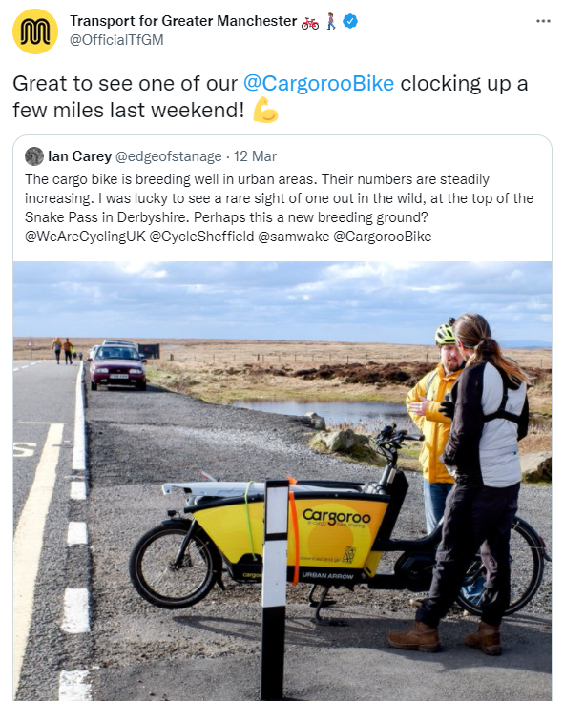
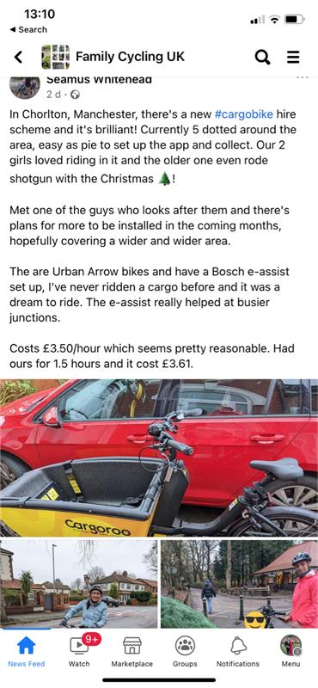
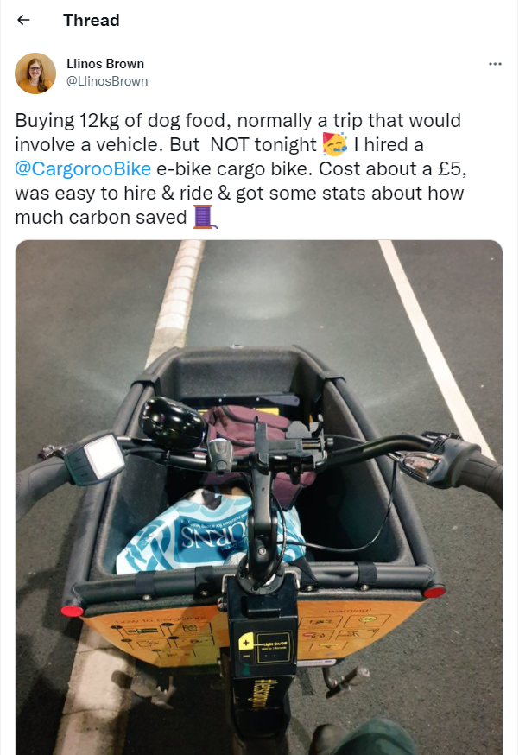
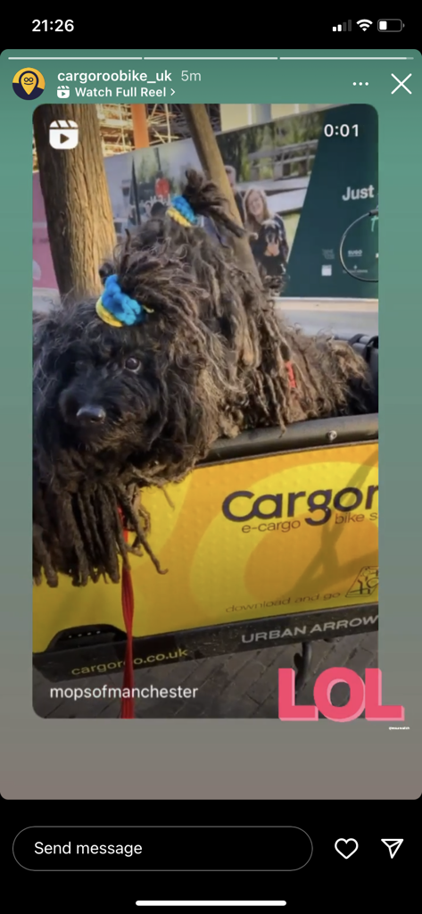
E-cargo Bike Feedback
TfGM have been pleased with the sentiment online about the scheme
Various people have posted about their positive experience using the bikes
TfGM also released a press statement, which was picked up by various Manchester based news outlets.
Recently an article was featured on BBC news, with a Cargoroo bike

Slide 7
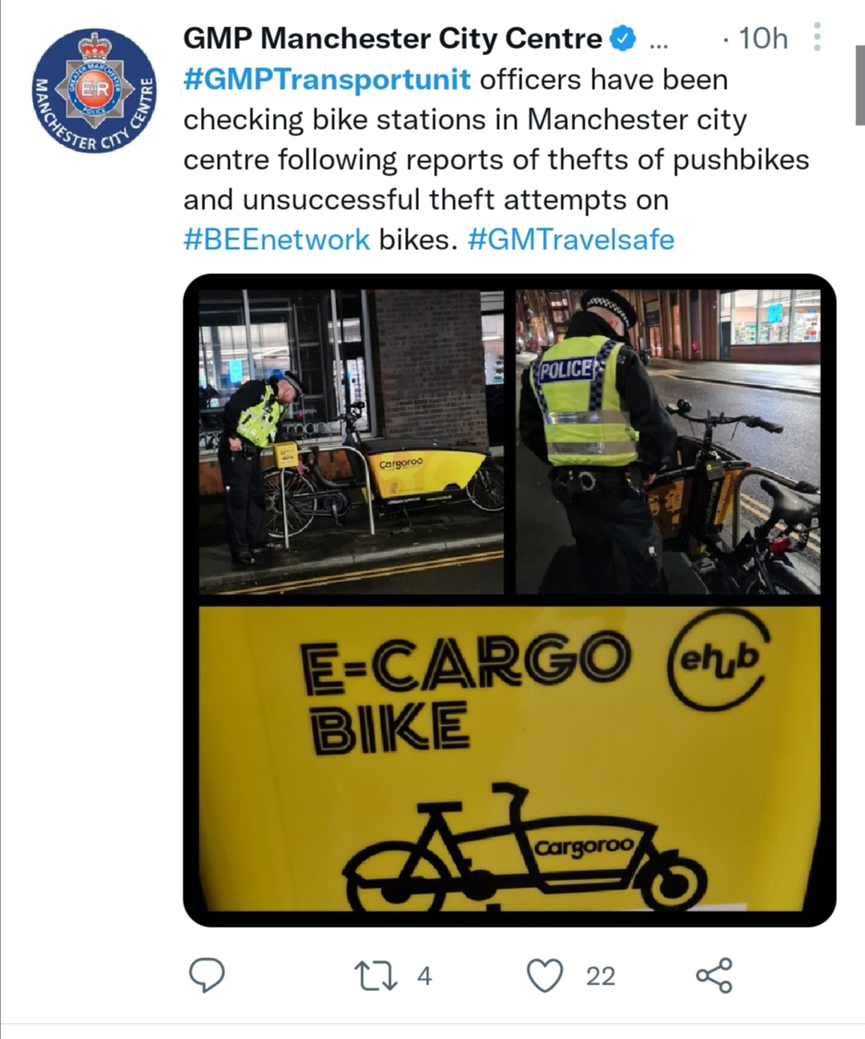
Next Steps for the e-cargo bikes
Unfortunately, there have been some incident of anti-social behavior with 5 of the bike located in the city central locations. TfGM have been working with MBH, Cargoroo and GMP to prevent this happening. However TfGM are communicating with MCC to understand if these bikes can be re-located
Obtain approvals for locations outside shopping centre, to help understand demand at a busy ‘destination’ based location
Continue roadshow events throughout the spring / summer months
Plan summer marketing campaign for social media
Continued promotion of ‘How to videos’ i.e. how to lock bikes properly

Slide 8
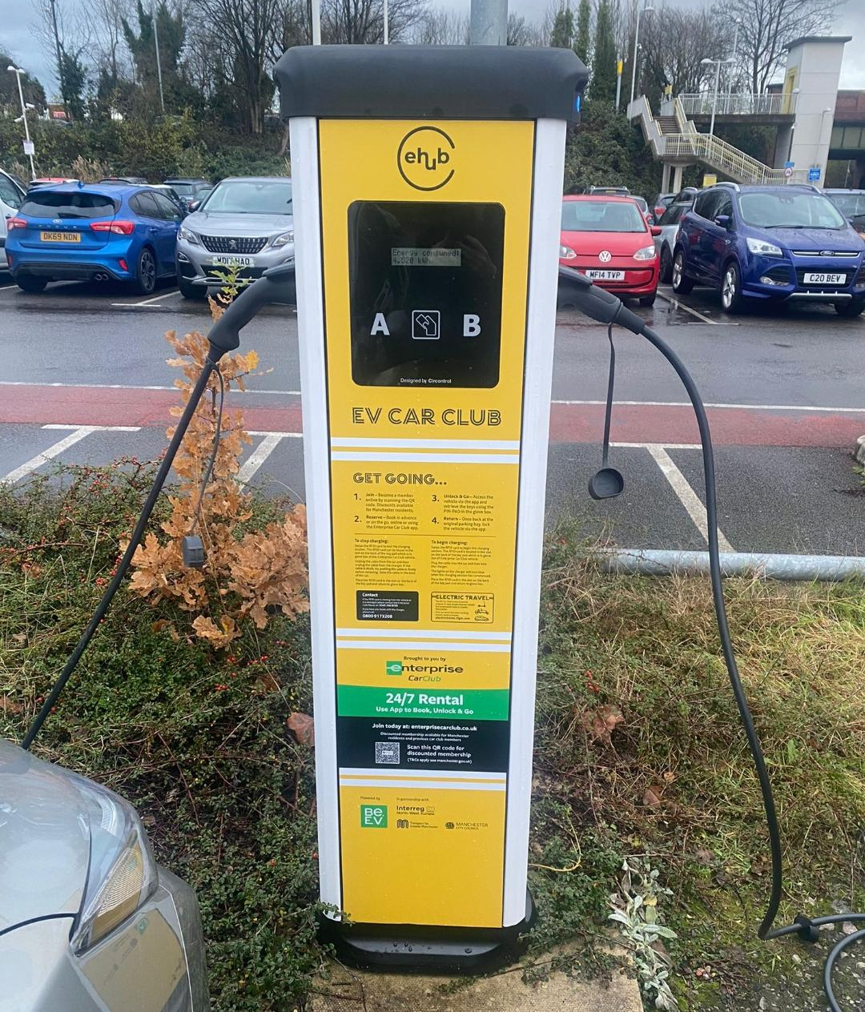
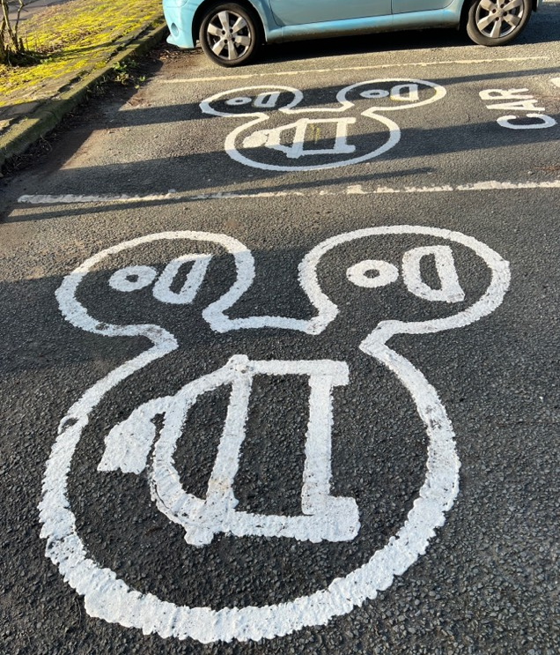
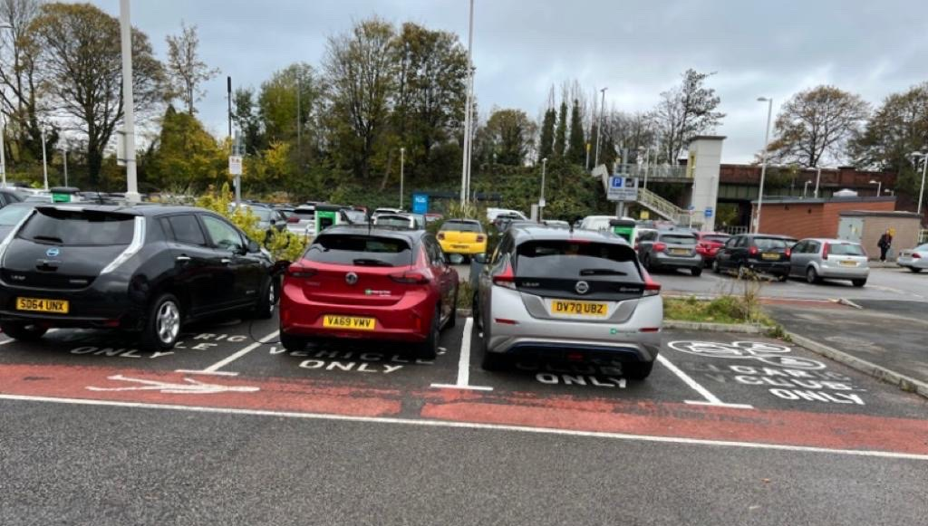
Status Update: EV Car Club
MOUs and Contracts agreed between local authorities, TfGM and Enterprise
2 x EV vehicles live at East Didsbury Park and Ride since Oct 2021.
Whilst EVCI is being commissioned a combination of fully electric and hybrid vehicles have been launched at remaining locations. Users are being incentivised by Enterprise to charge the vehicles at other chargers on the network, as part of their journey.
Branding installed, with Car Club floor markings
Remaining EVCI has been installed and awaiting connection by Electricity Northwest
Significant delays in regards to the procurement of the EVCI and lack of availability of contractors has meant delays in go live of remaining 10 vehicles
Notes:
EXPLAIN: The floating car club model is a useful exercise to understand how the car club fleet may be extended in the absence of each car club vehicle not being able to have their own dedicated EVCI.

Slide 9
Usage data of the EV Car Club
Headlines since launch in October:
No. of bookings in period: 84
No of hours booked: 2088
No of miles covered: 7513

Slide 10
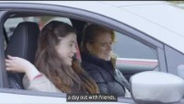
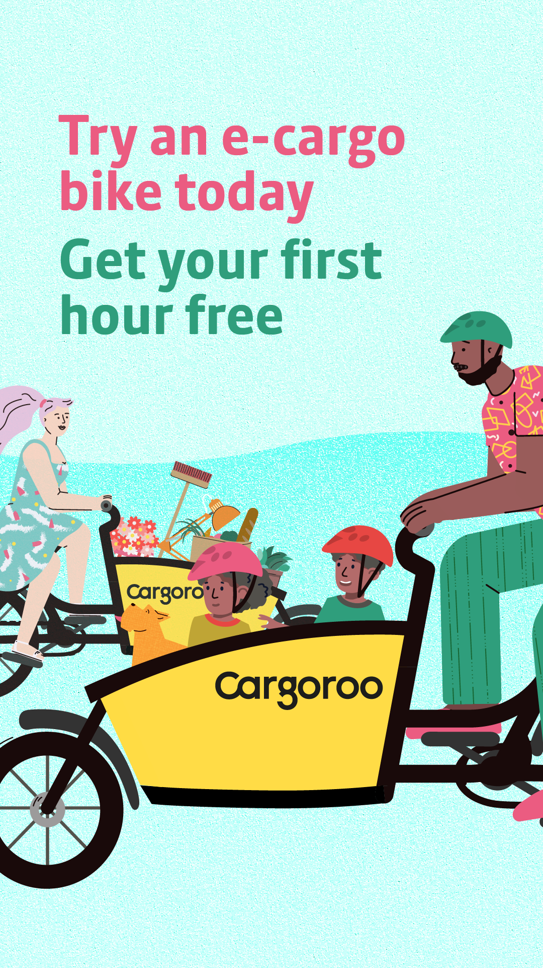
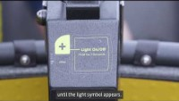
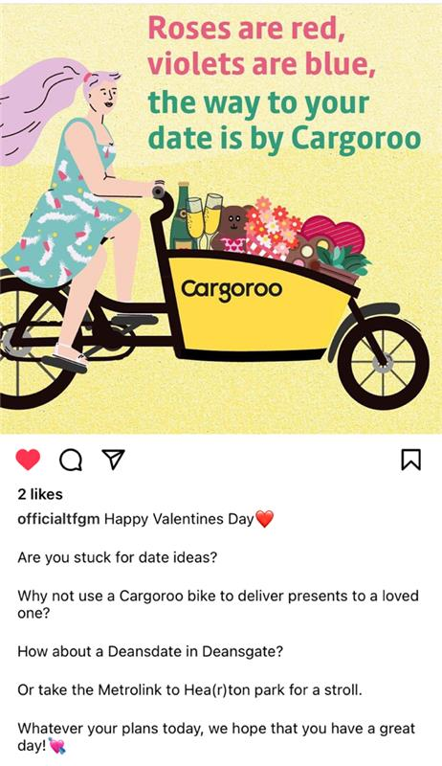
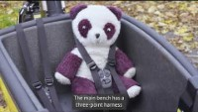
Promotional Activity
Dedicated eHUBs webpage created www.electrictravel.tfgm.com/ehubs/
A social media campaign has been undertaken to promote the uptake of the e-cargo bikes targeted based on location. This activity will be repeated with an car club focus
A/B testing undertaken to understand performance of promotional video vs. graphics
‘How to use’ and promotional videos added to the website
2 x roadshow events taken place, promoting the vehicles and the eHUBs programme. More planned throughout summer
Regular attendance at webinars to talk about the project and share learnings
Exploring the use of influencers to further encourage nudging behaviour
Posters at tram stops to share info about nearby EV car clubs

Slide 11
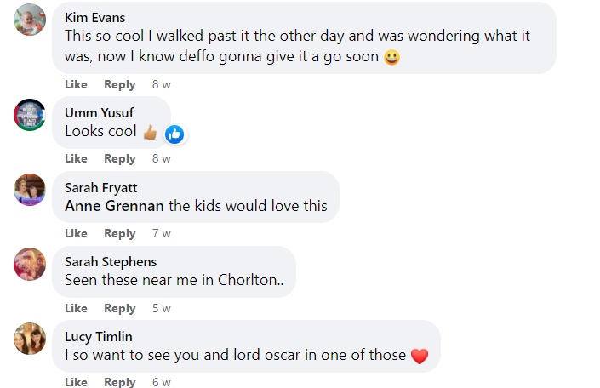
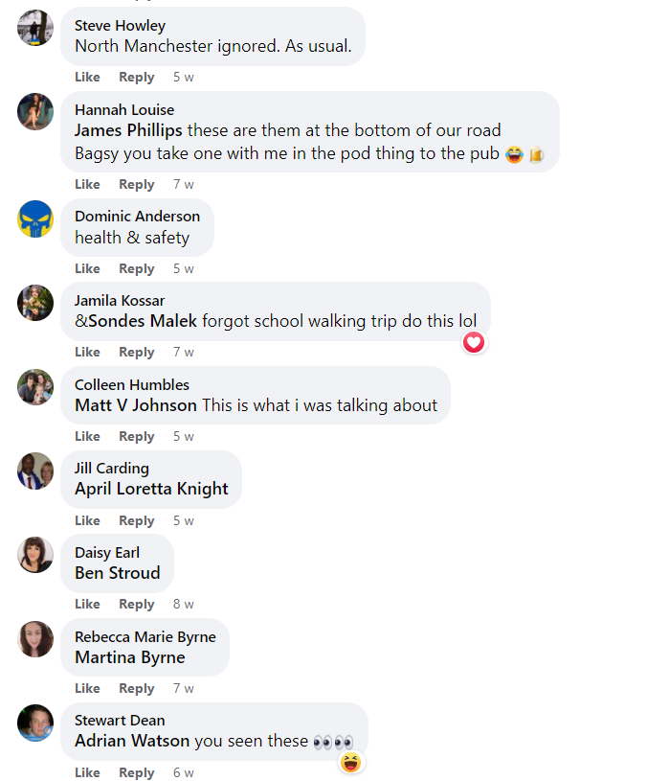
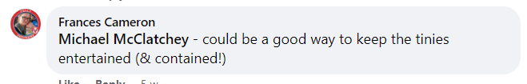
Impact of social media campaign
As part of the campaign, we directed people to the Cargoroo FAQs page which during the campaign period achieved 361 visits, an increase of 40% on the previous 4 week period.
Platform | Imps | Clicks | CTR % | Spend | CPM | CPC
Facebook | 377,464 | 1,833 | 0.49 | £2,896 | £7.67 | £1.58

Slide 12
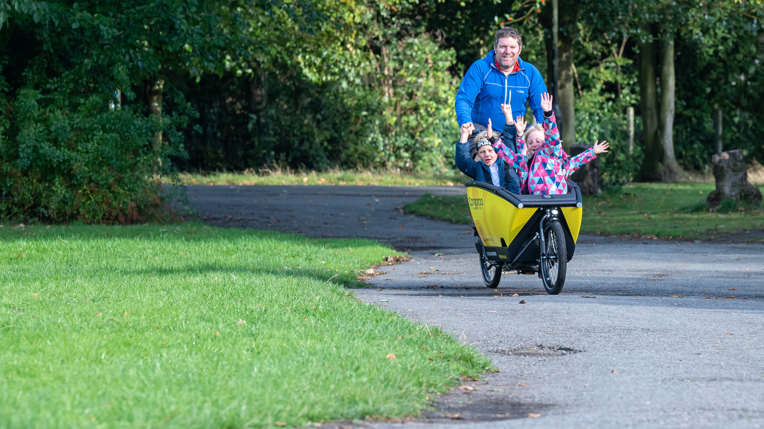
Future Plans
TfGM would like to explore a possible extension of the e-cargo bike element of the eHUBs project. There were significant delays in go-live due to COVID and Brexit related issues
TfGM are continuing to develop a “Shared Mobility Strategy and Roadmap”. A key element of this is the expansion of Car Clubs, this is being heavily influenced by the learnings from the eHUBs project.
TfGM is working with Bury Council and NHS (National Health Service) colleagues to understand how the EV car clubs could be trialled as a ‘grey fleet’. It is hoped that best practice can be developed which can be implemented elsewhere in Greater Manchester.
Continuing to develop site selection tool, which maps areas of high potential for a mobility hub. This was influenced by the work conducted by the University of Delft

Slide 13
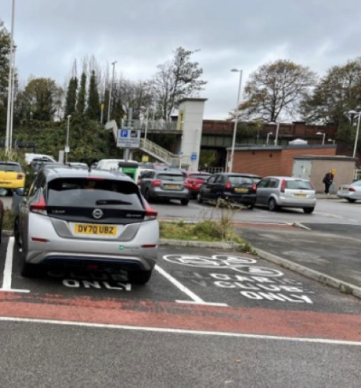
Recommendations
Early engagement with local authorities, officers and counciillors to gain agreement on locations. Co-ordination and co-operation required
Importance of creating a brand for the eHUBs to create consistency
Awareness of the EVCI market – unexpected delays
Recognition that e-cargo bikes are a new form of transport in the UK – make steps to make it recognised i.e. accreditation, training, videos etc.
Be flexible and test aspects i.e. locations, promotional campaigns etc.

Slide 14
Questions

