Slide 1
The Enabling Support Tool (EST)
& European Engagement
Tadgh Cummins
Tim Williamson
Marianna Rossi
Branca Delmonte
Place image in this area.
GenComm Project Partners’ Meeting
8th & 9th June 2022 - Luxembourg

Slide 2
The Enabling Support Tool
Tadgh Cummins
Place image in this area.
GenComm Project Partners’ Meeting
8th & 9th June 2022 - Luxembourg

Slide 3
The Enabling Support Tool – what is it?
A free online tool that will enable bus fleet operators to make better decisions in the transition to green bus fleets, eg:
“What bus types should I purchase to replace my existing fleet?”
“Are fuel cell electric buses (FCEBs) suitable for my fleet?”
“How much will it cost?”
Informs the user on role of green hydrogen in decarbonising public transport
Contains an interactive Total cost of Ownership (TCO) and Total Cost of Abatement (TCA) model
CAPEX
OPEX
TCO (€/km)
$$=$$
Bus cost
$$+$$
Fuel cost
$$÷$$
Distance
Infrastructure cost
Maintenance cost
TCA (€/kg_{CO2})
$$=$$
TCO_{zero/low emission fleet}
$$−$$
TCO_{diesel fleet}
$$÷$$
Emissions reduction
Notes:
TCO: Sum of operating costs and investment costs of a fleet (€/km)
Cost of Infrastructure, maintenance, vehicles and fuel can be compared across fleet types
Well known and widely used among fleet operators
Useful for making business cases
TCA: Cost of abating 1kg of CO₂ emissions when moving to a green fleet (€/kg)

Slide 4
Enabling Support Tool
online interface flow
1
Description of what the EST is
High
Medium
Low
2
Strong knowledge of FCEB potential
Strong knowledge of TCO & TCA
Some knowledge of FCEB potential
Some knowledge of TCO & TCA
Little to no knowledge of FCEB potential
Little to no knowledge of TCO & TCA
What is your level of knowledge? (select one)
Inform
Inform
What is TCA?
How are TCO & TCA useful?
How will BEBS and FCEBs coexist?
What is TCO and TCA and how are they useful?
How will BEBs and FCEBs coexist?
3
Description of how to use TCO & TCA model
4
Information & sources for price of H2 in your region
5
6
Inputs
View results

Slide 5
Enabling Support Tool Inputs
In order to optimise a mixed fleet of FCEBs and BEBs, the EST needs to collect information about factors affecting the range of a BEB:
HVAC systems
Energy consumption depends on climate and driving time
Can account for up to 50% of BEB energy consumption
Bus payload
Energy storage system (e.g. batteries)
Passengers
10% increase in weight : 6% increase in fuel consumption
Road gradient
Effect is only significant on very steep routes
UR = Utilisation Rate (km/day)

Slide 6
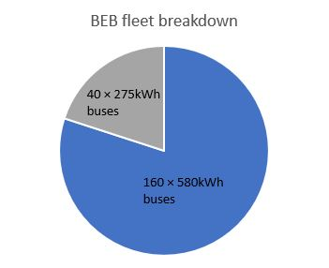
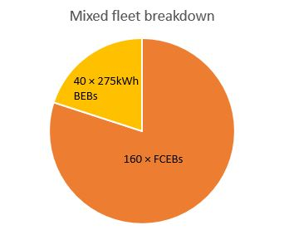
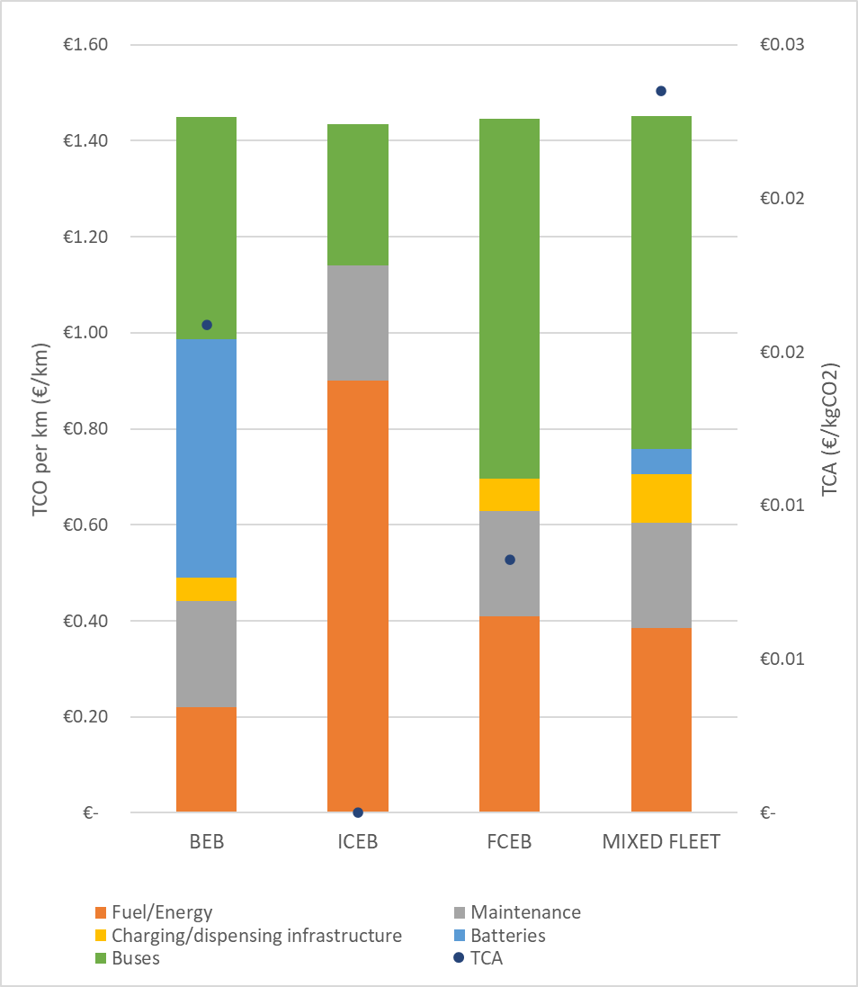
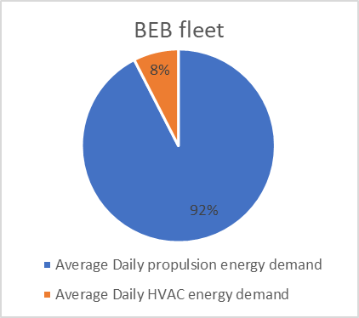
Enabling Support Tool Outputs
Financial outputs:
 | BEB | ICEB | FCEB | Mixed (BEB-FCEB)
CAPEX | € 204,496,998.70 | € 61,001,697.41 | € 167,201,008.34 | € 130,219,612.98
OPEX | € 95,950,746.96 | € 236,465,598.50 | € 132,464,867.98 | € 169,217,939.93
TCO | € 300,447,745.66 | € 297,467,295.91 | € 299,665,876.32 | € 299,437,552.91
TCO/km | € 1.45 | € 1.43 | € 1.45 | € 1.44
TCA (€/kgCO₂) | € 0.02 | € - | € 0.01 | € 0.01
Battery sizing based on distance and payload
HVAC % of total energy consumption

Slide 7
Opportunities for improvement
Investigate ‘depot-less’ modelling capability for smaller/private bus fleets with no central depot
Opportunity charging vs depot charging of BEBs
Verify all assumptions with industry & literature data
Gain feedback from usability tests/interviews

Slide 8
EST UI and Website Implementation
Tim Williamson
Place image in this area.
http://communityh2.eu/links/
GenComm Project Partners’ Meeting
8th & 9th June 2022 - Luxembourg

Slide 9
Saarland
Marianna Rossi
Place image in this area.
GenComm Project Partners’ Meeting
8th & 9th June 2022 - Luxembourg

Slide 10
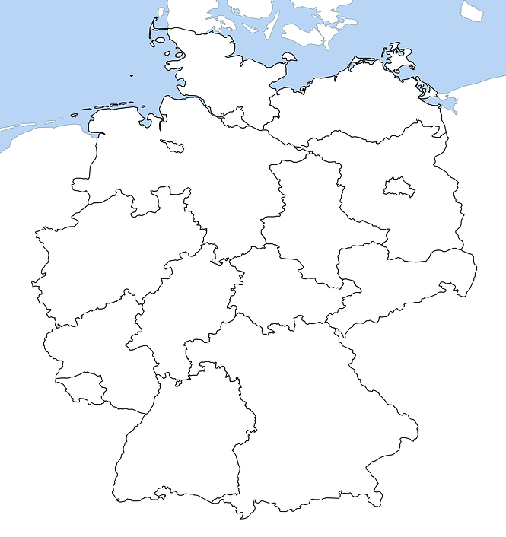
Contribution of the IZES to the EST
Primary Goals
Concept development for the use of hydrogen in local public transport focusing on the regions Merzig-Wadern and Saarpfalz.
Support for the development of the EST
Current Actions:
Usability Testing of the EST
GenComm Project Partners’ Meeting #20 - 8th & 9th June 2022

Slide 11
Usability
USER EXPERIENCE „A person's perceptions and responses that result from the use and/or anticipated use of a product, system or service.”
BEFORE | DURING | AFTER
Expectations and needs towards the EST | Usability testing of first test version of the EST | Usability testing of the adapted version of the EST
GenComm Project Partners’ Meeting #20 - 8th & 9th June 2022

Slide 12
Usability: Actions up until now
USER EXPERIENCE „A person's perceptions and responses that result from the use and/or anticipated use of a product, system or service.”
BEFORE | DURING | AFTER
Expectations and needs towards the EST | Usability testing of firt test version of the EST | Usability testing of the adapted version of the EST
Interviews
with relevant stakeholders
GenComm Project Partners’ Meeting #20 - 8th & 9th June 2022

Slide 13
INTERVIEWS BEFOREHAND
ANTICIPATED | EXPERIENCED
Relevant, local stakeholders Administration and politics Transportation and bus companies Project-related industries and companies Influential individuals | Participants of successful comparative projects Companies accompanying the project Stakeholder involved in the project
Analysis of the current situation in counties of interest Project evaluation Project expectations Expected project-inhibiting factors Potential project-beneficial factors General information needed, e.g. funding Analysis of EST user needs Information the EST should ideally provide, e.g. time of amortization Factors the EST should take into account e.g. available infrastructure | Supplementing local analysis with real experiences Lessons Learned Experienced project-inhibiting factors e.g. political restraints Experienced project-beneficial factors e.g. early stakeholder participation Analysis of EST user needs Information the EST should ideally provide e.g. time of amortization Factors the EST should take into account e.g. available infrastructure
PARTNERS
PURPOSE
GenComm Project Partners’ Meeting #20 - 8th & 9th June 2022

Slide 14
Usability: Planned Actions
USER EXPERIENCE „A person's perceptions and responses that result from the use and/or anticipated use of a product, system or service.”
BEFORE | DURING | AFTER
Expectations and needs towards the EST | Usability testing of first test version of the EST | Usability testing of the adapted version of the EST
How effective, efficient and satisfactory is the EST
GenComm Project Partners’ Meeting #20 - 8th & 9th June 2022

Slide 15
Usability: Planned Actions
Task appropriateness
Usage leads to the planned goal
Self descriptiveness
Appropriate information for successful user-system-interaction
External and internal consistency
Usage of universal interactions, symbols and terms; uniform design of other elements
Learnability
Quick recognition and implementation of unknown functions
Robustness against user errors
Automatic recognition and correction of errors or user support in correction
User engagement
System is appealing and inviting to the user
+ Additional inputs/outputs
+ Suggestions for improvement
+ Particularly positive elements
+ General feedback
GenComm Project Partners’ Meeting #20 - 8th & 9th June 2022

Slide 16
Luxembourg
Branca Delmonte
Jun/22
Place image in this area.
GenComm Project Partners’ Meeting
8th & 9th February 2022 - Luxembourg

Slide 17
Bus operator
Challenges to electrification
Routes
Distance
Steepness
Availability
Infrastructure
Operational parameters
Technical installations
GenComm Project Partners’ Meeting #20 - 8th & 9th June 2022

Slide 18
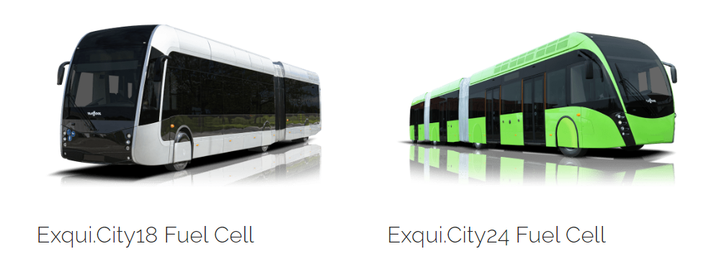
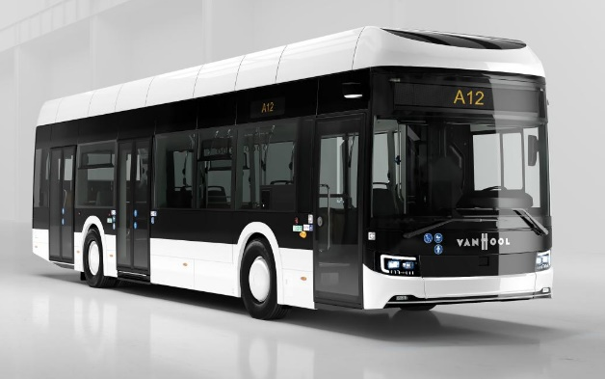
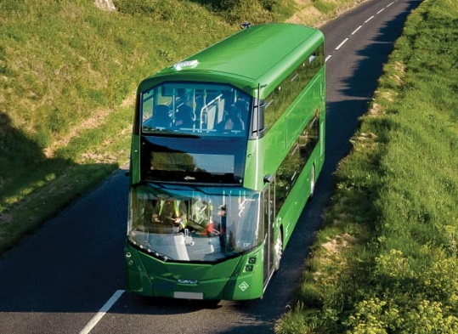
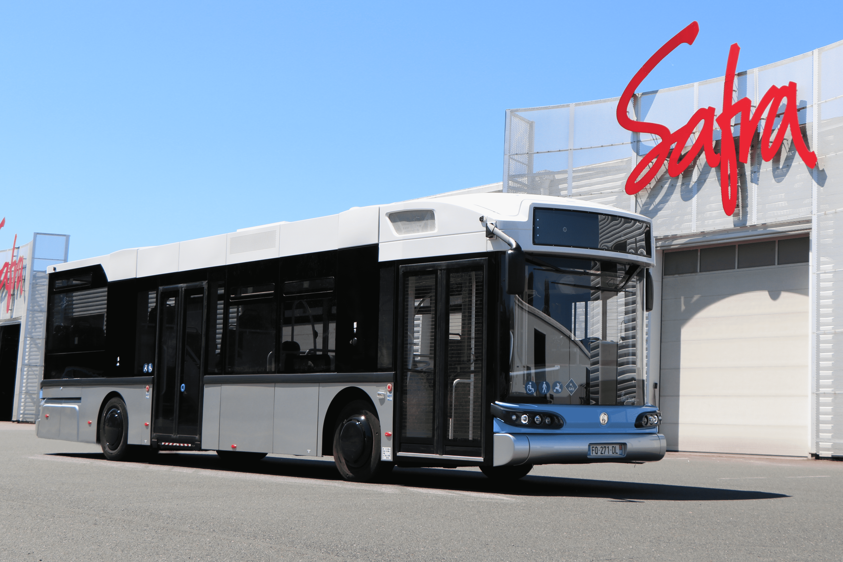
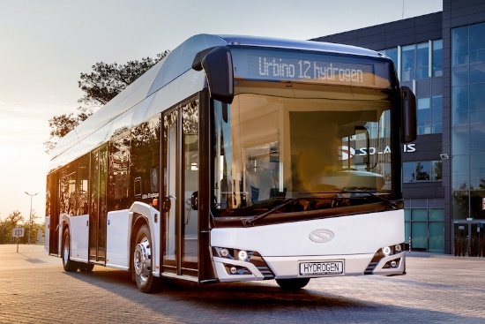
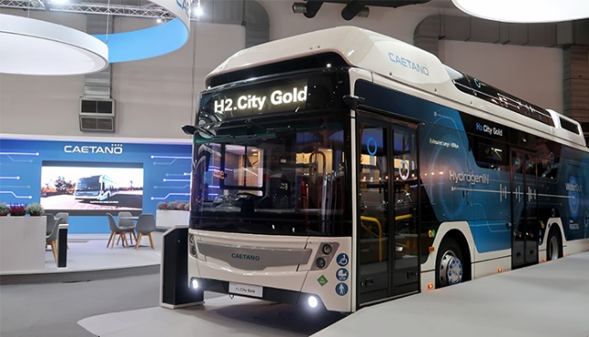
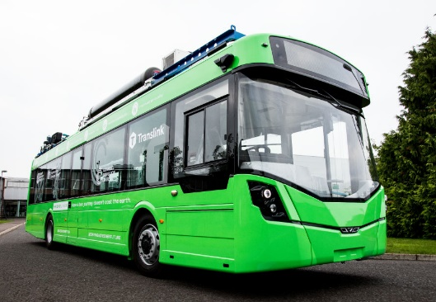
Fuel Cell Hydrogen Buses
Operational parameters
Capacity
Autonomy
Refueling time
Technical parameters
Motor type
Fuel cell
Storage (hydrogen and battery)
Financial parameters
GenComm Project Partners’ Meeting #20 - 8th & 9th June 2022

Slide 19
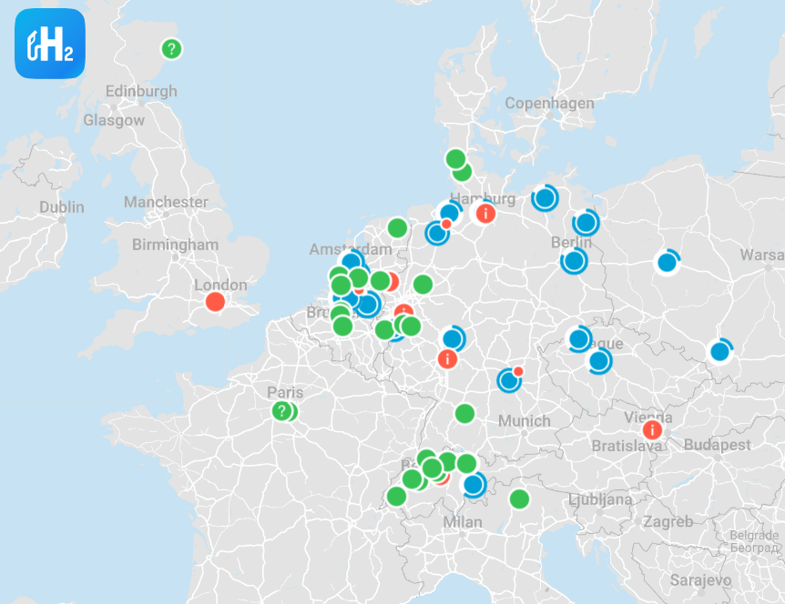
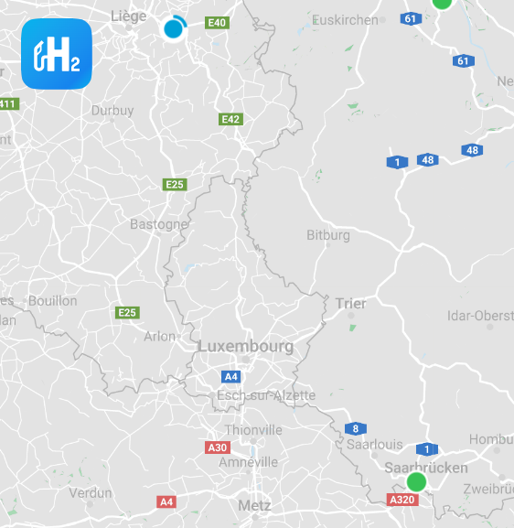
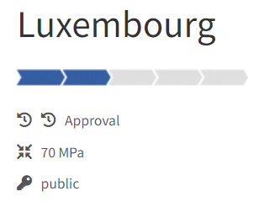
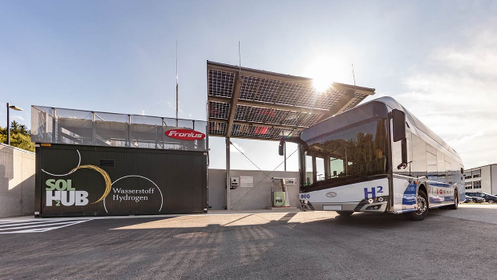
Supply chain and Infrastructure
Refueling stations
Hydrogen suppliers
Refueling infrastructure
Costs
GenComm Project Partners’ Meeting #20 - 8th & 9th June 2022

Slide 20
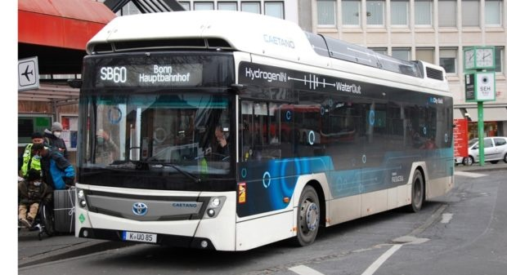
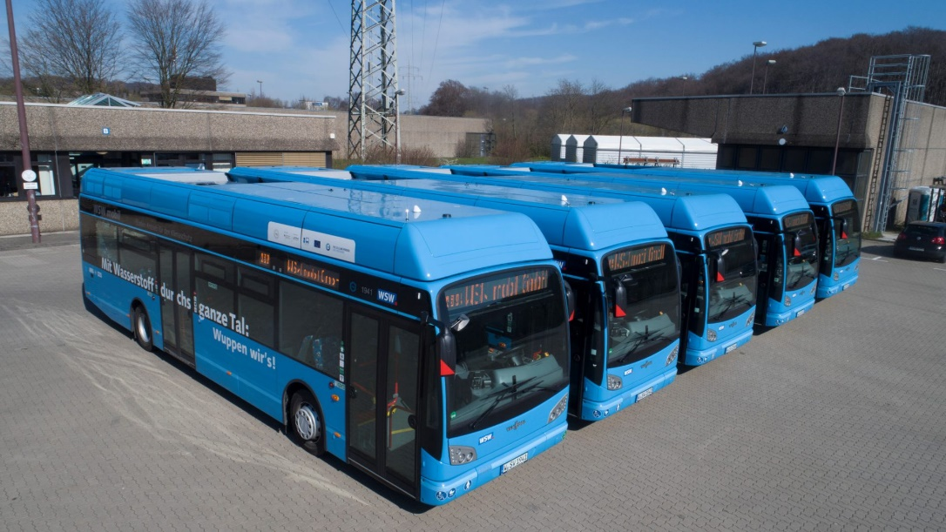
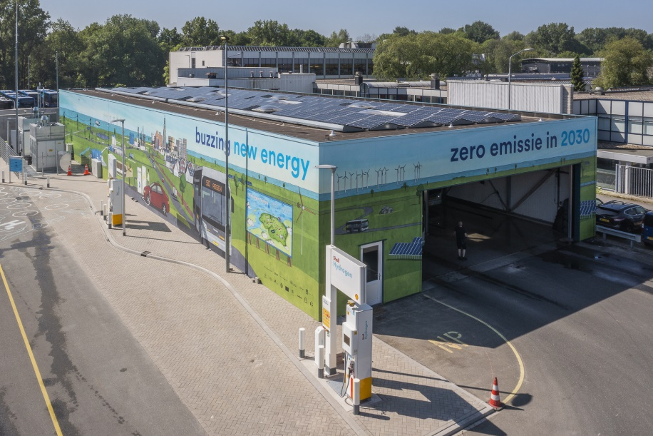
Technical support and Safety
Network
Regulations
Staff training
Safety measures
GenComm Project Partners’ Meeting #20 - 8th & 9th June 2022

Slide 21
Any Questions?
Tadgh Cummins – t.cummins@nuiggalway.ie
Tim Williamson – Tim.Williamson@hy-energy.co.uk
Marianna Rossi – rossi@izes.de
Branca Delmonte – branca.delmonte@uni.lu
For questions regarding the UI Design/Function email
Tim.Williamson@hy-energy.co.uk
GenComm Project Partners’ Meeting 8th & 9th June 2022 - Luxembourg

