Slide 1
GenComm
Open Session
GenComm – building a greener energy future
8th June 2022
Place image in this area.

Slide 2
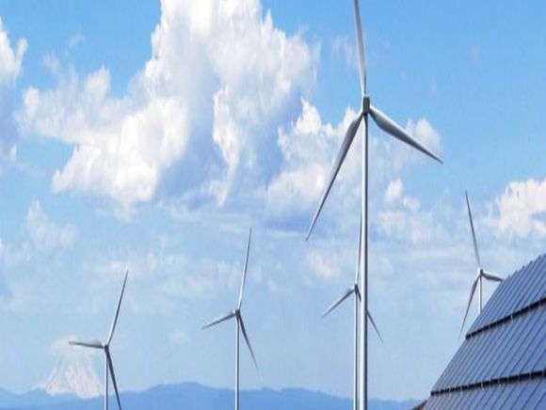
GenComm Focus
GENCOMM – GENerating energy secure COMMunities. Smart Hydrogen -Integrated renewable energy, generation & storage To develop a new model for exploiting remotely generated electricity from renewable sources to provide energy security for remote communities.
GenComm project focuses on increasing the uptake of the local renewable sources by communities, mostly peripheral, in the NWE region, by implementing an energy model that relies on hydrogen as an energy carrier and is utilised to supply the main forms of energy demand: electricity, heating and transportation fuels.
Notes:
hydrogen is a ‘game changing’ technology with extensive applications across transport, stationary power and beyond. Hydrogen, as an energy carrier, and as an enabling technology, will be critical in the delivery of a clean energy future.
As an energy carrier, hydrogen can play a significant role in energy security, carbon reduction and economic growth. It will be the crucial element of any future energy system.

Slide 3
GenComm Transition
GenComm Capitalisation Call: July 2021 - August 2023
July 2021 - December 2021: transition period closing off Phase I and starting Phase II
Phase I closing off delivery
Membership additions
Final Phase I reports and claims

Slide 4
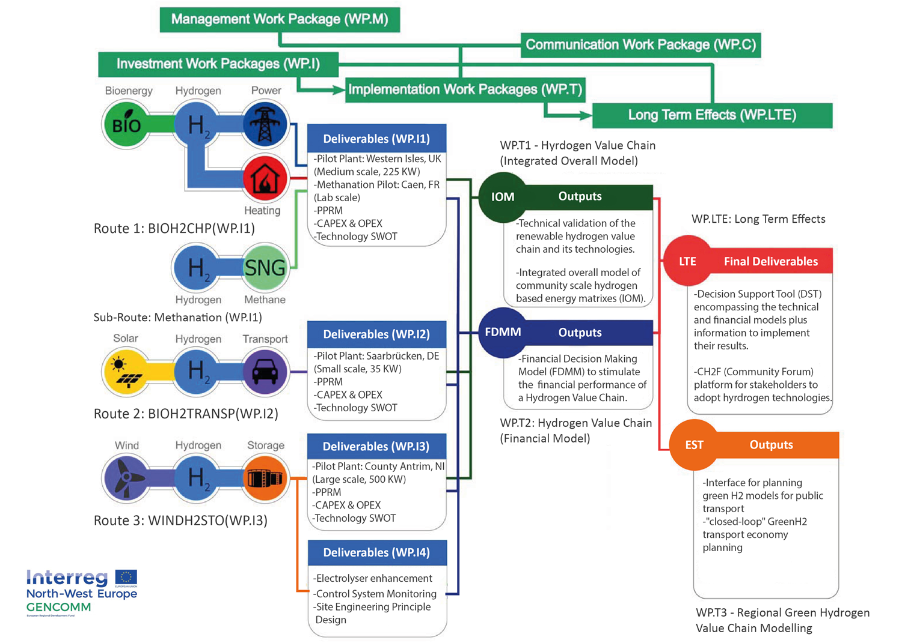
GenComm Project
GenComm Value Chain
GenComm Focus
Notes:
Rural and isolated communities in NWE face unique energy issues related to efficiency, reliability and sustainability. This is commonly due to dependency on external and fossil fuel energy supply, low electricity grid capacity and limited or no connection to wider grids. As a result these communities have higher than average carbon emissions and are more vulnerable to fluctuating fuel prices.

Slide 5
Transformation Technology
Green H2 is a transformational technology for long-term energy storage enabling an increasing uptake of renewables in power generation, as well as aiding the de-carbonization of some of the harder-to-abate sectors (iron & steel, long-haul transport, heating, petrochemicals). We estimate that clean hydrogen can aid the de-carbonization of c.15% of global GHG emissions (c.20% of CO2 emissions) while becoming a key pillar of the energy mix.
In order to achieve these transformations we need to scale quickly, change our thinking, accelerate our visions and imagine a more ambitious role for hydrogen in our energy future.
H2 dispatchability is the differentating factor. Hydrogen is dispatchable, and it can be transported over much larger distances than other electricity carriers, which boosts its efficiency and makes affordable hydrogen accessible outside the regions where it’s produced.

Slide 6
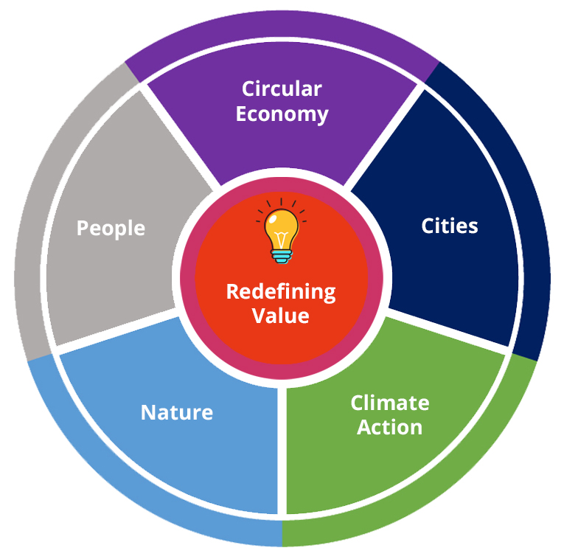
Hydrogenewables driving the circular economy
Hydrogenewables are capable of creating a truly sustainable economy: the technology doesn’t deplete raw minerals. In fact, hydrogen is the most abundant element in the universe. It doesn’t rely on a single precarious supply chain and can be produced in various ways, including from renewables like solar or wind.

Slide 7
Energy transition to renewables
In order to achieve successful energy transition to renewables in Europe we must look to achieving full commercial opportunity for renewable energy.
In order to achieve this, we have to ensure commercial flexibility in the coupling of the renewable energy sector and the energy system.
to scale quickly, we must change our thinking, and imagine a more ambitious role for hydrogen in our energy future.
The use of SMART H2 (Hydrogen produced from renewable energy sources) as an energy carrier to achieve this goal is crucial.

Slide 8
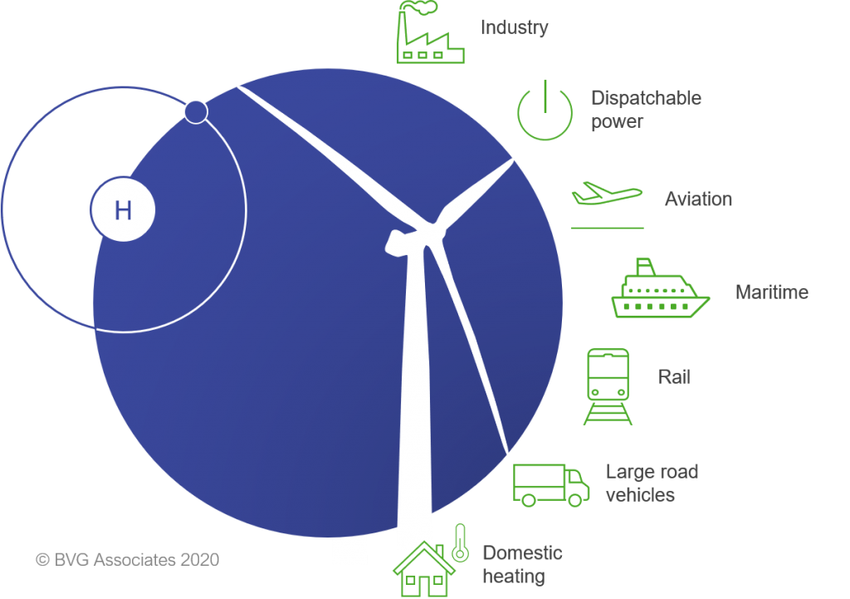
Hydrogen Leverage
Hard to decarbonise sectors
Clean hydrogen plays a critical role on the global path to net zero and importantly it forms a key interconnecting pillar between other key clean technologies

Slide 9
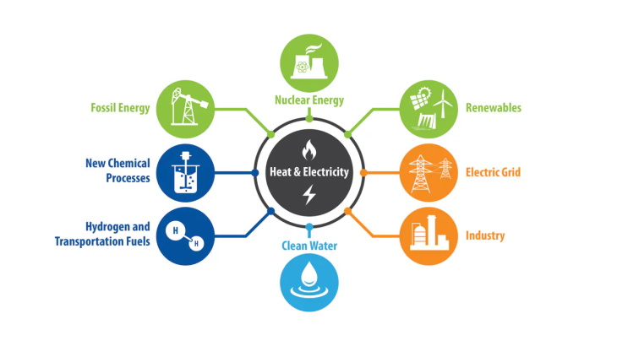
The Hydrogen Paradigm
Europe must develop and deliver a paradigm shift in our energy equation in order to achieve our emission targets
We need to acknowledge the need for positive energy projects and that energy vectors such as Hydrogen will play a key role in this shift.
We are witnessing a global energy revolution, one where hydrogen will become a global commodity and one where we need processes and procedures to keep pace.
“Energy Efficiency” Without becoming more efficient we cannot reach the goals set.

Slide 10
Europe’s Challenge
The $11 Trillion Hydrogen Revolution Is Coming in 2022. Are we Ready?
$66Bn was poured into hydrogen in 2021, across every aspect of the hydrogen value chain from R&D to refuelling infrastructure. We need more offtake agreements to accelerate our Green H2 pathway to net zero. This could mobilise an additional the $3.5-$22 Bn in 2022
Green H2 is the pathfinder for Industry to take full advantage of the H2 economy, set to grow by 8 times, and the electrolyser market forecast to grow more than 800 times over the next 20 years. Empowering the SMARTH2 generations of the future,

Slide 11
Hydrogen is a major opportunity for Europe
The development of a hydrogen ecosystem offers significant opportunities:
Hydrogen offers a practically zero emission (particulates and CO2) fuel for the transport sector,
Hydrogen is well suited for heavy-duty and high-use applications where battery electrification faces significant challenges.
Jobs are created and imported fossil fuels are replaced with locally produced hydrogen.
Hydrogen offers the major opportunity to export our renewable resources.
Hydrogen is a form of long-term renewable energy storage
Hydrogen can facilitate the integration of additional renewable energy into our energy system. In turn, this increases security of supply and eases system-wide pressures on the electricity network (less renewables and network infrastructure required).

Slide 12
Generating Future Growth
FE/HE are leading on the H2 Academy work. FE in developing L2 and L3 curriculum and engaging with QUB on developing and shared delivery in L4-L5 and PGCE modules.
Belfast Met driving forwards with QUB as the H2 Hub in FE.
Green Economy - Innovation and entrepreneurship are our next steps –Belfast Met/QUB/CASE the Innovation Centres for the Green H2 and wider Green Ecomony.
R&D – capitalise on the shared HE/FE pathway and have the Belfast Met/QUB partnership in R&D formally recognised
Cross curricular development- expand the work we have delivered in business and management and adapted by the business schools enabling industry to pivot to new business models fit for the green economy and deliver economic growth for NI

Slide 13
H2CAT
The catalyst for Northern Ireland - powering hydrogen innovation, entrepreneurship and deployment
Working in tandem with Government Departments and other stakeholders the centre will inform and support policymakers could do to commercially scale up: Hydrogen, Carbon Capture, Utilisation and Storage (CCUS), Renewables, Waste to energy, Biofuels, Green natural gas

Slide 14
The new Energy Normal
Business as usual is no longer an option
We must increase our pace towards a net-zero future.
Climate change presents a fundamental challenge to society. It is a shared challenge, and all must play their role.
An all inclusive approach investigating green hydrogen and the resultant benefits for NI society, industry and the environment

Slide 15
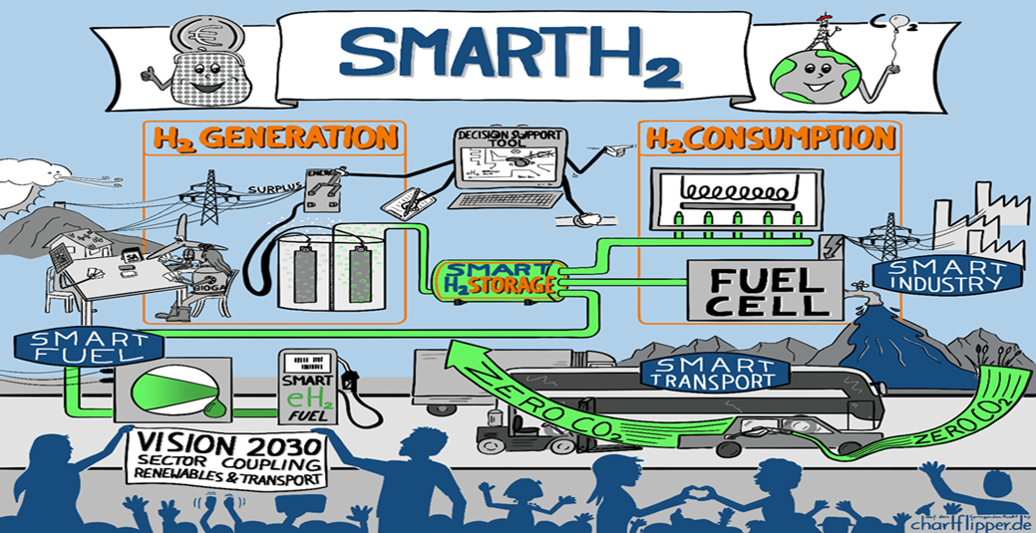
The world is racing to scale up Green Hydrogen to help meet our C02 reduction targets
However, as we scale up the use of GREEN H2 it must be done smartly and give us SMARTH2
SMART H2 is the commodification pathway for green hydrogen integration into our energy mix
SMART H2
PRODUCTION
H2
CONVERSION
H2
DISTRIBUTION
H2
USE
TRANSMISSION
H2

Slide 16
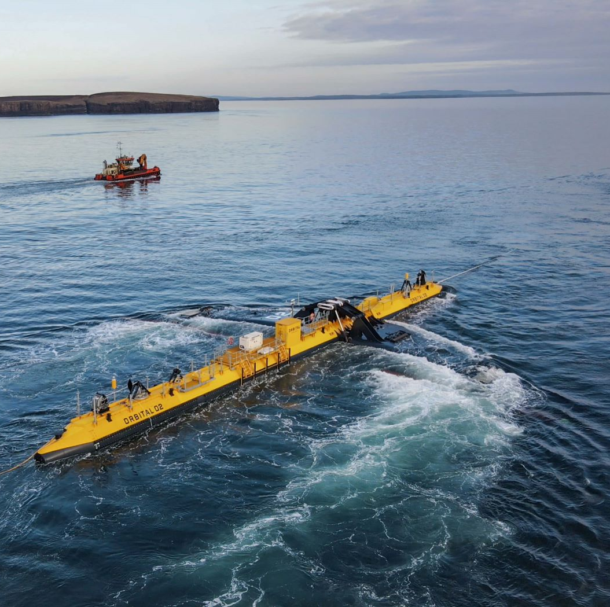
Net zero by 2050 requires huge leaps in clean energy innovation
Reaching net zero by 2050 requires further rapid deployment of available technologies as well as widespread use of technologies that are not on the market yet.
Most of the global reductions in CO₂ emissions through 2030 in our pathway come from technologies readily available today.
But in 2050, almost half the reductions come from technologies that are currently at the demonstration or prototype phase such as the ITEG Orbital or the GenComm GeoH2
In heavy industry and long-distance transport, the share of emissions reductions from technologies that are still under development today is even higher.

Slide 17
Green H2 Energy Opportunity
Renewable energy sources continue to increase their share of installed capacity worldwide. Their integration, in conjunction with increased energy efficiency and other low-carbon technologies, constitutes the best opportunity to achieve energy sustainability.
Renewable energy sources also constitute the best option to avert the risks that conventional non-renewable sources pose to health, geopolitics, the economy and the environment. In accordance with their commitment to the Paris Agreement of 2015,

Slide 18
Closing the H2 Gap
Hydrogen is now a fundamental pillar of energy policy of the EU as it transitions to a net zero future, it is the catalyst driving Europe’s energy transition. Long heralded as an alternative to fossil fuels Hydrogen faces challenges in helping solve the our dirtiest energy problems.
Optimising the Hydrogen journey by fortifying the hydrogen supply chain, production, storage and use for existing and new developing markets is key to creating a successful hydrogen Europe.

Slide 19
Affirmative Action
8 Steps to H2ZERO
Utilise Green H2 as an energy vector – this will be a key enabler in reaching Net Zero: 60 Gt of carbon emissions could be saved between 2021-50 (EU emission are ~2.5 Gt/y);
Deliver a paradigm shift to boost the uptake of Green H2 : we need to move from today's 90 Mt unabated hydrogen to 530 Mt low-carbon hydrogen by 2050;
Legislators and policy-makers need to take leading roles in Green H2 demand creation, setting the right set of regulations and channelling investments into R&D and hydrogen supply projects;
Repurpose existing infrastructure in the transition to net zero. Use the gas infrastructure can act as a catalyst in the deployment of low-carbon hydrogen: in the early stages via blending;
Widen the route to net zero -optimise every energy stage and opportunity on the route including biomethane, the 40 shades of hydrogen and other ‘lower carbon’ energy transition opportunities
Scale up innovation and demonstration, especially in end-use technologies, key to unlock the true potential of hydrogen
Develop the skills and training pathways to stimulate and support the deployment of hydrogen technologies and enable business’ to pivot to the new H2 economy
Market stimuli - short term economic business cases for industry as well individual use of Green H2
H₂GreenTECH Policy Forum

Slide 20
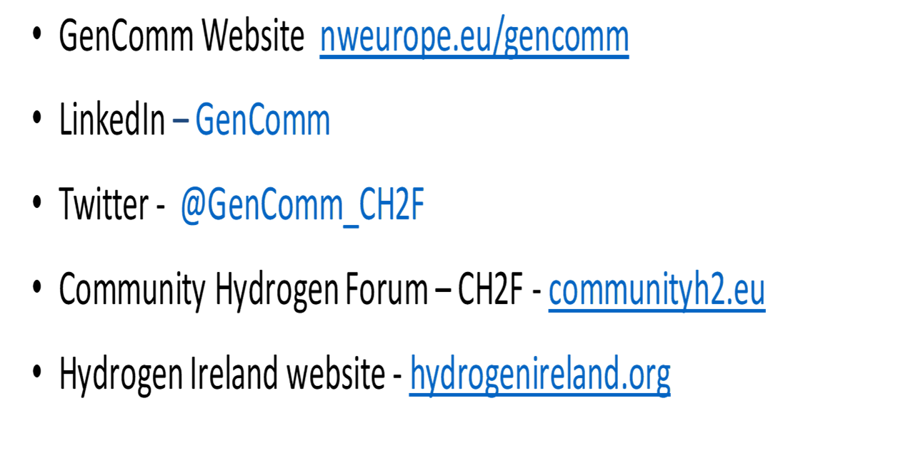
Q&A

