Slide 1
Energia
Galway Partner Meeting #21
22 September 2022
Place image in this area.

Slide 2
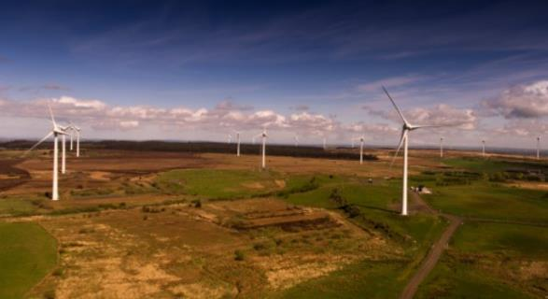
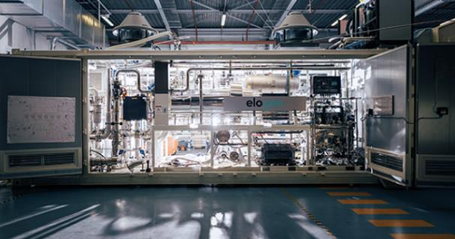
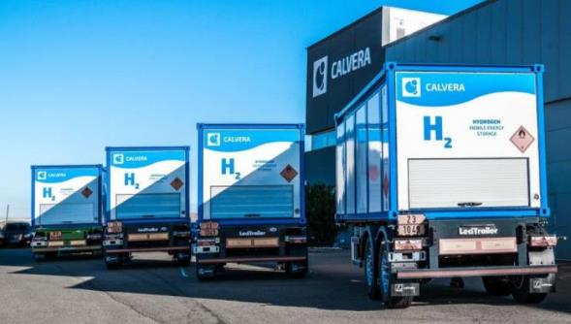
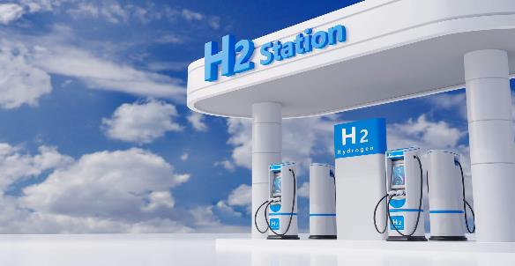
WPI3 – Wind to Wheel

Slide 3
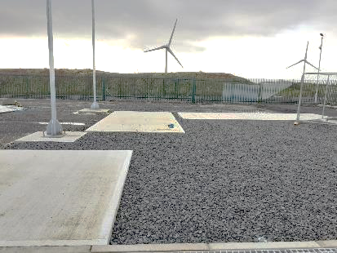
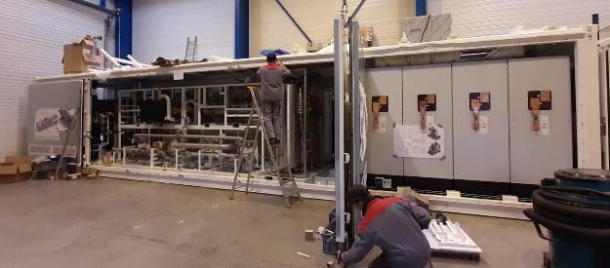
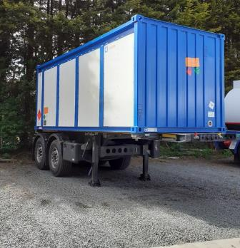
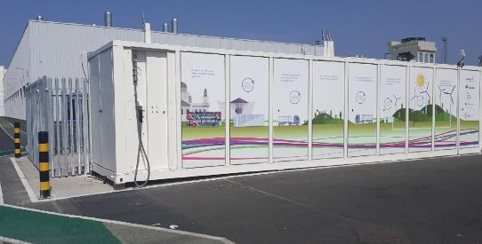
Looking Back to February 2022
Long Mountain civil works complete up to delivery.
Electrolyser still being built.
Three hydrogen trailers moving hydrogen from a temporary supply.
HRS dispensing hydrogen across six buses.

Slide 4
Long Mountain Wind Farm
19th August 2022

Slide 5
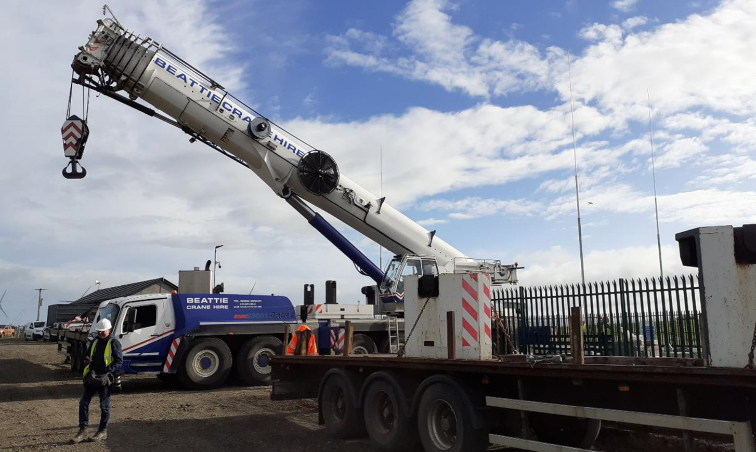

Slide 6
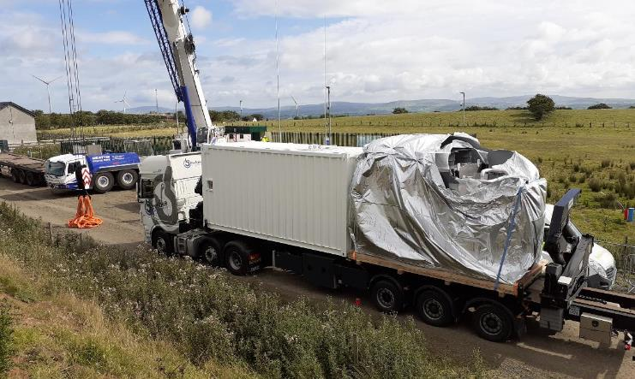
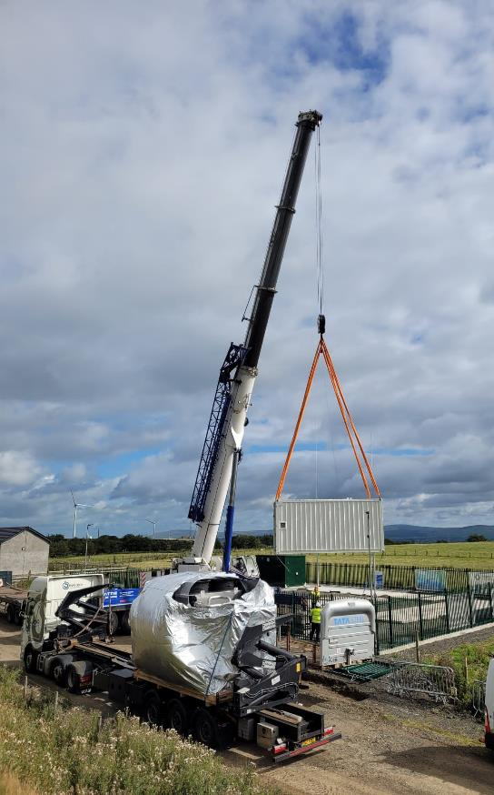
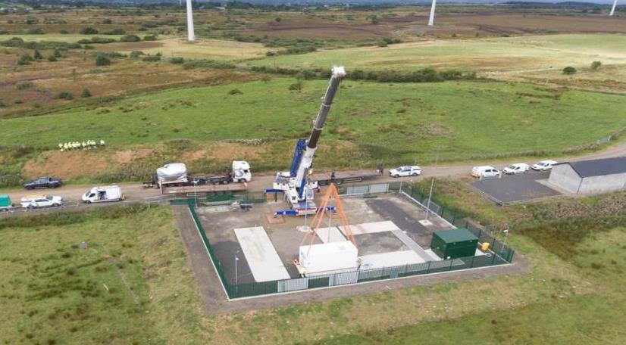

Slide 7
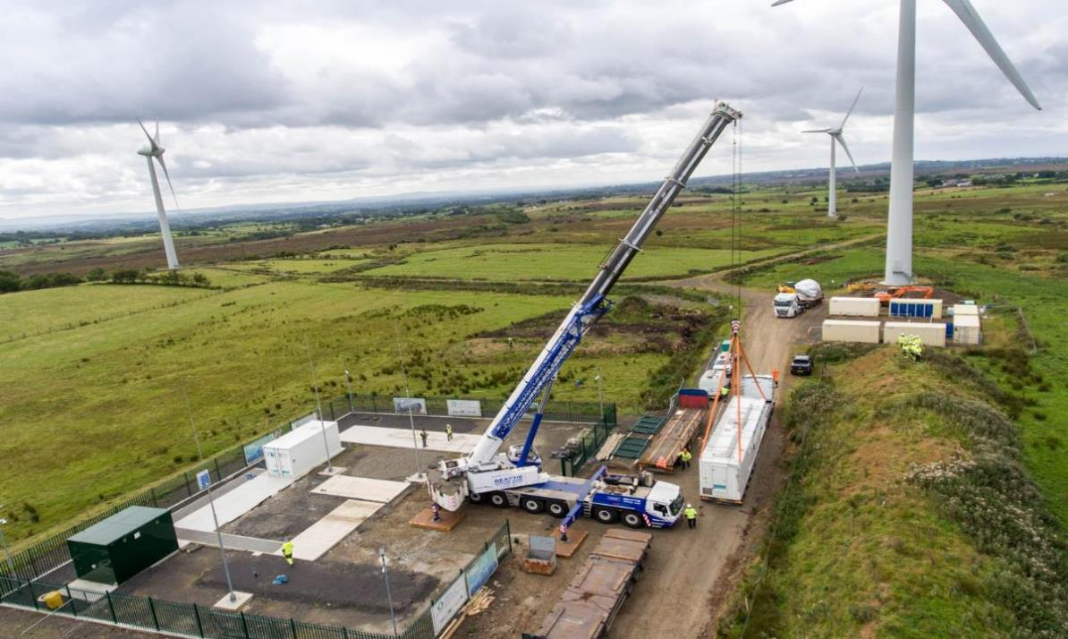
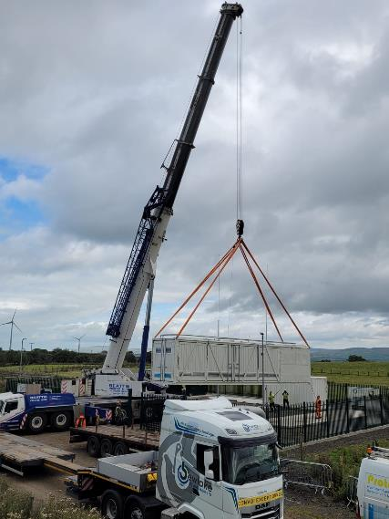

Slide 8
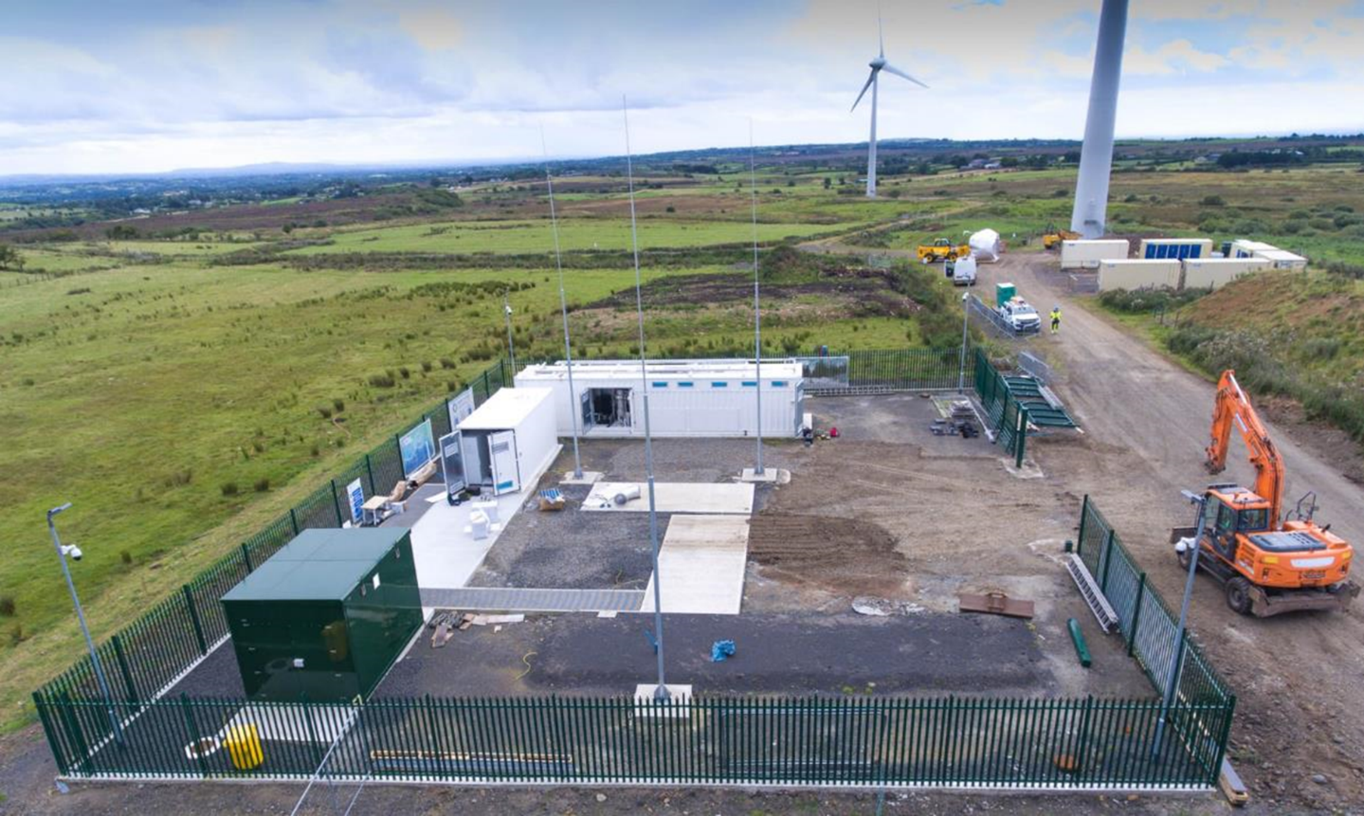

Slide 9
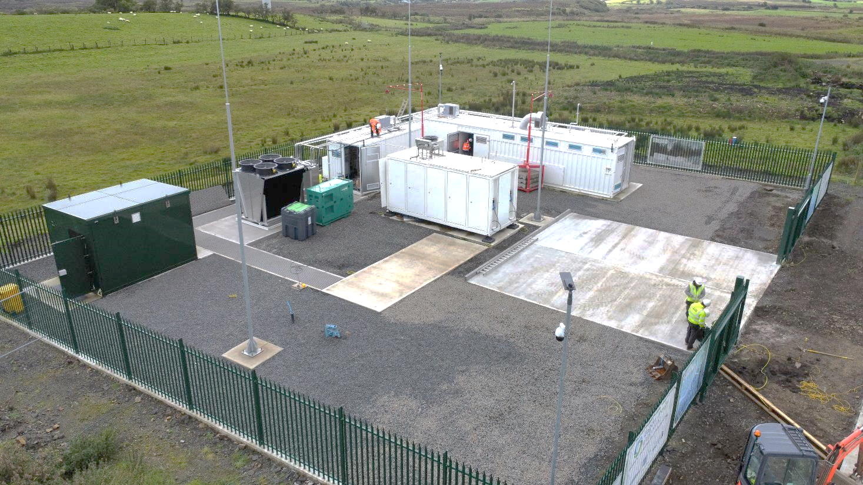
Utility Skid
Cooler
Electrolyser
Compressor
Transformer

Slide 10
Long Mountain Hydrogen Progress
Safety sign-off
Commissioning
Civil works
System integration
Electrolyser delivery
Compressor delivery

Slide 11
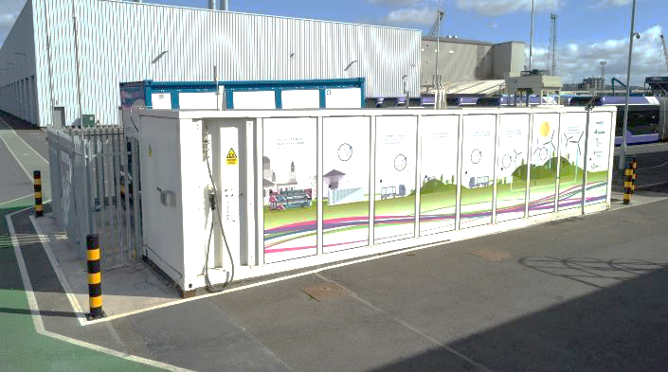
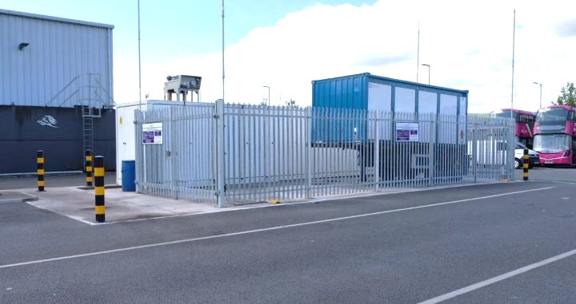
Hydrogen Refuelling Station
Over one year in operation
Over 6,000kgs dispensed
Servicing seven FCEV buses
System monitoring for maximum performance

Slide 12
Questions?

