Slide 1


GenComm Partner Meeting #21
Thursday 22nd September 2022
Development of an online Enabling Support Tool (EST) for decarbonising bus fleets with green hydrogen
Progress Update
Tadgh Cummins
Place image in this area.

Slide 2
Project Goals
Develop an online Enabling Support Tool to assist bus fleet operators in the transition to Zero Emission Bus (ZEB) fleets
Perform bus fleet decarbonisation case studies for chosen regions in Europe and determine potential of fuel cell electric buses (FCEBs) in those regions

Slide 3
Project Objectives
Create a Techno-Economic Total Cost of Ownership (TCO) and Total Cost of Abatement (TCA) model for bus fleets in Excel.
Validate model with data from bus fleet operators and literature
Work with Gencomm partners to develop the online EST by collating relevant information and implementing the Excel model on the online platform
Model TCO and TCA of different ZEB fleet combinations
Determine suitability of green hydrogen in bus fleets for regions in NWE

Slide 4
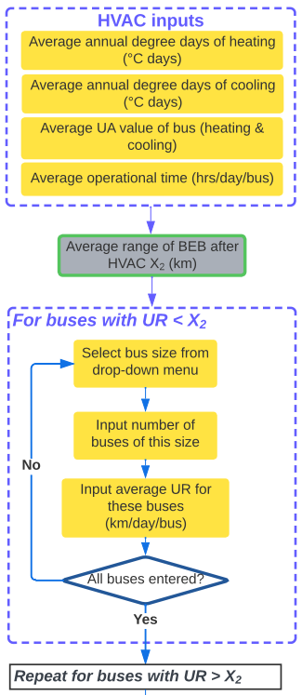
Techno-Economic Model
Currently models four fleet types:
  Internal combustion engine bus (ICEB)
  Battery Electric Bus (BEB)
  Fuel Cell Electric Bus (FCEB)
  Mixed fleet of BEBs & FCEBs
And three bus sizes:
  Single-Deck
  Double-Deck
  Articulated
Input process aimed at dividing the bus fleet into a mixed fleet considering regional weather conditions, road topology and bus weight
#1 Rule: Buses in new fleet must match existing buses in size and range

Slide 5
Battery Sizing
Iterative calculations done in Excel – polynomial function fitted to the results
Polynomial function for battery size can be used easily on online interface

Slide 6
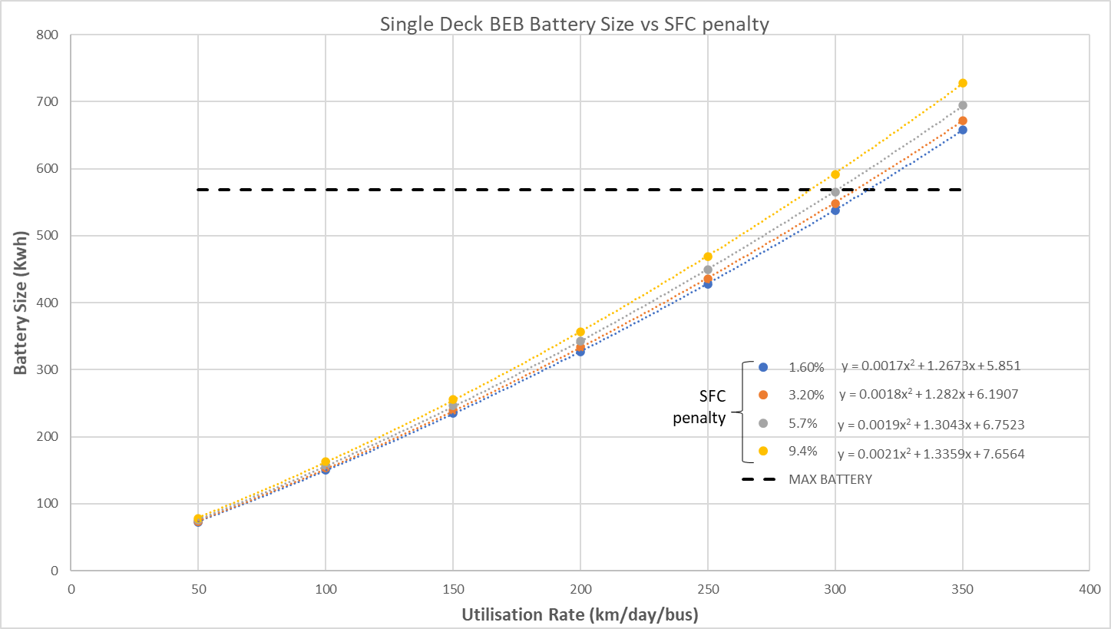
Battery Sizing- Steep routes
Iterative calculations done in Excel – polynomial function fitted to the results
Polynomial function for battery size can be used easily on online interface

Slide 7
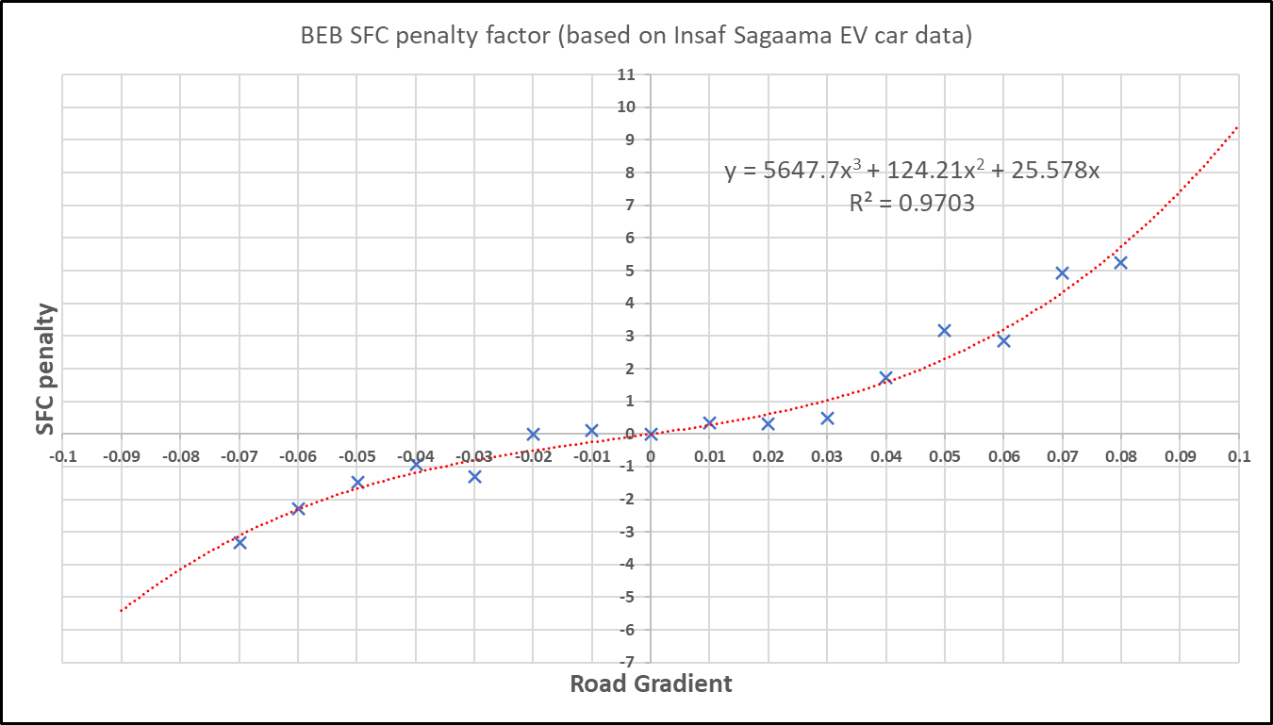
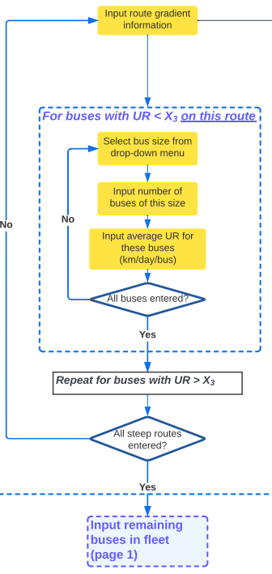
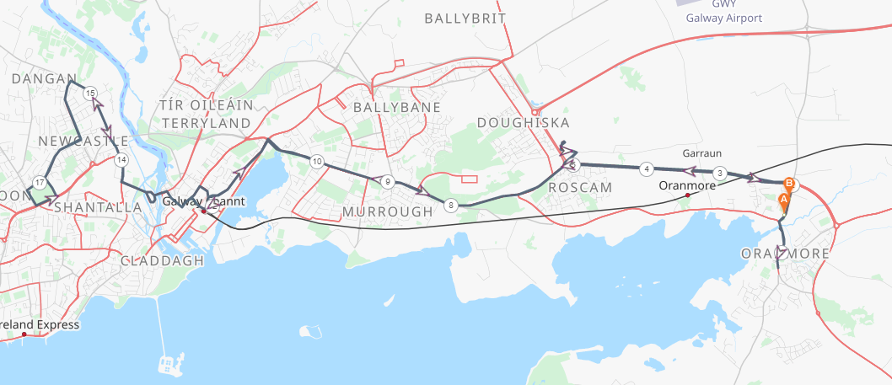
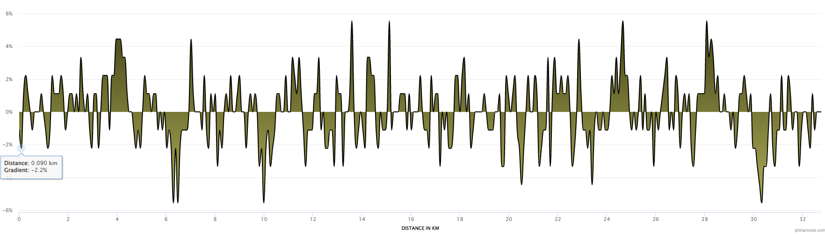
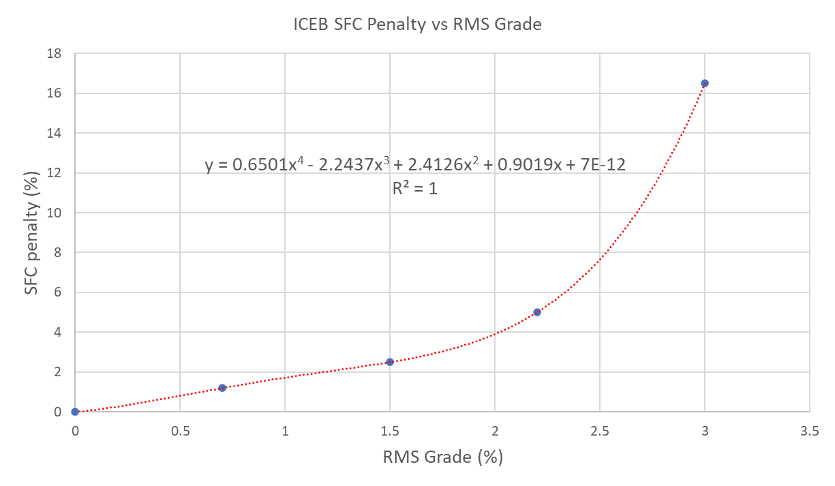
Steep Routes input
Distance from Start (km) | Gradient | SFC Penalty
0 | -1.10% | -0.27
0.09 | -2.20% | -0.56
0.18 | 1.10% | 0.30
0.27 | 2.20% | 0.68
Plot route and copy-paste route gradient data into model
Energy consumption penalty and BEB range reduction calculated for this route
Input buses on this route

Slide 8
Steep Routes input – simplified for online
Select a category between ‘moderately hilly’ and ‘very hilly’
Selection corresponds to a Specific Fuel Consumption penalty

Slide 9
Region-specific costs – optional inputs
Some aspects of CAPEX and OPEX of bus fleets cannot be assumed as they vary heavily with region, for example:
Cost of grid connection for charging station
Fuel & electricity costs
Bus and equipment costs
There will be the option to input these costs instead of using a basic assumption

Slide 10
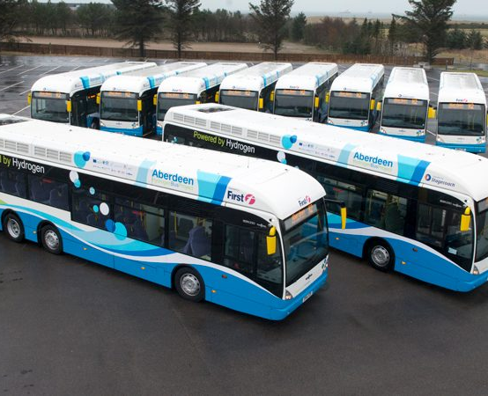
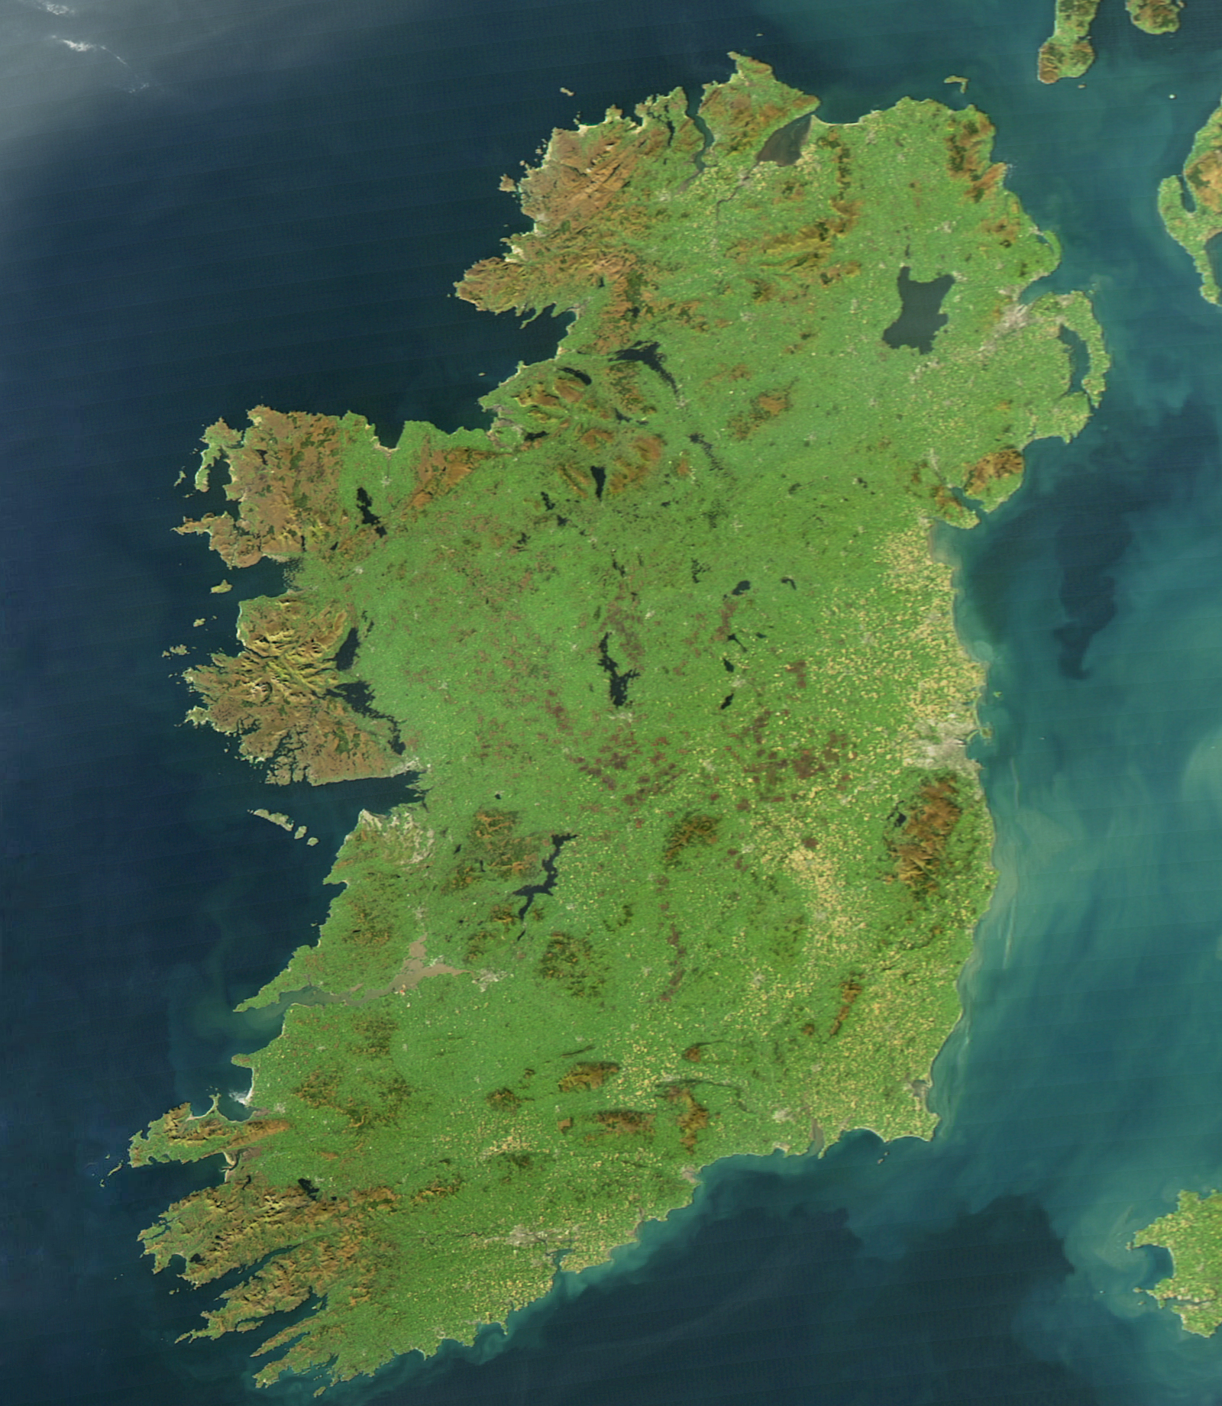
Case studies
How can BEBs and FCEBs be optimally deployed in Irish cities?
City bus fleets & inter-city coaches
How much would it cost the NTA?
Sensitivity analysis – cost of H2, electricity, diesel etc.

Slide 11
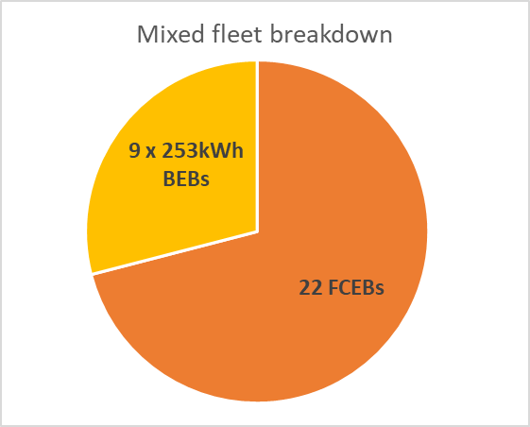
Galway city case study
HVAC energy consumption reduces BEB range by on average 19km
For a 350 kWh Double Deck BEB, range reduced from 195 km to 176 km
71% of buses drive >176km per day -> FCEB
29% drive <176km per day -> BEB
Fuel price inputs:
Price of green hydrogen | 7 | €/kg
Price of diesel | 1.55 | €/litre
Price of electricity | 0.16 | €/kWh

Slide 12
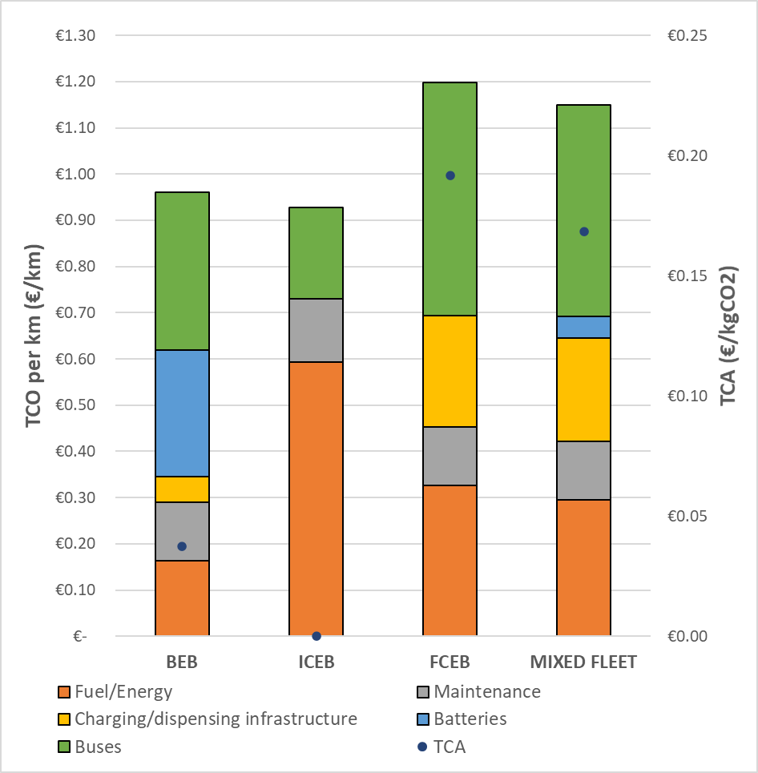
Galway city case study
Full fleet of overnight charged BEBs not feasible - Bus weight during peak hours (21 tonnes) would exceed EU GVW (19.5 tonnes) for 68% of the fleet
FCEB is most expensive due to higher bus CAPEX and fuel OPEX
Cheapest option: Mixed fleet or potentially an opportunity charged BEB fleet (further study required)

Slide 13
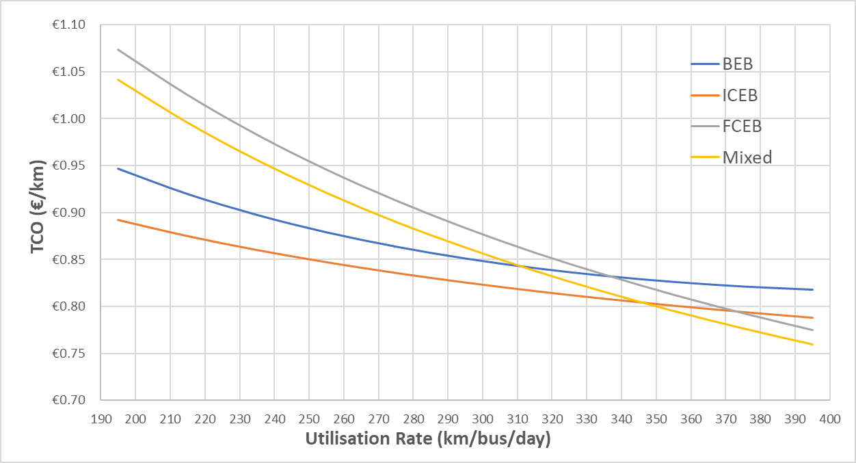
Galway city case study
Increasing the distance driven per day leads to a decrease in TCO
FCEBs become more cost competitive at higher Daily distances
Therefore there is potential for H2 to decarbonise commuter and intercity bus routes

Slide 14
Galway city case study
Comparing the TCO of a single bus for each powertrain type, Fixing the battery size of the BEB
Fixed Battery size of 350 kWh
DD BEB range: ~175km
Beyond 175 km, a second BEB is added to meet the range requirement – large TCO jump
Without considering infrastructure costs, FCEBs become cost competitive with ICEBs when daily distance exceeds 237 km

Slide 15
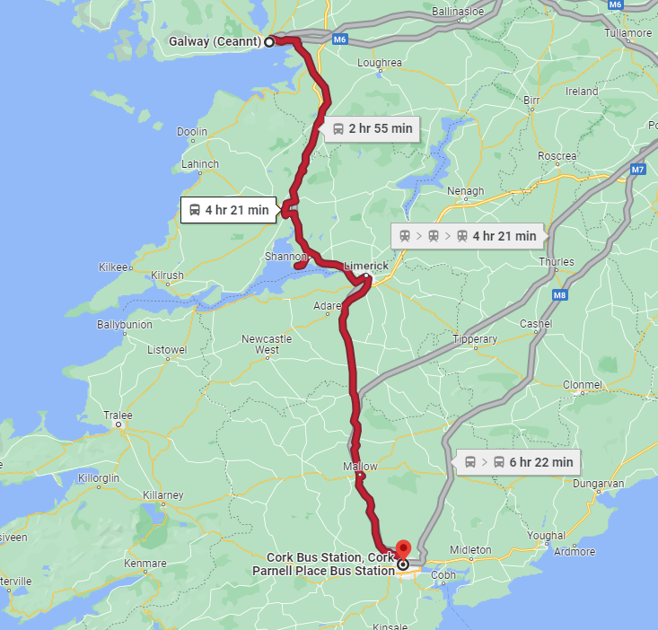
H₂ for Inter-city buses
Minimum of 500km range required for most inter-city buses.
To complete a day on one charge a BEB would need a battery with >1000kWh capacity – not feasible (weight & recharge time)
A FCEB could meet this range
Fuel cell electric coaches are still in development
The case study will aim to answer questions such as:
What inter-city and commuter routes would be best suited for fuel cell electric coaches?
How much would it cost to transition from the existing buses?
What emission reduction could be achieved?
Expressway Route 51
225km one way

Slide 16
Thank You

