Slide 1
EST UI and Website Implementation
Tim Williamson
Place image in this area.
GenComm Project Partners’ Meeting
24th & 25th February 2022 - Dublin

Slide 3
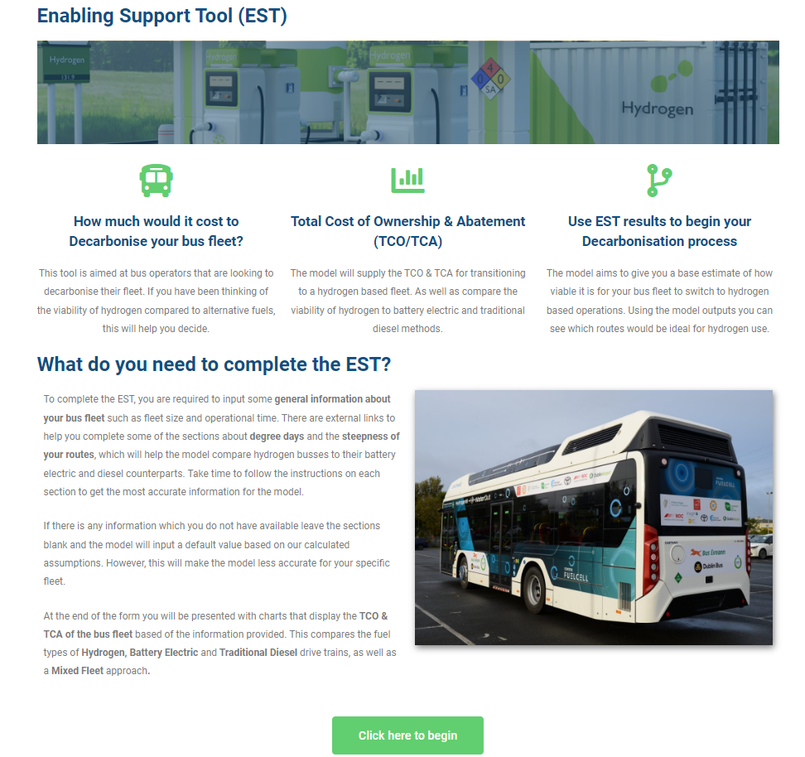

Slide 4
General Fleet Information

Slide 5
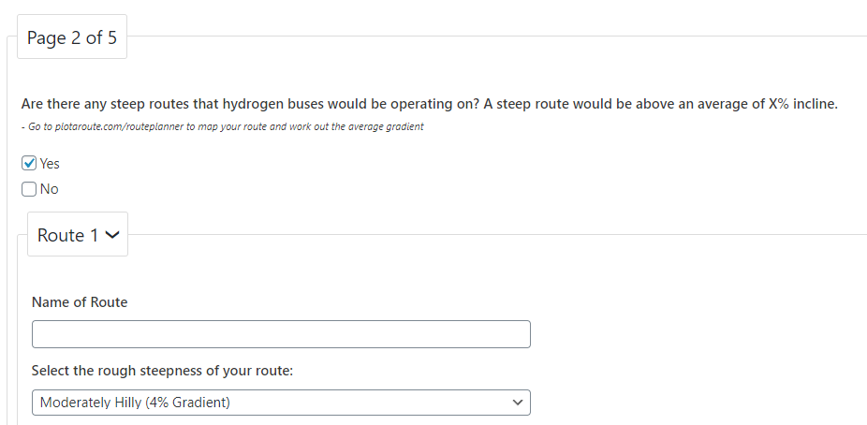
Steep Route Section

Slide 6
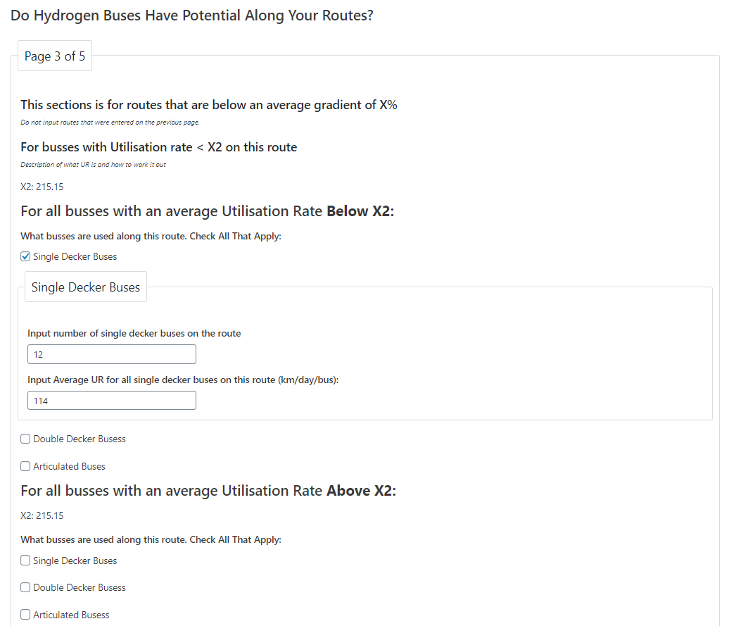
Non-Steep Route Section

Slide 7
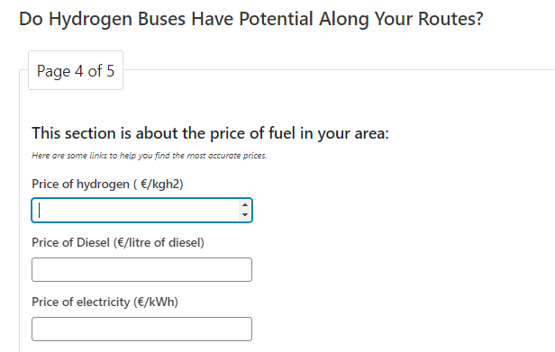
Fuel Prices

Slide 8
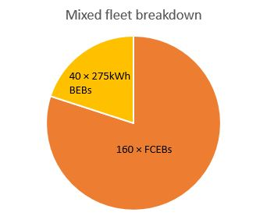
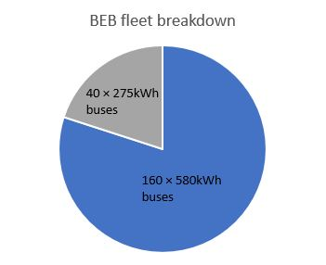
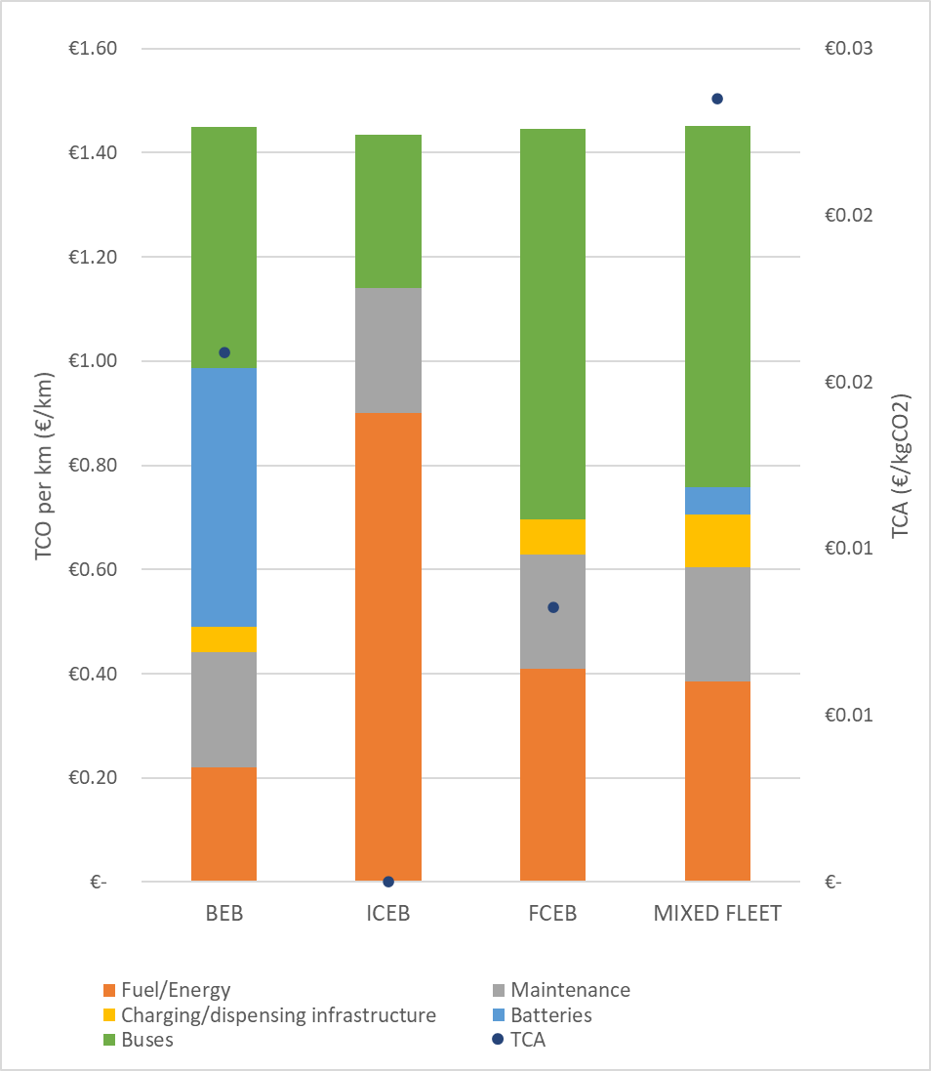
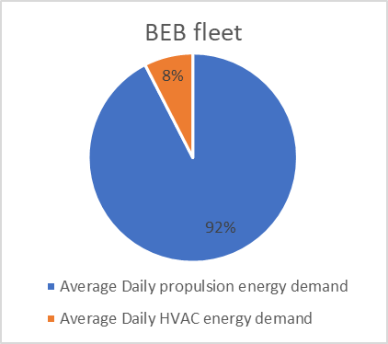
Potential Outputs
Financial outputs:
 | BEB | ICEB | FCEB | Mixed (BEB-FCEB)
CAPEX | € 204,496,998.70 | € 61,001,697.41 | € 167,201,008.34 | € 130,219,612.98
OPEX | € 95,950,746.96 | € 236,465,598.50 | € 132,464,867.98 | € 169,217,939.93
TCO | € 300,447,745.66 | € 297,467,295.91 | € 299,665,876.32 | € 299,437,552.91
TCO/km | € 1.45 | € 1.43 | € 1.45 | € 1.44
TCA (€/kgCO₂) | € 0.02 | € - | € 0.01 | € 0.01
 | BEB | ICEB | FCEB | Mixed (BEB-FCEB)
CAPEX | € 204,496,998.70 | € 61,001,697.41 | € 167,201,008.34 | € 130,219,612.98
OPEX | € 95,950,746.96 | € 236,465,598.50 | € 132,464,867.98 | € 169,217,939.93
TCO | € 300,447,745.66 | € 297,467,295.91 | € 299,665,876.32 | € 299,437,552.91
TCO/km | € 1.45 | € 1.43 | € 1.45 | € 1.44
TCA (€/kgCO₂) | € 0.02 | € - | € 0.01 | € 0.01
Battery sizing based on distance and payload
HVAC % of total energy consumption

Slide 9
Any Questions?
Tim Williamson – Tim.Williamson@hy-energy.co.uk
GenComm Project Partners’ Meeting 8th & 9th June 2022 - Luxembourg

