Slide 1




Galway Partner Meeting #21
22 September 2022
Place image in this area.

Slide 2
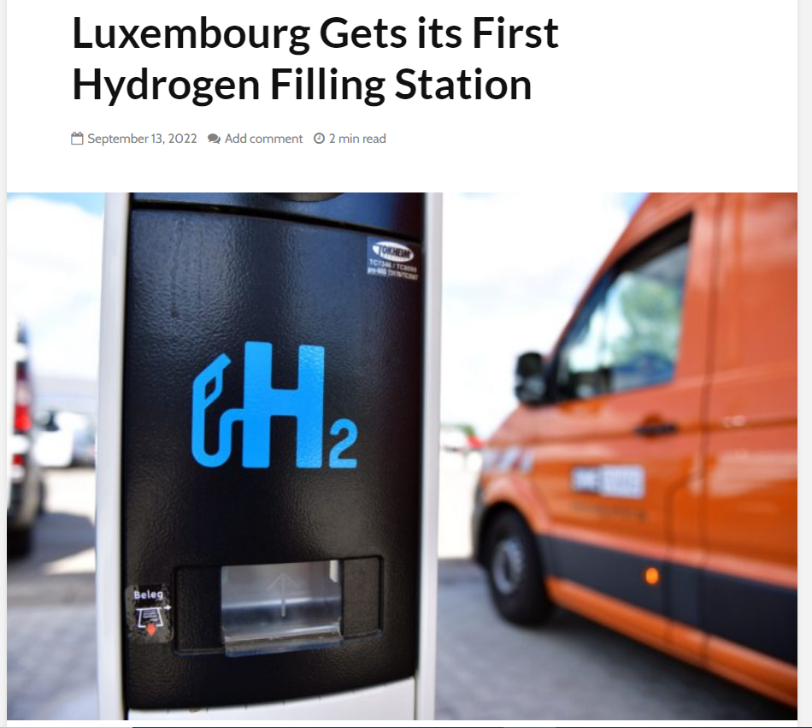
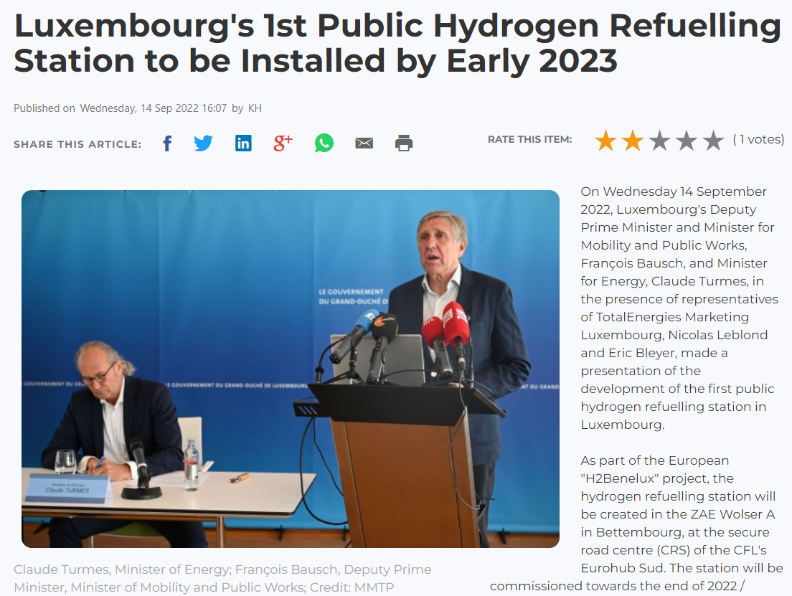
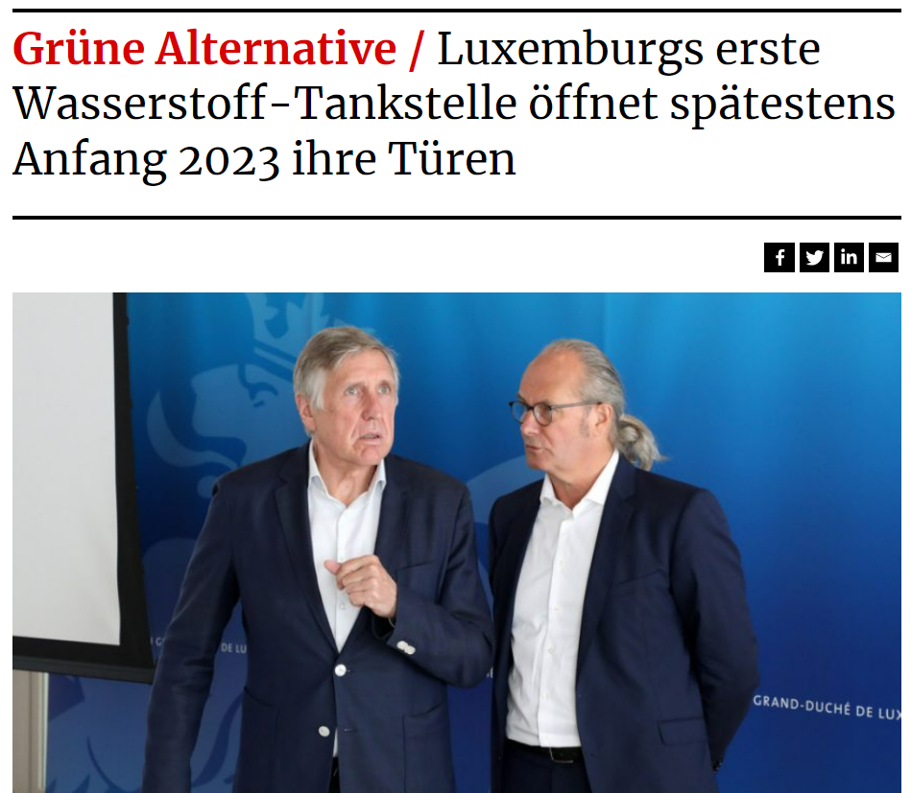
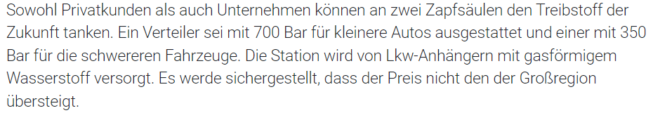
Supply chain and Infrastructure
https://hydrogen-central.com/luxembourg-gets-first-hydrogen-filling-station/
https://chronicle.lu/category/motoring-1/42442-luxembourgs-1st-public-hydrogen-refuelling-station-to-be-installed-by-early-2023
It is equipped with a 700 bar dispenser for smaller cars and one with 350 bar for the heavy-duty vehicles.
https://www.tageblatt.lu/headlines/luxemburgs-erste-wasserstoff-tankstelle-oeffnet-spaetestens-anfang-2023-ihre-tueren/#:~:text=Luxemburg%20hat%20laut%20Turmes%202019,H2)%20Wasserstoff%20pro%20Jahr.
GenComm Partner Meeting – Closed session – Galway 22 September 2022

Slide 3
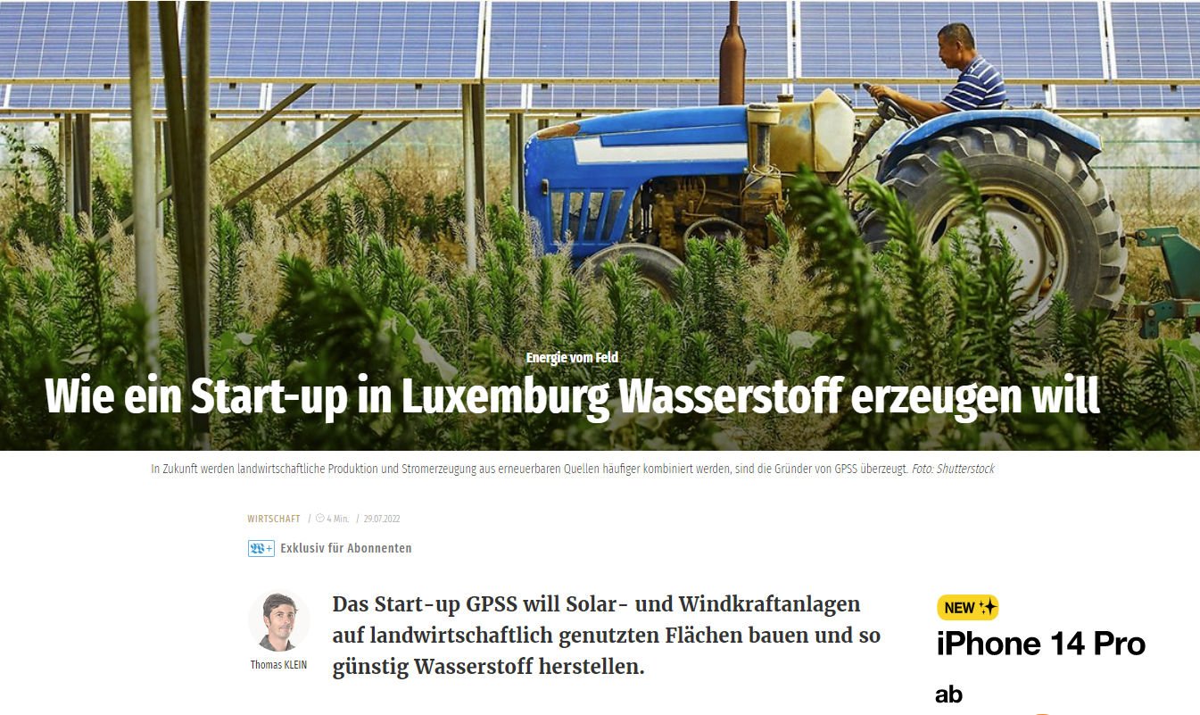

Supply chain and Infrastructure
https://www.gpss.lu/Start.html
https://www.wort.lu/de/business/wie-ein-start-up-in-luxemburg-wasserstoff-erzeugen-will-62daa574de135b9236ab6b68
GenComm Partner Meeting – Closed session – Galway 22 September 2022

Slide 4
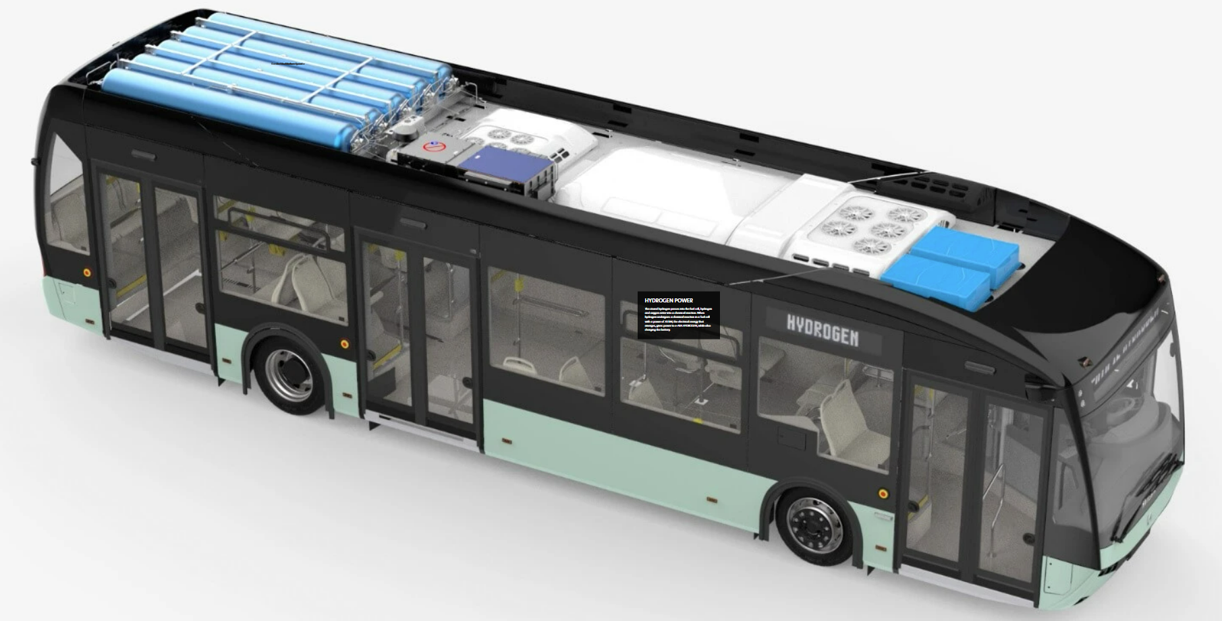
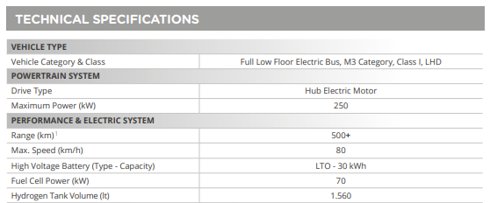
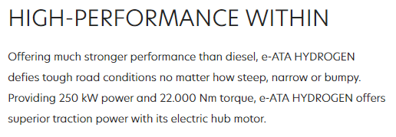
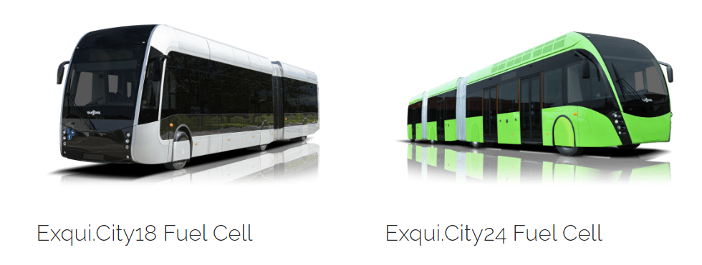
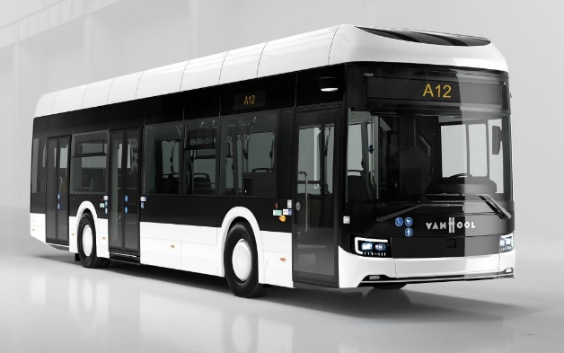
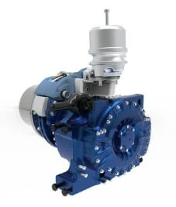
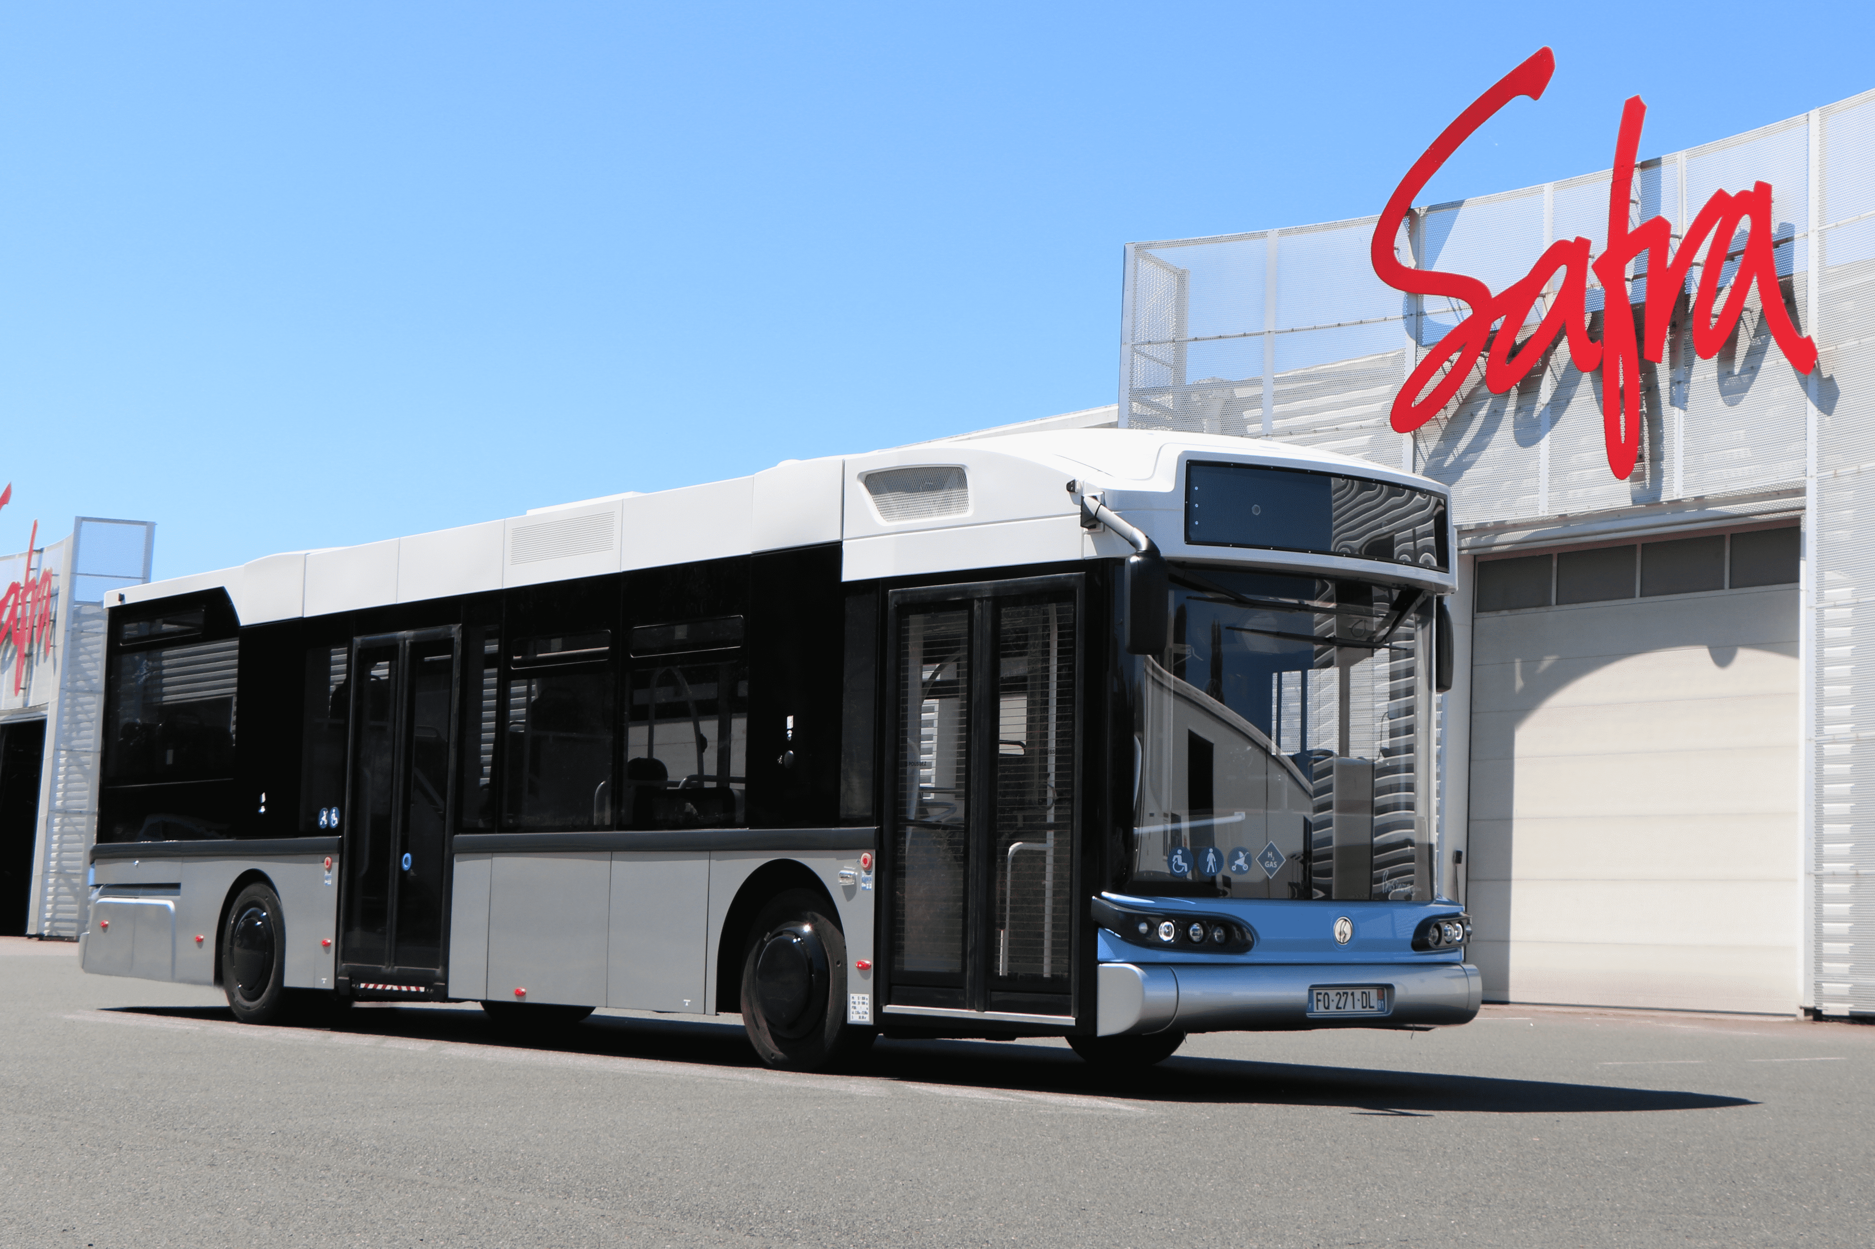
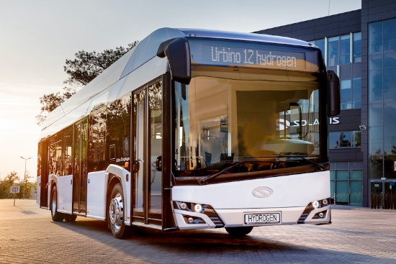
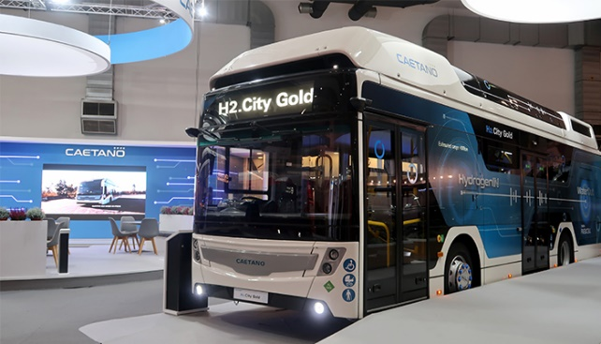
Fuel Cell Hydrogen Buses
GenComm Partner Meeting – Closed session – Galway 22 September 2022

Slide 5
EST
GenComm Partner Meeting – Closed session – Galway 22 September 2022

Slide 6
Thank you!
Questions?
GenComm Partner Meeting – Closed session – Galway 22 September 2022

