Slide 1



Galway Meeting
Closed Session
Day 2
22nd September 2022
Place image in this area.

Slide 2
Agenda

Slide 3
GenComm Transition
GenComm Capitalisation Call: July 2021 - August 2023
July 2021 - December 2021: transition period closing off Phase I and starting Phase II
Phase I closing off delivery
Membership changes
Final Phase I reports and claims

Slide 4
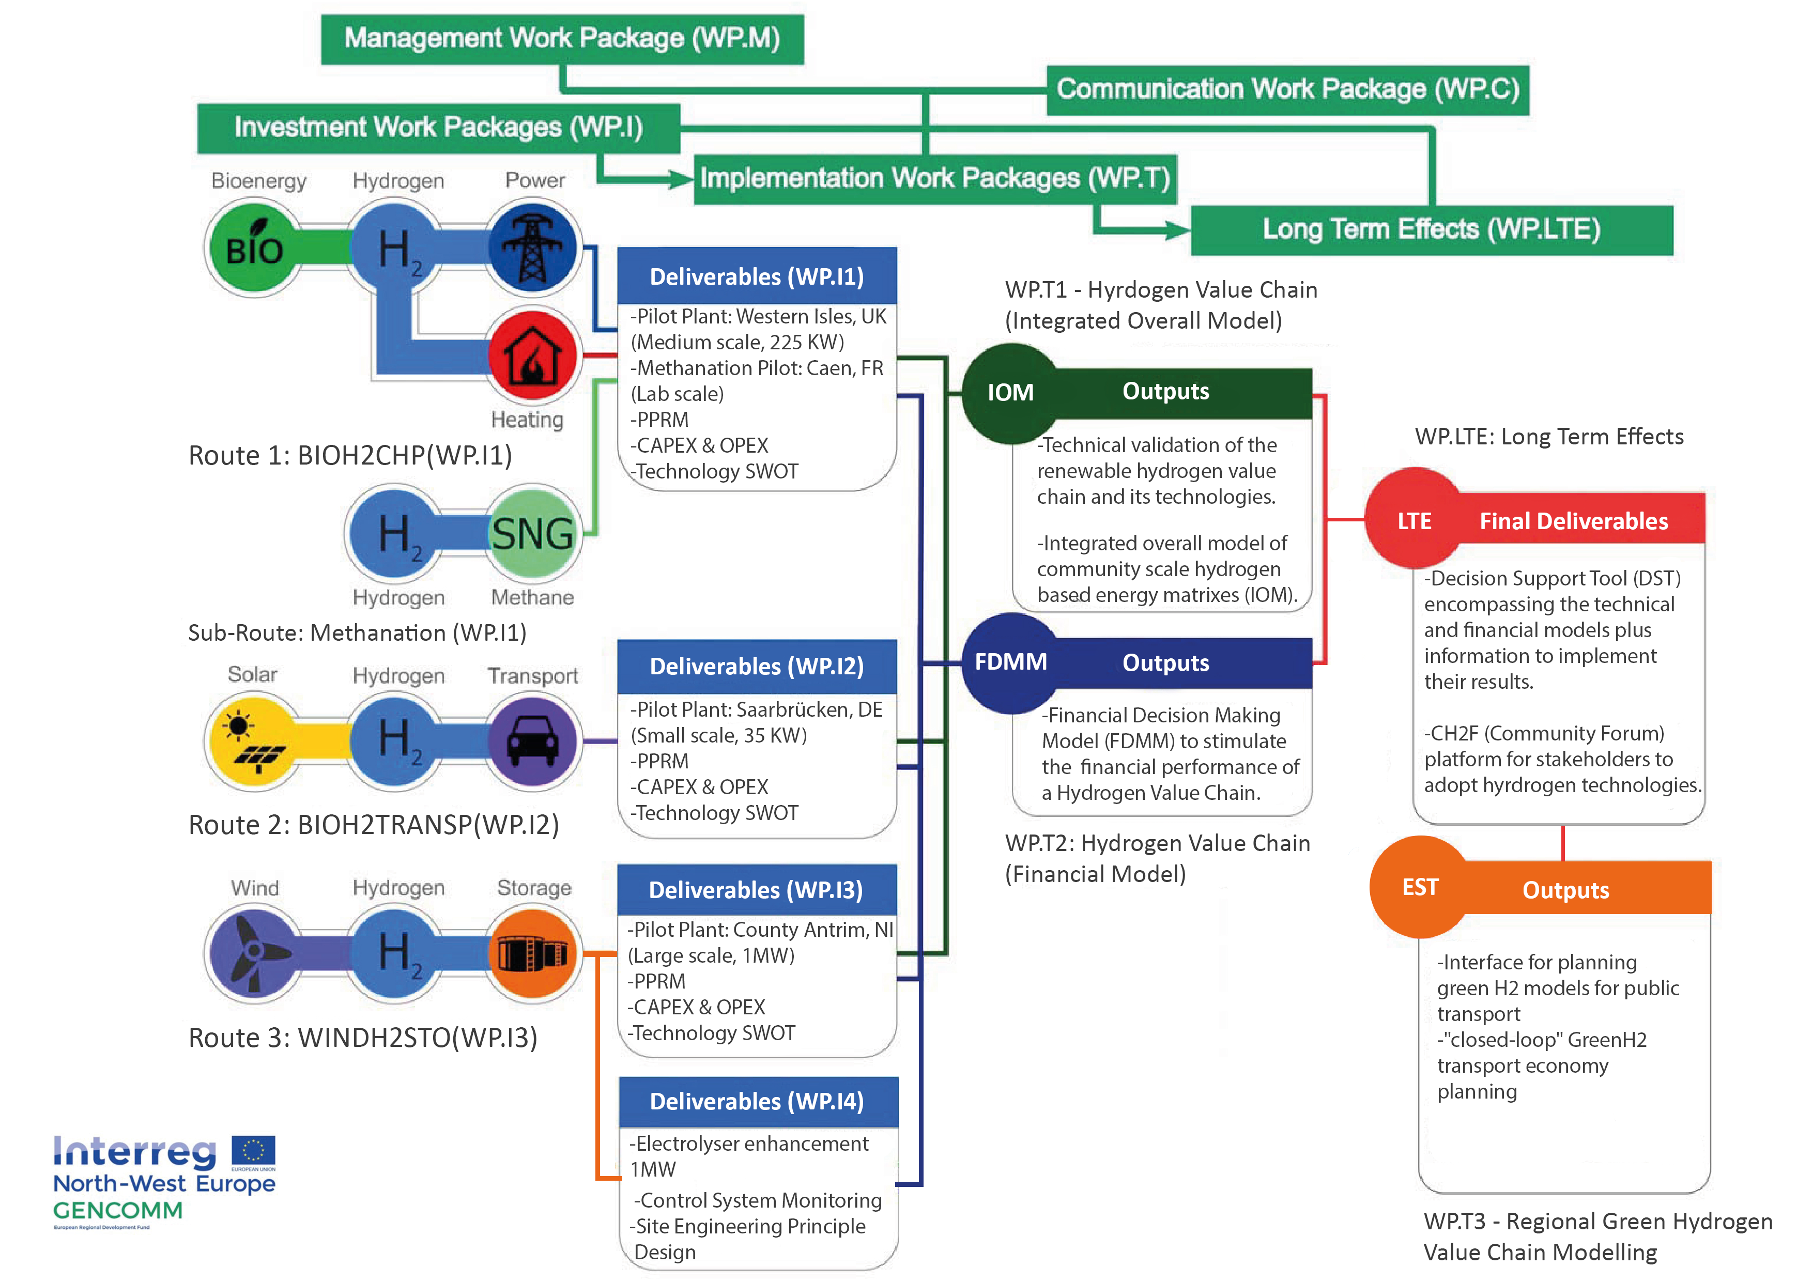
GenComm Value Chain
Notes:
Rural and isolated communities in NWE face unique energy issues related to efficiency, reliability and sustainability. This is commonly due to dependency on external and fossil fuel energy supply, low electricity grid capacity and limited or no connection to wider grids. As a result these communities have higher than average carbon emissions and are more vulnerable to fluctuating fuel prices.

Slide 5
Hydrogen Ireland Update
https://hydrogenireland.org/
Hydrogen Ireland Conference 2022
Conference Title - Europe’s Hydrogen journey to net zero
Dates Tuesday 23rd and Wednesday 24th November 2022
Venue Radisson Hotel Dublin

Slide 6

Clean Hydrogen Partnership
The Clean Hydrogen Partnership is launching its hydrogen research call for proposals – €300.5 million will be made available for proposed projects in an unprecedented drive to support the creation of cutting-edge hydrogen technologies. The calls open on 31st March 2022
https://www.clean-hydrogen.europa.eu/apply-funding/call-proposals-2022/call-proposals-2022_en

Slide 7

EUSEW 2022
The commodification of Green H2 for Europe
Europe faces multiple pressures to decarbonise economies and to accelerate the integration of greater renewable energy sources into our energy systems.
H2 - vectors of change for the energy industry
Hydrogen is a versatile energy vector that can circumnavigate many decarbonisation obstacles but in doing so, it has many challenges to become universally accepted and utilised

Slide 8
Communications Update
^{22nd} September 2022
Place image in this area.

Slide 9
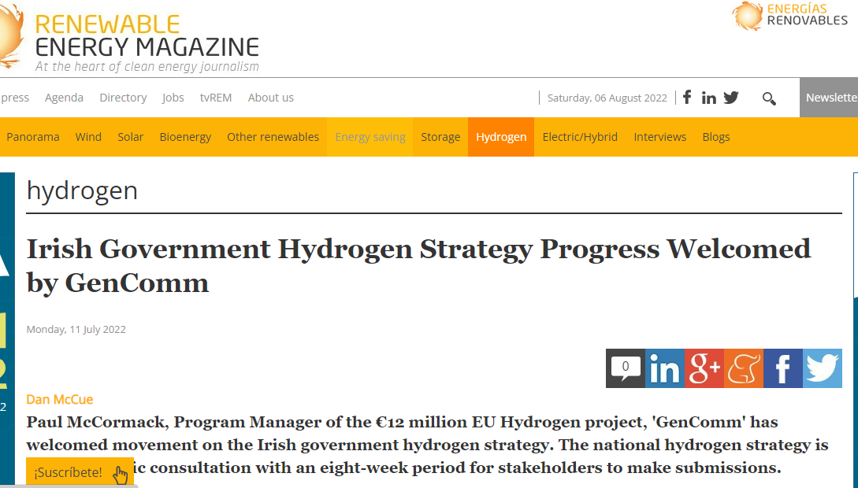
Renewable Energy Magazine July 11 2022

Slide 10
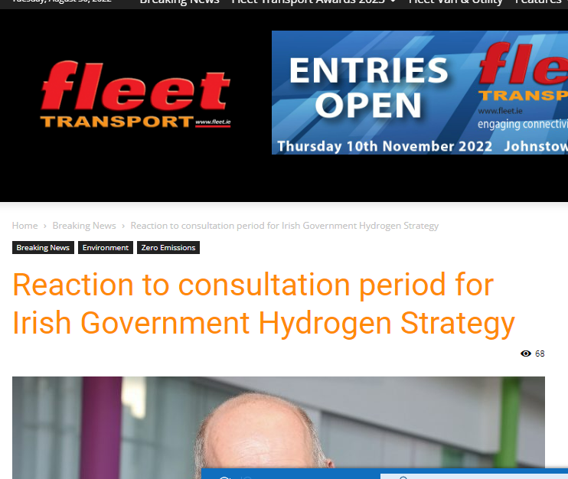
Fleet Transport magazine July 13 2022

Slide 11
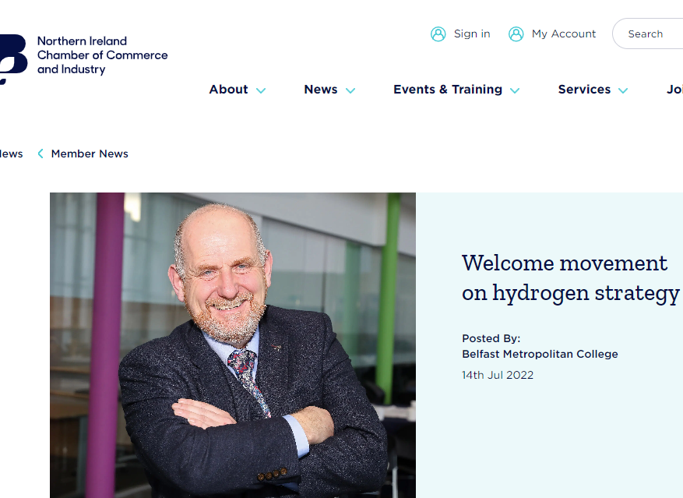
NI Chamber of Commerce website July 14 2022
GenComm Partner Meeting – Closed session – Galway 22 September 2022

Slide 12
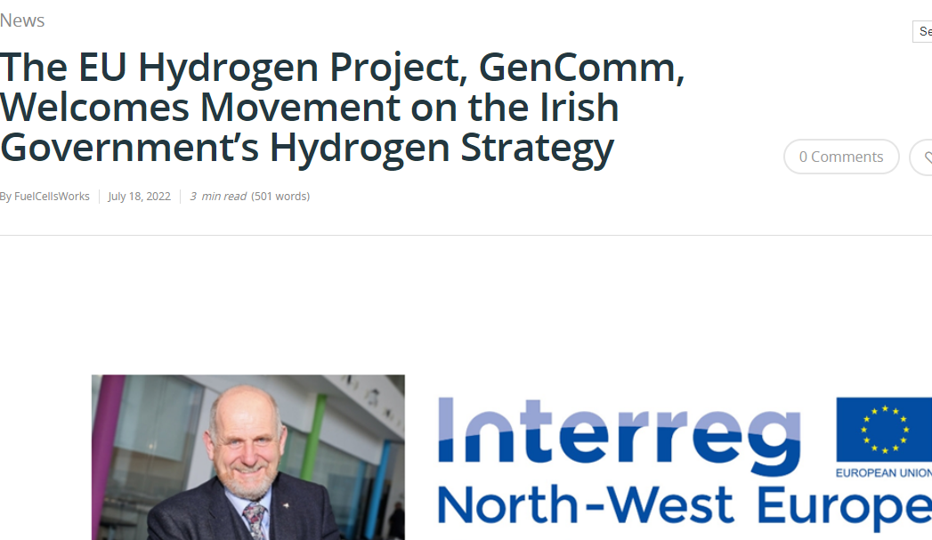
Fuel Cell Works website July 18 2022
GenComm Partner Meeting – Closed session – Galway 22 September 2022

Slide 13
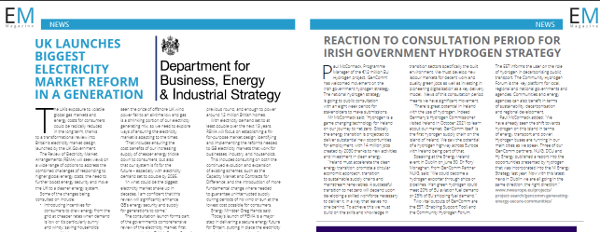
Energy Manager magazine July 26 2022
GenComm Partner Meeting – Closed session – Galway 22 September 2022

Slide 14
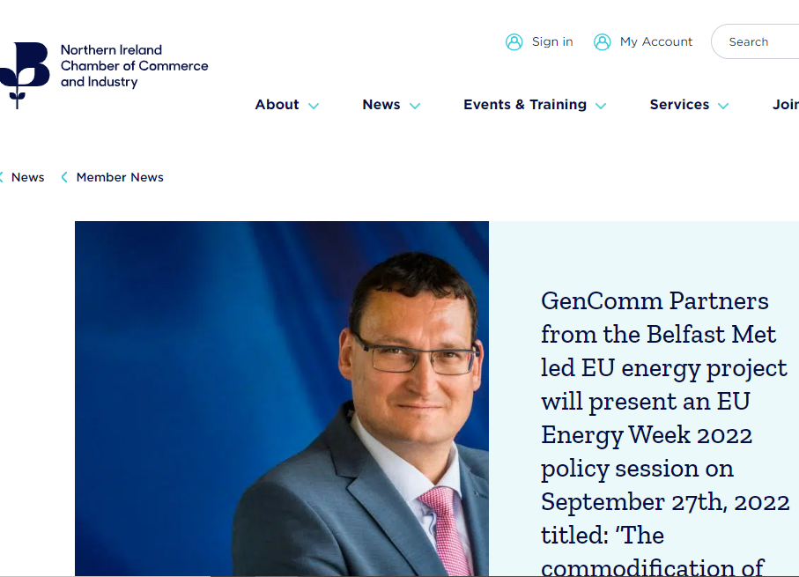
NI Chamber of Commerce website August 23 2022
GenComm Partner Meeting – Closed session – Galway 22 September 2022

Slide 15
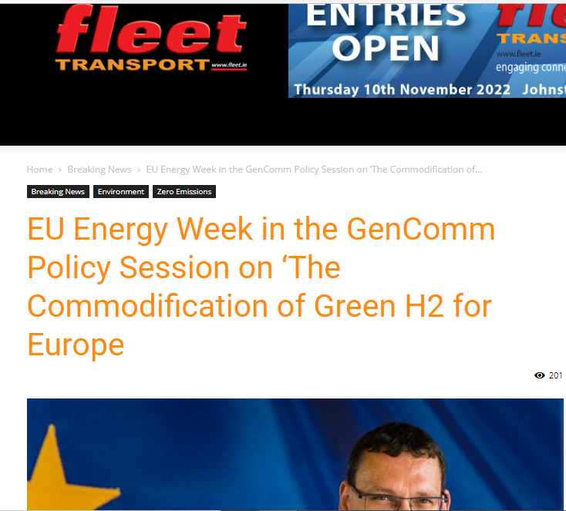
Fleet Transport magazine August 24 2022
GenComm Partner Meeting – Closed session – Galway 22 September 2022

Slide 16

Fuel Cell Works website August 24 2022
GenComm Partner Meeting – Closed session – Galway 22 September 2022

Slide 17
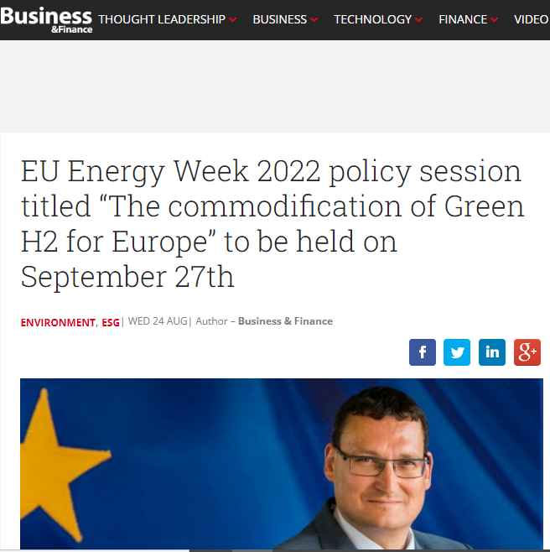
Business & Finance magazine August 25 2022
GenComm Partner Meeting – Closed session – Galway 22 September 2022

Slide 18
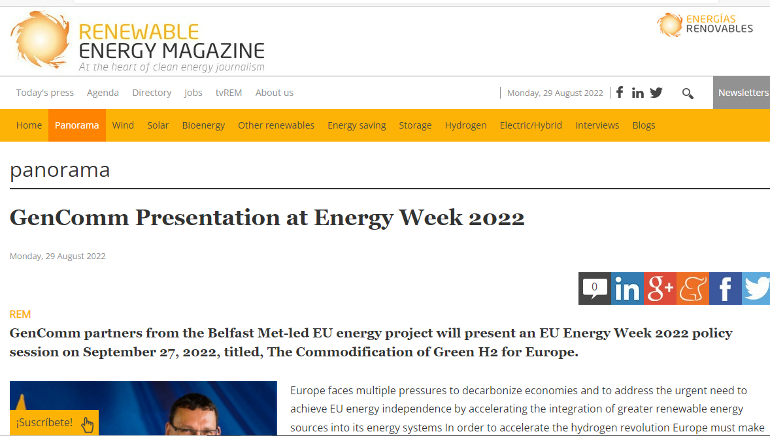
Renewable Energy magazine August 29 2022
GenComm Partner Meeting – Closed session – Galway 22 September 2022

Slide 19

Newstalk radio-Taking Stock with Mandy Johnston August 28 2022
GenComm Partner Meeting – Closed session – Galway 22 September 2022

Slide 20

GenComm September 2022 newsletter
GenComm Partner Meeting – Closed session – Galway 22 September 2022

Slide 21

Interview with Louise Cullen BBC NI September 1 2022
GenComm Partner Meeting – Closed session – Galway 22 September 2022

Slide 22
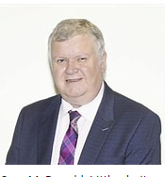
Interview with Gary Mc Donald Irish News September 9 2022
GenComm Partner Meeting – Closed session – Galway 22 September 2022

Slide 23

Galway Partner Meeting #21
Luxemburg
Branca Delamonte
22 September 2022
Place image in this area.

Slide 24
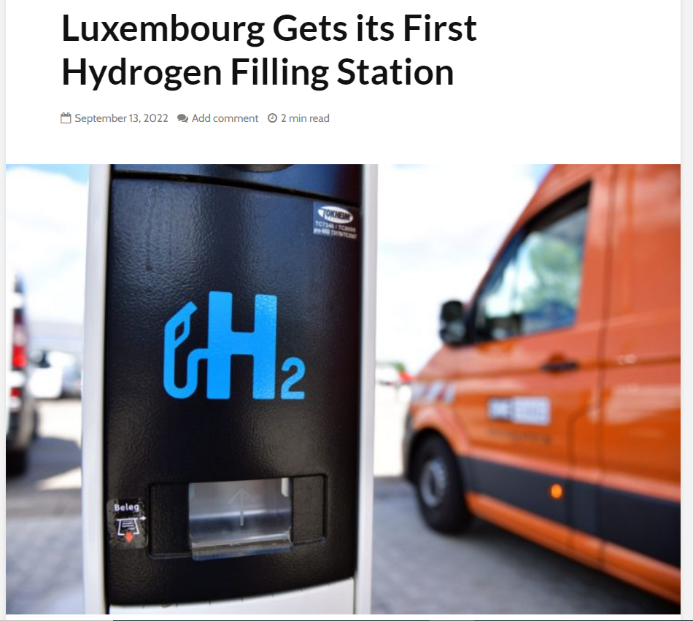
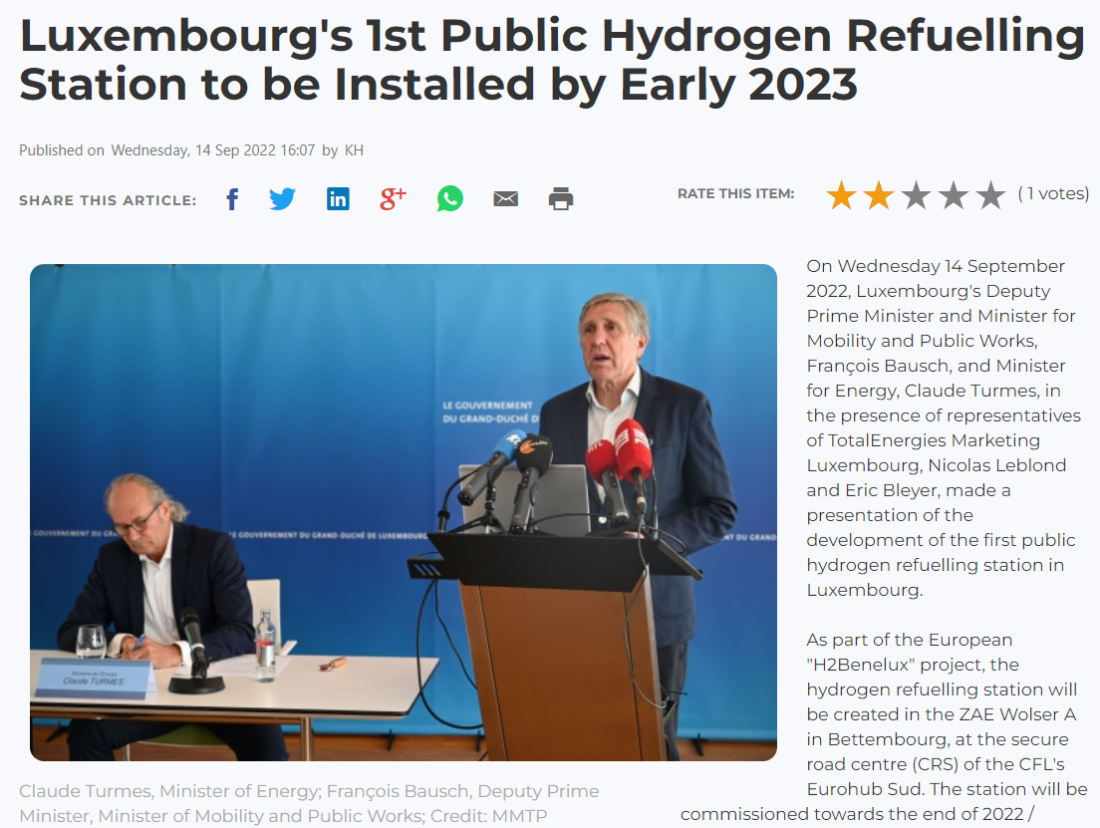
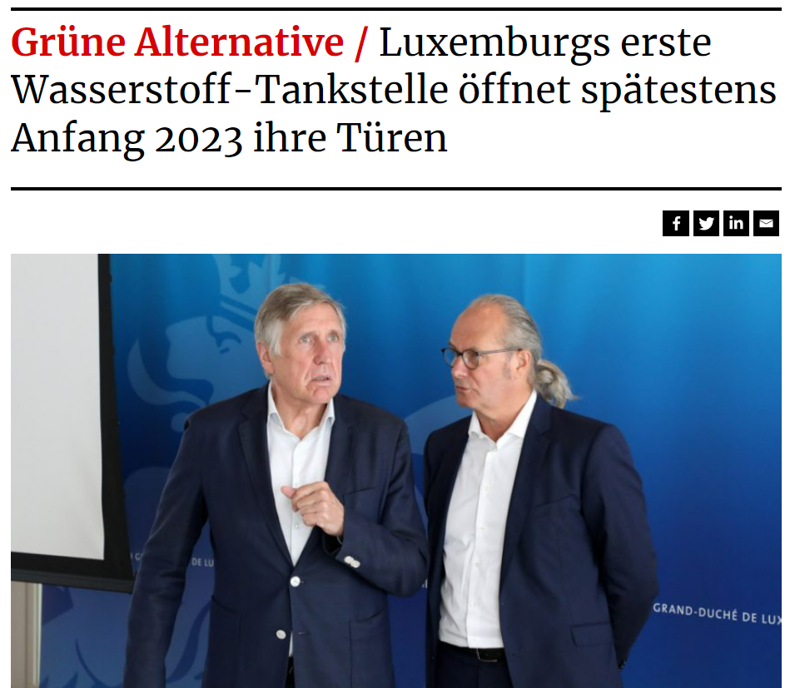
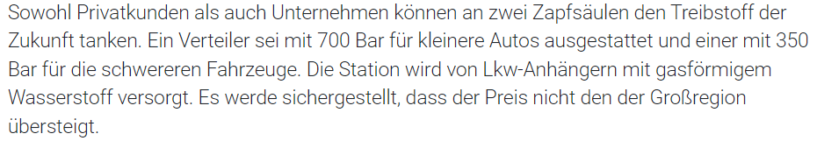
Supply chain and Infrastructure
https://hydrogen-central.com/luxembourg-gets-first-hydrogen-filling-station/
https://chronicle.lu/category/motoring-1/42442-luxembourgs-1st-public-hydrogen-refuelling-station-to-be-installed-by-early-2023
It is equipped with a 700 bar dispenser for smaller cars and one with 350 bar for the heavy-duty vehicles.
https://www.tageblatt.lu/headlines/luxemburgs-erste-wasserstoff-tankstelle-oeffnet-spaetestens-anfang-2023-ihre-tueren/#:~:text=Luxemburg%20hat%20laut%20Turmes%202019,H2)%20Wasserstoff%20pro%20Jahr.
GenComm Partner Meeting – Closed session – Galway 22 September 2022

Slide 25
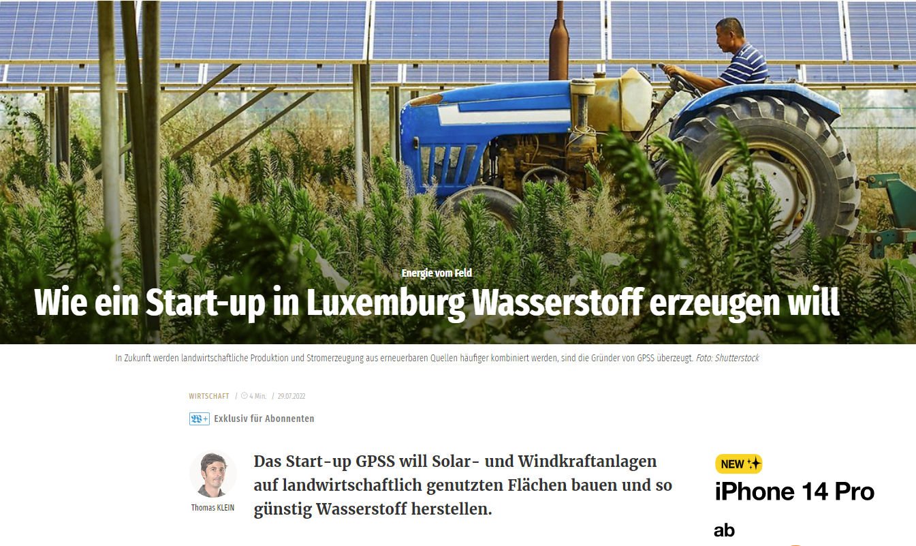

Supply chain and Infrastructure
https://www.gpss.lu/Start.html
https://www.wort.lu/de/business/wie-ein-start-up-in-luxemburg-wasserstoff-erzeugen-will-62daa574de135b9236ab6b68
GenComm Partner Meeting – Closed session – Galway 22 September 2022

Slide 26
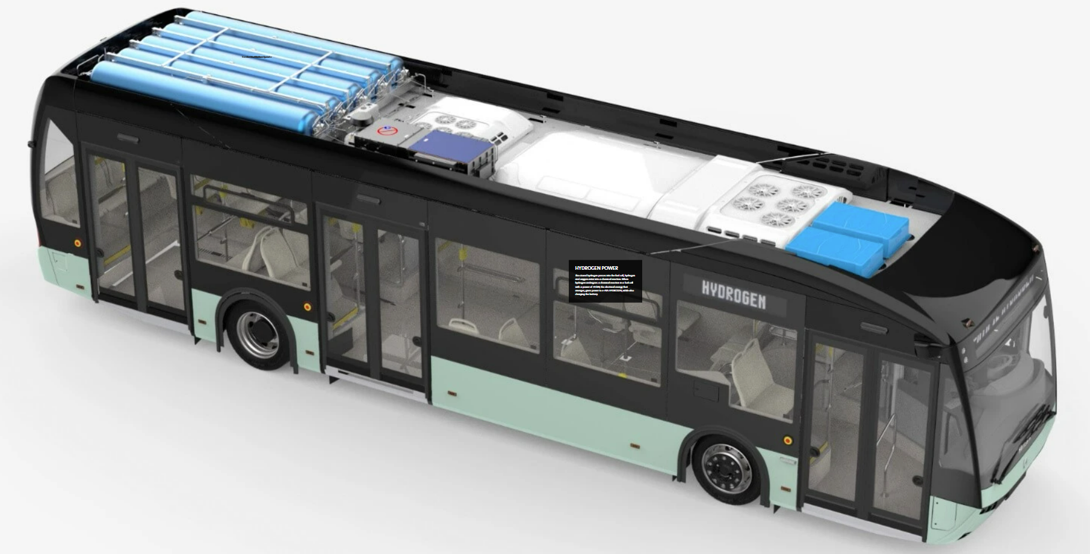
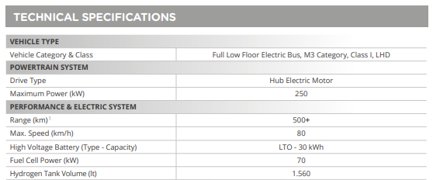
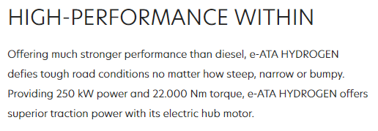
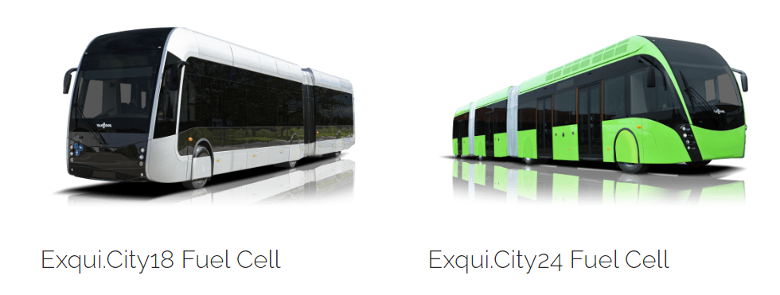
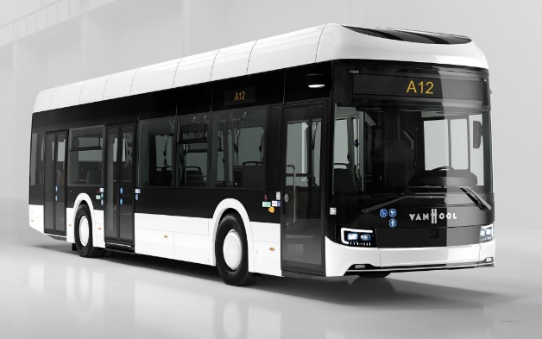
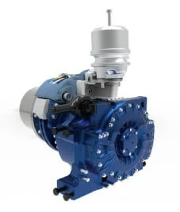
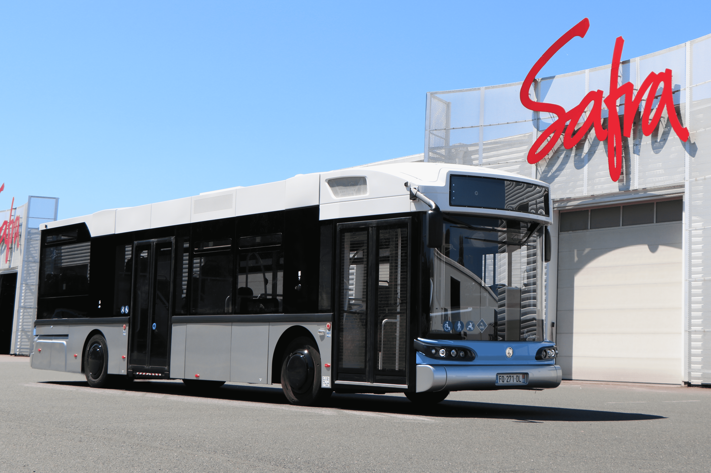
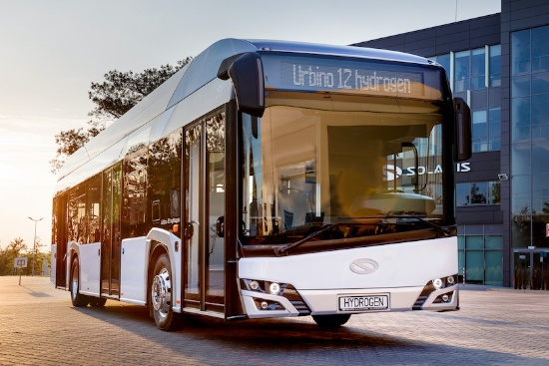
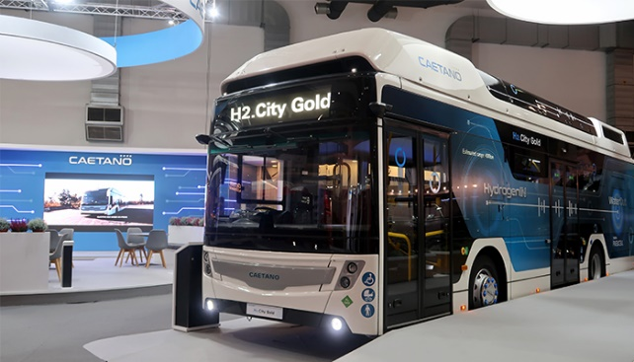
Fuel Cell Hydrogen Buses
GenComm Partner Meeting – Closed session – Galway 22 September 2022

Slide 27
EST
GenComm Partner Meeting – Closed session – Galway 22 September 2022

Slide 28
Thank you!
Questions?
GenComm Partner Meeting – Closed session – Galway 22 September 2022

Slide 29


