Slide 1
GenComm
EUSEW 2022
27th September 2022
The Commodification of Hydrogen
Place image in this area.

Slide 2
AGENDA
1.Policy introduction (5 min): Bart Biebuyck Executive. Director of the Fuel Cells and Hydrogen Joint. Undertaking (FCH JU)
2. Introduction/Roundtable - 4 Stage Green H2 Commodification value chain
H2 Optimisation – Paul McCormack Innovation Manager Belfast Met
H2 Actualisation – Diana Raine Worley United Kingdom
H2 Evaluation – Marianna Rossi IZES Germany
H2 Validation P2X – Rory Monaghan NUI Galway Ireland
3. Panel discussion Bart Biebuyck
4. Questions from audience
5. Conclusion - Bart Biebuyck

Slide 3
POLICY INTRODUCTION

Slide 4
INTRODUCTION
We are at one of the most pivotal times in the Energy industry, facing climate and security challenges. Sustainability initiatives are driving industry, communities and society through an accelerated energy transition.
The drive to reduce our carbon footprint has powered companies to unprecedented levels of innovation, transformation, productivity, and efficiency.
As we embrace a rich future of sustainable energy, catalysed by Green Hydrogen we are examining every step in the 4 Stage Green H2 Commodification value chain to enable this transformation for all.

Slide 5
THE EFFECTIVENESS OF GREEN HYDROGEN
Green Hydrogen is 360° effective
Environmental – zero carbon footprint
Social – community inclusive energy solution
Commercial – a key energy catalyst assisting industry pivot to green solutions
Financial – Innovations in electrolysers will ensure that Green Hydrogen will become more cost effective than natural gas

Slide 6
Key Message
Responding to our climate and energy crisis requires us all to respond. It will be a collaborative ‘all hands-on deck’ effort with governments, scientists, innovators, industry and communities all working in cohesion as partners in the clean energy transition that will deliver the solutions we require. contribute to our understanding of climate change and its impacts.

Slide 7
CONTEXT
In 2021 and early 2022 our EU goal was driving to build a clean energy future.
On the 24th February 2022 our goals were expanded and accelerated to a clean secure energy future for Europe.
The climate challenge allied with the current geopolitical situation makes an unparalleled case for a rapid clean energy transition.
The transition smarter use of current technologies, the development of next-generation technologies and the deployment of smart infrastructure to use and integrate these technologies in our energy system.
These steps allied with increased energy efficiencies across the entire energy value chain will deliver our energy goals.

Slide 8
COMMODIFICATION
The IEA estimates that nearly half of the clean energy technologies required to achieve net-zero emissions by 2050 are not commercially viable yet.
The recently announced EU project will help focus on R&D which in turn will drive down the cost of existing clean energy technologies and importantly unlocking new ones.
This push on many fronts will provide a central focus for many and help drive the commodification of Green Hydrogen.

Slide 9
The green dawn
The global energy crisis is a clean energy opportunity.
The oil shocks of the 1970s spurred vital progress in renewable energy opportunities but we allowed these to be side tracked.
Today’s crisis highlights the fragility and the unsustainability of our reliance on fossil fuels.
This can be the springboard towards a cleaner, more affordable and more secure energy system.

Slide 10
The green energy transition is fragile
Energy price rises are exposing failures in market design and regulation, creating a void that is being occupied by anti-renewables propaganda and false narratives.
Across the globe nations are turning to fill gaps in their fossil fuel supplies by looking to reopen coal mines, expanding domestic gas production, and securing new import contracts.
This new landscape offers difficult terrain for the clean energy transition and especially Green Hydrogen.
Renewed energy security concerns among many nations risk pushing clean energy ambitions back down the agenda while short-term crises are tackled.
‘Near term challenges shouldn’t obscure real opportunities.’

Slide 11
IT WILL TAKE MORE THAN TECHNOLOGY
Technology alone will achieve our net zero goals.
As detailed in Marianna’s Evaluation section of the Green H2 EVALUATION link in the SMART H2 value chain, substantial work is still needed on, understanding behaviours and attitudes around energy use, and on mechanisms for supporting households and communities through the energy transition.
In our drive for technological development, we cannot overlook the central role played by people, and ensure that we are also fostering innovation and collaboration at the social level.

Slide 12
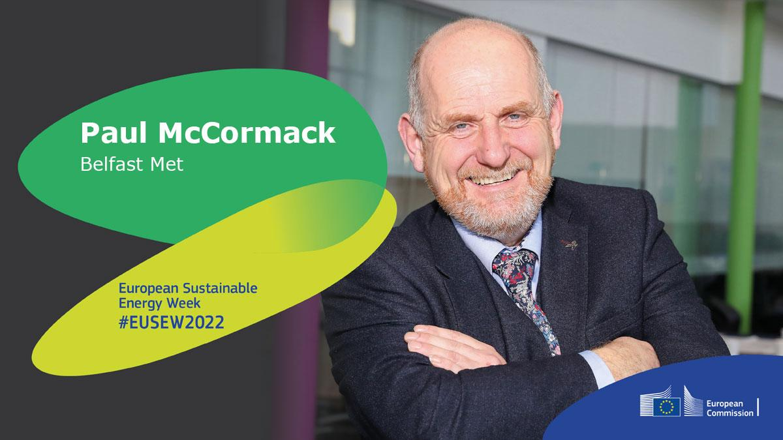
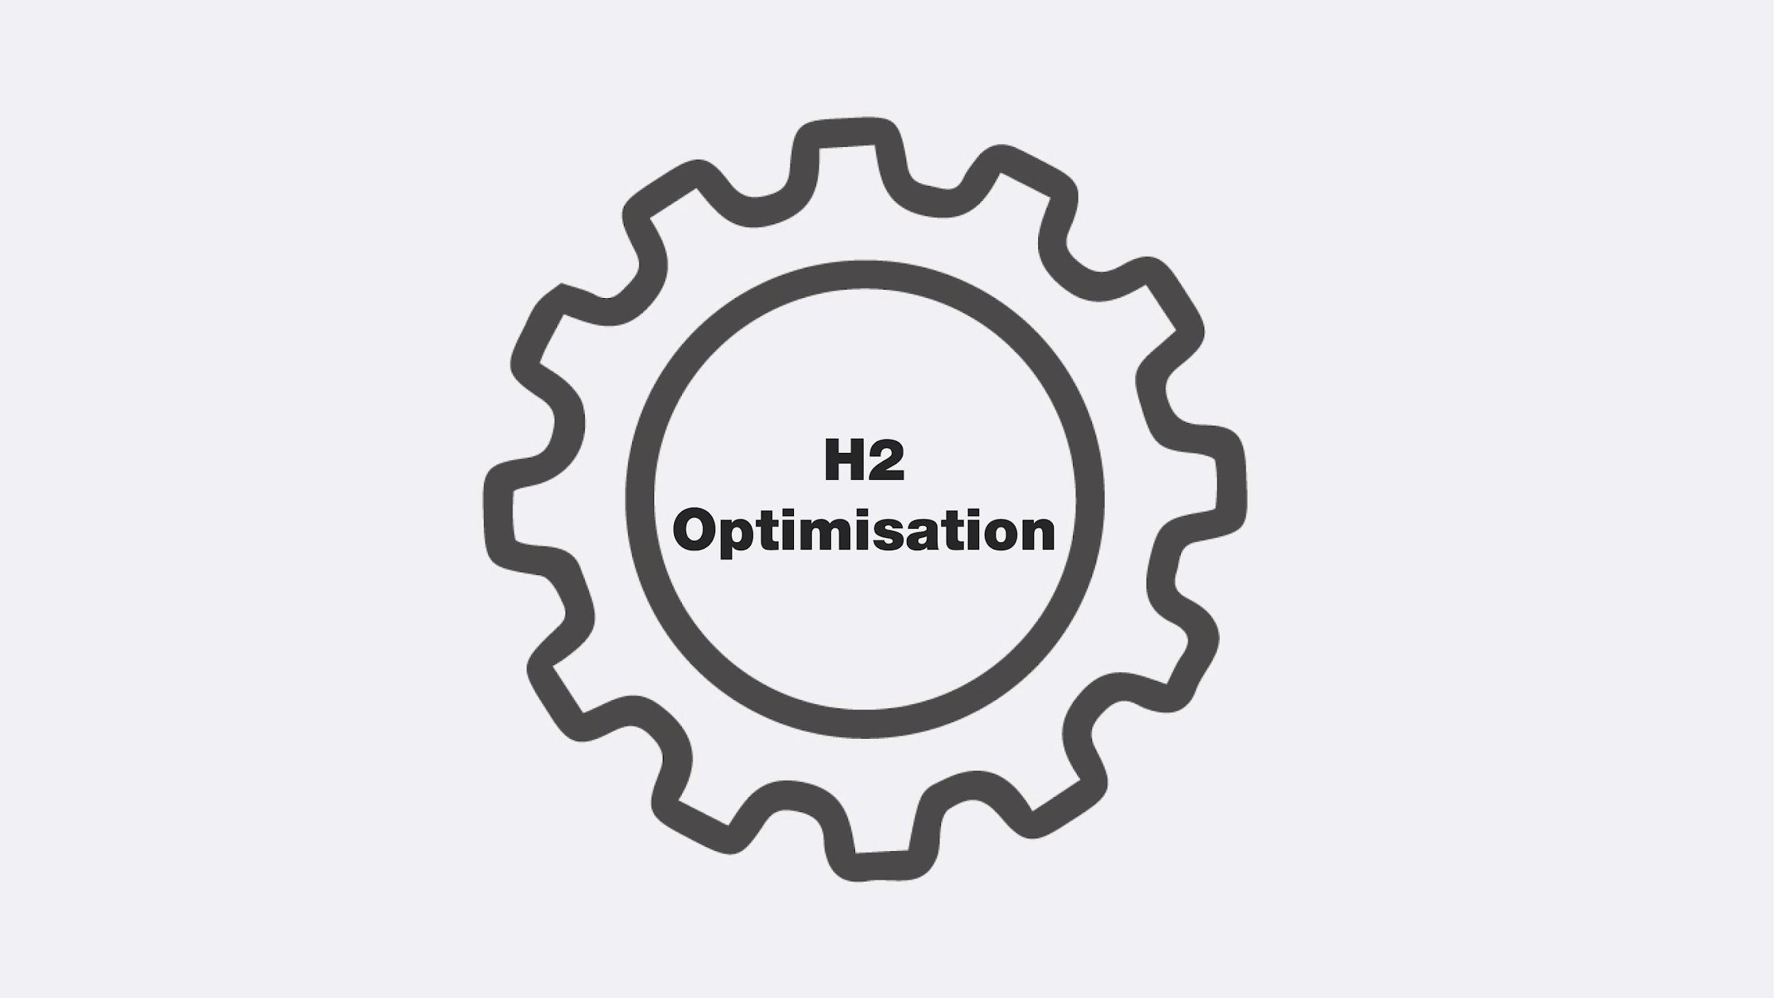
H2 OPTIMISATION

Slide 13
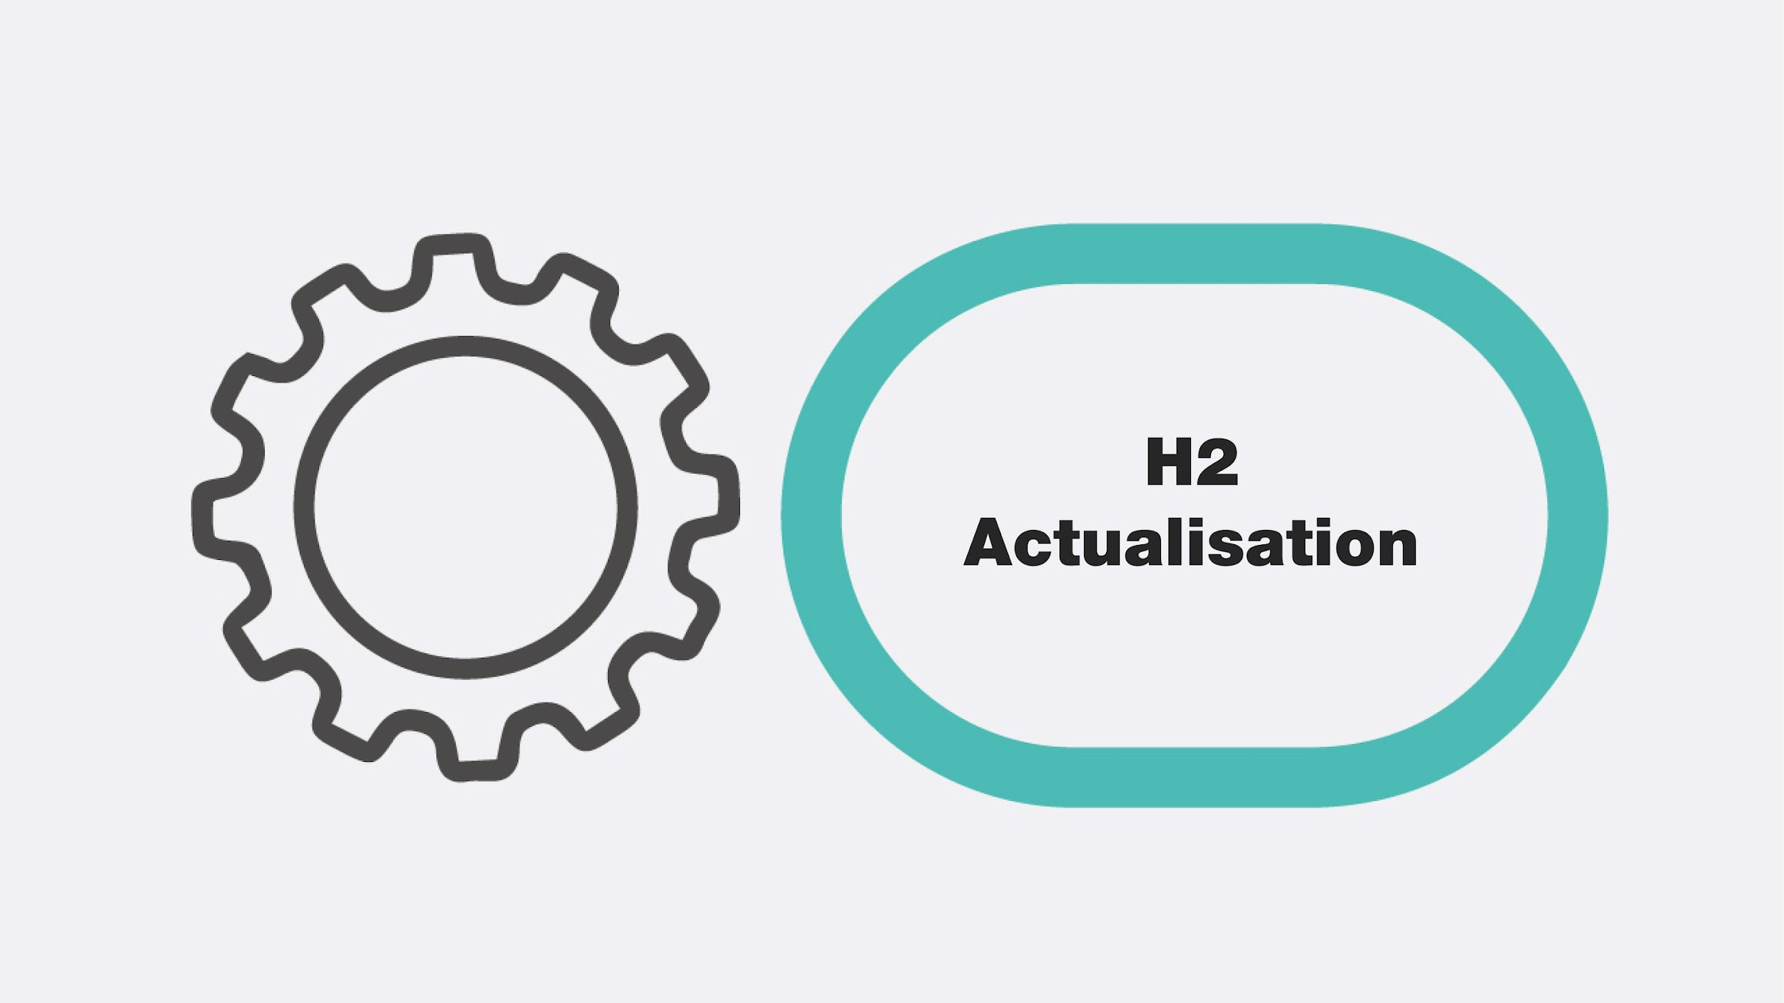
Key Message
Hydrogen is the catalyst driving Europe’s energy transition, enabling us to pioneer new and innovative paths to sustainability.
Optimising this journey, enhancing its cost-competitive production, storage, and end-use is critical.
Delivering SMARTH2 through valorization of the hydrogen supply chain, production, storage and use is key to creating a successful, sustainable secure energy future for Europe.

Slide 14
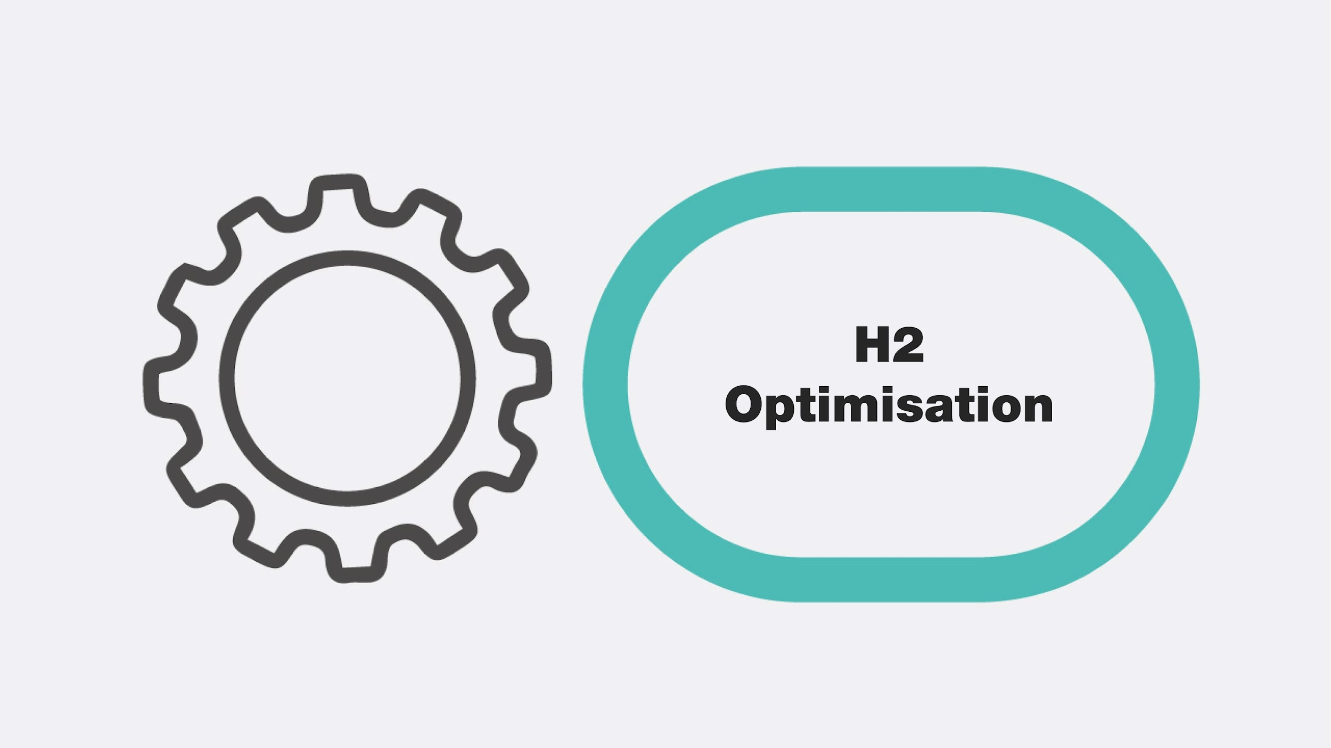
Optimisation
There are many challenges governments face today on our journey to achieve the twin goals of long-term sustainability and secure indigenous clean energy systems.
There is no ‘one-size fits all’ approach to reaching net-zero — technologies across all sectors of the economy will need to work together. And these technologies are all at varying stages of research, development and demonstration (RD&D).
We must also look to achieving efficiencies from every step on this journey and secure the most effective energy opportunities each step brings – a Green H2 NEXUS
OPTIMISATION
ACTUALISATION
EVALUATION
VALIDATION

Slide 15
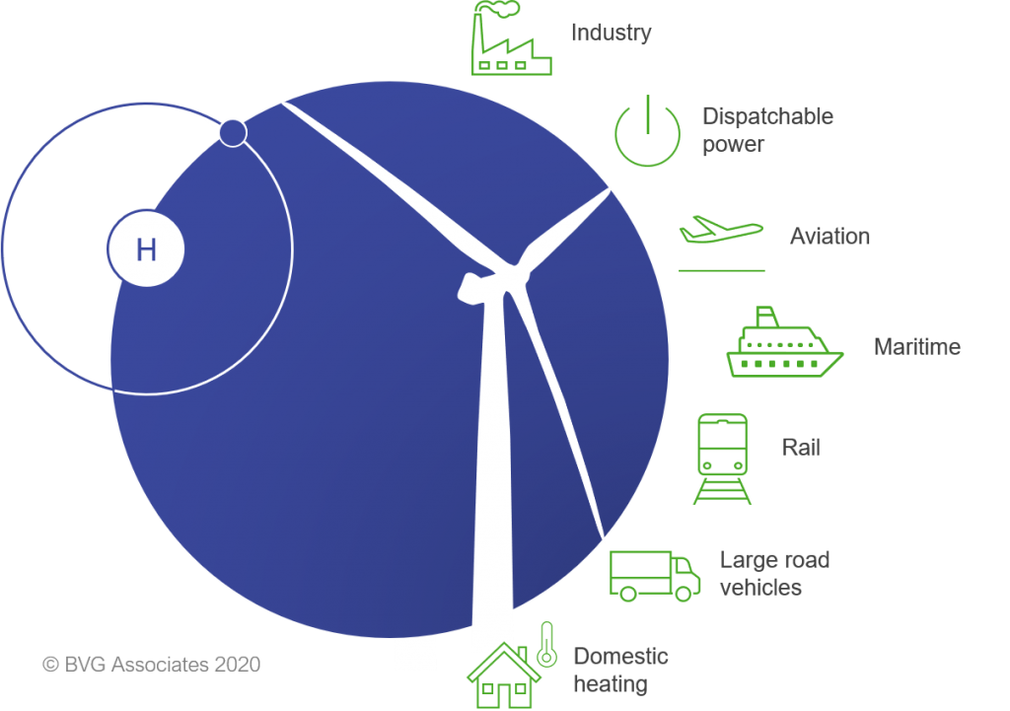
Hydrogen Leverage
Hard to decarbonise sectors
Clean hydrogen plays a critical role on the global path to net zero and importantly it forms a key interconnecting pillar between other key clean technologies

Slide 16
HYDROGENEWABLES
In order to achieve successful energy transition to renewables in Europe we must look to achieving full commercial opportunity for renewable energy. In order to achieve this, we have to ensure commercial flexibility in the coupling of the renewable energy sector and the transport sector.
The use of SMART H2 (Hydrogen produced from renewable energy sources) as an energy carrier to achieve this goal is crucial.

Slide 17
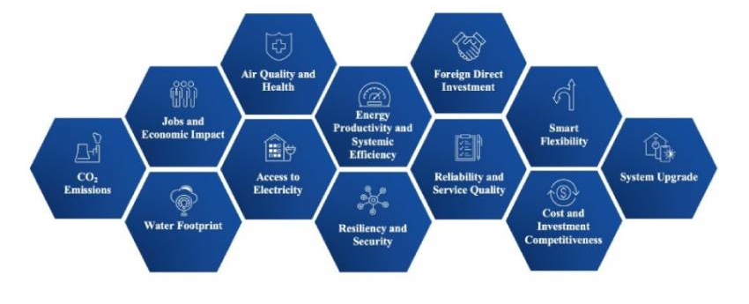
H2 Transition Opportunities
As Europe transitions to net zero, we must position as the lead in clean hydrogen trade Accelerate our current EU clean hydrogen journey
Develop increased additional links with other partners to accelerate this journey
Stimulate increased Green H2 awareness and demand and ‘position’ new energy transactions.
Progress the H2 CAT model internationally , transitioning European economy towards a climate-neutral and more resilient economy
Expand our work to include digitalization and implementing a well-thought-out circular economy model.
The Green Economy is predicated on the Green Economy and Digitalisation.

Slide 18
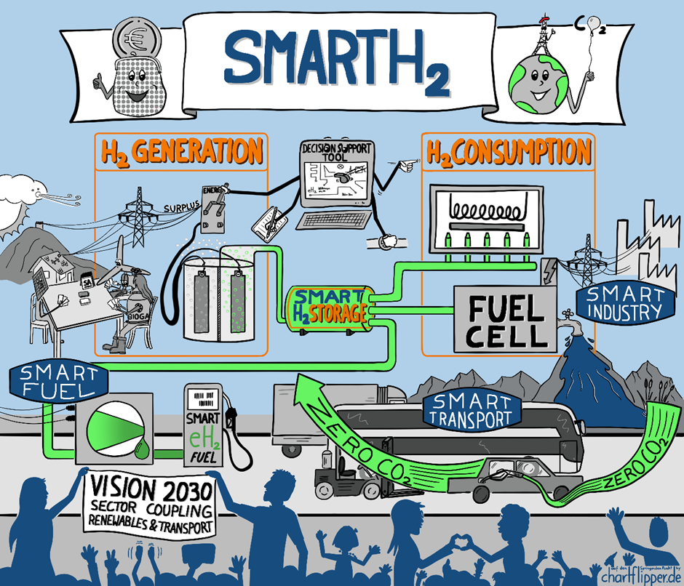
Fuelling the Just Transition
– The Role of Non-Carbon Energy
Notes:
New technologies as the one that is subject of HAZEL and
GENCOMM are examples of innovations deployed in real life, creation of climate-
resilient processes and professions, raise of public awareness of the
scientific importance for the creation of climate protective industry and
environment, all of that achieved by applying collaborative and inclusive
approach of work science - industry work.

Slide 19
SMART H2
The world is racing to scale up Green Hydrogen
However, as we scale up the use of GREEN H2 it must be done smartly, intelligently and efficiently giving us SMARTH2
PRODUCTION
CONVERSION
TRANSMISSION
DISTRIBUTION
USE
H2
H2
H2
H2

Slide 20
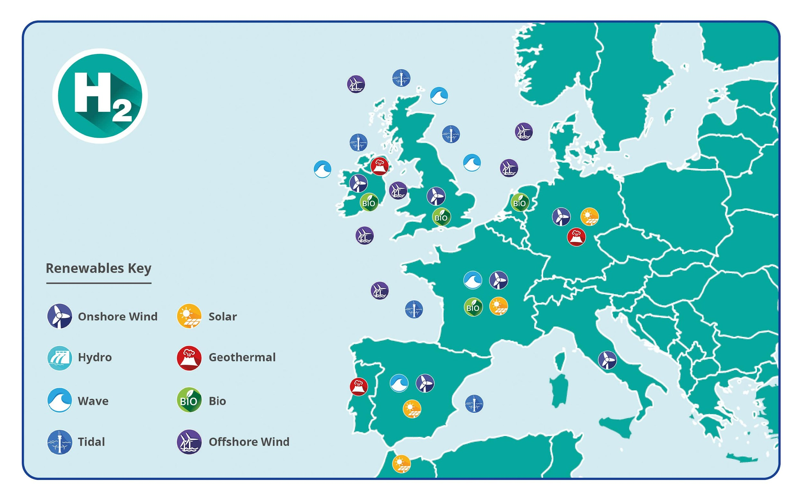
Hydrogen Topography
A geographical approach to developing zero carbon solutions for local use.
This approach empowers communities across Europe to access hydrogenewables, their own renewable opportunities wind, solar, bio, wave, tidal, geothermal and use these green sources to provide green energy solutions on their specific journey to net zero.
Positioning relevant Green H2 energy solutions that address regional opportunities, challenges and objectives.

Slide 21
INNOVATE THE TECHNOLOGIES OF THE FUTURE
half of the clean energy technologies required to achieve net-zero emissions by 2050 are not commercially viable yet.
selected technologies to showcase solutions that are accelerating and demonstrating progress toward our shared clean energy goals
there is no ‘one-size fits all’ approach to reaching net-zero — technologies across all sectors of the economy will need to work together. And these technologies are all at varying stages of research, development and demonstration (RD&D).

Slide 22
Summary
Green H2 is a disruptive technology – it is nonlinear change in a linear world.
Disruption, by definition, changes the “traditional way of doing things” and accelerates change and transformation.
We must optimise all steps of Green H2 in a logical, needs driven, exponential accelerated manner in order to fully exploit current and future clean energy applications
Energy innovation is not linear it is a conversion and Green H2 innovation can and will convert our energy systems to the green alternatives we need

Slide 23
Digital Transformation
We can use digitalisation and digital tools to optimise value at every stage in the Green Hydrogen value chain.
Blockchain will be a powerful tool in tracking emissions and green molecules along energy value chains
As we prioritize green hydrogen in the energy transition this will drive profound change and deliver new policies, business models, and regulatory models in the rapidly changing energy sector. Blockchain and other digital tools will play a prominent role in supporting these strategies.
Blockchain will disrupt today’s energy industry and will enable stakeholders to reap substantial benefits for years to come.

Slide 24
H2 ACTUALISATION
Notes:
d

Slide 25
The 2020’s was heralded as the decade of action in the fight against climate change. Hydrogen is universally recognised as having a significant role to play in the move away from fossil fuels, but we now urgently need a holistic, agile approach to address existing barriers and to drive costs out of the supply chain if this really is to be the decade of action.
There is no time to waste.

Slide 26
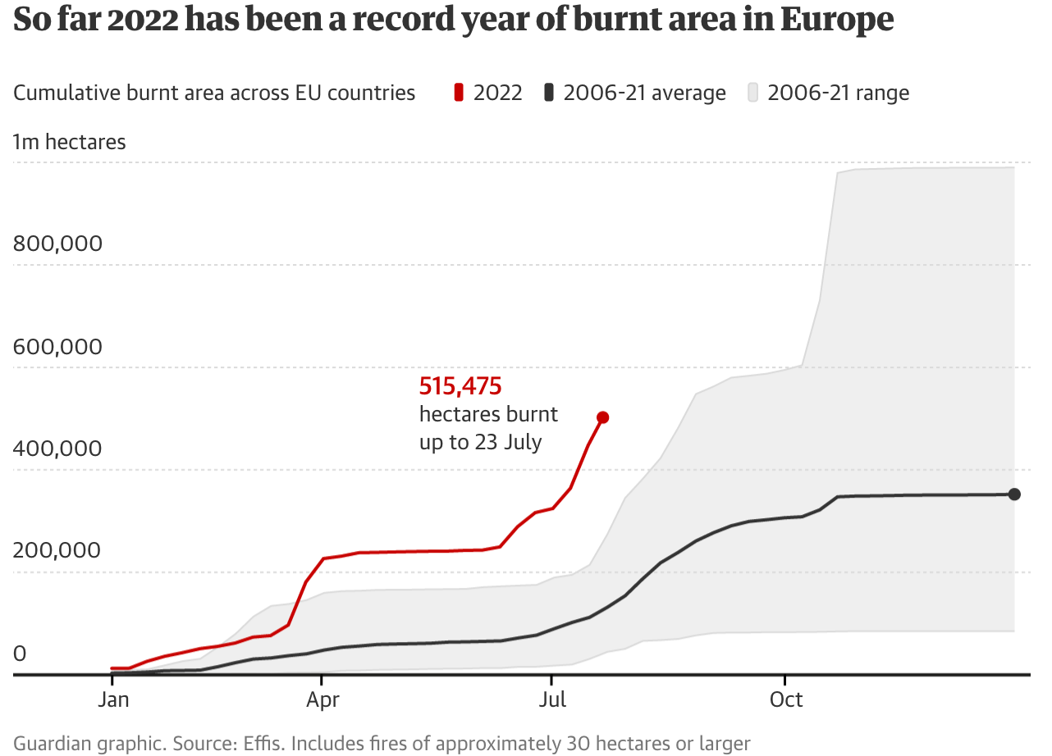
2022:A year of ‘Actualization’ on Climate Change

Slide 27
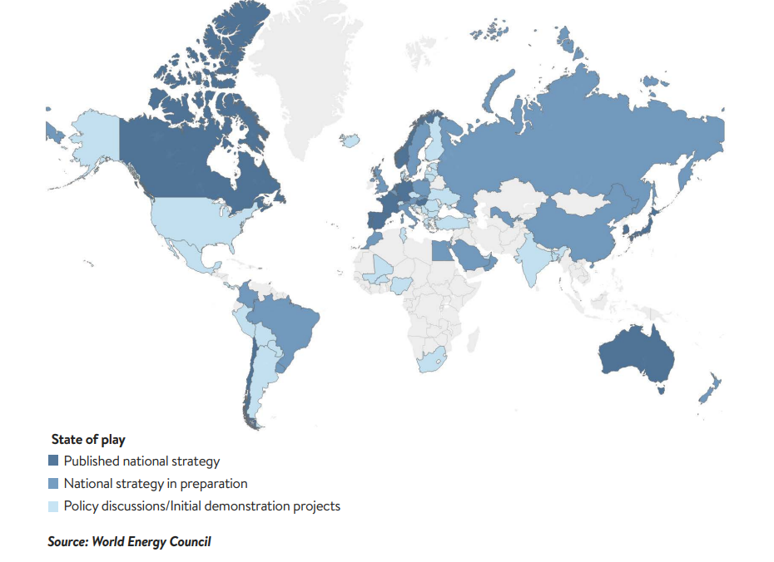
Global acceleration of Hydrogen
Countries are increasingly embedding hydrogen strategies
Falling cost of renewables generation
Expected reduction in electrolyser CAPEX and increase in systems efficiencies
Energy security is firmly alongside decarbonisation in importance in the energy transition, raising the hydrogen expectation further

Slide 29
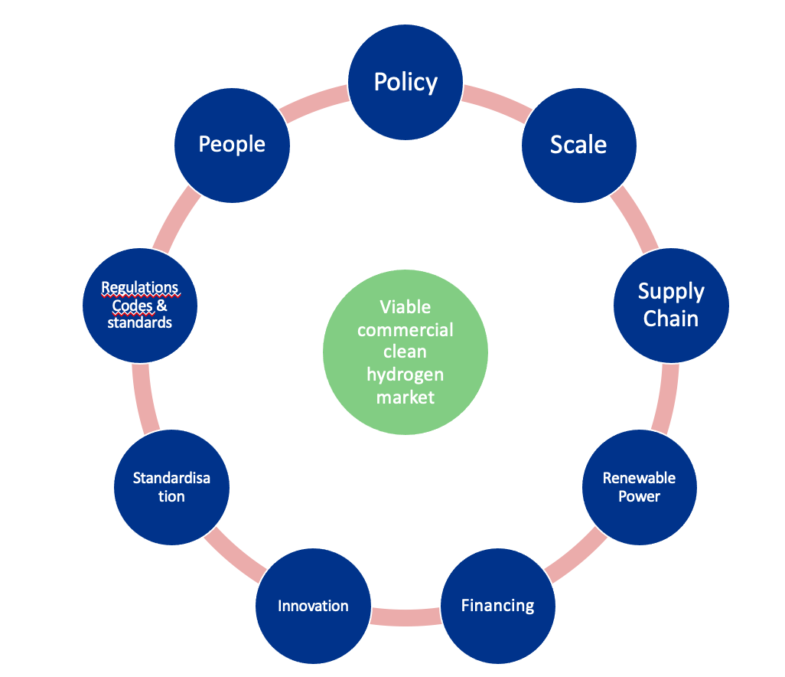
Creating a thriving hydrogen economy

Slide 30
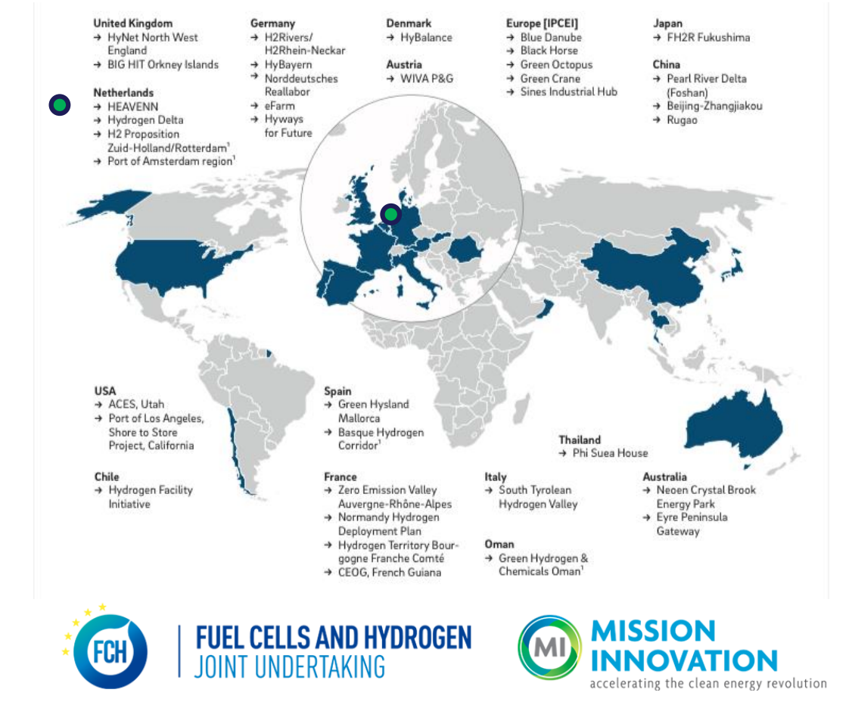
From Projects to Valleys
Hydrogen valleys are regional ecosystems that enable balancing of supply and demand whilst driving down cost
Can have one or more anchor tenants that provide baseload
Enables access to green hydrogen to a wide end user community by leveraging cost benefits of increased scale
Next Generation of Hydrogen Valleys
Supported by Clean Hydrogen Partnership
Large scale, breadth of applications, cross border
Kick starting hydrogen in new regions
E.g. Hydrogen Valley Ireland
https://h2v.eu/
Notes:
A Hydrogen Valley is a regional ecosystem
Strong links between hydrogen research, production, distribution, and transportation
Synchronises the supply and demand of hydrogen
Enables various end users such as transport and industry
Utilisation of indigenous green hydrogen at Hydrogen Valleys is key
GH2 is an important step towards enabling the development of a new hydrogen economy

Slide 31
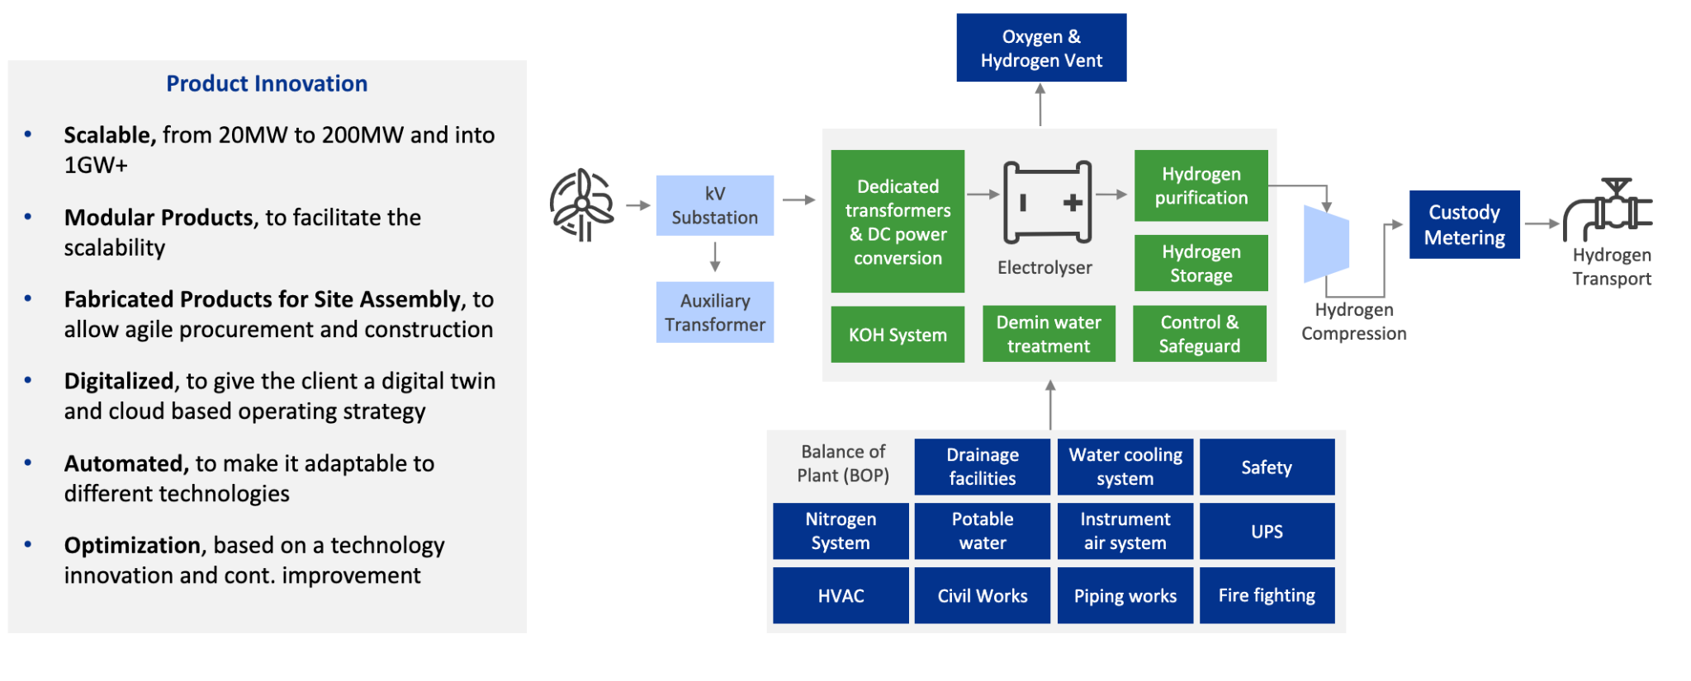
A building block approach to large scale green hydrogen projects
Worley Hydrogen WRAP™

Slide 32
Connected delivery model
Optimized engineering and repeatable fabrication with the operating asset in mind
Engineering and procurement
H
Reduced levelized cost of hydrogen (LCOH)
Adopting a modular approach that simplifies optioneering and accelerates engineering to deliver a standardized design.
Fabrication focused
2
Engineering
procurement
Fabrication and construction
A connected fabrication, delivery and installation solution which accelerates asset delivery timelines.
Operations focused
Asset
management
Fabrication
construction
Asset management
Utilizing a data driven approach with digital technology to deliver connected assets with smart operations functions.
Efficiency focused
Digitalisation across the ecosystem
Applying digitalisation upsteam into renewable geenerrataion and downstream into end use,, leveraging smart data for optimising operational excellence
Digitalisation focused

Slide 33
Agile and Scalable way of working in green hydrogen
Advisian
H₂ Excellence Centre
Enhanced GID
Enhanced GID, Construction
BEP
FID
Concept Design, Feasibility
Modular WRAP
Speed FEED
Engineering / Fabrication
Operations & Maintenance
Business Case (to support funding and investment decisions, incl. Offtake studies, Optioneering, renewable electricity & utilities supplies, effluent treatments, capacity)
Concept Development
Technology Selection (AWE, PEM, SO)
Strategy
Class V estimate ±50%
OEM Selection
Modular Plan (to facilitate future scalability, replication)
Hydrogen WRAP (design customized for water, power, heat, buildings, control, storage, etc..)
Execution Strategy (fabrication, delivery, installation, startup)
Permitting Plan (design customized to local conditions)
Class IV estimate ±30%
Technology selected – one size
Fixed price and schedule
Lean engineering Standardization
Datacentric Delivery
Modular engineering, to facilitate scalability
Repeatable formula
Class III Estimate +10%
Innovative commercial & execution models
Smart Engineering
Integrated plant
Fabrication yards
Modular fabrication, to allow agile procurement and construction
Modular execution
Construct SIM
SEAL
4D execution
Supply Change Mgmt.
We design early phase projects with big picture in mind, allowing us to better design for future optimization of operation and maintenance
Operational Readiness Assurance (ORA)
Objectives
Deploying digital solutions through the entire asset lifecycle
33

Slide 34
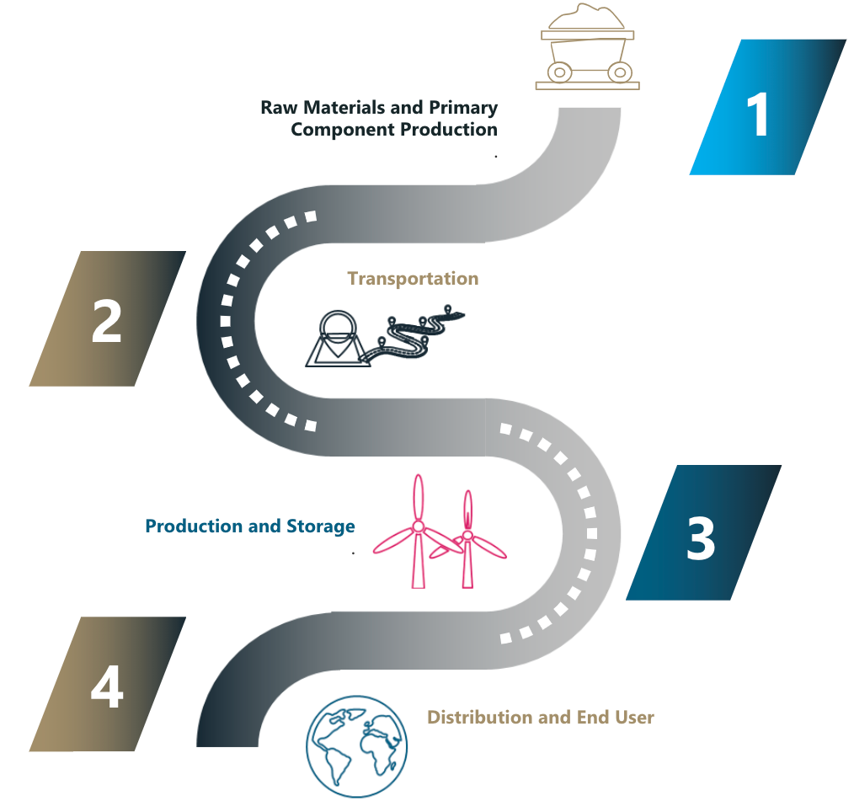
Digitalization across the entire H2 ecosystem
Blockchain development
Blockchain allows transparency and carbon accounting along the entire supply chain
Supports measurement of alignment with policy goals
Chain of Custody ​
Supply Chain Provenance​

Slide 35
Strength in Collaboration
1
2
3
An integrated digital approach considering the asset lifecycle and integration into the broader business ecosystem
Driving towards hydrogen with a levelized cost of $2/kg
Solutions which help resolve business challenges for the hydrogen market

Slide 36
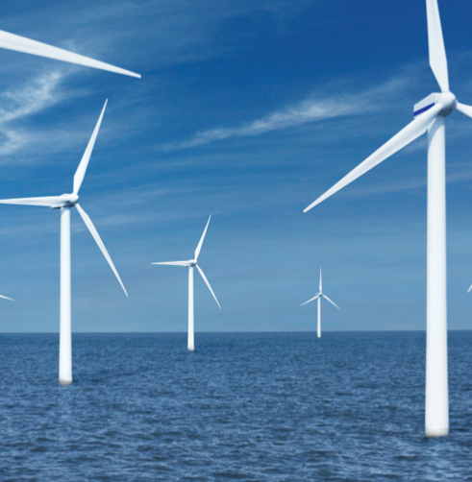
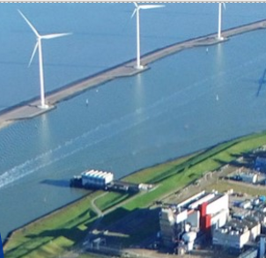
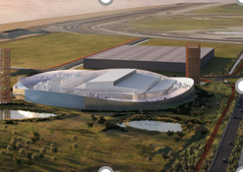
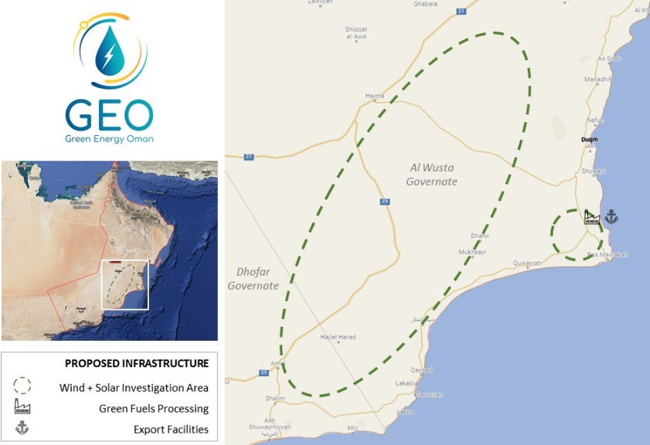
We are making progress….
Offshore Wind Farm and 100MW Electrolyzer Facility 760MW Offshore Wind farm, Netherlands
Worley acted as a technical counsel involving the development of a 760MW offshore wind farm and a 100MW hydrogen electrolyzer facilty
Worley’s role involved a business model for the hydrogen production
We built a financial model which determined the levelized cost of hydrogen
Identified potential hydrogen offtakers and building a joint business case.
Nouryon Alliance
Netherlands, Nouryon/Nobian
We are working with Nouryon to scale of hydrogen production to build a carbon-free Netherlands. Currently we are workin on three projects:
Djewels 1, 20MW electrolysis plant for production of green H2 for bio-methanol FEL 1, FEL 2 and currently FEED completed
Djewels 2, concept study for 50MW electrolysis plant for production of bio-kerosene for sustainable jet fuel
Hermes, 100MW project in concept study phase to decarbonize steel production
Green Hydrogen Plant utilizing Offshore Wind
Shell 200 MW Maasvlakte, Netherlands
We are working with Shell in the Netherlands to develop a 200MW green hydrogen plant in the Maasvlakte area in the Port of Rotterdam.
Our scope incorporates all different moving parts:
Integration of electricity supply from an offshore windfarm​
Technology selection and OEM selection in an integrated team
Integration of the 200MW electrolyzer OEM design in the conceptual design of the plant
The design of the balance ​of plant ​and infrastructure​
We are responsible for Integrating the green hydrogen into the Shell Pernis refinery as part of a decarbonization strategy.
Green Energy Oman
Oman
We are supporting Green Energy Oman (GEO), an international consortium, to developed a 25-gigawatt (GW) low-carbon fuels project.
Concept feasibility study services to further develop and challenge GEO's defined green hydrogen energy project.
Optimize 25 GW of wind and solar generation, transforming this renewable energy into green hydrogen, and the production, storage, and export of ammonia.
Produce 1.8 million tons of low-carbon green hydrogen which can produce up to 10 million tons of green ammonia per annum.
Identify opportunities to enhance in-country value delivered from the expected 10-year project implementation period.

Slide 37
Unlocking value and driving out cost across the delivery chain for green hydrogen
H2
Adopting a highly automated and repeatable approach in delivering the project to make sure the asset is optimized through the entire lifecycle.
Standardized BoP units
Digitally enabled to remove significant ‘soft costs’ associated with project delivery
Fabricated in a repeatable, manufactured fashion
Reducing the levelized costs of green hydrogen through focused cost minimization across concept, engineering, project delivery (CAPEX) and operations (OPEX)
Applying smart digitalisation across the entire hydrogen ecosystem
Digitally equipped for smart optimised operations
Blockchain for full traceability and validation along the green molecule value chain

Slide 38
TITLE
TEXT

Slide 39
TITLE
TEXT

Slide 40
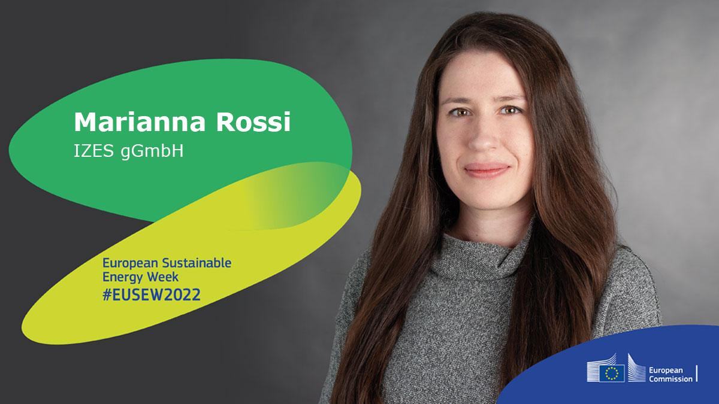
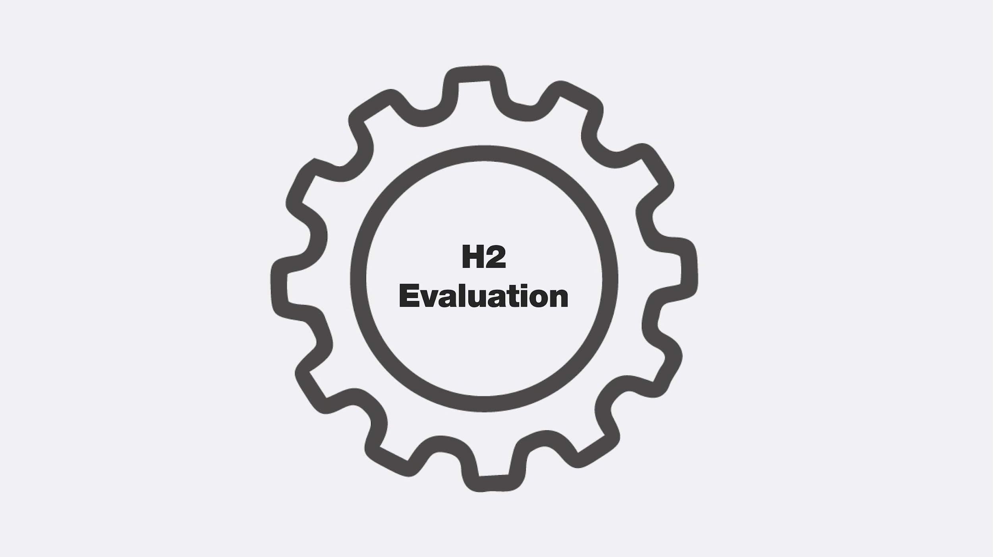
H2 EVALUATION

Slide 41
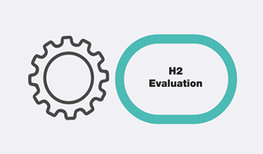
Hydrogen can be the key
to creating a successful, sustainable and secure energy future for Europe.
But it is people who need to open the door.

Slide 42
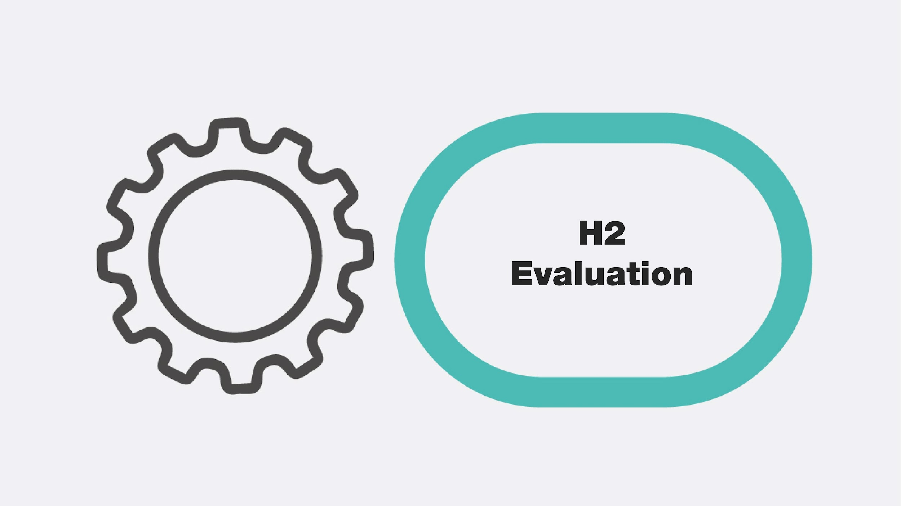
Green Hydrogen
ACCEPTANCE
(1) Acceptance of the Technology
The Technology is approved and favorably received
(2) Acceptance of the Process
Necessary processes are approved and seen as adequate
(3) Acceptance is the outcome of a process in which project and stakeholder interests become mutually aligned, possibly leading to both - project and societal changes.
(4) Acceptance is only one issue that determines overall successfulness innovation process
Notes:
While advances in technology will largely determine the
rate at which hydrogen energy technology (HET)1 becomes
commercially viable, the successful uptake of new energy
technologies is dependent on more than just cost competi-
tiveness. A lack of public acceptance can greatly impede
progress or even halt the development of energy technologies
entirely [6]. Energy-related technologies such as carbon cap-
ture and storage (CCS), nuclear power and hydrogen fuelling
stations have all faced public opposition in the past, which has
halted the development of planned projects [7e9]. Under-
standing how people think about HET and how this influences
acceptance is, therefore, a critical area of future research as it
can inform effective policy and industry standards, public
education and messaging, and assist with the implementation
of the technology.

Slide 43
Green Hydrogen
ACCEPTANCE
(1) Acceptance is not a one-way street in which stakeholders either accept or reject a technology
(2) Acceptance is a dynamic process. Social movements and evolving environments such as political and policy cultures or socio-economic development need to be considered
(3) Acceptance is the outcome of a process in which project and stakeholder interests become mutually aligned
(4) Acceptance is only one of many issues that determine overall success
Notes:
While advances in technology will largely determine the
rate at which hydrogen energy technology (HET)1 becomes
commercially viable, the successful uptake of new energy
technologies is dependent on more than just cost competi-
tiveness. A lack of public acceptance can greatly impede
progress or even halt the development of energy technologies
entirely [6]. Energy-related technologies such as carbon cap-
ture and storage (CCS), nuclear power and hydrogen fuelling
stations have all faced public opposition in the past, which has
halted the development of planned projects [7e9]. Under-
standing how people think about HET and how this influences
acceptance is, therefore, a critical area of future research as it
can inform effective policy and industry standards, public
education and messaging, and assist with the implementation
of the technology.

Slide 44
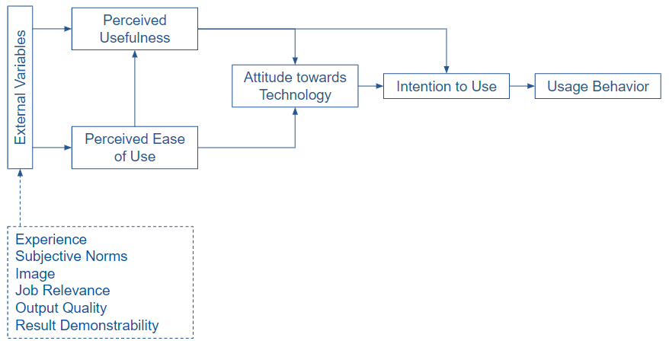
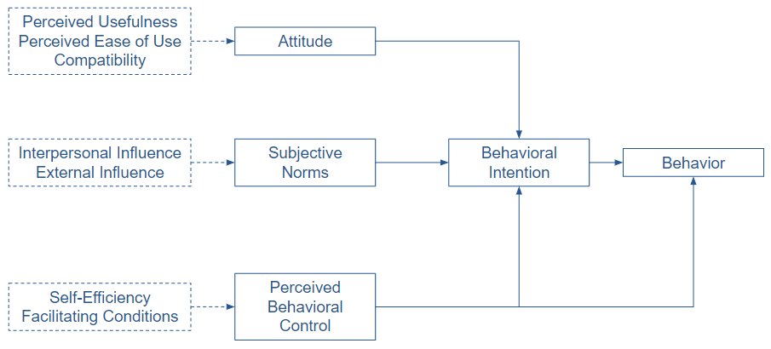
Social evaluation of green hydrogen
Parameters to influence people's acceptance of green hydrogen
Technology Acceptance Model (Davis et al. 1989)
Theory of Planned Behavior (Ajzen, 1991)
Notes:
Similar to the review of Carbon Capture and Storage accep-tance conducted by L'Orange Seigo et al. [72], this review usesthe Technology Acceptance Framework (TAF) as a theoreticalbase and structure for the review. The TAF is a review-basedframework that summarises the psychological factors thatinfluence energy technology acceptance informed by otherpsychological theories of human behaviour [56]. As such, theTAF is not a distinct psychological theory in that it makesunique testable predictions. Instead, the TAF is a synthesis ofthree commonly applied theories of human behaviour: thetheory of planned behaviour (TPB) [21], the norm activation model(NAM) [22,23] and affect/emotion focused theories like theaffect heuristic [24] and the risk-as-feelings hypothesis [25].Although it is beyond the scope of this paper to discussthese theories in detail, some the main claims made bythese theories are as follows. The TPB, posits that theproximate cause of one's behaviour is their intention toperform the behaviour, which is influenced by one's atti-tude towards the behaviour, subjective norms (e.g., socialinfluences) and their perceived behavioural control [21].The NAM suggests that human behaviour (specificallyaltruistic and proenvironmental behaviour) is primarilydriven by personal norms (i.e., subjective moral obligations)to act in a specific way, which are determined by one'sbeliefs about the consequences of their actions [22,23].Finally, affect/emotion focused theories like the affect heu-ristic [24] and the risk-as-feeling hypothesis [25] propose thatpeople's appraisals of, and reactions to, objects (e.g., tech-nological and environmental hazards) are strongly deter-mined by affect and/or emotions. The TAF, informed byempirical findings, proposes that these theories combinedcan help to explain public acceptance of new sustainableenergy technologies [56].In summary, the TAF, informed by psychologies theories,suggests that people's acceptance or acceptability2 is influencedby one's beliefs about the technology, perceived personal andsocial norms, affective responses (e.g., feelings and emotion-based appraisals), and other contextual factors (e.g., socialtrust). As the focus of the present review is to understand thepsychological factors that influence HET acceptance, thebreath of factors included in the TAF provides a usefulframework for structuring the review. As demonstrated byL'Orange Seigo et al. [72], the TAF seems to capture most of theimportant psychological factors that explain variability in CCSacceptance. Other literature reviews have also shown thatpsychological factors within the TAF are reliable predictors ofthe acceptance of other energy technologies like renewablesand nuclear power [16,85]. It is, however, important to notethat there are other potentially relevant theories that mayhelp to explain acceptance that focus on different explanatoryfactors and levels of analysis (e.g., acceptance at a group leveldue to socio-political influences) [15]. Whilst this review fo-cuses on exploring the psychological factors that influenceacceptance at the individual level, the author acknowledgesthat other theories and perspectives are necessary to gain abroader understanding of HET acceptance

Slide 45
Social evaluation of green hydrogen
WHO
Stakeholder
Production
Storage
Distribution
Utilization
WHAT

Slide 46
Social evaluation of green hydrogen
Mostly neutral to positive reactions
Mostly data in regards to the Mobility Sector

Slide 47
Social evaluation of green hydrogen
Seldom differentiation between “green” vs. “other” hydrogen in current research
In general the public appears to be in favor of introducing hydrogen vehicles.
But it is important that hydrogen is produced in an environmentally friendly way, i.e. through renewable sources

Slide 48
Social evaluation of green hydrogen
Mostly neutral to positive reactions
Mostly data in regards to the Mobility Sector
Effective parameters to influence Hydrogen acceptance
PARAMETER | Explanation
AWARENESS | Consciousness of Existence
SUBJECTIVE KNOWLEDGE | Believed Level of Knowledgeability
EXPERIENCE | Amount of Contact
PERCEIVED EFFECTS | Perceived Risks, Benefits and Costs
SOCIAL TRUST | Level of Trust in Source of Information

Slide 49
Example: The EST
The EST: Enabling Support Tool
Goal: support the implementation of the concepts for hydrogen in public transportation system by transporting the right information in an accessible and interesting manner.
Example Information:
Ideal bus routes for the use of hydrogen buses
Cost of a hydrogen-inclusive bus fleet
Method: two-stage user experience testing
Explorative assessment of stakeholder preferences and needs towards an EST
Usability testing of an early stage version of the EST

Slide 50
Next Steps
Optimized and Targeted Communication Strategies and Interventions
Enhance acceptance for (green) hydrogen
Heightened constructive involvement of stakeholders
Counteract negative feedback
Research on public acceptance along the whole hydrogen value chain
Operationalization of Constructs

Slide 51
Green Hydrogen
Hydrogen can be the key
to creating a successful, sustainable and secure energy future for Europe.
But it is people who need to open the door.

Slide 52
TITLE
TEXT

Slide 53
TITLE
TEXT

Slide 54
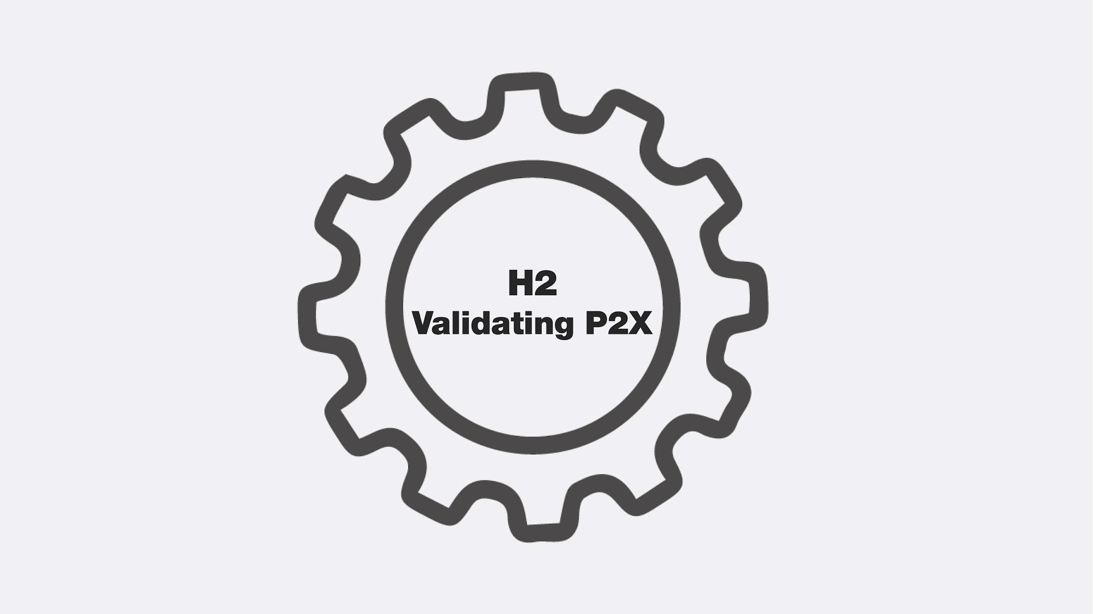
H2 VALIDATION

Slide 55
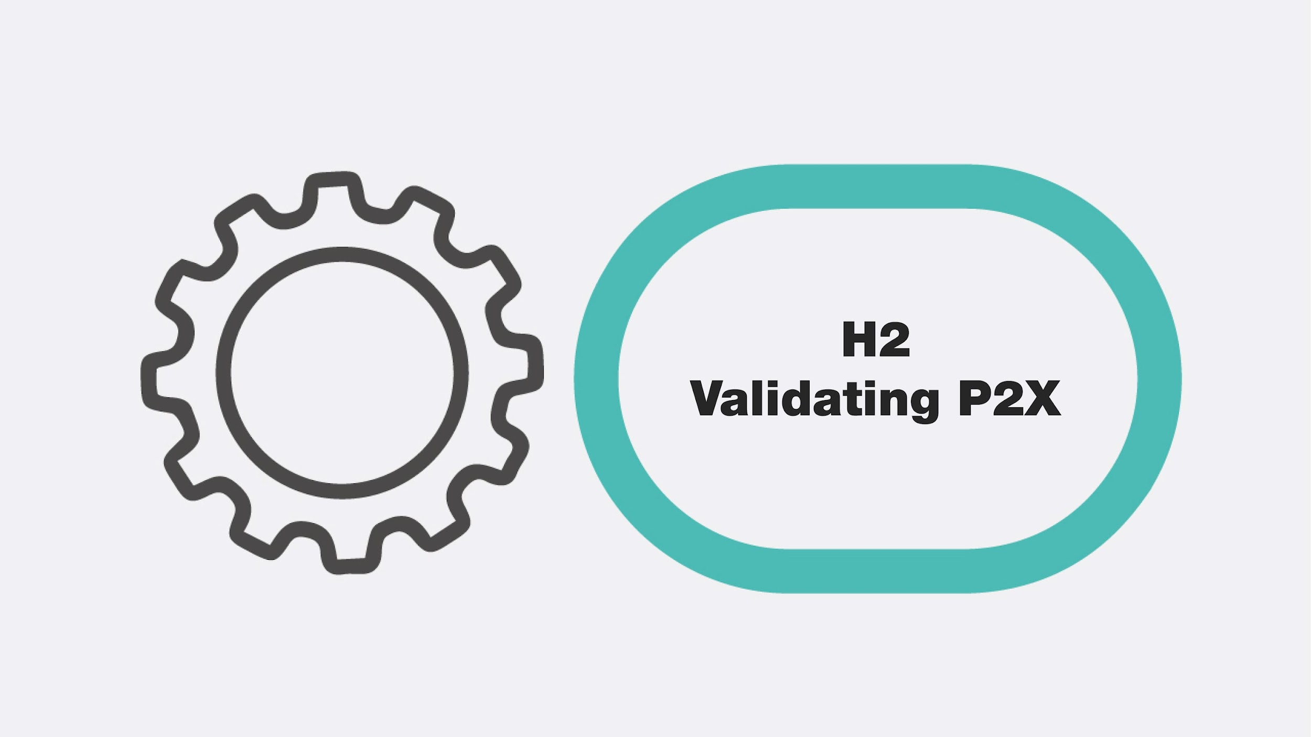
TEXT

Slide 56
TITLE
TEXT

Slide 57
TITLE
TEXT

Slide 58
TITLE
TEXT

Slide 59
TITLE
TEXT

Slide 61
Panel discussion -

Slide 62
Q&A

Slide 63
HYDROGEN IRELAND CONFERENCE 2022
Hydrogen: Securing Ireland’s Green Energy Future
22 - 23 November 2022
https://col.eventsair.com/h2irl-2022/registration/Site/Register

Slide 64
CONCLUSION

