Slide 1
Rhiannon Hunt
Circular Economy Project Manager
Fused Filament Fabrication (FFF) 3D-printing, using recycled
Single Use Plastic (SUP) waste

Slide 2
3D Printing
Key principles
Material is added, layer by layer to create an object
Digital 3D designs are created using Computer Aided Design (CAD) software
Manufacturing can be modelled and the design optimised prior to manufacture
3D designs are sliced using software
Each ‘slice’ represents a 2D layer of the finished product
The layers of a product are created (traced or cured) one on top of another using a 3D printer
Support materials, that are later removed, can be used to stabilise the object as it prints
A range of post-processing options also exist to remove imperfections and improve surface texture

Slide 3
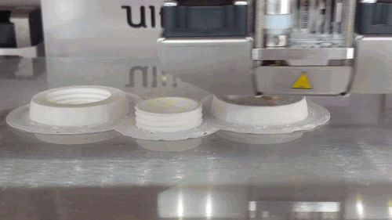
3D Printing
Fused Filament Fabrication

Slide 4
3D Printing
Fused Filament Fabrication
Heat is applied to melt plastic filament, which is forced through a nozzle, tracing each layer of an object
One of the most popular and common additive manufacturing technologies
Low cost and desk top options available
Wide range of (thermoplastic) filament material options (e.g. PLA, ABS, PETG, Nylon)
Specialty (plastic) filaments are available (e.g. conductive, flexible, reinforced)
Equipment and accessories are readily available
Some limitations in terms of print quality, speed and efficiency
Great potential for recycling thermoplastic

Slide 5
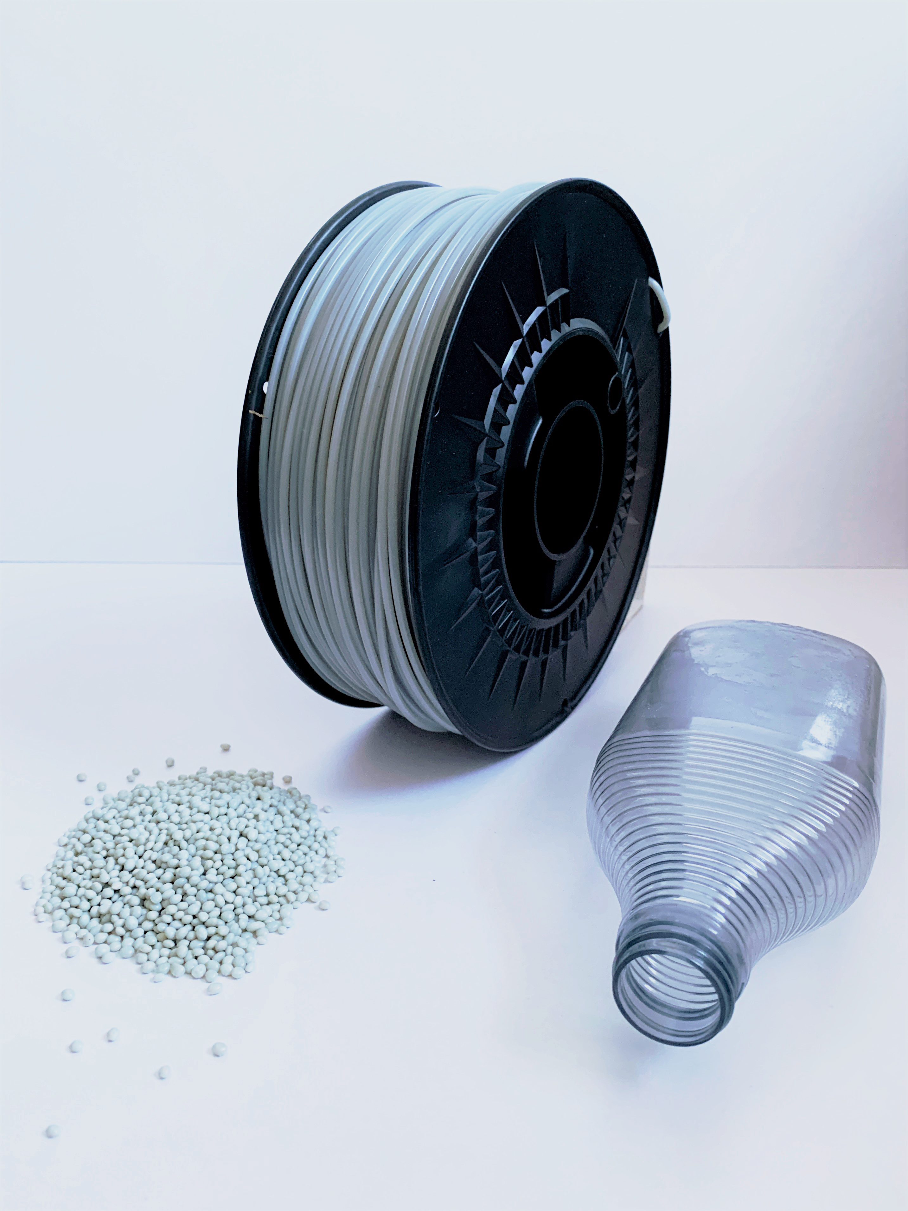
Recycled 3D Printing Filament
Single Use Plastic Waste as a Feedstock
Many Single Use Plastics are high-quality thermoplastic, predominantly PET, PP, HDPE and LDPE
Currently, only ~ 30% are recycled in NWE
The most popular materials for FFF 3D printing are PLA, ABS, PETG, Nylon
TRANSFORM-CE has been working to create recycled FFF 3D printing filaments from SUP plastic waste
The aim is to create a new, circular market for recycled SUP waste materials, increasing their uptake as a feedstock and improving recycling rates

Slide 6
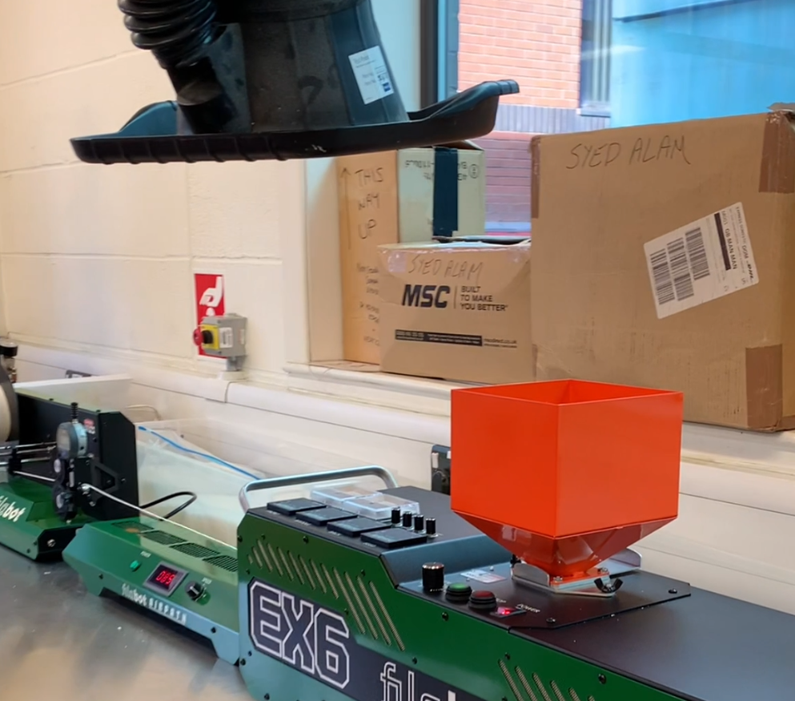
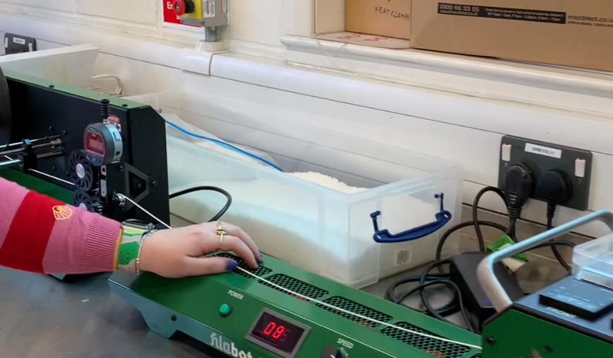
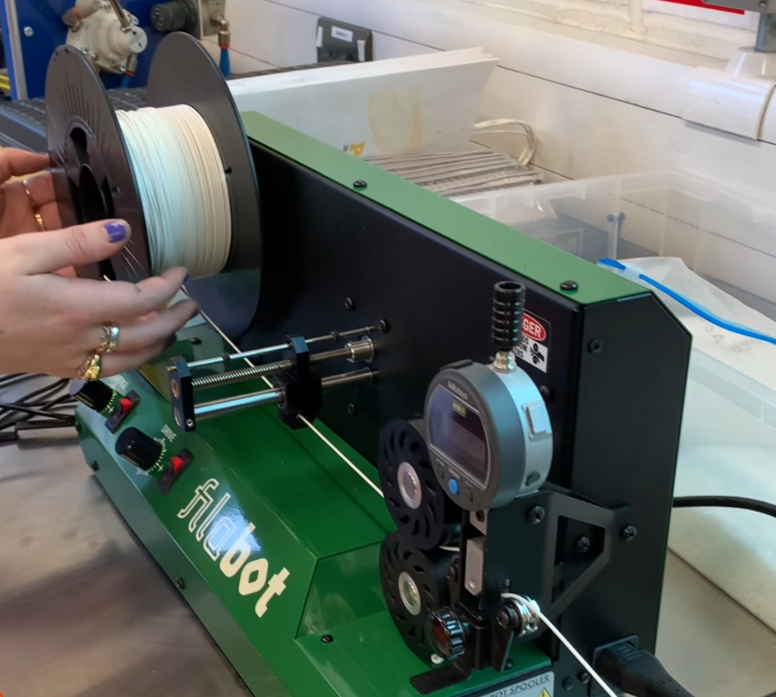
Recycled 3D Printing Filament
Filament Extrusion Process
Flaked or pelletised SUP waste is loaded into the hopper.
The SUP is moved through a heated chamber by a rotating corkscrew, where it begins to melt.
It is then forced through a round die head, creating a long strand of filament, which is cooled by a fan, allowing the SUP to reharden.
The long strand of filament is then wound onto a spool, ready for 3D printing.

Slide 7
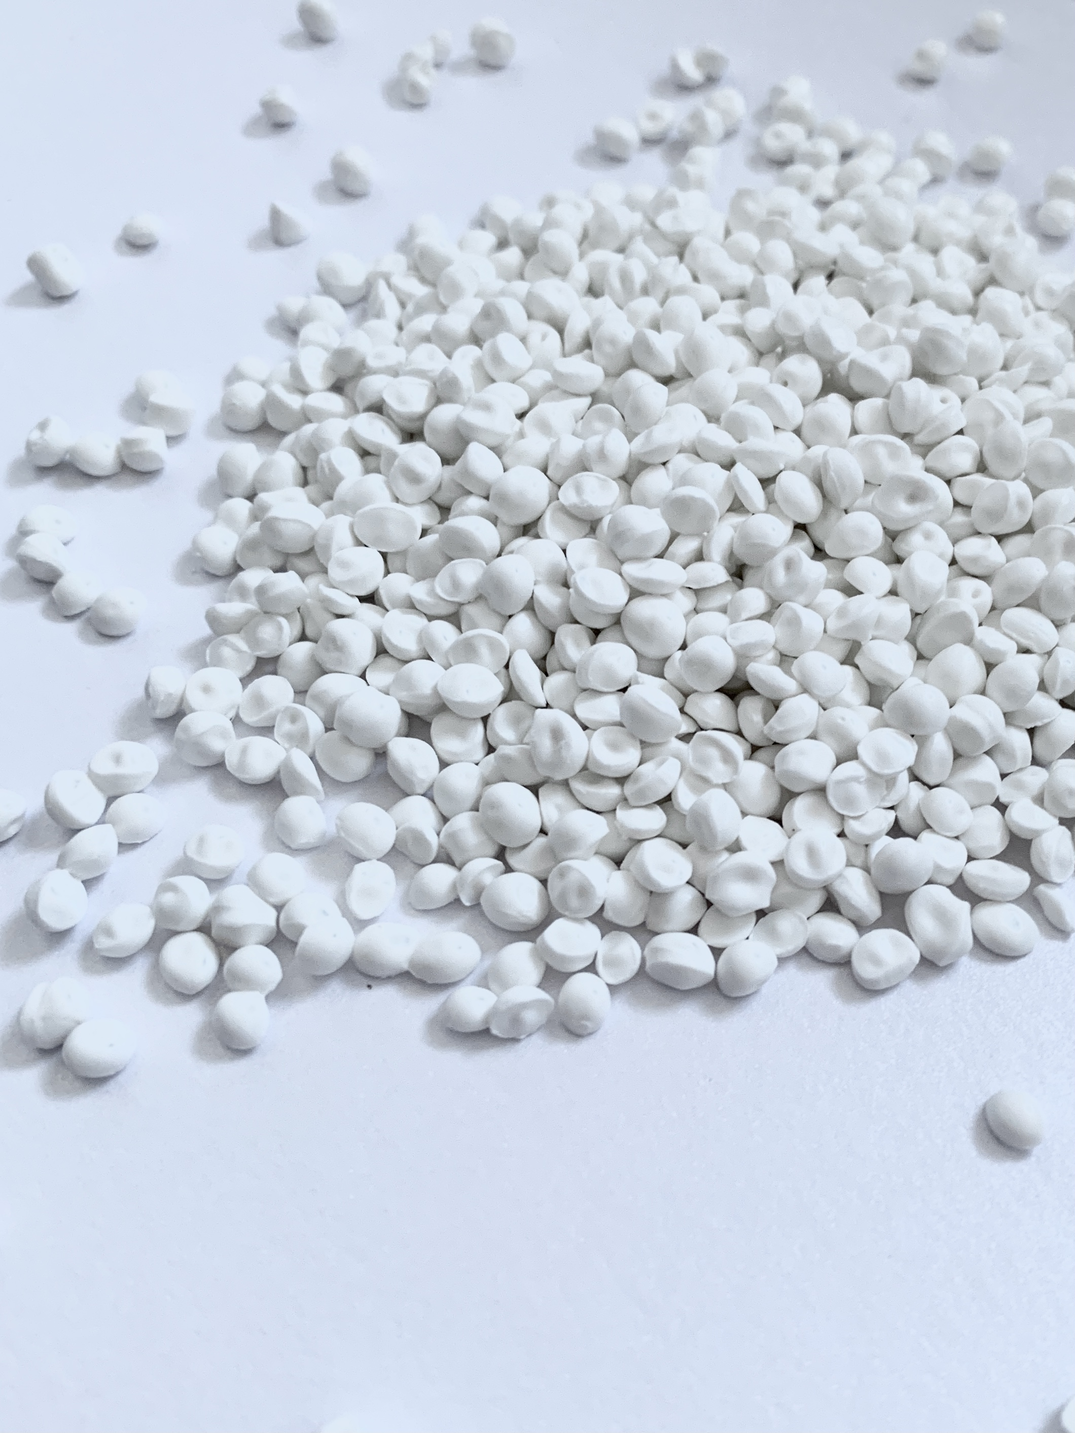
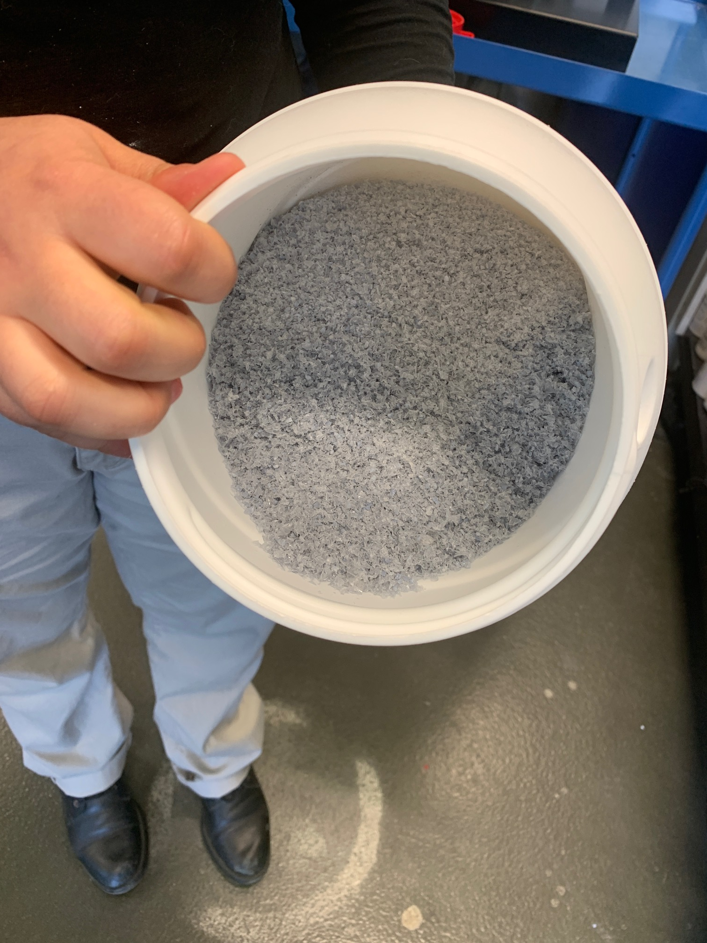
Recycled 3D Printing Filament
Single Use Plastic Waste as a Feedstock
Feedstocks must be clean, dry and broken down into smaller pieces
Can be sourced as recycled pellets or manually shredded SUP waste
Must be single-stream as they have different melting points
Feedstocks and filaments may absorb moisture from the atmosphere. Drying is advised

Slide 8
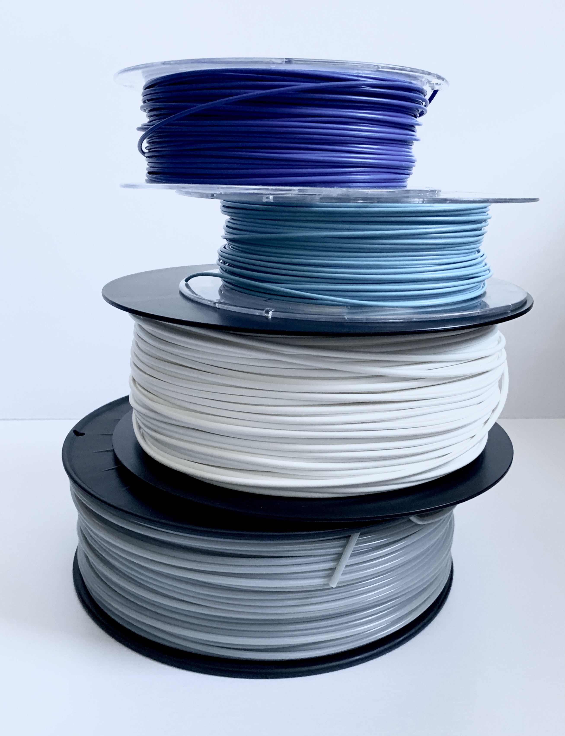
Recycled 3D Printing Filament
Scaling Production
Free 1KG trial spools through TRANSFORM-CE!
Online retailers (typically industrial waste and <% recycled content)
Access small-scale shredding and filament extrusion equipment through ‘maker spaces’ and ‘fab labs’
Invest in small-scale shredder and filament extrusion line ~ £5000
Outsource filament extrusion to a 3rd party
Invest in large-scale filament extrusion equipment

Slide 9

3D Printed Product Design
Rapid Prototyping
From initial concept to physical prototype in a few steps
Minimal time and cost
Create scaled prototypes to test design ideas
Quickly and easily modify designs
Share digital files and collaborate anywhere in the world
Print locally, on demand

Slide 10
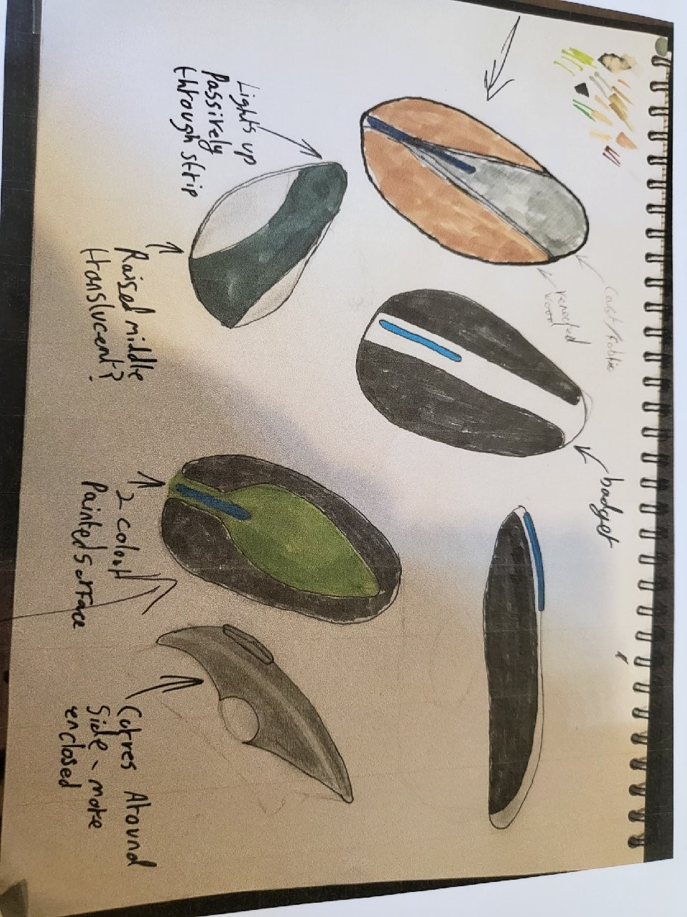
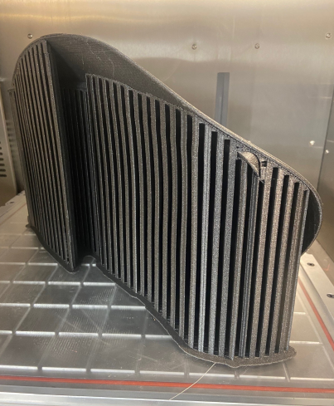
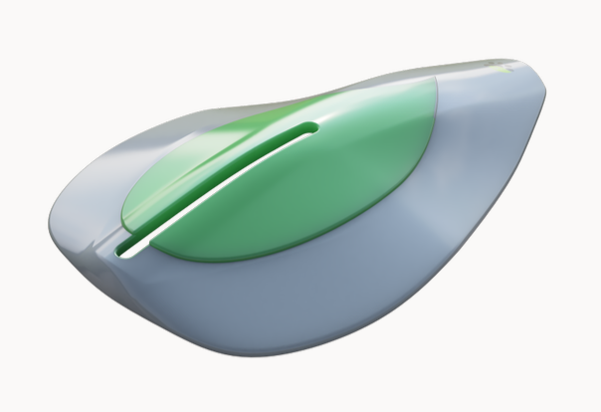
3D Printed Product Design
Rapid Prototyping
Design: Simbarashe Musonza, Student Design Assistant

Slide 11

3D Printed Product Design
Reuse and Repurposing
Create one-off, customised parts
Adapt the design of parts to be compatible with a variety of other parts and products
Facilitate reuse of existing materials and components
Easily manufacture spare parts
Enable the rapid disassembly, reconfiguration and reassembly of products

Slide 12
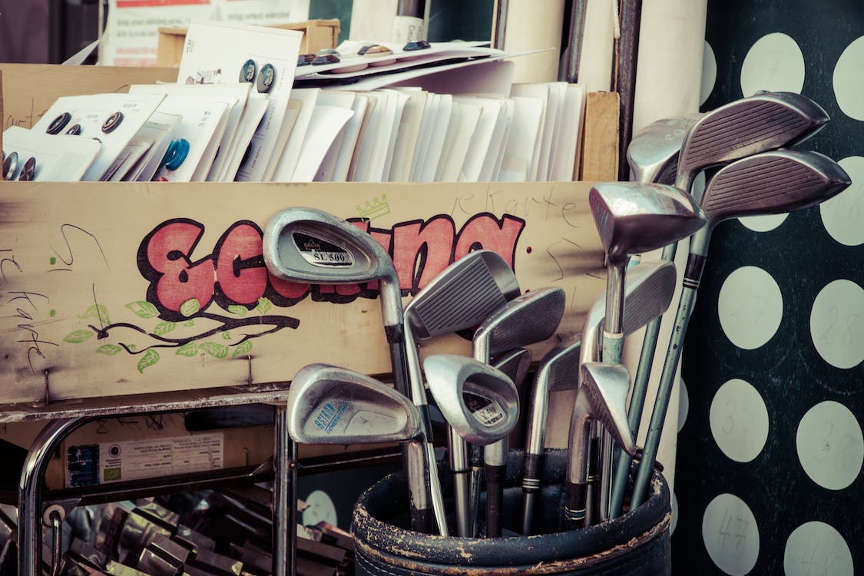
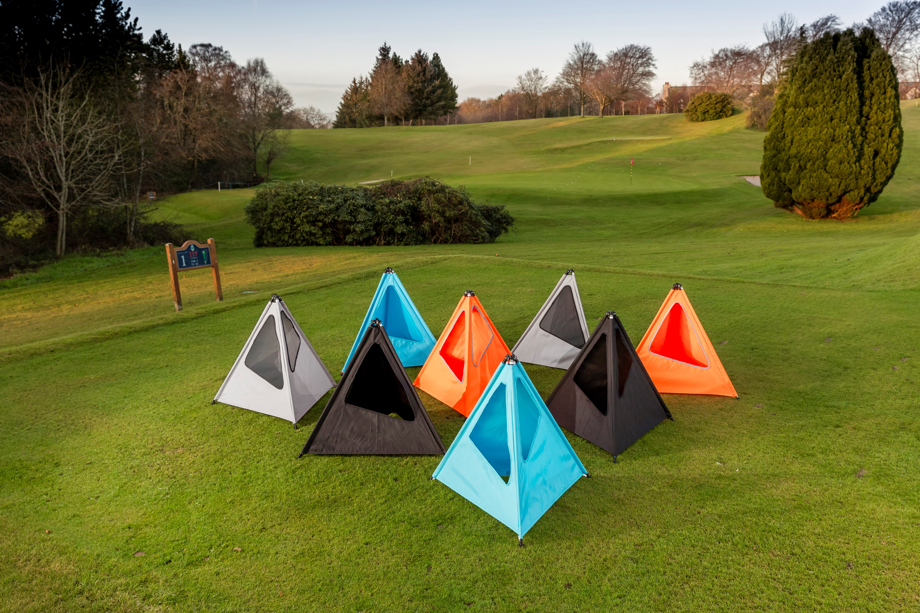
3D Printed Product Design
Reuse and Repurposing
Image: Circulogic

Slide 13
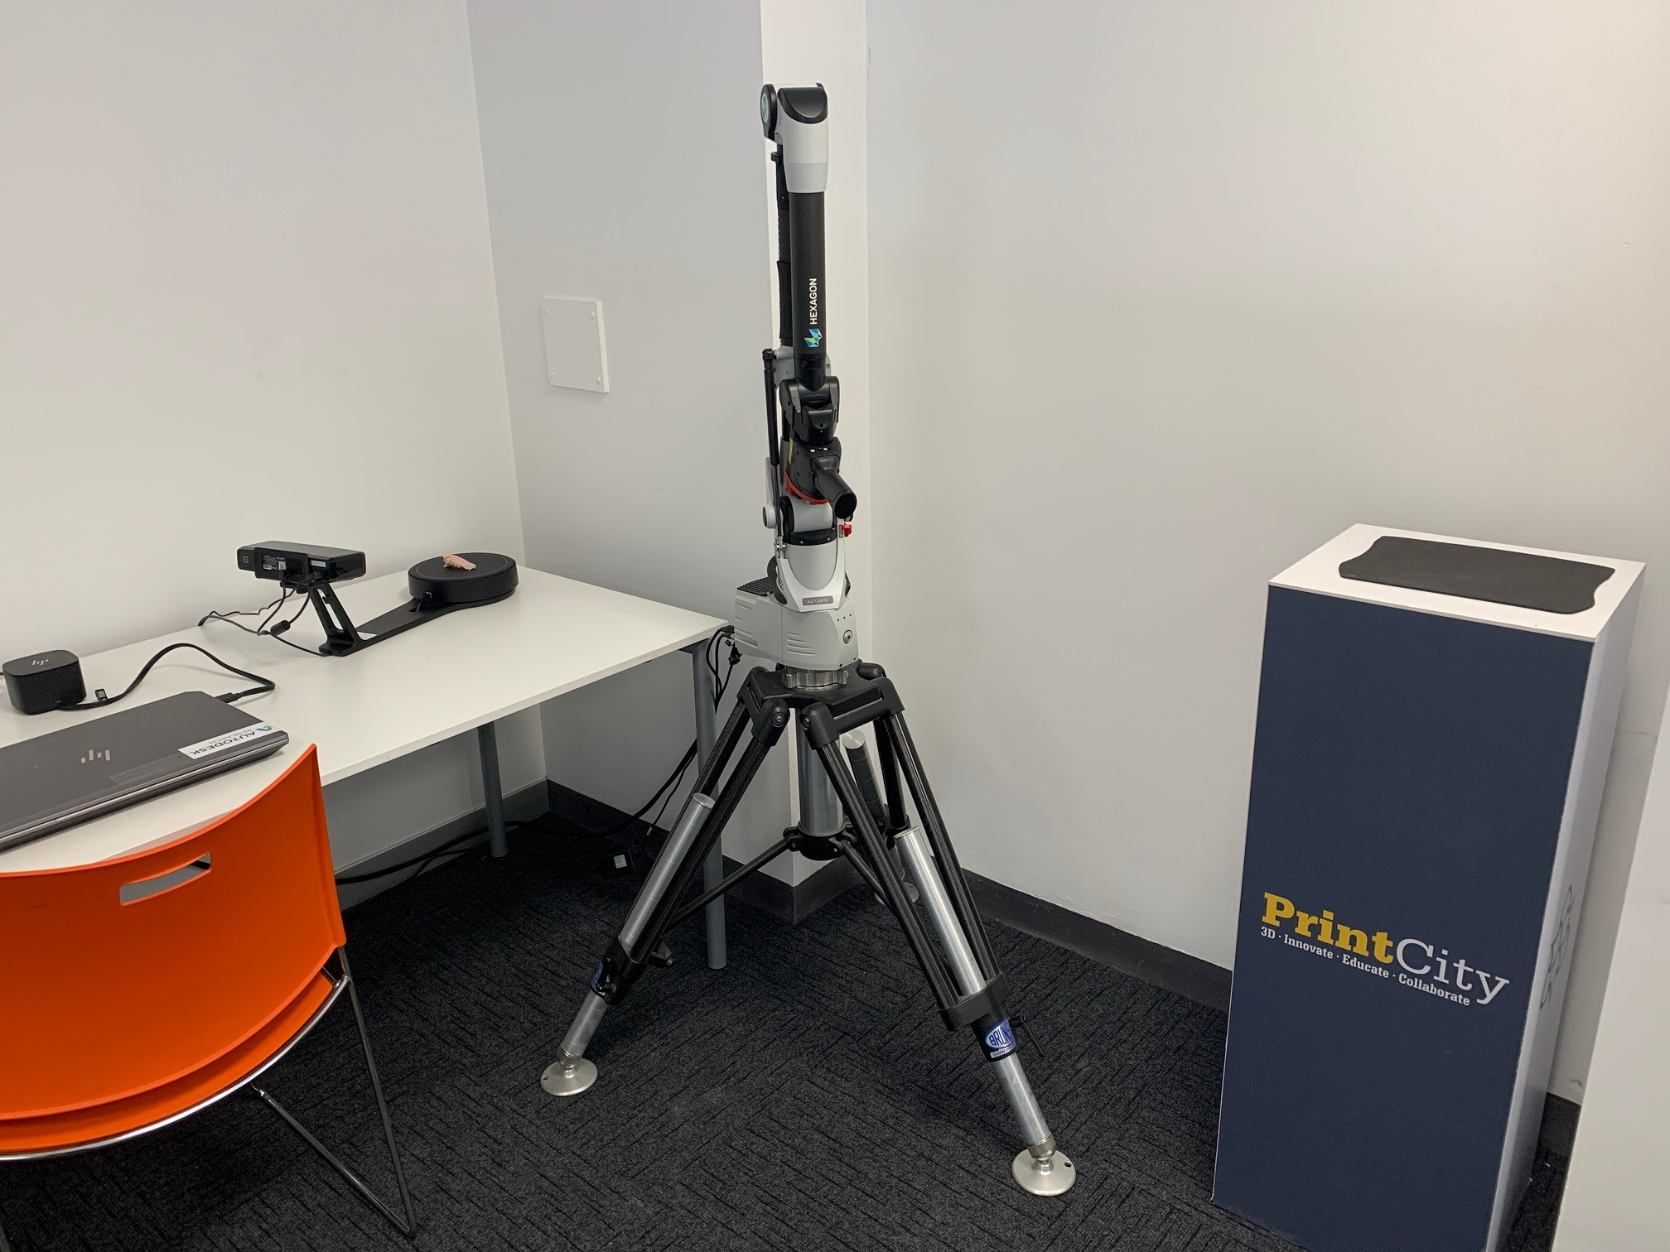
3D Printed Product Design
3D Scanning
Generate designs from everyday objects and items, both organic and manmade
Rapidly replicate existing parts and products
Create accurate parts to be retrofitted to existing products
Especially useful when accuracy is important
Many potential applications, from engineering to dentistry

Slide 14
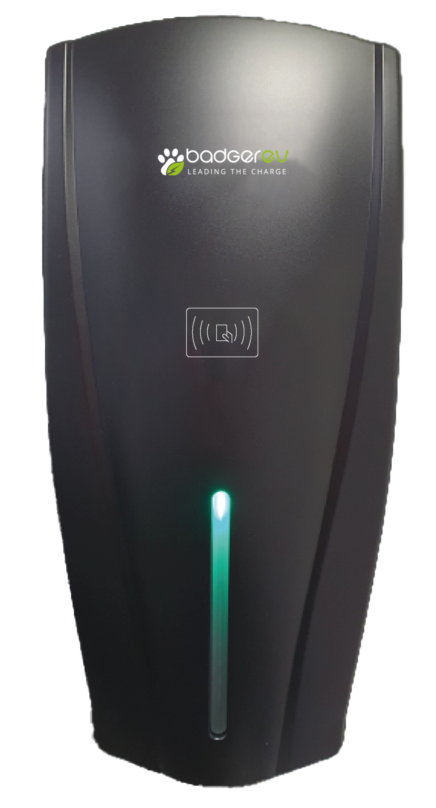
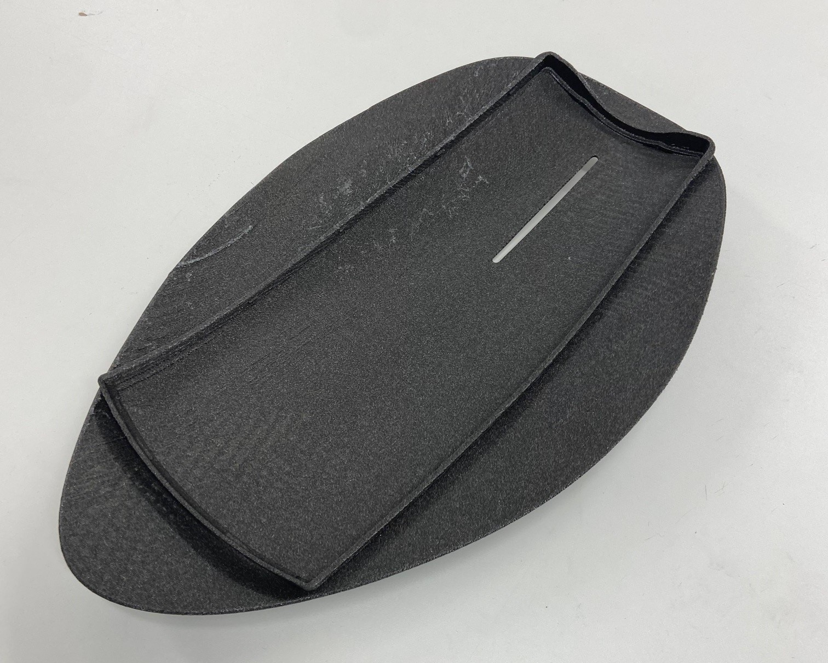
3D Printed Product Design
3D Scanning
Image: Badger EV
Design: Simbarashe Musonza, Student Design Assistant

Slide 15
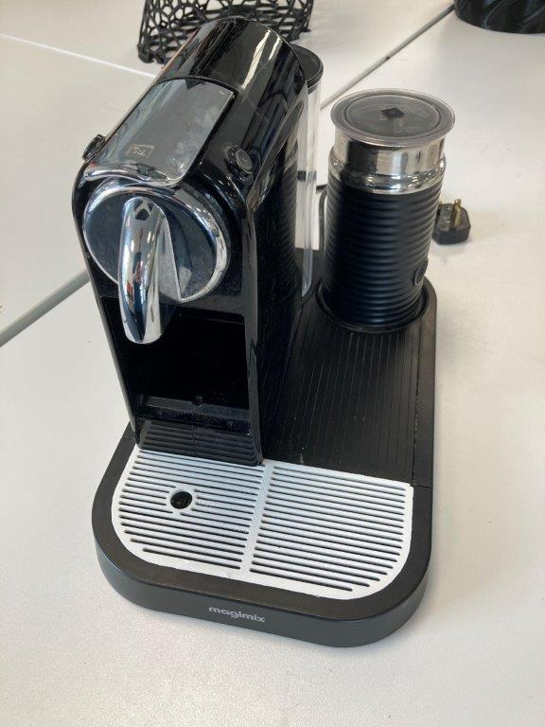
3D Printed Product Design
Repair and Upgrade
Create spare parts to replace broken ones
Facilitate affordable, on-demand repair
Opportunities to redesign and upgrade parts that commonly break
May help businesses to meet consumer expectations and growing legislative requirements as part of the ‘Right to Repair’ movement.

Slide 16
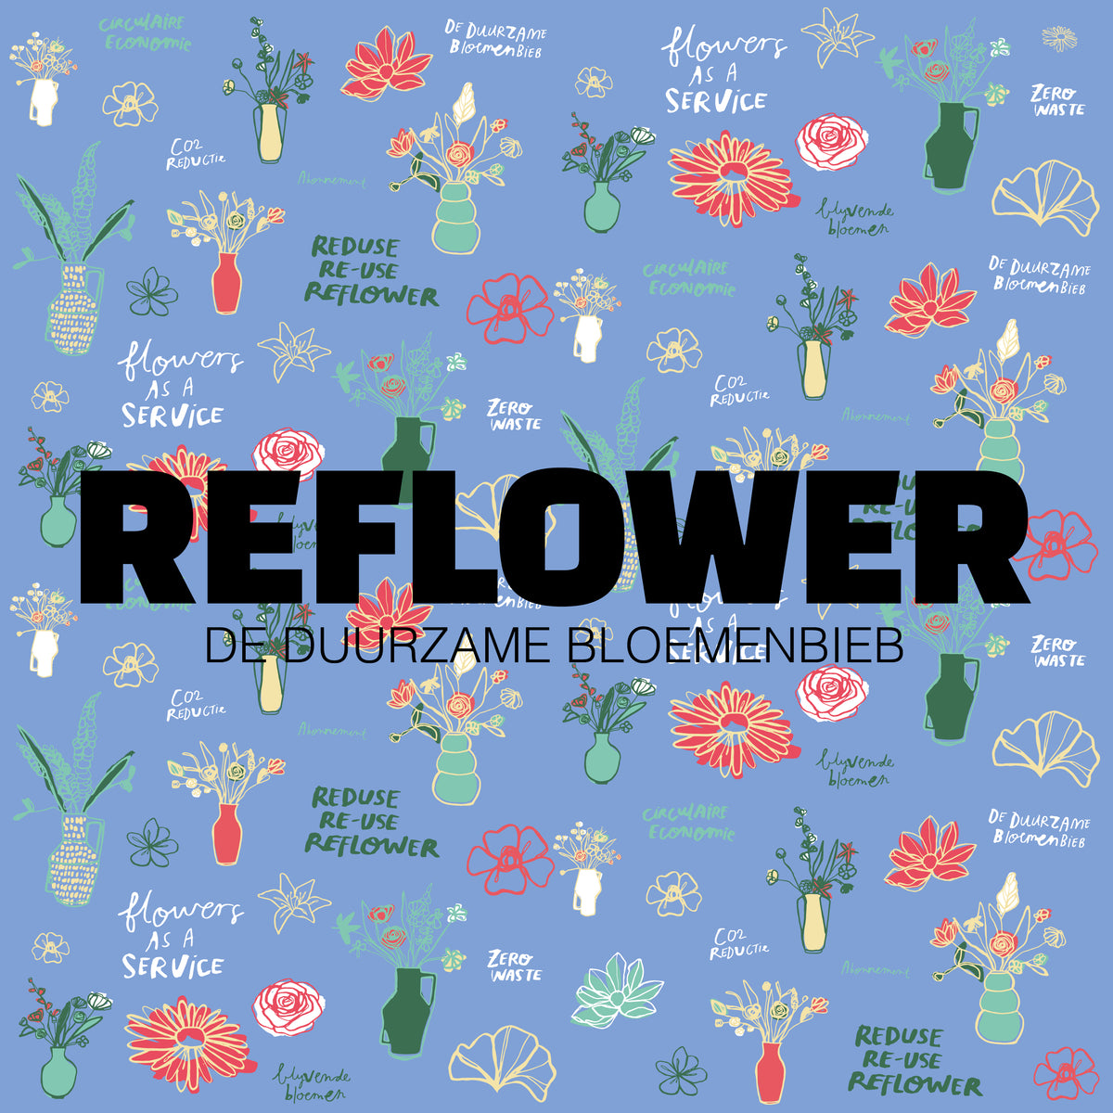
3D Printed Product Design
Unique Geometries and Custom Designs
Create structures not possible by other manufacturing processes
Hollow and nested designs are both possible with additive manufacture
Custom designs can be tailored to individual needs and tastes
Intricate surface patterns can be created rapidly and with a high level of accuracy

Slide 17
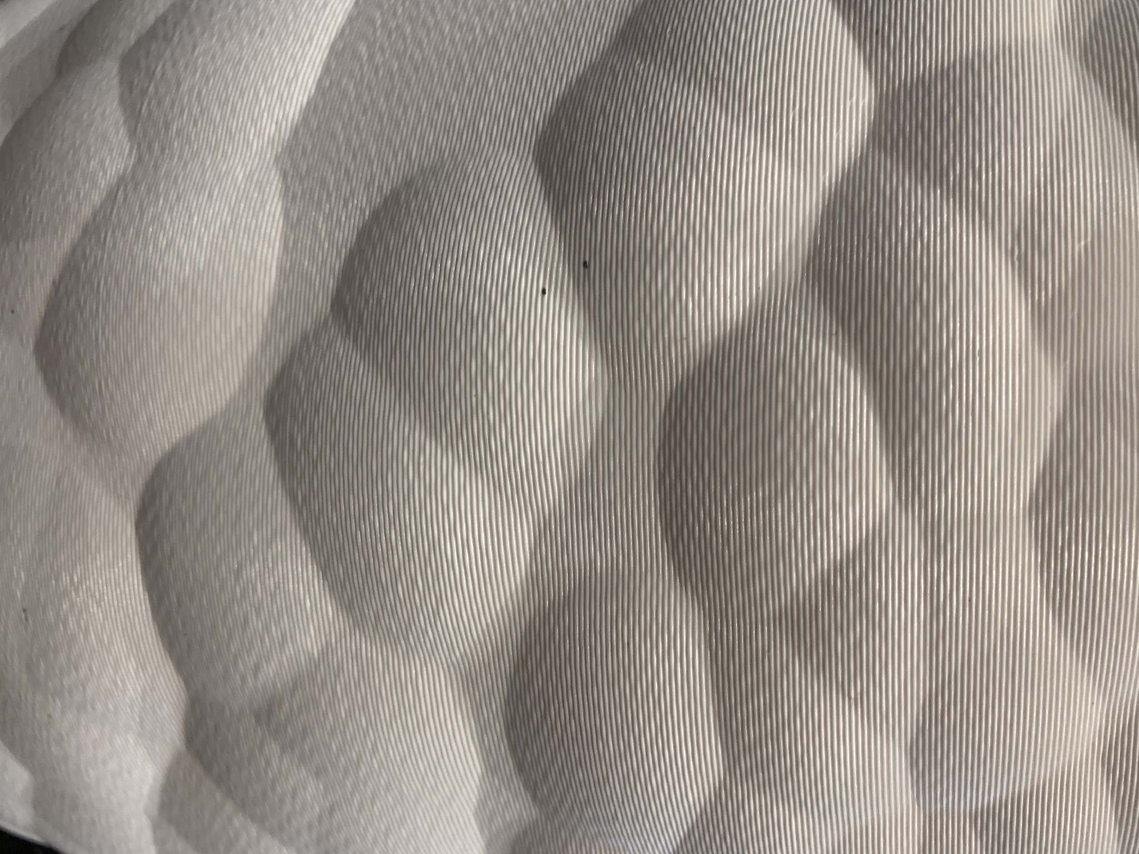
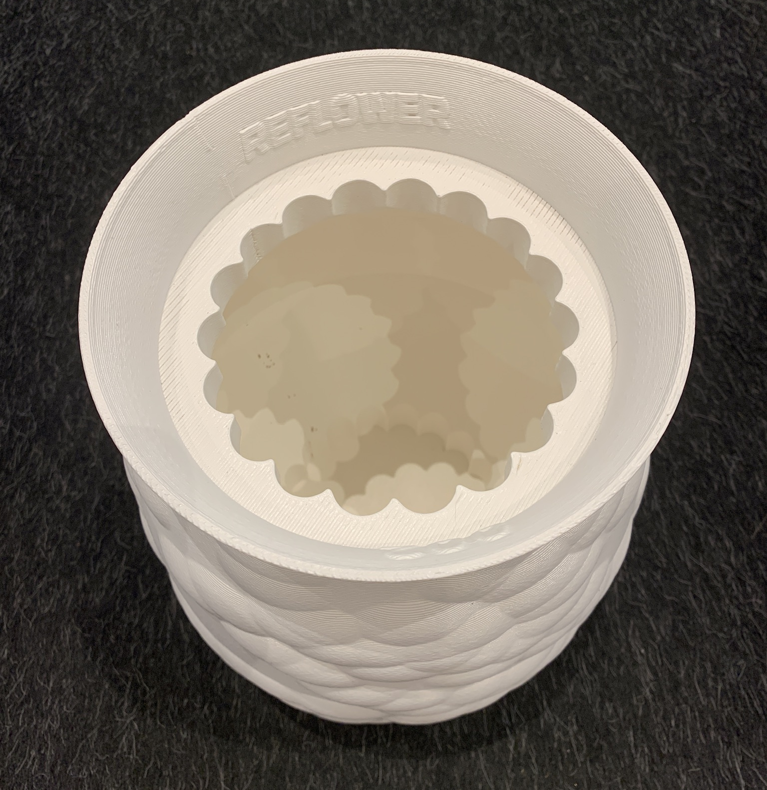
3D Printed Product Design
Unique Geometries and Custom Designs
Design: REFLOWER

Slide 18
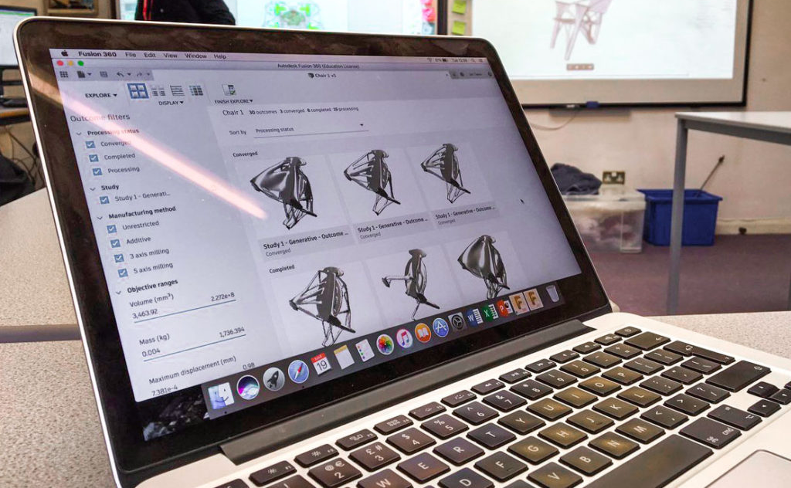
3D Printed Product Design
Generative Design & Light-Weighting
Set key parameters and criteria for your design
Rapidly generate hundreds of design variations
Solid structures can be light-weighted by integrating a honeycomb in-fill within the design
Achieve the same performance with less material
Reduce material consumption and improve efficiency

Slide 19
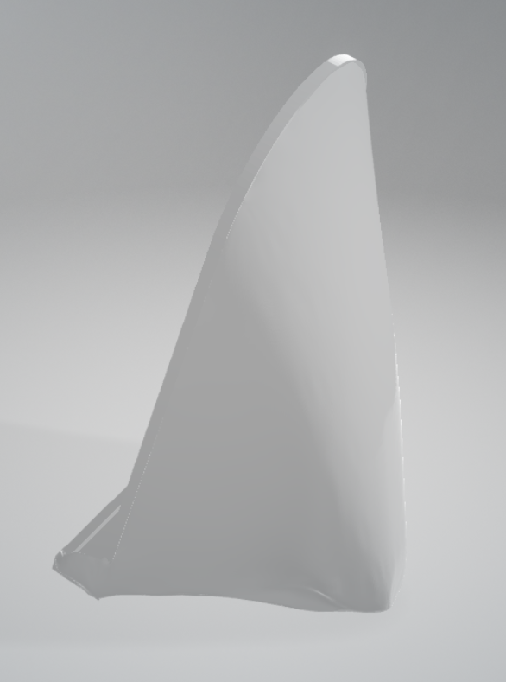
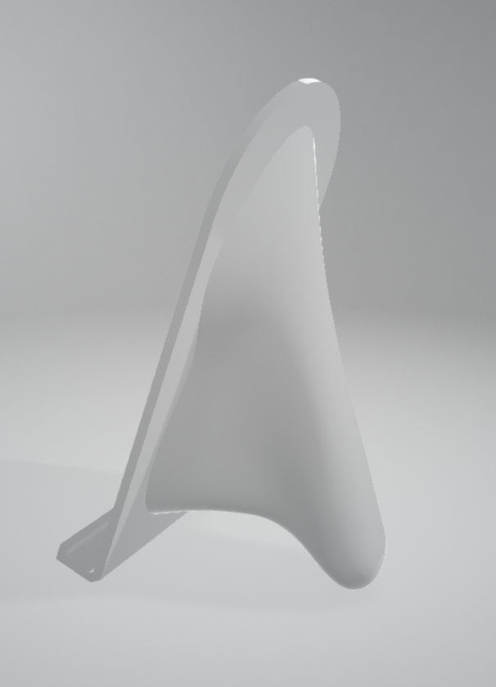
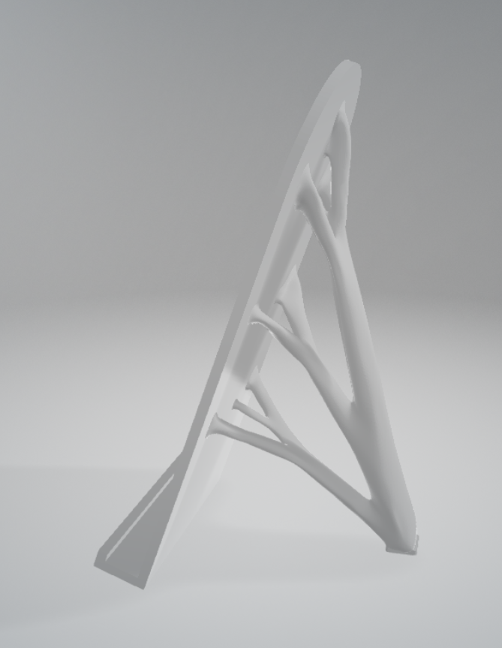
3D Printed Product Design
Generative design & Light-weighting
Design: Simbarashe Musonza, Student Design Assistant
Notes:
The Recycling Process
Post-consumer, single-use-plastic is collected
Sorted by material and colour
Shredded
Washed and cleaned
Pelletised
The pellets are then dried
Additives may be blended with the pellets
The blended material is extruded into filament and wound onto a spool

Slide 20
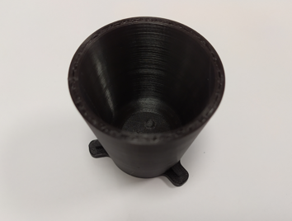
3D Printed Product Design
Bespoke Filaments
Customise the look, texture and functionality of filaments
Print functional parts and products with added performance capabilities
Integrate circuitry into products by 3D printing a combination of conductive and non-conductive filaments
Simplify the end-of-life recycling of complex products with bespoke filaments that can be recycled multiple times
Notes:
The Recycling Process
Post-consumer, single-use-plastic is collected
Sorted by material and colour
Shredded
Washed and cleaned
Pelletised
The pellets are then dried
Additives may be blended with the pellets
The blended material is extruded into filament and wound onto a spool

Slide 21
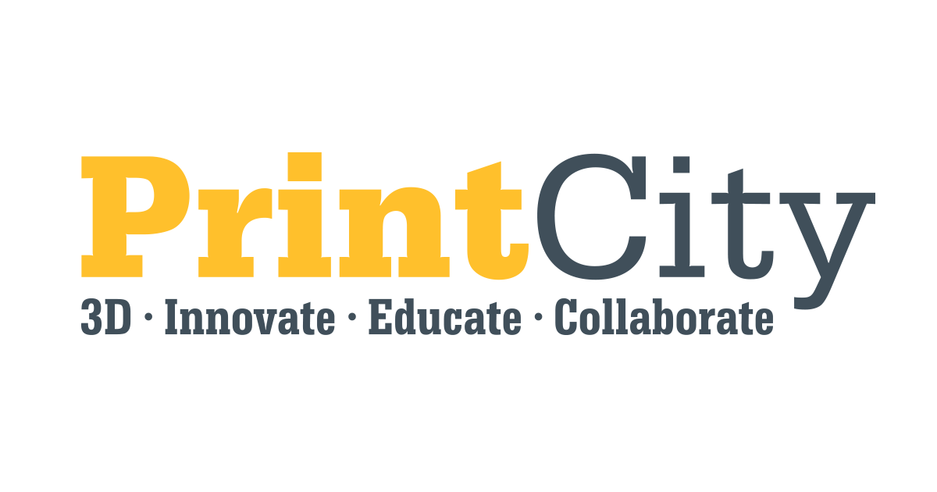

Please send enquiries to:
circulareconomy@mmu.ac.uk

