Slide 1
GenComm
INFORM EU network
Evora, Portugal.
17th November 2022
Place image in this area.

Slide 2
AGENDA
GenComm project dates, outline, aims and communications
Building on the Basics
Bringing cooperation to a new level
Accessing all areas
Communications cohesion
Carpe Diem – seizing the moment
Alignment
Reaction
Reach, Impact & Evaluation
Additionality
Conclusion

Slide 3
GenComm Key Dates
GenComm
Submitted 19th Dec 2016
Started 16th March 2017
Original End Date 14th September 2019 – Extended 14th September 2021
Budget €9,39 M
GenComm Capitalisation Call
Submitted 10th April 2021
Stared 12th July 2021
End date 30th September 2023
GENerating energy secure COMMunities. Smart Hydrogen - Integrated renewable energy, generation & storage. To develop a new model for exploiting remotely generated electricity from renewable sources to provide energy security for remote communities.
Project timeline 7 years – how our world has changed in 7 years

Slide 4
GenComm Objective & Baseline
GENCOMM will technically and financially validate and model the renewable H2 value chain and adapt it to a Decision Support Tool (DST) that leads NWE communities into sustainable, local and autonomous energy matrixes. The DST is directed to community energy stakeholders (utilities, policy-makers and private firms in the energy sector), as the key agents to implement the proposed matrix. The project will first engage energetically and territorial remote communities to then address the rest of NWE
The aggregated renewable energy share of NWE is 8,9%, with Wind, Solar and Bioenergy as main sources. All NWE countries are in track to meet their NREAPs 2020 goals in electricity and heating, but are behind in their transportation goals. Also, further uptake of renewable sources, beyond 2020, is stalled due to lack of: energy storage, flexibility and dispatchability. Despite confronting these issues, H2 for energy usage in NEW by all sectors is under 1% and is not present in future scenarios.

Slide 5
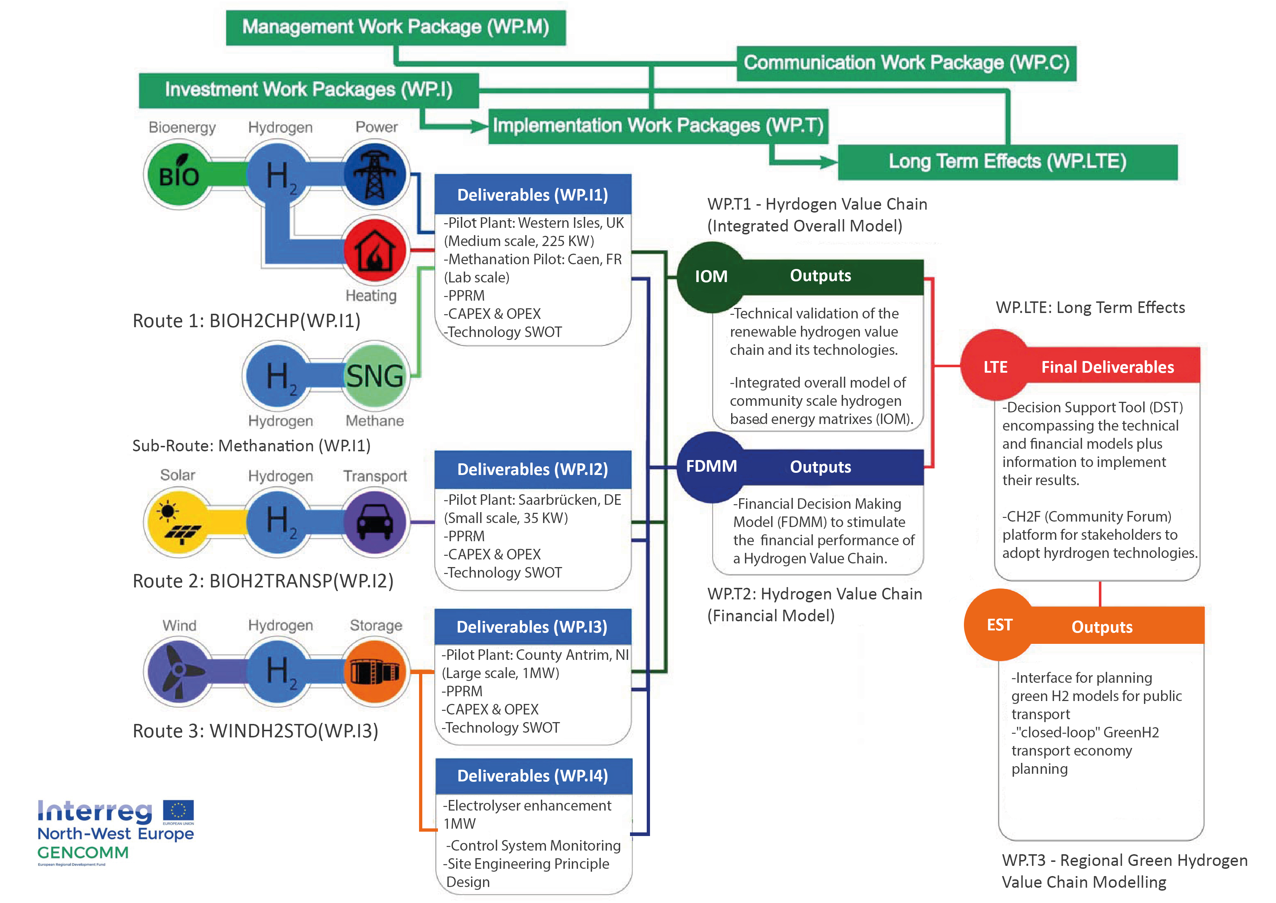
GenComm Value Chain
GenComm Steering Committee Meeting #21 - 17th May 2022
Notes:
Rural and isolated communities in NWE face unique energy issues related to efficiency, reliability and sustainability. This is commonly due to dependency on external and fossil fuel energy supply, low electricity grid capacity and limited or no connection to wider grids. As a result these communities have higher than average carbon emissions and are more vulnerable to fluctuating fuel prices.

Slide 6
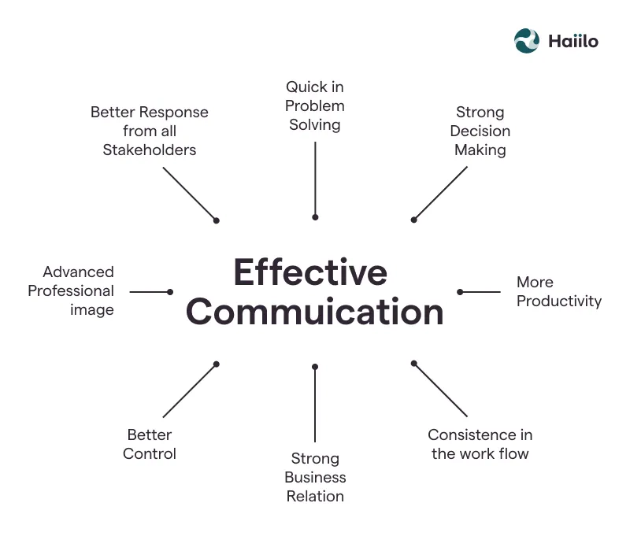
Building on the Basics
The foundation a solid communications plan
Quarterly Newsletters
Quarterly Meetings
2 day events
Day 1 closed session
Day 2 open Session
Full PR and comms associated
Periodicals
White papers
Integrated engagement
Policy and lobbying plans integrated
Agility and proactive

Slide 7
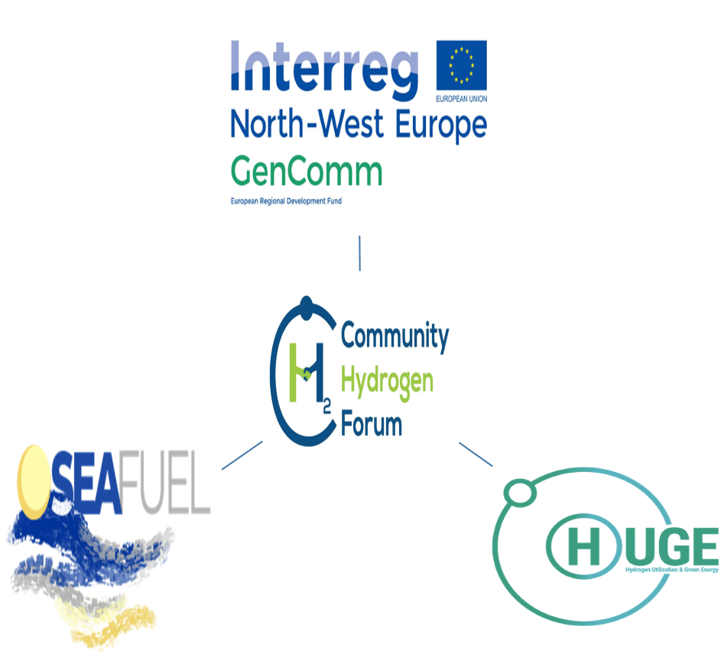
Bringing Cooperation to a new level
Cooperation should be at the heart of the project and should be visible throughout every stage of the project. The partnership is required to describe their approach to cooperation and explain how intensely they will cooperate in order to deliver the project and achieve its overall results.
In order to be eligible, projects must meet the 4 criteria ‘ joint development’, ‘ joint implementation’, ‘ joint staffing’ and ‘ joint financing’ in the cooperation intensity table of the Application Form in STEP 1 and STEP 2.
H2 Congregation

Slide 8
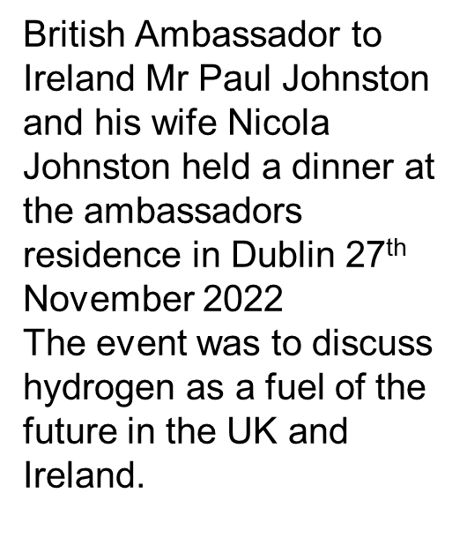
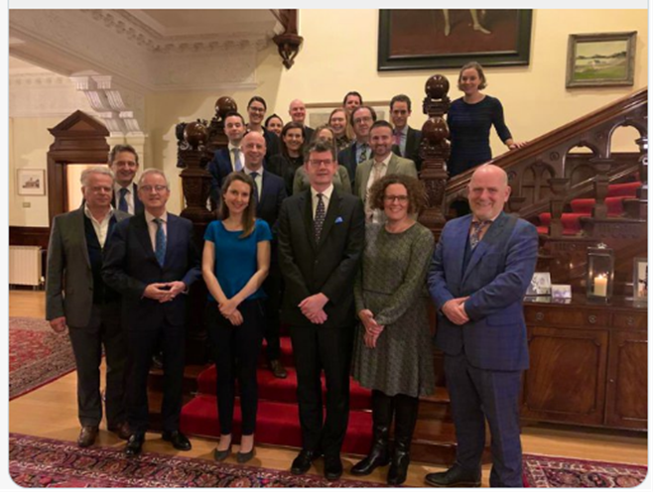
Accessing all areas - INFLUENCE

Slide 9
H2CAT
Communications Cohesion
The catalyst for H2 - powering hydrogen innovation, entrepreneurship and deployment
Working in Government Departments and other stakeholders the centre will inform, support and drive the commercial scale up: Hydrogen, Carbon Capture, Utilisation and Storage (CCUS), Renewables, Waste to energy, Biofuels, Green natural gas

Slide 10
Green H2 Hub
H2 hub
Inspire
Innovate
Invest
Instil
FE application - Green H2 Hub Belfast Met.
Skills pillar of the H2 CAT.
Cohesion with HE
Continuous pathway for skills development - reinforced with R&D.
Belfast Met with HE partners and major industrial in the green hydrogen supply chain to develop the Hydrogen Skills Alliance.
The H2 Skills Alliance will collaborate in assessing the readiness of NI industry to access the supply chain, to support green hydrogen projects and highlight the potential economic value.
The H2 Skills Alliance will also show the potential for green, sustainable skills and high-value jobs emerging from a future hydrogen sector, using live projects as case studies.

Slide 11
Hydrogen Training Academy
Prime example of project financial engineering
L2 and L3 - NRC and Belfast
L4 and L5 - Know Hy - CAF
Train the trainer - Know Hy -
L5 and above - QUB
PGCE - QUB and Belfast Met
L2 and L3 BMet/NRC
L4 and L5 BMet/NRC
Train the Trainer M&EA
L5 and L6 QUB
PGCE QUB

Slide 12
H2 CAT NI - Affirmative Action
8 Steps to H2ZERO
Utilise Green H2 as an energy vector - this will be a key enabler in reaching Net Zero: 60 Gt of carbon emissions could be saved between 2021-50 (EU emission are ~2.5 Gt/y).
Deliver a paradigm shift to boost the uptake of Green H2 : we need to move from today's 90 Mt unabated hydrogen to 530 Mt low-carbon hydrogen by 2050.
Legislators and policy-makers need to take leading roles in Green H2 demand creation, setting the right set of regulations and channelling investments into R&D and hydrogen supply projects.
Repurpose existing infrastructure in the transition to net zero. Use the gas infrastructure can act as a catalyst in the deployment of low-carbon hydrogen: in the early stages via blending.
Widen the route to net zero -optimise every energy stage and opportunity on the route including biomethane, the 40 shades of hydrogen and other ‘lower carbon’ energy transition opportunities.
Scale up innovation and demonstration, especially in end-use technologies, key to unlock the true potential of hydrogen.
Develop the skills and training pathways to stimulate and support the deployment of hydrogen technologies and enable business’ to pivot to the new H2 economy.
Market stimuli - short term economic business cases for industry as well individual use of Green H2.

Slide 13
Carpe Diem
November 28, 2019 Hydrogen & Alternative Low-Emission Fuels Seminar
July 1, 2020 Hydrogen getting the green light - driving Europe's green recovery
Webinar Series 1 HAZEL – Hydrogen Enabled Zero Emission Supply Chains
September 22, 2020 ‘Industrial Sector Coupling using a Connected eH2 cycle’.
October 6, 2020 Hydrogen Sustainability-H2 DXNET-Hydrogen injection into natural gas distribution networks
October 20, 2020 H2 Safety, analysis, measurements and applications
November 3, 2020 H2 Application and Use-Hydrogen in a net zero energy system and H2 powered hybrid heat pumps.
November 17, 2020 Marketable hydrogen innovations-innovation and entrepreneurship
November 11, 2020 Hydrogen – Exploring opportunities in the Northern Ireland Energy Transition webinar
January 13, 2021 H2 Triple Alliance webinar
Webinar Series 2 SMARTH2 – hydrogen optimisation
March 18, 2021 Hydrogen Optimisation webinar
April 15, 2021 Green H2 Supply Webinar
April 29, 2021 Hydrogen Opportunities emanating from energy transition webinar
May 18, 2021 Hydrogen demand, use and future production webinar
May 27, 2021 H2 Stakeholder Engagement webinar
November 11th 2021 TEDX Green hydrogen can be a West of Ireland solution to a global problem

Slide 14
EUSEW 2022
Alignment
The commodification of Green H2 for Europe
Europe faces multiple pressures to decarbonise economies and to accelerate the integration of greater renewable energy sources into our energy systems.
H2 - vectors of change for the energy industry
Hydrogen is a versatile energy vector that can circumnavigate many decarbonisation obstacles but in doing so, it has many challenges to become universally accepted and utilised

Slide 15
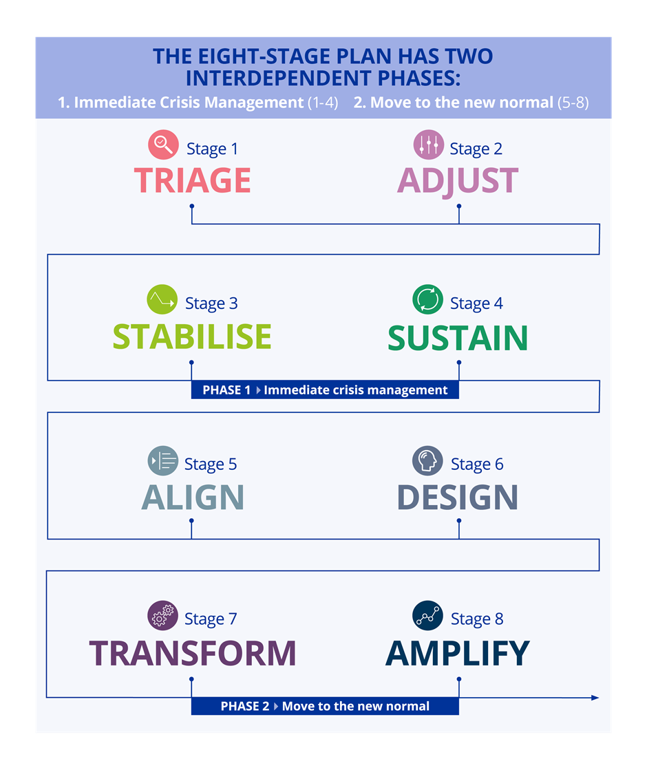
Reaction
The GenComm COVID-19 ‘mission critical’ platform detailing how we can continue to deliver on all project aims, objectives and outputs. We will also capture how we are continuing to employ innovation and digitalisation processes to explore capabilities, identify gaps, strengths and weaknesses and importantly identify potential differentiators to maximise the project deliverables for all.

Slide 16
Hydrogen Triple Alliance

Slide 17
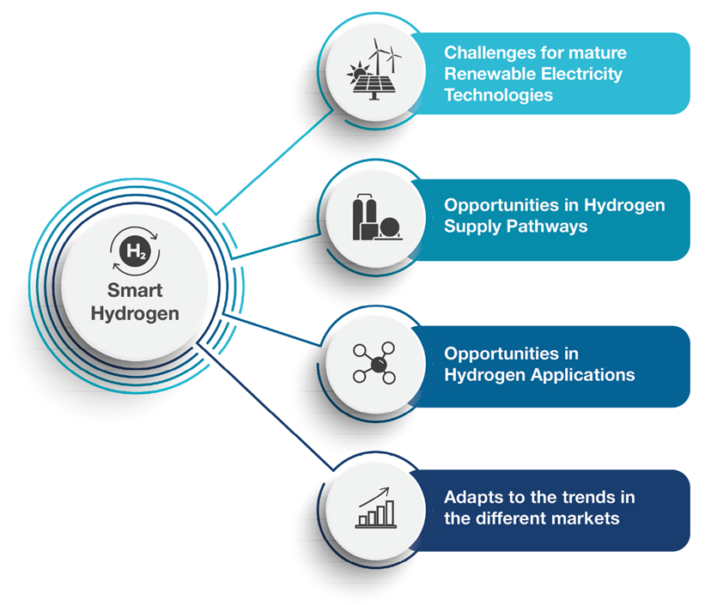
NETWORKS

Slide 18
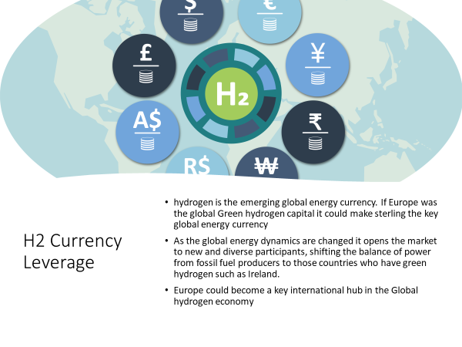
Reach Impact & Evaluation
28 newsletters
55 periodicals
60 articles
100 contributions
40 think pieces
55 community outreach sessions
25 School presentations
Curriculum development

Slide 19
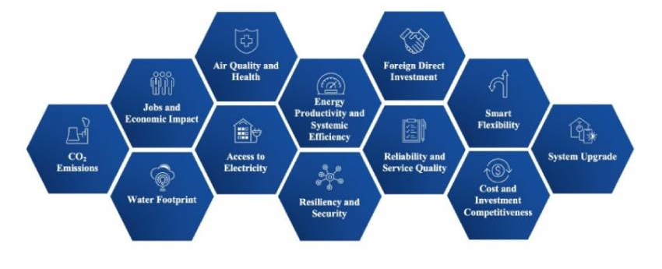
H2 Transition Opportunities
Reach Impact & Evaluation
As Europe transitions to net zero, position NI as the lead in clean hydrogen trade Accelerate our current EU clean hydrogen journey
Develop increased additional links with BEIS
Stimulate increased Green H2 awareness and demand and ‘position’ that all transactions are carried out in sterling.
Progress the H2 CAT model, transition NI towards a climate-neutral and more resilient economy
Expand our work to include digitalization and implementing a well-thought-out circular economy model.
The recovery post COVID is predicated on the Green Economy and Digitalisation.

Slide 20
BEYOND THE TRADITIONAL

Slide 21
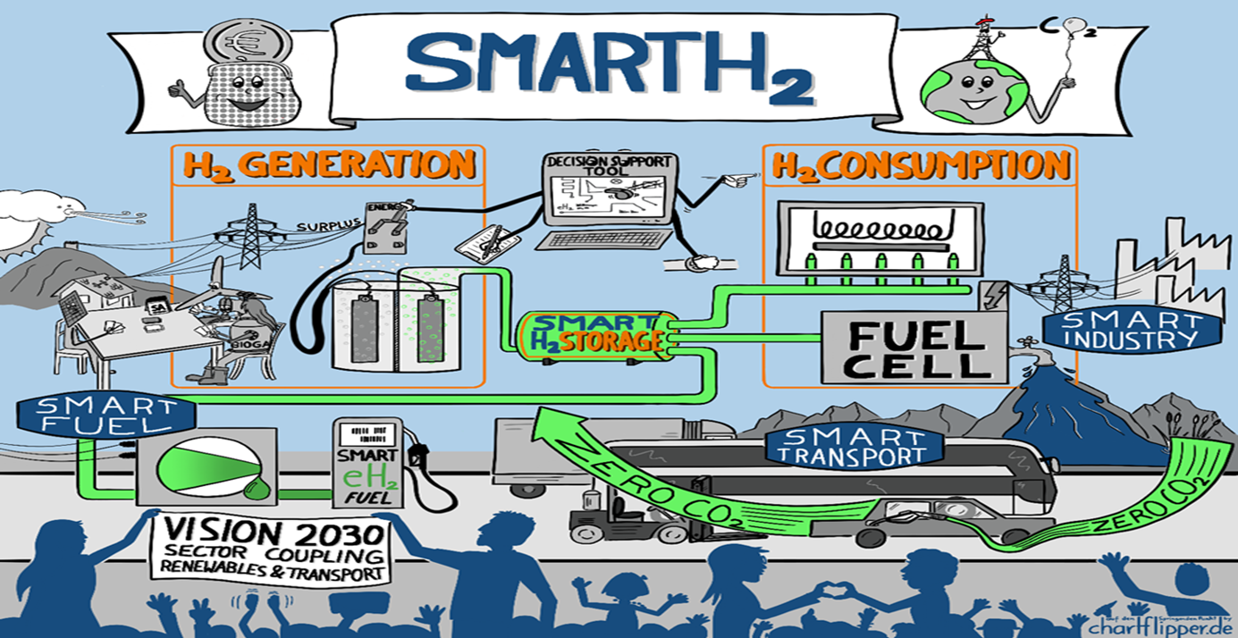
Additionality

Slide 22
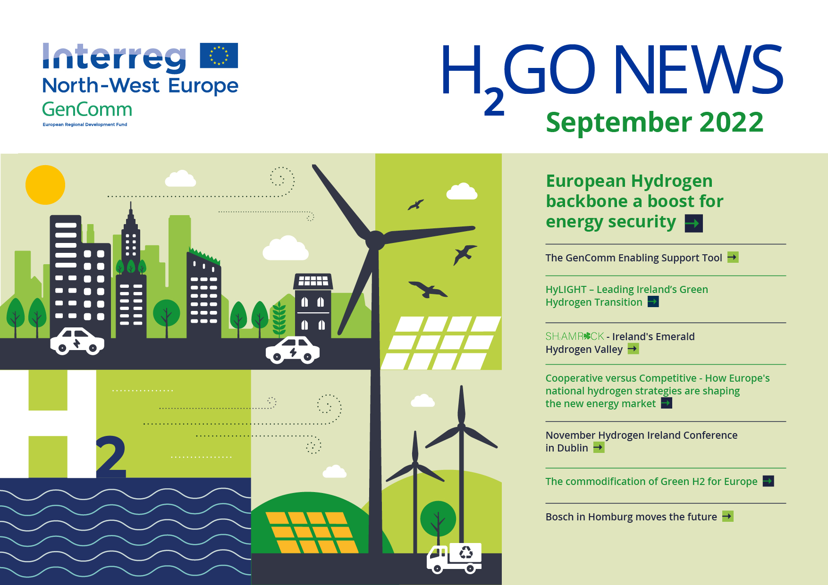
DIGITAL FIRST

Slide 23
SHARED PATHWAY

Slide 24
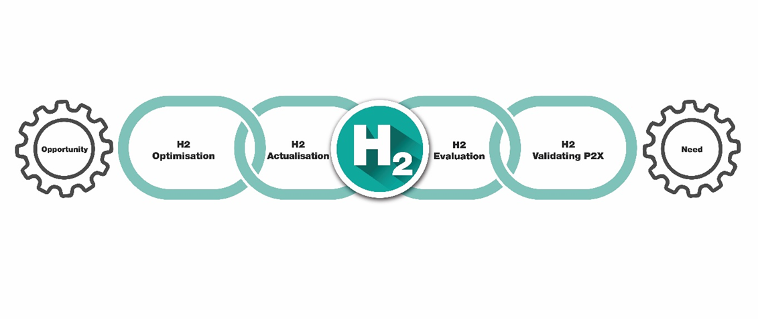
Optimalisation
The 4-Stage Green H2 Commodification Value Chain

Slide 25
CONCLUSION
For communications to be successful they must be agile, responsive, proactive, inclusive and assertive.
GenComm features an open communication link while not being overbearing. But empowers all partners to express their own needs, desires, ideas and feelings, while also considering the needs of others.

Slide 26
Contact details and media links
GenComm Website nweurope.eu/gencomm
GenComm LinkedIn GenComm
GenComm twitter @GenComm_CH2F
Community Hydrogen Forum www.communityh2.eu
GenComm Animation
https://vimeo.com/366993950/91cafb0bb6
E-mail - PaulMcCormack@belfastmet.ac.uk

