Slide 1



GenComm
EUSEW 2022
27th September 2022
The Commodification of Green Hydrogen
Place image in this area.

Slide 2
AGENDA
1.Setting the scene (15 min):
Bart Biebuyck Executive Director of the Clean Hydrogen Partnership
2. Introduction/Roundtable (10 min each)
Four stage Green H2 Commodification value chain
      H2 Optimisation – Paul McCormack Innovation Manager Belfast Met
      H2 Actualisation – Diana Raine Worley United Kingdom
H2 Evaluation – Marianna Rossi IZES Germany
H2 Validation P2X – Rory Monaghan NUI Galway Ireland
3. Panel discussion (15 min) Bart Biebuyck
4. Questions from audience (15 min)
5. Conclusion (5 min) - Bart Biebuyck

Slide 3
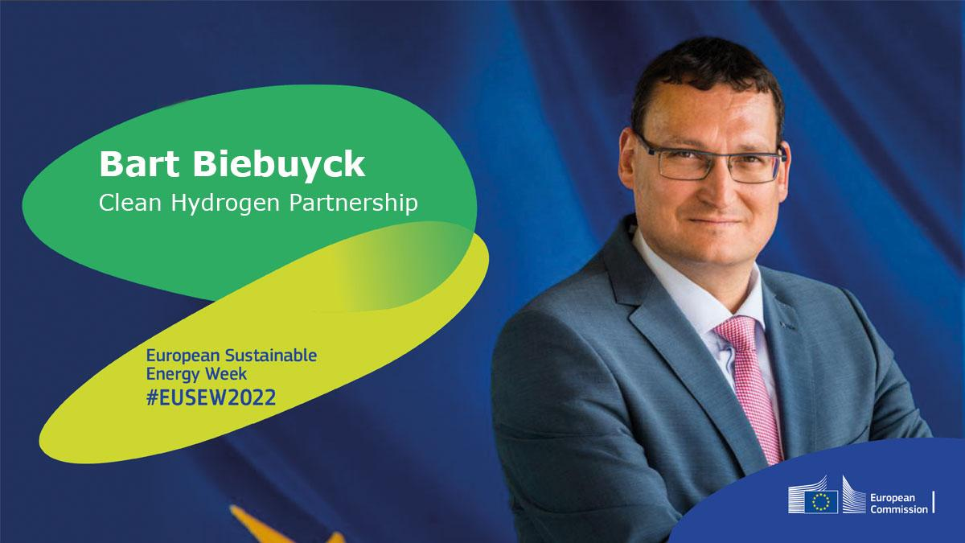
Setting the scene

Slide 4
INTRODUCTION
We are at one of the most pivotal times in the Energy industry, facing climate and security challenges. The urgency is driving industry, communities and society through an accelerated energy transition.
The drive to reduce our carbon footprint energy security has powered companies to unprecedented levels of innovation, transformation, productivity, and efficiency.
As we embrace a rich future of sustainable energy, catalysed by Green Hydrogen we are examining every step in a four stage Green H2 Commodification value chain to enable this transformation for all.

Slide 5

THE EFFECTIVENESS OF GREEN HYDROGEN
Green Hydrogen is 360° effective
Environmental – zero carbon footprint
Social – community inclusive energy solution
Commercial – a key energy catalyst assisting industry pivot to green solutions
Financial – Innovations in electrolysers will ensure that Green Hydrogen will become more cost effective than natural gas

Slide 6

Key Message
Responding to our climate and energy crisis requires us all to act. It will be a collaborative ‘all hands-on deck’ effort with governments, scientists, innovators, industry and communities all working in cohesion as partners in the clean energy transition that will deliver the solutions we require and contribute to our understanding of climate change and its impacts.

Slide 7
CONTEXT
In 2021 our EU goal was driving to build a clean energy future through the Fit for 55 package. On the 24th February 2022 our goals were expanded and accelerated to a clean secure energy future for Europe through the REPowerEU action plan.
The climate challenge allied with the current geopolitical situation makes an unparalleled case for a rapid clean energy transition.
The transition requires smarter use of current technologies, the development of next-generation technologies and the deployment of smart infrastructure to use and integrate these technologies in our energy system.
These steps together with increased energy efficiencies across the entire energy value chain will deliver our energy goals.

Slide 8
COMMODIFICATION
The IEA estimates that nearly half of the clean energy technologies required to achieve net-zero emissions by 2050 are not commercially viable yet.
The Clean Hydrogen Partnership will help to focus on R&D which in turn will drive down the cost of existing clean energy technologies and importantly unlocking new ones.
This push on many fronts will provide a central focus for many and help drive the commodification of Green Hydrogen.

Slide 9
The Green Dawn
The global energy crisis is a clean energy opportunity.
The oil shocks of the 1970s spurred vital progress in renewable energy opportunities but we allowed these to be side tracked.
Today’s crisis highlights the fragility and the unsustainability of our reliance on fossil fuels.
This can be the springboard towards a cleaner, more affordable and more secure energy system.

Slide 10
The green energy transition is fragile
Energy price rises are exposing challenges in market design and regulation, creating the need to rethink it.
Across the globe and especially in Europe nations are turning to fill gaps in their fossil fuel supplies by looking to reopen coal mines, expanding domestic gas production, and securing new import contracts.
This new landscape offers difficult terrain for the clean energy transition including Green Hydrogen.
Renewed energy security concerns among many nations risk pushing clean energy ambitions back down the agenda while short-term crises are tackled.
‘Near term challenges shouldn’t obscure real opportunities.’

Slide 11
IT WILL TAKE MORE THAN TECHNOLOGY
Technology alone will not achieve our net zero goals.
As detailed in Marianna’s Evaluation section of the Green H2 EVALUATION link in the SMART H2 value chain, substantial work is still needed on, understanding behaviours and attitudes around energy use, and on mechanisms for supporting households and communities through the energy transition.
In our drive for technological development, we cannot overlook the central role played by people, and ensure that we are also fostering innovation and collaboration at the social level.

Slide 12

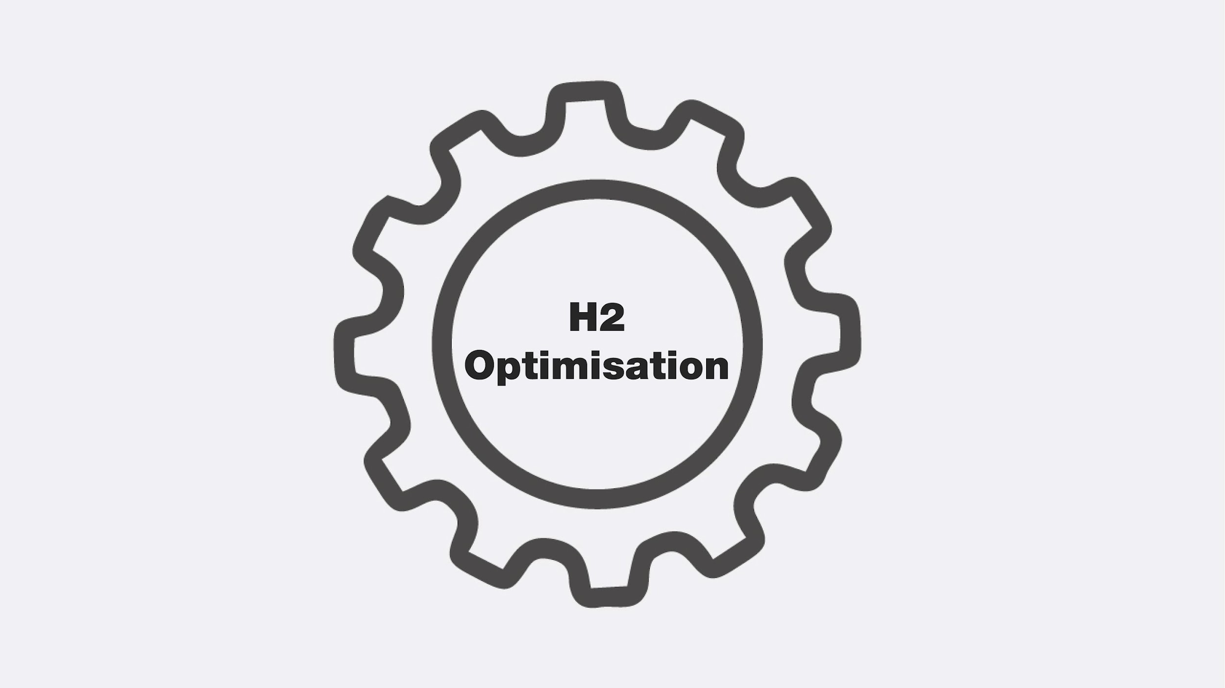
H2 OPTIMISATION

Slide 13
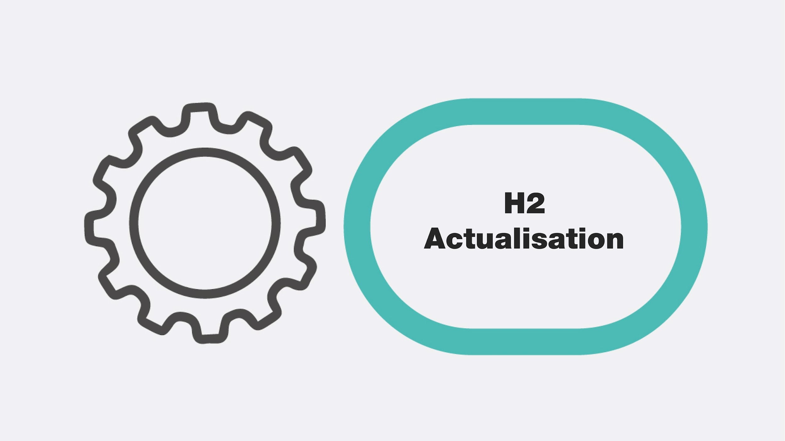
Key Message
Hydrogen is the catalyst driving Europe’s energy transition, enabling us to pioneer new and innovative paths to sustainability.
Optimising this journey, enhancing its cost-competitive production, storage, and end-use is critical.
Delivering SMARTH2 through valorization of the hydrogen supply chain, production, storage and use is key to creating a successful, sustainable secure energy future for Europe.

Slide 14
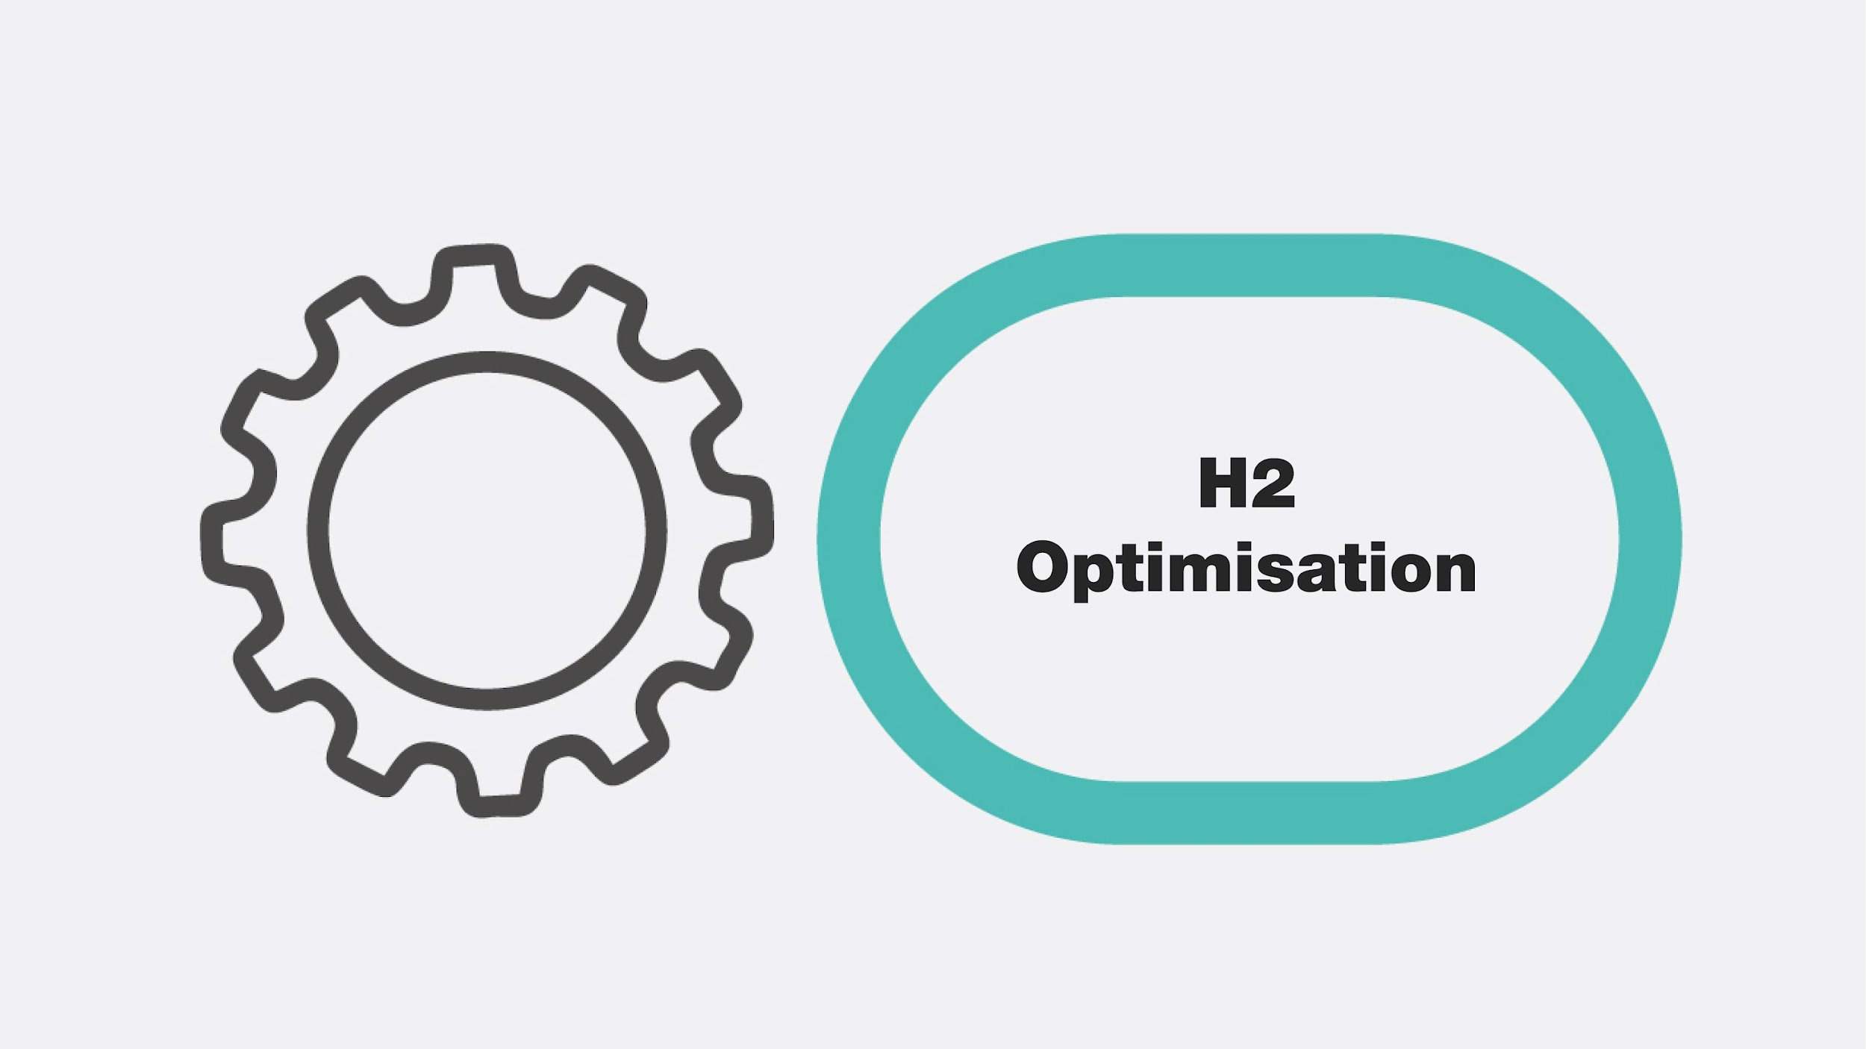
Optimisation
There are many challenges governments face today on our journey to achieve the twin goals of long-term sustainability and secure indigenous clean energy systems.
There is no ‘one-size fits all’ approach to reaching net-zero — technologies across all sectors of the economy will need to work together. And these technologies are all at varying stages of research, development and demonstration (RD&D).
We must also look to achieving efficiencies from every step on this journey and secure the most effective energy opportunities each step brings – a Green H2 NEXUS
OPTIMISATION
ACTUALISATION
EVALUATION
VALIDATION

Slide 15
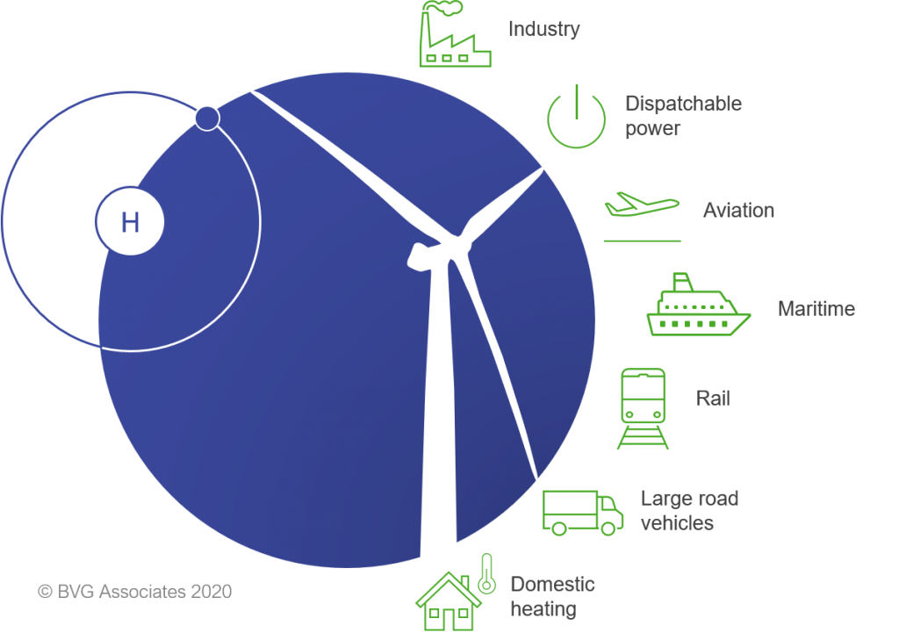

Hydrogen Leverage
Hard to decarbonise sectors
Clean hydrogen plays a critical role on the global path to net zero and importantly it forms a key interconnecting pillar between other key clean technologies

Slide 16
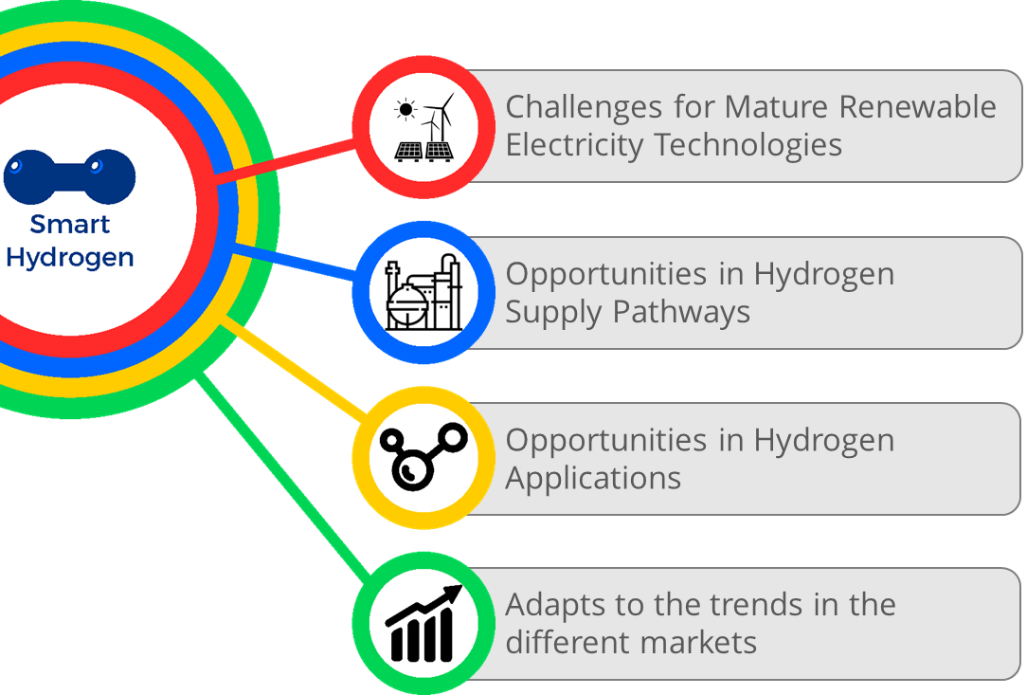
HYDROGENEWABLES
In order to achieve successful energy transition to renewables in Europe we must look to achieving full commercial opportunity for renewable energy. In order to achieve this, we have to ensure commercial flexibility in the coupling of the renewable energy sector and the transport sector.
The use of SMART H2 (Hydrogen produced from renewable energy sources) as an energy carrier to achieve this goal is crucial.

Slide 17
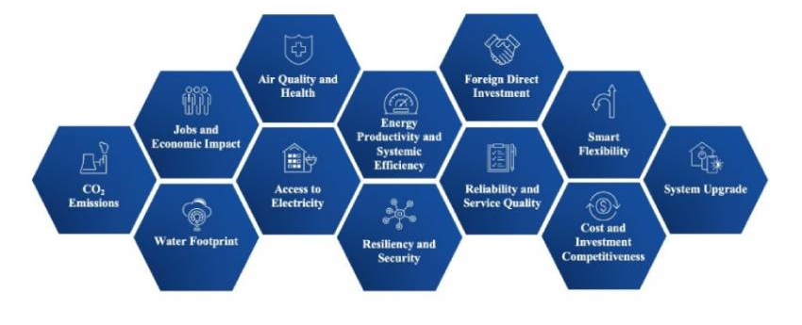
H2 Transition Opportunities
As Europe transitions to net zero, we must position as the lead in clean hydrogen trade Accelerate our current EU clean hydrogen journey
Develop increased additional links with other partners to accelerate this journey
Stimulate increased Green H2 awareness and demand and ‘position’ new energy transactions.
Progress the H2 CAT model internationally , transitioning European economy towards a climate-neutral and more resilient economy
Expand our work to include digitalization and implementing a well-thought-out circular economy model.
The Green Economy is predicated on the Green Economy and Digitalisation.

Slide 18
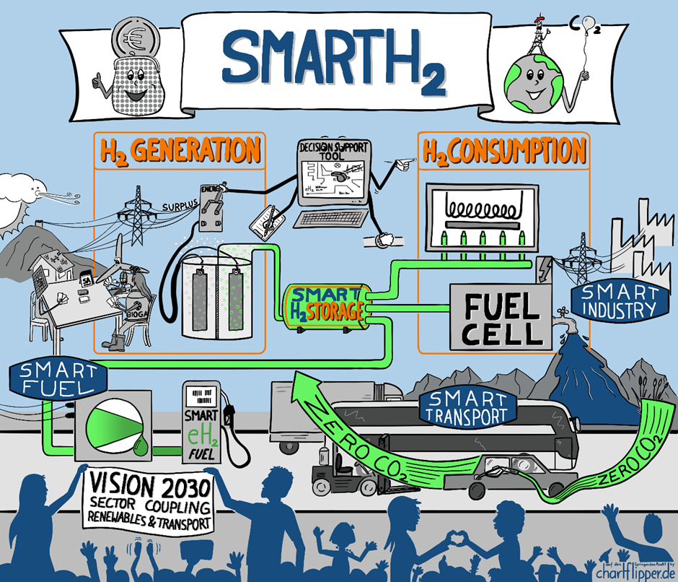
Fuelling the Just Transition
– The Role of Non-Carbon Energy
Notes:
New technologies as the one that is subject of HAZEL and
GENCOMM are examples of innovations deployed in real life, creation of climate-
resilient processes and professions, raise of public awareness of the
scientific importance for the creation of climate protective industry and
environment, all of that achieved by applying collaborative and inclusive
approach of work science - industry work.

Slide 19
SMART H2
The world is racing to scale up Green Hydrogen
However, as we scale up the use of GREEN H2 it must be done smartly, intelligently and efficiently giving us SMARTH2
PRODUCTION
  CONVERSION
  TRANSMISSION
DISTRIBUTION
USE
H2
H2
H2
H2

Slide 20
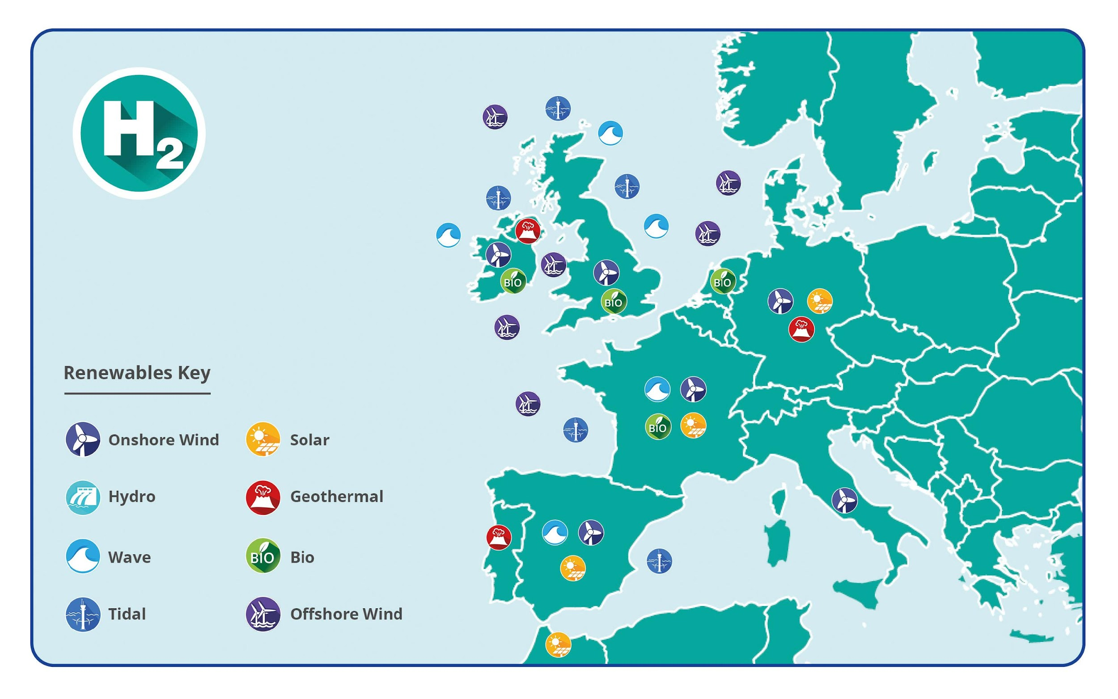
Hydrogen Topography
A geographical approach to developing zero carbon solutions for local use.
This approach empowers communities across Europe to access hydrogenewables, their own renewable opportunities wind, solar, bio, wave, tidal, geothermal and use these green sources to provide green energy solutions on their specific journey to net zero.
Positioning relevant Green H2 energy solutions that address regional opportunities, challenges and objectives.

Slide 21
INNOVATE THE TECHNOLOGIES OF THE FUTURE
Half of the clean energy technologies required to achieve net-zero emissions by 2050 are not commercially viable yet.
Selected technologies to showcase solutions that are accelerating and demonstrating progress toward our shared clean energy goals
There is no ‘one-size fits all’ approach to reaching net-zero — technologies across all sectors of the economy will need to work together. And these technologies are all at varying stages of research, development and demonstration (RD&D).

Slide 22

Digital Transformation
We can use digitalisation and digital tools to optimise value at every stage in the Green Hydrogen value chain.
Blockchain will be a powerful tool in tracking emissions and green molecules along energy value chains
As we prioritize green hydrogen in the energy transition this will drive profound change and deliver new policies, business models, and regulatory models in the rapidly changing energy sector. Blockchain and other digital tools will play a prominent role in supporting these strategies.
Blockchain will disrupt today’s energy industry and will enable stakeholders to reap substantial benefits for years to come.

Slide 23

Summary
Green H2 is a disruptive technology – it is nonlinear change in a linear world.
Disruption, by definition, changes the “traditional way of doing things” and accelerates change and transformation.
We must optimise all steps of Green H2 in a logical, needs driven, exponential accelerated manner in order to fully exploit current and future clean energy applications
Energy innovation is not linear it is a conversion and Green H2 innovation can and will convert our energy systems to the green alternatives we need

Slide 24


H2 ACTUALISATION
Notes:
d

Slide 25


The 2020’s was heralded as the decade of action in the fight against climate change. Hydrogen is universally recognised as having a significant role to play in the move away from fossil fuels, but we now urgently need a holistic, agile approach to address existing barriers and to drive costs out of the supply chain if this really is to be the decade of action.
There is no time to waste.

Slide 26


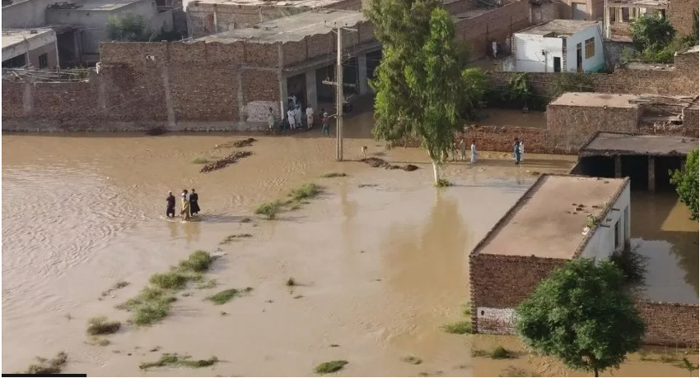

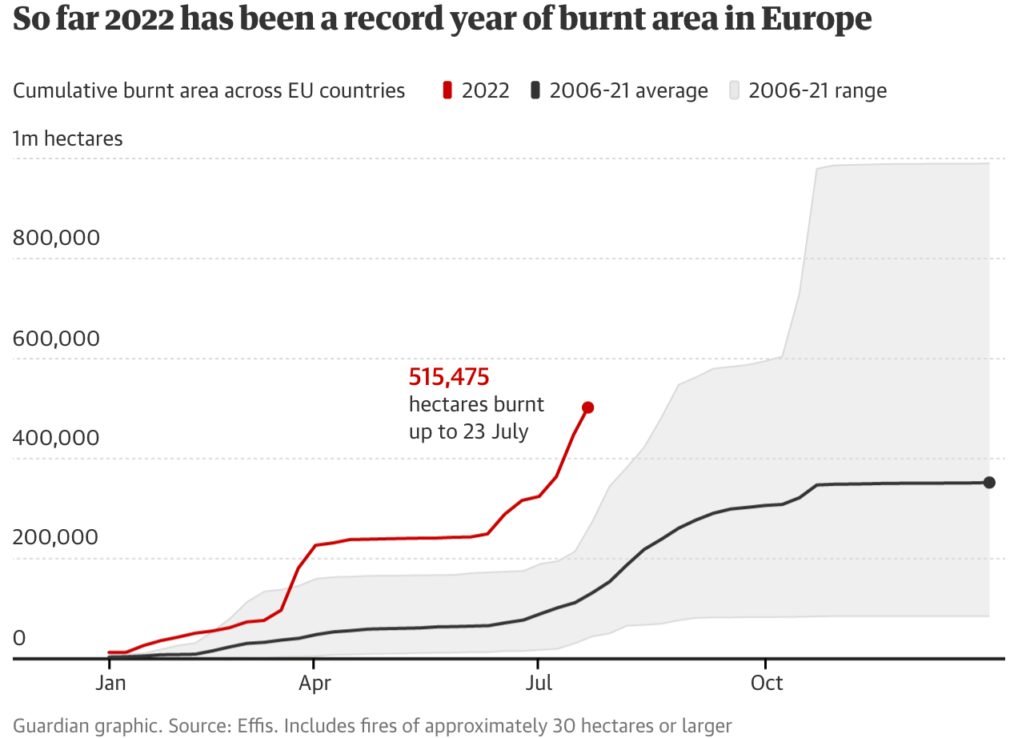
2022:A year of ‘Actualization’ on Climate Change

Slide 27
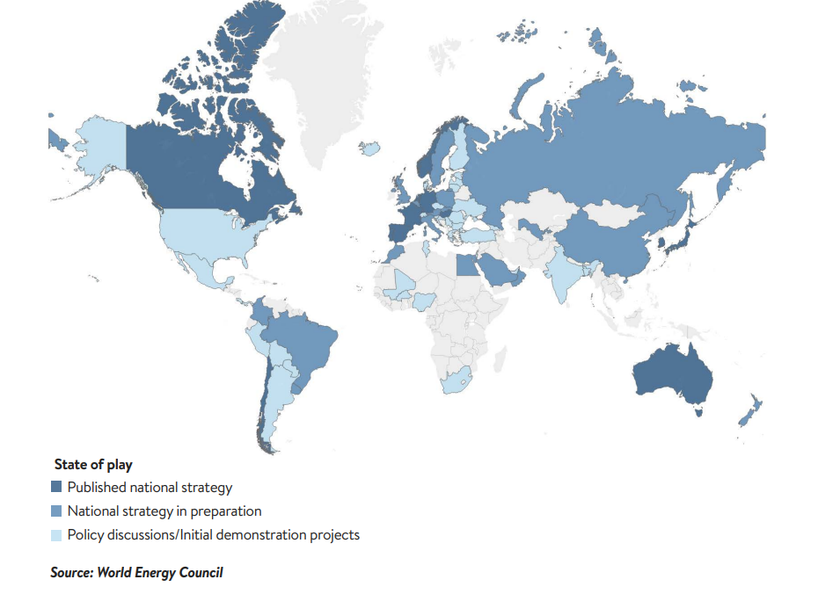
Global acceleration of Hydrogen
Countries are increasingly embedding hydrogen strategies
Falling cost of renewables generation
Expected reduction in electrolyser CAPEX and increase in systems efficiencies
Energy security is firmly alongside decarbonisation in importance in the energy transition, raising the hydrogen expectation further

Slide 28
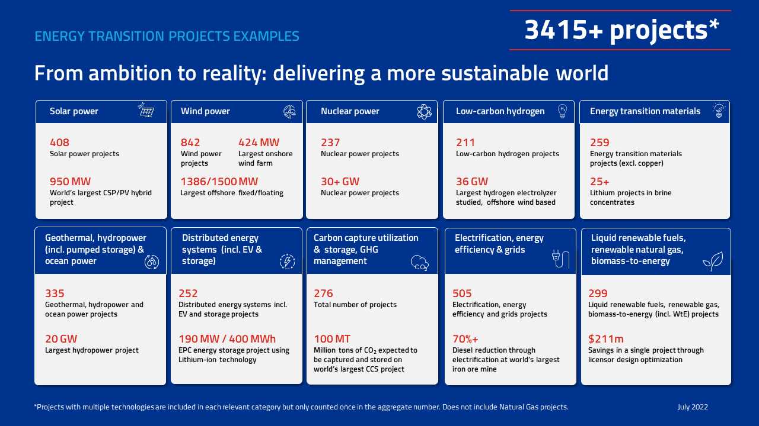

Slide 29
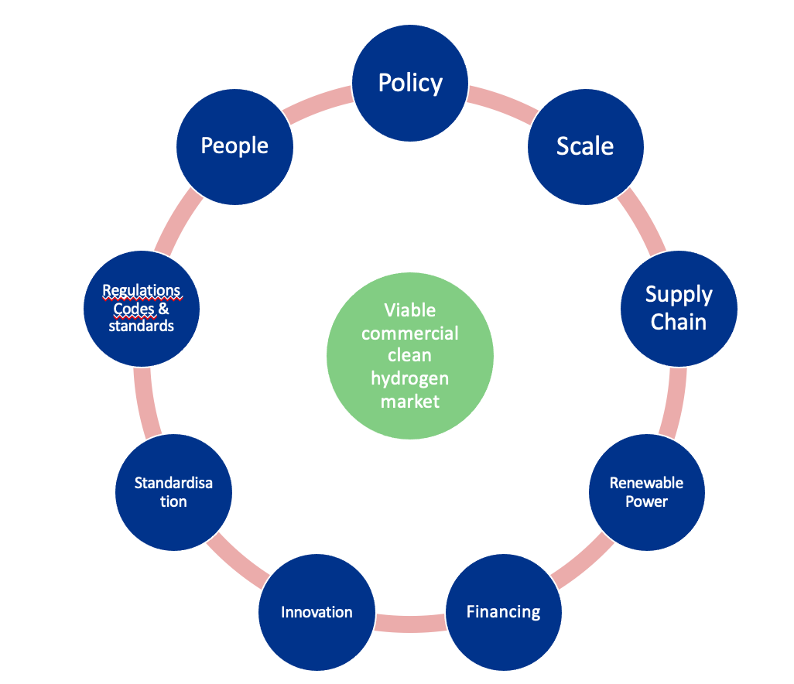
Creating a thriving hydrogen economy

Slide 30
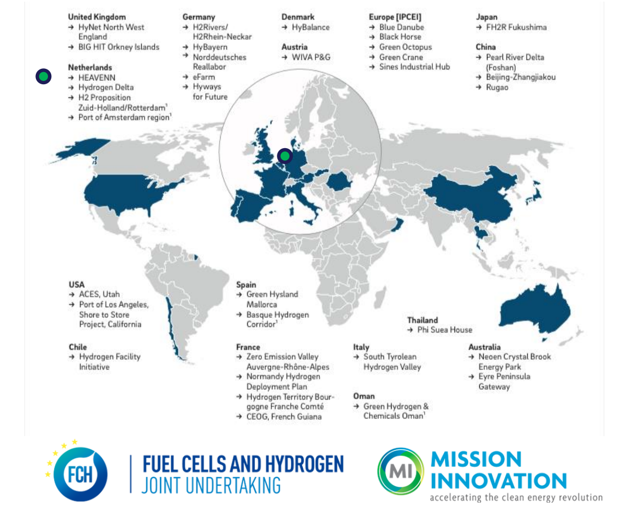

From Projects to Valleys
Hydrogen valleys are regional ecosystems that enable balancing of supply and demand whilst driving down cost
Can have one or more anchor tenants that provide baseload
Enables access to green hydrogen to a wide end user community by leveraging cost benefits of increased scale
Next Generation of Hydrogen Valleys
Supported by Clean Hydrogen Partnership
Large scale, breadth of applications, cross border
Kick starting hydrogen in new regions
E.g. Hydrogen Valley Ireland
https://h2v.eu/
Notes:
A Hydrogen Valley is a regional ecosystem
Strong links between hydrogen research, production, distribution, and transportation
Synchronises the supply and demand of hydrogen
Enables various end users such as transport and industry
Utilisation of indigenous green hydrogen at Hydrogen Valleys is key
GH2 is an important step towards enabling the development of a new hydrogen economy

Slide 31
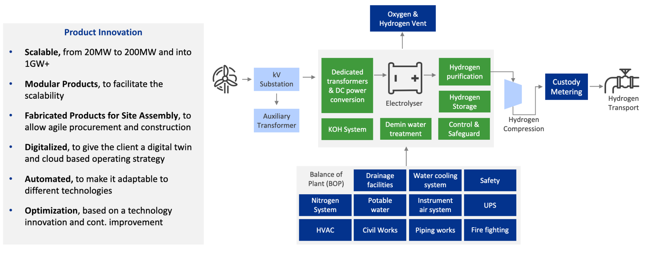
A building block approach to large scale green hydrogen projects
Worley Hydrogen WRAP™

Slide 32

Connected delivery model
Optimized engineering and repeatable fabrication with the operating asset in mind
Engineering and procurement
H
Reduced levelized cost of hydrogen (LCOH)
Adopting a modular approach that simplifies optioneering and accelerates engineering to deliver a standardized design.
Fabrication focused
2
Engineering
procurement
Fabrication and construction
A connected fabrication, delivery and installation solution which accelerates asset delivery timelines.
Operations focused
Asset
management
Fabrication
construction
Asset management
Utilizing a data driven approach with digital technology to deliver connected assets with smart operations functions.
Efficiency focused
Digitalisation across the ecosystem
Applying digitalisation upsteam into renewable geenerrataion and downstream into end use,, leveraging smart data for optimising operational excellence
Digitalisation focused

Slide 33
Agile and Scalable way of working in green hydrogen
Advisian
H₂ Excellence Centre
Enhanced GID
Enhanced GID, Construction
BEP
FID
Concept Design, Feasibility
Modular WRAP
Speed FEED
Engineering / Fabrication
Operations & Maintenance
Business Case (to support funding and investment decisions, incl. Offtake studies, Optioneering, renewable electricity & utilities supplies, effluent treatments, capacity)
Concept Development
Technology Selection (AWE, PEM, SO)
Strategy
Class V estimate ±50%
OEM Selection
Modular Plan (to facilitate future scalability, replication)
Hydrogen WRAP (design customized for water, power, heat, buildings, control, storage, etc..)
Execution Strategy (fabrication, delivery, installation, startup)
Permitting Plan (design customized to local conditions)
Class IV estimate ±30%
Technology selected – one size
Fixed price and schedule
Lean engineering Standardization
Datacentric Delivery
Modular engineering, to facilitate scalability
Repeatable formula
Class III Estimate +10%
Innovative commercial & execution models
Smart Engineering
Integrated plant
Fabrication yards
Modular fabrication, to allow agile procurement and construction
Modular execution
Construct SIM
SEAL
4D execution
Supply Change Mgmt.
We design early phase projects with big picture in mind, allowing us to better design for future optimization of operation and maintenance
Operational Readiness Assurance (ORA)
Objectives
Deploying digital solutions through the entire asset lifecycle
33

Slide 34
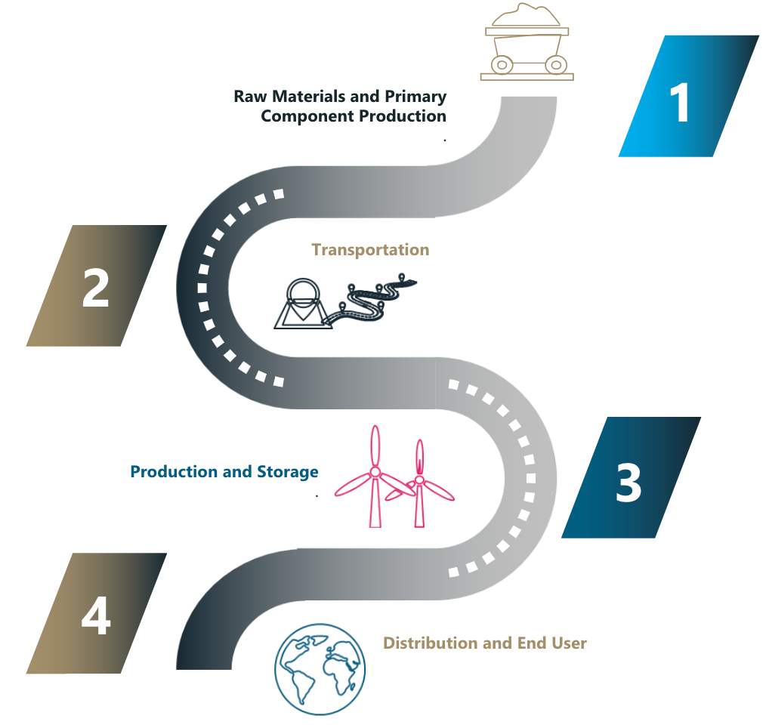
Digitalization across the entire H2 ecosystem
Blockchain development
Blockchain allows transparency and carbon accounting along the entire supply chain
Supports measurement of alignment with policy goals
  Chain of Custody ​
  Supply Chain Provenance​

Slide 35

Strength in Collaboration
1
2
3
An integrated digital approach considering the asset lifecycle and integration into the broader business ecosystem
Driving towards hydrogen with a levelized cost of $2/kg
Solutions which help resolve business challenges for the hydrogen market

Slide 36
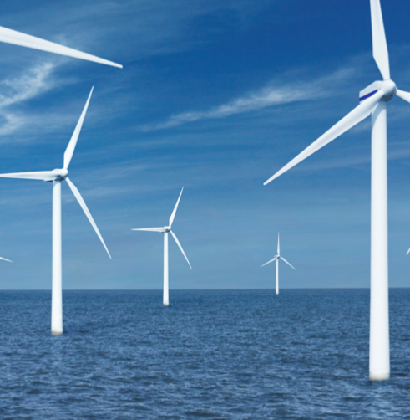
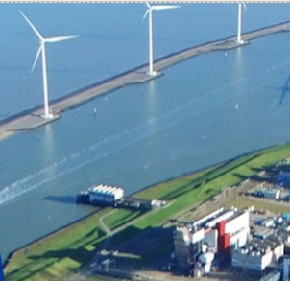
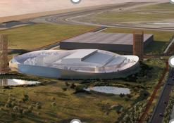
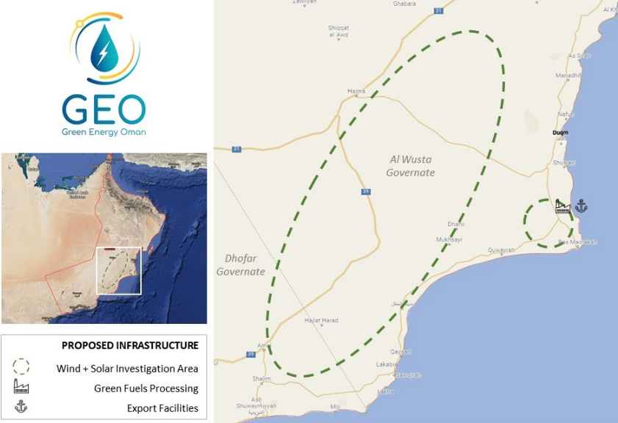
We are making progress….
Offshore Wind Farm and 100MW Electrolyzer Facility
760MW Offshore Wind farm, Netherlands
Worley acted as a technical counsel involving the development of a 760MW offshore wind farm and a 100MW hydrogen electrolyzer facilty
Worley’s role involved a business model for the hydrogen production
We built a financial model which determined the levelized cost of hydrogen
Identified potential hydrogen offtakers and building a joint business case.
Nouryon Alliance
Netherlands, Nouryon/Nobian
We are working with Nouryon to scale of hydrogen production to build a carbon-free Netherlands. Currently we are workin on three projects:
Djewels 1, 20MW electrolysis plant for production of green H2 for bio-methanol FEL 1, FEL 2 and currently FEED completed
Djewels 2, concept study for 50MW electrolysis plant for production of bio-kerosene for sustainable jet fuel
Hermes, 100MW project in concept study phase to decarbonize steel production
Green Hydrogen Plant utilizing Offshore Wind
Shell 200 MW Maasvlakte, Netherlands
We are working with Shell in the Netherlands to develop a 200MW green hydrogen plant in the Maasvlakte area in the Port of Rotterdam.
Our scope incorporates all different moving parts:
Integration of electricity supply from an offshore windfarm​
Technology selection and OEM selection in an integrated team
Integration of the 200MW electrolyzer OEM design in the conceptual design of the plant
The design of the balance ​of plant ​and infrastructure​
We are responsible for Integrating the green hydrogen into the Shell Pernis refinery as part of a decarbonization strategy.
Green Energy Oman
Oman
We are supporting Green Energy Oman (GEO), an international consortium, to developed a 25-gigawatt (GW) low-carbon fuels project.
  Concept feasibility study services to further develop and challenge GEO's defined green hydrogen energy project.
  Optimize 25 GW of wind and solar generation, transforming this renewable energy into green hydrogen, and the production, storage, and export of ammonia.
  Produce 1.8 million tons of low-carbon green hydrogen which can produce up to 10 million tons of green ammonia per annum.
  Identify opportunities to enhance in-country value delivered from the expected 10-year project implementation period.

Slide 37
Unlocking value and driving out cost across the delivery chain for green hydrogen
H2
Adopting a highly automated and repeatable approach in delivering the project to make sure the asset is optimized through the entire lifecycle.
Standardized BoP units
Digitally enabled to remove significant ‘soft costs’ associated with project delivery
Fabricated in a repeatable, manufactured fashion
Reducing the levelized costs of green hydrogen through focused cost minimization across concept, engineering, project delivery (CAPEX) and operations (OPEX)
Applying smart digitalisation across the entire hydrogen ecosystem
Digitally equipped for smart optimised operations
Blockchain for full traceability and validation along the green molecule value chain

Slide 38
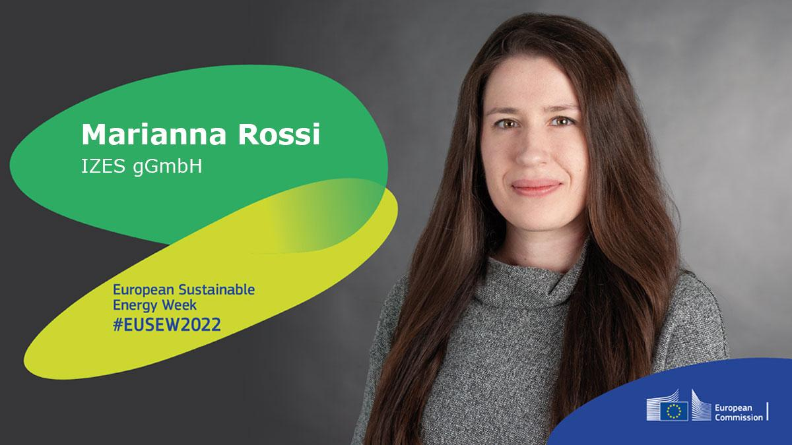
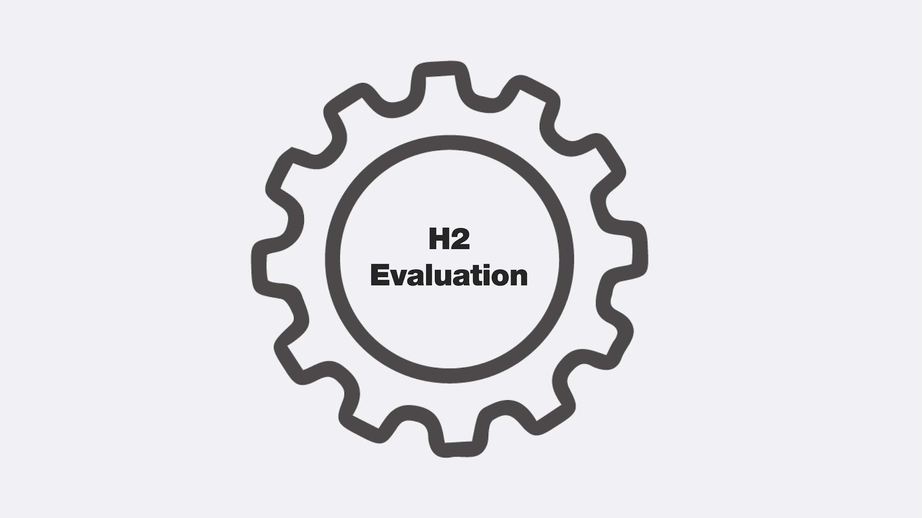
H2 EVALUATION

Slide 39
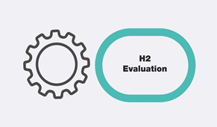
Hydrogen can be the key
to creating a successful, sustainable and secure energy future for Europe.
But it is people who need to open the door.

Slide 40
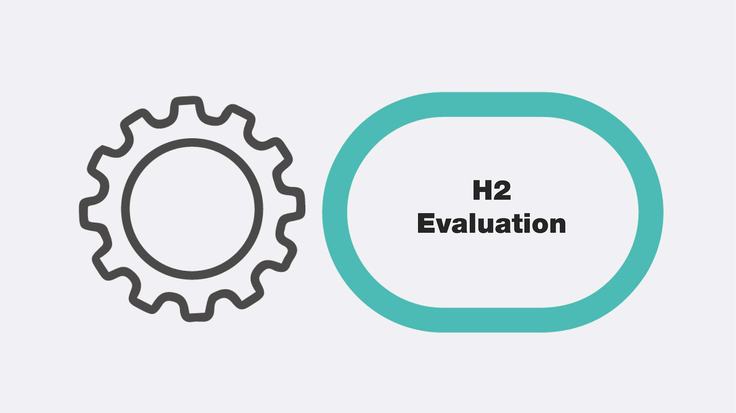
Acceptance of Hydrogen
WHAT WE NEED
Overall positive attitude towards hydrogen
Acceptance towards the process that comes with implementing it in the current system
WHAT WE HAVE
Mostly neutral to positive reactions
Mostly data in regards to the mobility sector
Hardly differentiation between different types of hydrogen

Slide 41
Psychological Parameters of Hydrogen Acceptance
AWARENESS
SUBJECTIVE KNOWLEDGE
EXPERIENCE
PERCEIVED EFFECTS
SOCIAL TRUST
Perceived Usefulness
Attitude
towards Technology
Behavioral Intention
Behavior
Perceived Ease of Use
Technology Acceptance Model (Davis et al. 1989)

Slide 42
Psychological Parameters - AWARENESS
Current Level
Needed Level
How to get there
Awareness
consciousness of existence
Large scale information campaigns
Identification of relevant information
Development of productive communication strategies

Slide 43
Psychological Parameters - EXPERIENCE
Current Level
Needed Level
How to get there
Awareness
consciousness of existence
Large scale information campaigns
Identification of relevant information
Development of productive communication strategies
Experience
direct contact with hydrogen technology
Satisfying information campaigns and interventions
Interventions that offer direct contact
Make use of digital possibilities

Slide 44
Psychological Parameters - SUBJECTIVE KNOWLEDGE
Current Level
Needed Level
How to get there
Awareness
consciousness of existence
Large scale information campaigns
Identification of relevant information
Development of productive communication strategies
Experience
direct contact with hydrogen technology
Satisfying information campaigns and interventions
Interventions that offer direct contact
Make use of digital possibilities
Subjective Knowledge
believed knowledgeability
Influence through other psychological factors
Awareness of Hydrogen
Amount of personal experience with Hydrogen

Slide 45
Psychological Parameters - PERCEIVED EFFECTS
Current Level
Needed Level
How to get there, e.g.
Perceived Risk
e.g. uncertainty of costs
Transparent calculations of costs for implementation and upkeep of hydrogen application

Slide 46
Psychological Parameters - PERCEIVED EFFECTS
Current Level
Needed Level
How to get there, e.g.
Perceived Risk
e.g. uncertainty of costs
Transparent calculations of costs for implementation and upkeep of hydrogen application
Perceived Cost
e.g. effort to learn new technology
Effective and efficient learning material
Interesting and entertaining information material

Slide 47
Psychological Parameters - TRUST
Current Level
Needed Level
How to get there, e.g.
Perceived Risk
e.g. uncertainty of costs
Transparent calculations of costs for implementation and upkeep of hydrogen application
Perceived Cost
e.g. effort to learn new technology
Effective and efficient learning material
Interesting and entertaining information material
Trust
firm belief in the reliability, truth or ability of someone or something
Trust in the source of information
Trust in the channel of information

Slide 48
Contextual Parameters of Hydrogen Acceptance
Cultural Particularities
Social Norms
Political and Structural Environment Socio-Economical State & Changes
Portrayed Technology Image
Job Relevance
Perceived Usefulness
Attitude
towards Technology
Behavioral Intention
Behavior
Perceived Ease of Use
Technology Acceptance Model (Davis et al. 1989)

Slide 49
Acceptance of Hydrogen
Hydrogen can be the key
to creating a successful, sustainable and secure energy future for Europe.
But it is people who need to open the door.
We need to understand and consider people's needs and attitudes around hydrogen to make the transformation process socially valuable and viable
People in research
People of the general public
People along
the supply chain
People in key structural positions

Slide 50
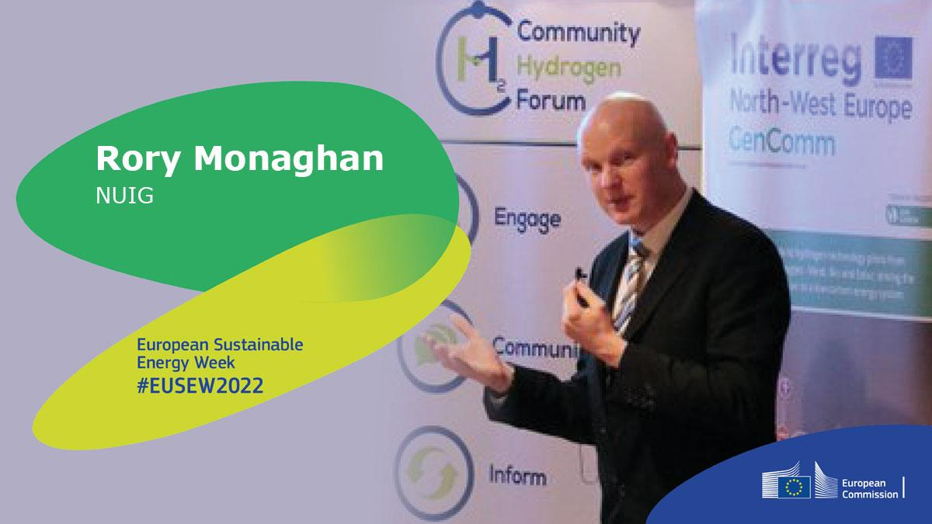
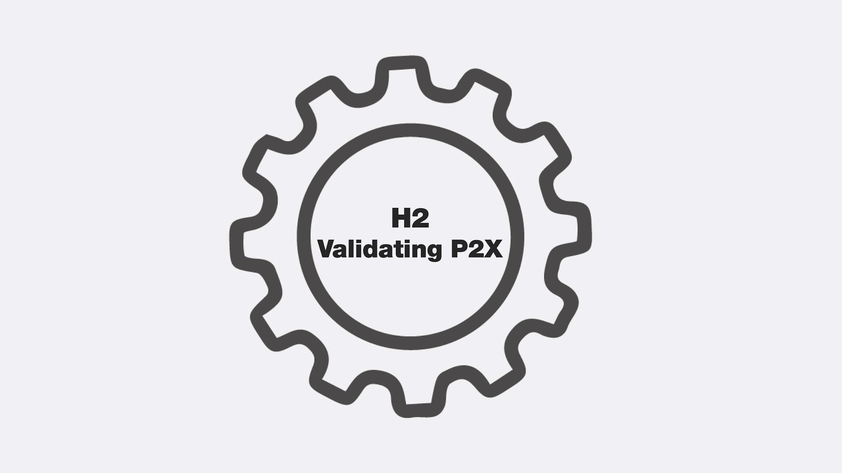
H2 VALIDATION

Slide 51
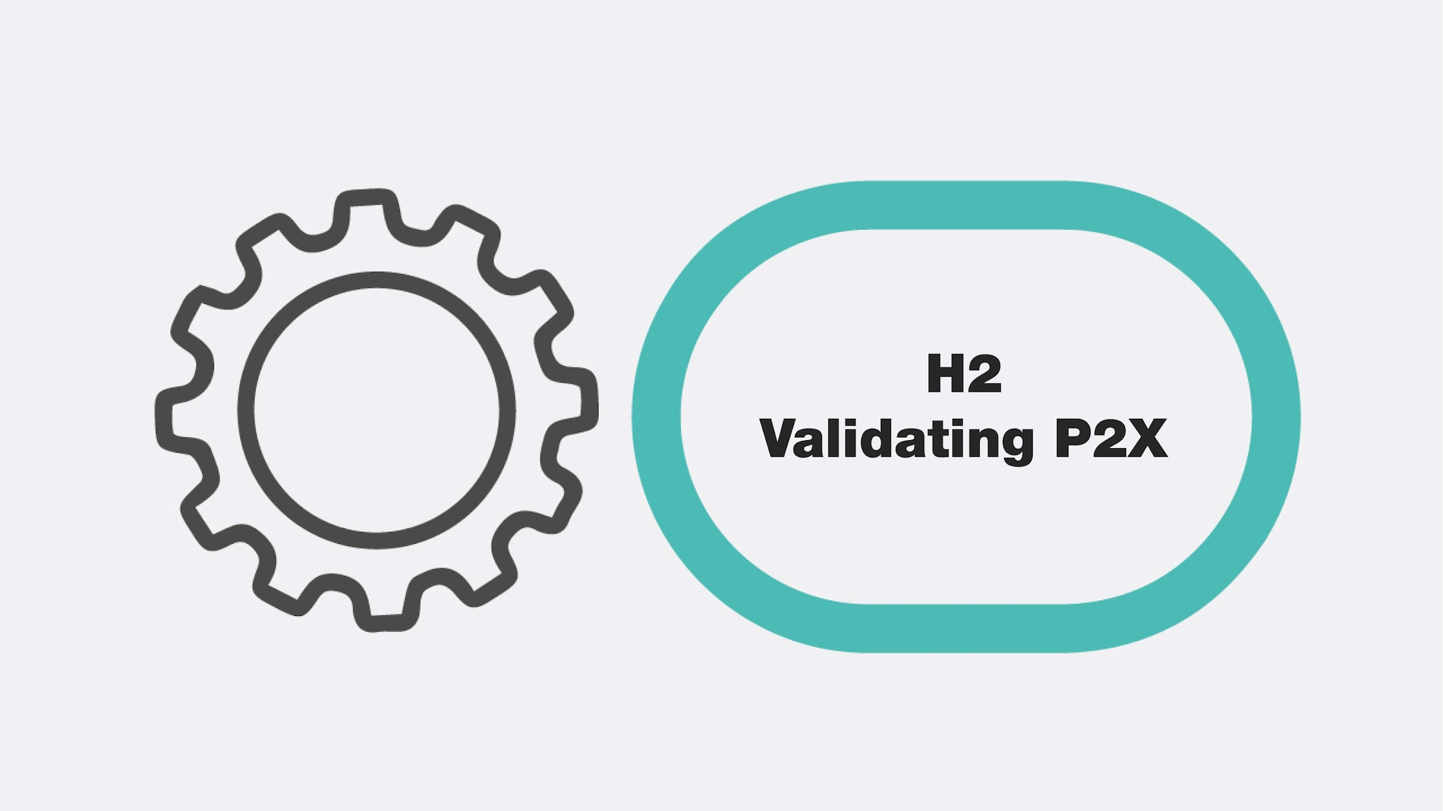
We need to speak to the End Users, those whose jobs it is to decarbonise and strengthen energy security.
We cannot promote “hydrogen for the sake of hydrogen”. We must find the right roles.
Industry-Research collaborations are essential for enabling clear-headed, objective decision-making

Slide 52
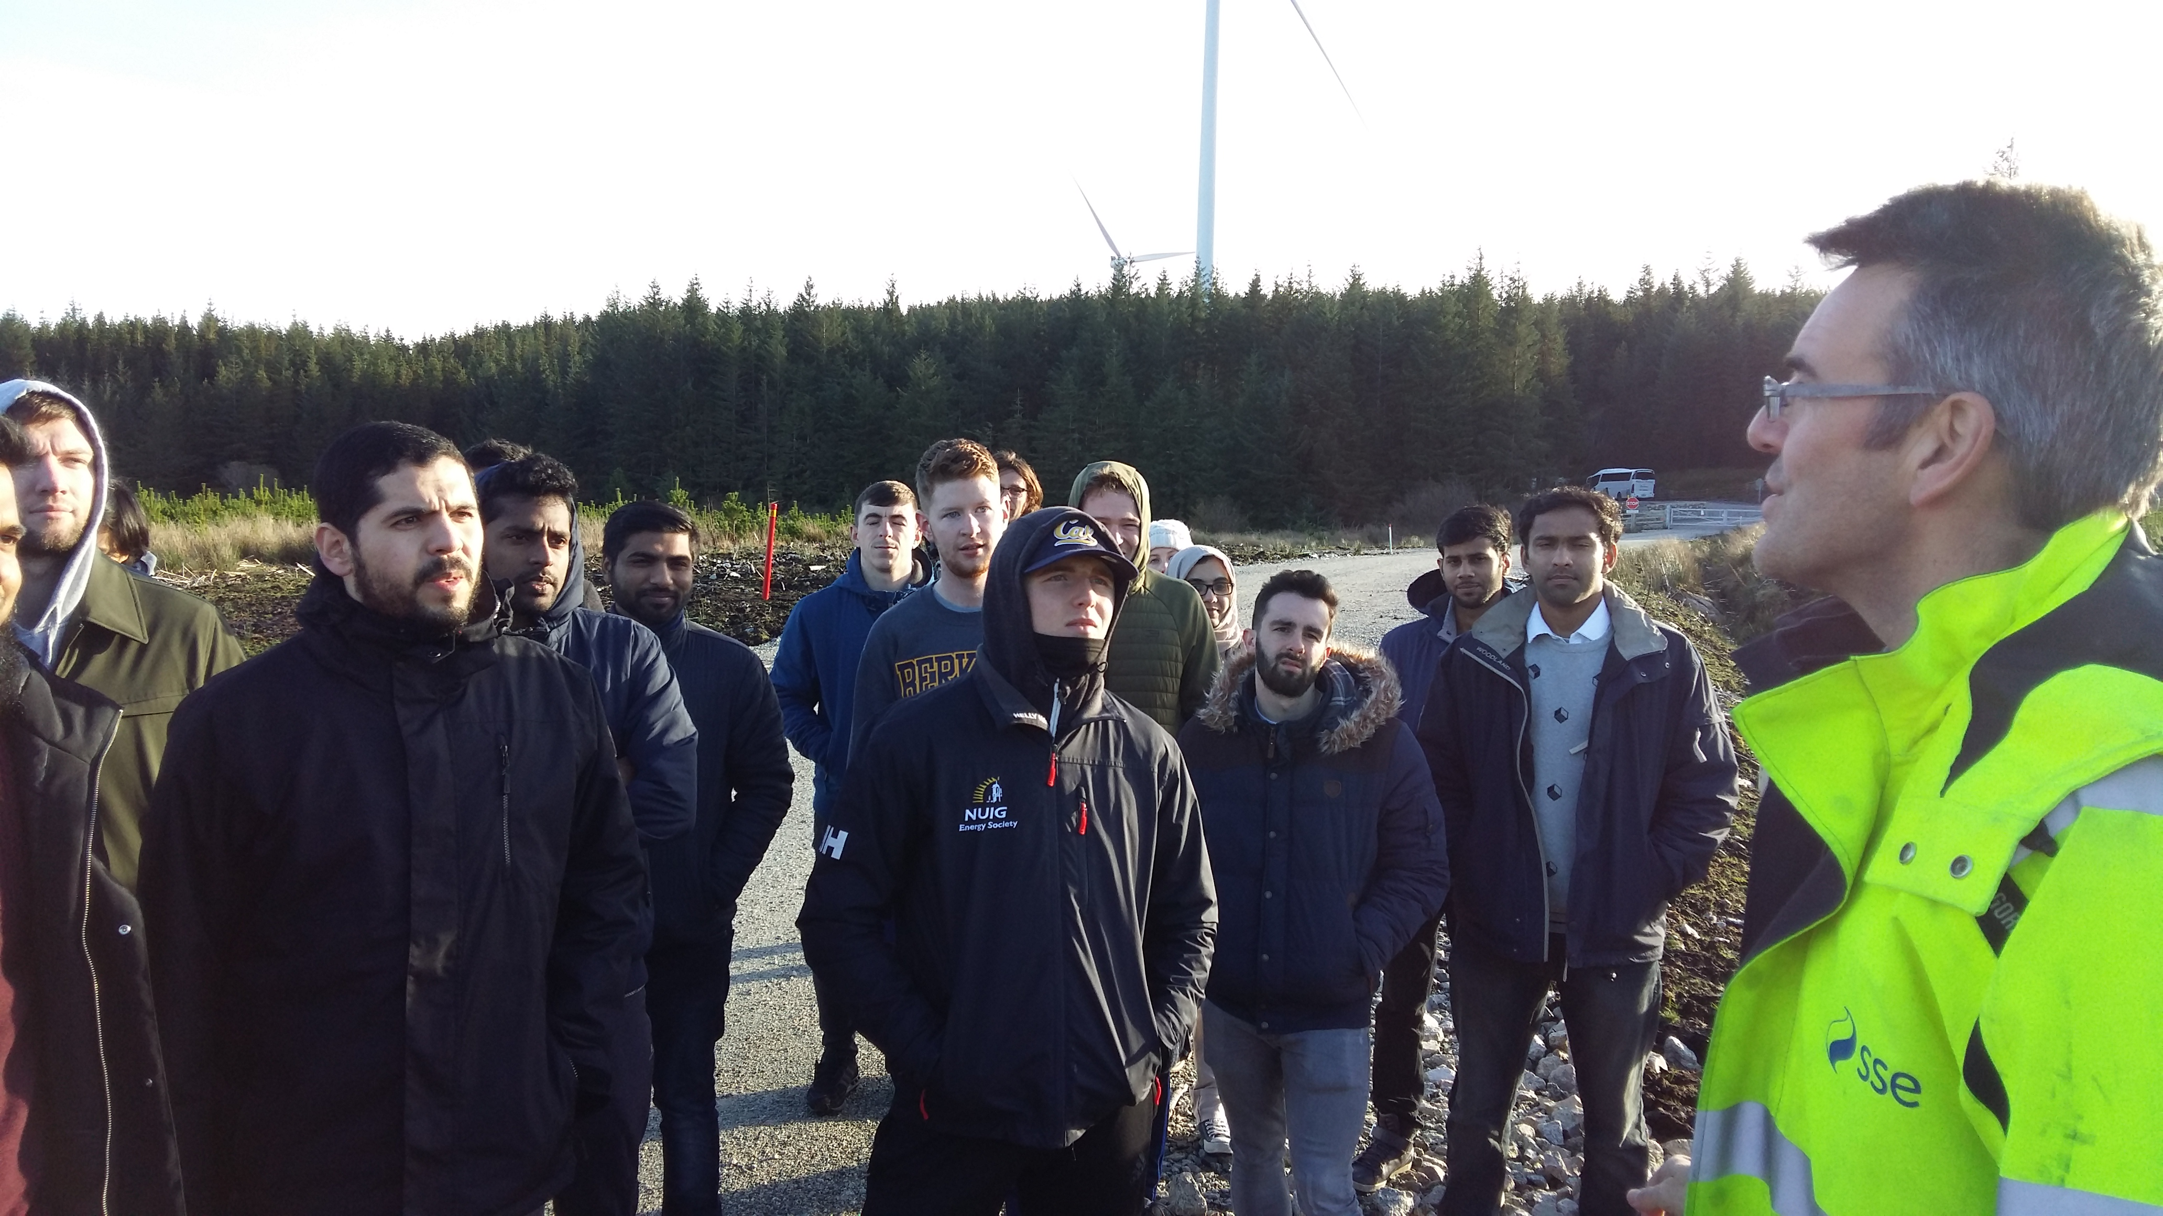
Five years ago…
At Ireland’s biggest wind farm
TEXT

Slide 53
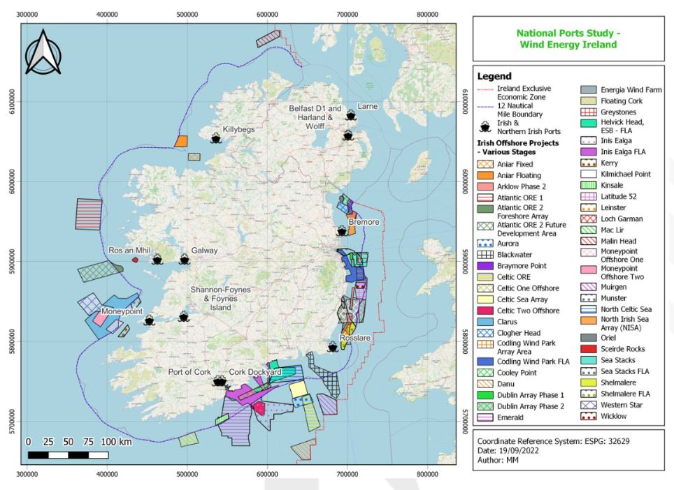
Europe’s H2 potential is immense
H2 demand exists in some countries
Green H2 production potential exists in others
Its deployment will go hand in hand with renewables
Common question: “How much will green H2 cost?”

Slide 54
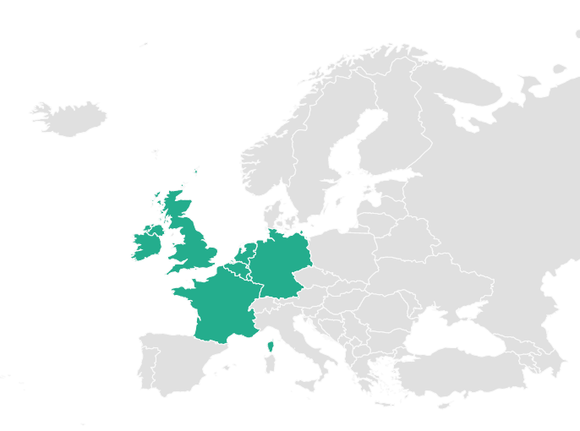
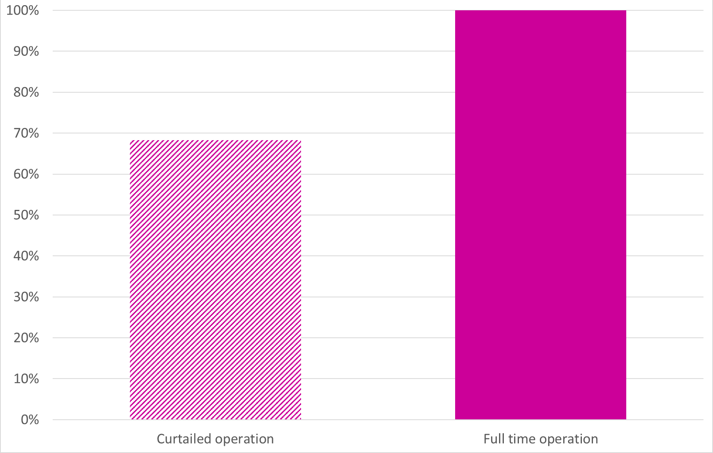
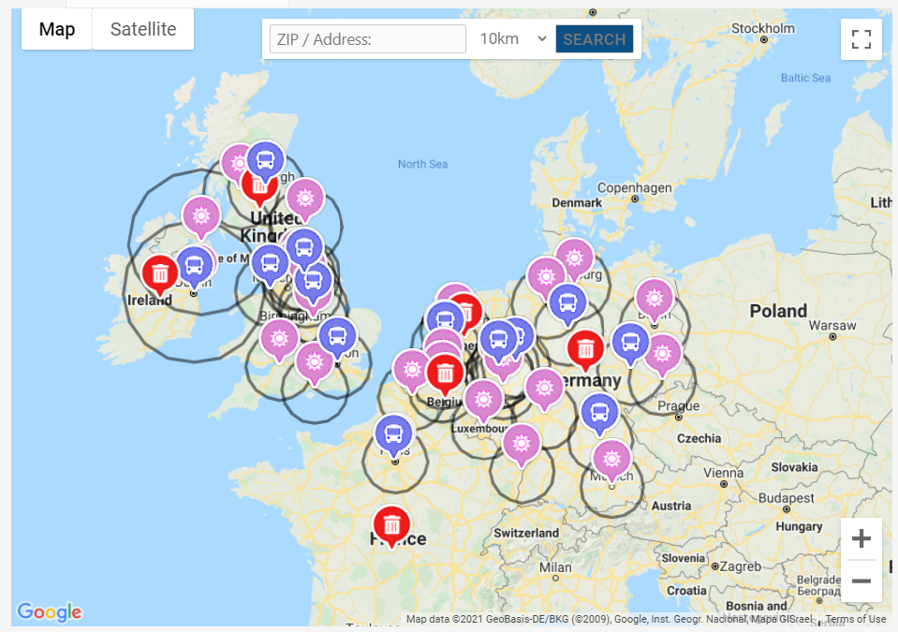
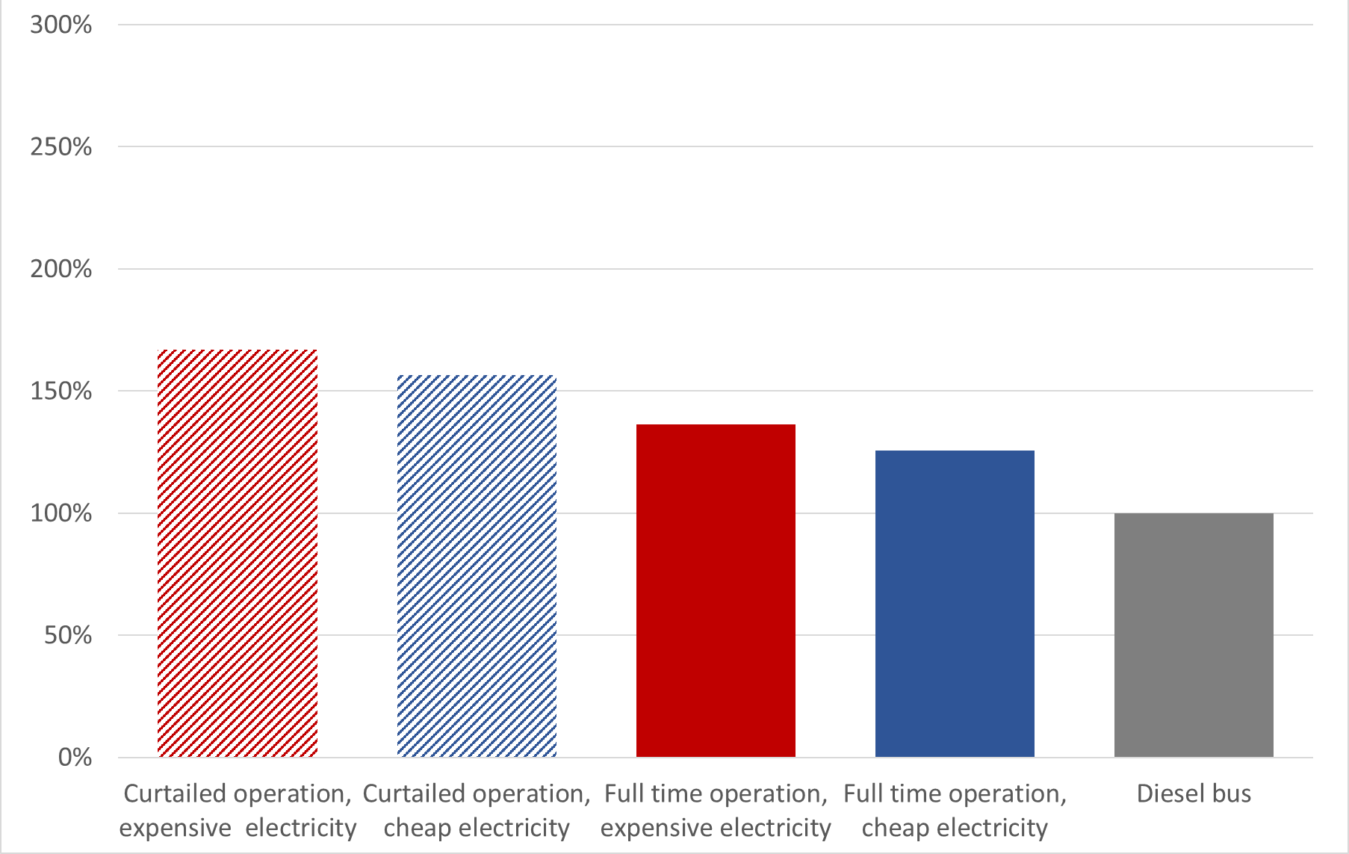
GenComm’s Decision Support Tool
Aimed to inform on quantities, costs, fossil fuel displacement for onshore green H2
Percentage of Dublin city bus fuel displaceable by H2 for different electrolyser operation modes
http://communityh2.eu/dst-simple/
http://communityh2.eu/dst/
Hydrogen costs for different electricity prices and electrolyser operation modes, relative to diesel for Dublin

Slide 55
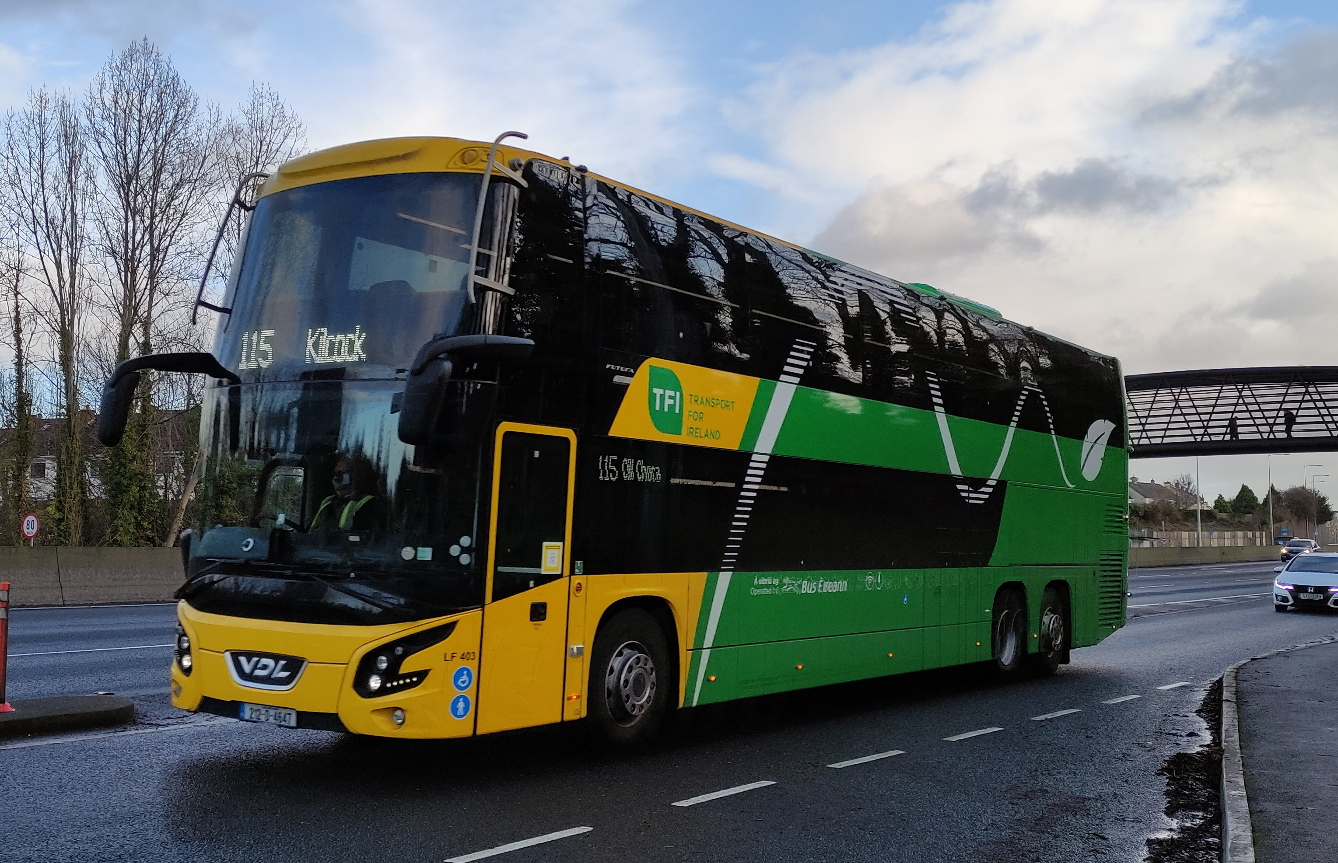
What about the End User?
The Enabling Support Tool
Focus is now on specific sectors that:
Will struggle to be fully electrified
Have H2 technology close to or at commercial reality
We need to communicate to potential end-users in terms they understand
Cost effective decarbonization and energy security are the drivers, not finding a use for green H2!
Total Cost of Ownership (TCO) is how bus fleet operators VALIDATE decarbonization performance

Slide 56
What does the EST do?
Enables bus fleet operators to plan best fleet decarbonization mix
Assumes first decarbonization approach will be battery electrification
Portion of routes in a network unsuited* to battery electrification are identified
* Due to HVAC loads, utilization rates, route range, steep gradients
The EST calculates Total Cost of Ownership of different decarbonization options

Slide 57
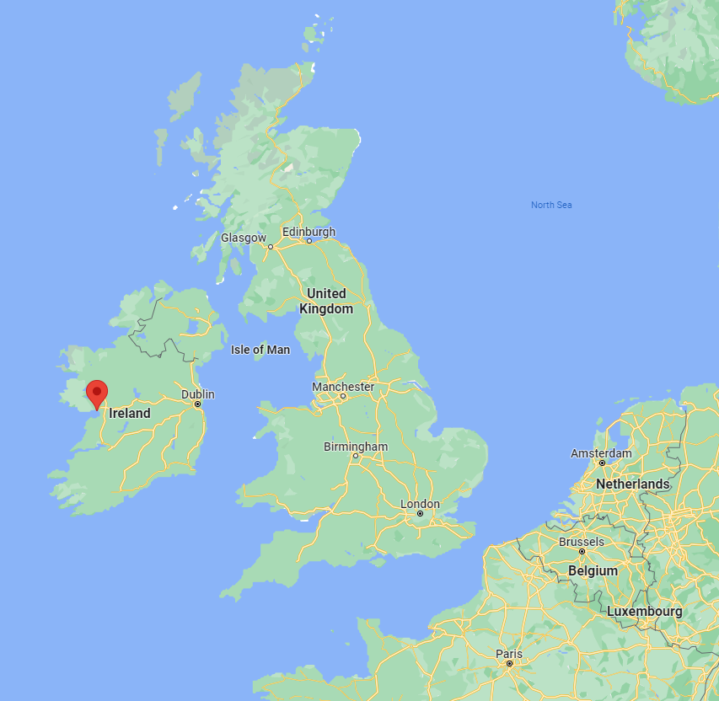
Decarbonizing a single bus route in Galway
Diesel
TCO drops as a bus is used more effectively
Diesel

Slide 58
Decarbonizing a single bus route in Galway
Calculated battery maximum km/day
Battery TCO drops quickly until…
Battery
Diesel
TCO drops as a bus is used more effectively
Diesel

Slide 59
Decarbonizing a single bus route in Galway
Calculated battery maximum km/day
Battery TCO drops quickly until…
Higher km/day needs more buses
Battery
Diesel
Battery
Diesel

Slide 60
Decarbonizing a single bus route in Galway
Calculated battery maximum km/day
Hydrogen
Battery
Diesel
Battery
Diesel
Battery is cost effective at lower km/day
Hydrogen is cost effective at higher km/day
Hydrogen

Slide 61
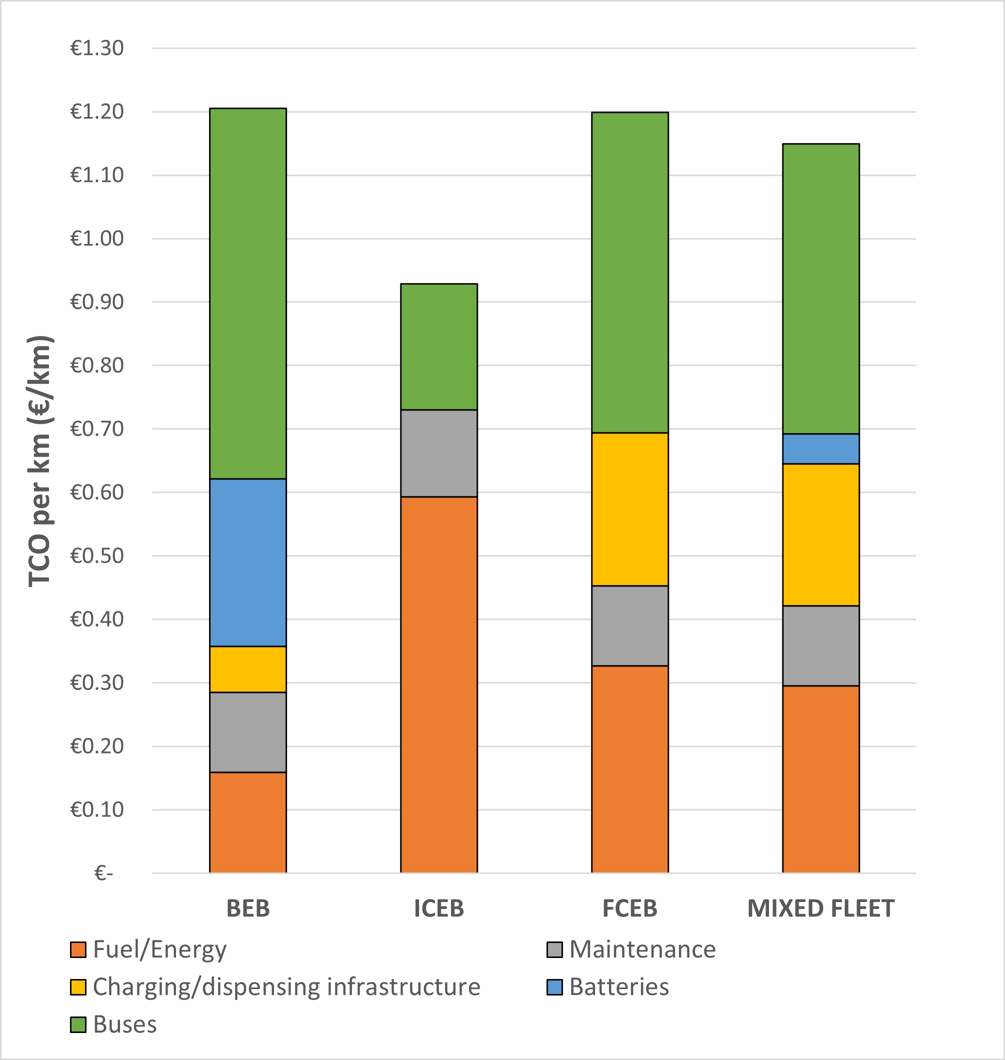
From routes to networks*
Galway has 40 double-deck buses in its fleet
More than 70% exceed the calculated battery maximum km/day. They can be decarbonized by:
A greater number of battery buses
An equal number of hydrogen buses
Key assumptions
Diesel price €1.55/L
Electricity price 16 c/kWh
Hydrogen price €7/kg
Mixed fleet gives the lowest TCO
Total Cost of Ownership across fleet
All battery
All diesel
All H2
Mixed
* These are unpublished preliminary results

Slide 62
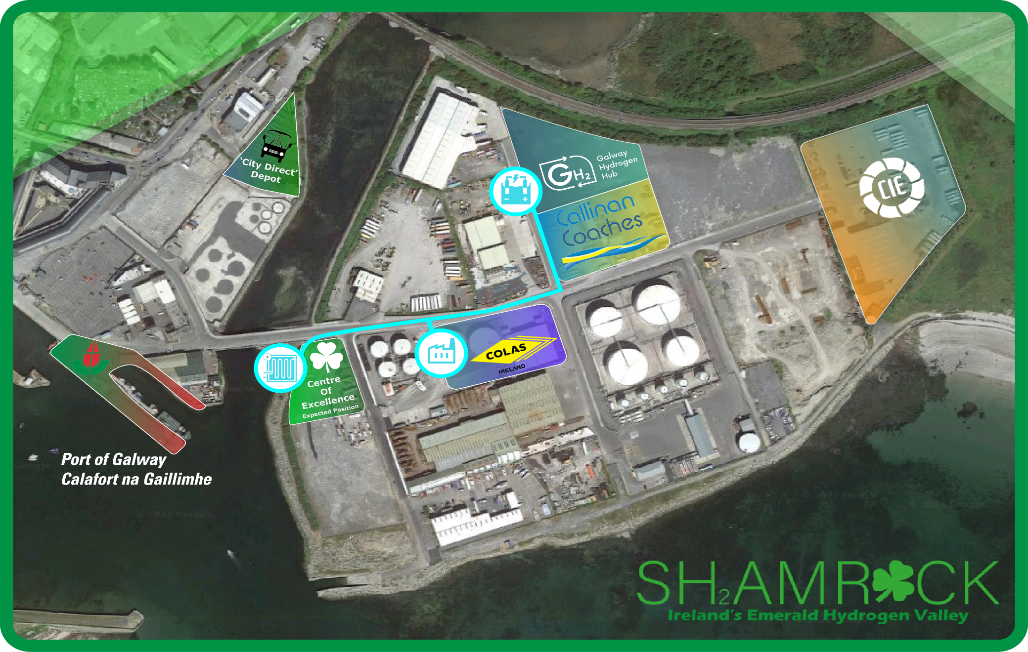
H2 Validation
Galway Hydrogen Hub

Slide 63
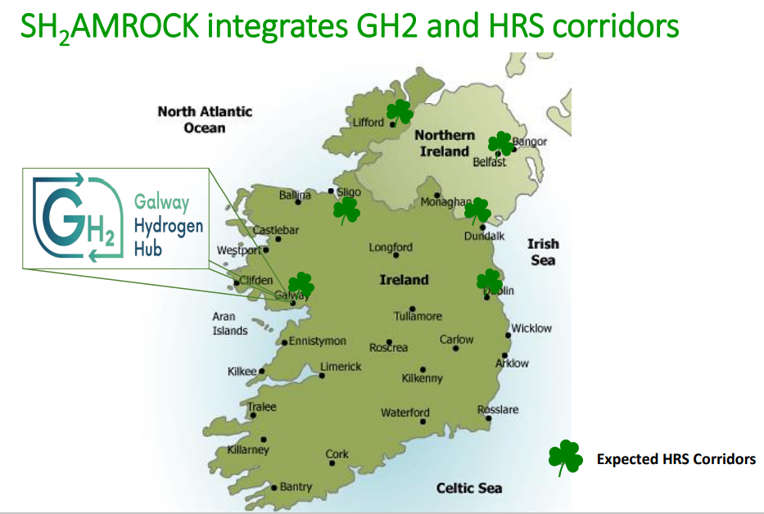
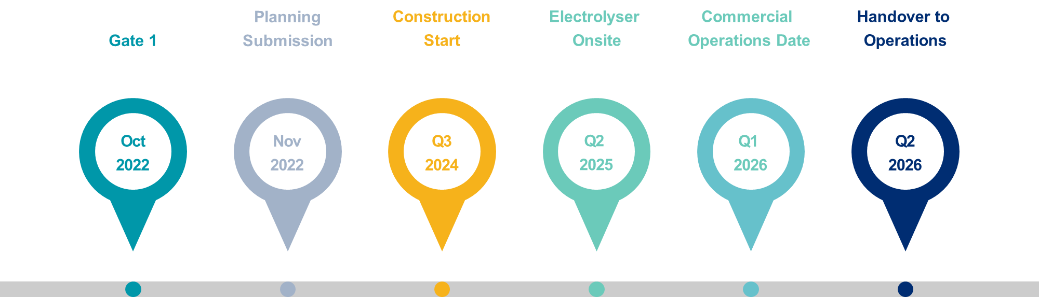
H2 Validation
Galway Hydrogen Hub
SH₂AMROCK is a bid to the Clean Hydrogen Partnership to build Ireland’s first Hydrogen Valley with Galway as a hub
www.gh2.ie

Slide 64
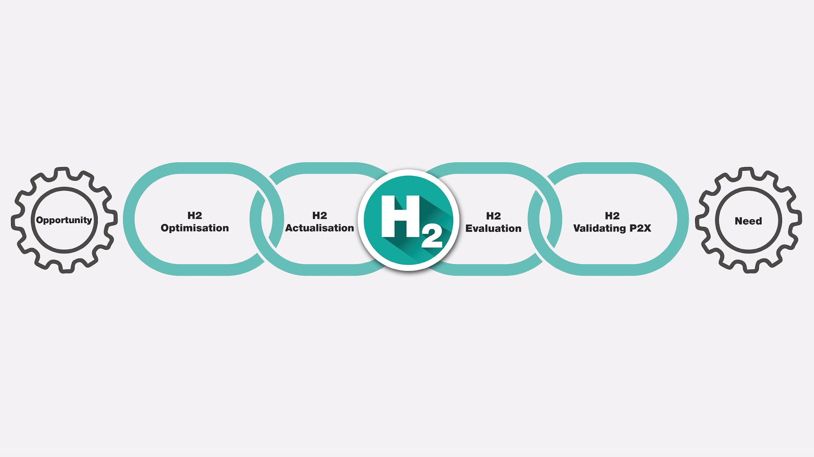

Slide 65
Panel discussion

Slide 66
Q&A

Slide 67


HYDROGEN IRELAND CONFERENCE 2022
Hydrogen: Securing Ireland’s Green Energy Future
22 - 23 November 2022
https://col.eventsair.com/h2irl-2022/registration/Site/Register

Slide 68
CONCLUSION

Slide 69




