Slide 1
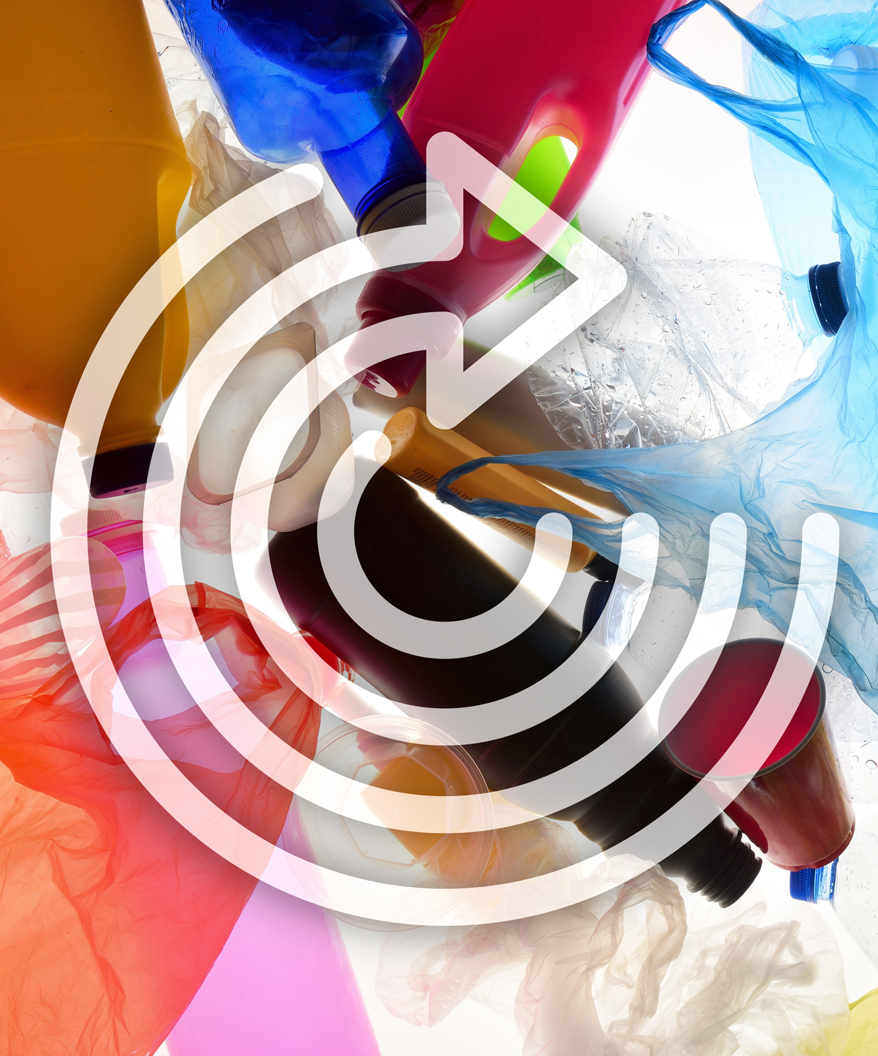

Plastic waste - Let’s use it to make something!

Slide 2
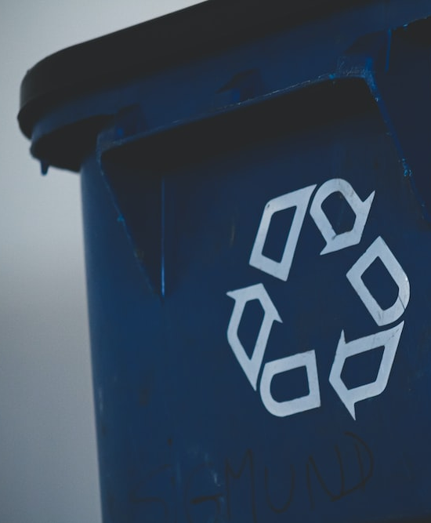
What are we going to do:
Make a mindmap
Hear what others are doing
Plastic hunt
Look at our plastic production process, now and in the future
Do the R-ladder
Look at technologies to recycle plastic
Make your own plastic design
Reflect: look at your own life

Slide 3
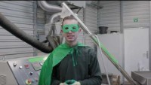
Welcome!
Notes:
https://www.youtube.com/watch?v=ViEKQA9G0Ys&t=1s

Slide 4
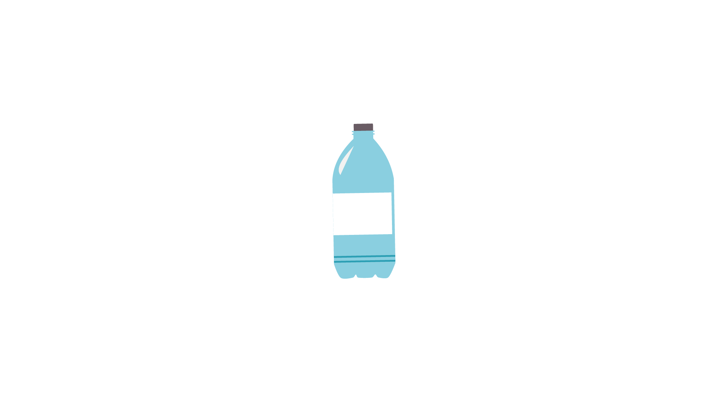

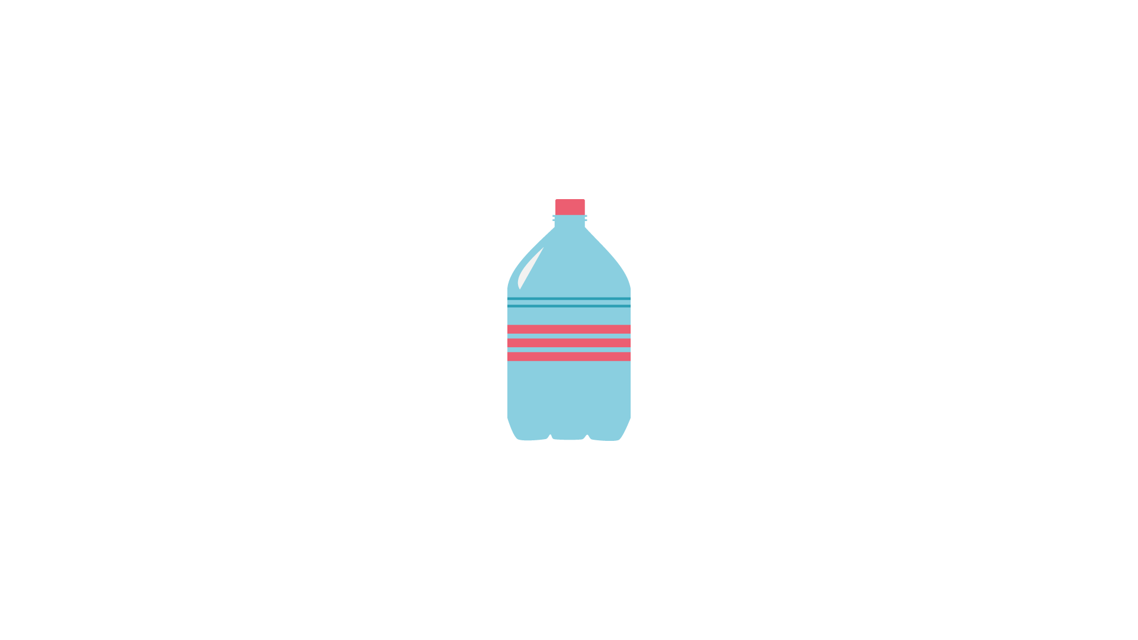
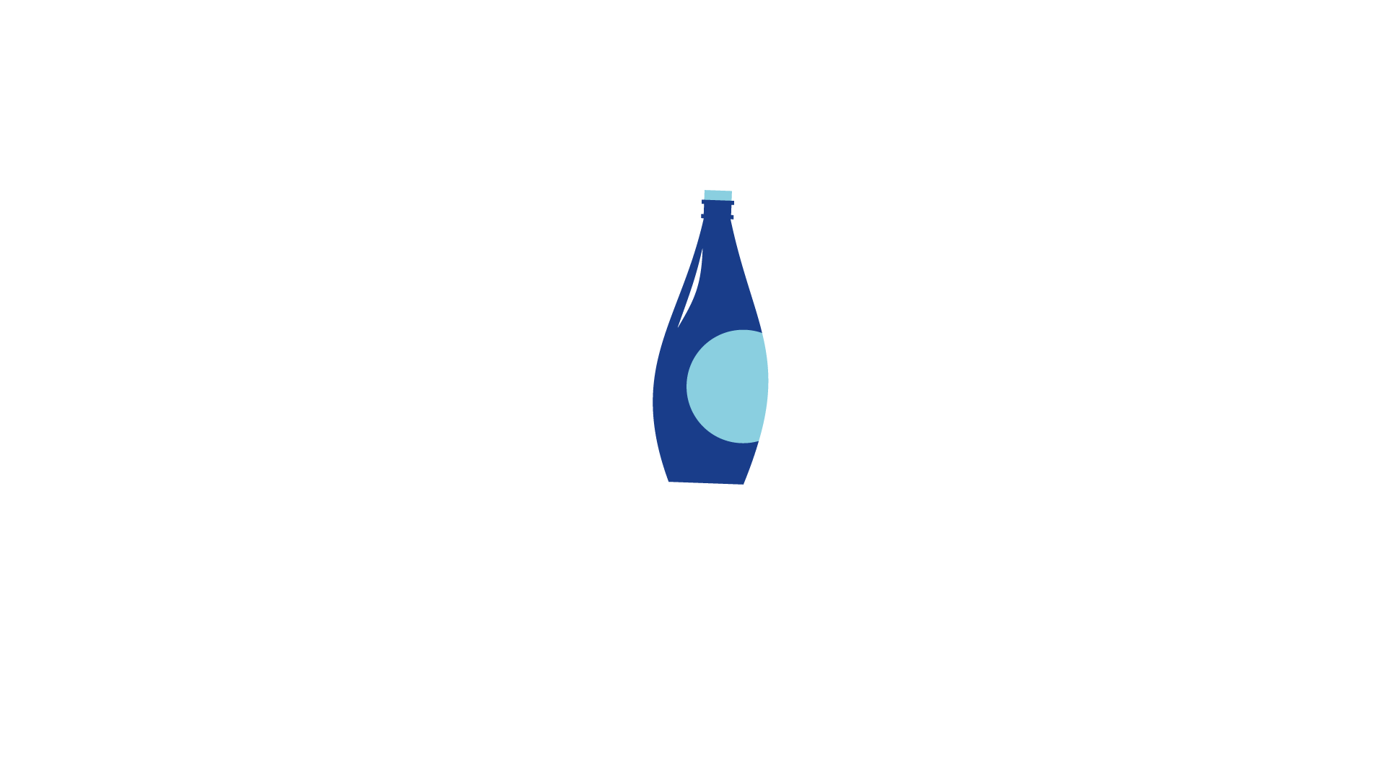


1. Make a mindmap
What do you think of when you think of plastic?
What are the positive and negative sides?
Notes:
Possible questions for the pupils:
Plastics are great because ...? (keep things dry, clean and fresh. They can be flexible, hard, soft ...)
Plastics are bad because ...? (do not degrade, Plastic Soup, waste ...)
What do you do with plastic waste?
Types of plastic: hard, soft
Disposable plastic or reusable plastic (bread bin)
What is plastic made of? (Petroleum, now more frequently from plant-based materials)

Slide 5

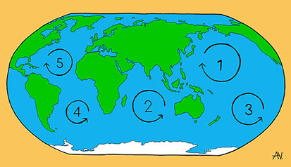
DID YOU KNOW THAT ...
There is more plastic in some parts of the ocean than in others. This is because of gyres.
Gyres are circular ocean currents, largely on the surface of the ocean. Most of the plastic collects together in these gyres.

Slide 6

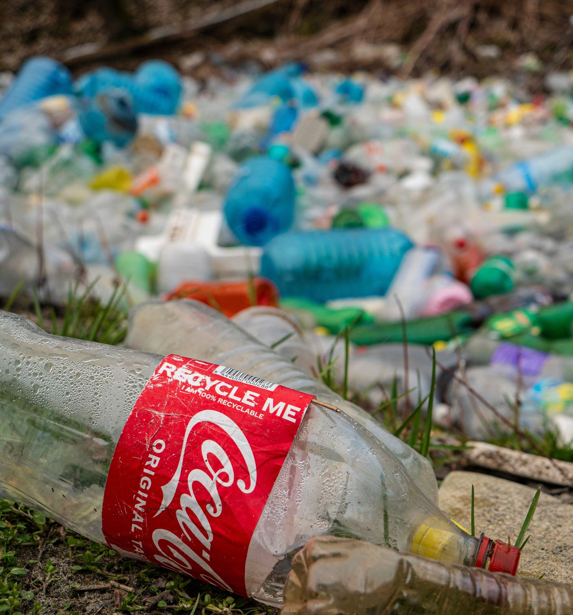
DID YOU KNOW THAT ...
Research has shown that in 2020 most of the products that ended up in the environment were Coca-Cola products.
Worldwide Coca-Cola produces 167,000 plastic bottles every minute. If you would line them up, they would go to the moon and back 31 times.

Slide 7
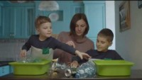
2. What do others think about plastic?
Notes:
https://www.youtube.com/watch?v=CtWfYm5UxHU

Slide 8
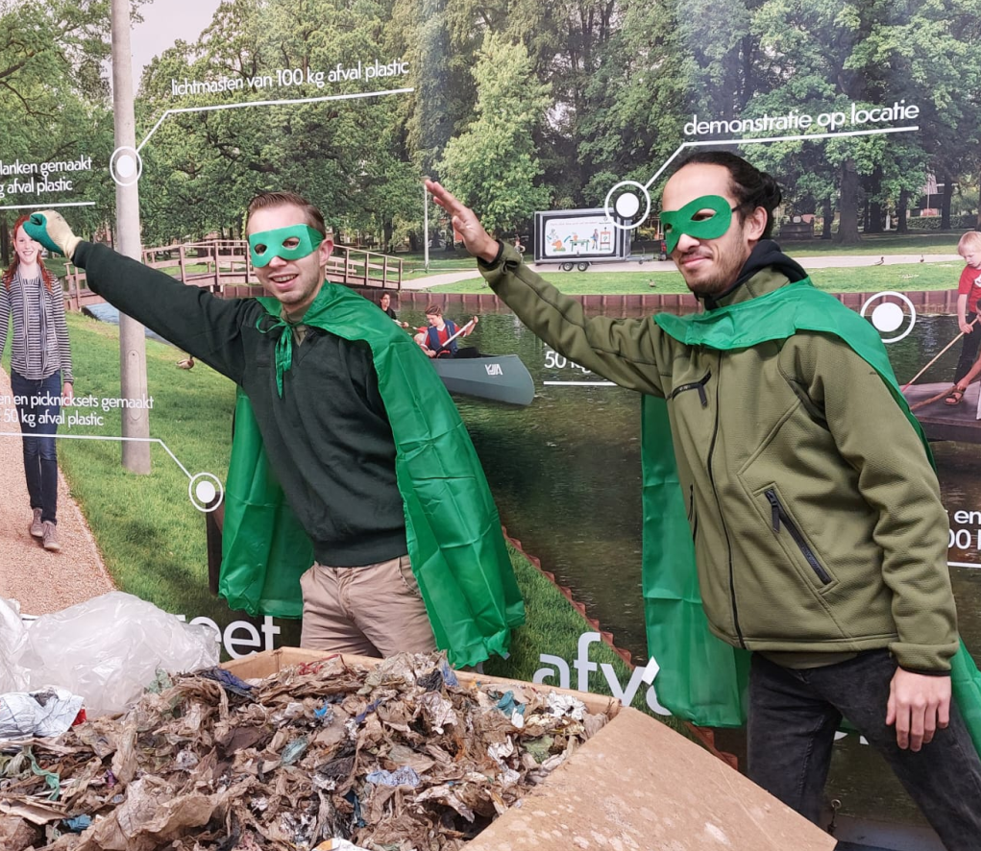
3. PLASTIC HUNT
What are we going to do?
You have all brought two pieces of clean plastic.
Get together in groups of 4.
Put all the plastic pieces onto 1 table and mark them on the Checklist according to their category.
Notes:
Put a timer on and see which group can separate the different types of plastic.

Slide 9
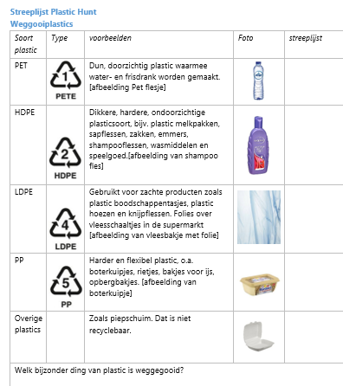
3. PLASTIC HUNT
What is one advantage of so many different types of plastic?
What is a disadvantage when recycling?
What does the recycling plant need to do with so many different types of plastic?
Notes:
With the pupils, count the amount of plastic waste that was thrown away.
It’s a lot.
See the next slide for facts about quantities.

Slide 10
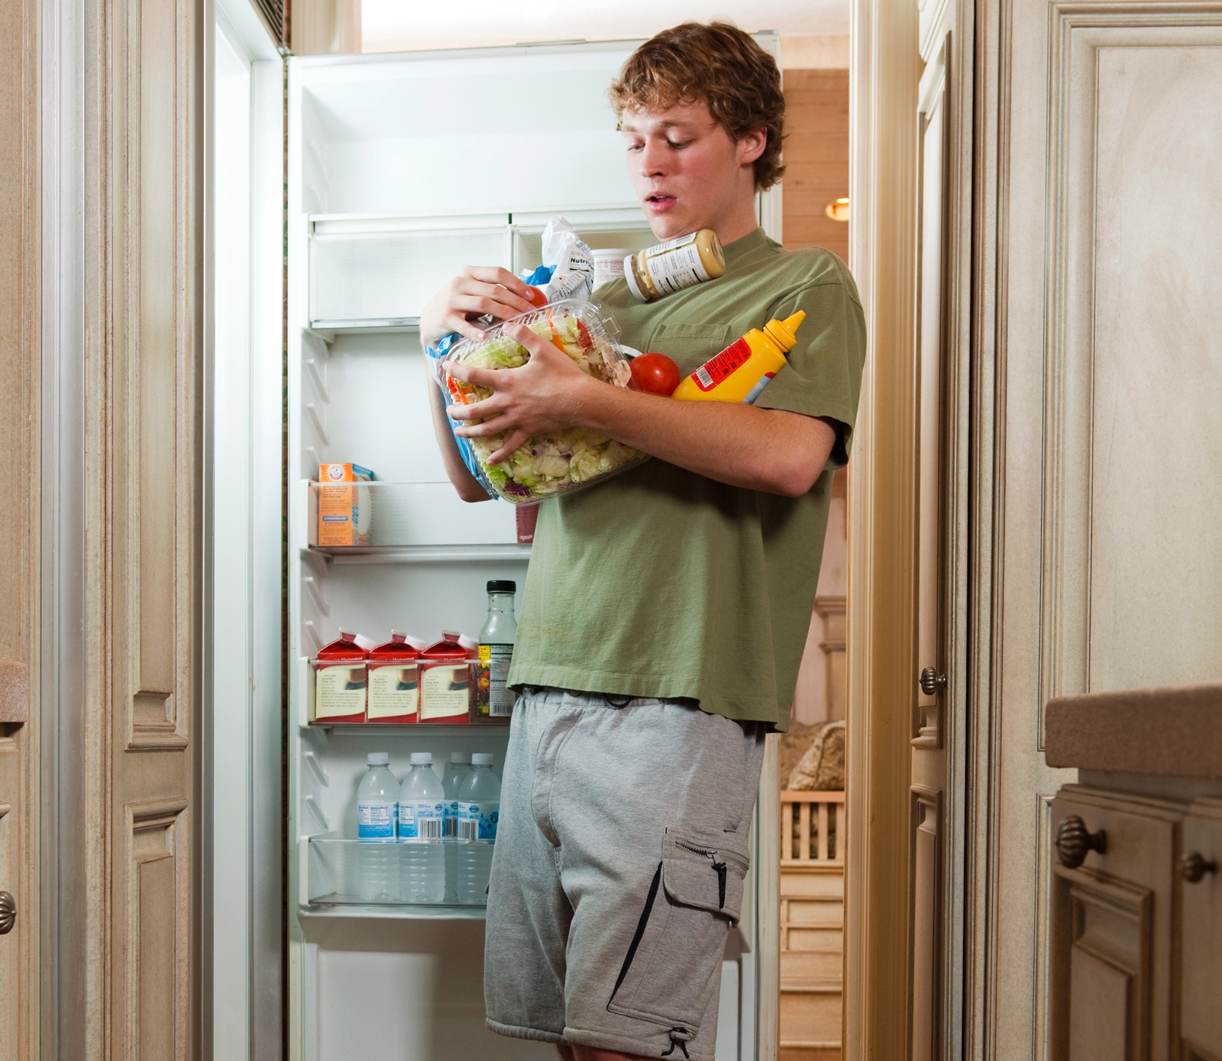
3. PLASTIC HUNT
Option 1
Go to the fridge and collect all the items packaged in plastic for single use.
Arrange them on the table to make a pretty picture
Count the number of disposable plastics
Notes:
The options are for the teacher

Slide 11
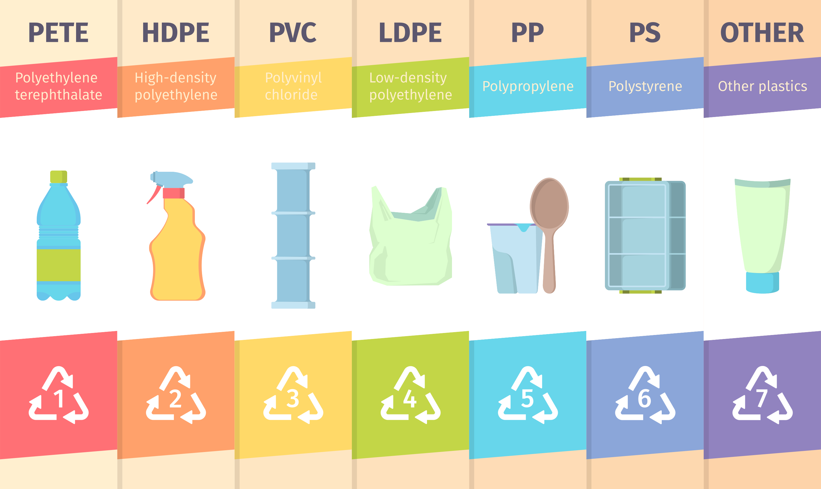
3. PLASTIC HUNT
Option 2
Make a list of all the single use plastics that you can think of.
Do this first in pairs, then with the class
How many did you think of?
Group them into different types of plastic.
Notes:
The options are for the teacher

Slide 12
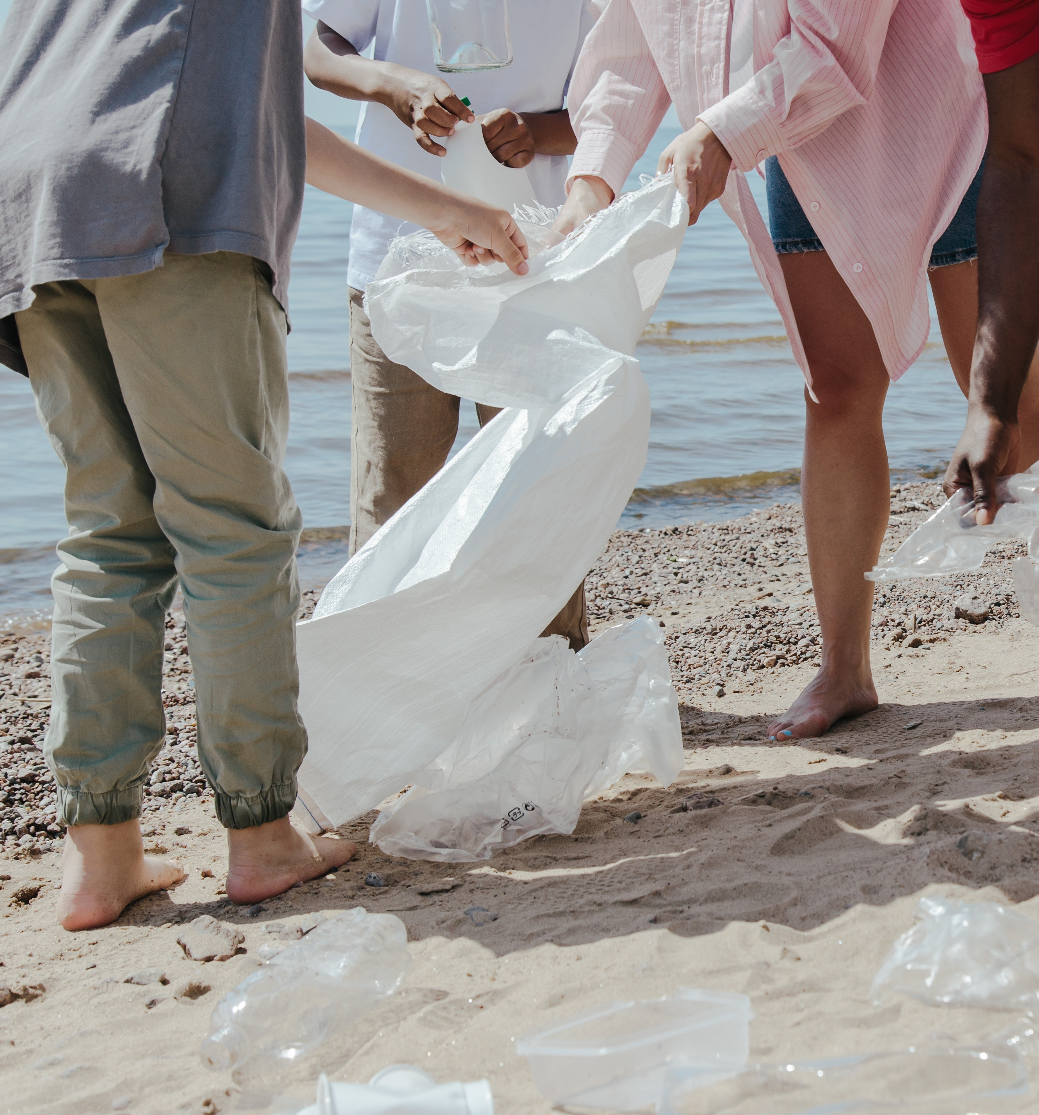
DID YOU KNOW THAT ...
65 million tonnes of plastic is
thrown away every year
65,000,000,000 kg
30% of it is collected
70% is incinerated, dumped or
becomes litter
In the Netherlands, people use 1,500
items of plastic packaging every year
This is 30 kilos of plastic packaging
every year!
How much do you use? What do you think?

Slide 13





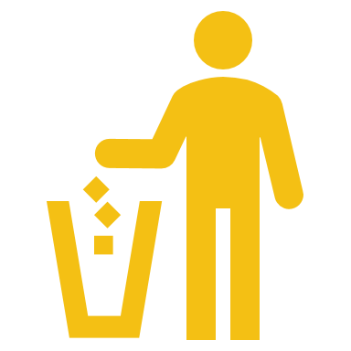



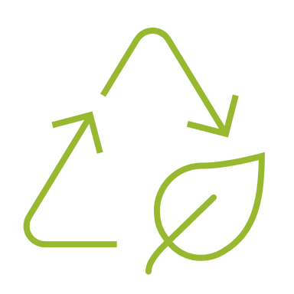
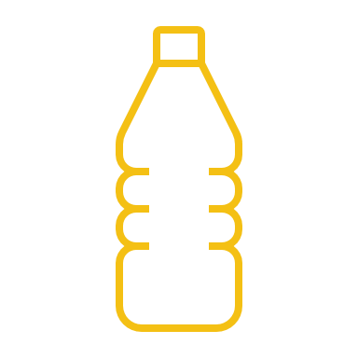

4. Linear versus circular
Notes:
Plastic can be found in all sorts of places. After it ends up in the rubbish bin, it is incinerated or ends up as litter in the environment. This could be improved. Watch the video about the linear and circular economies.
https://www.youtube.com/watch?v=2_orGl_s7UY&t=60s
Can you explain the difference between linear and circular?

Slide 14
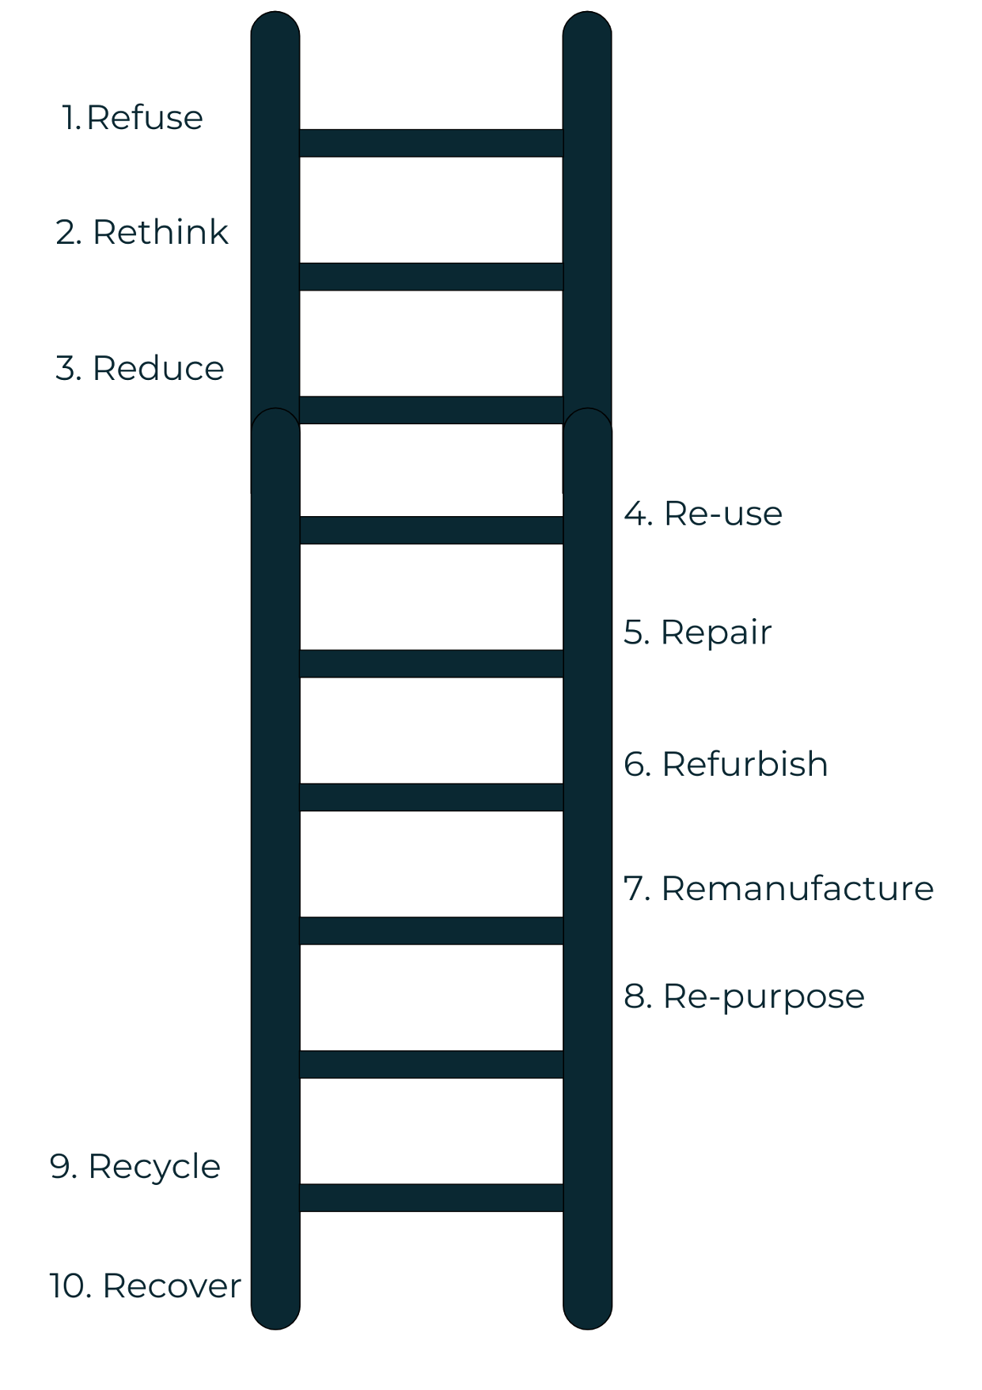
5. Why do we use the
R-ladder?
The higher up the R ladder you get, the lower your raw material use.
R1 is the highest rung.
What rung is Recycling?

Slide 15
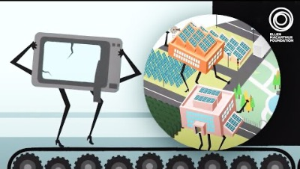
Plastic production and recycling
What types of plastic and disposable plastic waste streams are there?
Linear or circular
Explain the difference between linear and circular
Notes:
Plastic can be found in all sorts of places. After it ends up in the rubbish bin, it goes to the incinerator or ends up as litter in the environment. This could be improved. Watch the video about the linear and circular economies.
https://www.youtube.com/watch?v=2_orGl_s7UY&t=60s
Can you explain the difference between linear and circular?

Slide 16
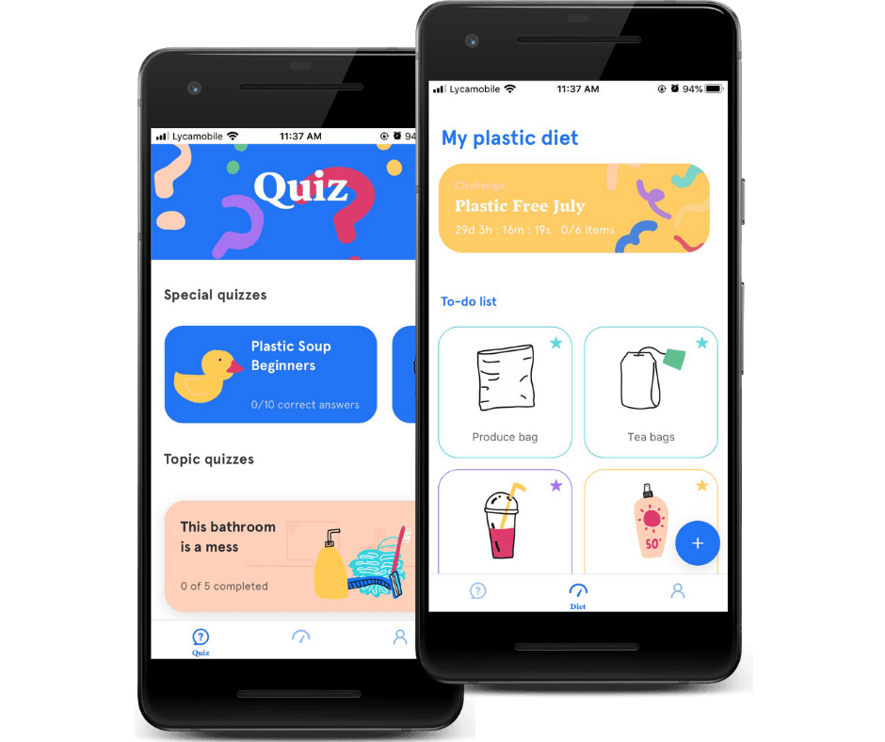
Plastic production and recycling
Plastic footprint
The Plastic Soup Foundation has an app with tips to replace plastic in our daily lives with more sustainable versions:
Download the app!
Notes:
Plastic is collected.
The different factories use recycled plastic.
Sometimes high quality plastic like PET, sometimes low quality plastic like foils.
The plastic needs to be separated at the waste processing plant.
PET sinks. The plastic cap floats. Plastic foil can also float in water.
Adding salt to the water can change the capacity of the plastic to float.

Slide 17
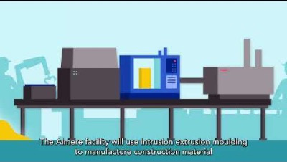
Plastic production and recycling
Plastic recycling of high value (AM) and low value (IEM) plastic
Notes:
Plastic can be found in all sorts of places. After it ends up in the rubbish bin, it is incinerated or ends up as litter in the environment. This could be improved. Watch the video about the linear and circular economies.
https://www.youtube.com/watch?v=2_orGl_s7UY&t=60s
Can you explain the difference between linear and circular?

Slide 18
Plastic production and recycling
Here you can see the difference between IEM and AM technology
Notes:
Plastic can be found in all sorts of places. After it ends up in the rubbish bin, it is incinerated or ends up as litter in the environment. This could be improved. Watch the video about the linear and circular economies.
https://www.youtube.com/watch?v=2_orGl_s7UY&t=60s
Can you explain the difference between linear and circular?

Slide 19
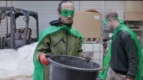
Plastic production and recycling
Notes:
Plastic can be found in all sorts of places. After it ends up in the rubbish bin, it is incinerated or ends up as litter in the environment. This could be improved. Watch the video about the linear and circular economies.
https://www.youtube.com/watch?v=2_orGl_s7UY&t=60s
Can you explain the difference between linear and circular?

Slide 20
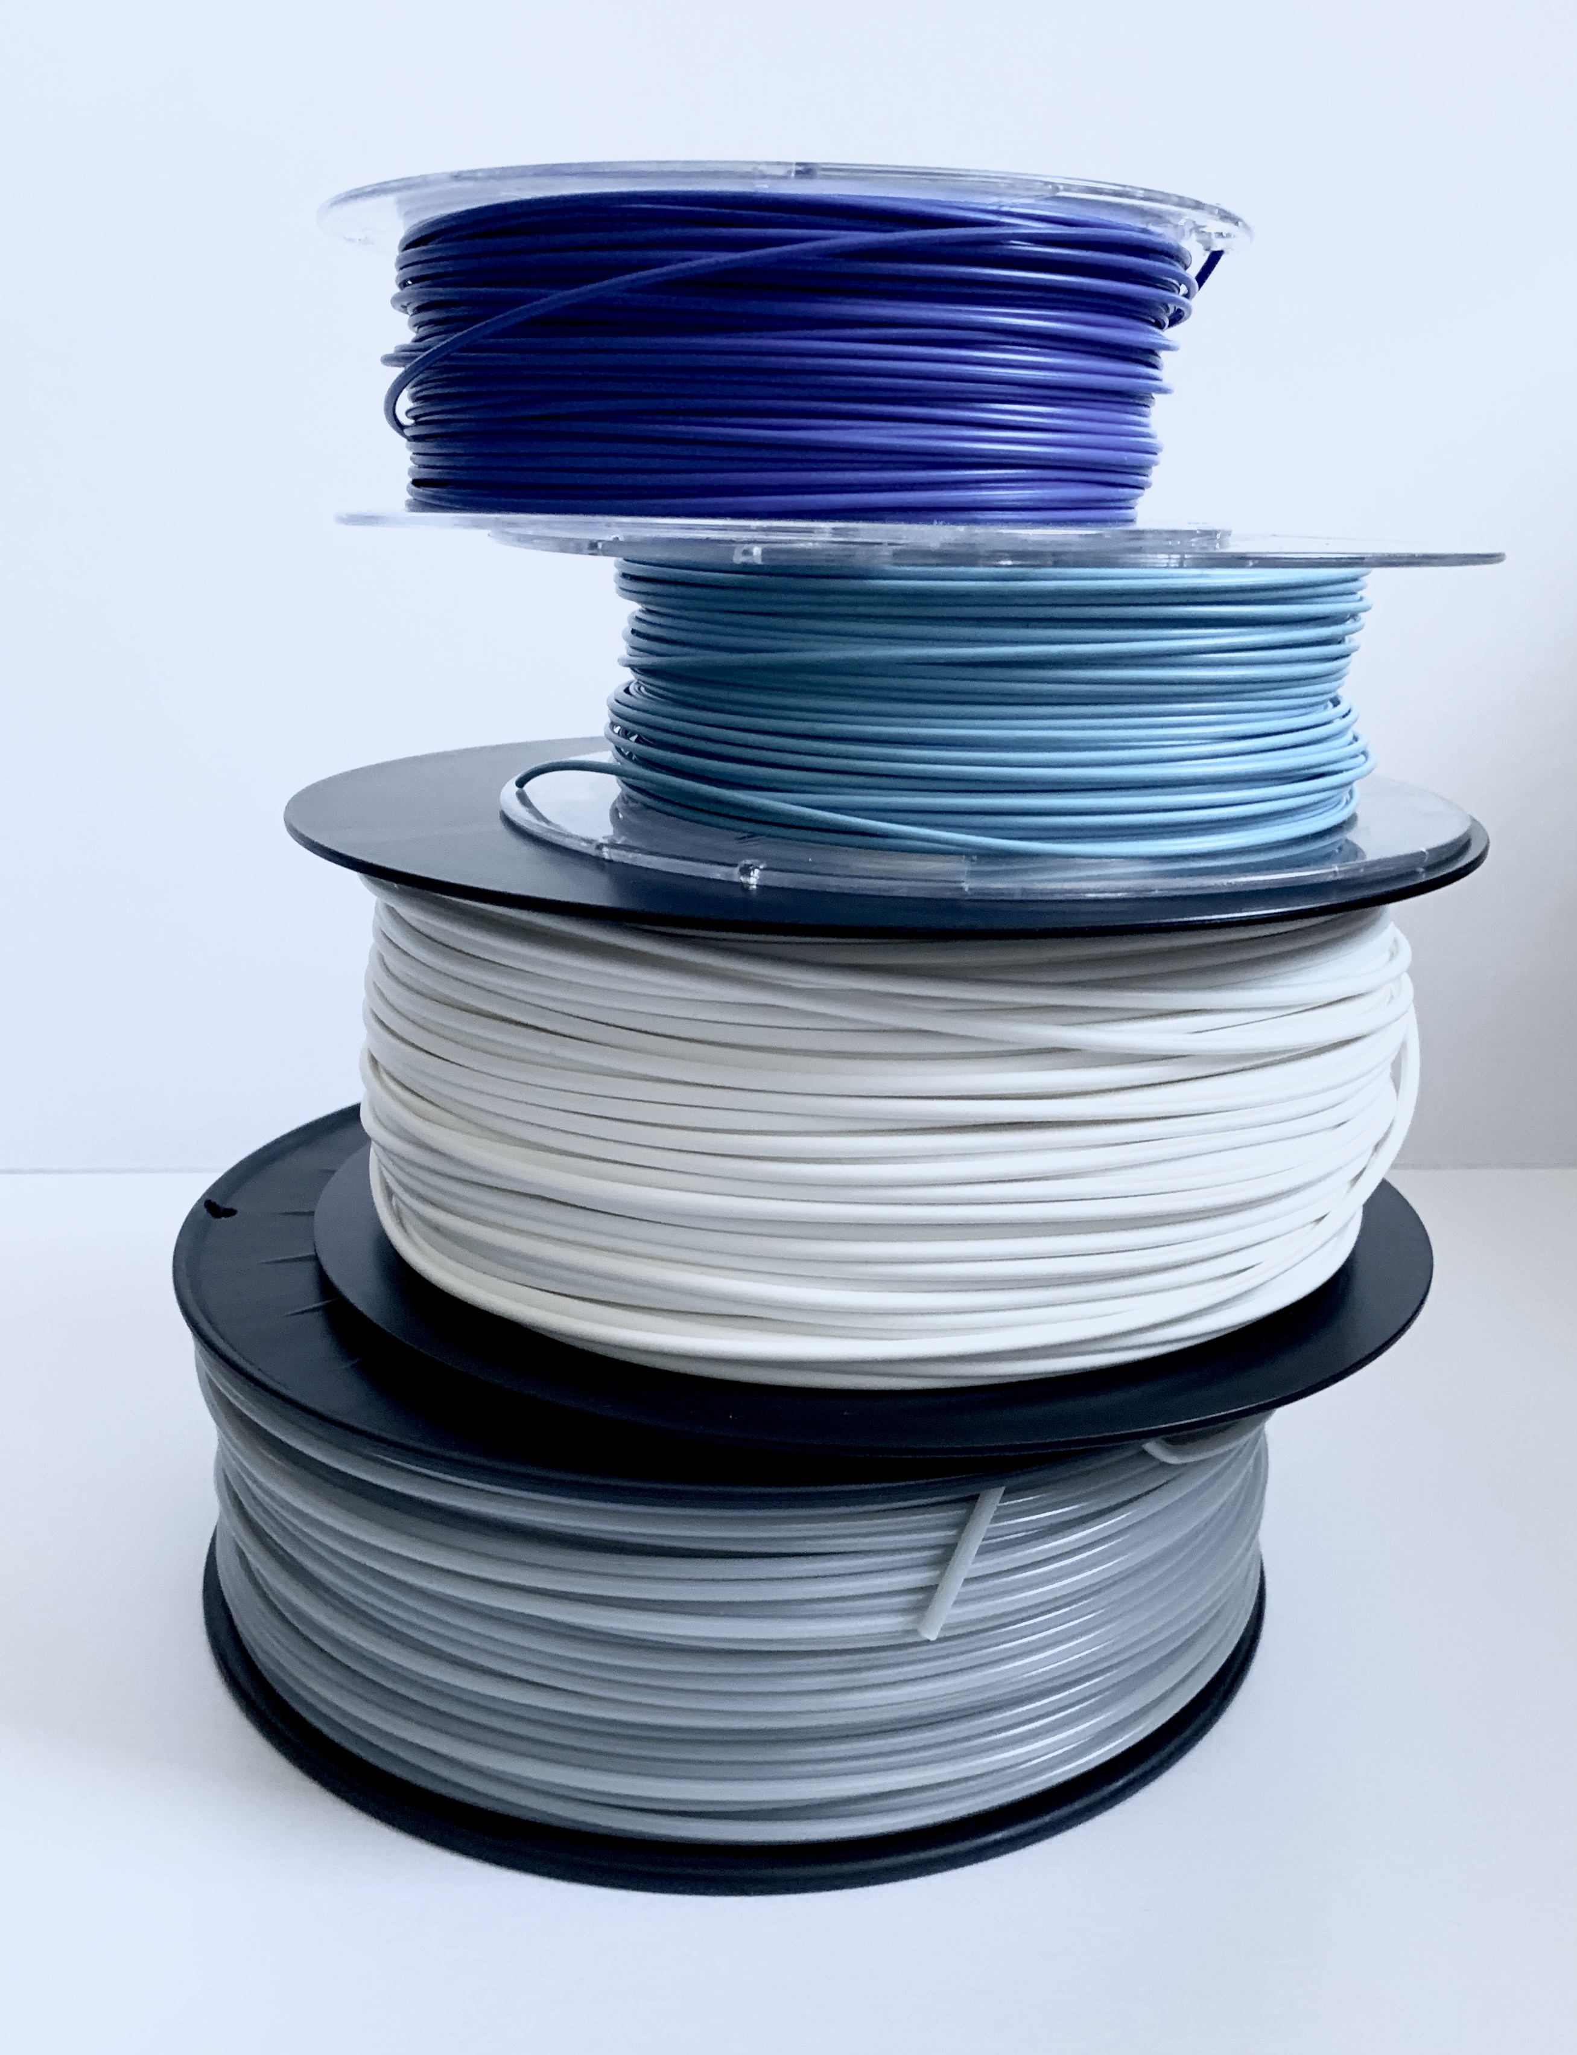
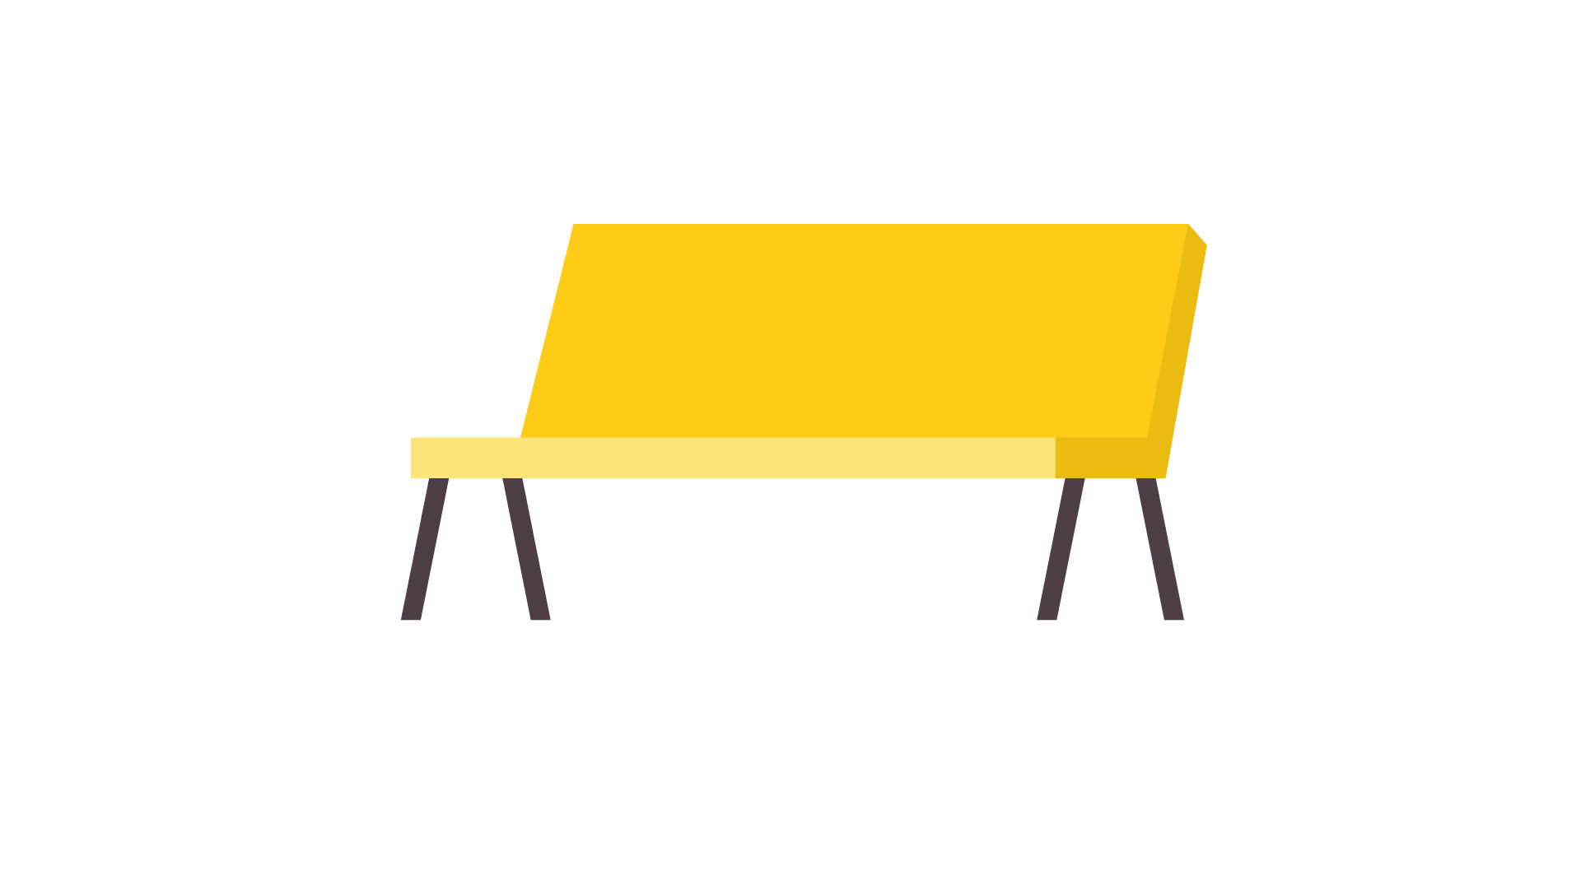

6. Plastic recycling of high value (AM) and low value (IEM) plastic
Technologies to remove plastic from waste
How is recycled plastic made?
Photos AM and IEM products

Slide 21
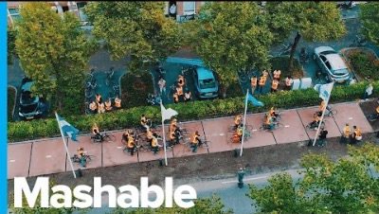
What can we make from plastic waste?
Be creative!
Notes:
Plastic can be found in all sorts of places. After it ends up in the rubbish bin, it is incinerated or ends up as litter in the environment. This could be improved. Watch the video about the linear and circular economies.
https://www.youtube.com/watch?v=2_orGl_s7UY&t=60s
Can you explain the difference between linear and circular?

Slide 22
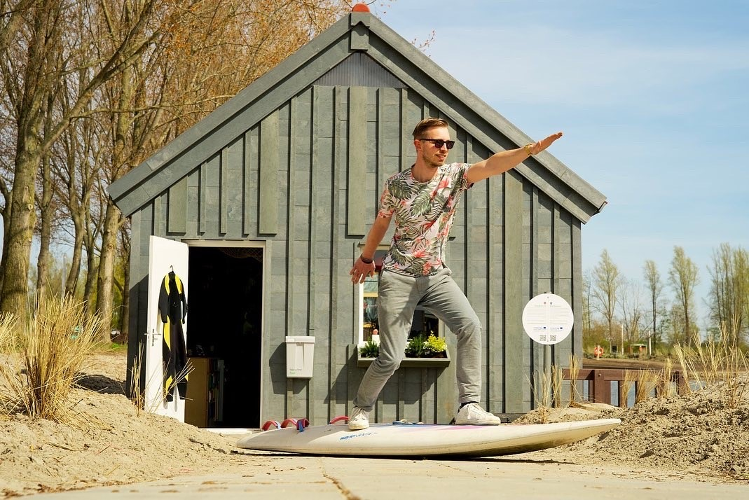
7. MAKE YOUR OWN DESIGN
“I find it difficult that the bench we produce sag. We’ve tried a lot: to put an extra part in the middle of the bench of making the bench smaller. But those are not working.
Can you help me find a solution for a bench that won’t sag?”

Slide 23

7. MAKE YOUR OWN DESIGN
“A company wants to redesign its phone cases using additive manufacturing (3D printing) and recycled plastic. The current design of their phone cases is very simple and they produce hundreds of them each year from virgin plastic using a process called injection molding. How would you use additive manufacturing and recycled plastics to revolutionize the design of the company's phone cases?
You would really help us with a nice design!”

Slide 24
7. MAKE YOUR OWN DESIGN
You are the new designer to make a product more circular. Congratulations!
Choose a product
Start designing
Make a prototype that can be shown

Slide 25
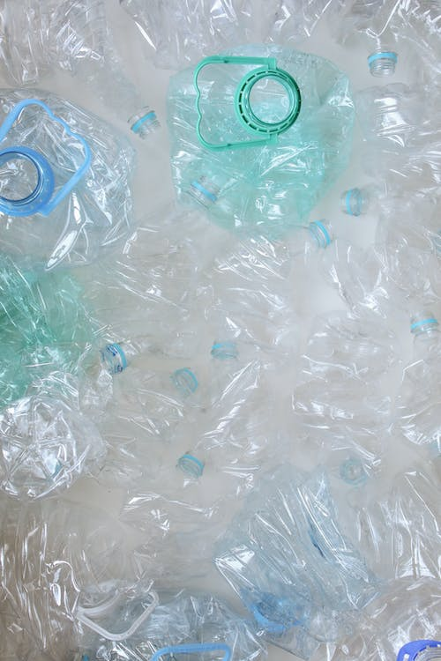
8. Evaluation
What was the most useful part?
Look at the mindmaps again
Share your thoughts about your own life and ideas
What would you advise the school board to do?

Slide 26
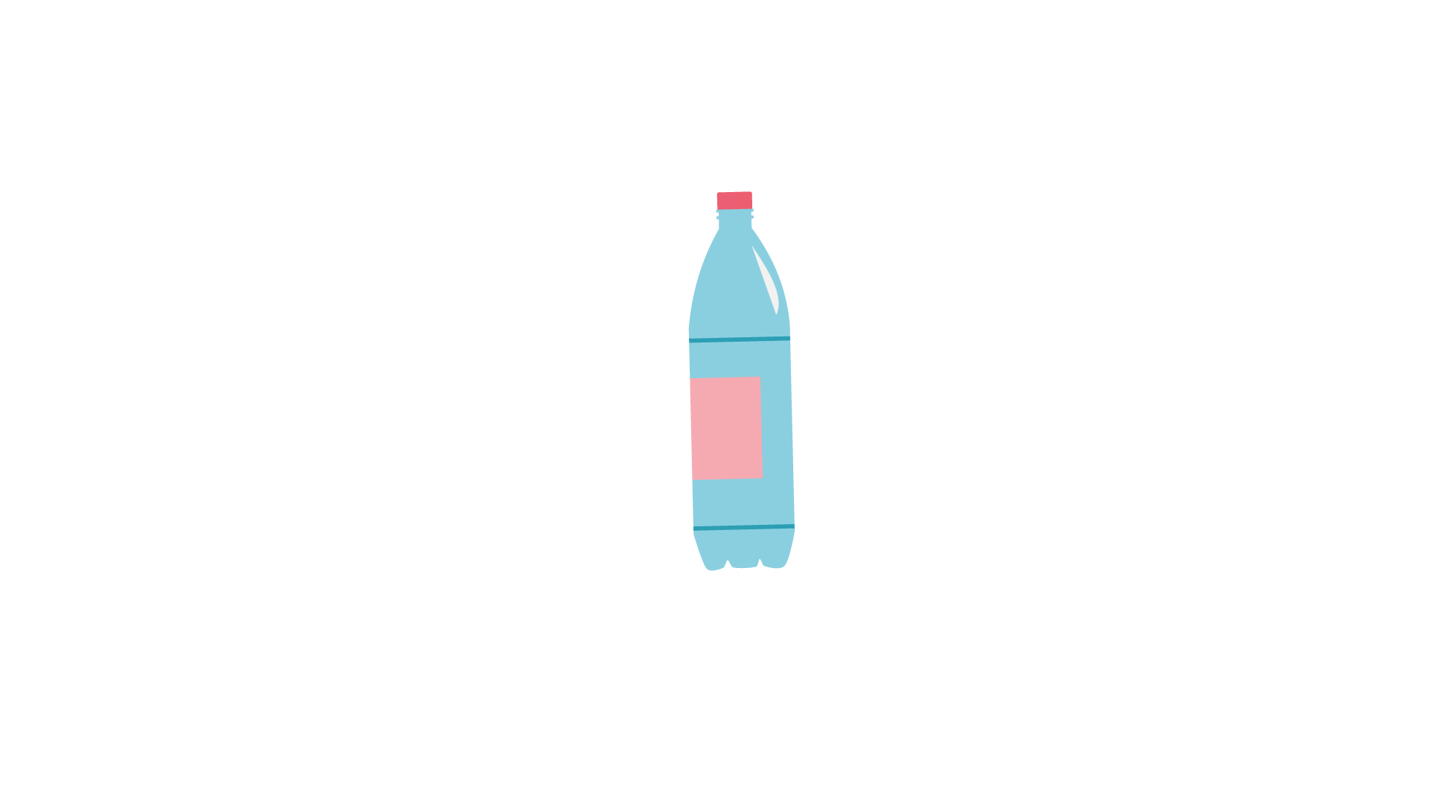
8. Evaluation
How did you think the lesson/lessons went? What went well? What tips do you have?
Did you learn anything in this lesson that you did not already know? If so, what?
Describe in two sentences what this lesson was about.
Name three words that you remember from this lesson.
Is there anything that you would do differently next time?

Slide 27
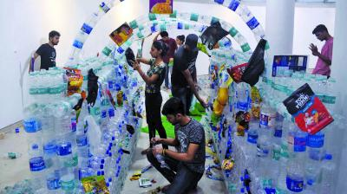

EXTRAS
Organise an exhibition
Organise a meeting with the school board
Organise a gathering with families
Notes:
Fill in the mindmap with what you have learned.
What did you learn about recycling plastic?
Why is it a good idea to recycle plastic?
Do you know why it is called circular?
What can you do to improve your use of plastic?

Slide 28


