Slide 1
GenComm
Building on foundations of micro hubs
GenComm
Partner meeting #23
Cork 29th March 2023
Place image in this area.

Slide 2
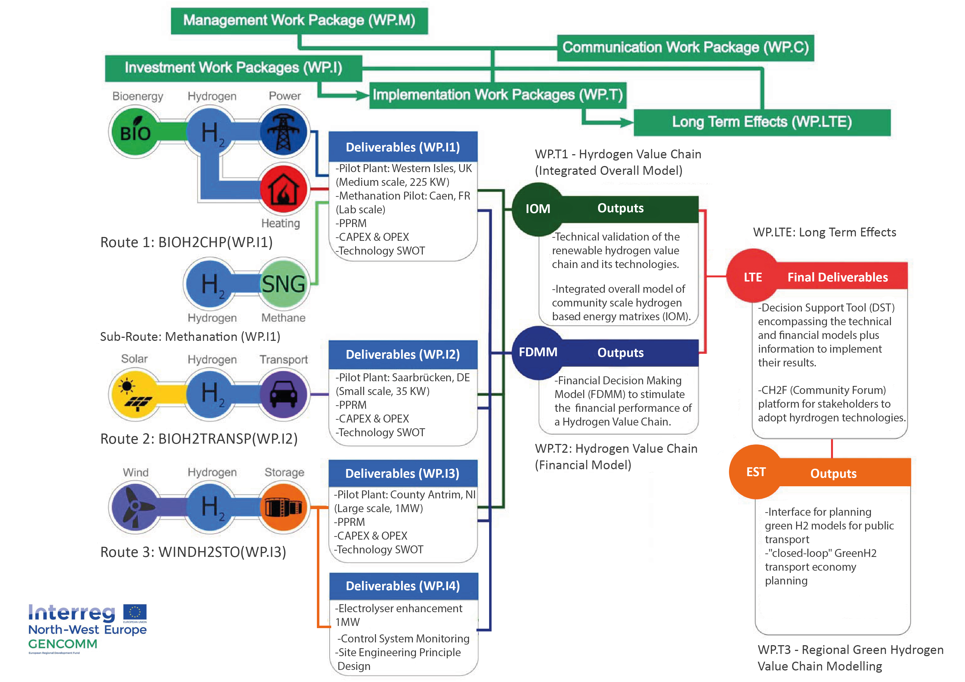
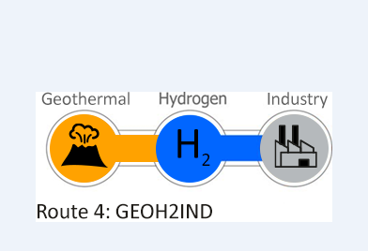
GenComm Value Chain
Notes:
Rural and isolated communities in NWE face unique energy issues related to efficiency, reliability and sustainability. This is commonly due to dependency on external and fossil fuel energy supply, low electricity grid capacity and limited or no connection to wider grids. As a result these communities have higher than average carbon emissions and are more vulnerable to fluctuating fuel prices.

Slide 3
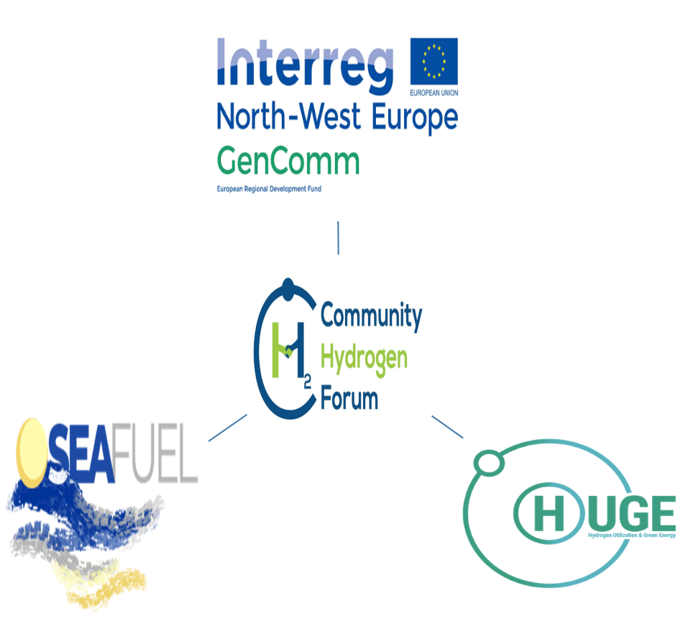
Bringing Cooperation to a new level
Cooperation should be at the heart of the project and should be visible throughout every stage of the project. The partnership is required to describe their approach to cooperation and explain how intensely they will cooperate in order to deliver the project and achieve its overall results.
In order to be eligible, projects must meet the 4 criteria ‘ joint development’, ‘ joint implementation’, ‘ joint staffing’ and ‘ joint financing’ in the cooperation intensity table of the Application Form in STEP 1 and STEP 2.
Community Hydrogen Forum
http://communityh2.eu/about-us/
H2 Congregation

Slide 4
GenComm EU footprint
GenComm project supported by the Interreg North-West Europe Programme.
One of the objectives of the project was to implement 3 pilot H2 Ecosystems using the main northwest European renewable sources (Solar, Wind, and Bioenergy) with energy storage.
Based on these pilot plants the project aimed at developing integrated technical and financial simulation models acting as a Decision Support Tool (DST) that provides a roadmap for communities to transition to renewable, hydrogen-based energy matrixes.
The model replicates Hydrogen Valleys developed in one part of Europe in other geographies.
Key support instrument recommended to allow less advanced regions to replicate the Hydrogen Valleys projects being developed in more “hydrogen mature” countries?

Slide 5
H2 Disruptive Technologies
Green H2 and Hydrogen Valleys are disruptive approaches in tackling our energy needs and challenging the conservative fossil fuelled energy market. This disruption is essential in the development of a new hydrogen economy because it disrupts at all stages in production, transportation and end use.
Disruption brings ‘change’ not ‘transformation.’ In order to meet our energy need we cannot merely transform the current energy system
Hydrogen disruption is a breed apart – it is carving out a whole new energy process that Europe can develop, manage and control. Therefore, as with the 4-Stage Value Chain in the Commodification of Green Hydrogen we must change every part of the current energy system to deliver disruptive solutions in hydrogen production, transportation and end use that will deliver the new hydrogen economy that is essential for Europe.
Hydrogen Valleys can and are delivering a change in our energy markets. They are disrupting the current fossil fuel based energy status quo that is clearly incapable of empowering Europe to meet the twin crises of climate and energy security. Hydrogen Valleys are carving out a new energy world, one which Europe can manage every step of the supply chain and one which will provide a green stable energy future for us all.

Slide 6
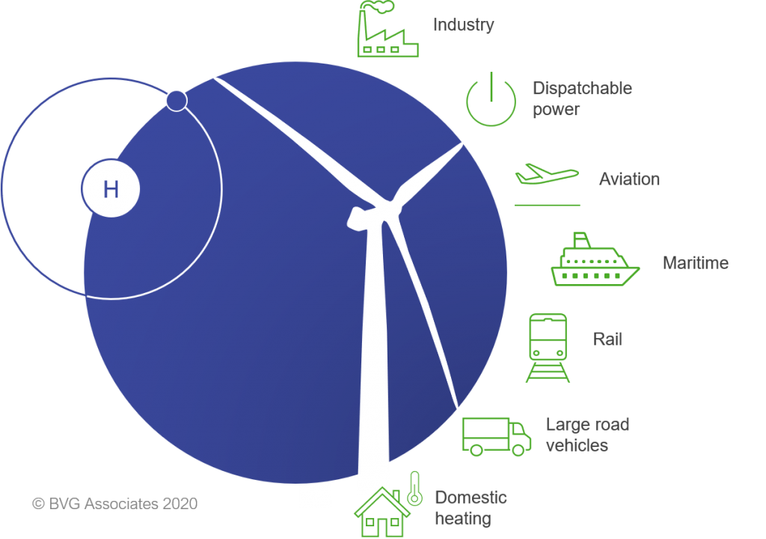
Hydrogen Leverage
Hard to decarbonise sectors
Clean hydrogen plays a critical role on the global path to net zero and importantly it forms a key interconnecting pillar between other key clean technologies

Slide 7
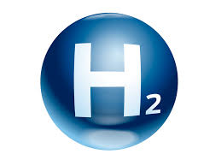
H2CAT
Partnership & Cohesion
The catalyst for H2 - powering hydrogen innovation, entrepreneurship and deployment
Working in Government Departments and other stakeholders the centre will inform, support and drive the commercial scale up: Hydrogen, Carbon Capture, Utilisation and Storage (CCUS), Renewables, Waste to energy, Biofuels, Green natural gas

Slide 8
Hydrogen Training Academy
Prime example of project financial engineering
L2 and L3 - NRC and Belfast
L4 and L5 - Know Hy - CAF
Train the trainer - Know Hy -
L5 and above - QUB
PGCE - QUB and Belfast Met
L2 and L3 BMet/NRC
L4 and L5 BMet/NRC
Train the Trainer M&EA
L5 and L6 QUB
PGCE QUB

Slide 9
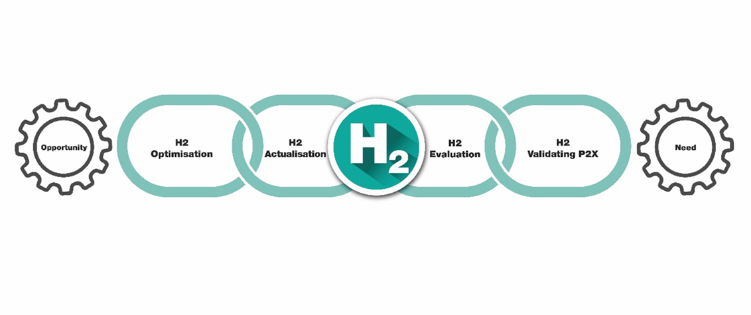
EUSEW 2022
Alignment &Optimisation
The commodification of Green H2 for Europe
Europe faces multiple pressures to decarbonise economies and to accelerate the integration of greater renewable energy sources into our energy systems.
H2 - vectors of change for the energy industry
Hydrogen is a versatile energy vector that can circumnavigate many decarbonisation obstacles but in doing so, it has many challenges to become universally accepted and utilised
The 4-Stage Green H2 Commodification Value Chain

Slide 10
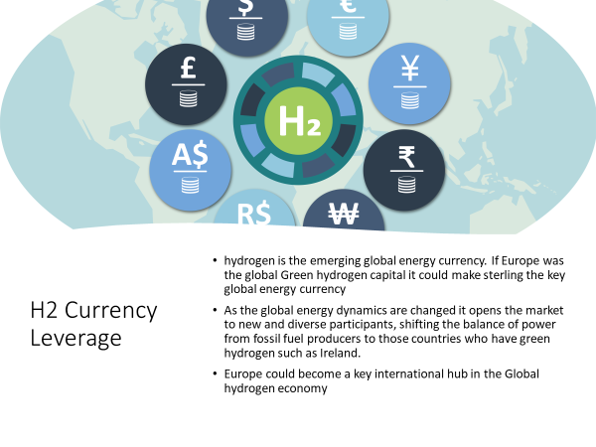
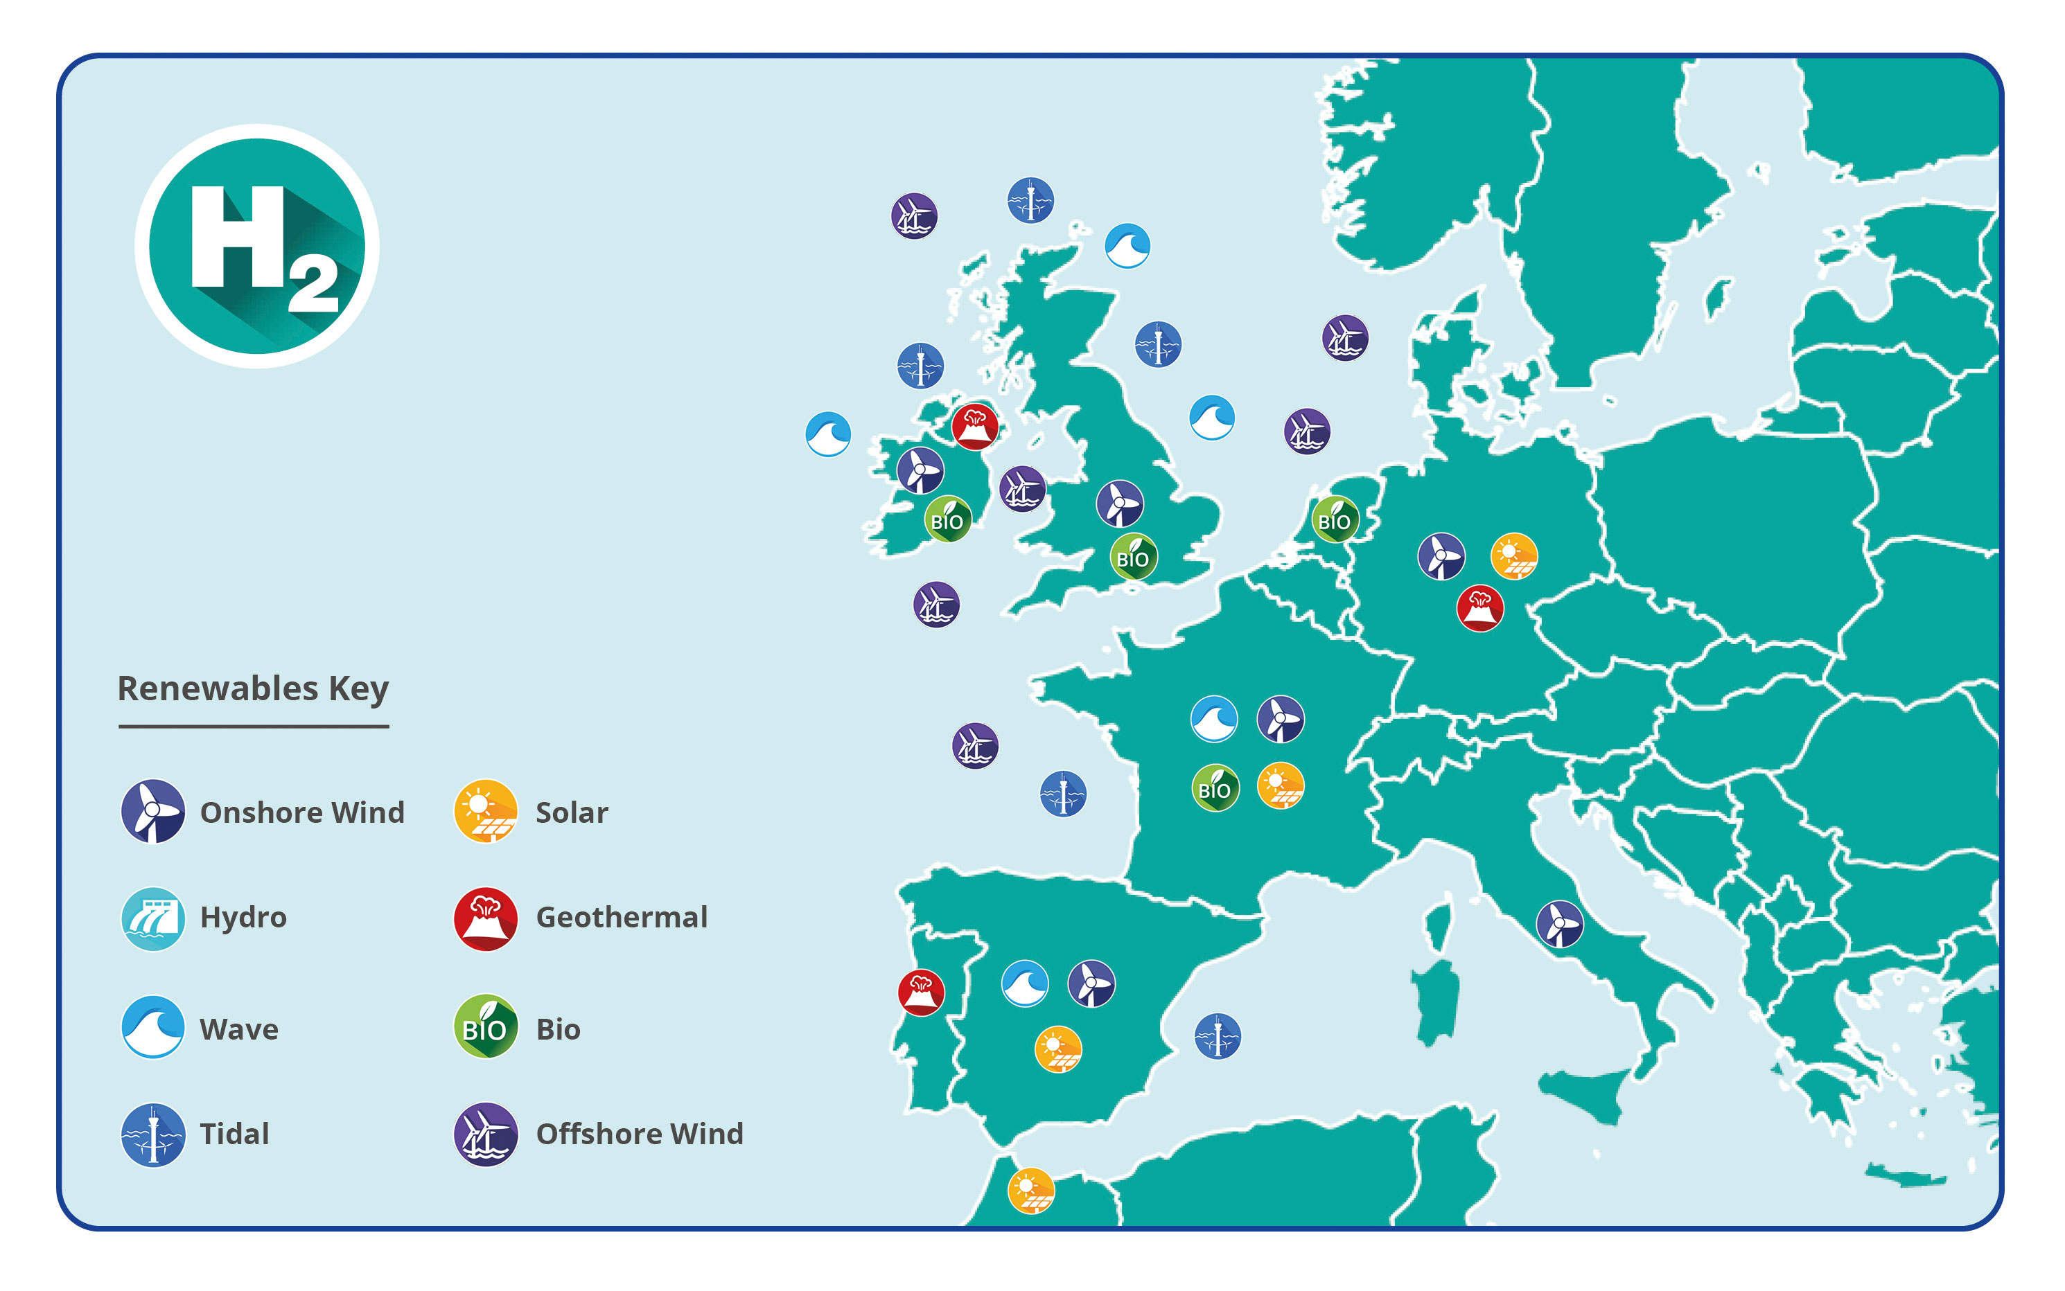
Going beyond the obvious
Hydrogen Topography

Slide 11
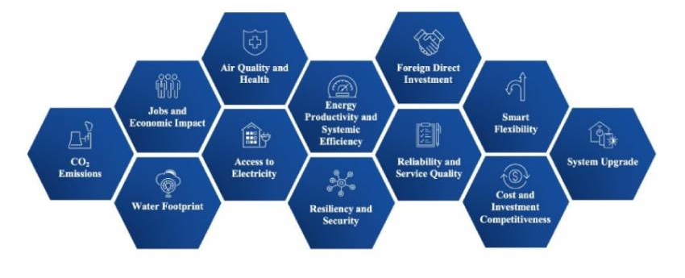
H2 Transition Opportunities
Reach Impact & Evaluation
As Europe transitions to net zero, position NI as the lead in clean hydrogen trade Accelerate our current EU clean hydrogen journey
Develop increased additional links with BEIS
Stimulate increased Green H2 awareness and demand and ‘position’ that all transactions are carried out in sterling.
Progress the H2 CAT model, transition NI towards a climate-neutral and more resilient economy
Expand our work to include digitalization and implementing a well-thought-out circular economy model.
The recovery post COVID is predicated on the Green Economy and Digitalisation.

Slide 12
Innovation
REPowerEU requires huge leaps in clean energy innovation
Reaching net zero by 2050 requires further rapid deployment of available technologies as well as widespread use of technologies that are not on the market yet.
Most of the global reductions in CO₂ emissions through 2030 in our pathway come from technologies readily available today.
But in 2050, almost half the reductions come from technologies that are currently at the demonstration or prototype phase.
In heavy industry and long-distance transport, the share of emissions reductions from technologies that are still under development today is even higher.

Slide 13
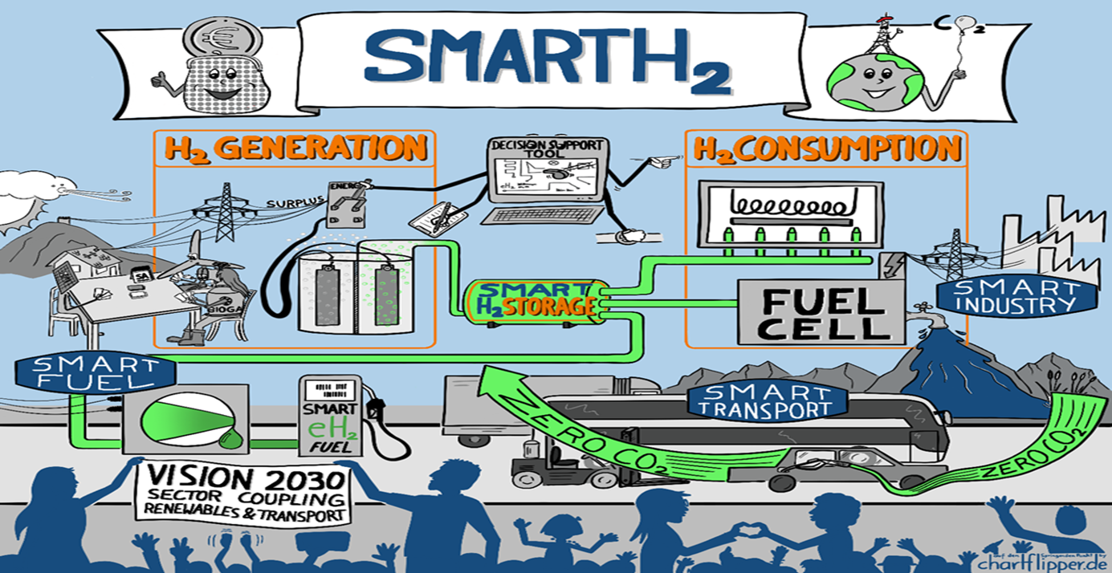
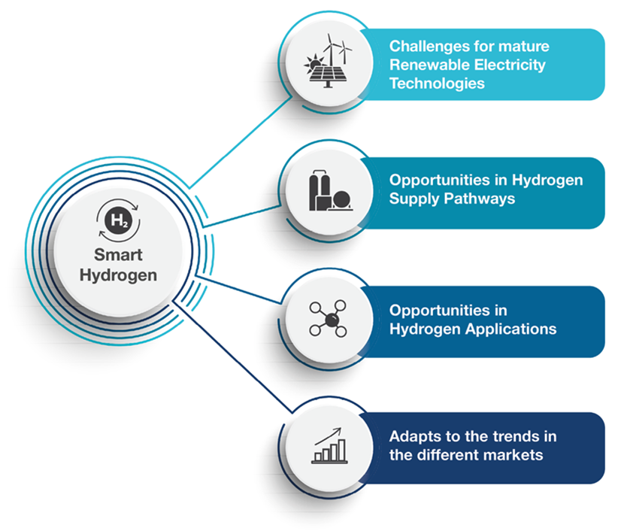
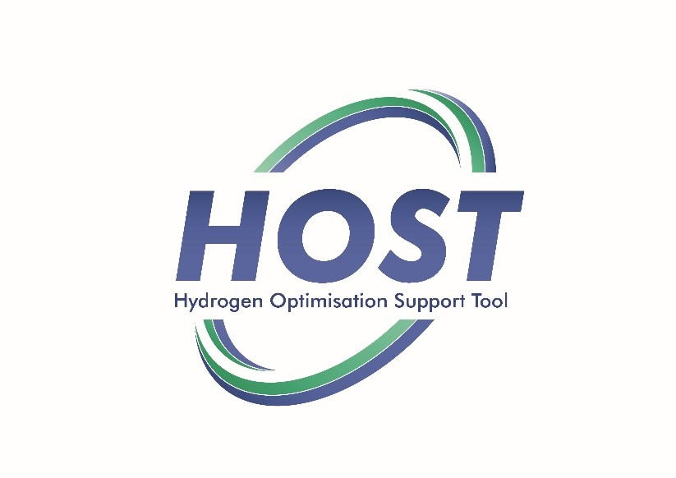
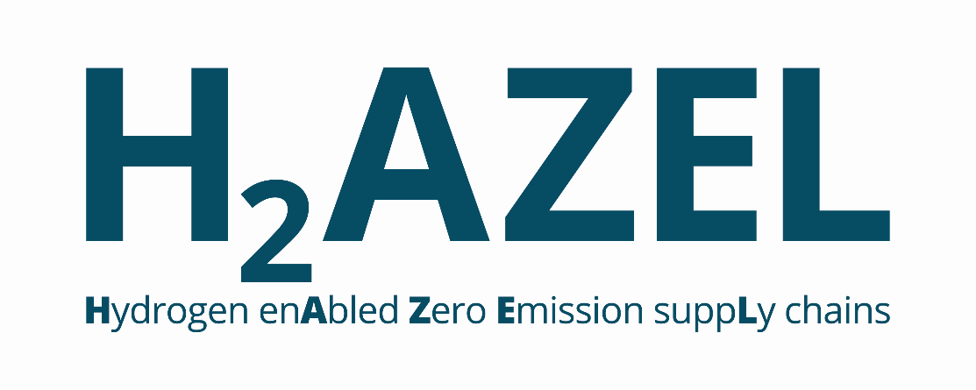
Future Opportunities

Slide 14
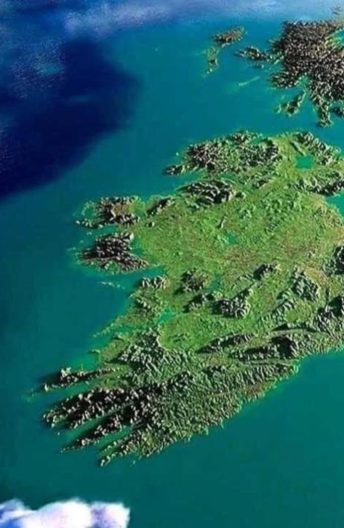
H2ORIZON
Using Green H2 as the catalyst we will develop regionally specific projects to provide energy security through innovative adaption/storage to rebalance current energy systems, smooth the intermittency of renewables, create innovative storage, enhance system renewables compliance and reduce the challenges of power shortages in peak times and in critical industries.
The aim is to develop replicable H2 micro grid & innovative sector coupling opportunities for green industry & power reinforcement. Focus will be on system resource efficiency with innovation & collaboration at technical, commercial & social levels to achieve net zero goals.
A further goal is to improve system resilience through smart, flexible, dispatchable electrolysers supporting the power system via load balancing & system services while producing & storing H2 to complement electrification in decarbonising mobility & for H2 fuel cells for back-up generation.
H2ORIZON will encompass the complete value chain from renewable generation for ‘smart’ H2 production to distribution, storage and end-use, decarbonising energy use sequentially: ferries, back-up power, industrial use, onshore transport & heat.
Hydrogen Valleys ecosystems that link hydrogen production, transportation, and various end
uses, and will be essential in the development of a new hydrogen economy

Slide 15
Contact details and media links
GenComm Website nweurope.eu/gencomm
GenComm LinkedIn GenComm
GenComm twitter @GenComm_CH2F
Community Hydrogen Forum www.communityh2.eu
GenComm Animation
https://vimeo.com/366993950/91cafb0bb6
E-mail - PaulMcCormack@belfastmet.ac.uk

