Slide 1
Hydrogen – Ireland’s Opportunity
Cork – 29th March 2023

Slide 2
Contents
About Hydrogen Europe
Structure
Services
Alliances & Partnerships
Overview of EU legislative developments
Role of ports in hydrogen transition

Slide 3
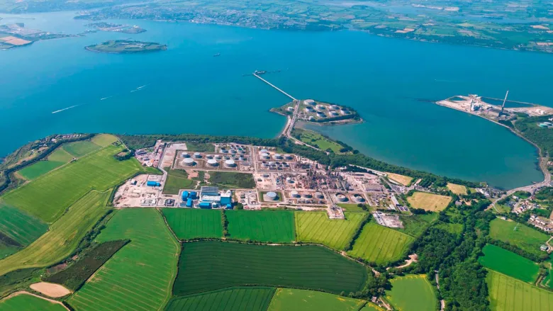
Ireland - From oil to hydrogen
Case 74/83 – Campus oil
Whitegate refinery;
One of the first rulings regarding to energy law;
Concerning the regime of trade of refined products in Ireland;
ECJ recognised the importance of oil products for the security of supply;
40 years later – another energy crisis for EU, but we do not talk about oil anymore, but hydrogen!

Slide 4
About Hydrogen Europe

Slide 5
Hydrogen Europe - our vision and mission
Our Vision: Hydrogen Europe is propelling global carbon neutrality by accelerating the European hydrogen industry.
Our Mission:
To represent European based companies and stakeholders that are committed to moving towards a (circular) carbon neutral economy.
To be the spearhead of the hydrogen industry towards policy and decision makers for hydrogen technology and applications.
To support and facilitate our members in their transition towards (circular) carbon neutral economy while creating and maintaining sustainable jobs.
To drive Markets to Hydrogen-based solutions and remain the key industrial partner of the Clean Hydrogen Joint Undertaking.
Notes:
- Trade association

Slide 6
Hydrogen Europe in Numbers
450+
Members
40+
Employees
We encompass the entire value chain of the hydrogen ecosystem: from production, distribution to end uses, including Industry, EU regions & H2 National Associations. Meet Our Members
120k+
Followers
on Social Media
Follow us on:
Notes:
Trade associations representing the entire hydrogen value-chain in Europe. Slide info.

Slide 7
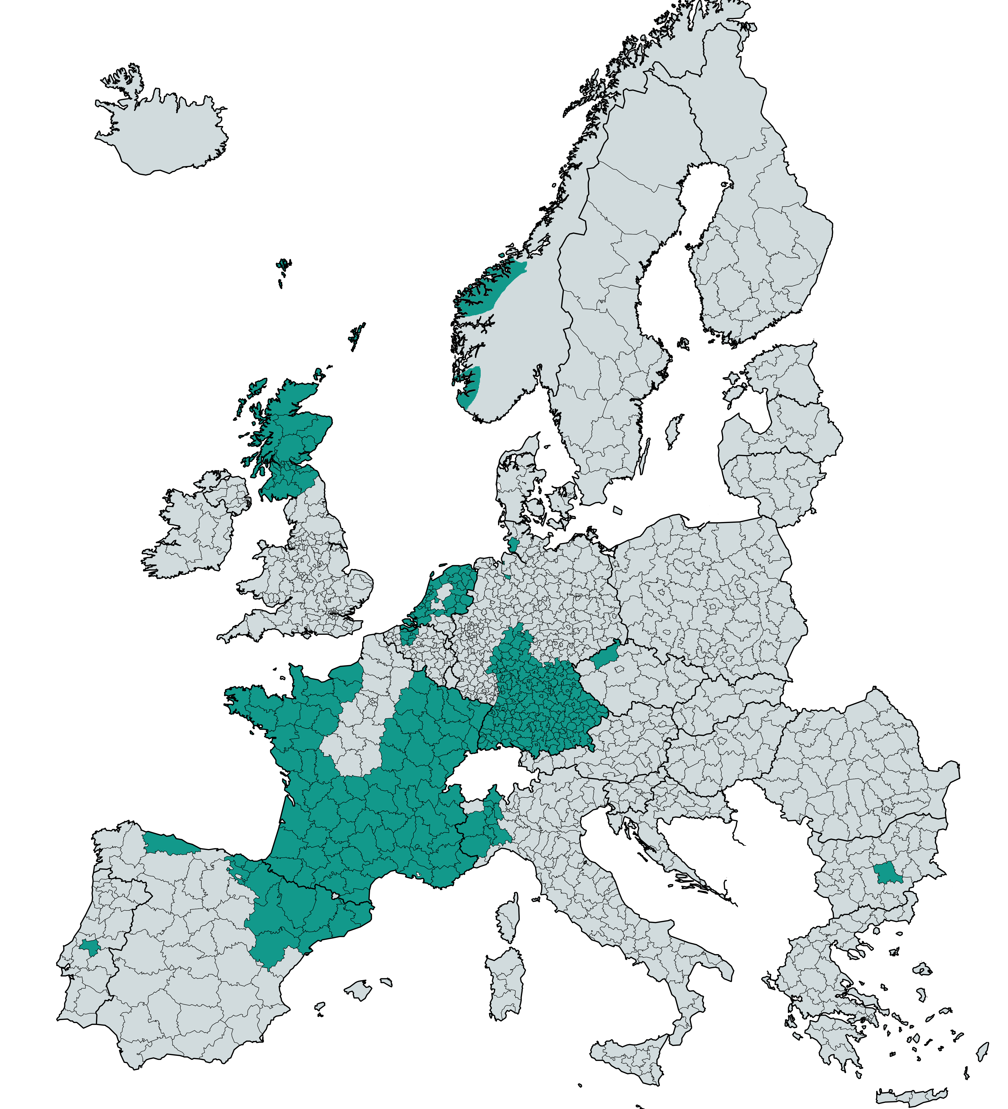
Regional Pillar
Regional Pillar launched in January 2022
32 official members; and several regions in process of joining
Regional representative in the Board of Directors of Hydrogen Europe
Objective of the Pillar
Promoting regional and local support and investment in the H2 value-chain
Facilitating set-up of public funded projects
Match making sessions with industry and research
Promoting interaction between industry, regional and local authorities to improve knowledge sharing
Regional Pillar members
March 2023

Slide 8
Our services

Slide 9
The Backbone of Hydrogen Europe: Our Working Groups
Cars and Vans
Subgroup
Buildings
Production
Energy &
Infrastructure
Aviation
Subgroup
Industry
Water Transport Subgroup
Skills
Funding & Finance
Mobility
Sustainability
Heavy-duty & Non-Road
Vehicles Subgroup
Regional Pillar
Regulation, Codes, Standards & Market
Carbon market reform Ad Hoc Group
Notes:
11 working-groups

Slide 10
Data and Analysis production
Our Market & Technologies Team offers data analyses, fact sheets and deep dive reports on a variety of topics such as, hydrogen production, consumption, logistic costs, relevant EU policies and national strategies.
Notes:
CHM – 2022 – Flagship yearly report, which presents the most comprehensive overview of the hydrogen sector in Europe.

Slide 11
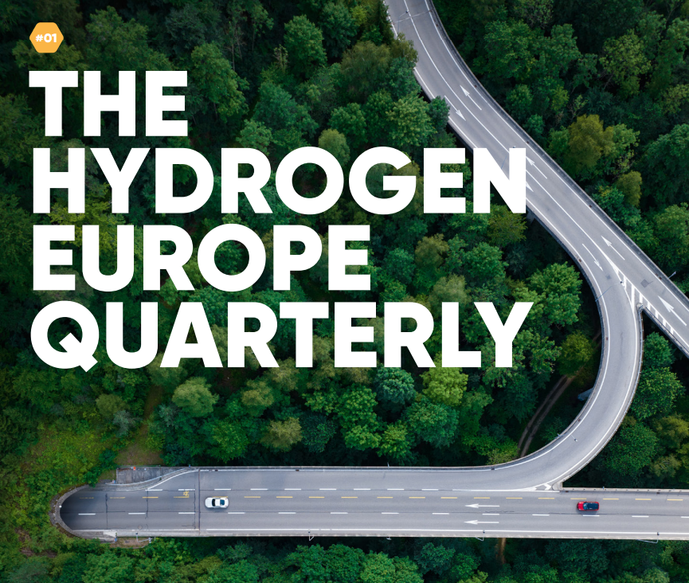
Promoting hydrogen in Europe
Communications
Events
See all Hydrogen Europe’s upcoming events: www.hydrogeneurope.eu/events/

Slide 12
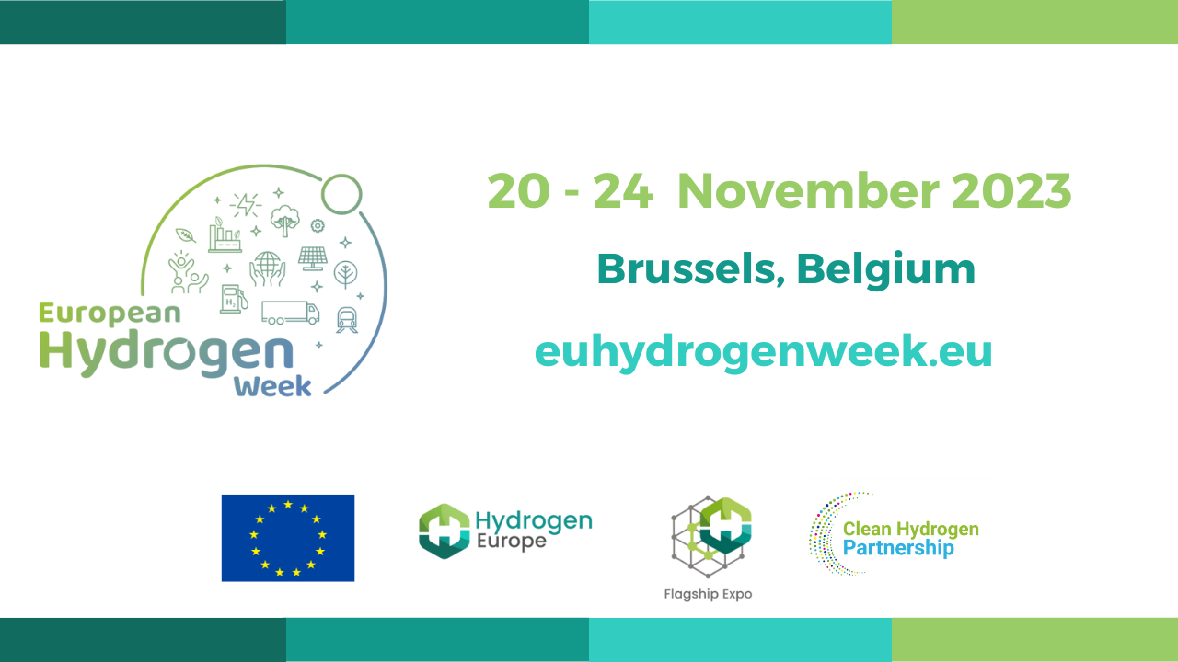
Check the new website!
If you would like to be actively involved in the 2023 edition, please email Jasvinder Sidhu at j.sidhu@hydrogeneurope.eu.
Get in touch and book your presence soon as exhibition spaces sell out very fast!

Slide 13
Our role in EU alliances & partnerships

Slide 14
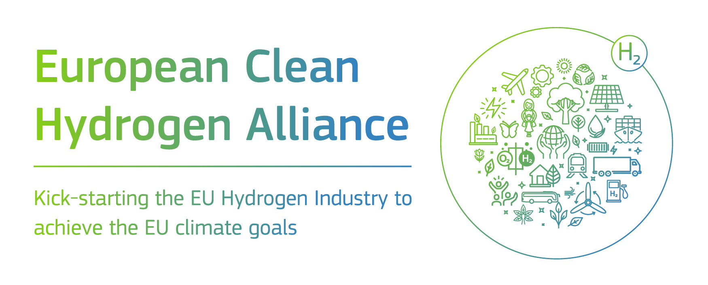
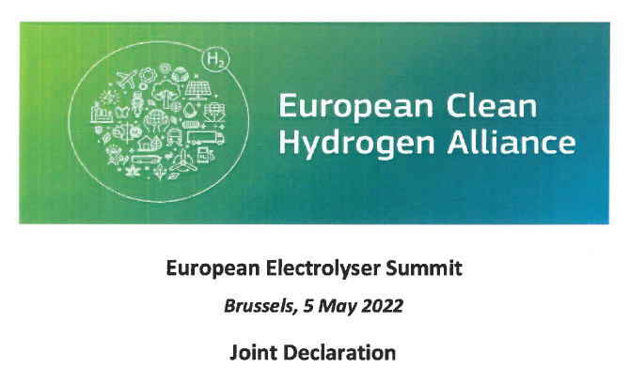
European Alliances
European Clean Hydrogen Alliance (ECH2A)
Aims to promote investments and stimulate clean hydrogen production and use
European Electrolyser Partnership (ELYP)
Aims to address the challenges of scale-up of electrolyser manufacturing capacity in Europe
Renewables and Low-carbon Fuel Alliance (RLCFA)
Focuses on boosting production and supply of renewable and low-carbon fuels for the aviation and waterborne sectors. Key flanking measure to the FuelEU Maritime and RefuelEU Aviation.

Slide 15
Clean Hydrogen Partnership
Private
Public
To facilitate the transition to a greener EU society through the development of hydrogen technologies with a budget of EUR 1Bn.

Slide 16
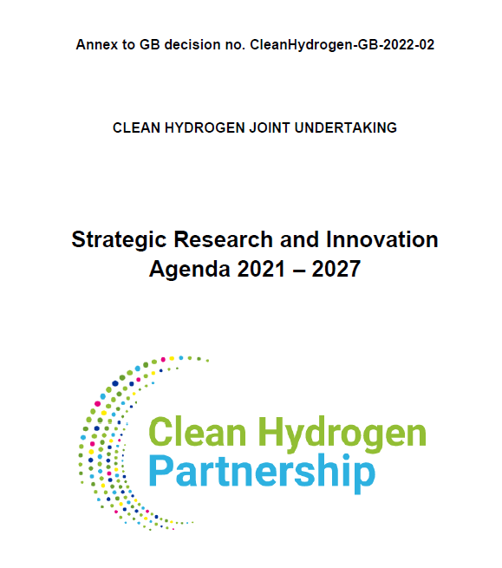
Clean Hydrogen Partnership
Multi-Annual & Annual Work Plans (SRIA & AWP)
The Strategic Research & Innovation Agenda
Provides a frame for our activities
Defines actions to be undertaken
Is revised at mid-term of Horizon Europe
Annual Work plans
Are derived from the SRIA
Are defined on an annual basis
Have a budget usually c.100M€
Are co-created between the two partners
AWP 23
Total budget: EUR 195 mln
Deadline to submit applications: 18 April
Projects expected to start January 2024
Annual Work Plan 2021-22
Annual Work Plan 2023
Annual Work Plan 2024
Etc.

Slide 17
Topics covering Hydrogen Valleys
Description
Part of continuous development of eco-systems, demonstrating H2 technologies working together within a wider renewable eco-system and visible to the public
It should cover the whole value chain, from Production to End-uses
Areas of interest: multi-modal platforms (ports & airports), major urban areas, integration of renewables into hard to abate industry
Large-scale valley
Budget from EC is capped at EUR 20 mln
Target of at least 4000t/year of clean hydrogen produced, using new hydrogen production capacity
Reasonable distributed between end-uses
One valley
Small-scale valley
Budget from EC is capped at EUR 9 mln
Target of at least 500t/year of clean hydrogen produced, using new hydrogen production capacity
Reasonable distributed between end-uses
Two valleys

Slide 18
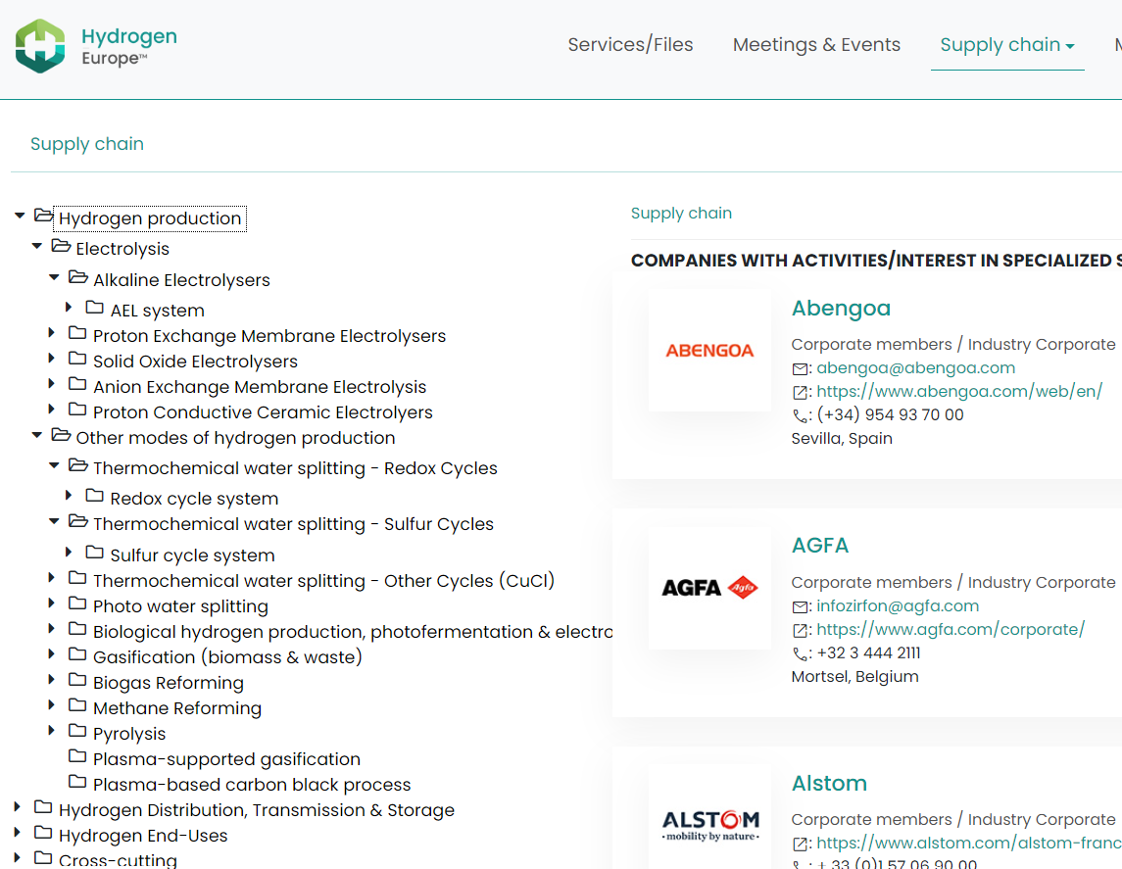
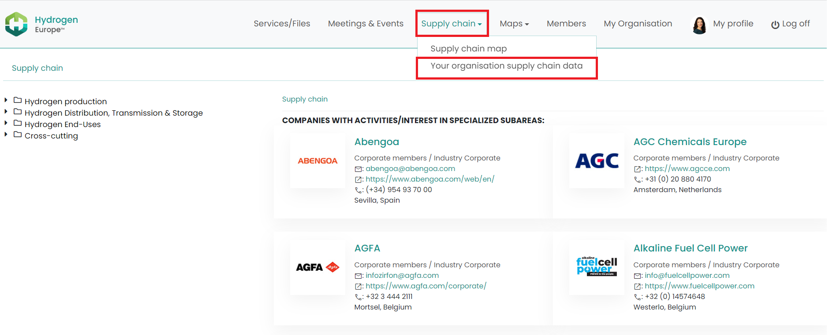
Supply Chain Mapping
First-of-its-kind mapping of the Hydrogen Supply Chain in Europe
130 participating members to date
The mapping is meant to enable members to gain
an overview of our supply chains
visibility for their own activities, and to
identify potential business, consortia or project partners
Only participating members will have full access to the mapping.

Slide 19
EU Legislation

Slide 20
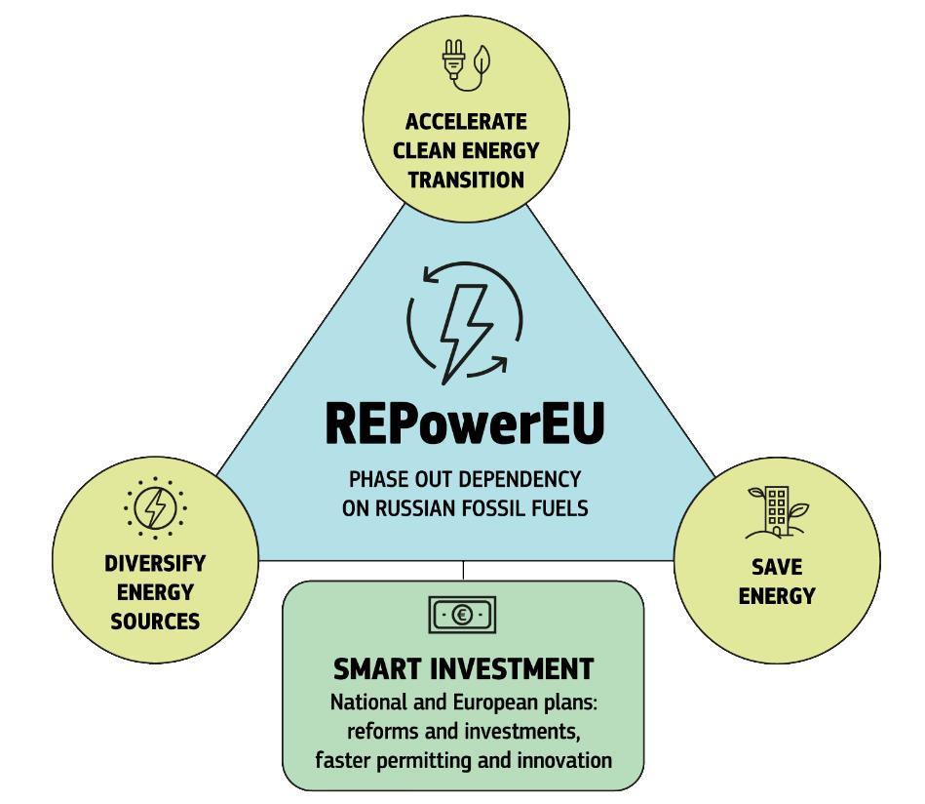
EU Green Deal and REPowerEU
EU Green Deal
Roadmap of key actions
Framework to achieve climate-neutrality by 2050
It launched the largest legislative review of EU law to date;
Fit for 55 package
Hydrogen and decarbonised gas market package
REPowerEU
Targets 2030:
10Mt domestic H2 production
10Mt imported H2
Additional EUR 200 mln for H2 Valleys.
Publication of delegated acts
Faster IPCEI assessment
Identification of priority H2 import corridors;
Higher ambition for RED targets

Slide 21
Timeline of some EU legislative acts
 | EC Proposal | Council (GA) | EP Committee | EP Plenary | In Trilogues | Final legislation
AFIR | Fit455 | 2 June | 3 October | 19 October | 27 October, 7 December, 13 December, 7 February | Trialogues ongoing
CO2 standards for LDVs | Fit455 | 29 June | 11 May | 8 June | 5 September, October 27 | Deal – 27 October
REFuelEU Aviation | Fit455 | 2 June | 27 June | 7 July | 8 September, 13 October, 8 December | Trialogues ongoing
FuelEU Maritime | Fit455 | 2 June | 03 October | 19 October | 27 October, 8 December | Trialogues ongoing
RED II-III | Fit455 | 26 June | 13 July | 13 September | 06 October, 15 Nov, 07 February, 09 March, 21 March, 29 March | Deal – 23 March
Energy Taxation Directive | Fit455 |  | - | -
Energy Efficiency Directive | Fit455 | 24 June | 13 July | 13 September | 06 October, 22 November, 14 December | Deal – March 2023
EPBD | Fit455 | 26 October | 09 February | 14 March
ETS | Fit455 | 29 June | 24 May | 22 June | 11 July, 10 October, 22 November, 29 November, 12 December | Deal – 14 December
CBAM | Fit455 | 15 March | 25 May | 22 June | 11 July, 4 October, 8 November, 16-17 December | Deal – 18 December
REPowerEU | May 2022 | RED IV – 24 November 19 December | RRF – 24 October RED IV - 14 November | RRF – 10 November RED IV – 12 December | 16 November, 14 December | Partial deal – 14 December Trilogue on RED IV
TEN-T | Dec 2021 | 5 December | 21 March 2023 | April 2023 (tentative)
Gas&H2 Directive & Regulation | Dec 2021 | 28 March | 09 February | No plenary needed
IED | April 2022 | 16 March 2023 | 27 April 2023 | 2 May 2023
ESPR (sust. product regulation) | March 2022 | 22 June 2023 | 5 June 2023
NZIA | March 2023
Critical Raw Materials Act | March 2023 | - | - | -
Carbon Removal Certification | November 22 | - | - | -

Slide 22
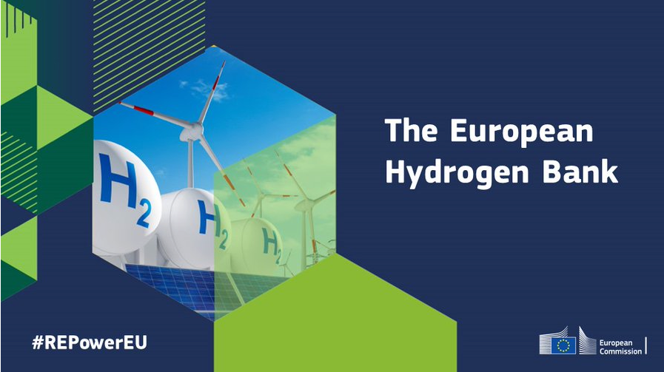
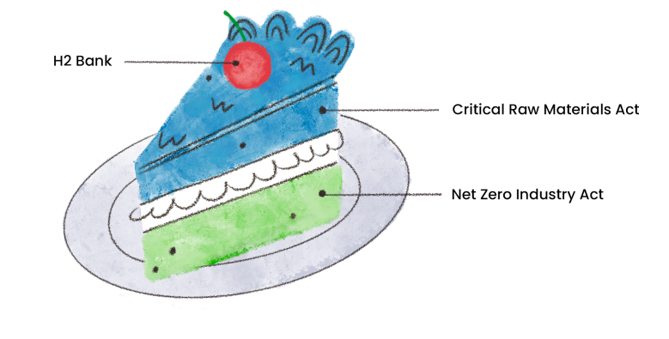
EU Commission announces NZIA

Slide 23
Zoom in on the role of ports

Slide 24
Critical role for ports in the hydrogen transition
Maritime ports have a central role in the transition towards the hydrogen economy.
A large portion of hydrogen industrial production and consumption takes place in ports or in close proximity to ports
Just 5 industrial hubs in Belgian and Dutch ports consume around 20% of the EU total consumption of hydrogen. Most of it is produced locally.
These industrial facilities (chemicals, steels, refinery, etc) are increasingly looking at hydrogen as an option for decarbonisation
The falling prices of offshore wind for production of renewable hydrogen make ports ideally placed to become production centers.
As imports are needed to cover the entire future demand, the solution is to import clean hydrogen through ships, from countries with favorable wind/solar resources. Ports will be at the forefront of hydrogen imports reception.
Existing grey hydrogen production plants can be retrofitted, offering a local supply of hydrogen and limiting the need for investment in hydrogen infrastructure, already in place in ports.

Slide 25
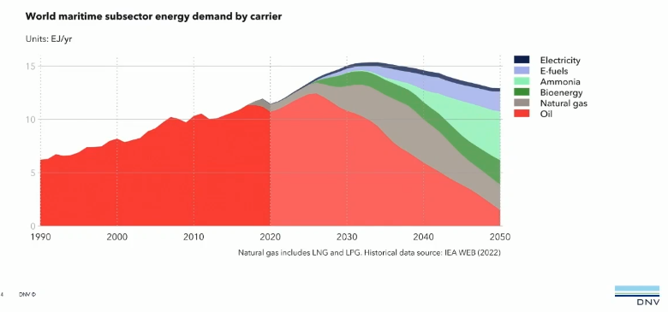
Hydrogen as an opportunity to decarbonize shipping
Large hydrogen demand center in ports makes possible a clean hydrogen supply chain for shipping at a large scale, even if the demand will take time to grow.
Greenhouse Gas Emissions of the sector have increased steadily since mid-2000s – the maritime sector is responsible for 3% of the global share of CO2 emissions. A shift from fossil fuels to zero carbon fuels for shipping is needed.
Hydrogen, hydrogen-based fuels (like ammonia, methanol) and hydrogen technologies offer a great potential for the maritime sector decarbonisation.
Ports can thus be direct users of the hydrogen imported or produced within its vicinity – converted on site, it can become fuel for ships and decarbonize the maritime sector.
Notes:
Ammonia for bigger ships (bigger share of ships and of demand) / liquified hydrogen and compressed h2 for smaller ships

Slide 26
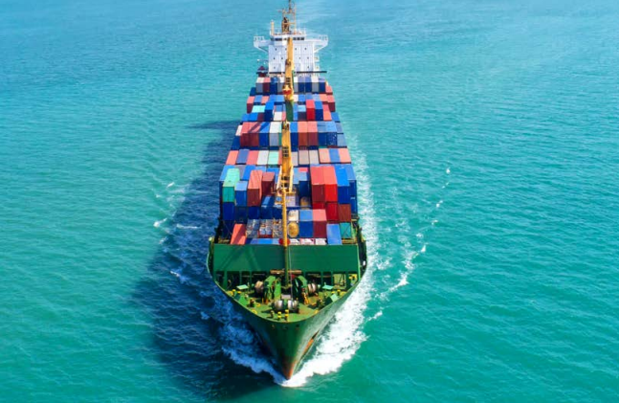
Critical role for ports in the hydrogen transition
Recognized in EU legislation
Alternative Fuel Infrastructures Regulation (AFIR)
Trans European Network for Transport Regulation (TEN-T)
Fuel EU Maritime Regulation
Setting standards for alternative fuels infrastructures for ships to be deployed in ports located on the TEN-T network
Requiring along the TEN-T network, the deployment of recharging and refueling infrastructures needed for alternative transport fuels in line with AFIR
Increasingly recognizing the role of ports as hubs for decarbonization of the economy and imports of renewable hydrogen – opening them eligibility to funding through the CEF Transport programme
Requiring ships to progressively switch to sustainable fuels, including hydrogen and hydrogen derivatives
Trans-European Network for Energy Regulation (TEN-E)
Revision of the regulation including hydrogen transport infrastructures and electrolysers in the scope of the Regulation and making ports gain PCI status
‘The consumption of 20 million tonnes of renewable hydrogen will also require accelerated investments in hydrogen infrastructure to bring renewable hydrogen production in areas with high renewable energy resources to the end-consumers. The development of port infrastructure and their connection to both industrial and transport users in the vicinity will be of critical importance. Therefore, the Commission considers as crucial support for the development of necessary port infrastructures to receive imports of hydrogen, including in the form of renewable ammonia and other renewable hydrogen by-products”
REPowerEU Plan Staff Working Document: Investment needs, hydrogen accelerator and bio-methane plan - SWD(2022) 230 final
Notes:
These files are all still in negotiations between the European institutions but should be adopted soon

Slide 27
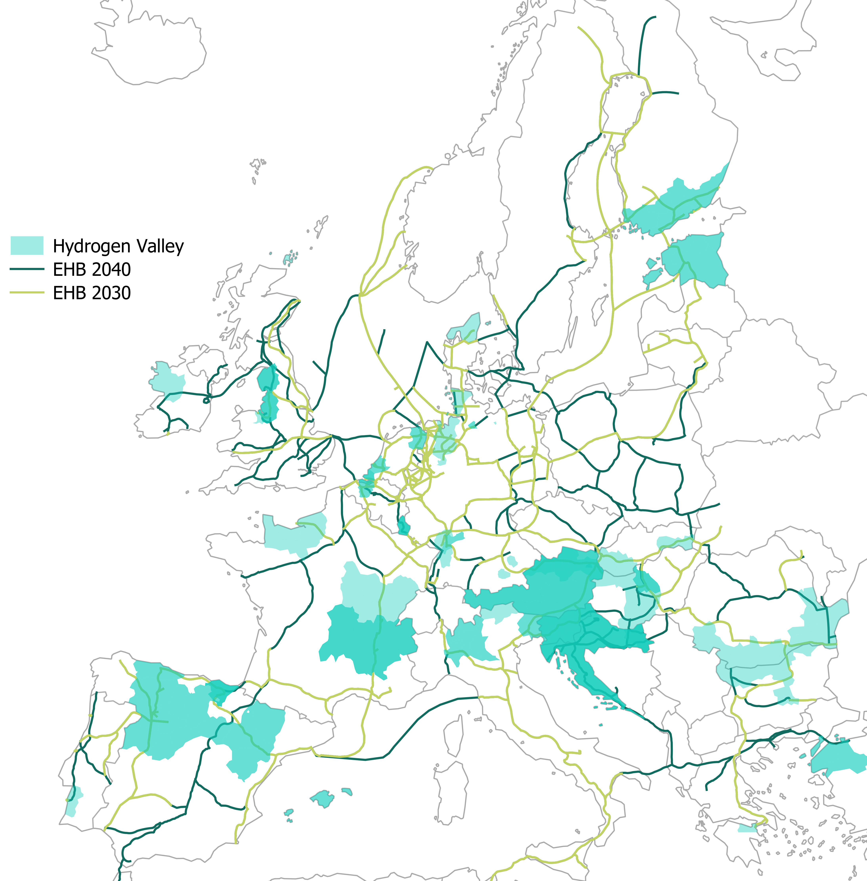
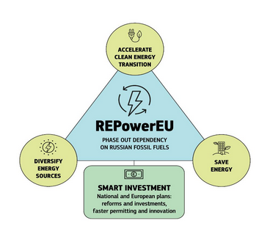
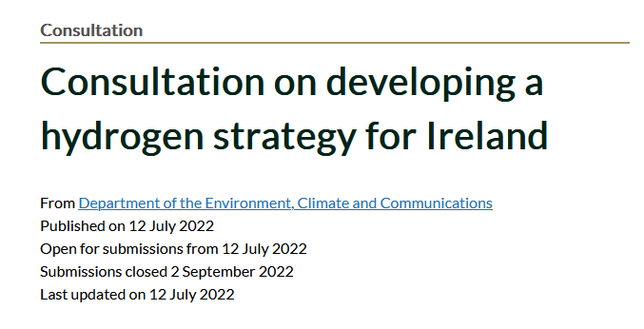
Conclusions
We are in a new paradigm of the energy transition with hydrogen
2023 is the year for make-or-break for hydrogen
Action is needed on all levels – European, national, regional to start the hydrogen markets!

