Slide 1
ESB Hydrogen Strategy & Lighthouse Projects

Slide 2
Making a Difference, ESB Strategy for a Brighter Future - Net Zero by 2040

Slide 3
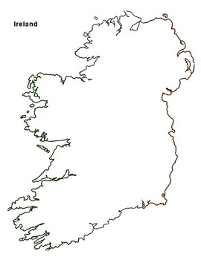
Delivering a Resilient, Reliable Net-Zero Integrated Energy System
H₂
1. ESB’s vision for a secure net zero energy system is firmly based on offshore wind, green hydrogen, storage and backup power fuelled by green hydrogen.
2. ESB , with partners, will develop energy clusters of H2 production and use. To achieve required scale, co-location with offshore wind is vital.
3. ESB’s early hydrogen partnerships will focus on lighthouse projects decarbonising transport, aviation and replacing fossil fuel use in industry.
Salt cavern
H2 Storage
KESTREL
H2 Storage

Slide 4
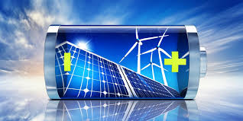
Delivering Net-Zero, an Integrated Energy System
Renewables
Storage
Backup Zero-Carbon
Power Generation
Renewable Enablers
Technology
Hydrogen
Ireland has the potential to attain very high levels of energy security ​
ESB is actively investing in all elements of the Energy Transition
Notes:
Pat Fenlon spoke earlier about ESB’s strategy to get to Net Zero carbon emissions by 2040 across all our activities.
Ireland has a significant offshore wind resource, one of the best in Europe and multiples of our domestic demand. This can make help make Ireland energy independent, provide security for our economic activities and just as importantly enable sustainable growth for those economic actitivites.
We believe Net Zero can only be achieved through bulk storage of renewable energy, in which Hydrogen will play a key role.
The Net Zero future will require not only large scale renewable generation, but also because of the intermittency of renewable sources, the conversion of the surplus renewable electricity at any point of time into Hydrogen, the storage of that energy as Hydrogen or it’s derivatives, and the conversion of that stored hydrogen energy into electricity when the renewables are not available. All four of these infrastructure elements of net zero need to be developed in parallel and on a Utility scale.

Slide 5
Lighthouse Demonstration Projects – Learn by doing
Notes:
working with partners to demonstrate the use of Hydrogen in transport, industry and power generation. These lighthouse projects are models or blueprints for the net zero integrated energy system of the future and help show us the path to get there.
We see there is a crucial role for hydrogen in reaching net zero and decarbonising the hardest to abate parts of these three sectors. This is also critical for the wider Irish economy decarbonisation and why we must deliver these projects asap to help reach Ireland’s 2030 targets.
I’ve shown the three sectors as intersecting – that represents the way that ESB sees that these sectors will be much closer and interdependent in the integrated energy system of the future. ESB sees the clustering of hydrogen production, storage and transport infrastructure as the most cost effective way to deliver a hydrogen economy of scale.

Slide 6
Notes:
While subject to formal agreement, EU has legislated for hydrogen refuelling stations every 200 km on the TEN-T, and green hydrogen targets will be introduced across a range of transport modes. ESB's hydrogen for transports will focus on decarbonising public transport fleets, and the deployment of electrolysers at ports, airports where there is the potential to scale H2 use.

Slide 7
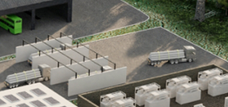
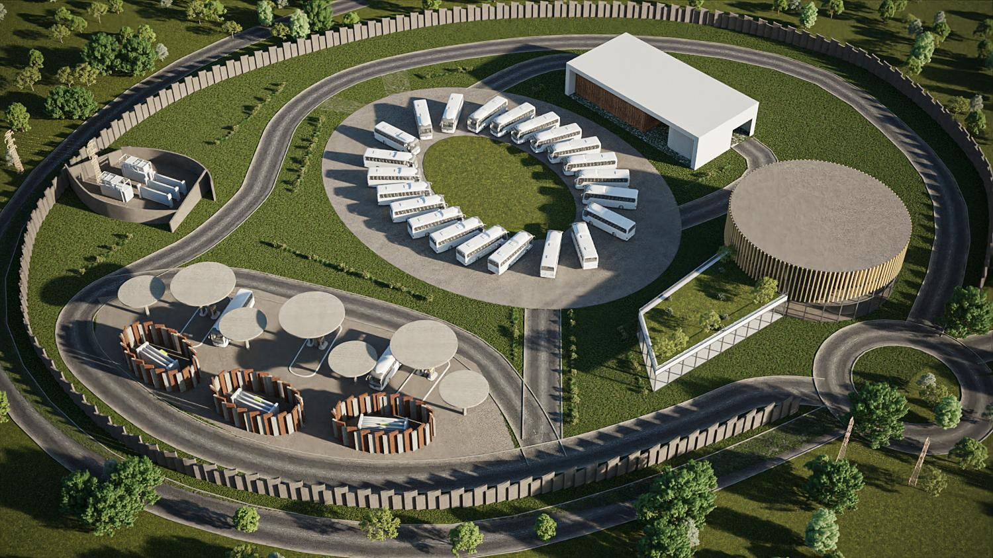
Case 1: Zero Emission Smart Transport (ZEST)
Tube-Trailers to Industry & HRS
Smart Power controller – balancing electricity supply to EV and H₂
Bus service
Electrolysers & Low pressure storage
Bus EV charging
Office space
Education & Training
400 Bar H₂ dispensers
Compressors & high pressure storage
Commercial PAYG and Contract commercial offering
Notes:
The ZEST model was designed with a view to meeting assisting public transport fleets and private HGV fleet operators meet their decarbonisation targets, whilst maximising efficiencies on the electricity grid. EV buses can be charged at optimum times, whilst hydrogen is produced for consumption on site and also for consumption by industry in proximity.

Slide 8
Case 2: Shannon Airport Group Lighthouse Project
ESB and Shannon Airport Group to develop hydrogen demonstration for aviation and transport
Notes:
As announced earlier today by Shannon Airport Group CEO Mary Considine, ESB are delighted to be working with Shannon Airport Group to investigate the feasibility of developing a Zero Emissions Refuelling Station on the Shannon Campus. The vision for this project sees a stream of hydrogen provided for a Refuelling for heavy goods and airport vehicles, for use in the testing and development of SAF and for use in local industry. This Lighthouse project at Shannon would be the first of its kind at an airport and logistics hub, is a kickstarter for a hydrogen ecosystem in the Shannon Estuary and showcases the vast potential of offshore wind off the west coast of Ireland.
is to facilitate the use of hydrogen in aviation and in heavy goods transport, heavy goods and airport vehicles . This is a pilot project that would act as a demonstration location for those technologies and would be the first of its kind at an airport and logistics hub in Ireland.
ESB and Shannon Airport Group are working to develop a hydrogen demonstration testbed for the aviation and transport sectors. This project concept sees a stream of hydrogen provided for a Hydrogen Refuelling Station for heavy goods and airport vehicles, for use in the testing and development of SAF and for use in local industry. This Lighthouse project at Shannon is a kickstarter for a hydrogen ecosystem in the Shannon Estuary.
…..
Hydrogen would be produced by electrolysis, with on site storage, a hydrogen refuelling station for HGV and airport fleet and the ability to supply local industrial sites with hydrogen. This aligns with EU ambition to have a hydrogen refuelling station every 100 km along both the core and comprehensive TEN-T networks by 2028.
This would be a pilot scale facility initially for Phase 1 but would have the potential to scale beyond that as hydrogen demand increases.
It is envisaged that the demand would come predominantly from logistics companies travelling in and out of Shannon, airport operations and potentially some demand from local industry. This Lighthouse project and the provision of hydrogen acts as an enabler for the testing and development of decarbonised aviation fuels at Shannon.
We have been working very closely with ESB on this and have been discussing with potential off-takers in the Shannon Campus. We are open to discussing this Lighthouse project with other companies who wish to collaborate on hydrogen in the region.
Elevator Pitch (Suggested)
Shannon Lighthouse Project
ESB and Shannon Airport Group are working to develop a hydrogen demonstration testbed for the aviation and transport sectors. This project concept sees a stream of hydrogen provided for a Hydrogen Refuelling Station for heavy goods and airport vehicles, for use in the testing and development of SAF and for use in local industry. This Lighthouse project at Shannon is a kickstarter for a hydrogen ecosystem in the Shannon Estuary.

Slide 9
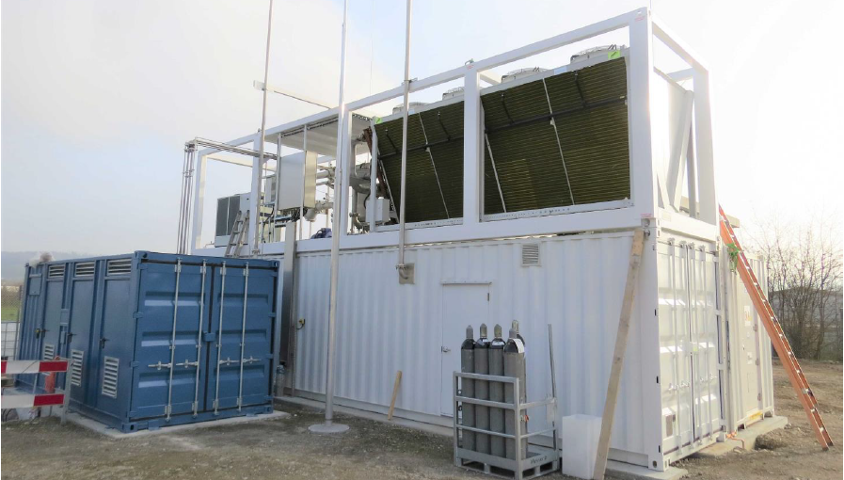
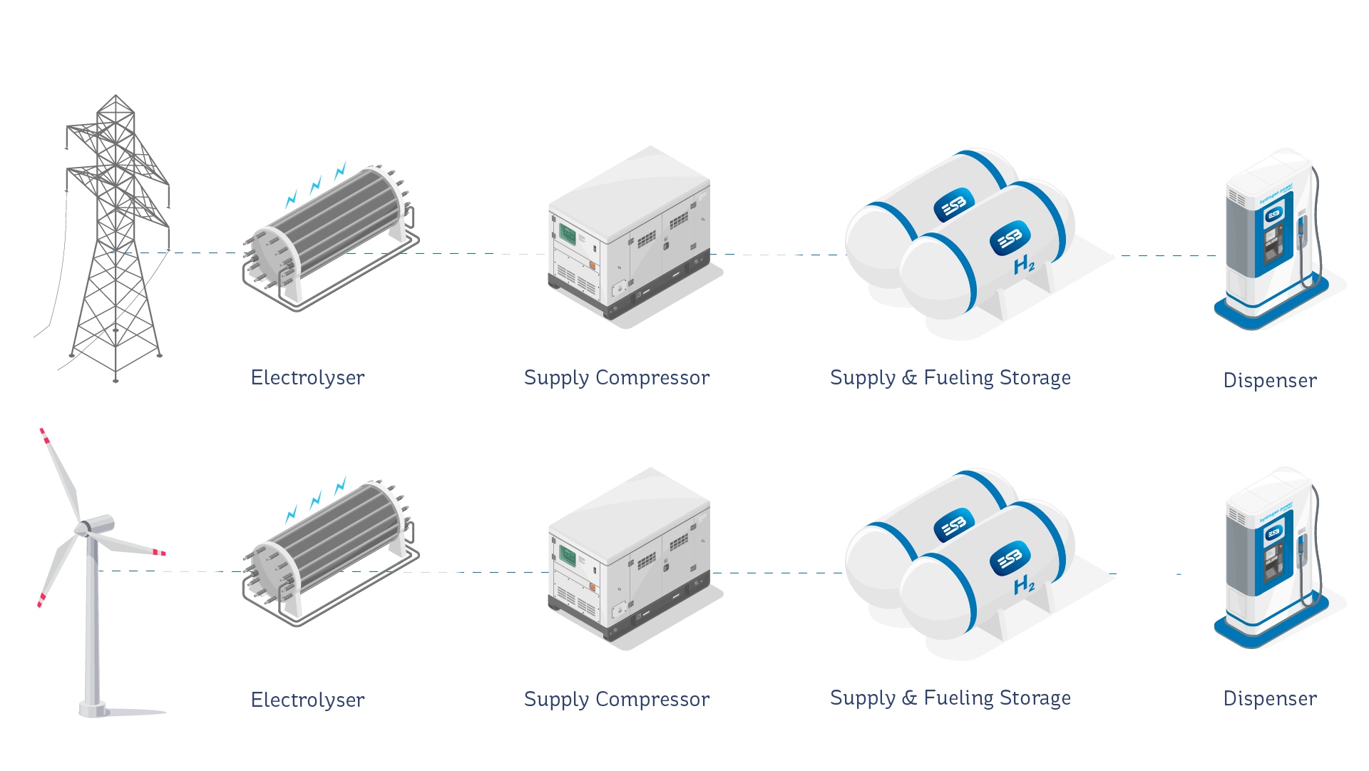
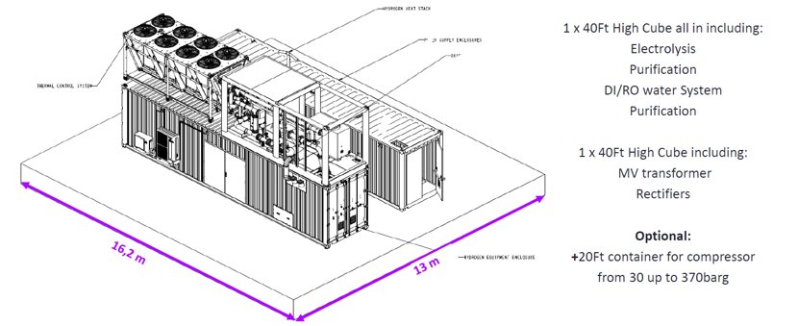
Design concept Shannon Lighthouse Project
20+ FCEV buses/heavy goods vehicles/load movers/emergency vehicles
~2.5MW Electrolyser
3rd Party usage – transport/logistics, sustainable aviation fuel & industry
Reduced night-time capacity to allow EV charging
1 H₂ dispenser sufficient – recommend 2 for redundancy
Potential to scale this further as demand increases
Notes:
~2.5MW Electrolyser required to avoid peak electricity pricing period & supply + 20% for 3rd Party if required ( 500 NM3/hr / 45 kg/hr )
Trucks, avg. 350km/day, 7.5 kg/100km, 2 refills per day total H₂ daily 525 kg/day
Ballpark capex €7-8m
Single Electrolyser for Phase 1 with second for Phase 2
Electrolyser ball park – around 3million euro for 1000kg H2/day
HRS ~2.1m for what is shown there, double that if were to add capacity for cars (emergency fleet type vehicles - )
Development Costs/Site/Planning/ground works/ - maybe another 1m?

Slide 11
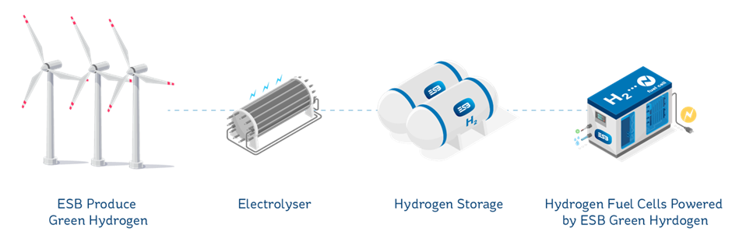
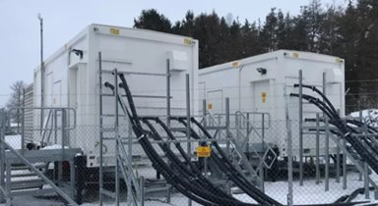
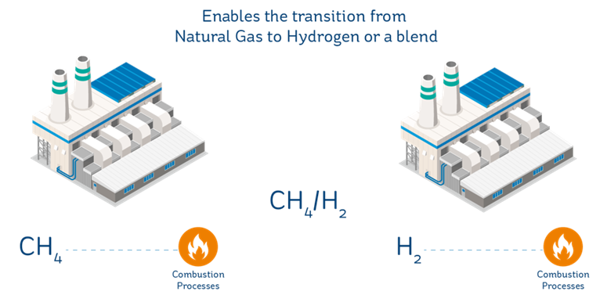
Case 3: H2 as a replacement for diesel back up power or for natural gas

Slide 12
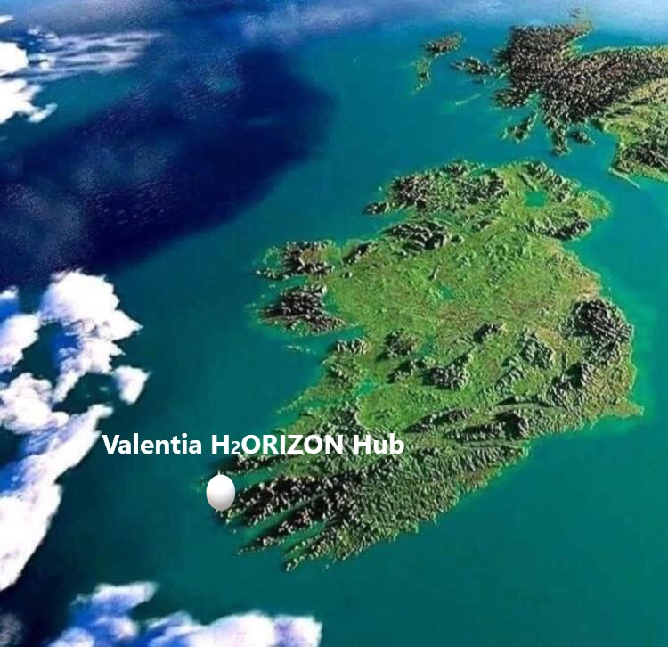
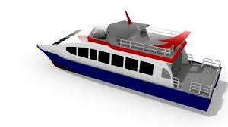
Valentia Island – Project Development Assistance
Clean Hydrogen Partnership will fund a H2ORIZON study to explore the role of hydrogen in decarbonising energy on Valentia Island, especially around maritime use.
They will define the exact hydrogen use cases, the volumes of H2 required and method of H2 production.
Make a technically and geographically report community energy independent using Green Renewable Energy.

