Slide 1

H-Wind – Hydrogen from Offshore Wind
GenComm / Energy Cork Workshop
Paul Leahy, UCC
30/03/2023

Slide 2





H-Wind : Bringing Wind Energy from Irish Waters to International Markets
H-Wind Project Goals
2021-2024
PIs: Paul Leahy, MAREI Centre and School of Engineering, UCC
Nguyen Dinh, Senior Research Fellow, MAREI Centre, UCC
Unlock new markets for Irish offshore wind energy via power-to-gas
Hydrogen/Ammonia production and storage from offshore wind
Safe distribution and market development
Scalable hub design for offshore hydrogen production, storage and transportation

Slide 3
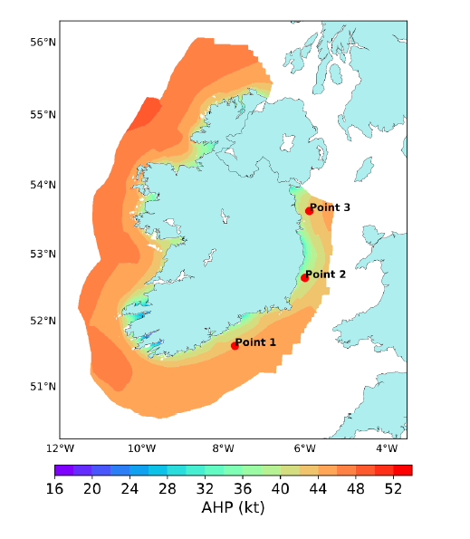
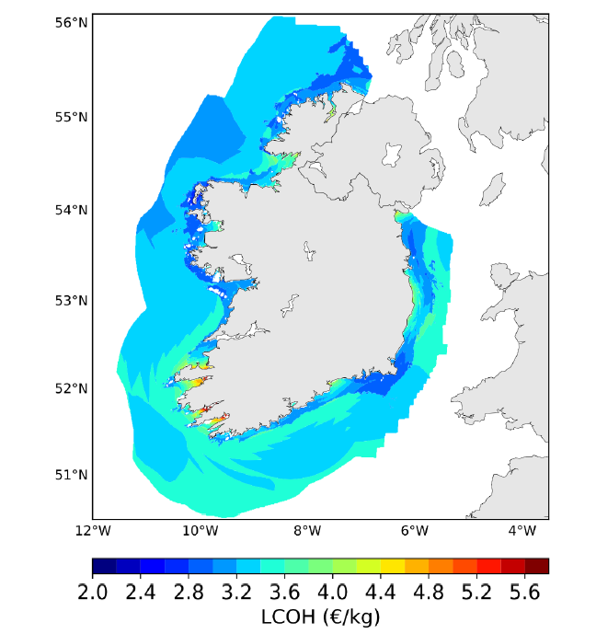
LCOH Mapping
Notes:
Phase 2 will focus on
Sustainable Energy Systems
developing technology pathways, policy roadmaps and enabling measures by integrating energy systems models with policy simulation models and ex-post analysis of policy measures
further methodological development of multi-model approaches to combine a range of modelling frameworks to gain additional policy insights.
expansion of this research will include taking integrated models developed for Ireland to an EU and global level
interactions between a range of policy areas, including trade-offs and co-benefits between climate mitigation and air quality policies.
Sustainable Energy Economy
Investigate the interactions between the energy system and the economy.
explore energy market and regulatory innovation, important because of the interdependencies between (new) technologies on the one hand and markets and regulation on the other.
research distributional fairness of market mechanism which is necessary for acceptance by consumers and society.
extended analysis will include innovation dynamics and general equilibrium modelling.
linking multi-modelling approaches with the innovations systems analysis
Sustainable Energy Society
develop research on the role of society in the energy transition152, 153, fostering new strategic collaborations with experts on the social dimension of the energy transition
develop new methods to link and integrate quantitative energy systems models with qualitative transdisciplinary approaches improve understanding of the interactions between societal dynamics and the energy system transition
enlarge the conceptualisation of innovation to include the role of social innovation and societal transitions
develop frameworks on the synergies and trade-offs between different policy priorities and goals

Slide 4
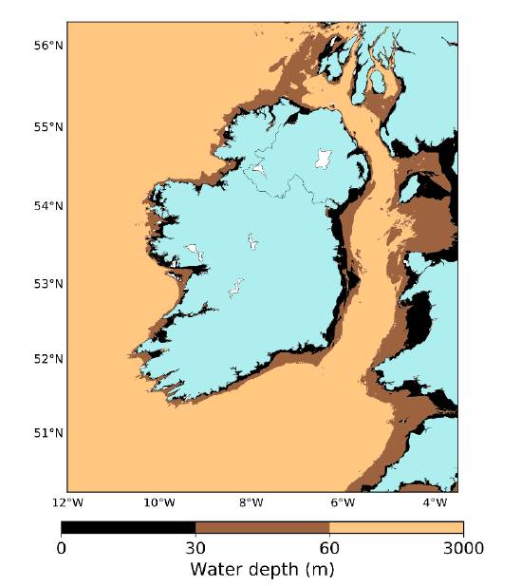
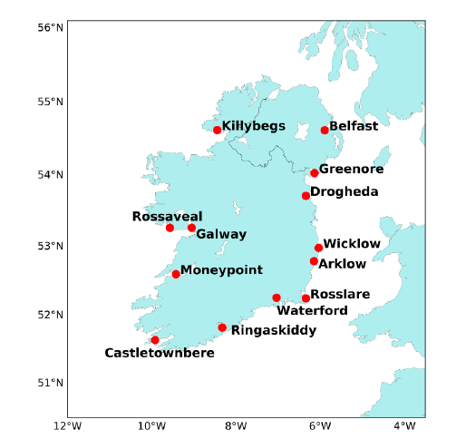
Simplified LCOH model
Variables:
Water depth
Distance to port
Distance to injection point
Wind statistics:
  k, C
(vu Dinh et al., 2023)

Slide 5
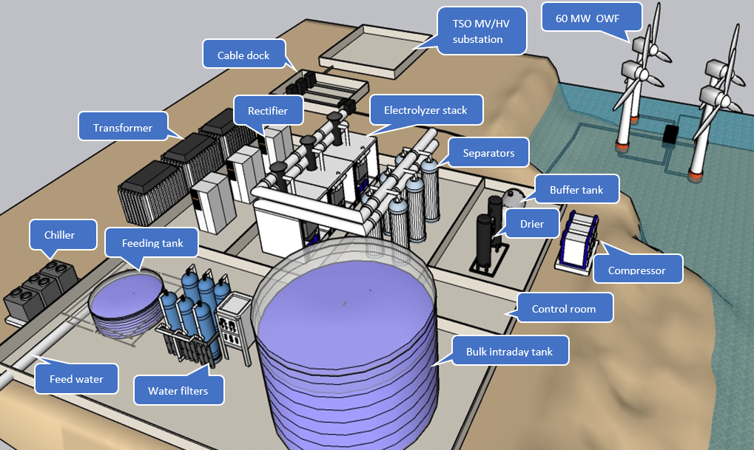
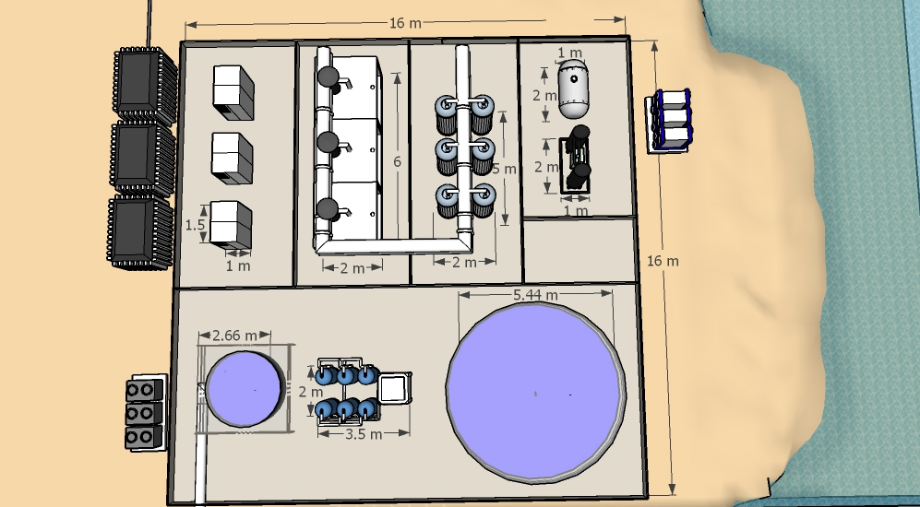
Plant layout & footprint
Offshore Wind - Onshore Electrolyser

Slide 6
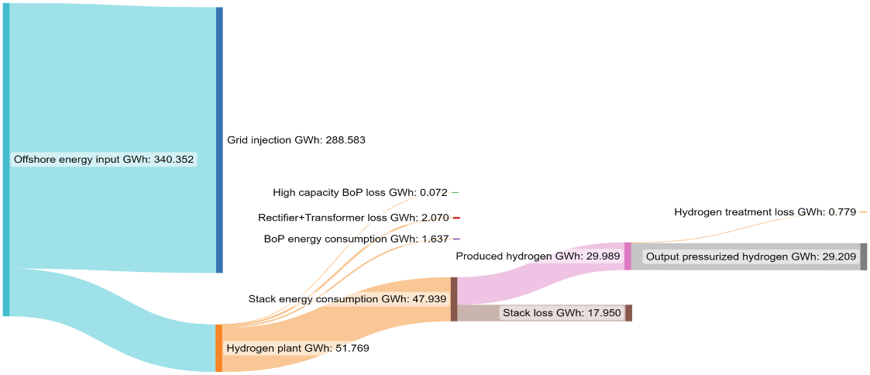
Balance of Plant LOSSES

Slide 7
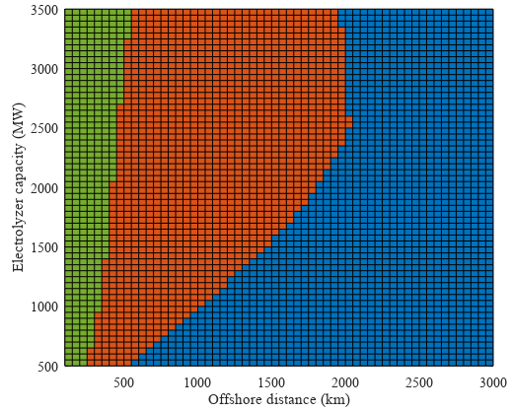
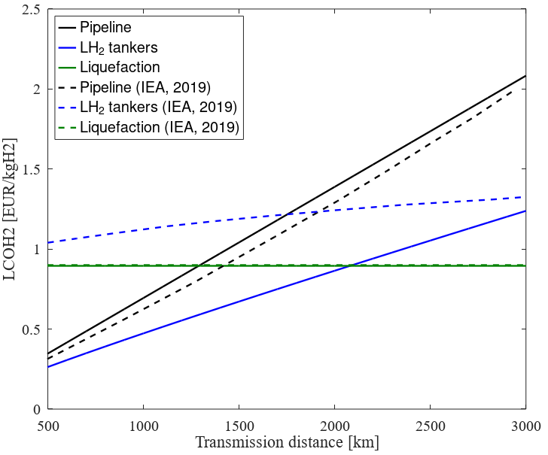

Levelised Cost of Transmission (LCOT) of H₂
Levelised cost of transmission of energy for green hydrogen
H2 pipelines, liquid H2 tankers, or electrical interconnection?
Detailed cost models
(Manuscript in preparation)

Slide 8


