Slide 1
Green Hydrogen vs Electrification in Bus Fleets
A presentation of the
Enabling Support Tool
GenComm Partner Meeting #23
Tadgh Cummins, Tim Williamson
Place image in this area.

Slide 2
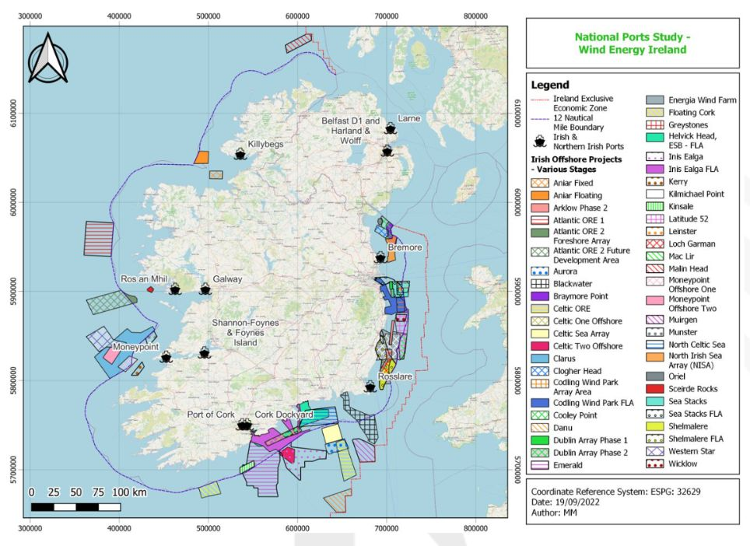
Europe’s H2 potential is immense
H2 demand exists in some countries
Green H2 production potential exists in others
Its deployment will go hand in hand with renewables
Common question: “How much will green H2 cost?”

Slide 3
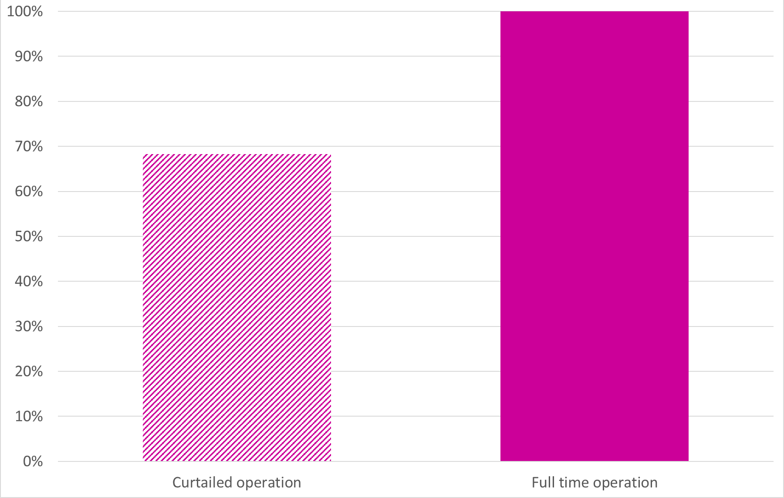
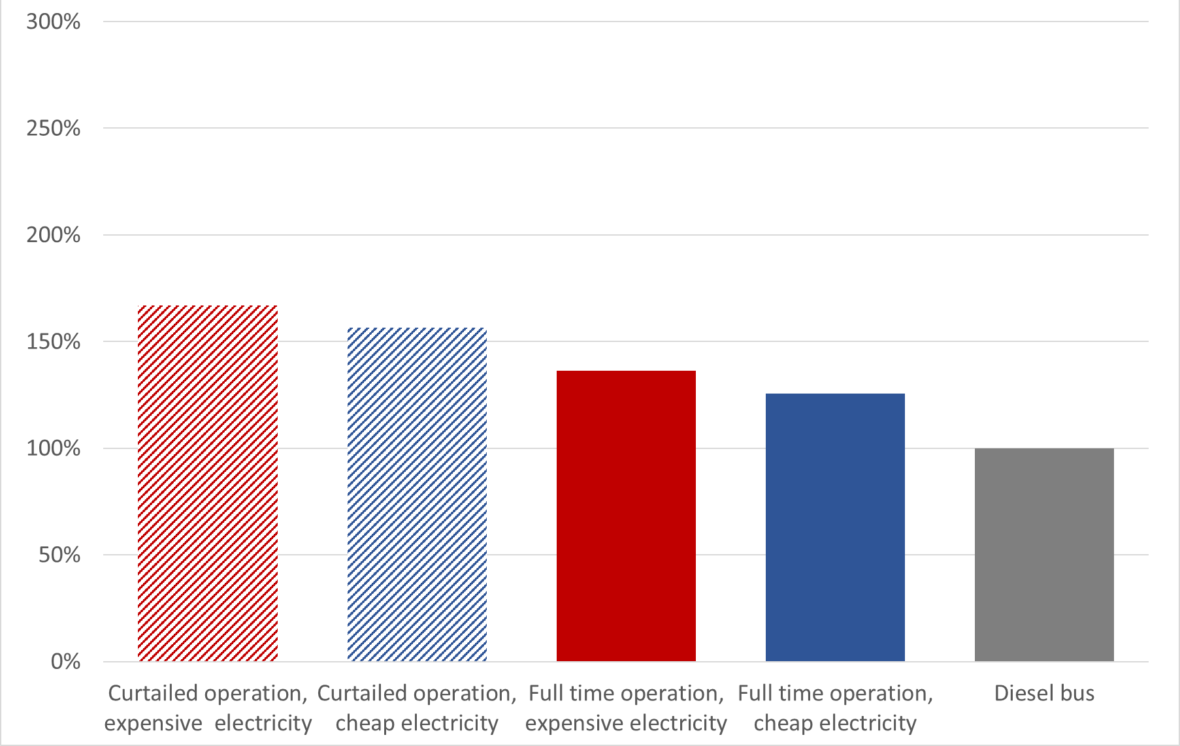
GenComm’s Decision Support Tool
Aimed to inform on quantities, costs, fossil fuel displacement for onshore green H2
Percentage of Dublin city bus fuel displaceable by H2 for different electrolyser operation modes
http://communityh2.eu/dst-simple/
http://communityh2.eu/dst/
Hydrogen costs for different electricity prices and electrolyser operation modes, relative to diesel for Dublin

Slide 4
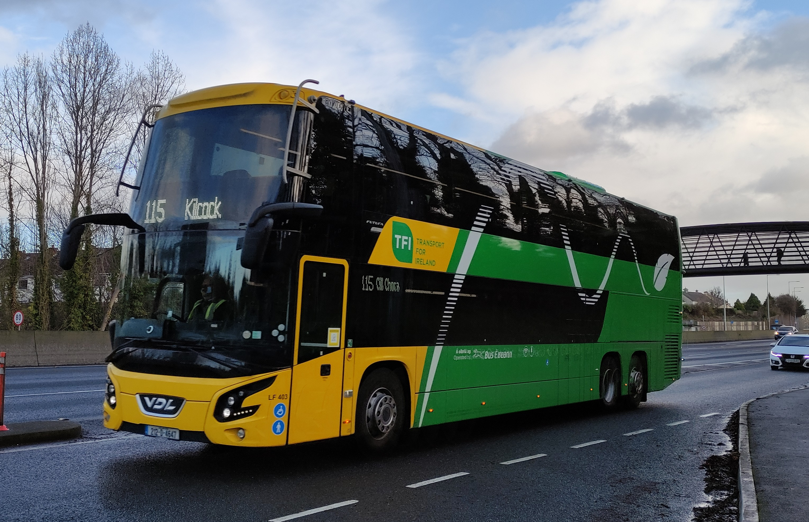
What about the End User?
The Enabling Support Tool (EST)
Cost effective decarbonization and energy security are the drivers, not finding a use for green H2!
Focus is now on specific sectors that:
Will struggle to be fully electrified
Have H2 technology close to or at commercial reality
We need to communicate to potential end-users in terms they understand
Total Cost of Ownership (TCO) is how bus fleet operators VALIDATE decarbonization performance

Slide 5
What does the EST do?
Enables bus fleet operators to plan best fleet decarbonization mix
Assumes first decarbonization approach will be battery electrification
Portion of routes in a network unsuited* to battery electrification are identified
* Due to HVAC loads, utilization rates, passenger & battery weight, steep gradients
The EST calculates Total Cost of Ownership of different decarbonization options

Slide 6
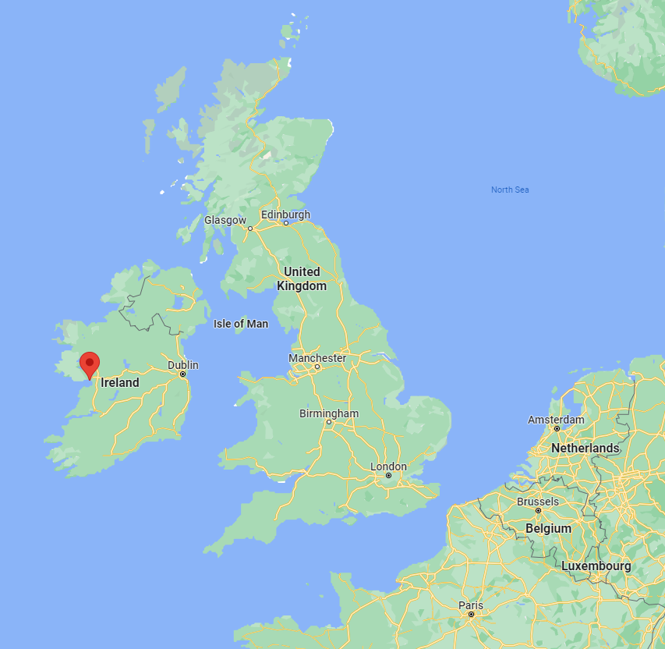
Decarbonizing a single bus route in Galway
Diesel
TCO drops as a bus is used more effectively
Diesel

Slide 7
Decarbonizing a single bus route in Galway
Calculated battery maximum km/day
Battery TCO drops quickly until…
Battery
Diesel
TCO drops as a bus is used more effectively
Diesel

Slide 8
Decarbonizing a single bus route in Galway
Calculated battery maximum km/day
Battery TCO drops quickly until…
Higher km/day needs more buses
Battery
Diesel
Battery
Diesel

Slide 9
Decarbonizing a single bus route in Galway
Calculated battery maximum km/day
Hydrogen
Battery
Diesel
Battery
Diesel
Battery is cost effective at lower km/day
Hydrogen is cost effective at higher km/day
Hydrogen

Slide 10
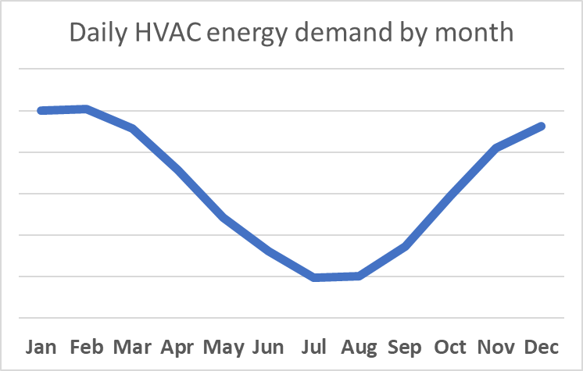
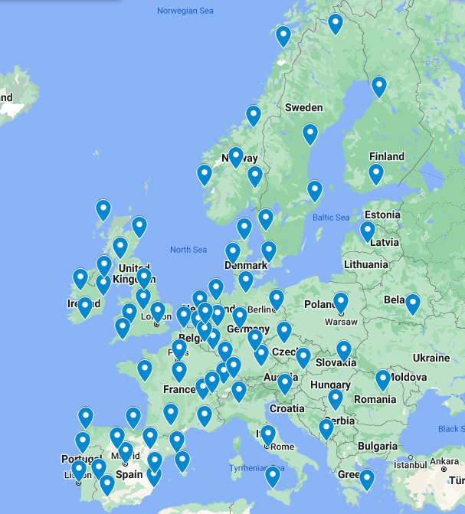
EST Input process
Select location from list
Input average operational hours per day
Model estimates worst-day energy demand of HVAC systems
Maximum range of BEB is reduced
1
BEB range (km/day)
2
Buses can be input into four ‘hilliness’ categories:
Hilly routes
Very hilly routes
Three bus sizes can be input:
Input number of buses below BEB range, and an average daily distance.
Repeat for buses below range of BEB
Flat routes
Moderately hilly routes
310 km/day
270 km/day
200 km/day
BEB range
BEB range
BEB range
BEB range
140 km/day
110 km/day
3
Economic inputs: price of electricity, diesel, hydrogen
This input process circumvents the need for complex drive cycle inputs, while still capturing the essential fleet data required to compare & combine BEBs & FCEBs in a mixed fleet

Slide 11
Galway city fleet
Select location from list
Input average operational hours per day
Model estimates worst-day energy demand of HVAC systems
Maximum range of BEB is reduced
1
BEB range (km/day)
-19km
2
Buses can be input into four ‘hilliness’ categories:
Hilly routes
Very hilly routes
Flat routes
Moderately hilly routes
312 km/day
256 km/day
BEB range: 254 km
BEB range: 240 km
BEB range
BEB range
181 km/day
176 km/day
3
Economic inputs: price of electricity, diesel, hydrogen
H2 | 8 | €/kg
Diesel | 1.66 | €/litre
Electricity | 0.22 | €/kWh

Slide 12
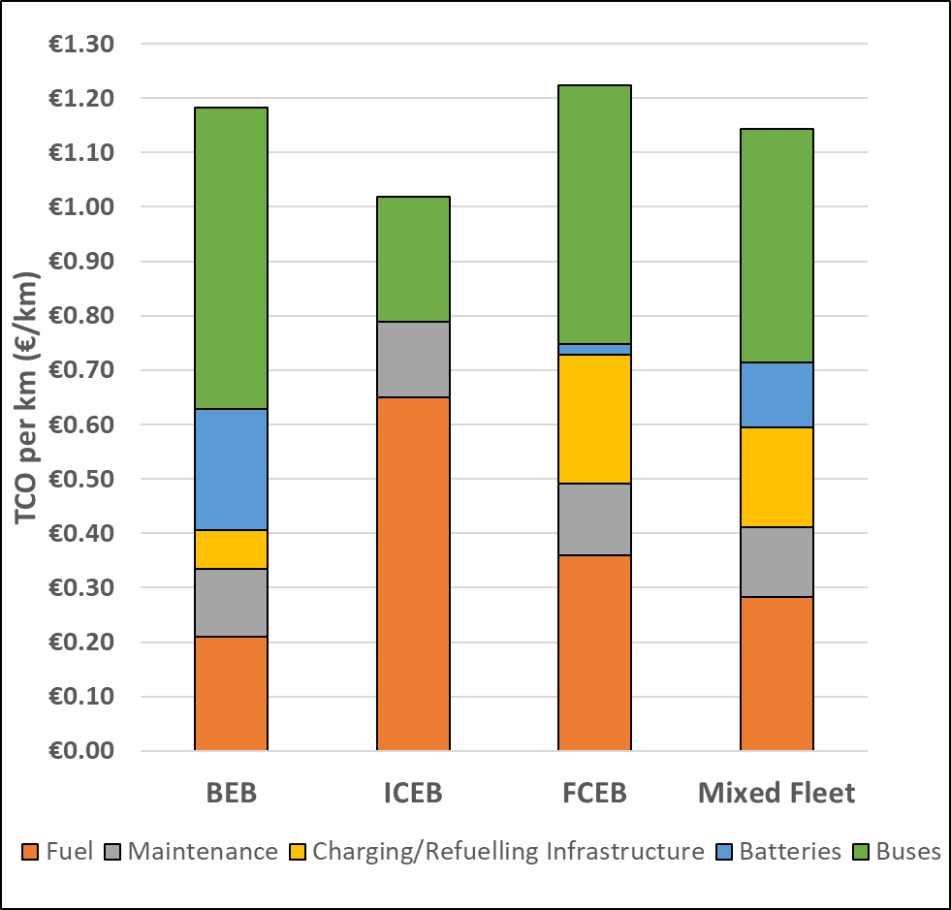
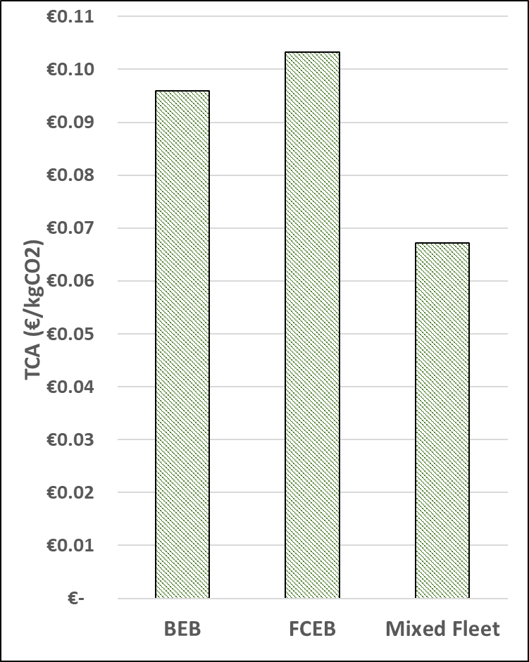
Galway city fleet
Total Cost of Ownership
Total Cost of Abatement
BEB fleet requires +12 additional buses to maintain operations
BEB fleet peak charging station power of 1.1 MW
The mixed fleet of BEBs and FCEBs becomes the cheapest option after diesel at a hydrogen price of 8 – 9 €/kg*
* These are unpublished preliminary results

Slide 13
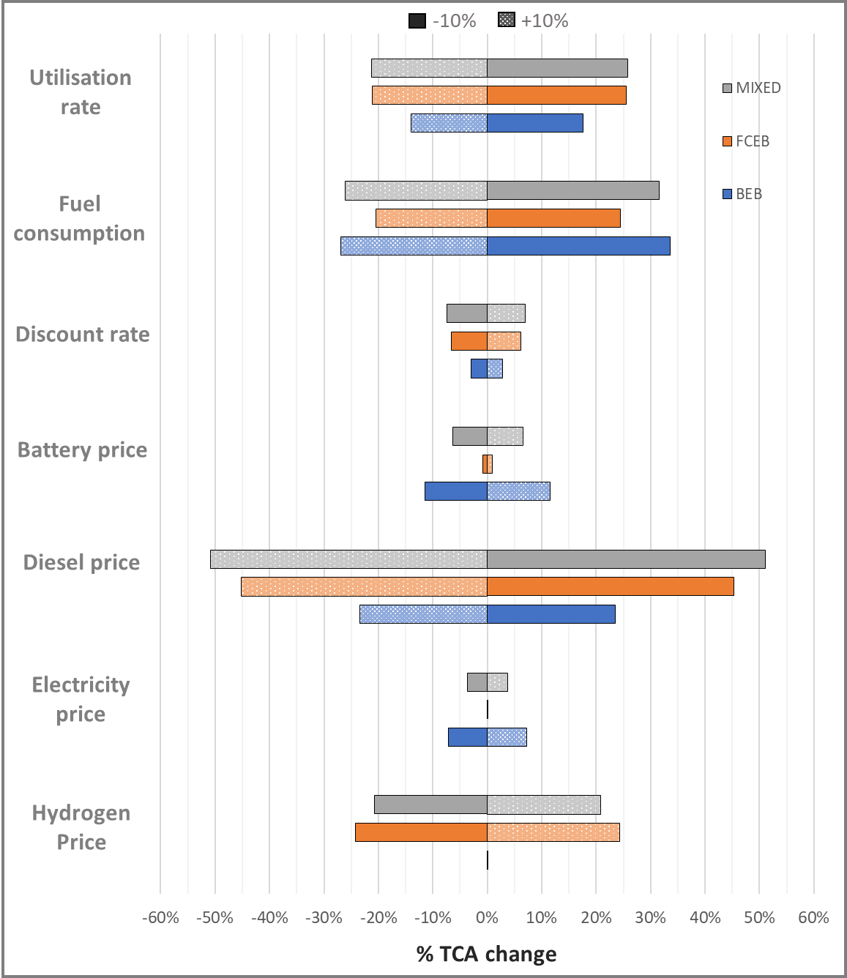
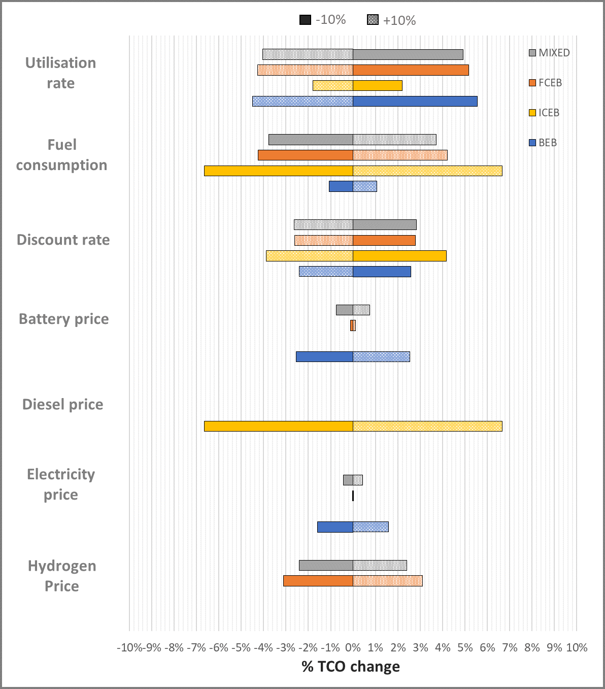
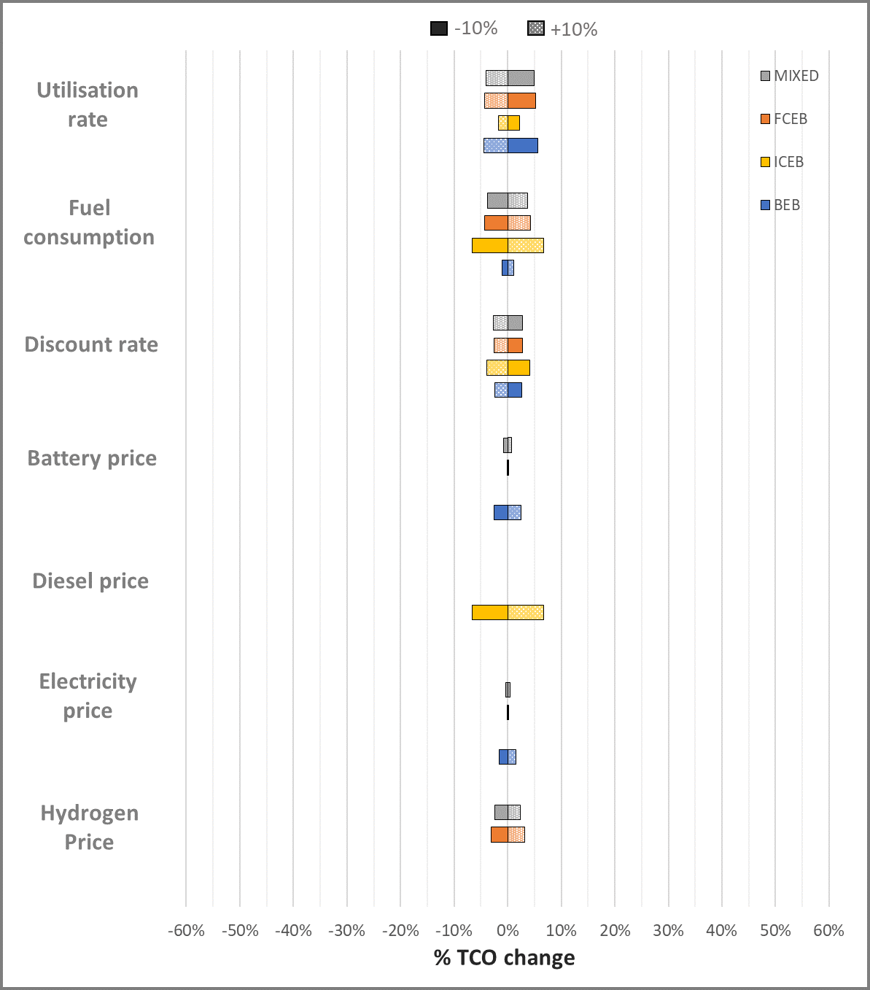
Sensitivity Analysis

Slide 14
Journal Paper
Journal paper in progress – “An Online Tool for Guiding Bus Fleet Decarbonisation through Green Hydrogen and Electrification”
Scenarios will be developed to investigate the shifting role of BEBs and FCEBs in bus fleets from 2023 to 2035 using prediction trends for the development of key parameters such as fuel/energy price, battery price, hydrogen infrastructure price and availability, and grid CO2 intensity

Slide 15
Thank You

