Slide 1
GenComm
Developing Hydrogen Ecosystems
30th March 2023
Place image in this area.

Slide 2
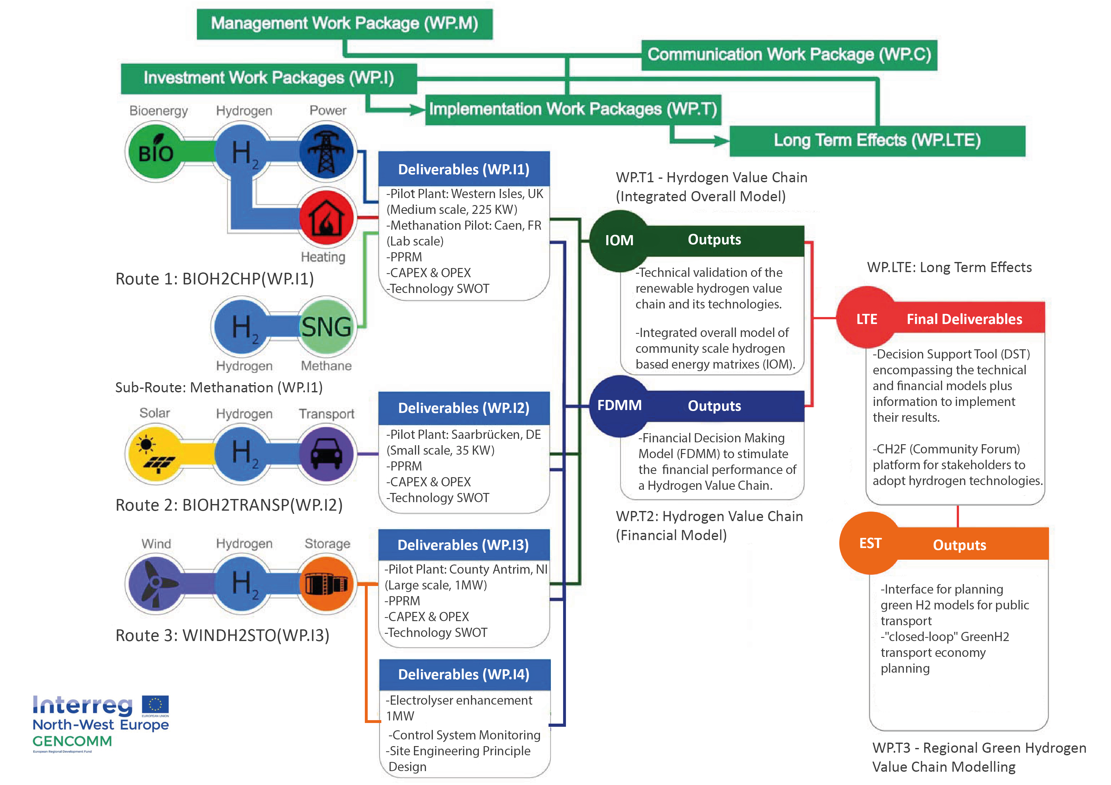
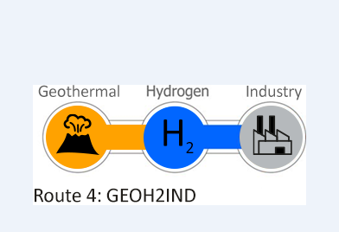
GenComm Value Chain
Notes:
Rural and isolated communities in NWE face unique energy issues related to efficiency, reliability and sustainability. This is commonly due to dependency on external and fossil fuel energy supply, low electricity grid capacity and limited or no connection to wider grids. As a result these communities have higher than average carbon emissions and are more vulnerable to fluctuating fuel prices.

Slide 3
GenComm EU footprint
GenComm project supported by the Interreg North-West Europe Programme.
One of the objectives of the project was to implement 3 pilot H2 Ecosystems using the main northwest European renewable sources (Solar, Wind, and Bioenergy) with energy storage.
Based on these pilot plants the project aimed at developing integrated technical and financial simulation models acting as a Decision Support Tool (DST) that provides a roadmap for communities to transition to renewable, hydrogen-based energy matrixes.
The model replicates Hydrogen Valleys developed in one part of Europe in other geographies.
Key support instrument recommended to allow less advanced regions to replicate the Hydrogen Valleys projects being developed in more “hydrogen mature” countries?

Slide 4
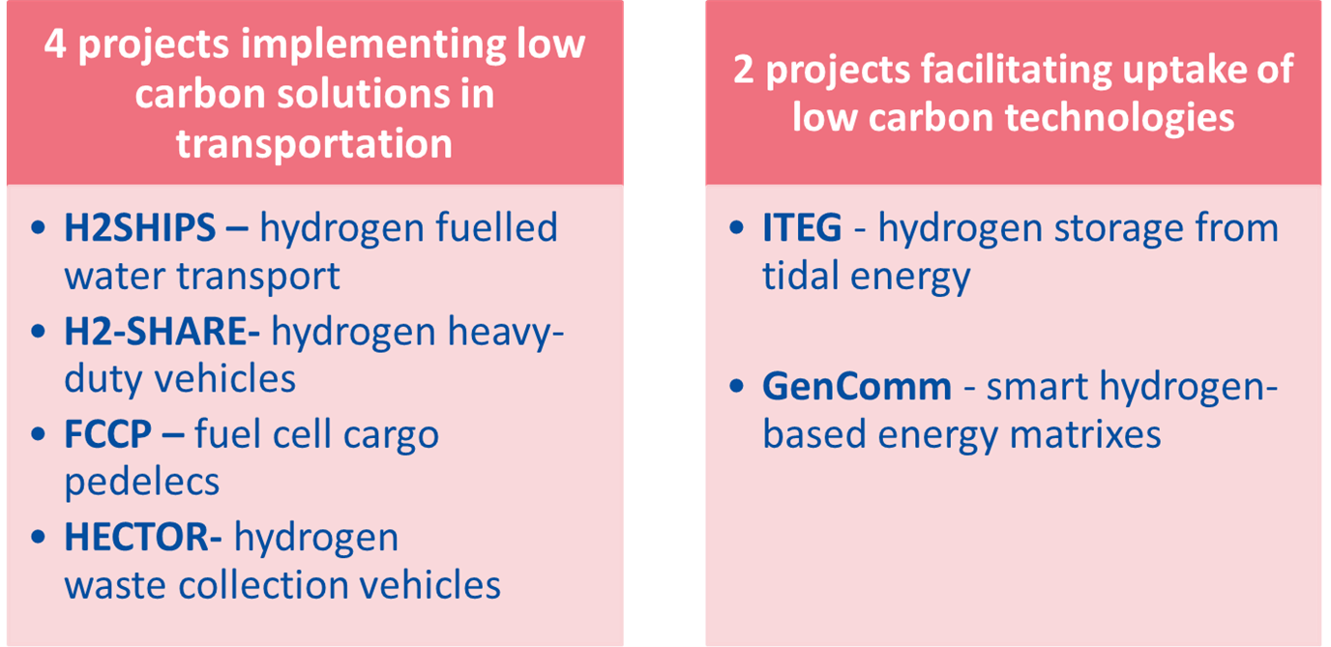
NWE Hydrogen cluster
€49.3 Million:
Total ERDF committed to hydrogen 2014-2020
(13% of programme budget)
Notes:
NWE has financed 6 H2 projects. We’ve seen that the first projects were more resarch focused whereas the most recently approved ones are about demonstration and influencing the market, with an increased focus on green H2. green H2 continues to be expensive. So where can NWE help? By supporting projects that prove the viability of H2, this can influence the market and bring prices down. The H2 projects can be broken down into
Overall budget : EUR 49,309,500.99 EUR 27,953,194.29
Total n° partners : 65
Overall ERDF budget dedicated to topic (approx.!)

Slide 5
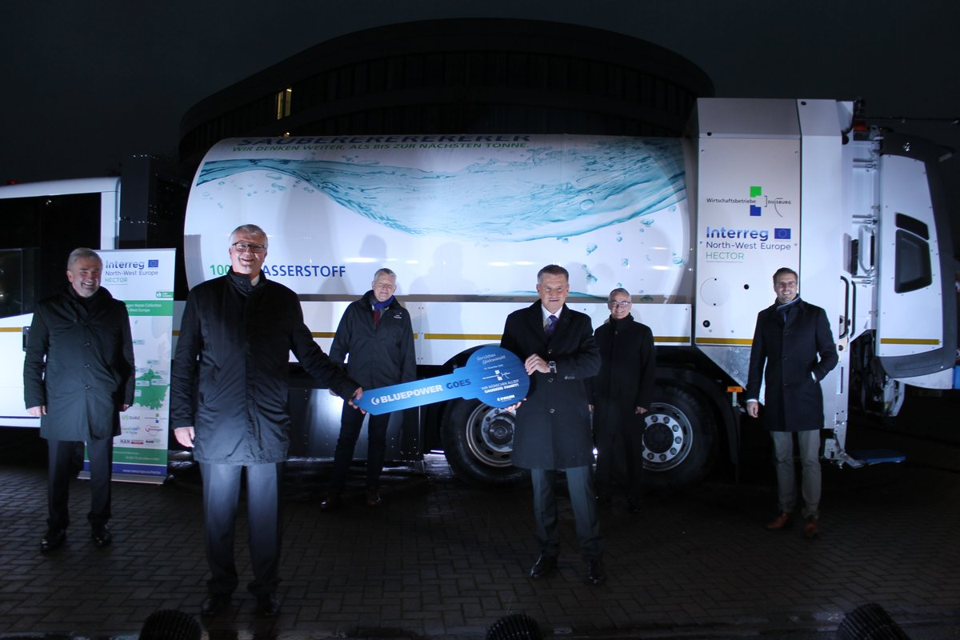
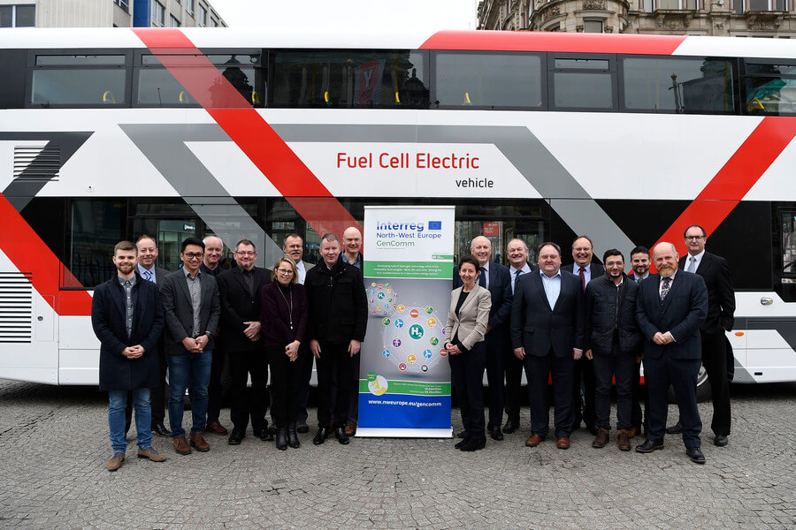
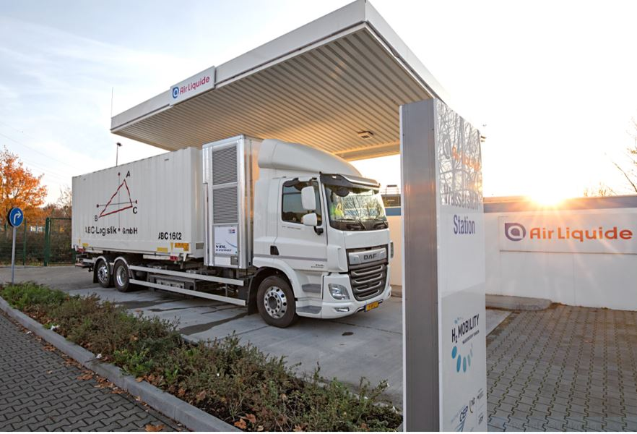
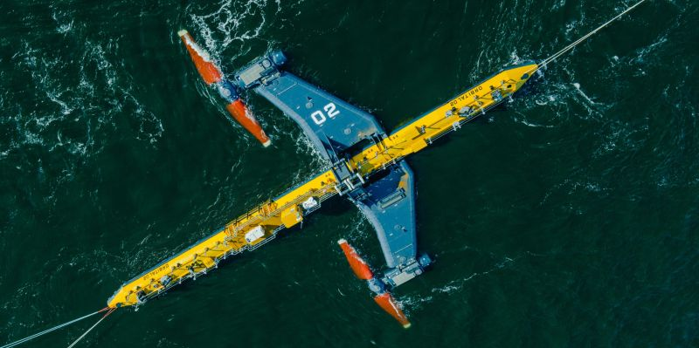
Results of cooperation
Source www.h2-view.com/story/hydrogen-ireland-association-hoping-to-create-hydrogen-economy-for-ireland/
Source : https://twitter.com/project_hector
Source: Orbital Marine Power
Notes:
Cooperation has led to a decrease in GHG and increase of H2 transportation and working towards critical mass.
4.01. Number of implemented low carbon solutions in transport = 5
4.03. Number of transport operators supported implementing low carbon solutions = 13
CO34. Estimated annual decrease of GHG 3389.76 ton/year
CO28. Number of enterprises supported to introduce new to the market products 47

Slide 6
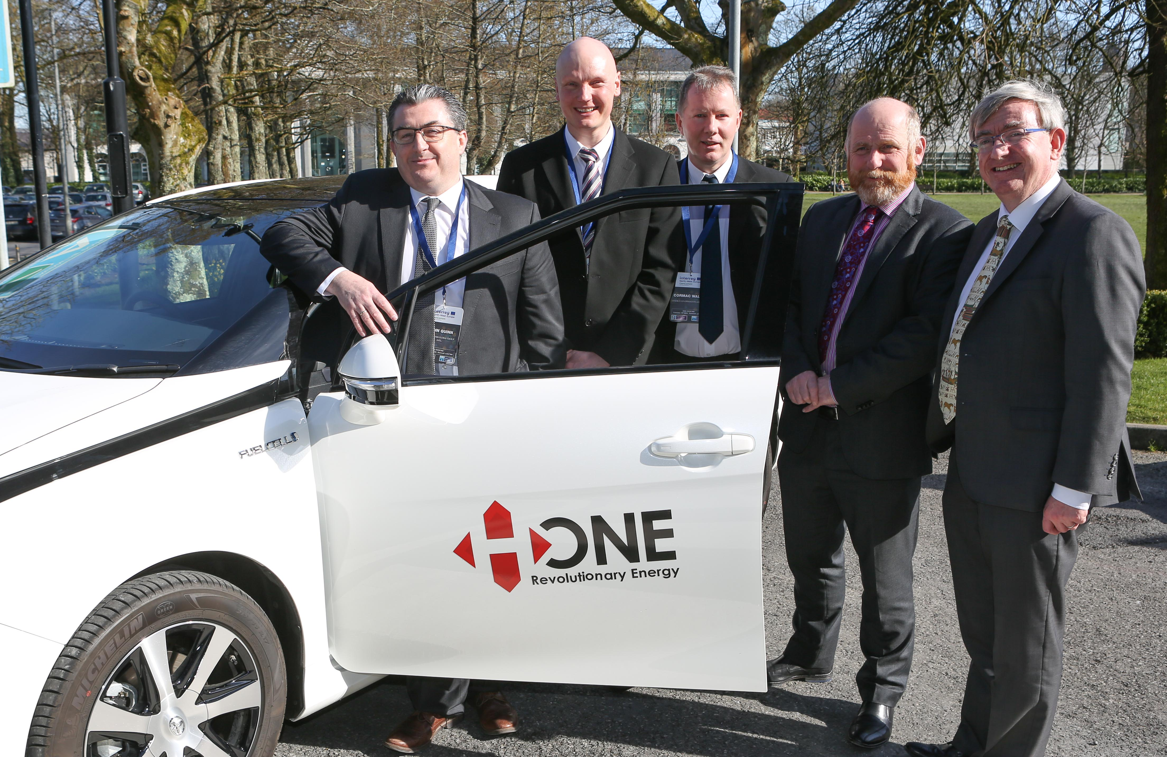
Why GENCOMM
• Implemented communication strategically and provided tangible results
• Strong voice on the added value of Interreg to regions and cities
• Addresses an extremely relevant topic for Interreg and the EU
• Influences policy in its sector
• Capitalises activities by creating networks
• Communicates directly to local citizens in remote areas
• Reached audiences way beyond traditional stakeholders

Slide 7
GenComm Objective & Baseline
GENCOMM will technically and financially validate and model the renewable H2 value chain and adapt it to a Decision Support Tool (DST) that leads NWE communities into sustainable, local and autonomous energy matrixes. The DST is directed to community energy stakeholders (utilities, policy-makers and private firms in the energy sector), as the key agents to implement the proposed matrix. The project will first engage energetically and territorial remote communities to then address the rest of NWE
The aggregated renewable energy share of NWE is 8,9%, with Wind, Solar and Bioenergy as main sources. All NWE countries are in track to meet their NREAPs 2020 goals in electricity and heating, but are behind in their transportation goals. Also, further uptake of renewable sources, beyond 2020, is stalled due to lack of: energy storage, flexibility and dispatchability. Despite confronting these issues, H2 for energy usage in NEW by all sectors is under 1% and is not present in future scenarios.

Slide 8
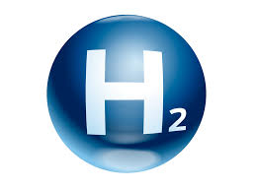
H2CAT
Communications Cohesion
The catalyst for H2 - powering hydrogen innovation, entrepreneurship and deployment
Working in Government Departments and other stakeholders the centre will inform, support and drive the commercial scale up: Hydrogen, Carbon Capture, Utilisation and Storage (CCUS), Renewables, Waste to energy, Biofuels, Green natural gas

Slide 9
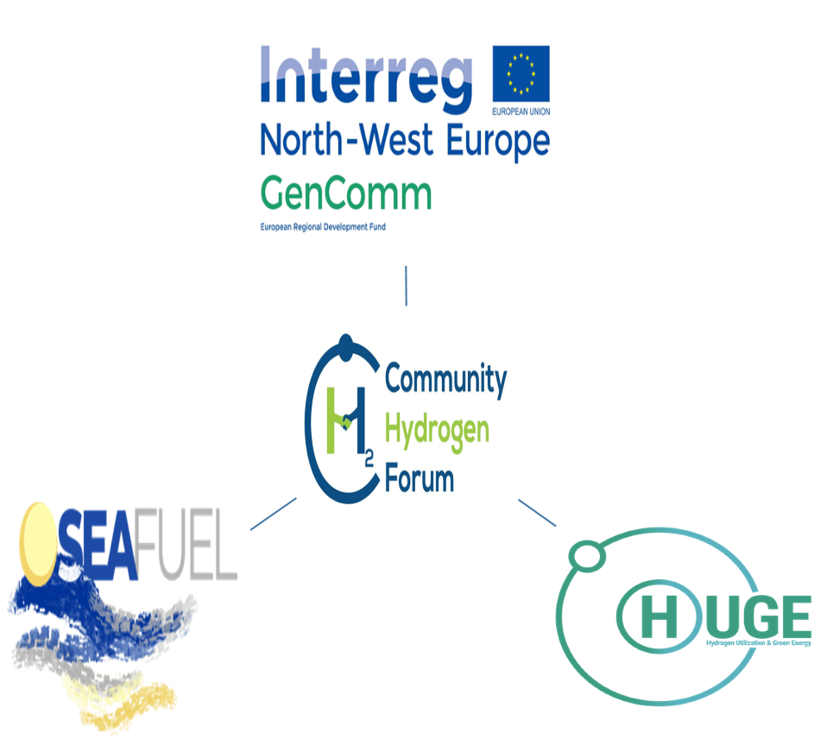
Bringing Cooperation to a new level
Cooperation should be at the heart of the project and should be visible throughout every stage of the project. The partnership is required to describe their approach to cooperation and explain how intensely they will cooperate in order to deliver the project and achieve its overall results.
In order to be eligible, projects must meet the 4 criteria ‘ joint development’, ‘ joint implementation’, ‘ joint staffing’ and ‘ joint financing’ in the cooperation intensity table of the Application Form in STEP 1 and STEP 2.
H2 Congregation

Slide 10
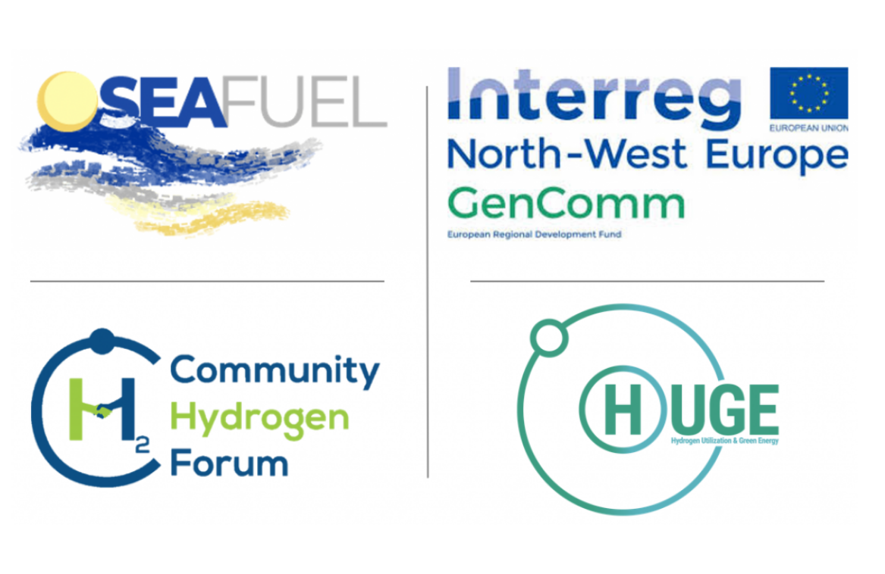
Hydrogen Triple Alliance

Slide 11
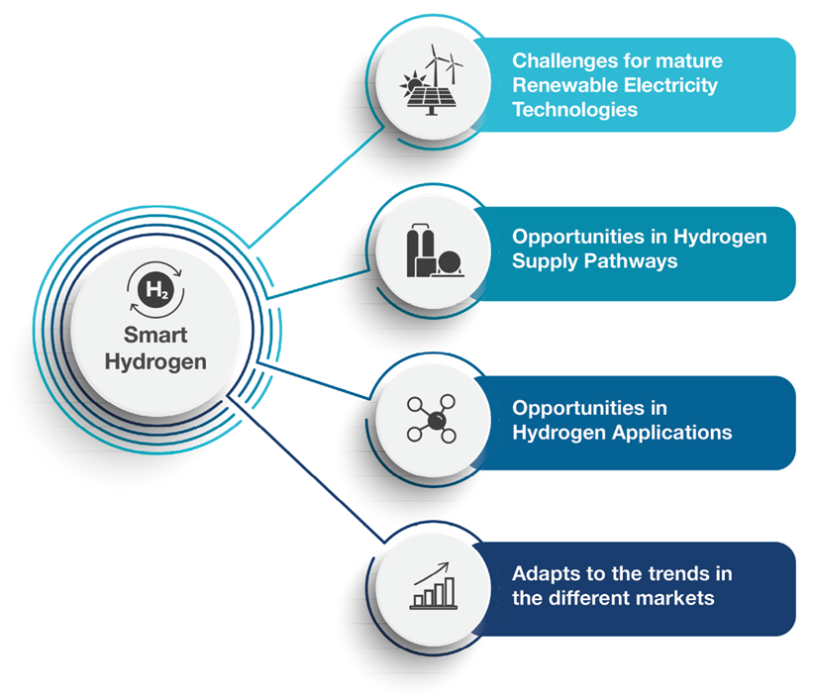
NETWORKS

Slide 12
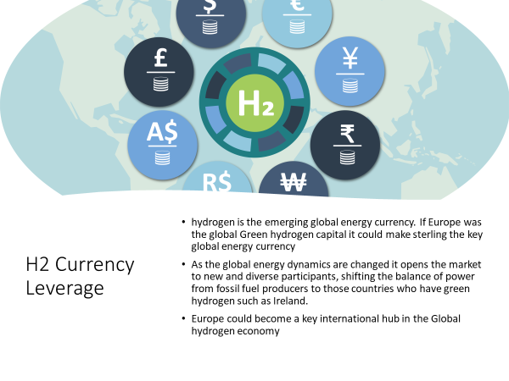
Reach Impact & Evaluation
28 newsletters
55 periodicals
60 articles
100 contributions
40 think pieces
55 community outreach sessions
25 School presentations
Curriculum development

Slide 13
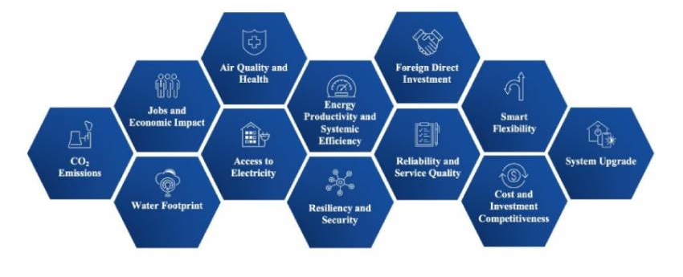
H2 Transition Opportunities
Reach Impact & Evaluation
As Europe transitions to net zero, position NI as the lead in clean hydrogen trade Accelerate our current EU clean hydrogen journey
Develop increased additional links with BEIS
Stimulate increased Green H2 awareness and demand and ‘position’ that all transactions are carried out in sterling.
Progress the H2 CAT model, transition NI towards a climate-neutral and more resilient economy
Expand our work to include digitalization and implementing a well-thought-out circular economy model.
The recovery post COVID is predicated on the Green Economy and Digitalisation.

Slide 14
BEYOND THE TRADITIONAL

Slide 15
Contact details and media links
GenComm Website nweurope.eu/gencomm
GenComm LinkedIn GenComm
GenComm twitter @GenComm_CH2F
Community Hydrogen Forum www.communityh2.eu
GenComm Animation
https://vimeo.com/366993950/91cafb0bb6
E-mail - PaulMcCormack@belfastmet.ac.uk

Slide 16
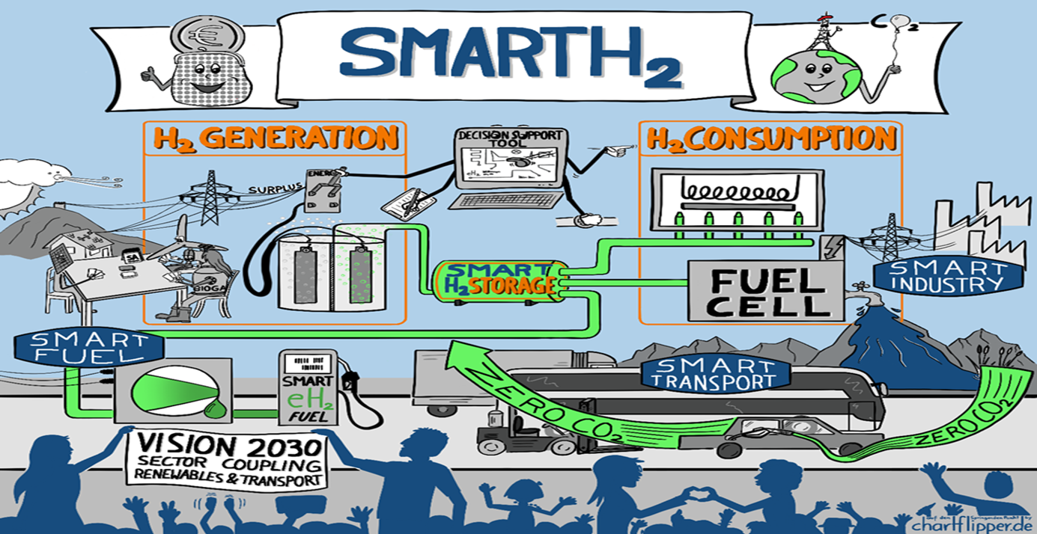
Additionality

Slide 17
Green H2 Hub
H2 hub
Inspire
Innovate
Invest
Instil
FE application - Green H2 Hub Belfast Met.
Skills pillar of the H2 CAT.
Cohesion with HE
Continuous pathway for skills development - reinforced with R&D.
Belfast Met with HE partners and major industrial in the green hydrogen supply chain to develop the Hydrogen Skills Alliance.
The H2 Skills Alliance will collaborate in assessing the readiness of NI industry to access the supply chain, to support green hydrogen projects and highlight the potential economic value.
The H2 Skills Alliance will also show the potential for green, sustainable skills and high-value jobs emerging from a future hydrogen sector, using live projects as case studies.

Slide 18
Hydrogen Training Academy
Prime example of project financial engineering
L2 and L3 - NRC and Belfast
L4 and L5 - Know Hy - CAF
Train the trainer - Know Hy -
L5 and above - QUB
PGCE - QUB and Belfast Met
L2 and L3 BMet/NRC
L4 and L5 BMet/NRC
Train the Trainer M&EA
L5 and L6 QUB
PGCE QUB

Slide 19
H2 CAT NI - Affirmative Action
8 Steps to H2ZERO
Utilise Green H2 as an energy vector - this will be a key enabler in reaching Net Zero: 60 Gt of carbon emissions could be saved between 2021-50 (EU emission are ~2.5 Gt/y).
Deliver a paradigm shift to boost the uptake of Green H2 : we need to move from today's 90 Mt unabated hydrogen to 530 Mt low-carbon hydrogen by 2050.
Legislators and policy-makers need to take leading roles in Green H2 demand creation, setting the right set of regulations and channelling investments into R&D and hydrogen supply projects.
Repurpose existing infrastructure in the transition to net zero. Use the gas infrastructure can act as a catalyst in the deployment of low-carbon hydrogen: in the early stages via blending.
Widen the route to net zero -optimise every energy stage and opportunity on the route including biomethane, the 40 shades of hydrogen and other ‘lower carbon’ energy transition opportunities.
Scale up innovation and demonstration, especially in end-use technologies, key to unlock the true potential of hydrogen.
Develop the skills and training pathways to stimulate and support the deployment of hydrogen technologies and enable business’ to pivot to the new H2 economy.
Market stimuli - short term economic business cases for industry as well individual use of Green H2.

Slide 20
EUSEW 2022
Alignment
The commodification of Green H2 for Europe
Europe faces multiple pressures to decarbonise economies and to accelerate the integration of greater renewable energy sources into our energy systems.
H2 - vectors of change for the energy industry
Hydrogen is a versatile energy vector that can circumnavigate many decarbonisation obstacles but in doing so, it has many challenges to become universally accepted and utilised

Slide 21
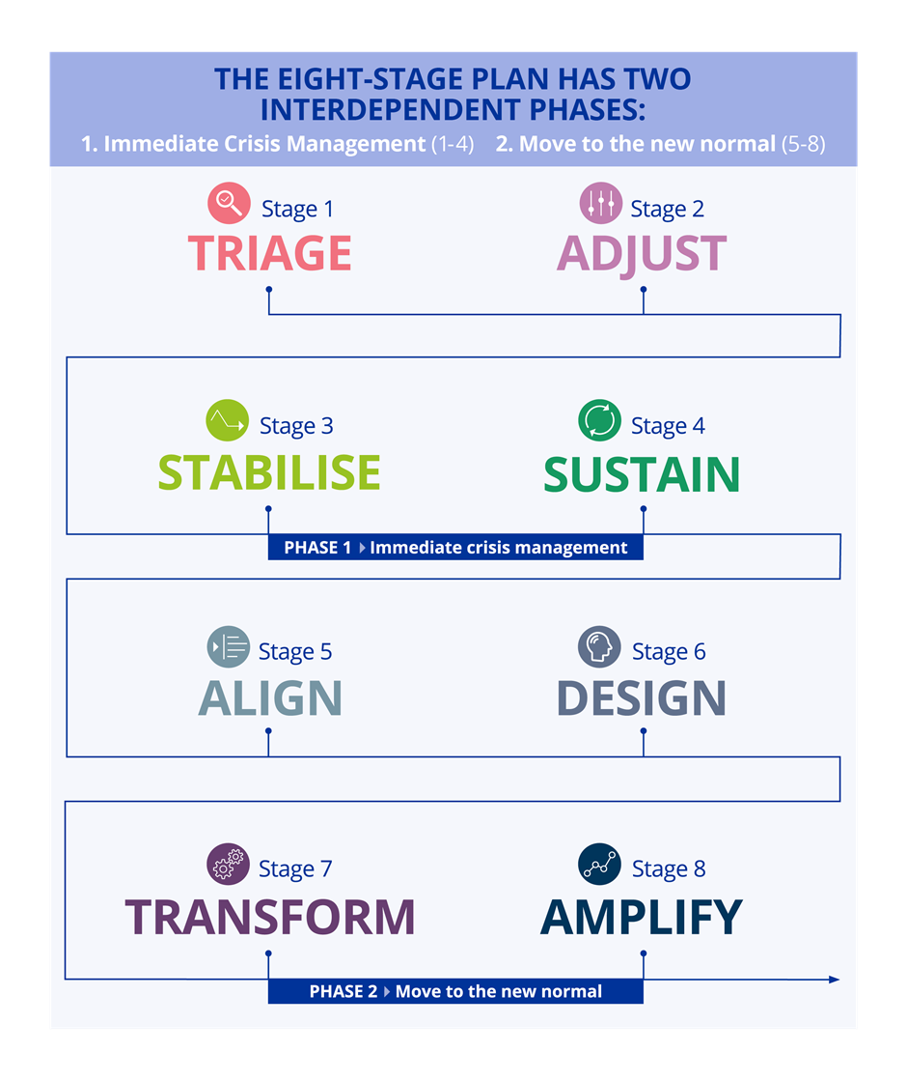
Reaction
The GenComm COVID-19 ‘mission critical’ platform detailing how we can continue to deliver on all project aims, objectives and outputs. We will also capture how we are continuing to employ innovation and digitalisation processes to explore capabilities, identify gaps, strengths and weaknesses and importantly identify potential differentiators to maximise the project deliverables for all.

Slide 22
SHARED PATHWAY

Slide 23
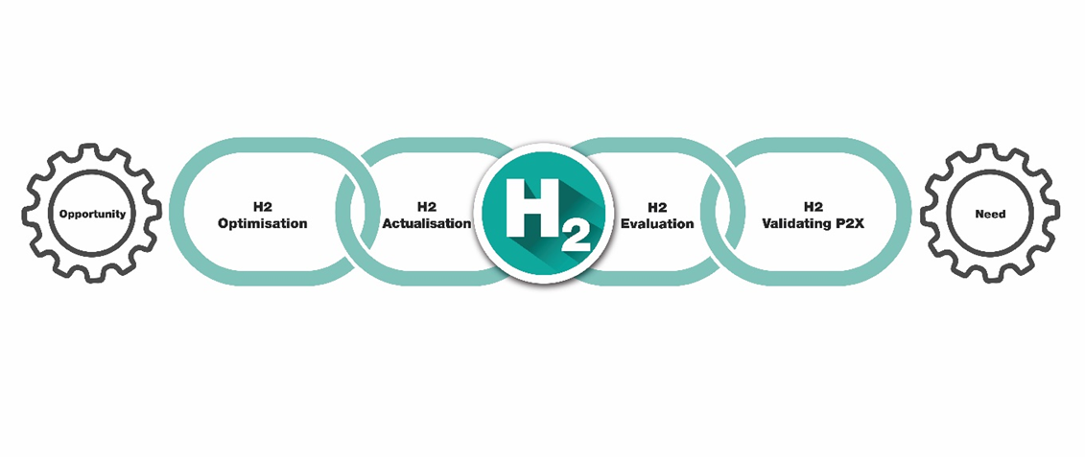
Optimalisation
The 4-Stage Green H2 Commodification Value Chain

Slide 24
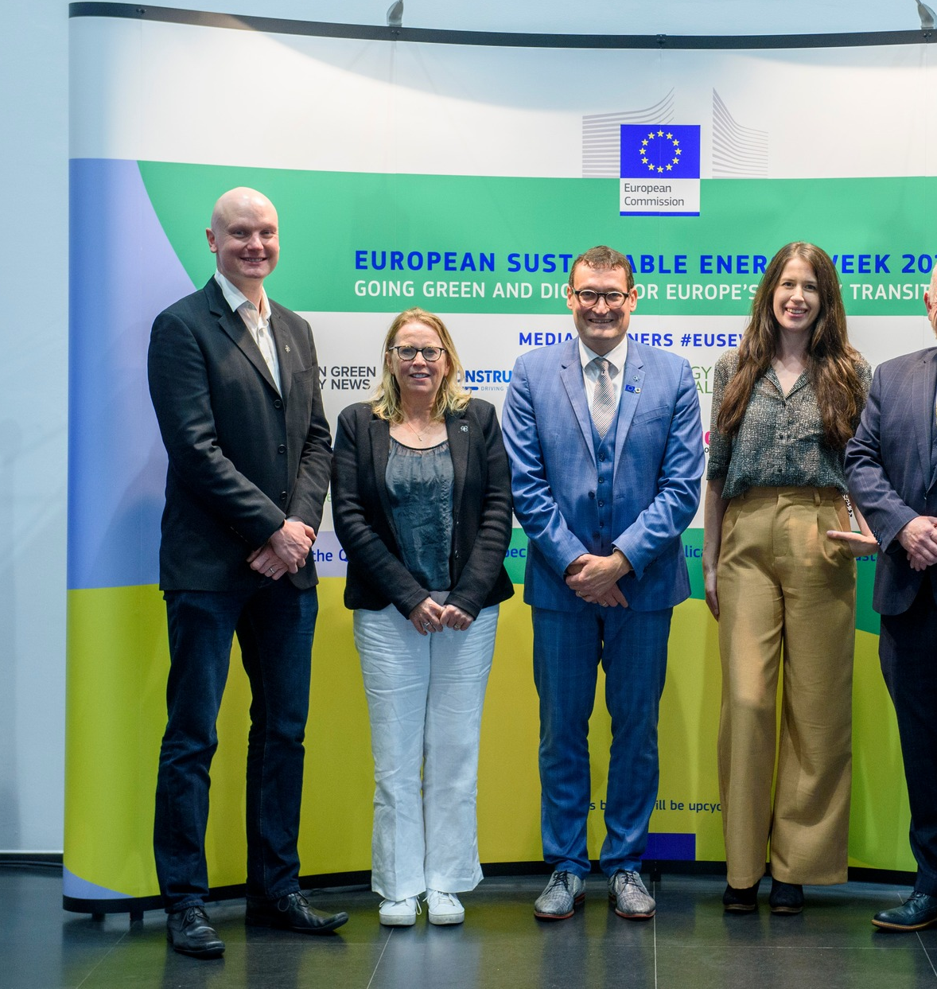
EUSEW 2022
The commodification of Green Hydrogen for Europe

Slide 25
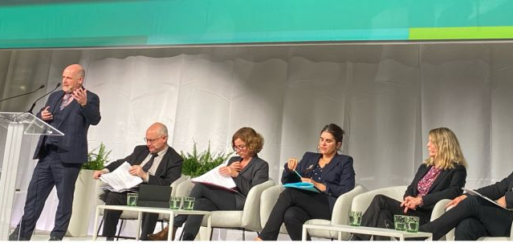
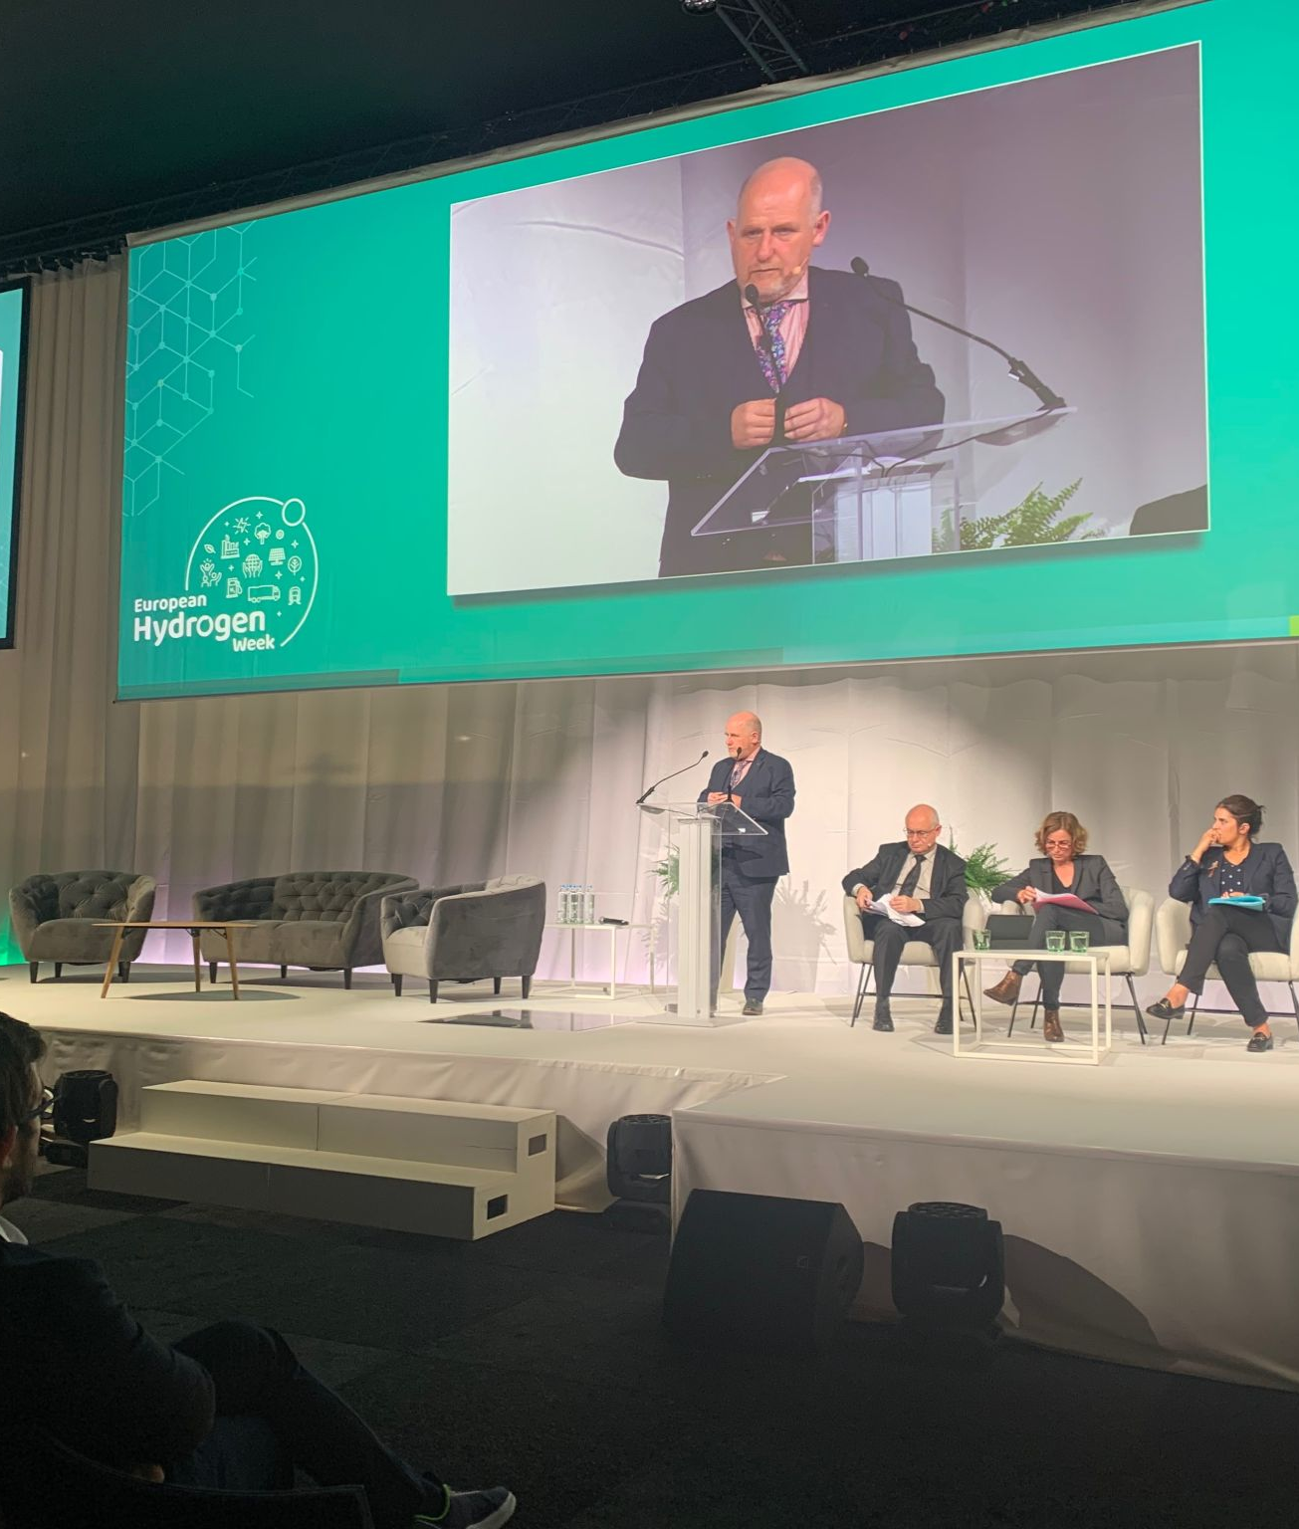
Hydrogen Week 2022
GenCommproject implemented 3 pilot H2 Ecosystems using the main northwest European renewable sources (Solar, Wind, and Bioenergy) with energy storage. Based on these pilot plants the project aimed at developing integrated technical and financial simulation models acting as a Decision Support Tool (DST) that provides a roadmap for communities to transition to renewable, hydrogen-based energy matrixes. What are the main learnings you can share with us? And
GenComm model foundations for Hydrogen Valleys developed in one part of Europe in other geographies
Detailed type of support instrument to enable less advanced regions to replicate the Hydrogen Valleys projects being developed in more “hydrogen mature”

Slide 26
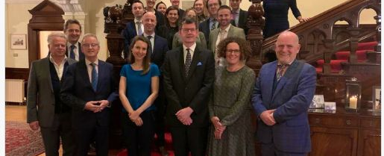
UK Ambassador to Ireland meeting
The British Ambassador to Ireland Mr Paul Johnston and his wife Nicola Johnston have held a dinner at the ambassadors residence in Dublin to discuss hydrogen as a fuel of the future in the UK and Ireland.

Slide 27
Hydrogen Valleys are disruptive technologies
Green H2 and Hydrogen Valleys are disruptive approaches in tackling our energy needs and challenging the conservative fossil fuelled energy market. This disruption is essential in the development of a new hydrogen economy because it disrupts at all stages in production, transportation and end use.
Hydrogen Valleys can and are delivering a change in our energy markets. They are disrupting the current fossil fuel based energy status quo that is clearly incapable of empowering Europe to meet the twin crises of climate and energy security. Hydrogen Valleys are carving out a new energy world, one which Europe can manage every step of the supply chain and one which will provide a green stable energy future for us all.

Slide 28
Mission Innovation
November 8, 16:45-17:25, Climate Action Innovation Zone, “Hydrogen Transition Summit”
Julie Cerqueira, Chair of MISC, in a panel discussion on how governments and the private sector can work together to deliver on needed hydrogen infrastructure.

Slide 29
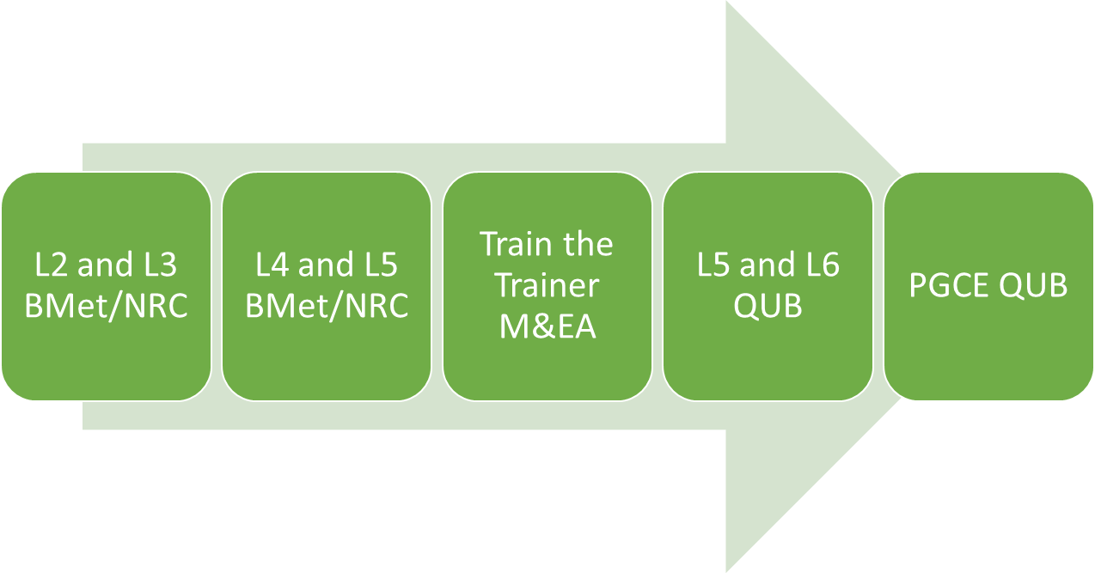
Hydrogen Training Academy
The circulated HTA documents and links below, provide the background to the project and the equipment that is now available to us to enhance and progress this exciting and ground-breaking work.
Hydrogen Training Academy (investmideastantrim.com)
https://youtu.be/NC8CDVHsrSA
To support this capacity building project we have invested in a H2 Fuel Cell Trainer to begin the process of embedding this further into the curriculum. The Fuel Cell Trainer is currently in TQ training will be organised its operation in the near future.
Heliocentris (heliocentrisacademia.com)

Slide 30
SHAMROCK Hydrogen Valley
GH2, or the Galway Hydrogen Hub, is a consortium consisting of
eight members NUI Galway, the Port of Galway, CIÉ Group and Bus
Éireann , Colas, Aran Islands Ferries, Lasta Mara Teo, Aer Arann Islands, and SSE Renewables
GH2 will be the initial flagship demonstrator project for the indigenous production and supply of clean green hydrogen fuel for public and private vehicles in southern Ireland
It will deliver a multi modal, zero emission, renewable hydrogen
transport hub to initially fuel buses and trucks expanding to ferries and aviation and industrial heat applications

Slide 31
H20RIZON PDA
H2ORIZON
represents islands & regions that need energy resilience & security to support their economy, matched by community & industry support to ensure success.
has identified suitable locations to address a diverse range of H2 production, storage, consumption needs/challenges that can be replicated.
bid partner regions, due to geographical & technical isolation, are at the end of energy grids & opportunity, leaving these regions socially & technically remote.
Energy connectivity for remote island communities is essential, enabling people to access goods, services, information, and employment & is foundational for their main economies including tourism.
Secure, affordable, sustainable energy is a constant challenge for geographically and technically remote communities. Sector Coupling energy & mobility sectors by harnessing local renewable generation to produce & store H2 for ferries & backup power will provide sustainable, secure energy & mobility for these communities

Slide 32
Hydrogen Valleys - our challenge
Globally there will be 100 Clean Hydrogen Valleys identified by 2024.
We need to articulate the how and why H2orizon will be unique, deliver a differentiated Green H2 value chain, showcase innovative end-use technologies/applications/sectors and enable us to build scale. We need to highlight how our H2Hub for geographically/technically remote regions will successfully demonstrate Green H2 Production, Storage, Distribution and End-Use in our defined geographic regions and how it will be a vital step in a global H2 economy
President Ursula von der Leyen, has stated: “Research and innovation will propel the clean energy transition that is more needed than ever. Together with our EU Member States, we expect “Team Europe” to make a leading contribution to our shared ambition of investing more, faster and bolder in breakthrough energy innovation demonstration projects.”
Europe has identified alternative fuels such as hydrogen as essential to drive long-term emissions reductions across energy-intensive sectors such as steel, cement and chemicals, dramatically reducing the need for fossil fuels and exposure to future fluctuating prices. We don’t have big industry in parts of H2orizon but need to look to develop systems innovation that can be world class.

Slide 33
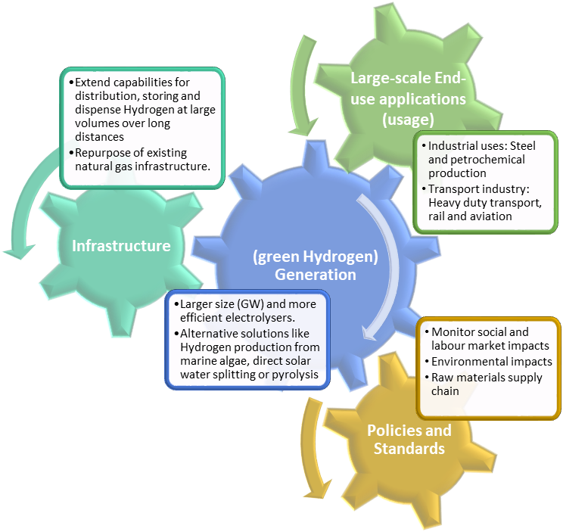
Marie Curie PhD Application
Doctoral Networks (DN)
Call: HORIZON-MSCA-DN-2021
“HALLIE” Hydrogen applications on a scientific/industrial level as a leading instrument for decarbonisation of the future energy system in Europe

Slide 34
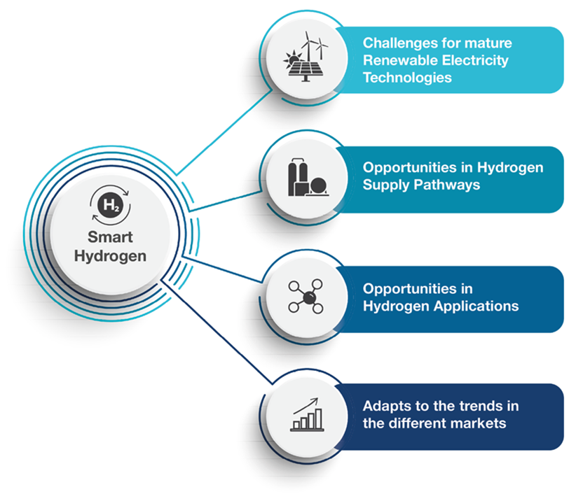
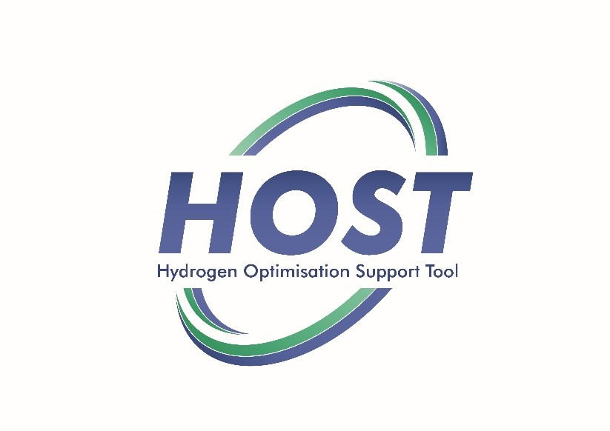
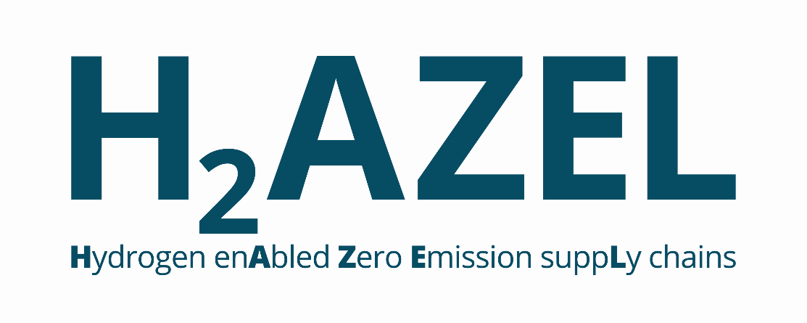
Future Opportunities

Slide 35
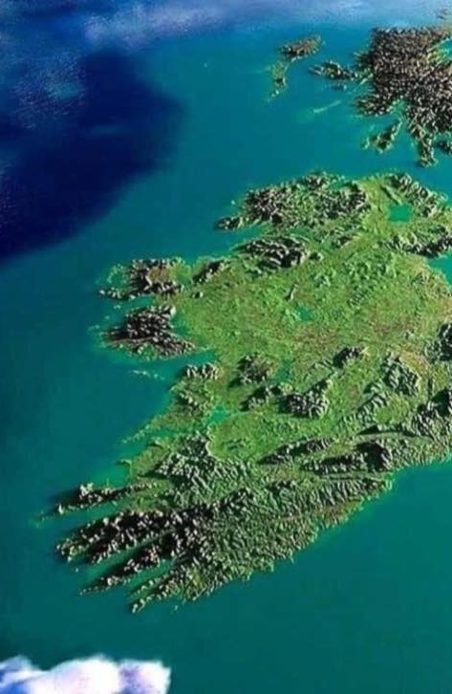
H2ORIZON
Using Green H2 as the catalyst we will develop regionally specific projects to provide energy security through innovative adaption/storage to rebalance current energy systems, smooth the intermittency of renewables, create innovative storage, enhance system renewables compliance and reduce the challenges of power shortages in peak times and in critical industries.
The aim is to develop replicable H2 micro grid & innovative sector coupling opportunities for green industry & power reinforcement. Focus will be on system resource efficiency with innovation & collaboration at technical, commercial & social levels to achieve net zero goals.
A further goal is to improve system resilience through smart, flexible, dispatchable electrolysers supporting the power system via load balancing & system services while producing & storing H2 to complement electrification in decarbonising mobility & for H2 fuel cells for back-up generation.
H2ORIZON will encompass the complete value chain from renewable generation for ‘smart’ H2 production to distribution, storage and end-use, decarbonising energy use sequentially: ferries, back-up power, industrial use, onshore transport & heat.
Hydrogen Valleys ecosystems that link hydrogen production, transportation, and various end
uses, and will be essential in the development of a new hydrogen economy

Slide 36
Contact details and media links
GenComm Website nweurope.eu/gencomm
GenComm LinkedIn GenComm
GenComm twitter @GenComm_CH2F
Community Hydrogen Forum www.communityh2.eu
GenComm Animation
https://vimeo.com/366993950/91cafb0bb6
E-mail - PaulMcCormack@belfastmet.ac.uk

