Slide 1
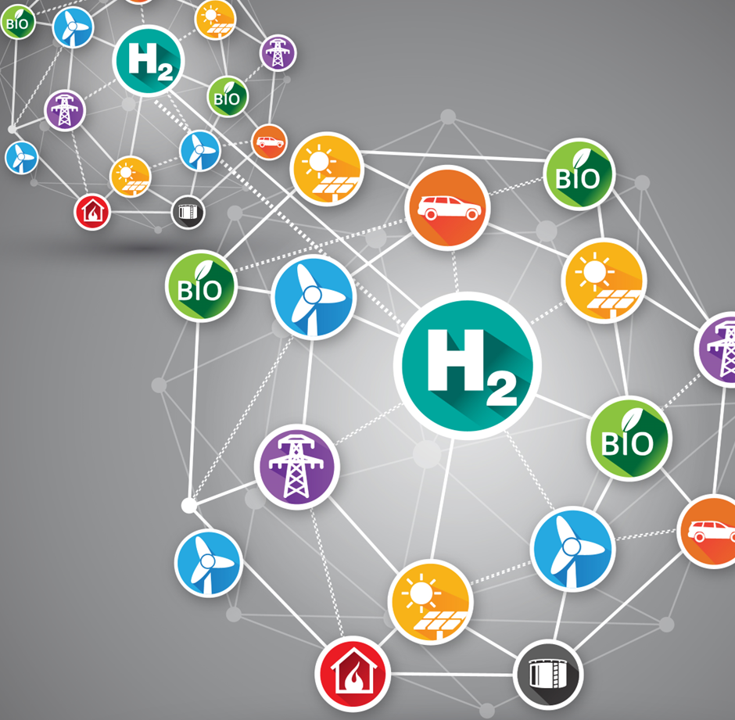
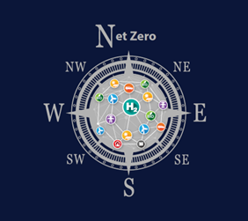
GenComm GENerating Energy Secure COMMunities
Sectoral Smart Energy Systems Workshop (SEES)
Tuesday 25th July

Slide 2
GenComm main animation-2023 | Interreg NWE (nweurope.eu)
Gencomm animation

Slide 3
Generating Energy Secure Communities
GenComm bid commenced 2016
Communities especially in remote areas, face multiple challenges to become energy secure and sustainable.
Growth in electricity from renewable sources is stalling due to intermittency, grid restrictions, curtailment, and high costs.
Sustainable energy to supply the transport sector and heating demand are even further underexploited.
GENCOMM will address these issues by developing a sustainable, renewable community-scaled, hydrogen (H2)-based, energy model based on the results of 3 pilot plants that will use local renewable sources to supply electricity, heating and transportation fuels.
The main output of the project is an H2-based energy model. The second output is the adaptation of the model The final output is the creation of an H2 stakeholder’s forum.

Slide 6
Green Headlines
24 quarterly GenComm H2GO Newsletters
13 white papers
4 Academic papers
10 H2 strategy papers
4 EU energy Week (EUSEW) presentations
200+ articles
4 Webinar series – 20 webinars
85 GenComm press releases
Rathlin/Valentia Hylanders,
a renewable energy journey of two Irish islands
360˚Destination Green©
& much more

Slide 7
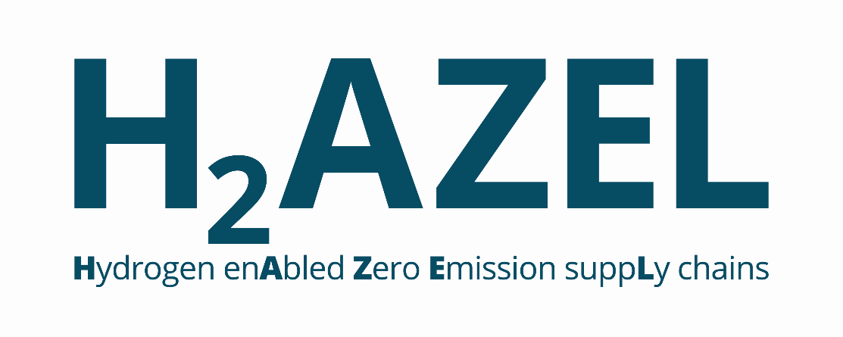
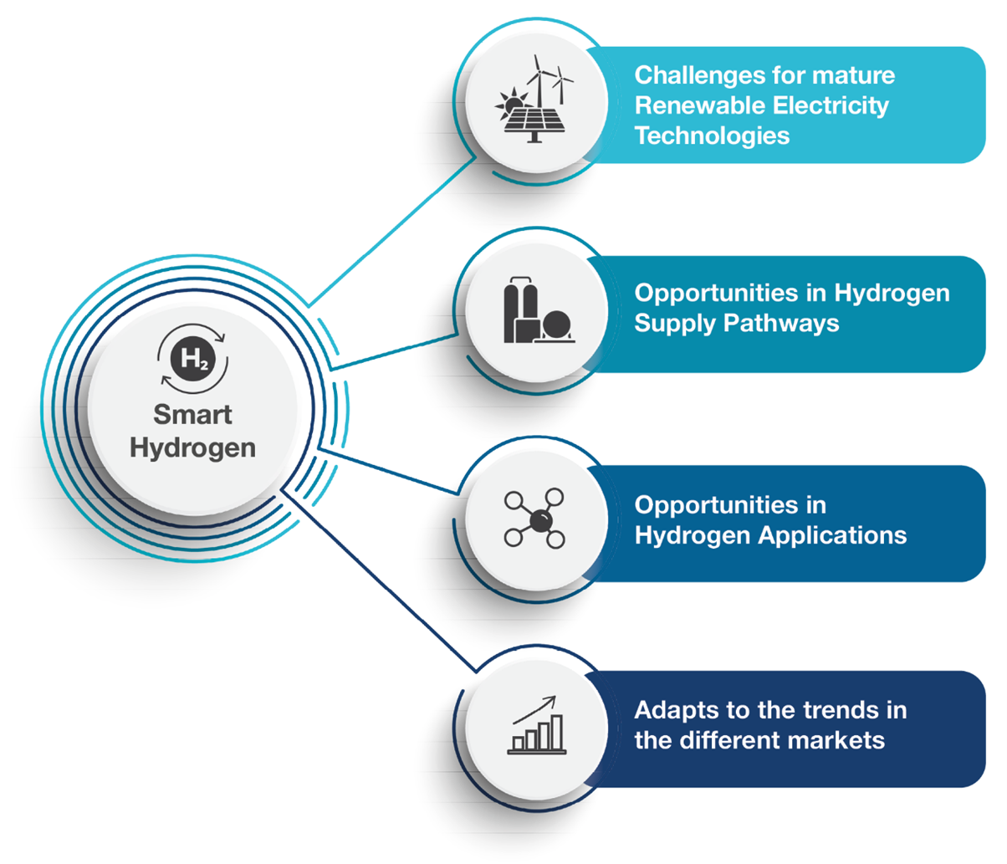
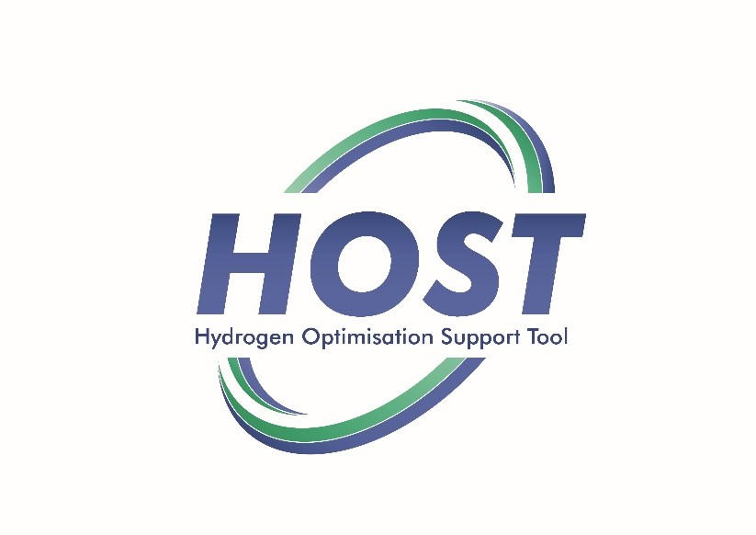
GENERATION H₂ PLUS
HALLIE

Slide 8
Hydrogen Topography
This approach empowers communities across Europe to access hydrogenewables- their own renewable opportunities wind, solar or bio and use these green sources to provide green solutions and end use on their specific journey to net zero.
https://hydrogeneurope.eu/wp-content/uploads/2022/05/How-to-deliver-on-the-EU-Hydrogen-Accelerator_Final.pdf

Slide 9
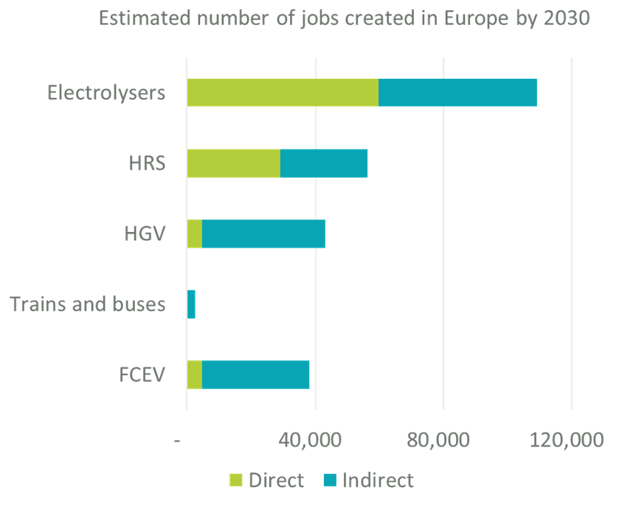
Skills the engine of the economy
Hydrogen Europe estimates that the sector will generate 249,000 jobs (98,000 direct and 151,000 indirect) by 2030, assuming that by 2030 the levels of key equipment manufacturing will be the following:
•Electrolysis: 130 GW
•FCEV: 500,000
•FC Buses: 3,500
•HGV: 60,000
•Trains: 100
•HRS: 2,500

Slide 10
Energy Innovation at scale
The impact of crises of climate change, energy security and energy cost on global operations, supply chains, and entire populations have shown us that learning fast and adapting quickly is a business necessity.
True innovators are using this newfound capacity as a foundation for accelerating change, building advantage, and consolidating success.
GenComm epitomises ‘Opportunity Driven Innovation’ a dramatic evolution in enabling more effective, efficient, and predictable innovation.

Slide 11
Repowering Europe Reskilling Europe
Skills - paving the way for a clean Hydrogen economy in Europe
Providing workers and industry with the new skills that are required to meet the challenging targets of the Green Transition.
The EU is aiming for 1 million highly skilled jobs by 2030 and up to 5.4 million by 2050
Green Skills for Hydrogen will help meet REPowerEU targets by fast-tracking the upskilling and reskilling of students and members of the workforce all over Europe. Workers in declining sectors and transition regions will also benefit from upskilling and reskilling opportunities, through VET programmes that will enable them to access new employment opportunities within the Hydrogen sector.

Slide 12
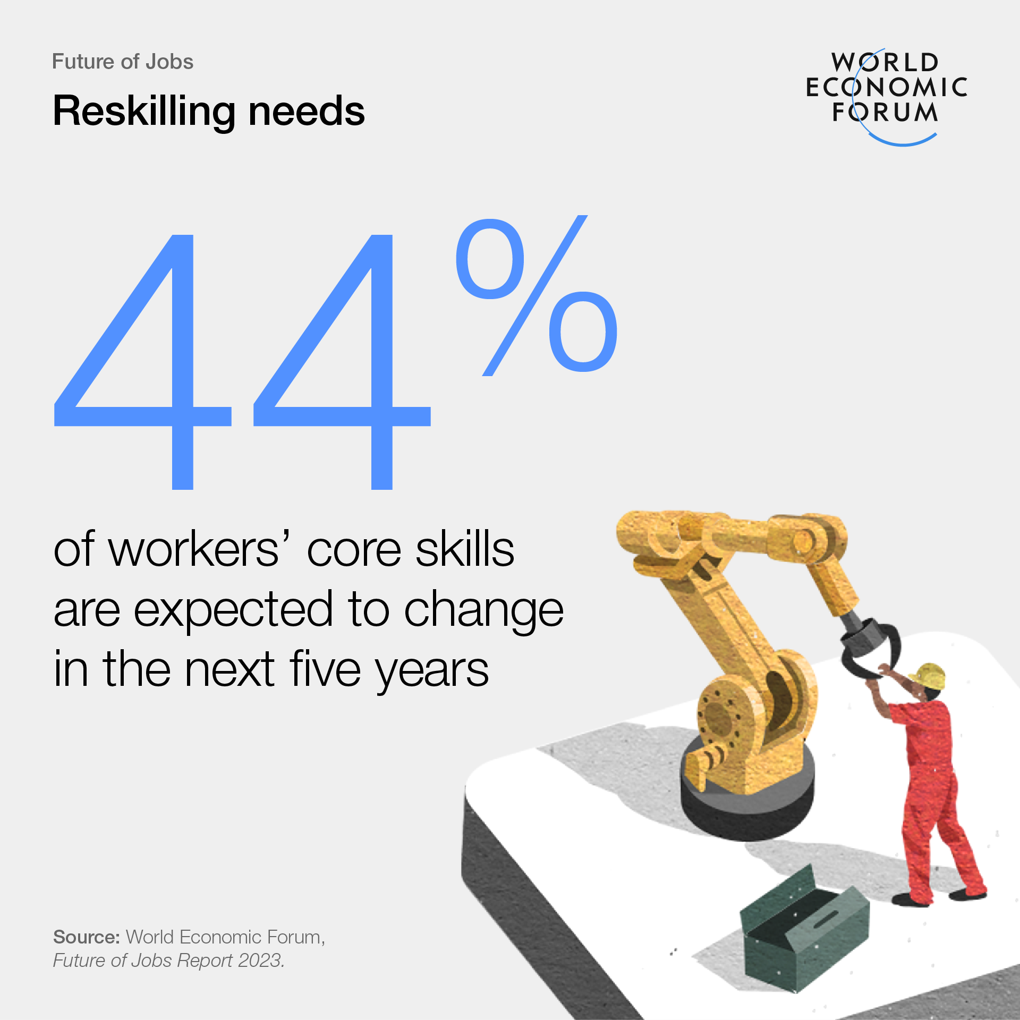
Training access
Six in 10 workers will require training before 2027, but only half of workers are seen to have access to adequate training opportunities, World Economic Forum Report May 2023.

Slide 13
Hydrogen everyday vernacular
‘Hydrogen is not a silver bullet it is more a silver buckshot.’
Mark uses this term to reflect the many solutions where green hydrogen can be utilised in as part of a hybrid solution to achieve net zero by 2050. Mark states ’Green hydrogen is a key ingredient in the recipe for net zero in our energy mix. As an energy vector it can be used as a single solution or as part of a ‘solution of choice’ or in a power-to-X (P2X) solution where the consumer chooses what energy mix is best suited to their technical, geographical or environmental need. In short green hydrogen has a myriad of applications and is a key energy decarbonisation catalyst closing one of the many gaps in the energy transition strategy’ Mark Welsh Energia Feb 2019

Slide 14
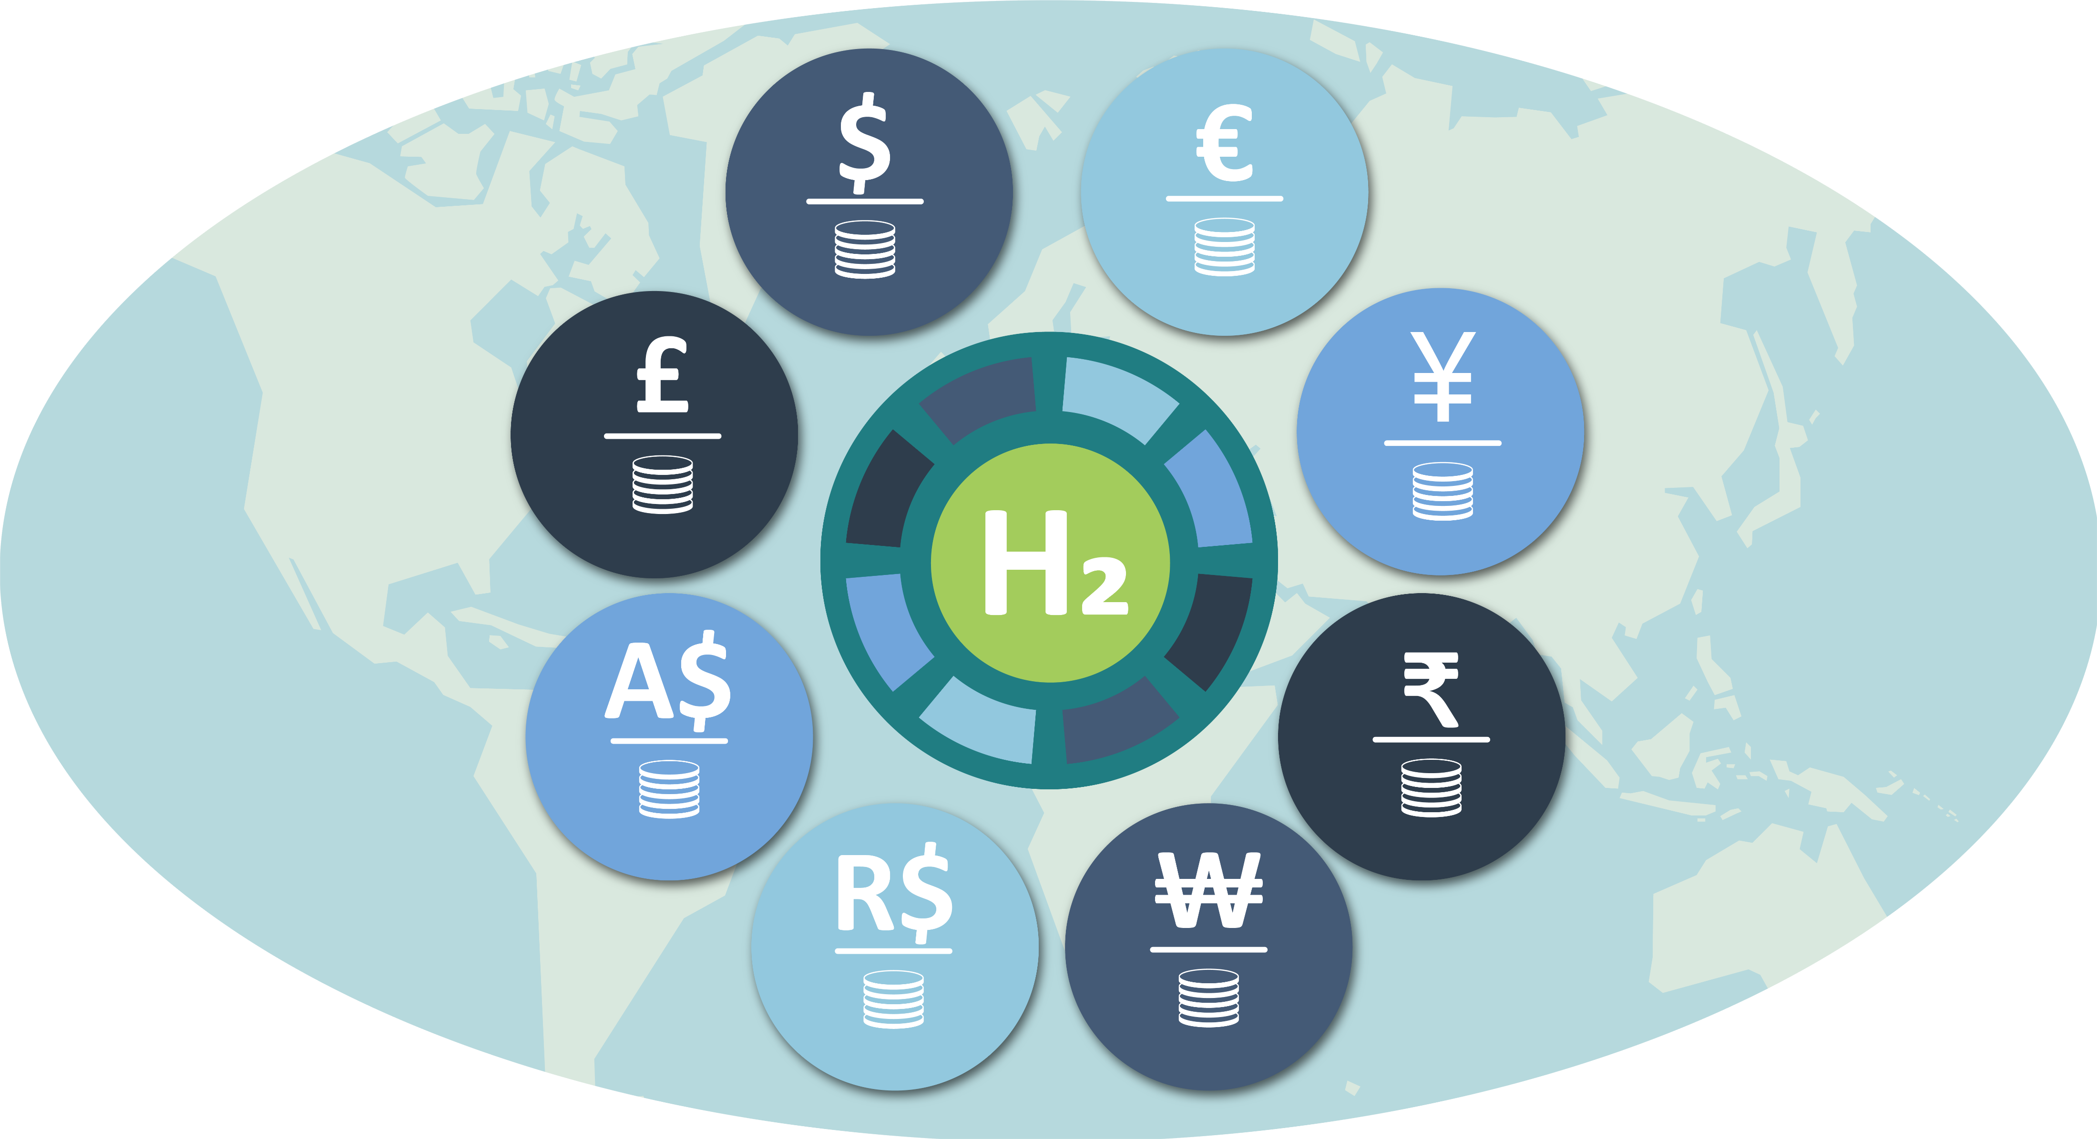
Economic opportunity & Social equality
Environmental, Social, and Governance (ESG) has gained significant traction as a way to address the climate change and energy impact environmental issues and to ensure sustainable development.
Economic growth is something that benefits both companies and local communities, and with this growth tied to a global transition to sustainability and climate action.
ESG policies are providing a platform for private entities to collaborate with public sector projects.
Green Hydrogen is opening new opportunities on a pathway to public-private partnerships capable of creating lasting positive change.

Slide 15
Global Hydrogen
Future growth and success can and will be achieved by exploring mutual opportunities between the
European Union Fit for 55 package and REPowerEU plan,
USA Inflation Reduction Act,
Japan’s Green Transformation programme,
India’s Production Linked Incentive scheme
China who is working to meet and even exceed the goals of its latest Five-Year Plan.

Slide 17
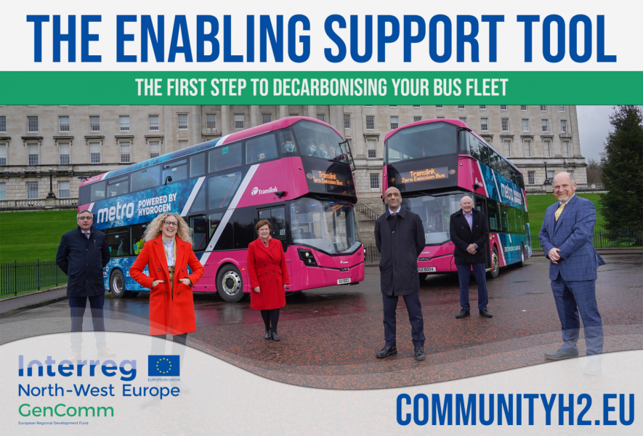

Slide 18
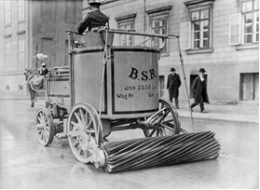
Clean technology isn’t new
In the early 20th century, the streets of the city of Berlin were cleaned with the help of electric-powered heavy-duty wagons that roamed the city. Believe it or not, electric-powered vehicles have been around a lot longer than we think. Since the 19th century, electric vehicles have been a known and viable mode of transport, though they were not necessarily the fastest. Electric vehicles eventually fell out of favour as consumers shifted to cheaper, oil-powered cars. Now decades electric vehicles are become popular again.

Slide 19
Ahead of the h2 Curve
From its inception in March 2017 GenComm has been ahead of of its time
Positioning Northern Ireland at the vanguard of the clean energy revolution
Ensuring we are well positioned to take full social, commercial and economic advantage of the new clean economy

Slide 20
Skills ARE key
The GenComm project has proved to be a key catalyst helping drive the clean hydrogen energy transition.
Hydrogen is one of the clean energy solutions that will decarbonize Europe’s industry, transport, buildings, and energy sectors, demonstrated by the ambitious targets for production of hydrogen set by the European Green Deal and REPowerEU.
Skills will be key in translating the policy ambitions into reality. Belfast Met is delivering the skills mechanisms, modules and mobility that will provide the foundations for a sustainable clean energy economy.’

Slide 21
Transition economies
Building world class FE industry partnerships
Creating new cohesive skills provision Powering 10X for a sustainable future
Design, Development and Delivery innovative curriculum solution, enabling learners to engage in a cycle of participation

Slide 22
Shifting Economic paradigms
We are living in a time of exciting technological innovations. Hydrogen is driving transformative change. Economic paradigms are shifting, new technologies are reshaping product and factor markets and profoundly altering business and work. The latest advances in clean energy technologies and related innovations are expanding the frontiers of the clean energy revolution. Our shared digitalisation approach - learning technologies, digital tools and pedagogies - helping close the skills gaps so that Northern Ireland has the skills it needs for an economy in transition.
Creating a sustainable skills system that is geared to adapt, continuously and rapidly, with the channels to those whom are key to deploying the skills to accelerate economic growth.
Transitioning to a world class skills system that is agile, flexible, and responsive. Where all skills especially vocational skills are valued and celebrated as the engine of a sustainable economy.
This will be achieved by a skills system underpinned by digital tools and pedagogies, that delivers employer needs and is open and accessible to all.

Slide 23
Addressing the skills challenge
Clean energy transitions will require innovative solutions and business models to be adopted and greater participation from a diverse talent pool.
Change is the new normal, how can we deliver the skills required for the construction sector, an economy in transition?
FE working to create a better skills system, addressing the challenges of the here and now, stimulating demand and building capacity to adapt and deliver the skills we need for the future

Slide 24
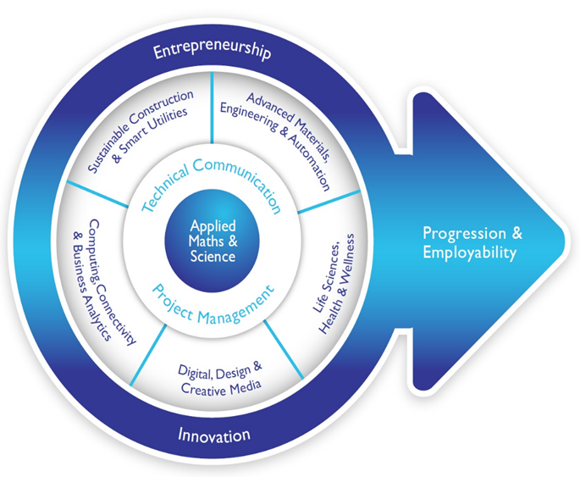
Green Economy
Developing a cohesive FE curriculum
Delivering enhanced economic growth/social inclusion benefits
Broadening the reach of skills development to be more inclusive in the new economy
Assisting learners progress to higher skill levels and supporting the development of vocational and higher skills
Contributing to the promise of skills development for all
Moving NI out of the low skills equilibrium
Developing hybrid training courses with industry
Broadening the curriculum and employment pathways
Assisting all to reach their potential through inclusive growth.

Slide 25
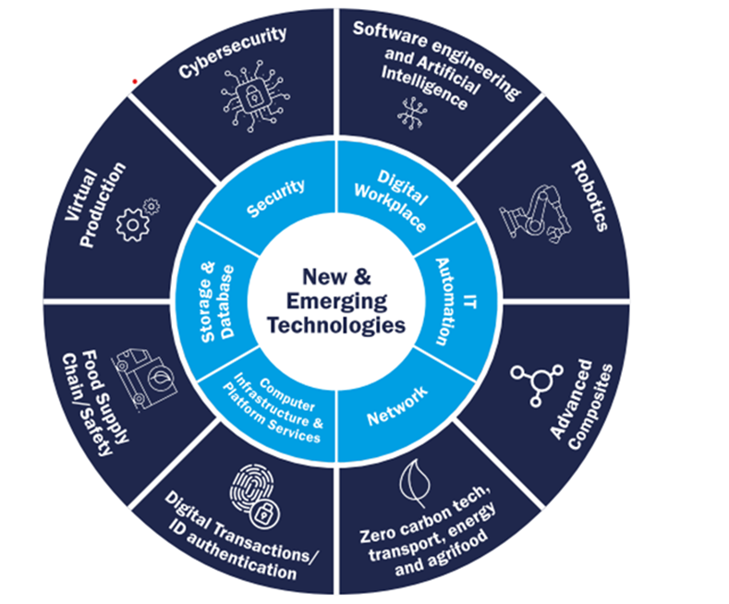
Developing a Sustainable Curriculum
Significant advances in the skills required to develop the 10 technologies identified in the 10X Economy.
Develop new opportunities for FE working in partnership with HE to help to develop innovation and skills to the benefit of Green Growth, digitalisation and economic development
Demonstrable evidence and foundations for FE to scale up its provision of digital skills across all subject areas, ensuring all learners are work-ready and equipped to meet industry needs
Deliver enhanced skills intelligence and ensure that our learners have the right skills for jobs

Slide 26
Conclusion
The new clean economy presents a significant economic and environmental opportunity for Europe, but it also creates considerable labour market challenges.
Belfast Met is meeting these challenges
Delivering Green Skills for Hydrogen
industry and market ready programmes and qualifications,
anticipating the latest market needs
leverage all instruments and tools,
providing continuous green and digital skills, and ongoing career development to empower workers and technical professionals.
To stay ahead in this dynamic landscape, we are working with both workers and employers to focus on cultivating key green growth skills.

Slide 27
GenComm GENerating Energy Secure COMMunities
The Sat Nav for
Green H2
Deployment

