Slide 1
Circular Housing Asset Renovation & Management – No More Downcycling
ONLINE TUTORIAL PART 1: INTRODUCTION
Prof. Vincent Gruis
Delft University of Technology
Notes:
Welcome to this online tutorial about the lessons from the CHARM project.
(SC) CHARM is an Interreg NWE-funded project and stands for circular housing asset renovation and management.
(SC) This tutorial series will consist of x episodes and this first part of the tutorial where we will introduce the background of the project, and the structure of the tutorial. In the second and third part we dive deeper into the demonstration exemplars and material exchange platforms developed in CHARM. We hope you have good fun following this introduction.
(SC) It could be nice to add another slide after this to show the three parts of the tutorial so the audience can follow the flow better.

Slide 2
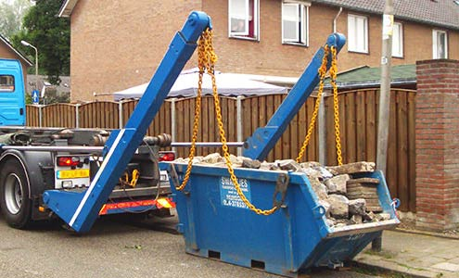
Challenge
The construction sector is responsible for more than 60% of the resource use in Europe
More than 30-50% of material use taking place in the housing construction sector
The sector generates about one third of all waste in the EU
Notes:
CHARM relates to the challenge of reducing the environmental damage of our construction activities. It is well known that the construction sector uses a lot of resources and causes a lot of pollution, both in terms of emissions as well as waste.
(SC)- I copy a part of my dissertation below where I took numbers from EU sources or stats:
“In the European Union (EU), for example, the built environment accounts for about 50% of all materials extracted (European Commission, 2022a). In parallel, buildings consume 40% of the EU’s energy and produce around one-third of its greenhouse gas emissions and waste (European Construction Sector Observatory, 2018; Eurostat, 2020). “

Slide 3
Social Housing Organisations
Large portfolio’s
Professional management
Sustainability key value
Notes:
Social housing organisations are actually well placed to do something about this. They operate large portfolios ranging from a few hundreds to tens of thousands of dwellings, and thus, they perform a lot of construction, renovation and maintenance activities. Also, most of them have a professional management and have sustainability as one of their key values. As such, they can make a substantial contribution to upscaling circular practices.

Slide 4
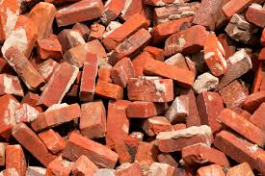
No More Downcycling!
Notes:
The main principle in CHARM is that we developed approaches that prevent downcycling of materials. As this simple example shows, we do not want bricks to end up as gravel on the tennis court. Although nice for tennis players, ideally we want to reuse bricks at the same or even higher value level, for instance by re-using bricks from a demolition project in new or renovated housing.

Slide 5
Project Scope
Circular housing with re-use and for re-use
Digital and physical material exchange platforms
Demonstration exemplars of circular renovation and new construction
Notes:
In essence the CHARM project has three elements. First we developed strategies for circular housing focusing both on construction and renovation. These strategies enabled construction with re-use of materials as well as construction that enables future re-usability of building components.
(SC) Second, we developed (DIGITAL and PHYSICAL) material exchange platforms. These platforms enable circular flows of materials and building components when buildings reach their end of life
In one variant this is a physical storage place and in the other variant this is a digital exchange platform. Third, we showcased circular approaches for both renovation and new construction in demonstration exemplars of our four social housing partner organisations. We will now talk you briefly through these demonstration exemplars.

Slide 6
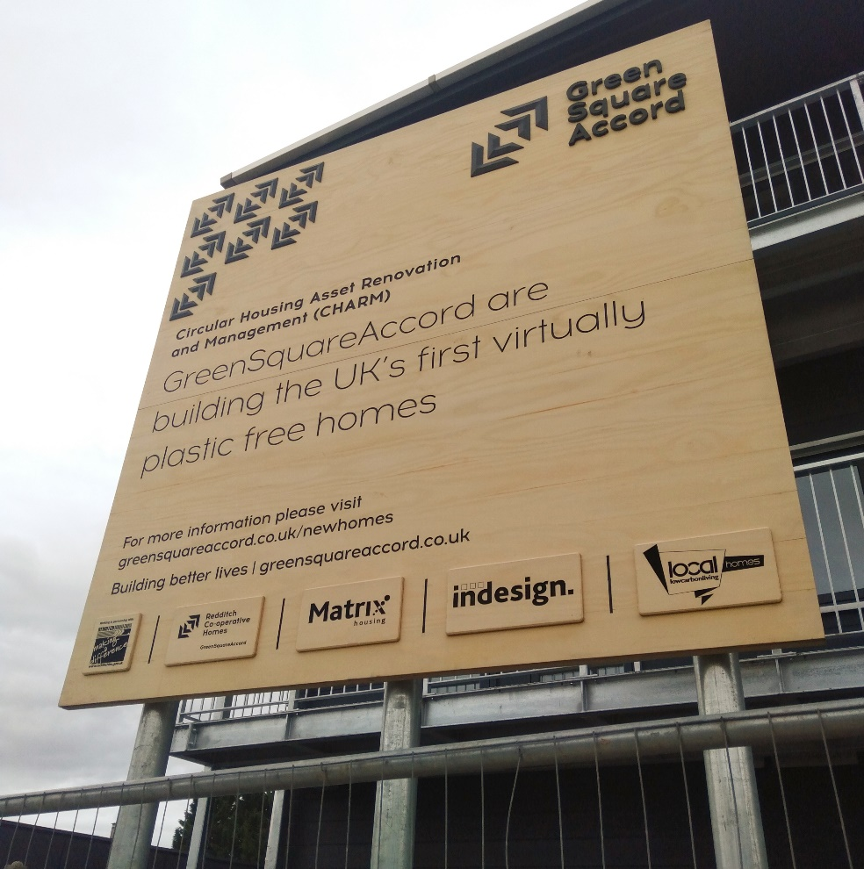
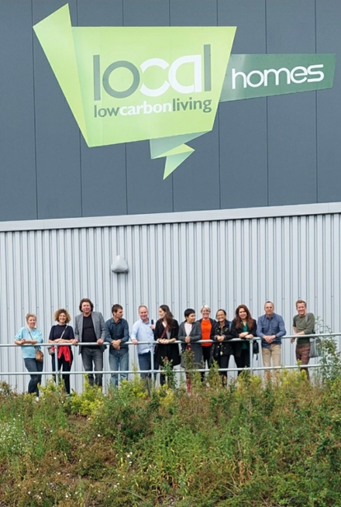
Plastic free house
Notes:
The first demonstration exemplar is the so-called plastic free house developed by social housing organisation GreensquareAccord in the United Kingdom. Polution from plastic ending up as particles in our land and water is a huge concern.
GreensquareAccord, therefore wanted to prevent this pollution (AND PERHAPS REDUCE WASTE?) by seeing if they could ban the use of plastics in housing altogether. Moreover, they construct their social housing in their own factory– the LocalHomes factory. These houses are easy to assemble and, if necessary in the far future, also easy to disassemble and reassemble. And they use a (LIGHT?) timber frame construction method, which lowers the carbon footprint of the houses.

Slide 7
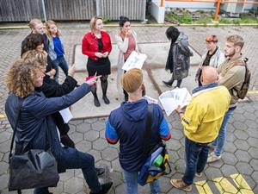
Design for re-use
Notes:
The second demonstration exemplar is from social housing organisation Woonbedrijf in the Netherlands and focusses on designing houses that are fit for future re-useability. Woonbedrijf designed a plan for modular temporary housing. These houses were intended to be built to be in use for about 15 years on a development location, after which they would be replaced by permanent housing and relocated to another location. The plans were developed in a co-design process with the future tenants.

Slide 8
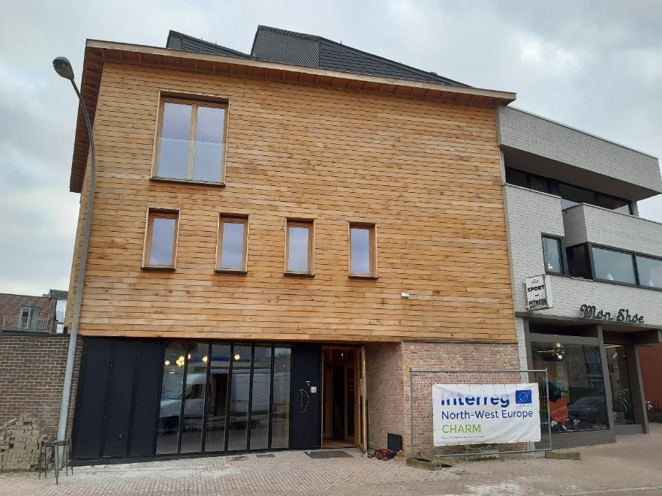
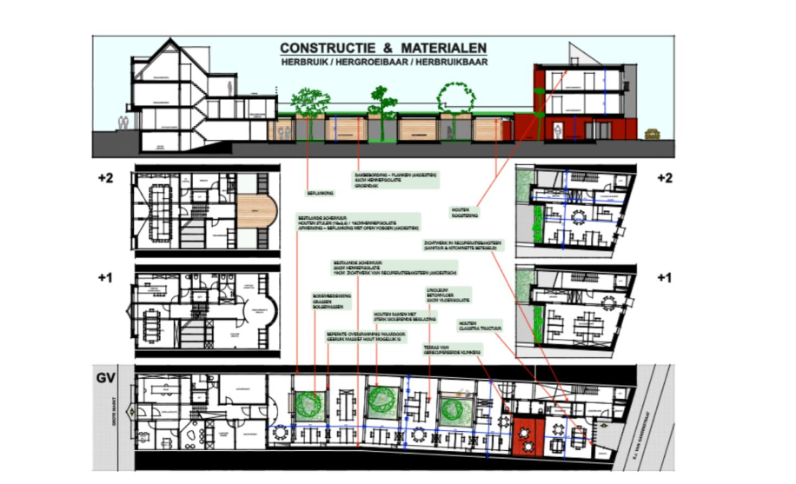
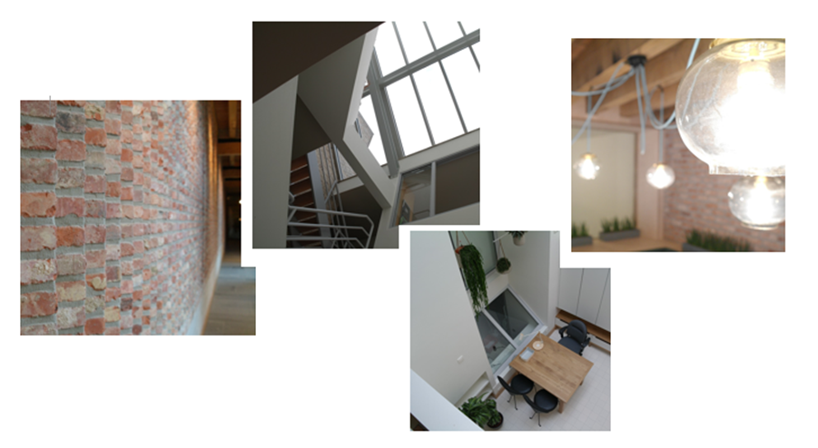
Construct with re-use
Notes:
The Flemish social housing organisation Zonnige Kempen, developed the third demonstration exemplar. To show to their tenants what is possible in building with reclaimed materials, they built their own office with using second hand materials as much as possible. They also included two social rented dwellings with reclaimed materials in this project.
(SC) IT COULD BE NICE TO MENTION THAT THEY DESIGNED THEIR OFFICE SPACE WITH FLEXIBLE PRINCIPLES SO AFTER THEY MOVE OUT THESE OFFICE UNITS COULD BE TRANSFERRED TO HOUSING UNITS FOR ELDERLY.

Slide 9
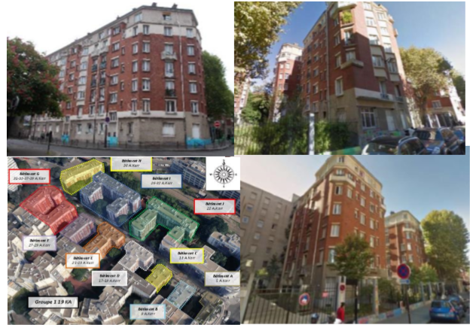
Renovate with re-use
Notes:
Paris Habitat, a large social housing organisation in France (THE LARGEST IN PARIS), has made renovation with reclaimed materials a key focus in their operations. With the help of internal and external contractors and architects, they either refurbish and materials and components for re-use in their current function, or they use materials coming out of renovation projects to develop new components, such as kitchen cabinets made from old doors.

Slide 10
Key Stakeholders
Key Activities
Profit
Customer Relationships
Customer segments
Value creation
Value propo-sition
Value delivery
Key Resources & Capabilities
People
Planet
Channels
Value capture
Cost structure
Revenue Streams
Sustainable business model canvas. Source: Bocken et al. (2018) based on Osterwalder &Pigneur (2010) and Richardson (2008)
Notes:
Now you know the basics of CHARM, it is time to start the online tutorial. In the following two recorded presentations we explain the approaches developed in CHARM and lessons learned. In doing so, we follow the elements of the sustainable business model canvas. For each of the approaches and tools applied in CHARM, we summarise what the value proposition is, how the value is created, how it is delivered to the users and how values are captured. The second part of this online tutorial explains the sustainable business models for the demonstration exemplars. The third part focusses on the material exchange platforms.
Bocken, N., Schuit, C., Kraaijenhagen, K. 2018. Experimenting with a circular business model: Lessons fromeight cases. Environmental innovation and societal transitions, 28, 79-95 (PDF) Sustainable Business Models.
Osterwalder, A., Pigneur, Y., Tucci, C. L. 2005. Clarifying business models: Origins, present, and future of theconcept. Communications of the association for Information Systems, 16(1), 1. (PDF) Sustainable Business Models.
Richardson, J. 2008. The business model: an integrative framework for strategy execution. Strategic change,17(5-6), 133-144.

Slide 11
ADD PARTNER LOGOS
Notes:
On behalf of all the partners, I wish you great pleasure with following the other two parts of the tutorial and hope that it will help you to contribute to circularity in the housing and construction sector yourself. Thank you for watching this introduction!

Slide 12
Circular Housing Asset Renovation & Management – No More Downcycling
ONLINE TUTORIAL PART 2: DEMONSTRATION EXEMPLARS
Prof. Vincent Gruis
Delft University of Technology
Notes:
In our introduction, we explained the background of the CHARM project. Now, in this second part of the tutorial, we dive deeper into the content. In this part we provide insight in the demonstration exemplars of CHARM, through the lens of the sustainable business model canvas.

Slide 13
Key Stakeholders
Key Activities
Profit:
Value that is offered to customers
Customer Relationships
Customer segments
Value creation
Value propo-sition
Value delivery
Key Resources & Capabilities
People:
Positive impact for common interest of society
Planet:
Positive impact for the environment
Channels
Value capture
Cost structure
Revenue Streams
Sustainable business model canvas. Source: Bocken et al. (2018) based on Osterwalder &Pigneur (2010) and Richardson (2008)
Notes:
As explained in the first part of the tutorial, we will follow the sustainable business model canvas to explain the demonstration exemplars. The sustainable business model canvas starts from the value propositions, which are placed in the center. The value propositions are divided in three categories, following the well-known people, planet, profit distinction. Overall, all the approaches in CHARM start from the planet motivation. Everything has been developed to reduce waste and emissions, either by re-using materials now, or to prevent waste in the future. This does not lead to more profit. There are costs involved in making materials re-useable and to construct for future re-usability and waste prevention. On the other hand, we also prevent having to buy new materials, so there is a plus as well. The value for the people, is directly derived from the environmental objectives. Moreover, as we will show, our partners also try to use the circular approaches to stimulate awareness of how important this is to tenants.

Slide 14
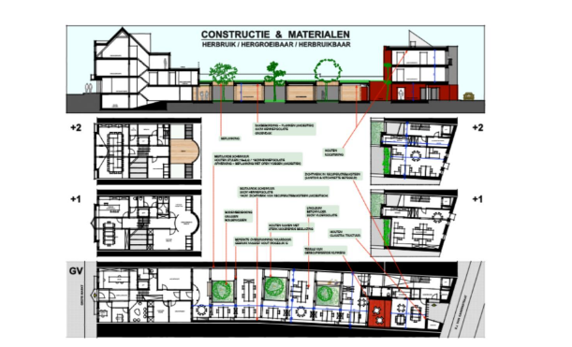
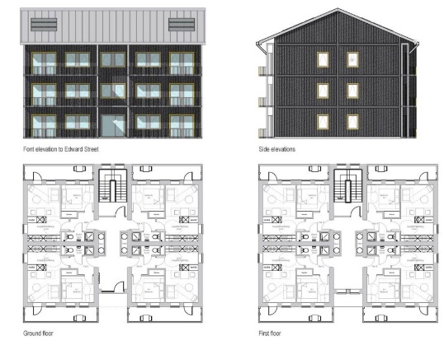
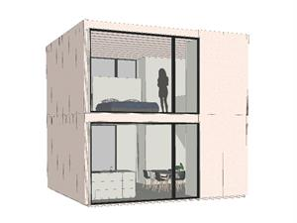
Value propositions demonstration projects
Paris Habitat
Zonnige Kempen
Profit:
Value that is offered to customers
prevent waste and new materials
education and awareness
Value propo-sition
GreensquareAccord
Woonbedrijf
People:
Positive impact for common interest of society
Planet:
Positive impact for the environment
prevent plastic pollution
temporality with reuseability
Notes:
When we dive a bit deeper into the demonstration projects developed in CHARM we can see more nuanced value propositions. In case of Paris Habitat’s strategy to renovate with refurbished building components, there is a clear strategy to prevent waste and reduce production of new components during the running operations. In case of GreensquareAccord’s plastic free house, there is a focus on the prevention of pollution through plastic in the far future. In the case of Zonnige Kempen’s circular office and housing project, there is an emphasis on educating the employees, which gained experience with circular practices with their own working environment before starting with housing projects, as well as showing the tenants how good it can get if you work with re-used materials, thereby increasing the support for applying circular approaches in housing development and maintenance. In the case of Woonbedrijf, the challenge was to built housing that would only be used for 15 years on the intended location. Therefore, it was important to develop these dwellings in a re-usable way, so the houses would not go to waste after 15 years, but could be used again on another location.

Slide 15
Key Stakeholders
Key Activities
Profit
Customer Relationships:
Relation between user and organisation
Customer segments:
Target groups who make use of the offering
Value creation
Value propo-sition
Value delivery
Key Resources & Capabilities
People
Planet
Channels:
Touchpoints between users and organisation
Value capture
Cost structure
Revenue Streams
Sustainable business model canvas. Source: Bocken et al. (2018) based on Osterwalder &Pigneur (2010) and Richardson (2008)
Notes:
The value propositions also have to be delivered to the costumers. The sustainable business model canvas distinguishes three aspects of value delivery: the costumer relationships, the channels and the costumer segments.

Slide 16
Value delivery demonstration projects
Customer Relationships:
Relation between user and organisation
Customer segments:
Target groups who make use of the offering
Tenants as clients
Tenants as co-designers
Housing customers:
Tenants
Material costumers:
Project managers
Maintenance officers
Contractors
Architects
Value delivery
Channels:
Touchpoints between users and organisation
Awareness activities & design workshops with tenants and stakeholders
Notes:
On the right side of this slide you see the customers distinguished in the demonstration exemplars in CHARM. When employing the canvas to CHARM, we can make a distinction between the customers of the housing, in our case tenants of social housing and the costumers for the materials. When working with reclaimed materials, employees within the social housing organisations or supply chain partners, such as architects and contractors can also be seen as clients, when they act on the demand side for these materials. And Woonbedrijf followed a completely different design process, in which the future tenants were not only treated as customers but also as co-designers. Thus the channels require much more intensive contact with both internal and external parties and in all of our demonstration exemplars a lot of attention was paid to awareness activities with housing and material customers.

Slide 17
Key Stakeholders:
Internal and external supply chain partners
Key Activities:
Processes to produce the product, service and value
Profit
Customer Relationships
Customer segments
Value creation
Value propo-sition
Value delivery
Key Resources & Capabilities:
Human, material and financial resources
People
Planet
Channels
Value capture
Cost structure
Revenue Streams
Sustainable business model canvas. Source: Bocken et al. (2018) based on Osterwalder &Pigneur (2010) and Richardson (2008)
Notes:
The left side of the sustainable business model canvas focusses on aspects of value creation: first, the key stakeholders: who are the partners in the value creation, second, the key activities, what is actually done to create the value and, third, the key resources: what is necessary to be able to create the value.

Slide 18
Value creation demonstration projects
Key Stakeholders:
Internal and external supply chain partners
Key Activities:
Processes to produce the product, service and value
Redesign of standard housing product
Inventory of materials
Refurbishment of products
Developing material exchange platform
Training of internal and external professionals
Internal stakeholders:
Project managers
Maintenance officers
Factory designers
External stakeholders:
Specialised contractors
Specialised architects
Alternative material suppliers
Tenants as co-designers
Value creation
Key Resources & Capabilities:
Human, material and financial resources
Notes:
The list of key stakeholders, almost mirrors the so-called material costumers in the value delivery part of the canvas that we just explained. In addition the designers of GreensquareAccord’s Local Homes factory are added. The stakeholders could also be seen as so-called usual suspects if you know the construction industry a bit. But we should not forget these stakeholders needed to acquire different skills, procedures and mindsets to adopt the circular strategies. For GreensquareAccord, for example, their factory design team, needed to completely revise their business as usual product to ban the plastics as much as possible. Zonnige Kempen and Paris Habitat, who both emphasise working with reclaimed materials, had to develop expertise to assess the reuse potential and together with their contractors ways to refurbish building components that would have otherwise ended up on the waste pile. All social housing organisations also incorporated contractors, architects and material suppliers, that had expertise in the circular approaches.

Slide 19
Key Stakeholders
Key Activities
Profit
Customer Relationships
Customer segments
Value creation
Value propo-sition
Value delivery
Key Resources & Capabilities
People
Planet
Channels
Value capture
Cost structure
Revenue Streams
Sustainable business model canvas. Source: Bocken et al. (2018) based on Osterwalder &Pigneur (2010) and Richardson (2008)
Notes:
The value capture part of the sustainable business model canvas, also the fourth and final part, consists of a simple division between costs and revenues. As we explained when we discussed the value propositions, the approaches developed in CHARM do not lead to additional financial revenues. Mainly, there are costs involved in making materials re-useable and to construct for future re-usability and waste prevention as well as to develop and maintain the material exchange platforms. The main financial revenue is that costs are saved because the social housing organisations need to purchase less new materials, now and in the future.
(SC) IT COULD BE BETTER IF WE COULD ADD ANOTHER SLIDE AS YOU DID FOR THE OTHER PARTS OF SBM CANVAS, WHERE YOU ZOOM IN ONE ELEMENT AT A TIME.

Slide 20
ASK YOURSELF…
Key Stakeholders
Key Activities
Profit
Customer Relationships
Customer segments
?
?
?
Value creation
Value propo-sition
Value delivery
Key Resources & Capabilities
People
Planet
Channels
?
Value capture
Cost structure
Revenue Streams
Sustainable business model canvas. Source: Bocken et al. (2018) based on Osterwalder &Pigneur (2010) and Richardson (2008)
Notes:
With this brief overview of the business models of the demonstration exemplars, we conclude the second part of this online tutorial. In the third part, we focus on the business model principles behind the material exchange platforms that have been developed in CHARM. But before you go there, you might want to ask yourself: what are the value propositions related to your circular ambitions, and what and who do you need to deliver this? For now, thank you for having watched this second part.

Slide 21
Circular Housing Asset Renovation & Management – No More Downcycling
ONLINE TUTORIAL PART 3: MATERIAL EXCHANGE PLATFORMS
Prof. Vincent Gruis
Delft University of Technology
Notes:
In the second part of our online tutorial, we discussed the business model principles of the demonstration projects in CHARM. In this third part, we turn our attention to the material exchange platforms, again using the sustainable business model canvas to explain the main principles.

Slide 22
Key Stakeholders
Key Activities
Profit:
Value that is offered to customers
Customer Relationships
Customer segments
Value creation
Value propo-sition
Value delivery
Key Resources & Capabilities
People:
Positive impact for common interest of society
Planet:
Positive impact for the environment
Channels
Value capture
Cost structure
Revenue Streams
Sustainable business model canvas. Source: Bocken et al. (2018) based on Osterwalder &Pigneur (2010) and Richardson (2008)
Notes:
For those of you who have not watched the second part of the tutorial, the sustainable business model canvas starts from the value propositions, which are placed in the center. The value propositions are divided in three categories, following the well-known people, planet, profit distinction. Overall, all the approaches in CHARM start from the planet motivation. Everything has been developed to reduce waste and emissions, either by re-using materials now, or to prevent waste in the future. This does not lead to more profit. There are costs involved in making materials re-useable and to construct for future re-usability and waste prevention. On the other hand, we also prevent having to buy new materials, so there is a plus as well. The value for the people, is directly derived from the environmental objectives.

Slide 23
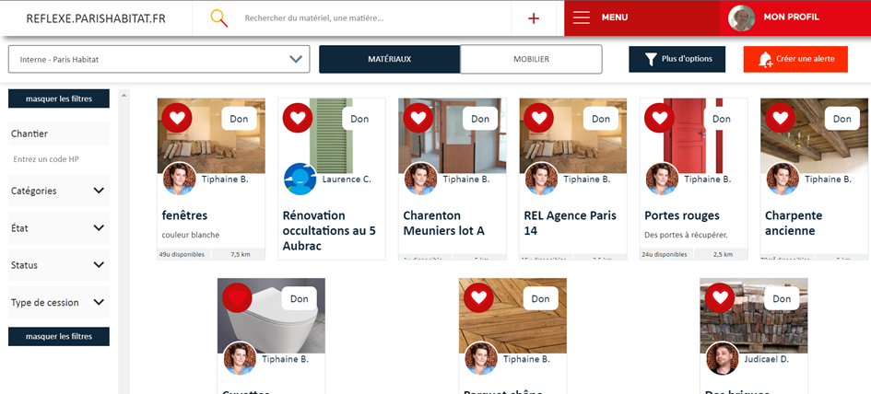
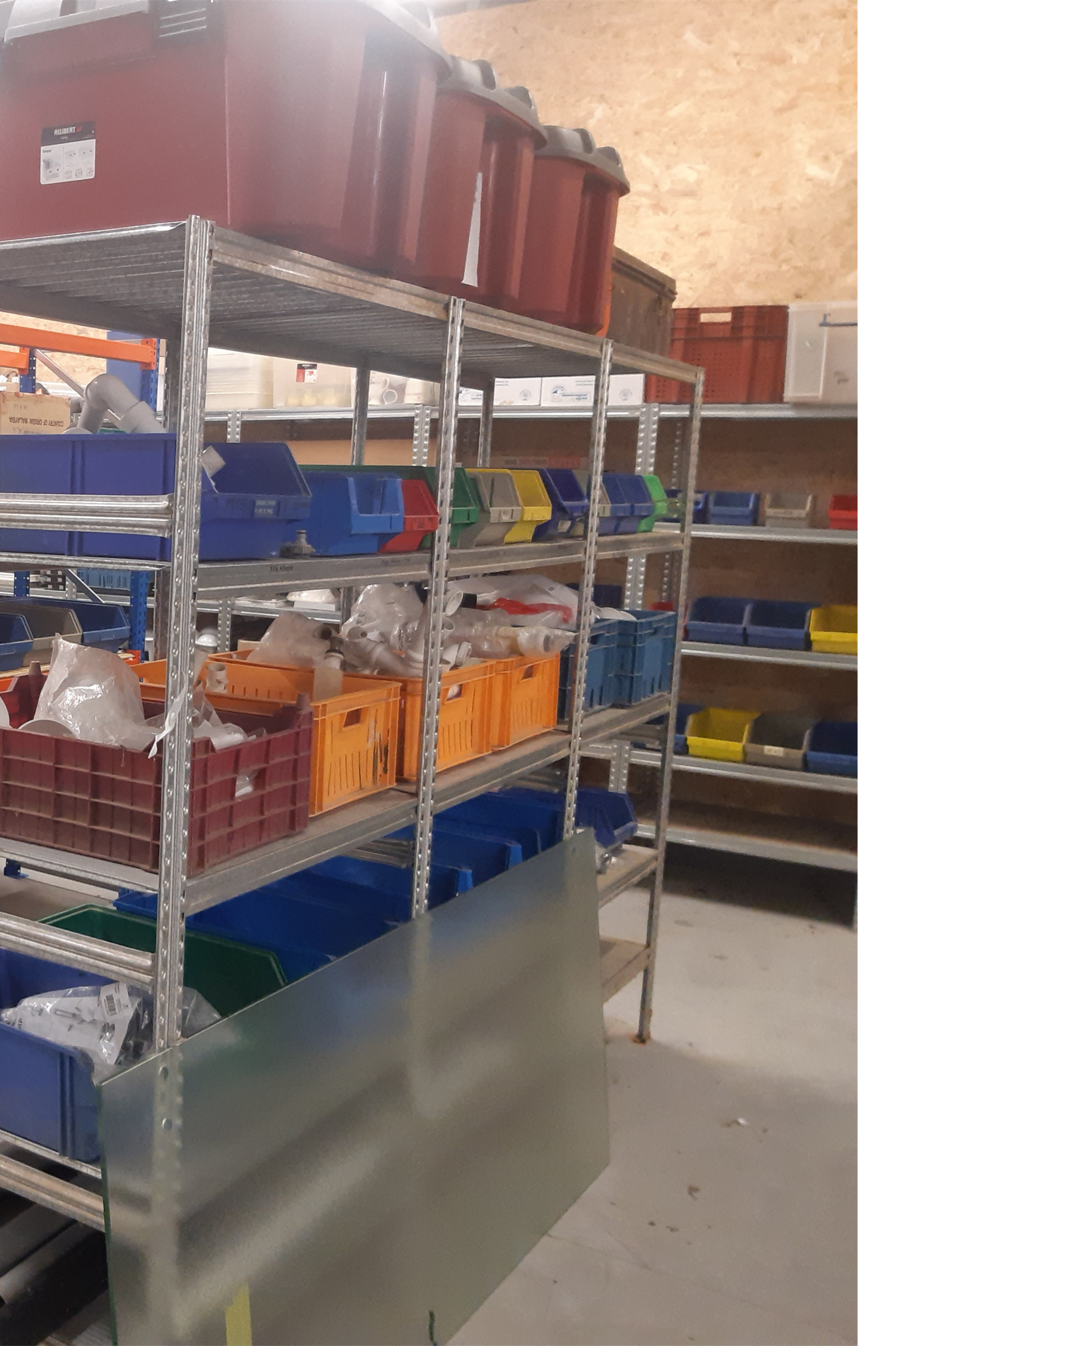
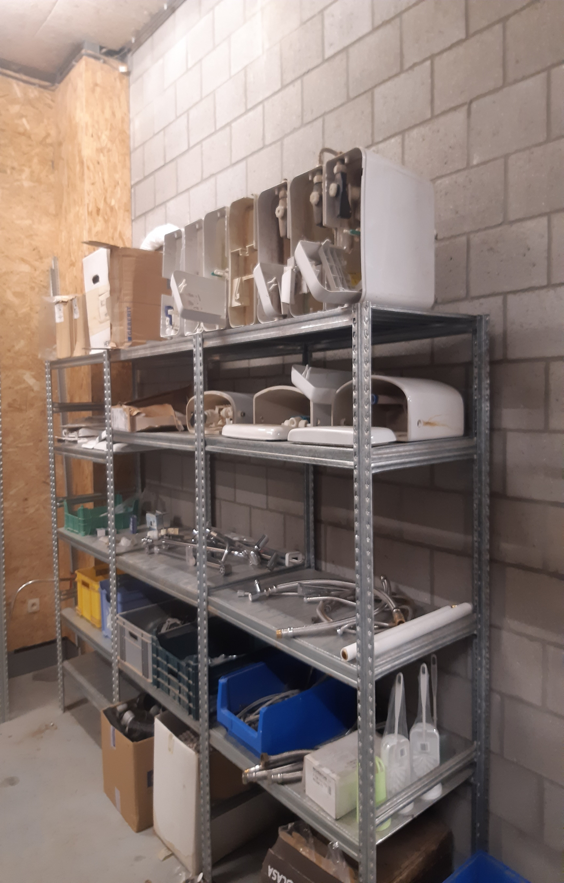
Value propositions exchange platforms
Digital MEP
Profit:
Value that is offered to customers
Easy access to available materials by internal project officers and external contractors
Value propo-sition
Physical MEP
People:
Positive impact for common interest of society
Planet:
Positive impact for the environment
Notes:
In addition to the demonstration projects, two material exchange platforms have been developed in CHARM. One digital platform, by Paris Habitat and one physical platform, by Zonnige Kempen. In general both platforms have similar value propositions to the overall value propositions of circular strategies for housing construction and renovation. Because they enable re-use of materials, they contribute both to the reduction of waste as well as avoiding environmental burdens and financial costs of having to produce and buy new products. When we zoom in, we notice that primary costumers, or better perhaps users, are not the tenants, but the people working in the supply chain. These range from internal employees, such as handymen and project managers, to external partners, including architects and contractors. The main value that is offered to these users is that it actually enables them to work with re-used materials, coming out of the portfolio of both housing organisations. In the case of Paris Habitat’s digital platform, the professionals gain insight in which materials will become available for reuse from running projects and also how long they will remain available. This allows them to opt for re-using these materials in other projects, on other sites. In the case of Zonnige Kempen’s physical platform, the storage of reusable materials enables the maintenance personnel to quickly carry out repairs, without having to wait for the delivery of new products. So, in essence, the value proposition of the exchange platforms is quite simple: it makes re-use possible in practice.

Slide 24
Value delivery exchange platforms
Customer Relationships:
Relation between user and organisation
Customer segments:
Target groups who make use of the offering
Internal users as suppliers
Internal and external
users as clients
Internal users:
Project managers
Maintenance officers
External users:
Contractors
Architects
(Potential) customers:
Other housing organisations
Tenants
Value delivery
Channels:
Touchpoints between users and organisation
Physical platform: storage management by internal maintenance officers
Digital platform: regular newsflashes of new offers
Notes:
When we turn to the value delivery in the exchange platforms, we can make a distinction between internal and external costumers. The internal users operate both as suppliers, indicating when new materials for reuse become available as well as clients, or potential users of the reclaimed materials. In the digital platform, this can be supported by regular newsflashes to indicate when new materials become available and also when materials are claimed through the platforms. But there are also other, potential, costumers. Zonnige Kempen for example, wants to explore if they can also grant their tenants access to their physical material exchange platform, so they can buy materials for a small fee. And Paris Habitat is exploring if they can open up their material exchange platform to other housing organisations. Complicating factor in these cases is that our social housing partner organisations are embedded in a public regulatory framework that limits their possibilities to trade in materials and building components.

Slide 25
Value creation exchange platforms
Key Stakeholders:
Internal and external supply chain partners
Key Activities:
Processes to produce the product, service and value
Collect, clean, repair, store, register and communicate availability of materials
Express interest in available materials and incorporate in design
Trained professionals
ICT
Storage place
Internal stakeholders:
Project managers
Maintenance officers
Communication officers
External stakeholders:
Specialised contractors
Specialised architects
ICT contractors
Value creation
Key Resources & Capabilities:
Human, material and financial resources
Notes:
The value creation in the material exchange platforms takes place in part by the regular stakeholders, such as internal project managers, maintenance and communication officers as well as contractors and architects with expertise in working with reclaimed materials. Additionally, for the digital exchange platform, Paris Habitat contracted an external ICT developer to set up the database and web-based interface tool. Working with re-used materials also implies a lot of additional activities in the process, such as the collection, cleaning, repairment, registration and storage of materials. Moreover, it requires effort from project managers to both communicate about the upcoming availability of materials as well as to express and act upon the interest to re-use these materials. Thus, key resources are trained professionals, as well as the ICT tooling in case of the digital platform and the storage place in case of the physical platform. Ideally both physical and digital platforms are intertwined, in case materials do not find a new use during their initial period of availability.

Slide 26
Key Stakeholders
Key Activities
Profit
Customer Relationships
Customer segments
Value creation
Value propo-sition
Value delivery
Key Resources & Capabilities
People
Planet
Channels
Value capture
Cost structure
Revenue Streams
Sustainable business model canvas. Source: Bocken et al. (2018) based on Osterwalder &Pigneur (2010) and Richardson (2008)
Notes:
The value capture part of the sustainable business model canvas, also the fourth and final part, consists of a simple division between costs and revenues. As we explained when we discussed the value propositions, the approaches developed in CHARM do not lead to additional financial revenues. Mainly, there are costs involved in making materials re-useable and to construct for future re-usability and waste prevention as well as to develop and maintain the material exchange platforms. The main financial revenue is that costs are saved because the social housing organisations need to purchase less new materials, now and in the future.

Slide 27
ASK YOURSELF…
Key Stakeholders
Key Activities
Profit
Customer Relationships
Customer segments
?
?
?
Value creation
Value propo-sition
Value delivery
Key Resources & Capabilities
People
Planet
Channels
?
Value capture
Cost structure
Revenue Streams
Sustainable business model canvas. Source: Bocken et al. (2018) based on Osterwalder &Pigneur (2010) and Richardson (2008)
Notes:
With this brief overview of the business model principles of the material exchange platforms, we conclude the third and final part of this tutorial. Again, we encourage you to ask yourself: what are the added values in your circular initiatives and ideas, and what and who do you need to deliver this?

Slide 28
THANK YOU!
Notes:
On behalf of all our partners, we thank you for watching our tutorial. On our website, we have included some links for if you want to know more about our and related projects. We wish you all the best with realizing your circular ambitions!

