Slide 1
Welcome to our Webinar 11 September 2018

Slide 2
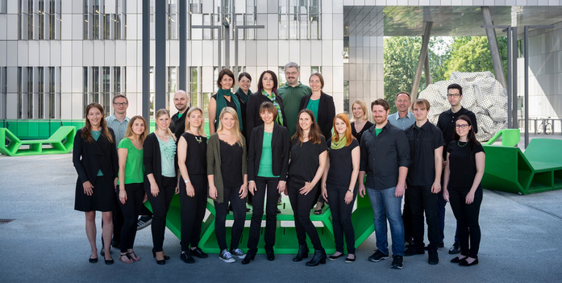
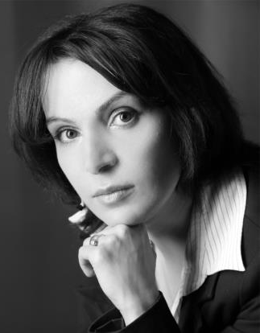
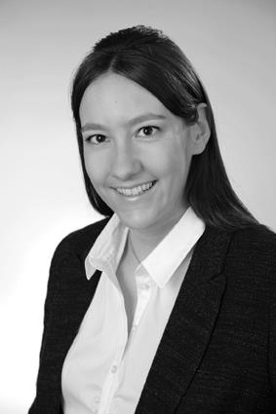
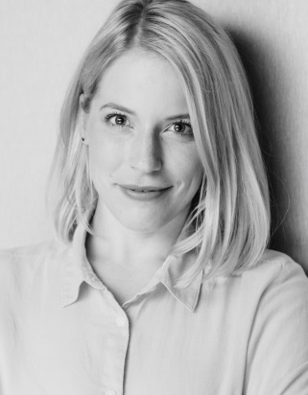
The Biobank Team
v.h. Prof. Karine Sargsyan, MD
Franziska Vogl, PhD
Sarah Frajuk, MSc

Slide 3
AGENDA
1
Introduction
of Biobank Graz (BBG)
2
The part of BBG in the Interreg-NWE
Codex4SMEs project
3
How to apply for the services
Medical University of Graz – Biobank Graz  codex4smes@medunigraz.at

Slide 4
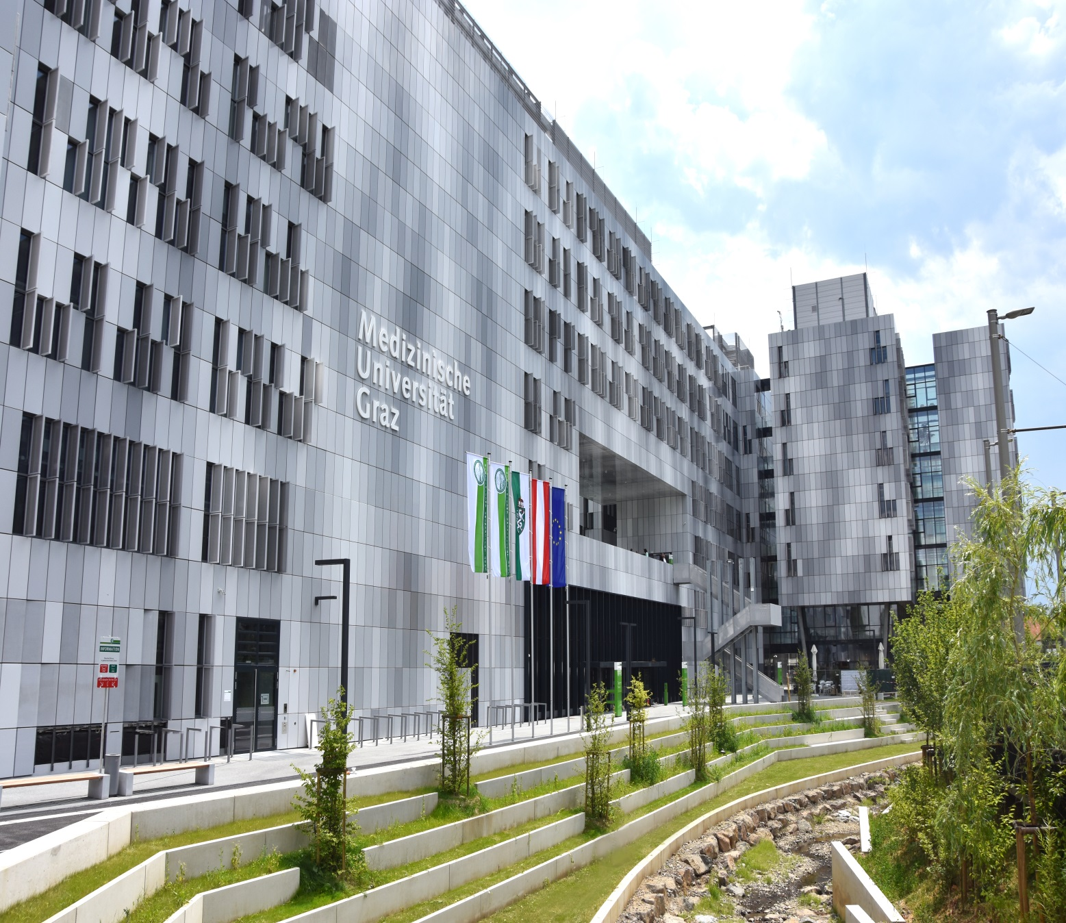
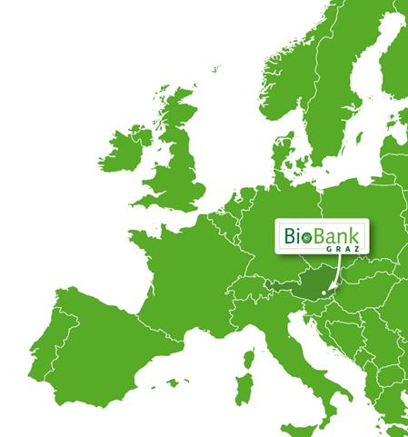
1 Introduction BBG
BioBank Graz
is embedded in the campus of the Medical University of Graz
and the
University Hospital of Graz

Slide 5
1 Introduction BBG
One of the largest clinical biobanks in Europe (=> https://directory.bbmri-eric.eu/)
Central service facility of Medical University of Graz
Storage of biomaterials and their associated data
More than 20 million samples from more than 1 million donors
FFPE tissue samples at RT (6 million blocks + 13 million slides)
Fresh frozen tissue samples in liquid N₂ (100.000)
Body fluids at -80°C (1.5 million)
Collections date back 30 years
Biobank Graz operates a QMS according to ISO 9001:2015
Medical University of Graz – Biobank Graz  codex4smes@medunigraz.at

Slide 6
1 Introduction BBG
Services provided by Biobank Graz
Provision of samples and data
Prospective sample collection; planning and realization of prospective study cohorts
Project development and project coordination
Preparation of derivatives (e.g. nucleic acid extraction, etc.)
Consulting and training (legal, ethical, technical and organizational aspects of biobanking)
Contact to and networking with other biobanks
Medical University of Graz – Biobank Graz  codex4smes@medunigraz.at

Slide 7
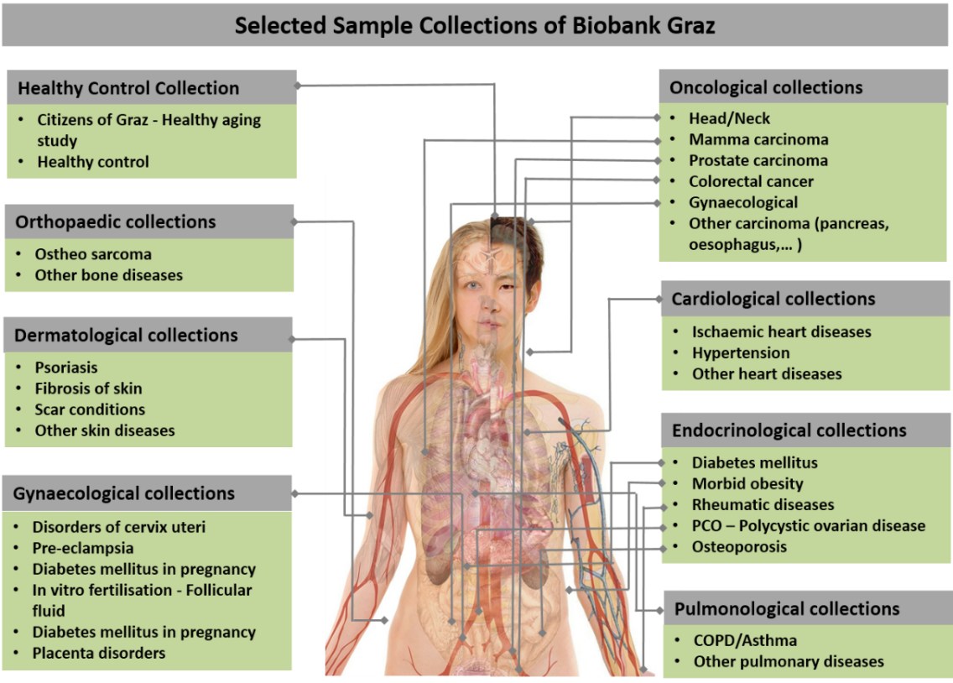
1 Introduction BBG
Medical University of Graz – Biobank Graz  codex4smes@medunigraz.at

Slide 8
1 Introduction BBG
Types of Samples
Medical University of Graz – Biobank Graz  codex4smes@medunigraz.at

Slide 9
1 Introduction BBG
Bio Bank Graz: The goals
Integration of existing and future collection initiatives within a joint, interdisciplinary biobank for a cooperative and competitive use of resources
Support of academic, industrial and cooperative research fostering the development of biomarkers and the improvement of diagnostics and therapies
Ensuring that operations of Biobank Graz database systems are in accordance with data protection regulations and legislation
Adjustment of the implemented Biobank Graz quality standards for sample/data collection to ensure highest quality
Active participation of Biobank Graz in pan-European as well as international biobanking Networks
Medical University of Graz – Biobank Graz  codex4smes@medunigraz.at

Slide 10
1 Introduction BBG
BioBank Graz: The mission
Biobank Graz supplies high quality clinically annotated
human samples to researchers in academic and commercial
institutions to foster medically relevant research discoveries
and improve treatment options.
Biobank Graz: The core values
Honesty – Transparent and ethically approved use of donors’ specimens in biomedical research
Diversity – Delivery of high quality human samples from a large variety of diseases
Innovation – Centralized access based on automated handling and storing of samples
Knowledge Transfer – Teaching and training the next generation of biobankers
Medical University of Graz – Biobank Graz  codex4smes@medunigraz.at

Slide 11
AGENDA
1
Introduction
of Biobank Graz (BBG)
2
The part of BBG in the Interreg-NWE
Codex4SMEs project
3
How to apply for the services
Medical University of Graz – Biobank Graz  codex4smes@medunigraz.at

Slide 12
2 The part of BBG in the Interreg-NWE Codex4SMEs project
BBG is responsible for the Codex4SMEs support schemes
Access to both support schemes is limited!
Important: first come first serve!
Sample Access
Knowledge Transfer
Medical University of Graz – Biobank Graz  codex4smes@medunigraz.at

Slide 13
3 How to apply for the services – Sample Access
Sample Access
Two principal project-types for Sample Access from Biobank Graz
1. Pilot-project/study
limited sample access – easier sample access
2. Research-project/study
- sample amount higher – sample access regulated
Medical University of Graz – Biobank Graz  codex4smes@medunigraz.at

Slide 14
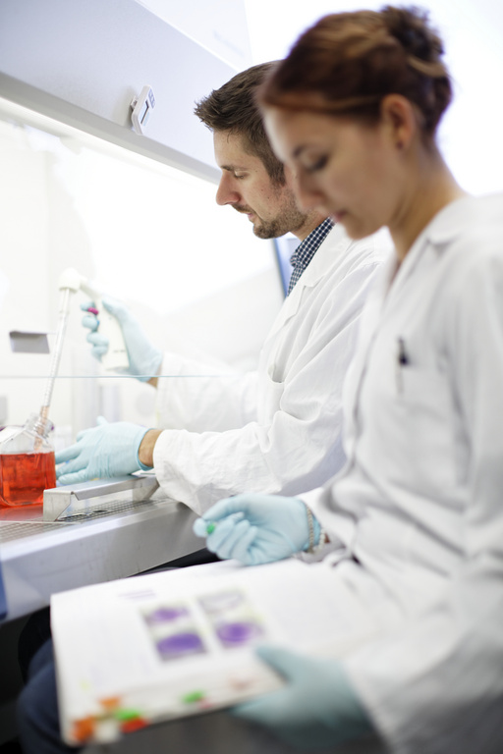
3 How to apply for the services – Sample Access
1. Pilot-study
To test or establish a new method
Samples limited to a maximum number of 5 patients
No ethics vote required
Results from a pilot study must not be published!
Medical University of Graz – Biobank Graz  codex4smes@medunigraz.at

Slide 15
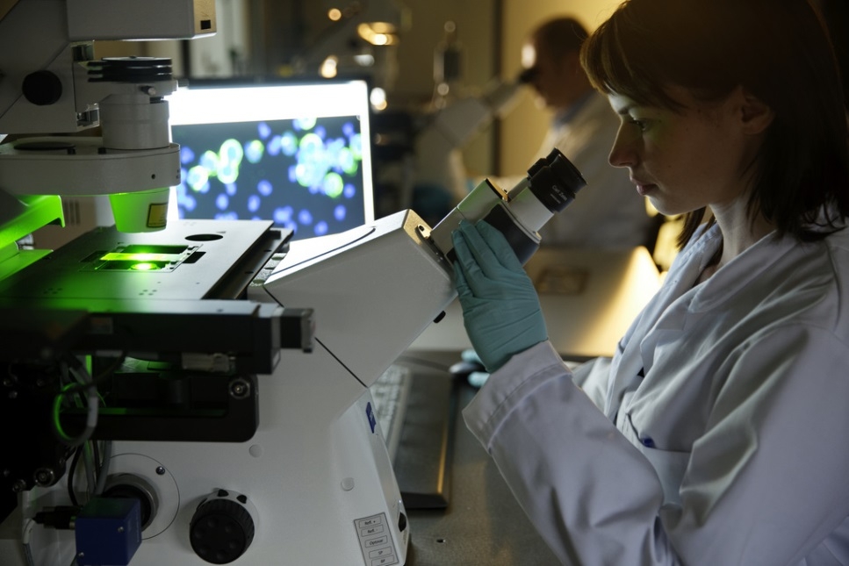
3 How to apply for the services – Sample Access
2. Research-study
Sample access for research projects/biomarker research
Sample materials from up to 20 patients available
Full application including all documents required:
Project application
De Minimis declaration
Ethics vote
Short Study protocol
PLEASE NOTE:
Applications for ethics approval can be submitted to the local ethics committee in Graz with support of BBG. (→ Support scheme: Knowledge Transfer)
Medical University of Graz – Biobank Graz  codex4smes@medunigraz.at

Slide 16
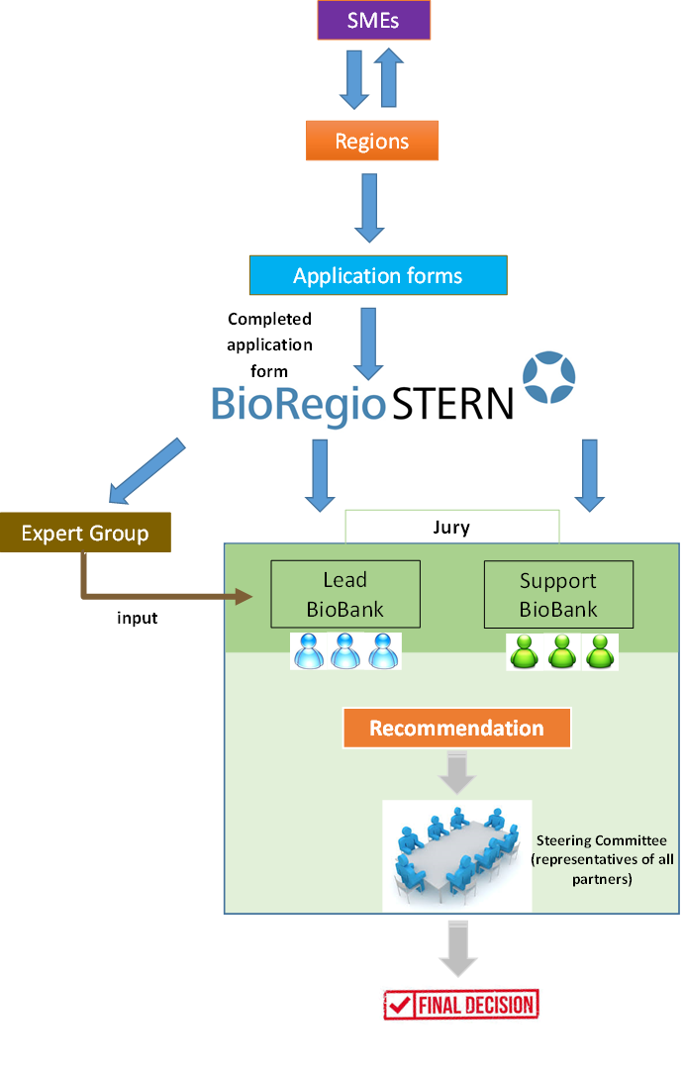
3 How to apply for the services – Sample Access
The workflow
Project Request
yes
Data and Sample Availability
no
yes
End
Codex4SMEs
Jury
no
yes
Project Implementation
Medical University of Graz – Biobank Graz  codex4smes@medunigraz.at

Slide 17
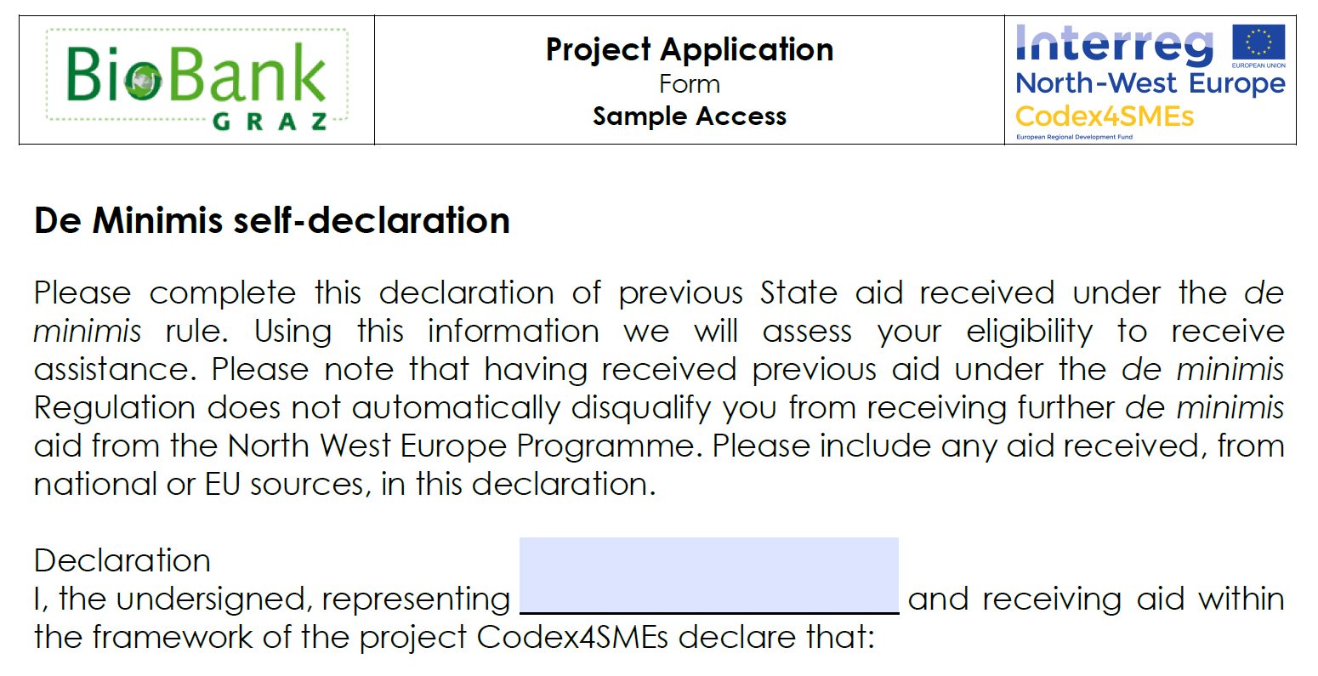
3 How to apply for the services – Sample Access
Required forms and documents for Sample Access
Project Application Form for Sample Access
De Minimis declaration
Application Form: http://www.nweurope.eu/media/4071/codex4smes_sample-access_sc_application_bbg.pdf
Medical University of Graz – Biobank Graz  codex4smes@medunigraz.at

Slide 18
2 The part of BBG in the Interreg-NWE Codex4SMEs project
BBG is responsible for the Codex4SMEs support schemes
Access to both support schemes is limited!
Important: first come first serve!
Sample Access
Knowledge Transfer
Medical University of Graz – Biobank Graz  codex4smes@medunigraz.at

Slide 19
3 How to apply for the services – Knowledge Transfer Service (KTS)
Knowledge Transfer Service
Development of projects with educational contents and biobanking trainings
Consulting and coaching
Contact to and networking with other biobanks
General Webinars on biobanking OR specialized Webinars on request
Guided tour through the Biobank Graz
Biobanking courses
Master of Science in Biobanking
Medical University of Graz – Biobank Graz  codex4smes@medunigraz.at

Slide 20
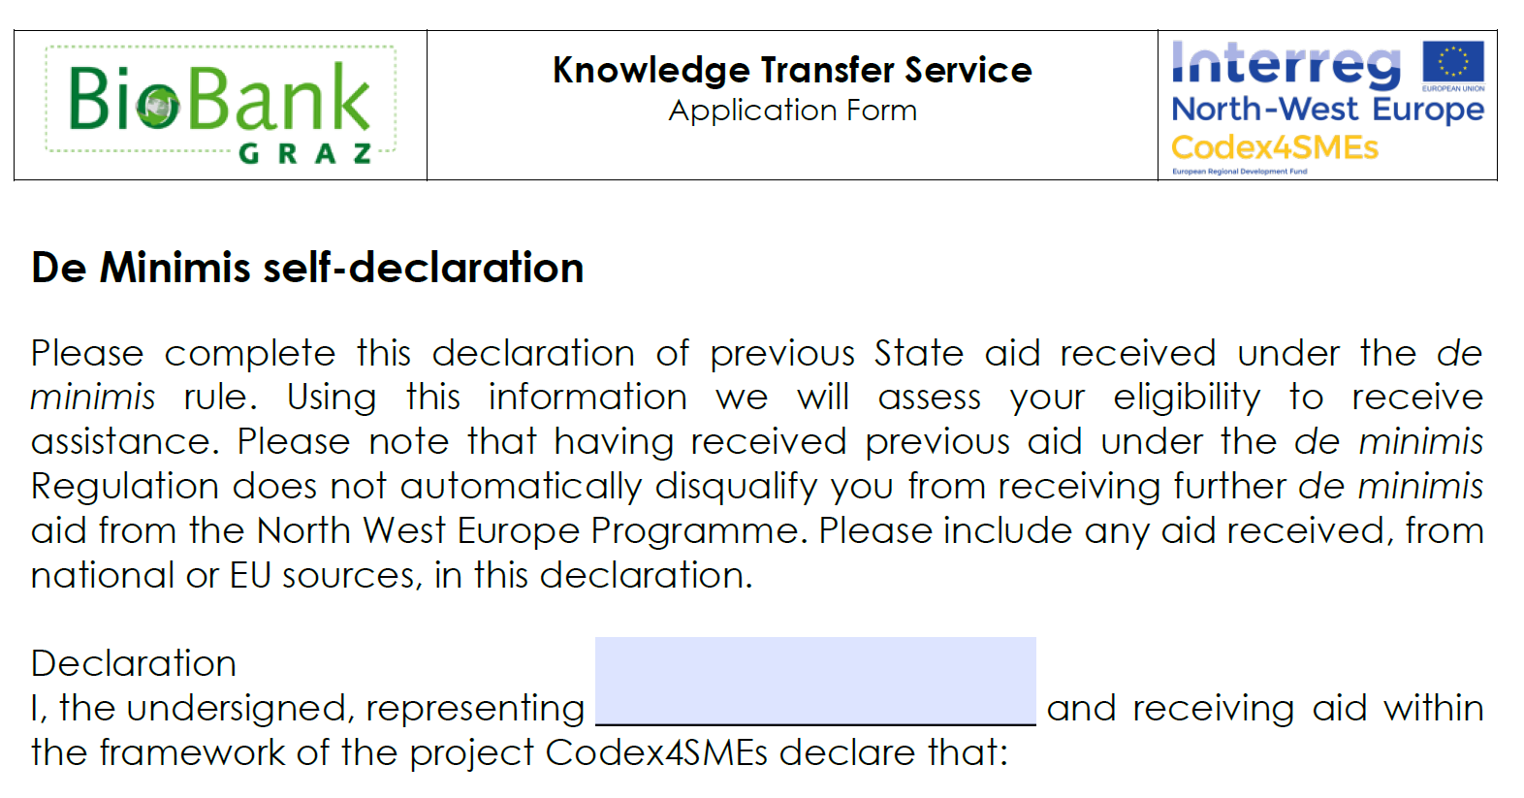
3 How to apply for the services – Knowledge Transfer Service (KTS)
Required forms and documents for KnowledgeTransfer Service:
Project Application Form for KTS
De Minimis Declaration
Application Form: http://www.nweurope.eu/media/4076/codex4smes_knowledge_transfer-sc_application_bbg.pdf
Medical University of Graz – Biobank Graz  codex4smes@medunigraz.at

Slide 21
Important Links
Codex4SMEs Homepage:
http://www.nweurope.eu/projects/project-search/codex4smes-companion-diagnostics-expedited-for-smes/
Application forms and guidelines:
Sample Access Application Form
http://www.nweurope.eu/media/4071/codex4smes_sample-access_sc_application_bbg.pdf
Sample Access Guideline
http://www.nweurope.eu/media/4068/codex4smes_sample-access_sc_guidelines_bbg.pdf
Knowledge Transfer Service Application Form
http://www.nweurope.eu/media/4076/codex4smes_knowledge_transfer-sc_application_bbg.pdf
Knowledge Transfer Service Guideline
http://www.nweurope.eu/media/4077/codex4smes_knowledge_transfer-sc_guidelines_bbg.pdf
Material Transfer Agreement of Biobank Graz
http://www.nweurope.eu/media/4069/biobank-graz-material-transfer-agreement.pdf
Biobank Graz:  For project requests:
https://biobank.medunigraz.at/ codex4smes@medunigraz.at
Medical University of Graz – Biobank Graz  codex4smes@medunigraz.at

Slide 22
Thank you for your attention!
Medical University of Graz – Biobank Graz  codex4smes@medunigraz.at

Slide 23
Questions?
 codex4smes@medunigraz.at
Franziska Vogl, PhD
Sarah Frajuk, MSc
Medical University of Graz – Biobank Graz  codex4smes@medunigraz.at

Slide 24
Sources
https://oeffentlichkeitsarbeit.medunigraz.at/image-fotos/
https://biobank.medunigraz.at/
http://catalog.bbmri.at/biobank.html?_cachebust=2.6.2&bbid=MUG
https://www.vectorstock.com/free-vectors
Medical University of Graz – Biobank Graz  codex4smes@medunigraz.at

