Slide 1
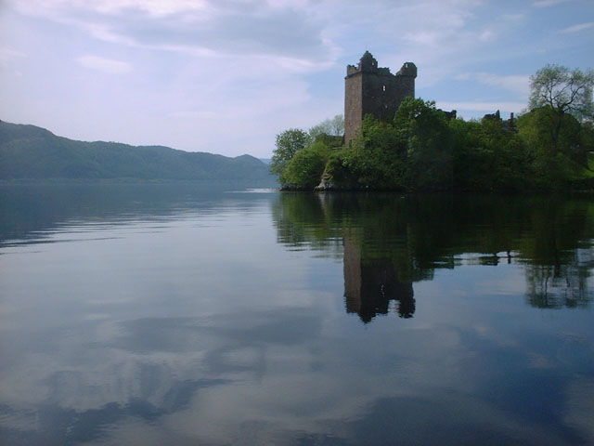

Barry Greig
Scottish Government Water Industry Division
Scotland: the Hydro Nation Supporting Innovation
Water Test Network Launch Event – Brussels, December 2018

Slide 2
Scotland The Hydro Nation
Water Resources Scotland Act 2013 places a duty on the Scottish Ministers who must
‘take such reasonable steps as they consider appropriate for the purpose of ensuring the development of the value of Scotland’s water resources’
Scotland the Hydro Nation – a nation which manages its water environment to the best advantage, employing its knowledge and expertise effectively at home and internationally.

Slide 3
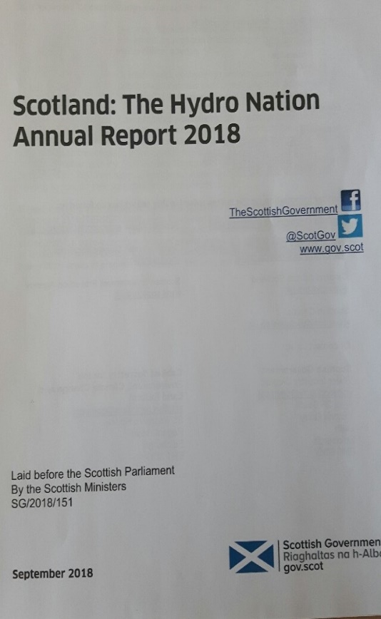
Hydro Nation structure
Hydro Nation Forum – chaired by Cabinet Secretary - advises on delivery of HN Strategy under 4 key themes of activity:
National
International
Knowledge
Innovation
Annual Hydro Nation Report laid in Parliament each Autumn

Slide 4

SCOTLAND: HYDRO NATION – AN INNOVATION NATION
Significant market opportunity - > £245bn global annual turnover
UK level £15.2bn turnover in water and sewage sector - @ 127000 jobs
Water tech market estimated to grow from £1.5bn to £8.8bn by 2013
Scottish market alone £1.8bn (2014) growth around 10% pa

Slide 5

SUPPORTING INNOVATION- HNWIS.2
www.hnwis.scot

Slide 6

Delivering for Today, Investing for Tomorrow
Programme for Government 2018-19
PfG published 4 September commits SG to:
provide £210 million to support Scottish Water’s £3.6 bn capital investment programme
grow Scotland’s water economy through Scottish Water International consultancy, the Hydro Nation innovation service and test facilities, world-class research, overseas development aid and working with Scottish Development International

Slide 7

barry.greig@gov.scot
Water Industry Team
Scottish Government

