Slide 1
GenComm Generating Energy Secure Communities
Mark Welsh
Kevin Verleysen T.A. Gunawan
Research hub at All- Energy
Glasgow, 15th - 16th May, 2019
Place image in this area.

Slide 2
Overview
Introduction to GenComm (Mark Welsh)
Energy Challenges
GenComm Pilot Plants
GenComm Deliverables
Smart H₂ (Kevin Verleysen)
Hydrogen characteristics
Current H2 supply and demand
H₂ Mobility Technologies
The Concept of Smart H₂
Hydrogen Based Energy Carriers Decision Support Tool (T.A. Gunawan)
Smart H2GO Objectives
Building the Smart H2GO
Smart H2GO model
Case studies
Case study in Valentia Island
Case study in Belfast
Case study in Northwest Europe

Slide 3
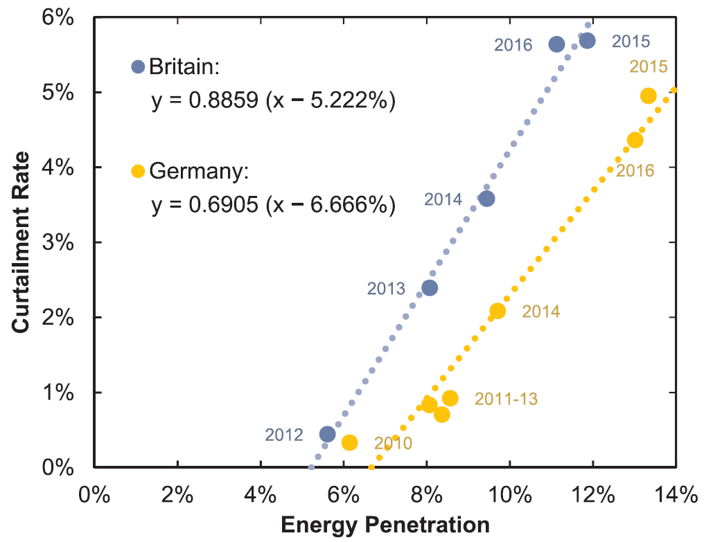
Energy Challenges
Curtailment in Ireland
Curtailment in the UK & Germany
Graph sources: Eirgrid Constraint and Curtailment Report, 2017.
Joos, M. Short-term integration costs of variable renewable energy: Wind curtailment and balancing in Britain and Germany. Renewable and Sustainable Energy Reviews. 2018.

Slide 4
GenComm Pilot Plants
Curtailed renewable energy sources
Energy demands
Electrolysis
Handling
N. Ireland pilot
N. Ireland pilot
Industry
Wind Energy
O₂
Mobility
Germany pilot
Germany pilot
Solar Energy
Scotland pilot
Scotland pilot
AD Plant
Stationary Energy

Slide 5
GenComm Deliverables
Curtailed renewable energy sources
Hydrogen could make sense for my community, organisation or company.
But how do I make it happen?
How do I find a hydrogen source or market?
Energy demands
Industry
Wind Energy
Mobility
Solar Energy
Smart H2GO
Decision Support Tool
AD Plant
Stationary Energy
Can I get in contact with like-minded groups across Europe?
CH2F
Community Hydrogen Forum

Slide 6
Overview
Introduction to GenComm (Mark Welsh)
Energy Challenges
GenComm Pilot Plants
GenComm Deliverables
Smart H₂ (Kevin Verleysen)
Hydrogen characteristics
Current H2 supply and demand
H₂ Mobility Technologies
The Concept of Smart H₂
Hydrogen Based Energy Carriers Decision Support Tool (T.A. Gunawan)
Smart H2GO Objectives
Building the Smart H2GO
Smart H2GO model
Case studies
Case study in Valentia Island
Case study in Belfast
Case study in Northwest Europe
Notes:
hydrogen became the central energy carrier in modern energy systems because of its high versatile applications.
It is the most abundant element on earth. It exists mainly in demineralized form and naturally occurs only as a part of a molecule, mainly in hydrocarbons and water.
Hydrogen is also, under normal conditions, colourless, odourless and non-toxic, making it environmentally neutral
Hydrogen, as an energy carrier, is a clean fuel that can be used to generate electricity, motive power and heat/cooling. However, even though hydrogen is the most abundant chemical element on earth, it does not exist in its pure form in nature. Therefore, it must be extracted from existing sources such as water. This requires the use of energy in the form of electricity to split water into hydrogen and oxygen using a process called electrolysis. The important note to remember about hydrogen produced via electrolysis is that it requires only electricity and water. As long as the electricity is from renewable sources, then hydrogen will be produced free from emissions. On the other hand, when hydrogen is reconverted through electrochemical conversion (fuel cells) into electrical power, heating and motion power, it only produces pure water as a by-product. As such, the full cycle from hydrogen production to hydrogen consumption as fuel is totally free from emissions. This finding is an enormous step for humanity in the search for a solution to emissions for all of the energy sectors. From the above, it is clear that hydrogen is a highly suitable fuel for carbon-free energy generation, heating, cooling and transport systems.

Slide 7
Hydrogen Characteristics
Source: Eia.gov. (2017). Analysis & Projections - U.S. Energy Information Administration (EIA).
Notes:
It exists in gaseous form under normal temperature and pressure conditions
Liquefaction therefore is primarily performed by cooling to dramatically increase the density of hydrogen, by a factor amount of 800. In comparison LPG has a factor of 250 and natural gas a factor of 600. This makes hydrogen liquefaction an interesting transportation method for long distances. The transportation temperature is very low (-253°C). It must utilize a highly efficient isolation system to ensure that hydrogen does not evaporate. Transport of hydrogen can also be achieved in gaseous form under moderate or high pressure. However, a promising way of storing hydrogen is currently being developed and known as adsorption on solids and liquids. This promising storage solution can store high H2 quantities even at atmospheric pressures.
This wide ignition range allows for extremely lean air/gas mixtures, which minimises fuel consumption and leads to more efficient combustion.

Slide 8
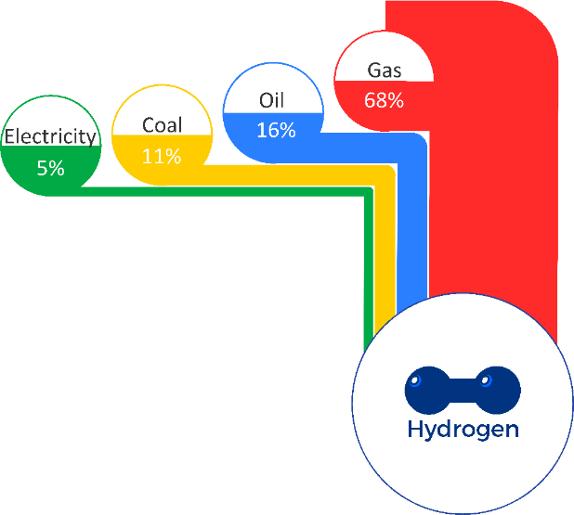
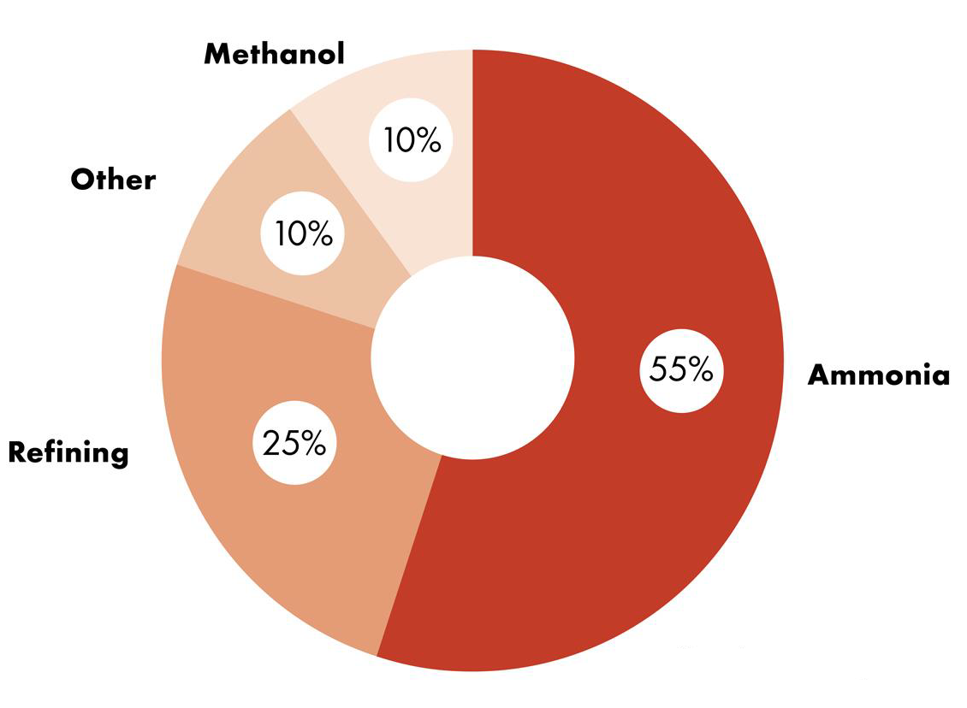
Current H₂ supply and demand
Global hydrogen supply
Global hydrogen demand
Source: Hydrogen-Based Energy Conversion. More than Storage: System Flexibility (Fact Book). (2014). 1st ed. SBC Energy Institute.
Shell Hydrogen Study: Fuel of the Future ?.(2017). Shell GmbH and Wuppertal Institute.
Notes:
Hydrogen exists naturally on Earth as a constituent element in other compounds, so it needs to be extracted through thermochemical, biochemical or electrochemical processes. The primary energy sources include solid, liquid or gaseous fossil fuels, and renewable electricity. Currently, the most important primary energy source for hydrogen production is natural gas, at almost 70%, followed by oil, coal and, far behind, electrolysis of water using electricity.
The electricity share of hydrogen production presented in here includes conventional power production technologies. This creates a considerable problem regarding Greenhouse Gas emissions. While electrolysis itself produces no GHGs, the use of carbon-intensive electricity does.
Currently, this hydrogen is being used for the production of mainly ammonia as a fertilizer, to fertilise our crops

Slide 9
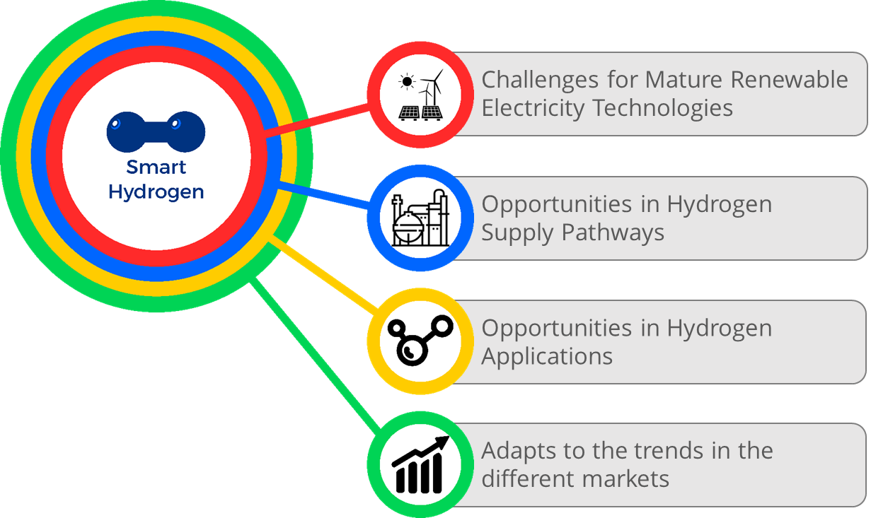
The Concept of Smart H2
Source: Renewable Smart Hydrogen for a Sustainable Future. GenComm. 2018.
Notes:
Smart Hydrogen gives a solution to the electrical grid network challenges faced by the mature renewable electricity technologies, (2) opportunities in hydrogen supply pathway, (3) prospects for new hydrogen applications and (4) creation of different and new trends in energy markets with “Power to X technologies”. The aim of Smart Hydrogen is to create a hydrogen value chain that is optimal in technical performance and financial revenues
Currently there are eight different renewable sources identified and present in global energy markets, particularly in the power market: (1) biomass energy, (2) geothermal power and heat, (3) hydropower, (4) ocean energy, (5) solar photovoltaics (PV), (6) concentrating solar thermal power (CSP), (7) solar thermal heating and cooling, and (8) wind power.
Mature technologies are those that have reached competitive levelised costs of electricity generation compared to conventionally generated power. At present, the technologies that are considered mature include: onshore and offshore wind, solar photovoltaics PV, hydropower, geothermal power, and some forms of bioenergy.
These conversion technologies also grant the use of hydrogen as an energy carrier the necessary flexibility to react to the variable natures of (1) energy supply and demand and (2) energy markets. In the case of overcapacity, the ease and speed with which hydrogen fuel cells and combustion engines can ramp up and down will render the need for this practice obsolete. Hydrogen can offer several alternatives to the problem of distance between energy supply and demand.

Slide 10
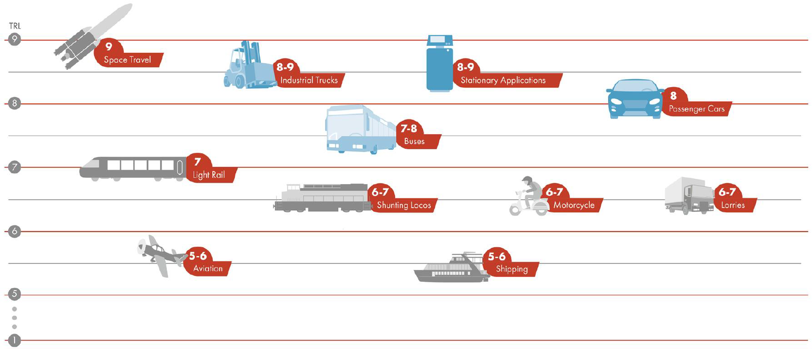
H₂ Mobility Technologies
Commercial
Source: Shell Hydrogen Study: Fuel of the Future ?.(2017). Shell GmbH and Wuppertal Institute.
Notes:
Mobility applications involve using hydrogen as an energy source for the transport sector. As for the case of stationary applications, transport technologies make use of fuel cells and combustion engines and cover all the different forms of transport. Nonetheless the different forms of transport have different levels of maturity. The US space agency, NASA, has created a system to contrast the level of maturity of different technologies called Technology Readiness Level (TRL). The TRL scale goes from levels 1 to 9. TRL of at least 8 implies sufficient technological maturity, which means at least proven functionality in the field of use

Slide 11
Overview
Introduction to GenComm (Mark Welsh)
Energy Challenges
GenComm Pilot Plants
GenComm Deliverables
Smart H₂ (Kevin Verleysen)
Hydrogen characteristics
Current H2 supply and demand
H₂ Mobility Technologies
The Concept of Smart H₂
Hydrogen Based Energy Carriers Decision Support Tool (T.A. Gunawan)
Smart H2GO Objectives
Building the Smart H2GO
How does Smart H2GO work?
Case studies for curtailment-based H₂ supply
Local-scale in Valentia Island, Ireland
Regional/National-scale in Belfast, Northern Ireland
Transnational-scale across Northwest Europe

Slide 12
Smart H2GO objectives
Solution for renewables curtailment and decarbonisation
Increase people awareness towards hydrogen economy
Provide H₂ production potential locations and its costs
Figure on how H₂ can be used for public transport demand

Slide 13
Building the Smart H2GO
Smart H2GO
User Interface
INSA
Technical
model
ENERGIA,
IZES, PEC
NUIG
BURN
Smart H2GO
model
Reduction
model
Pilot plants
TKR
Economic
model

Slide 14
How does Smart H2GO work?
Hydrogen energy equivalent
Annual energy demands
Total hydrogen demand
Demand location
Hydrogen supply chain
Wind farm locations
Total hydrogen supply
Optimal electrolyser size at every wind farm
Available curtailed wind at every wind farm
Notes:
AE: Available energy
CP: Capacity wind farm
CF: Capacity factor wind farm DD: Dispatch down
ES: Electrolyser size
EG: Electrical grid CM : Compressor

Slide 15
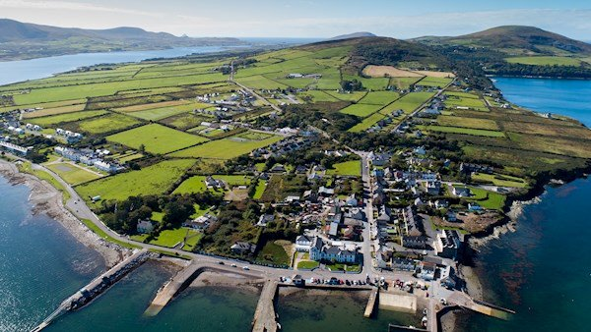
Smart H2GO Case Study 1 Local-scale in Valentia Island, Ireland
Community-owned Energy Cooperative seeks to develop H₂-based transportation and heating
Supply: local curtailed wind power
Demand: Industrial heating, residential heating, delivery truck, local bus, car ferry
Questions:
How much curtailment-based H₂ can be produced?
What is its source?
How much might curtailment-based H₂ cost?
Picture source: https://www.irishexaminer.com/

Slide 16
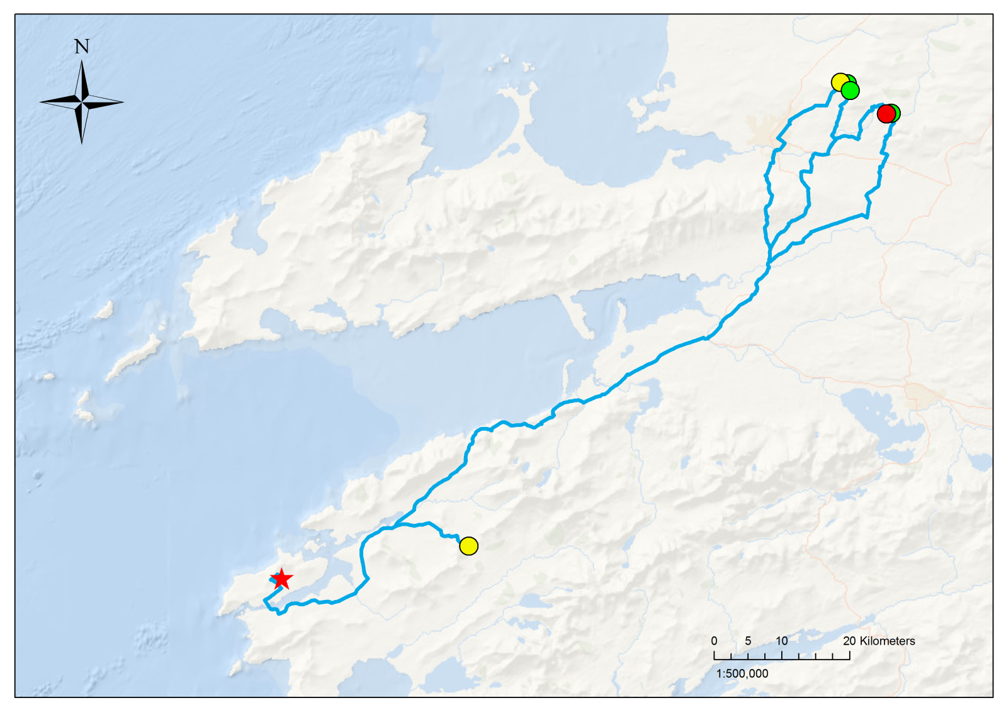
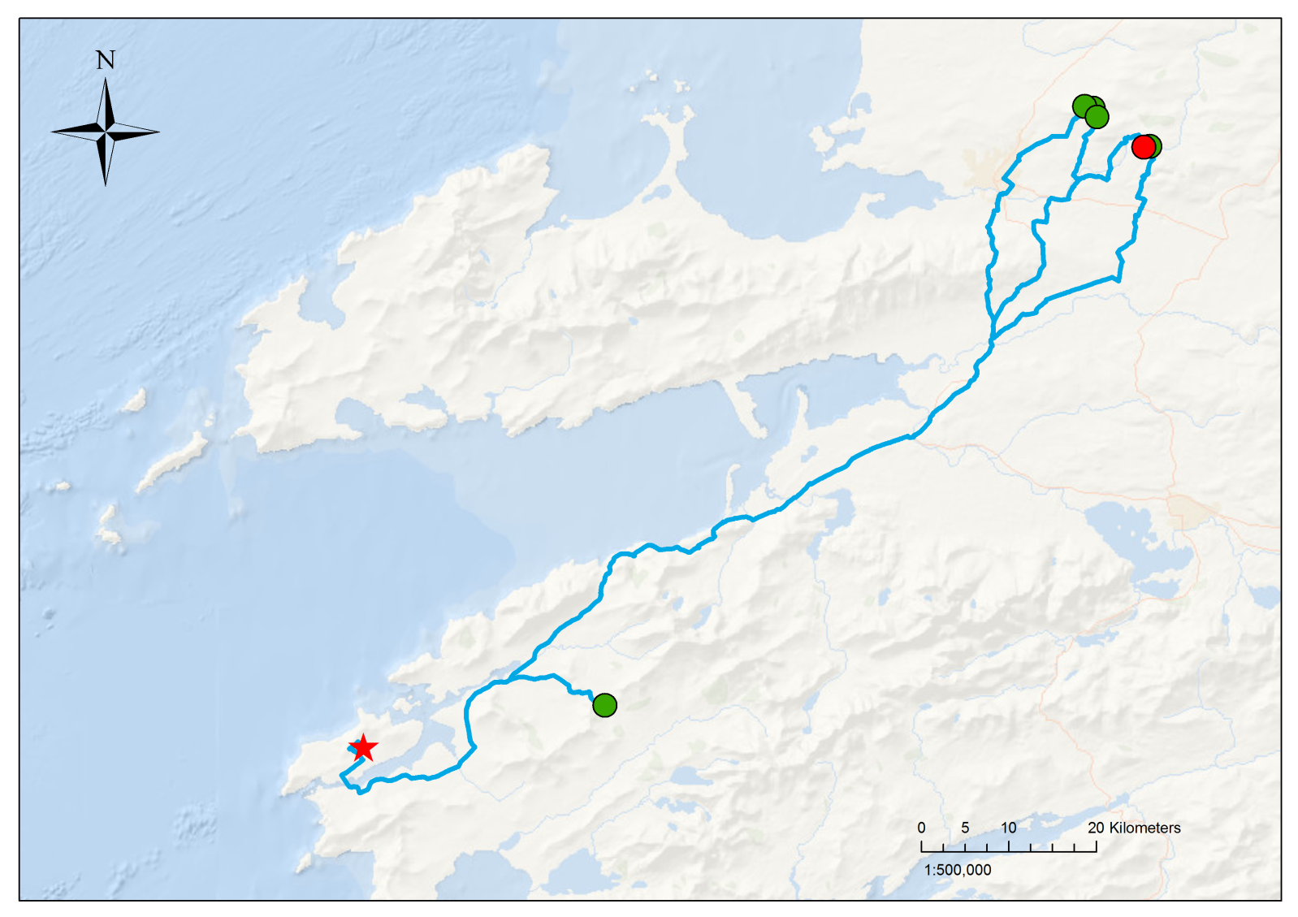
Smart H2GO Case Study 1 Local-scale in Valentia Island, Ireland
Hydrogen production capacity
Hydrogen production costs
H2 production (t/y)
 | 5 – 10
 | 10 – 15
 | 15 – 20
 | 20 – 25
 | 25 – 30
LCOH (€/kg)
 | 25 – 30
 | 30 – 35
 | 35 – 40

Slide 17
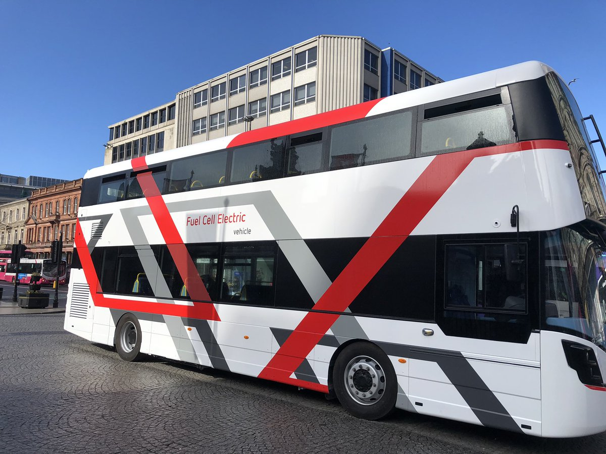
Smart H2GO Case Study 2 Regional/National-scale in Belfast, Northern Ireland
Public transport operator is piloting hydrogen fuel cell buses
Local company Wrightbus has launched world’s first hydrogen fuel cell double-decker bus
Supply: curtailed wind power on the island of Ireland
Demand: Entire Belfast bus network
Questions:
How much curtailment-based H₂ can be supplied?
What is its source?
How much might curtailment-based H₂ cost?

Slide 18
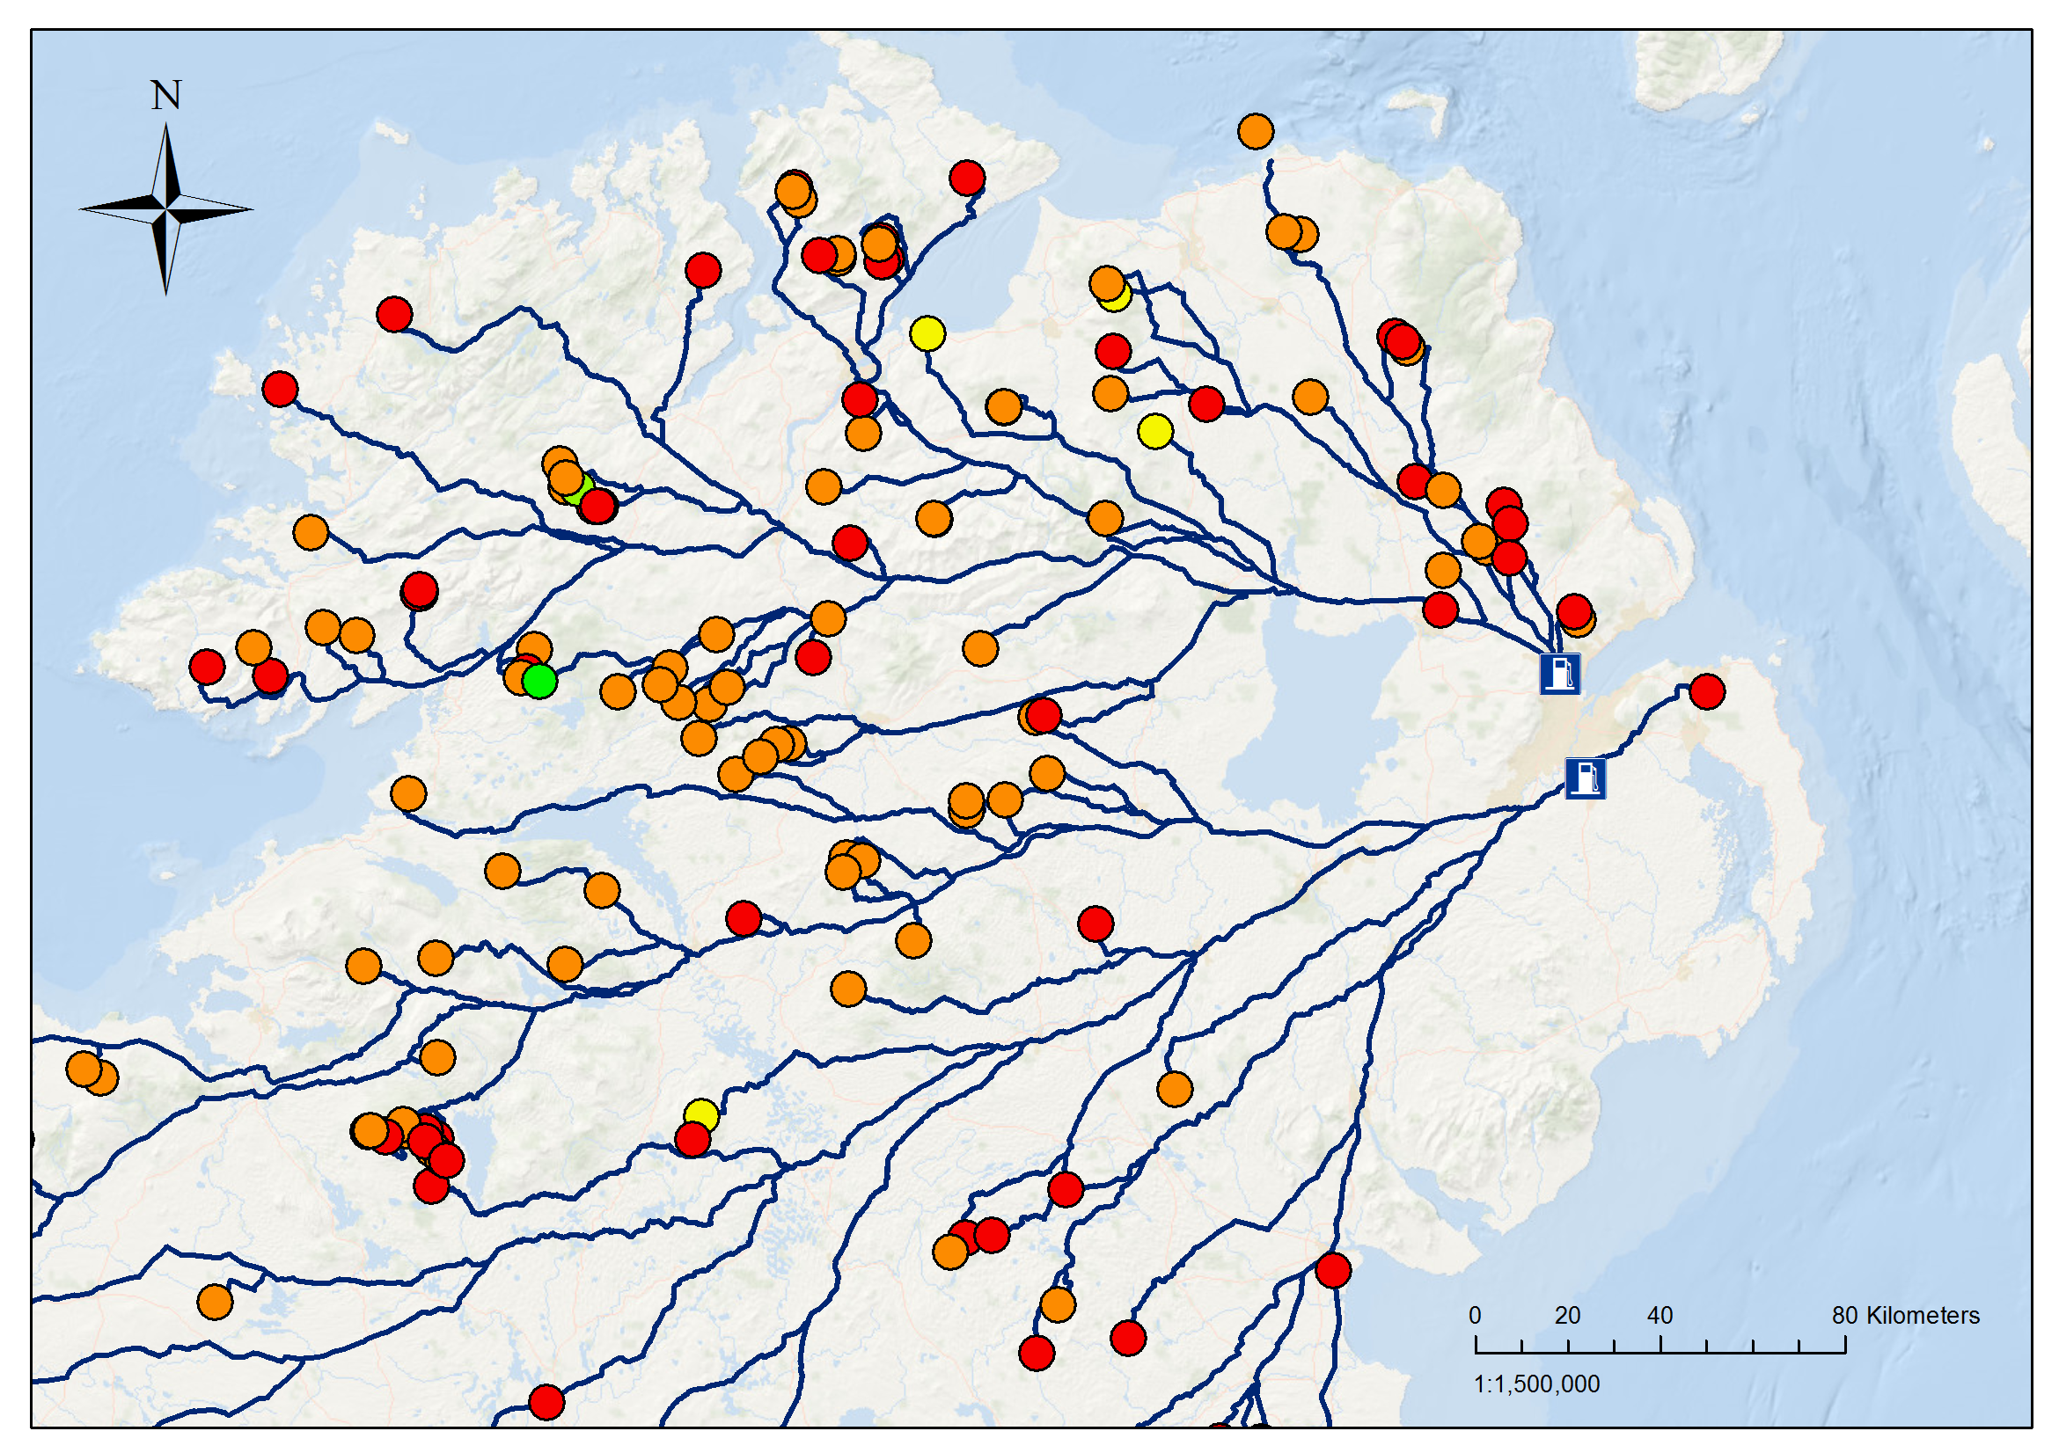
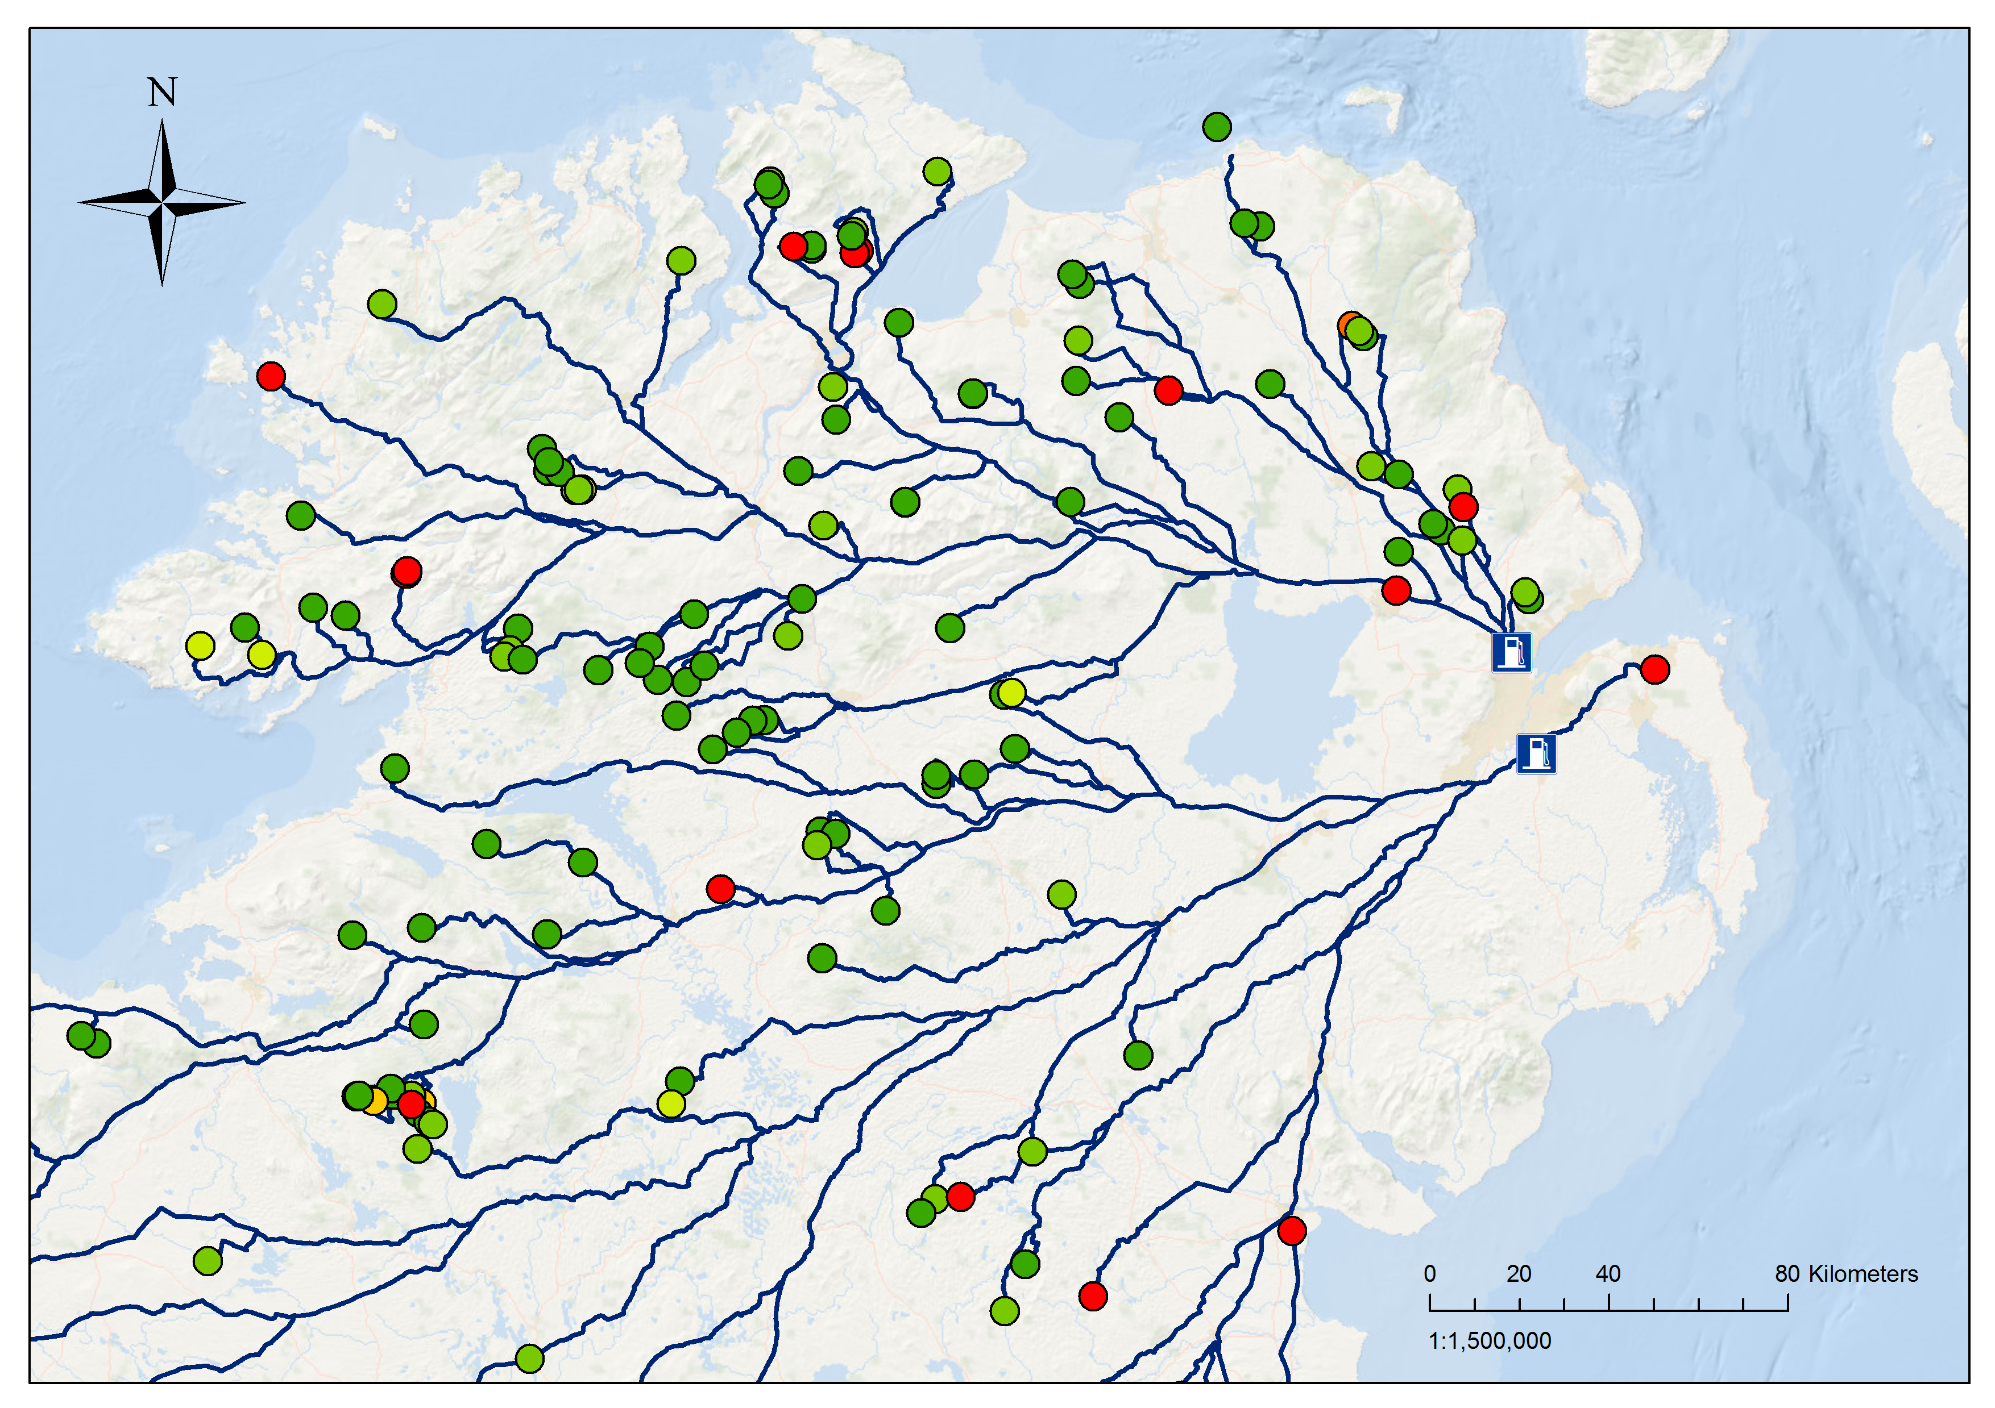
Smart H2GO Case Study 2 Regional/National-scale in Belfast, Northern Ireland
Hydrogen production capacity
Hydrogen production costs
100 km
694 (t/y) ≈ 90 buses
50 km
456 (t/y) ≈ 59 buses
H2 production (t/y)
 | < 30
 | 30 - 60
 | 60 - 90
 | 90 - 120
 | 120 - 150
 | 150 - 180
LCOH (€/kg)
 | 25 - 30
 | 30 - 35
 | 35 - 40
 | 40 - 45
 | 45 - 50
 | > 50

Slide 19
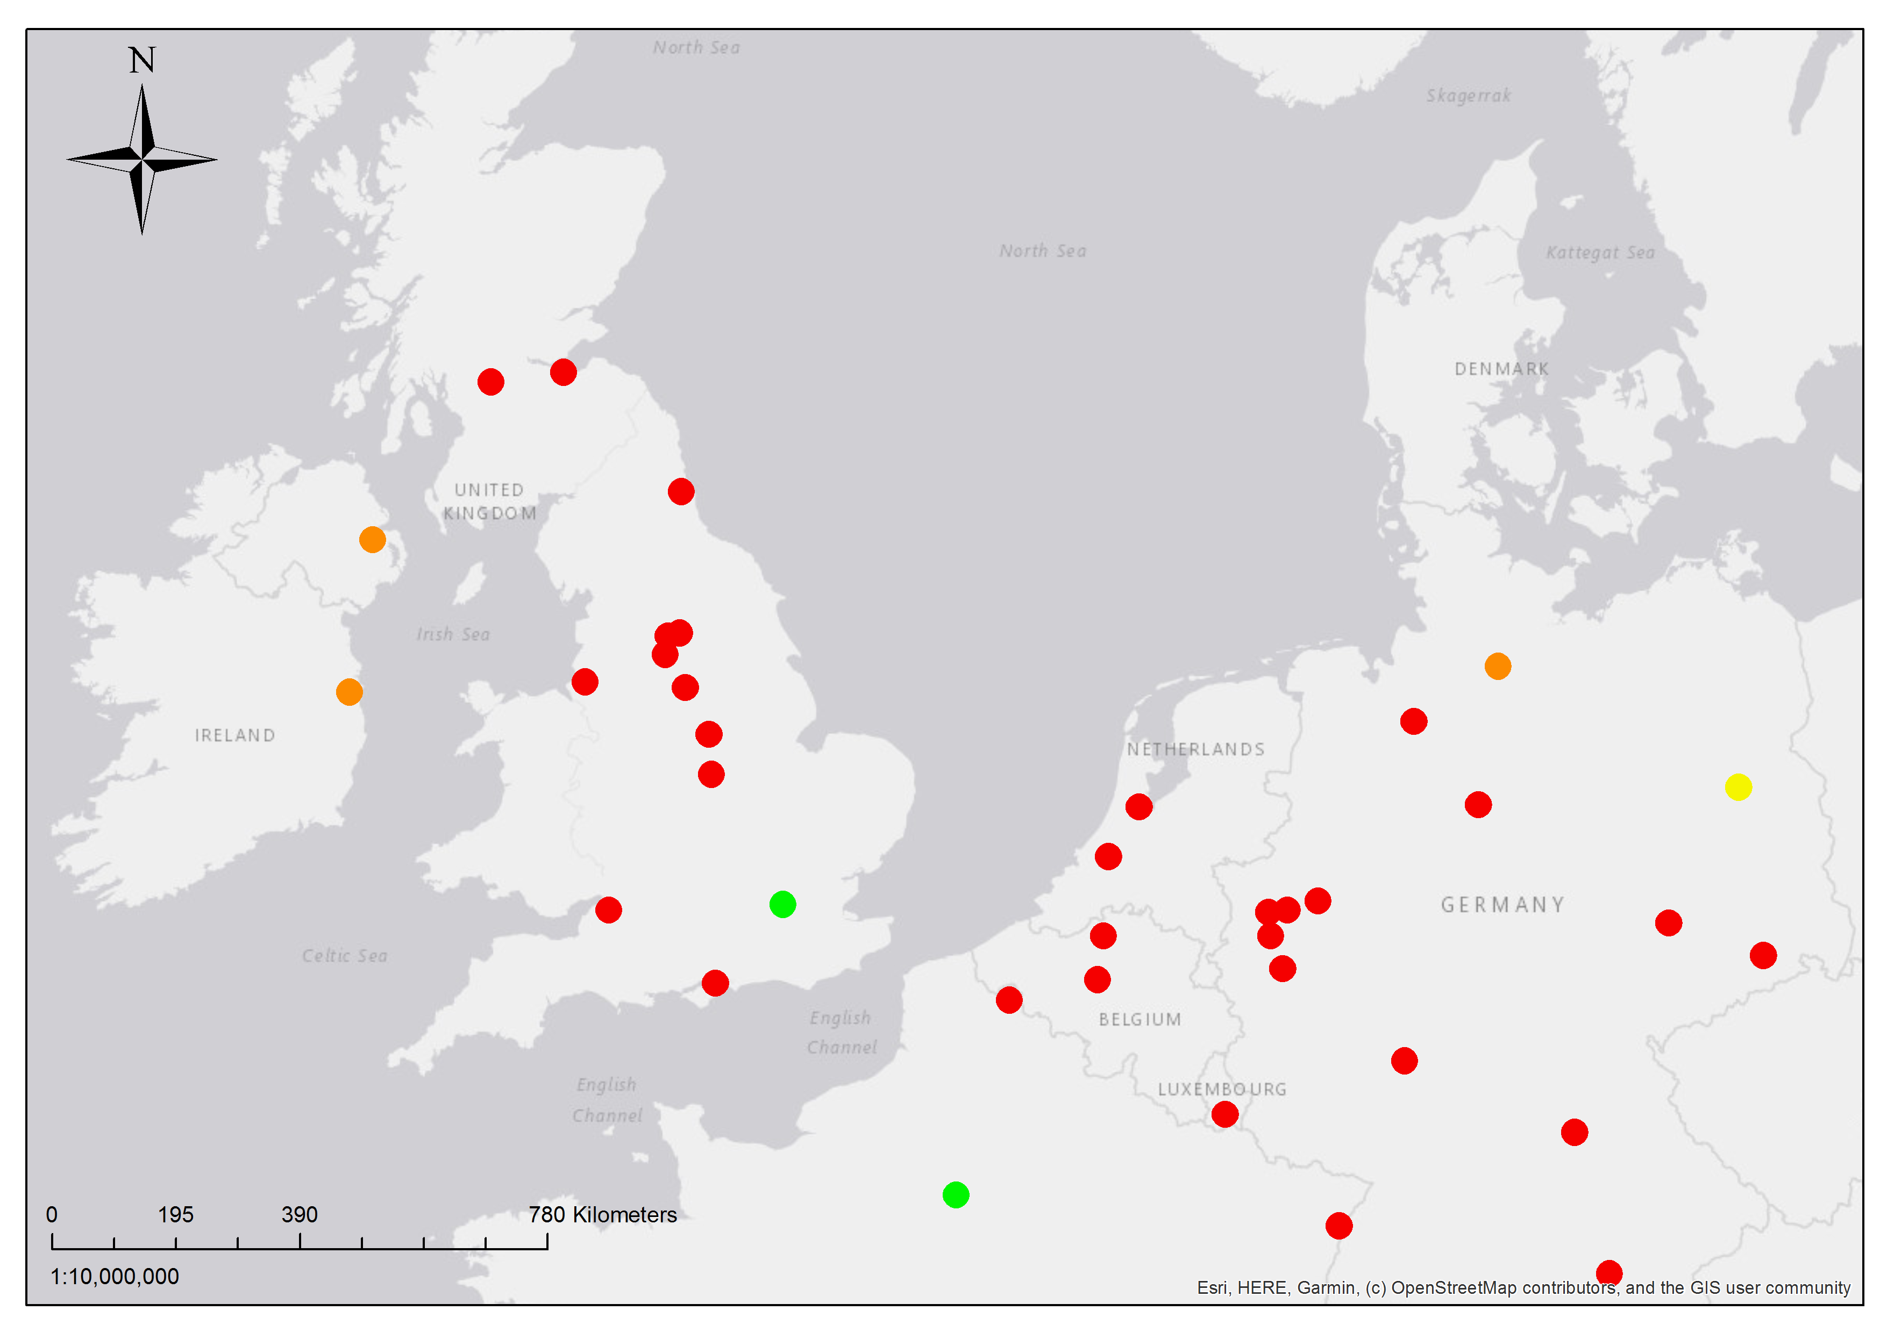
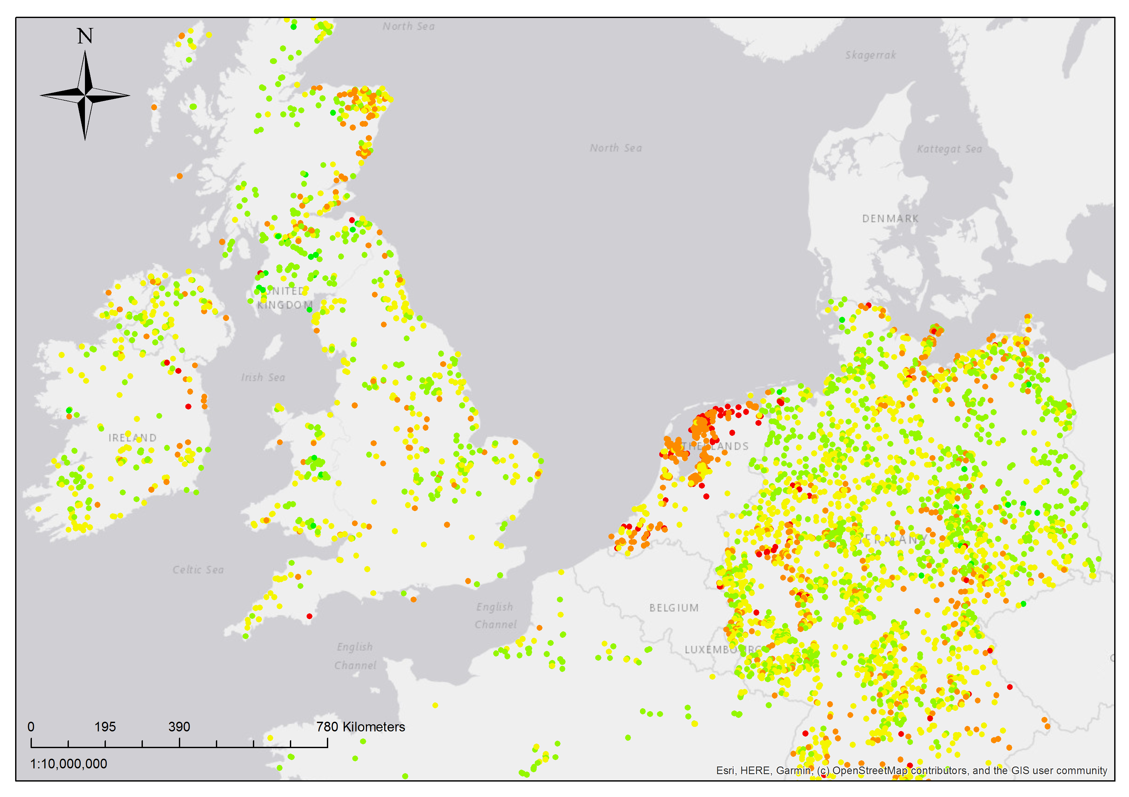
Smart H2GO Case Study 3 Transnational-scale across Northwest Europe
Bus fleet sizes for NW Europe’s largest cities
European cities are starting to impose diesel bans
Diesel bus fleets must be replaced with zero-emissions alternatives
Supply: curtailed wind power across of northwest Europe
Demand: City bus networks in northwest Europe’s largest cities (pop.>400k)
Questions:
How much curtailment-based H₂ can be supplied across NW Europe?
Where are its sources?
How much might curtailment-based H₂ cost?
Buses (units)
 | < 500
 | 500 - 1000
 | 1000 - 1500
 | 1500 - 2000
 | > 2000
Annual curtailed energy at NW Europe’s wind farms
Curtailed energy (MWh)
 | < 10¹
 | 10¹ - 10²
 | 10² - 10³
 | 10³ - 10⁴
 | 10⁴ - 10⁵

Slide 20
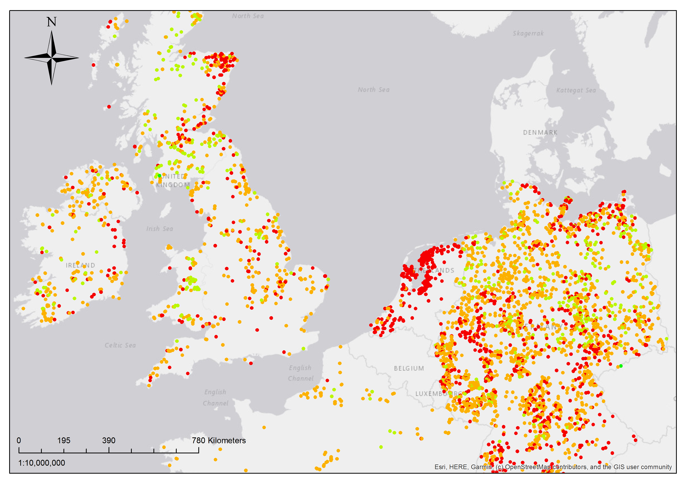
Smart H2GO Case Study 3 Transnational-scale across Northwest Europe
Optimum electrolyser size for curtailment-based H₂ production at NW Europe wind farms
Electrolyser size (kW)
 | 10¹ - 10²
 | 10² - 10³
 | 10³ - 10⁴
 | 10⁴ - 10⁵

Slide 21
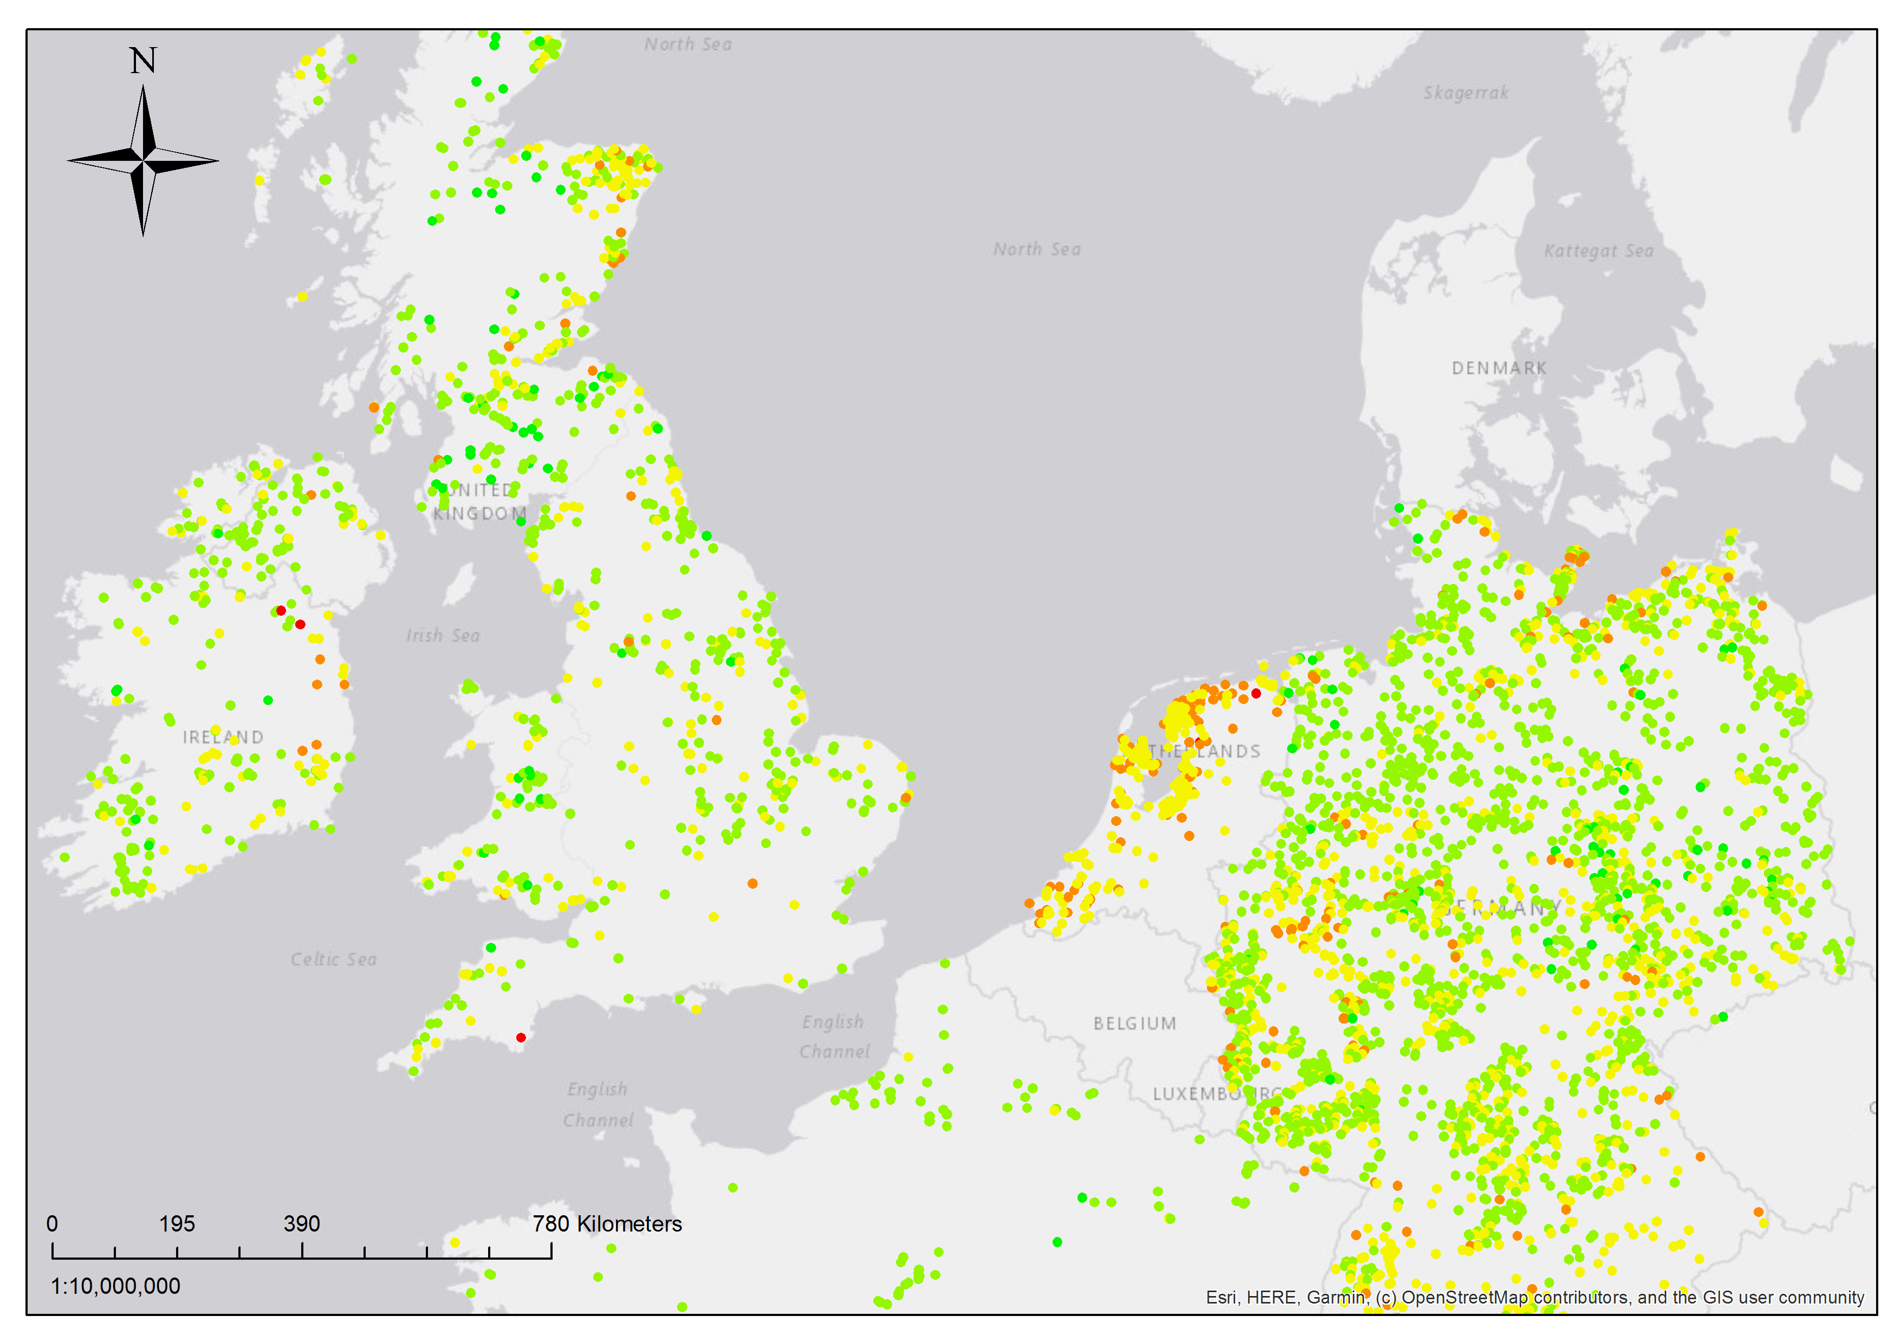
Smart H2GO Case Study 3 Transnational-scale across Northwest Europe
Annual curtailment-based H₂ production at NW Europe wind farms
Hydrogen production (kg per year)
 | 10¹ - 10²
 | 10² - 10³
 | 10³ - 10⁴
 | 10⁴ - 10⁵
 | 10⁵ - 10⁶

Slide 22
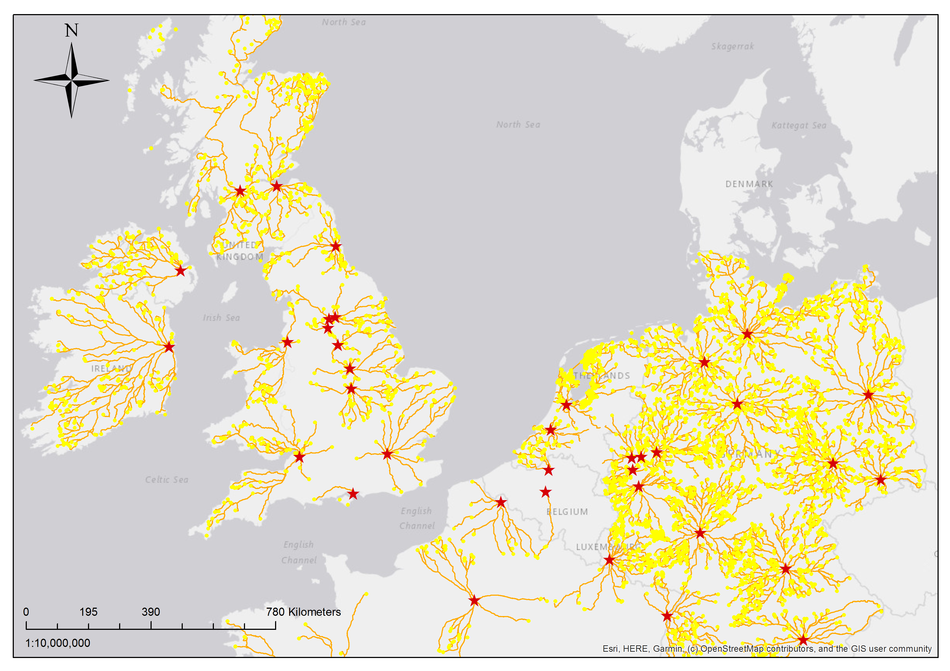
Smart H2GO Case Study 3 Transnational-scale across Northwest Europe
Supply routes of curtailment-based H₂ to NW Europe’s largest cities
Legend :
 | Big cities
 | Wind farms
 | Routes

Slide 23
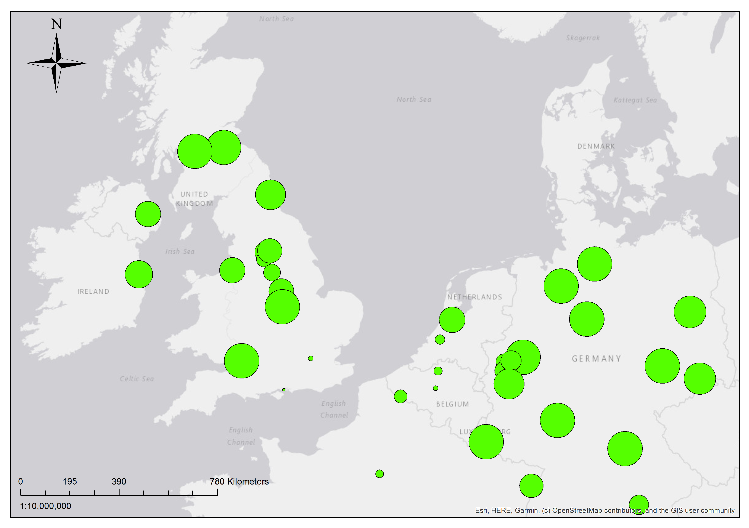
Smart H2GO Case Study 3 Transnational-scale across Northwest Europe
Percentage of bus network demand met by hydrogen at NW Europe’s largest cities
Legend :
 | 1%
 | 5%
 | 10%
 | 25%
 | 50%
 | 100%

Slide 24
Smart H2GO Case Study 3 Transnational-scale across Northwest Europe
Curtailment-based H₂ supply curve for Dublin bus network

Slide 25
Community Hydrogen Forum (CH2F)
The objectives:
Education of its members and public on role of H₂ in community development, decarbonisation, energy security
Development of strategy related to H₂ advancement
Influence of policy for H₂ advancement
CH2F covers Northwest Europe (Ireland, UK, France, Belgium, Netherlands, Luxembourg, Germany)
Members will include community organisations, energy agencies, local authorities, academic institutions, members of the public
The Community Hydrogen Forum will launch in Q4 2019.
For any questions on community-scale hydrogen and to be kept informed of progress, contact rory.monaghan@nuigalway.ie.

Slide 26
Concluding Remarks & Next Steps
Smart Hydrogen has a role to play in reducing renewable energy curtailment, avoiding grid saturation and enabling energy sector coupling
GenComm will validate a model to roll out Smart Hydrogen across Northwest Europe by developing Smart H2GO and the Community H₂ Forum
Smart H2GO work to date has focused only on curtailment-based H₂, future efforts will drive down H₂ production costs through grid integration
Future efforts will also model H₂ production from solar energy
Smart H2GO and the Community H₂ Forum will launch in Q4 2019, contact rory.monaghan@nuigalway.ie for details

Slide 27
Thank you for your attention

Slide 28
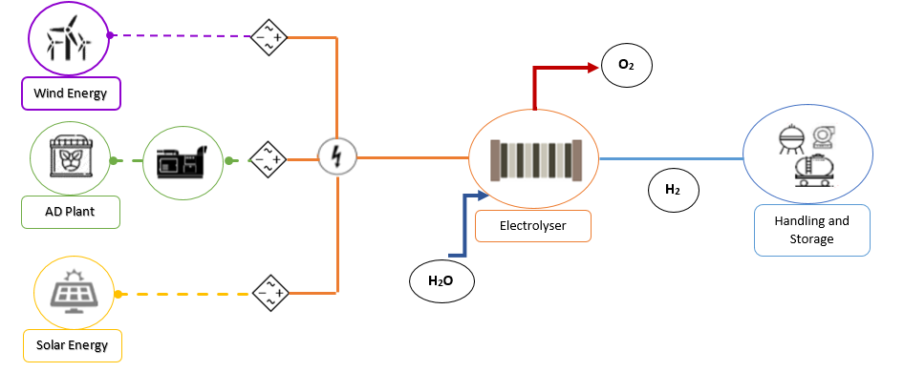
Technical model by INSA
Process definition
(feed, operating conditions, reactor design)
Process Model
Pilot plant data
No
Comparaison
Input:
Technical parameters of the technology and
geographical information
Output:
Potential of H2 production and specificationsop
Model adaptations /modifications
Yes
Validation

Slide 29
Reduction model by BURN
probability
$$\sum{yiψ}i\left(ξ\right)$$
objective
$\sum{y0 }$= mean
$\sum_{i≠0}{yi2}$= variance

