Slide 1
Welcome to Care Peat
Manchester Start-up Conference June 2019

Slide 2
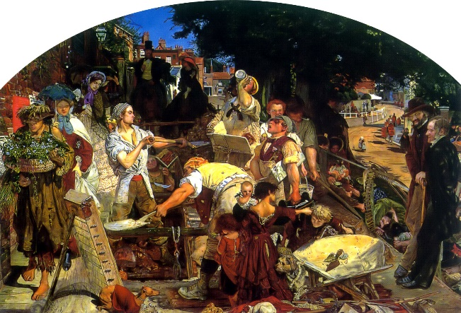
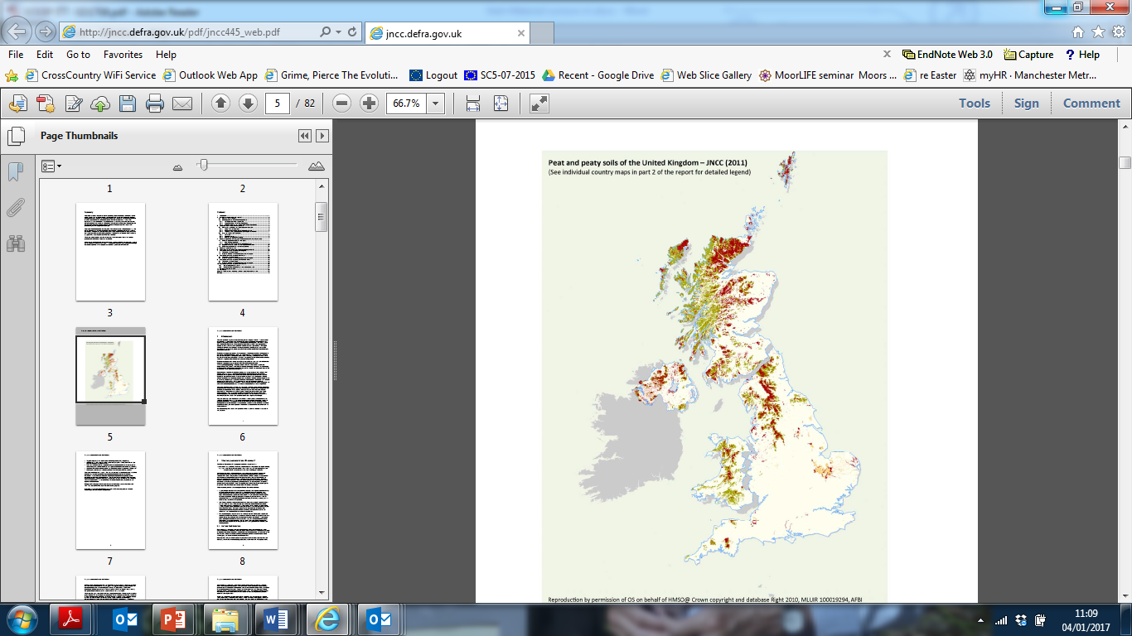

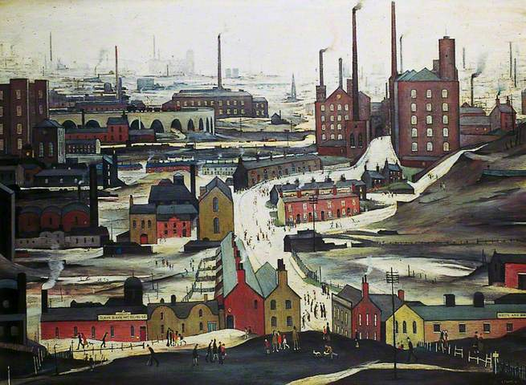
Manchester Metropolitan University (MMU)
Large University
Near peatlands
Industrial centre
Historical legacy
Damaged peatlands
Peat and Peaty soils

Slide 3
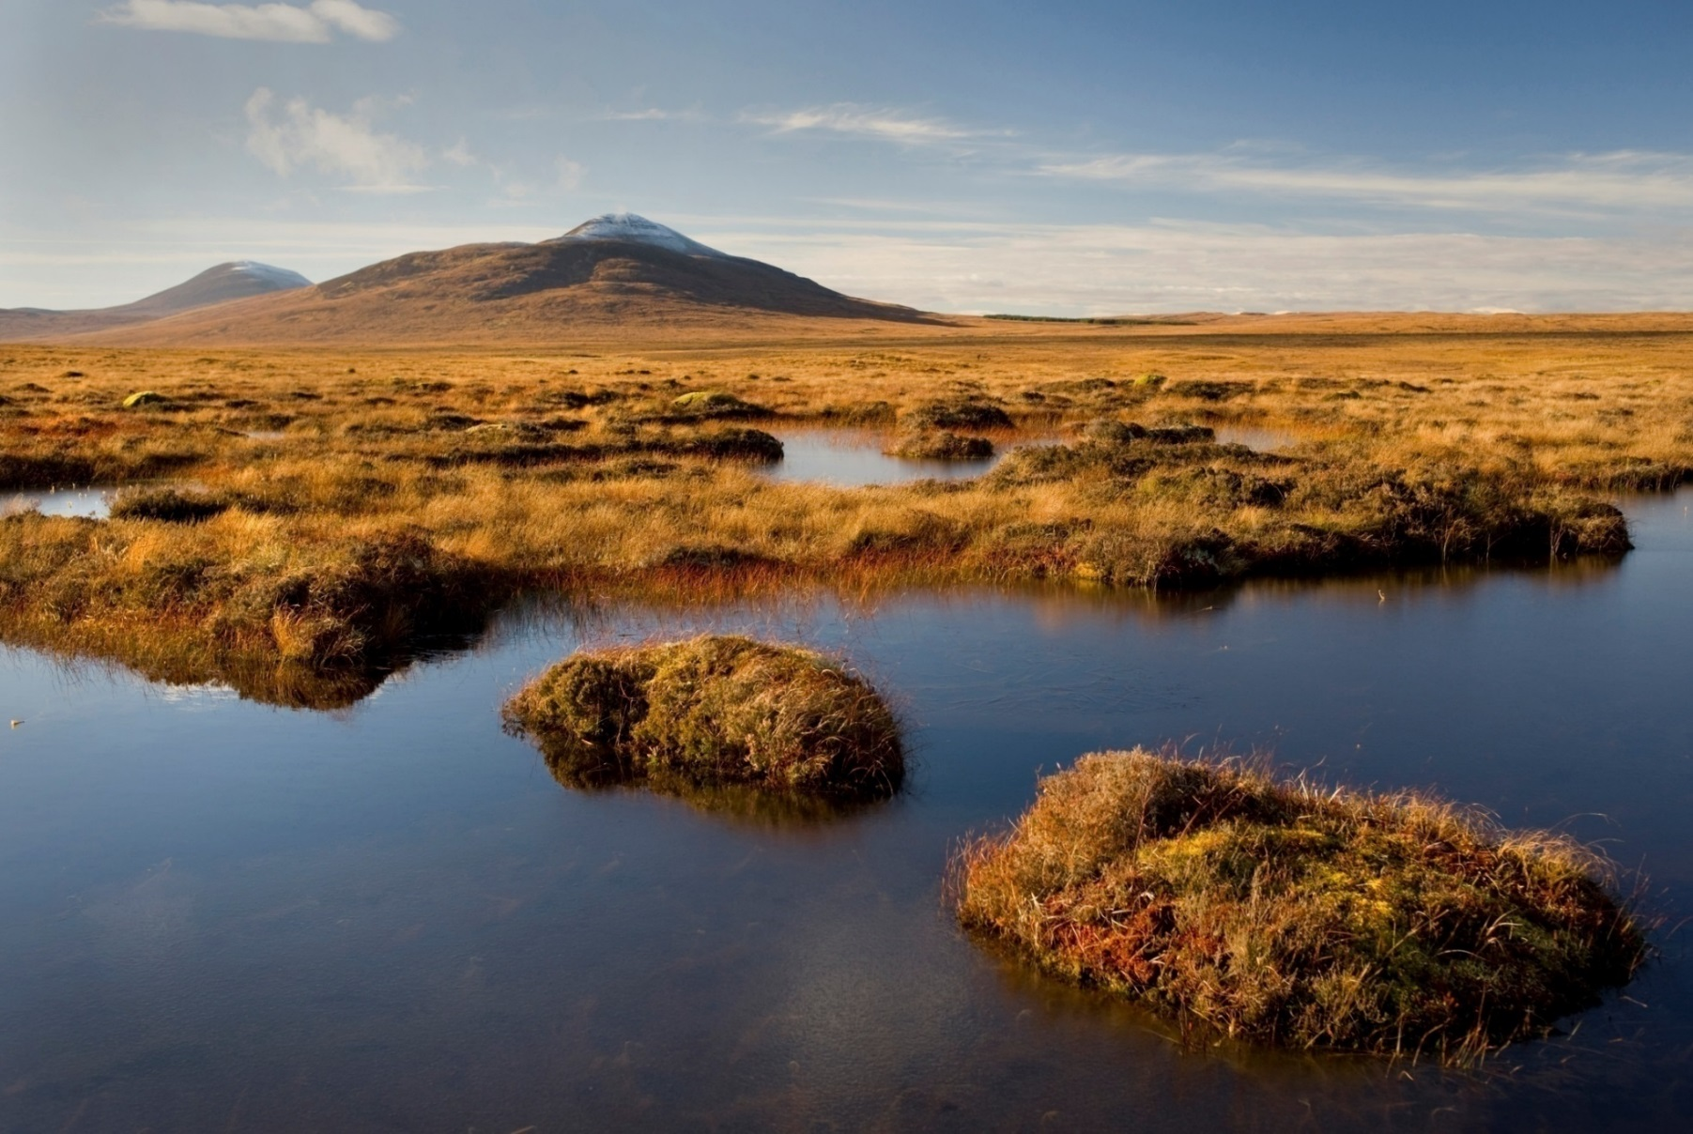
Lowland blanket bog - Scotland Flow Country
the UK’s biggest land Carbon reserve & a unique wildlife reserve
Flow Country (Eleanor Bentall, rspb-images)
Notes:
Scotland Flow Country: the UK’s biggest land Carbon reserve & a unique wildlife reserve – the jewel in the crown

Slide 4
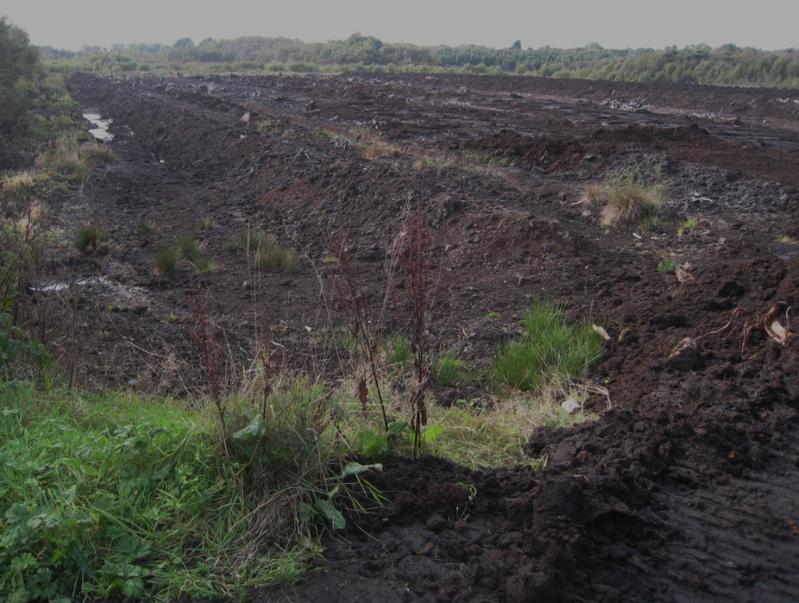
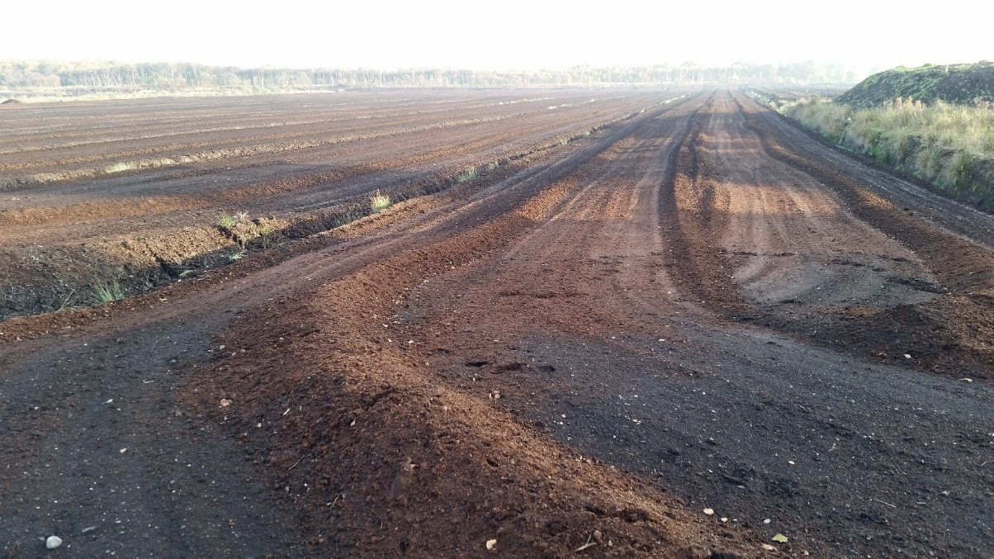
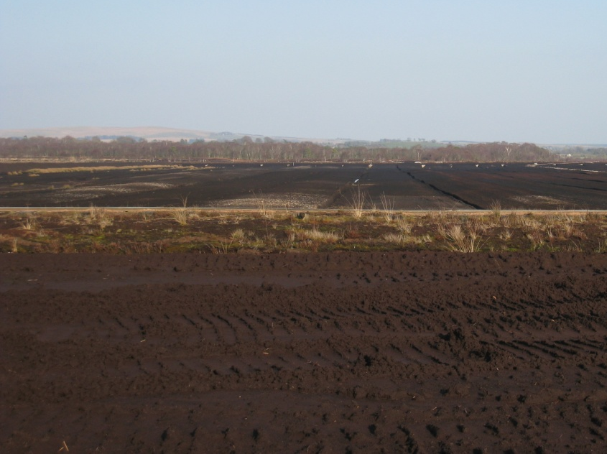
Damaged lowland bogs in the North West
…cut for Horticulture
Lindow Moss
Manchester Mosslands
Bolton Fell Moss

Slide 5
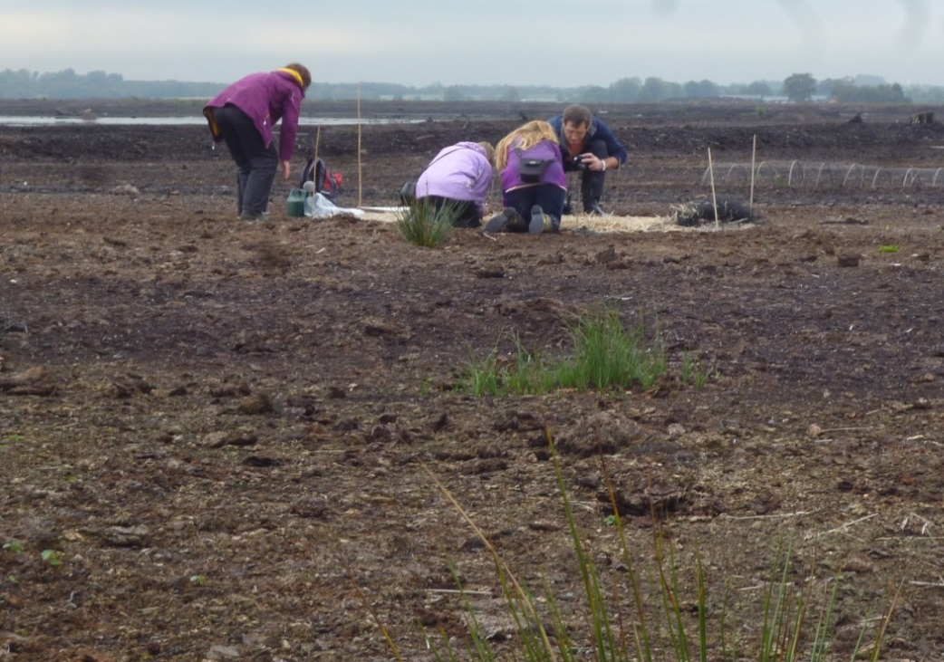
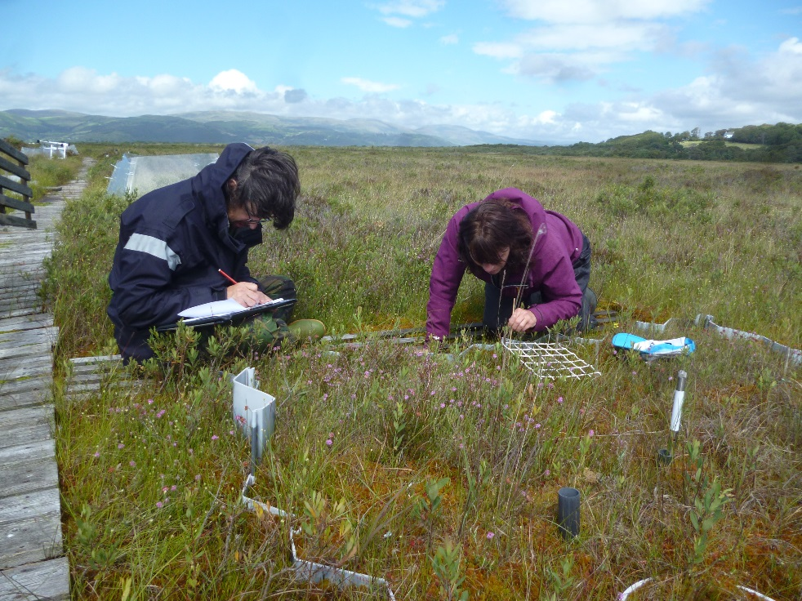
Restoration of damaged peatlands
Can we go from this ………
…. to this…?

