Slide 1
Interreg Care-Peat
Restoring the carbon storage capacity of peatlands
Katrien Wijns
Project coordinator
Natuurpunt

Slide 2
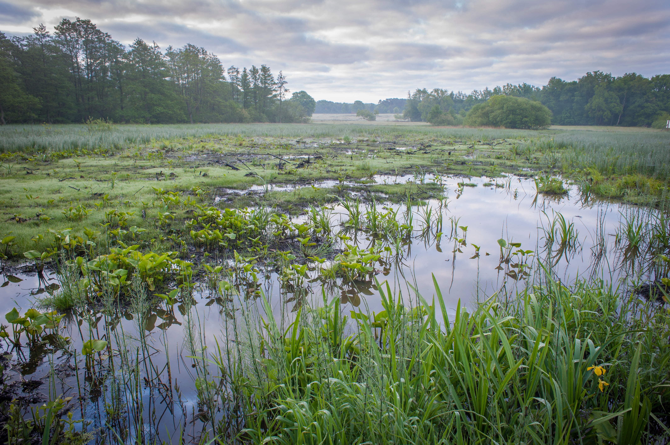
Interreg Care-Peat
What(‘s in a name)?
A project about taking care of peatlands and carbon reduction
Why?
Peatlands play an important role in global climate regulation. Nowadays they emit more carbon than they store.
Where?
North-West European region
When?
January 2019 to July 2022
Budget?
6,235,433.46 euro

Slide 3
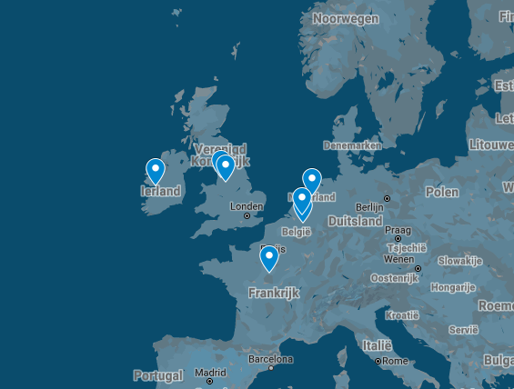
Together with nine partners
In Belgium, The Netherlands, France, Ireland and United Kingdom

Slide 4
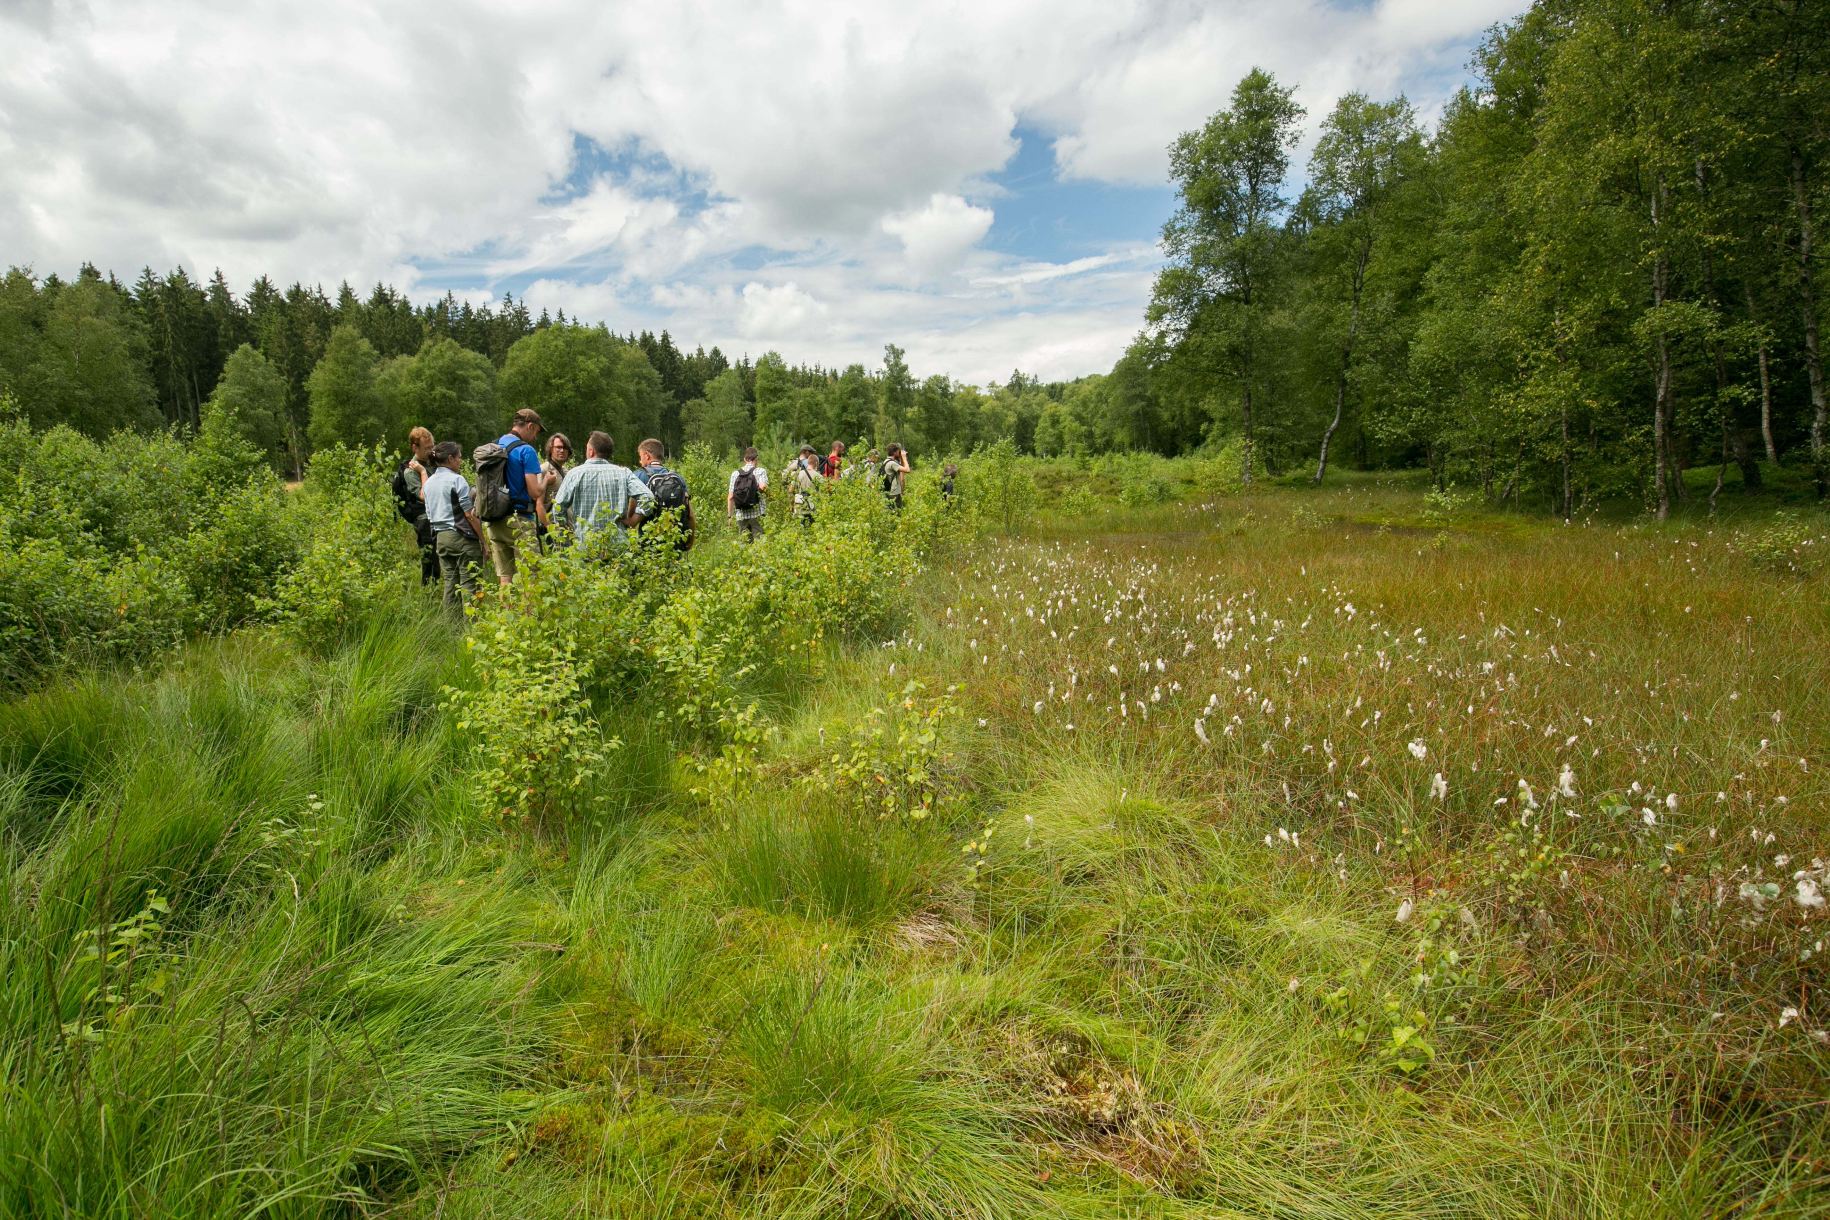
Together with nine partners
Nature organisations
  Natuurpunt (BE)
  Lancashire Wildlife Trust (UK)
  Natuurmonumenten (NL)
Knowledge institutes
  National center of scientific research (FR)
  Geologic and mines research center (FR)
  Manchester Metropolitan University (UK)
  National University of Ireland Galway (IE)
  University of Orleans (FR)
Eurosite (NL)
Also working with sub partners (7) and associated partners (35) as innovative companies, governmental institutes and private landowners.

Slide 5
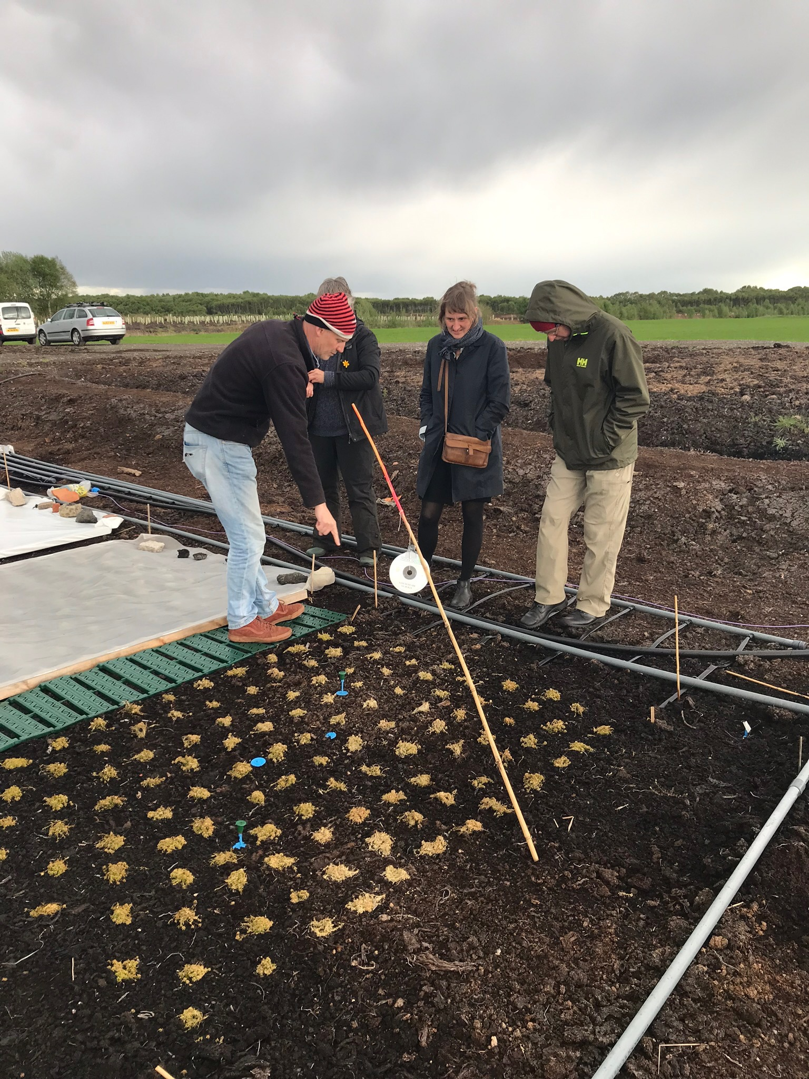
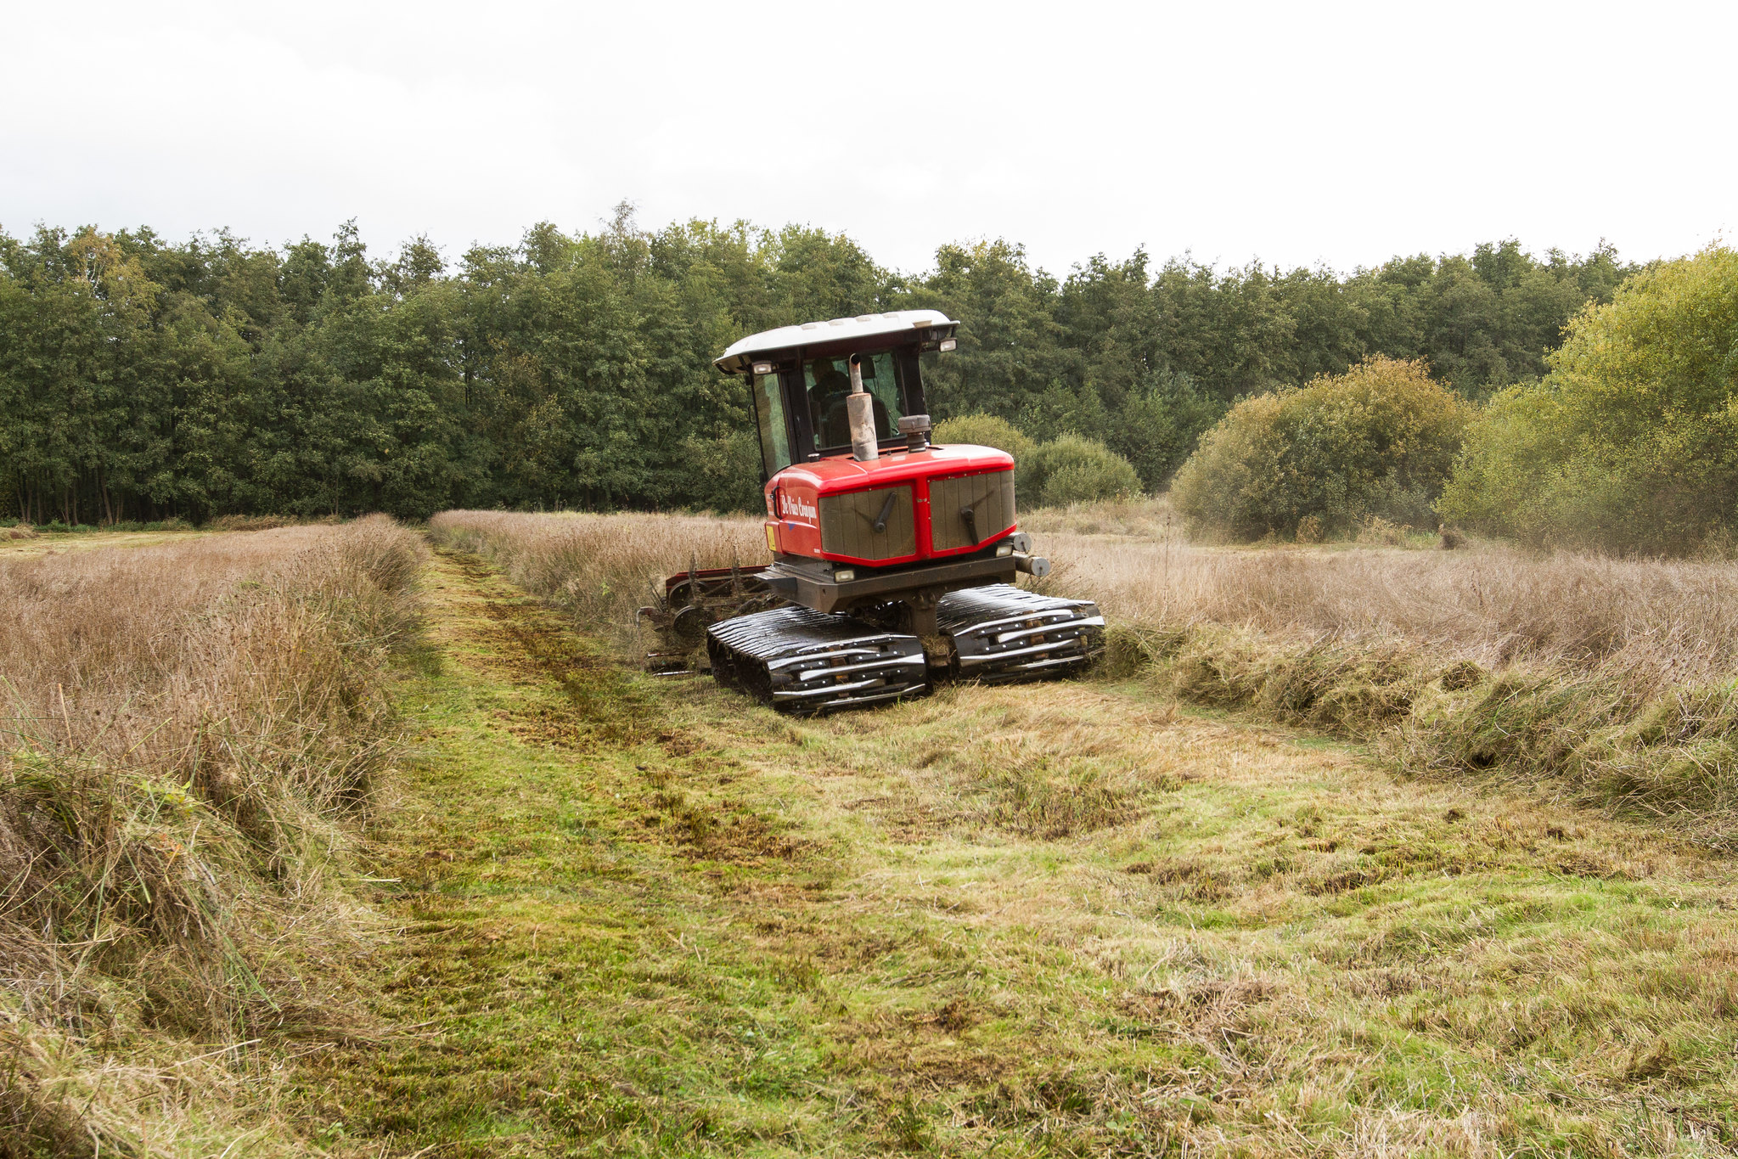
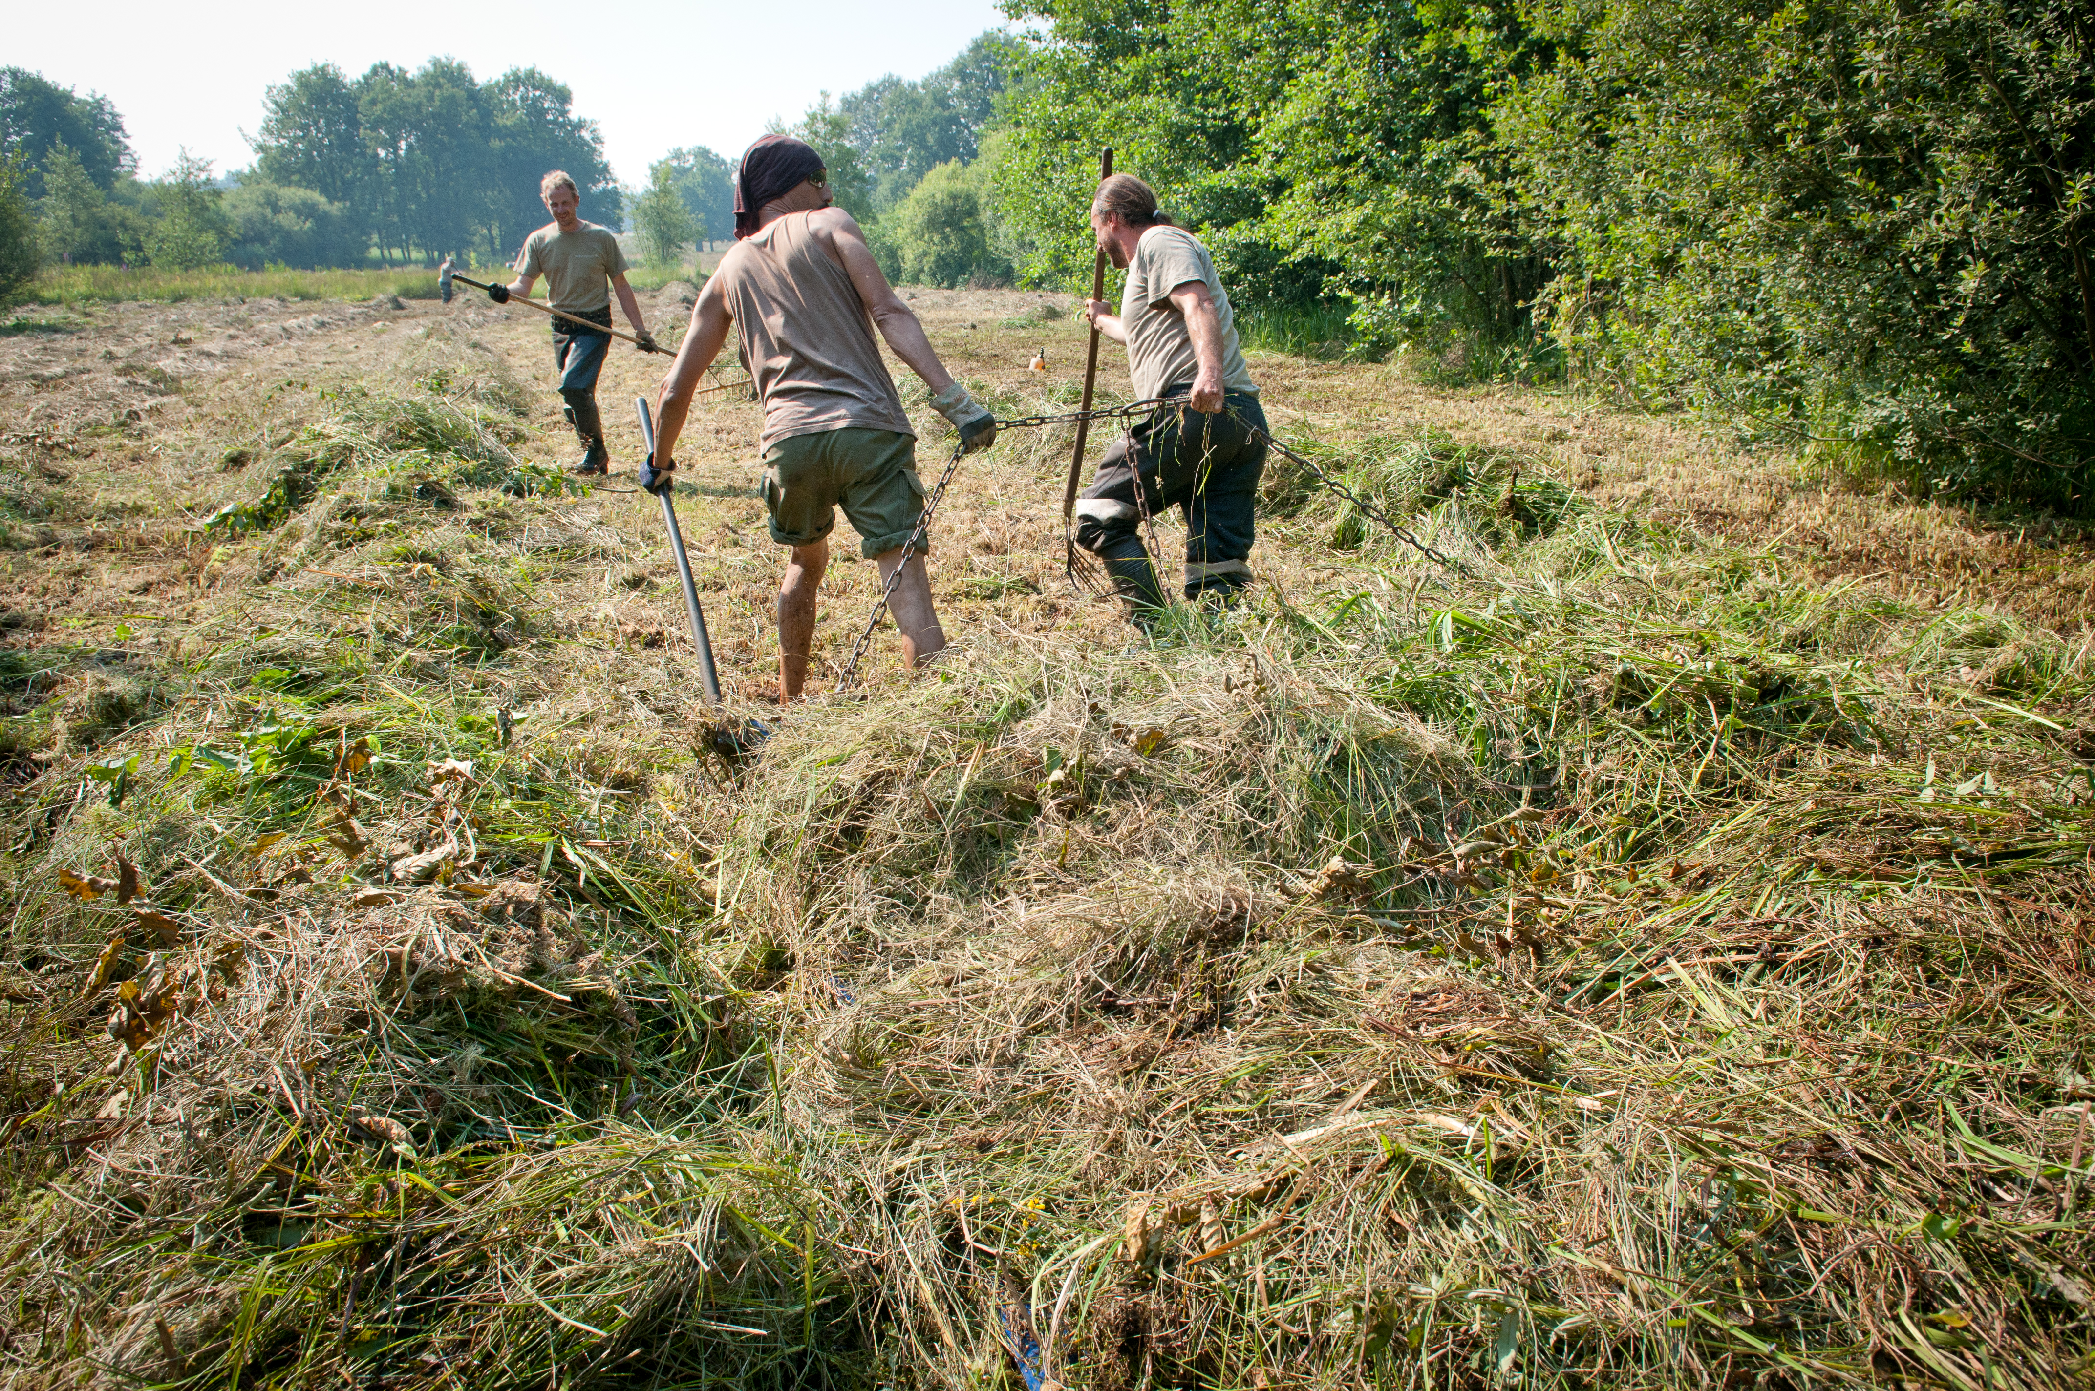
What does Care-Peat do
  Develop, test and demonstrate new restoration and carbon measurement techniques
    5 pilot sites (in 5 countries)
    Different restoration techniques from manual labour to growing additional peat moss
    Determine the most effective restoration measures to maximize the carbon storage potential of different peatland ecosystems

Slide 6
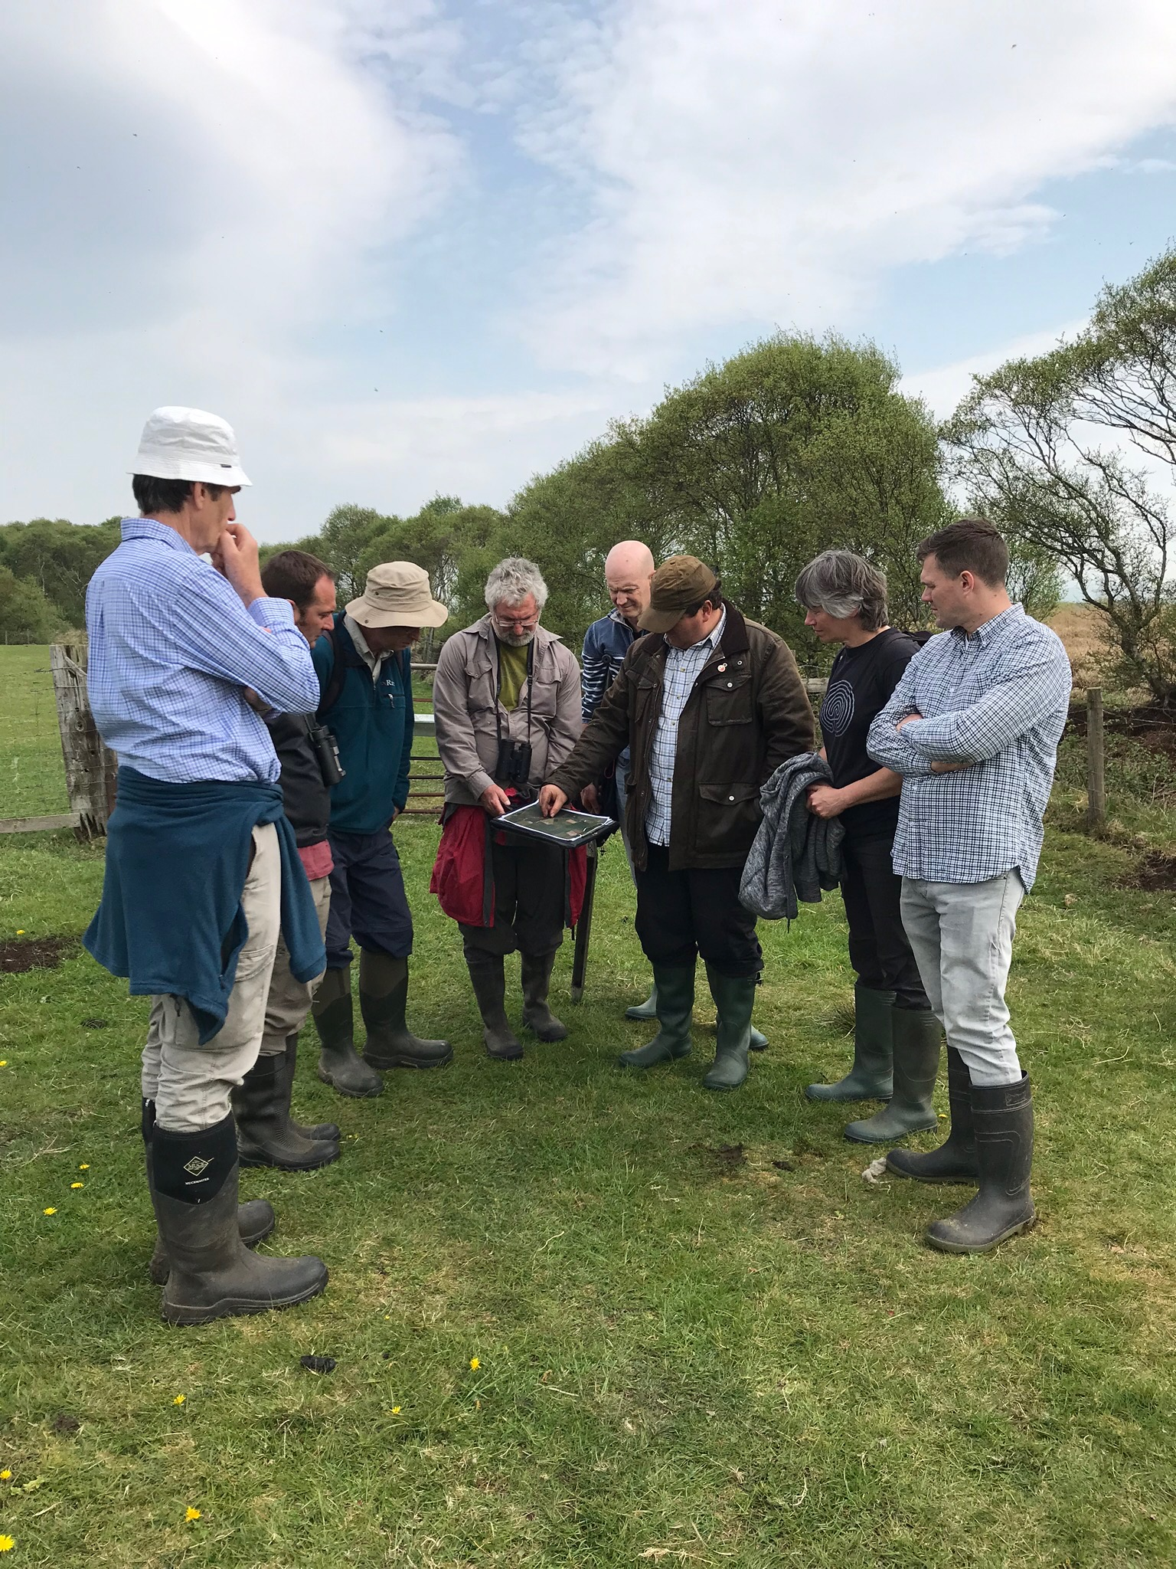
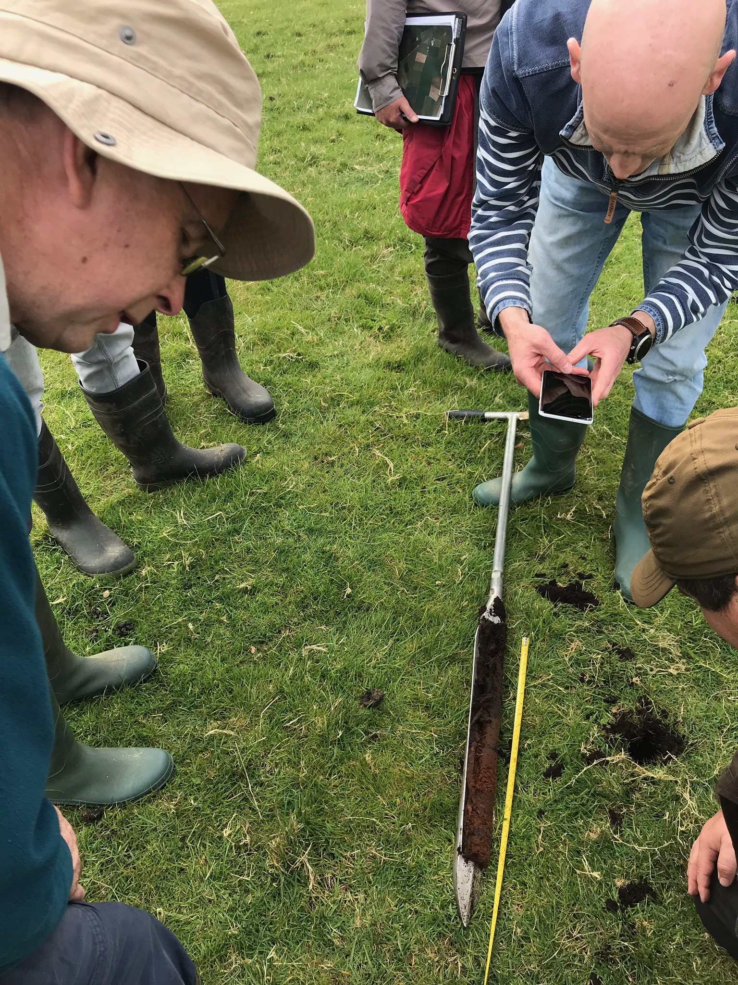
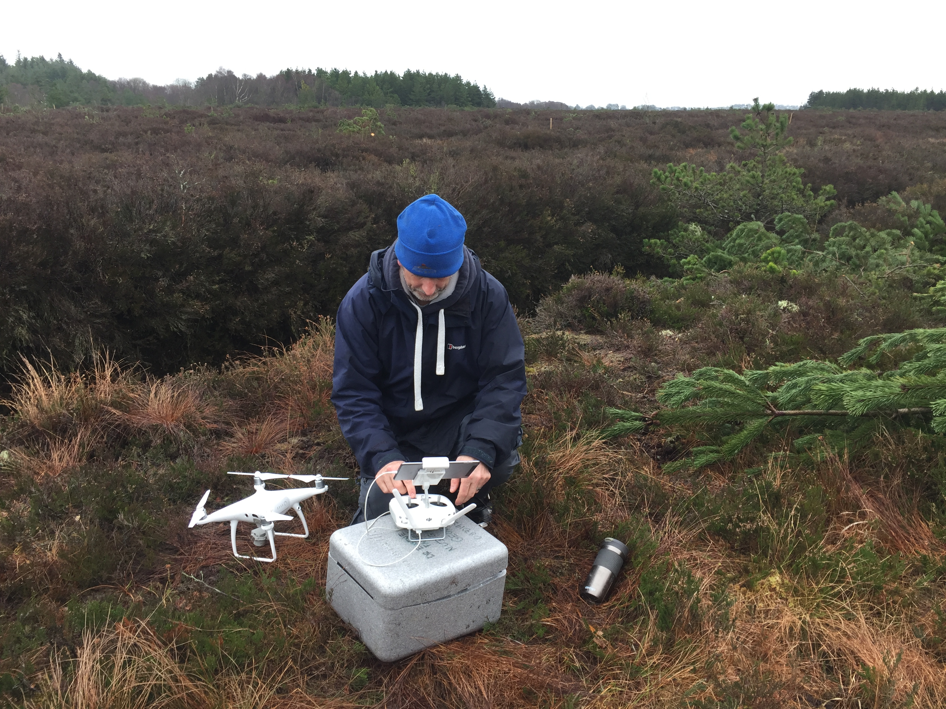
What does Care-Peat do
Knowledge institutes (4) work together and develop an integrated measurement method of carbon fluxes by using ground, drone and satellite measurements
Involve local and regional stakeholders
    Maximise socio-economic benefits
    The publication of management and decision tools concerning the best options for peatland restoration in regard to carbon storage
    Results are replicable and transferable

Slide 7
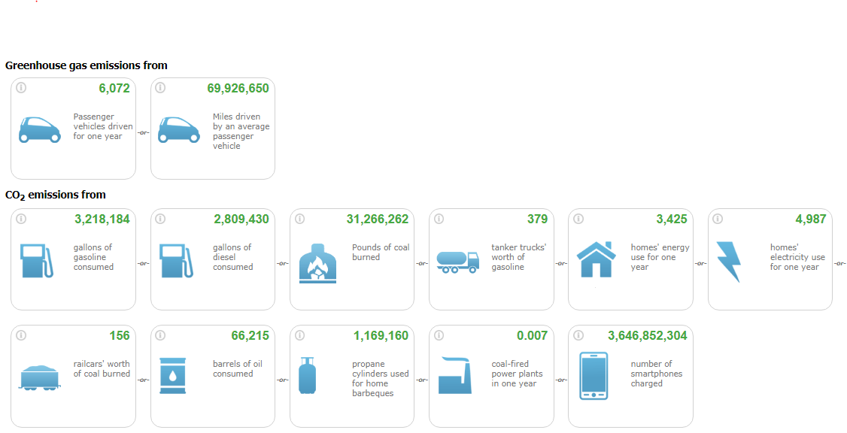
How much carbon can be saved?
By the end of the project we expect to save about 7,800 ton carbon emission per year.

Slide 8
www.nweurope.eu/care-peat
Sign up for our newsletter
Contact project coordinator Katrien Wijns

