Slide 1
Subtitel

Slide 2

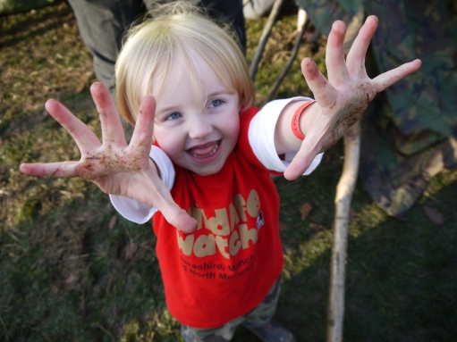
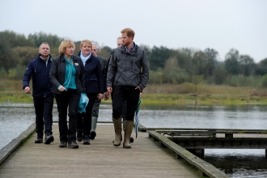
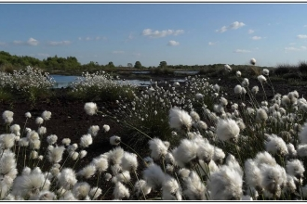
Lancashire Wildlife Trust - key facts
The Wildlife Trusts as a whole are the UK’s leading wildlife charity - LWT covers Lancashire, Manchester and North Merseyside.
We currently have around 180 staff, 4,000 volunteers, 28,000 members and manage 50 nature reserves and wildlife sites across nearly 1300 hectares.
^{Our aims are:}
To protect, create and enhance wildlife, creating living landscapes and seas
To stand up for wildlife and the environment
To inspire people about the natural world and encourage them to take action for wildlife
To foster sustainable One Planet living – where the functioning of the natural environment is appreciated as essential for supporting life
To ensure our work is based on knowledge and sound evidence
To be recognised and respected for our work
To grow our resources and increase support for our mission
TRACK RECORD OF RESTORING PEAT HABITATS (MOSSLANDS) FOR OVER 20 YEARS

Slide 3
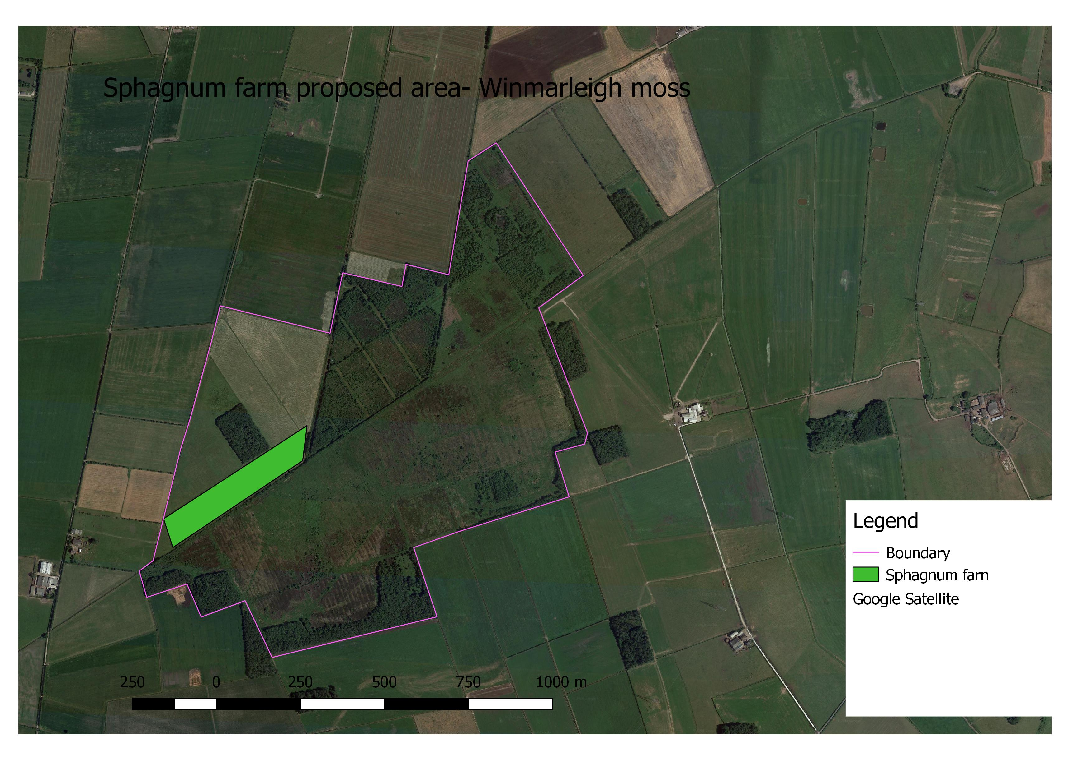
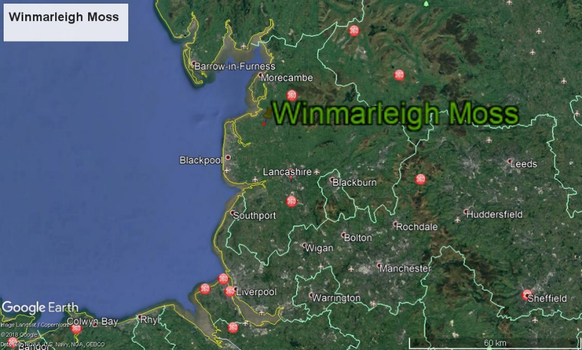
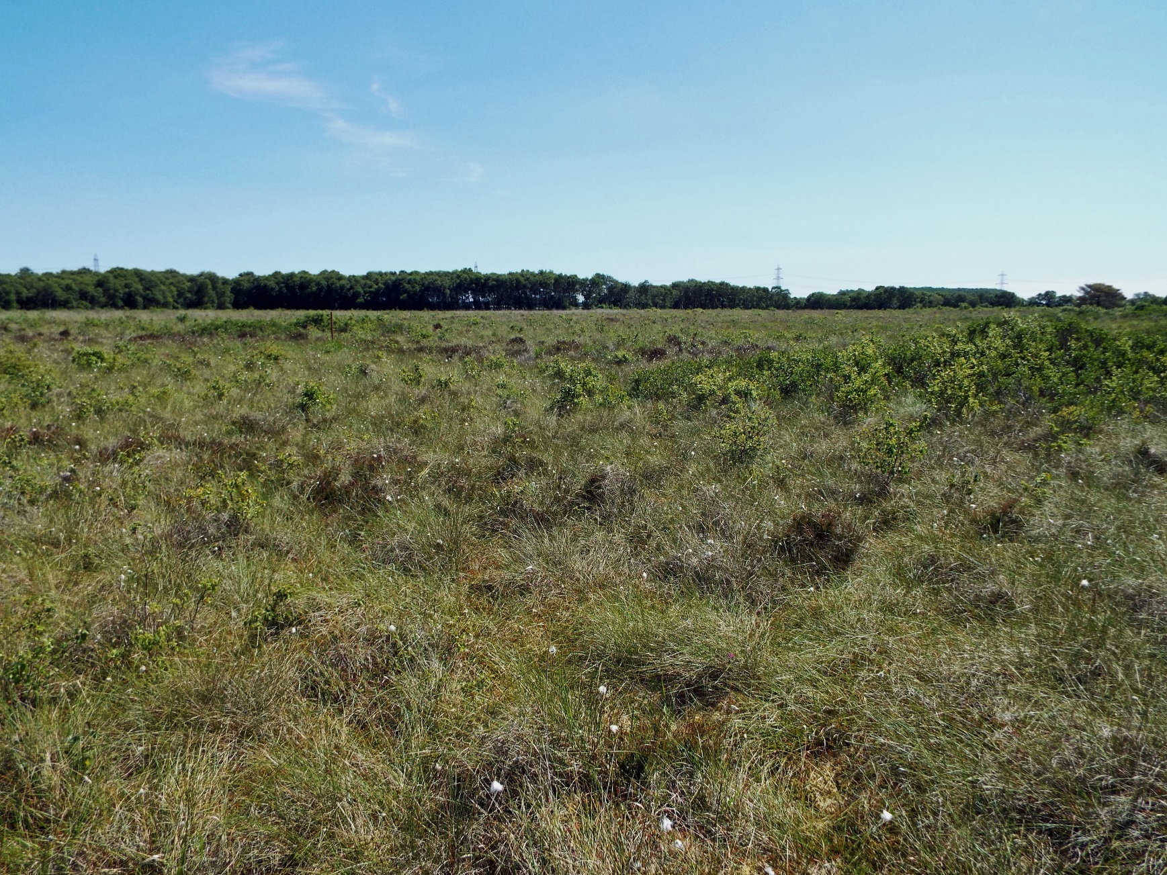
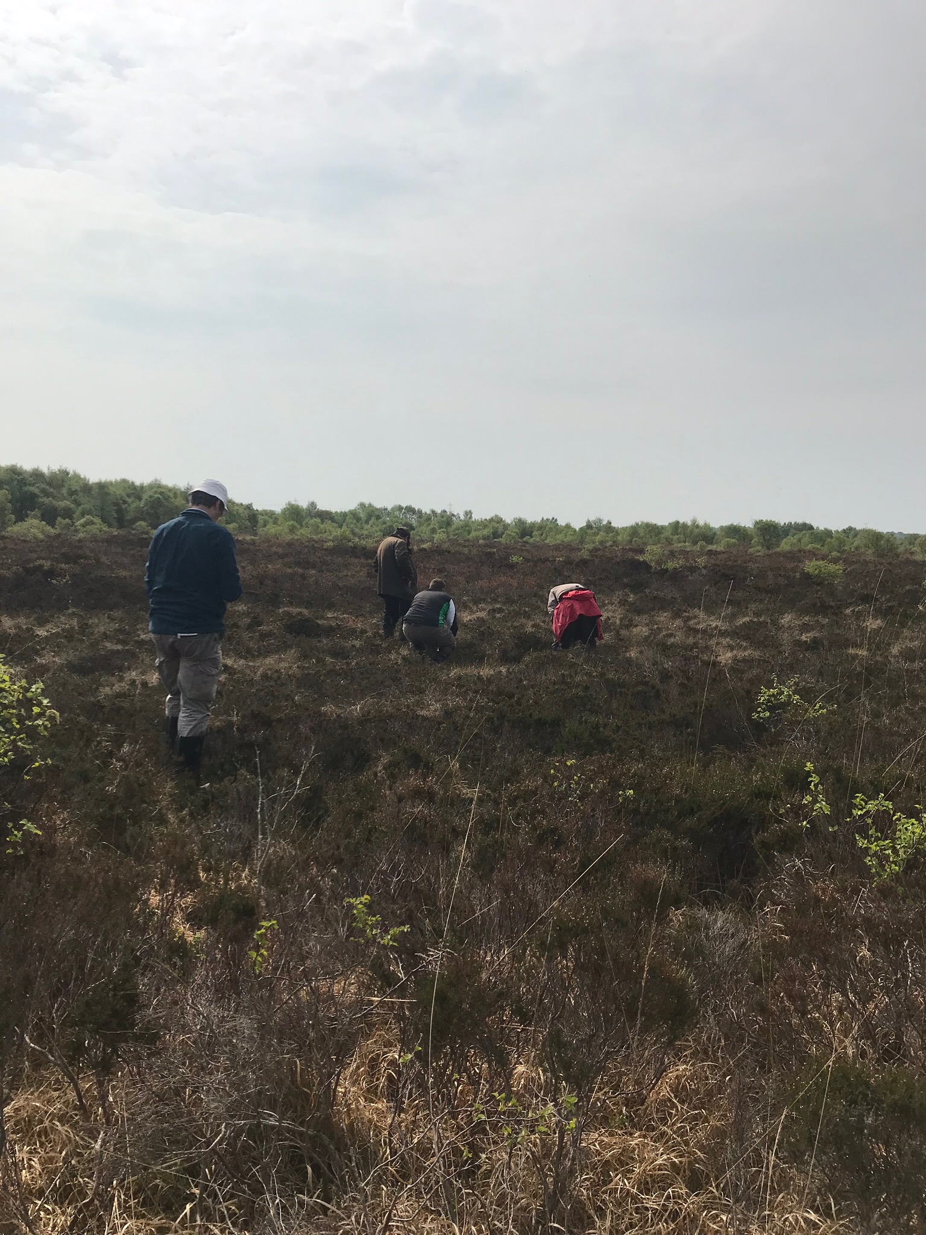
Our Pilots – Winmarleigh Sphagnum Farm

Slide 4
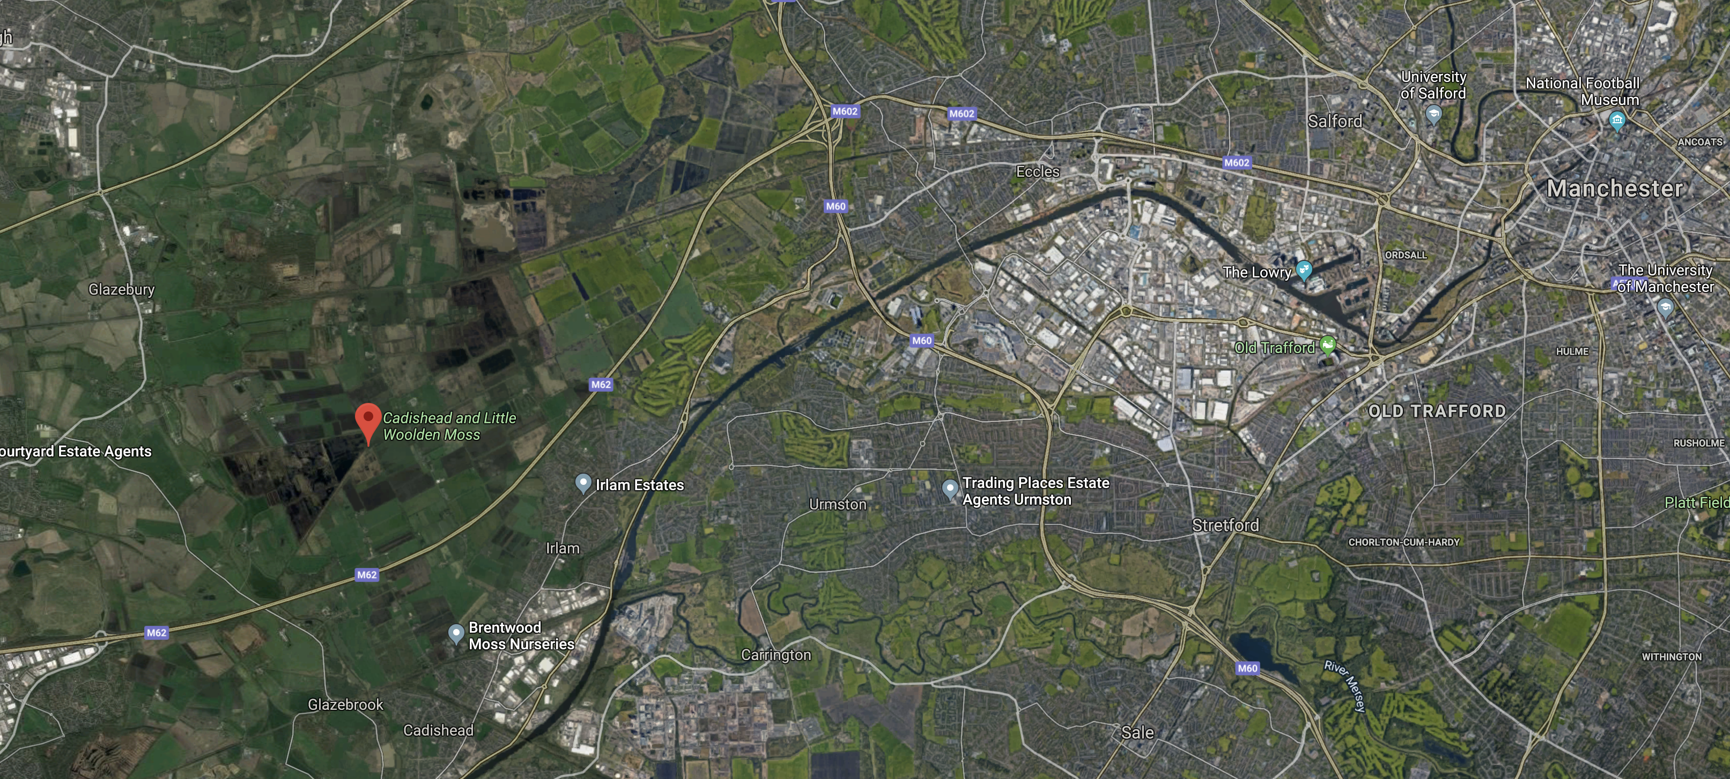
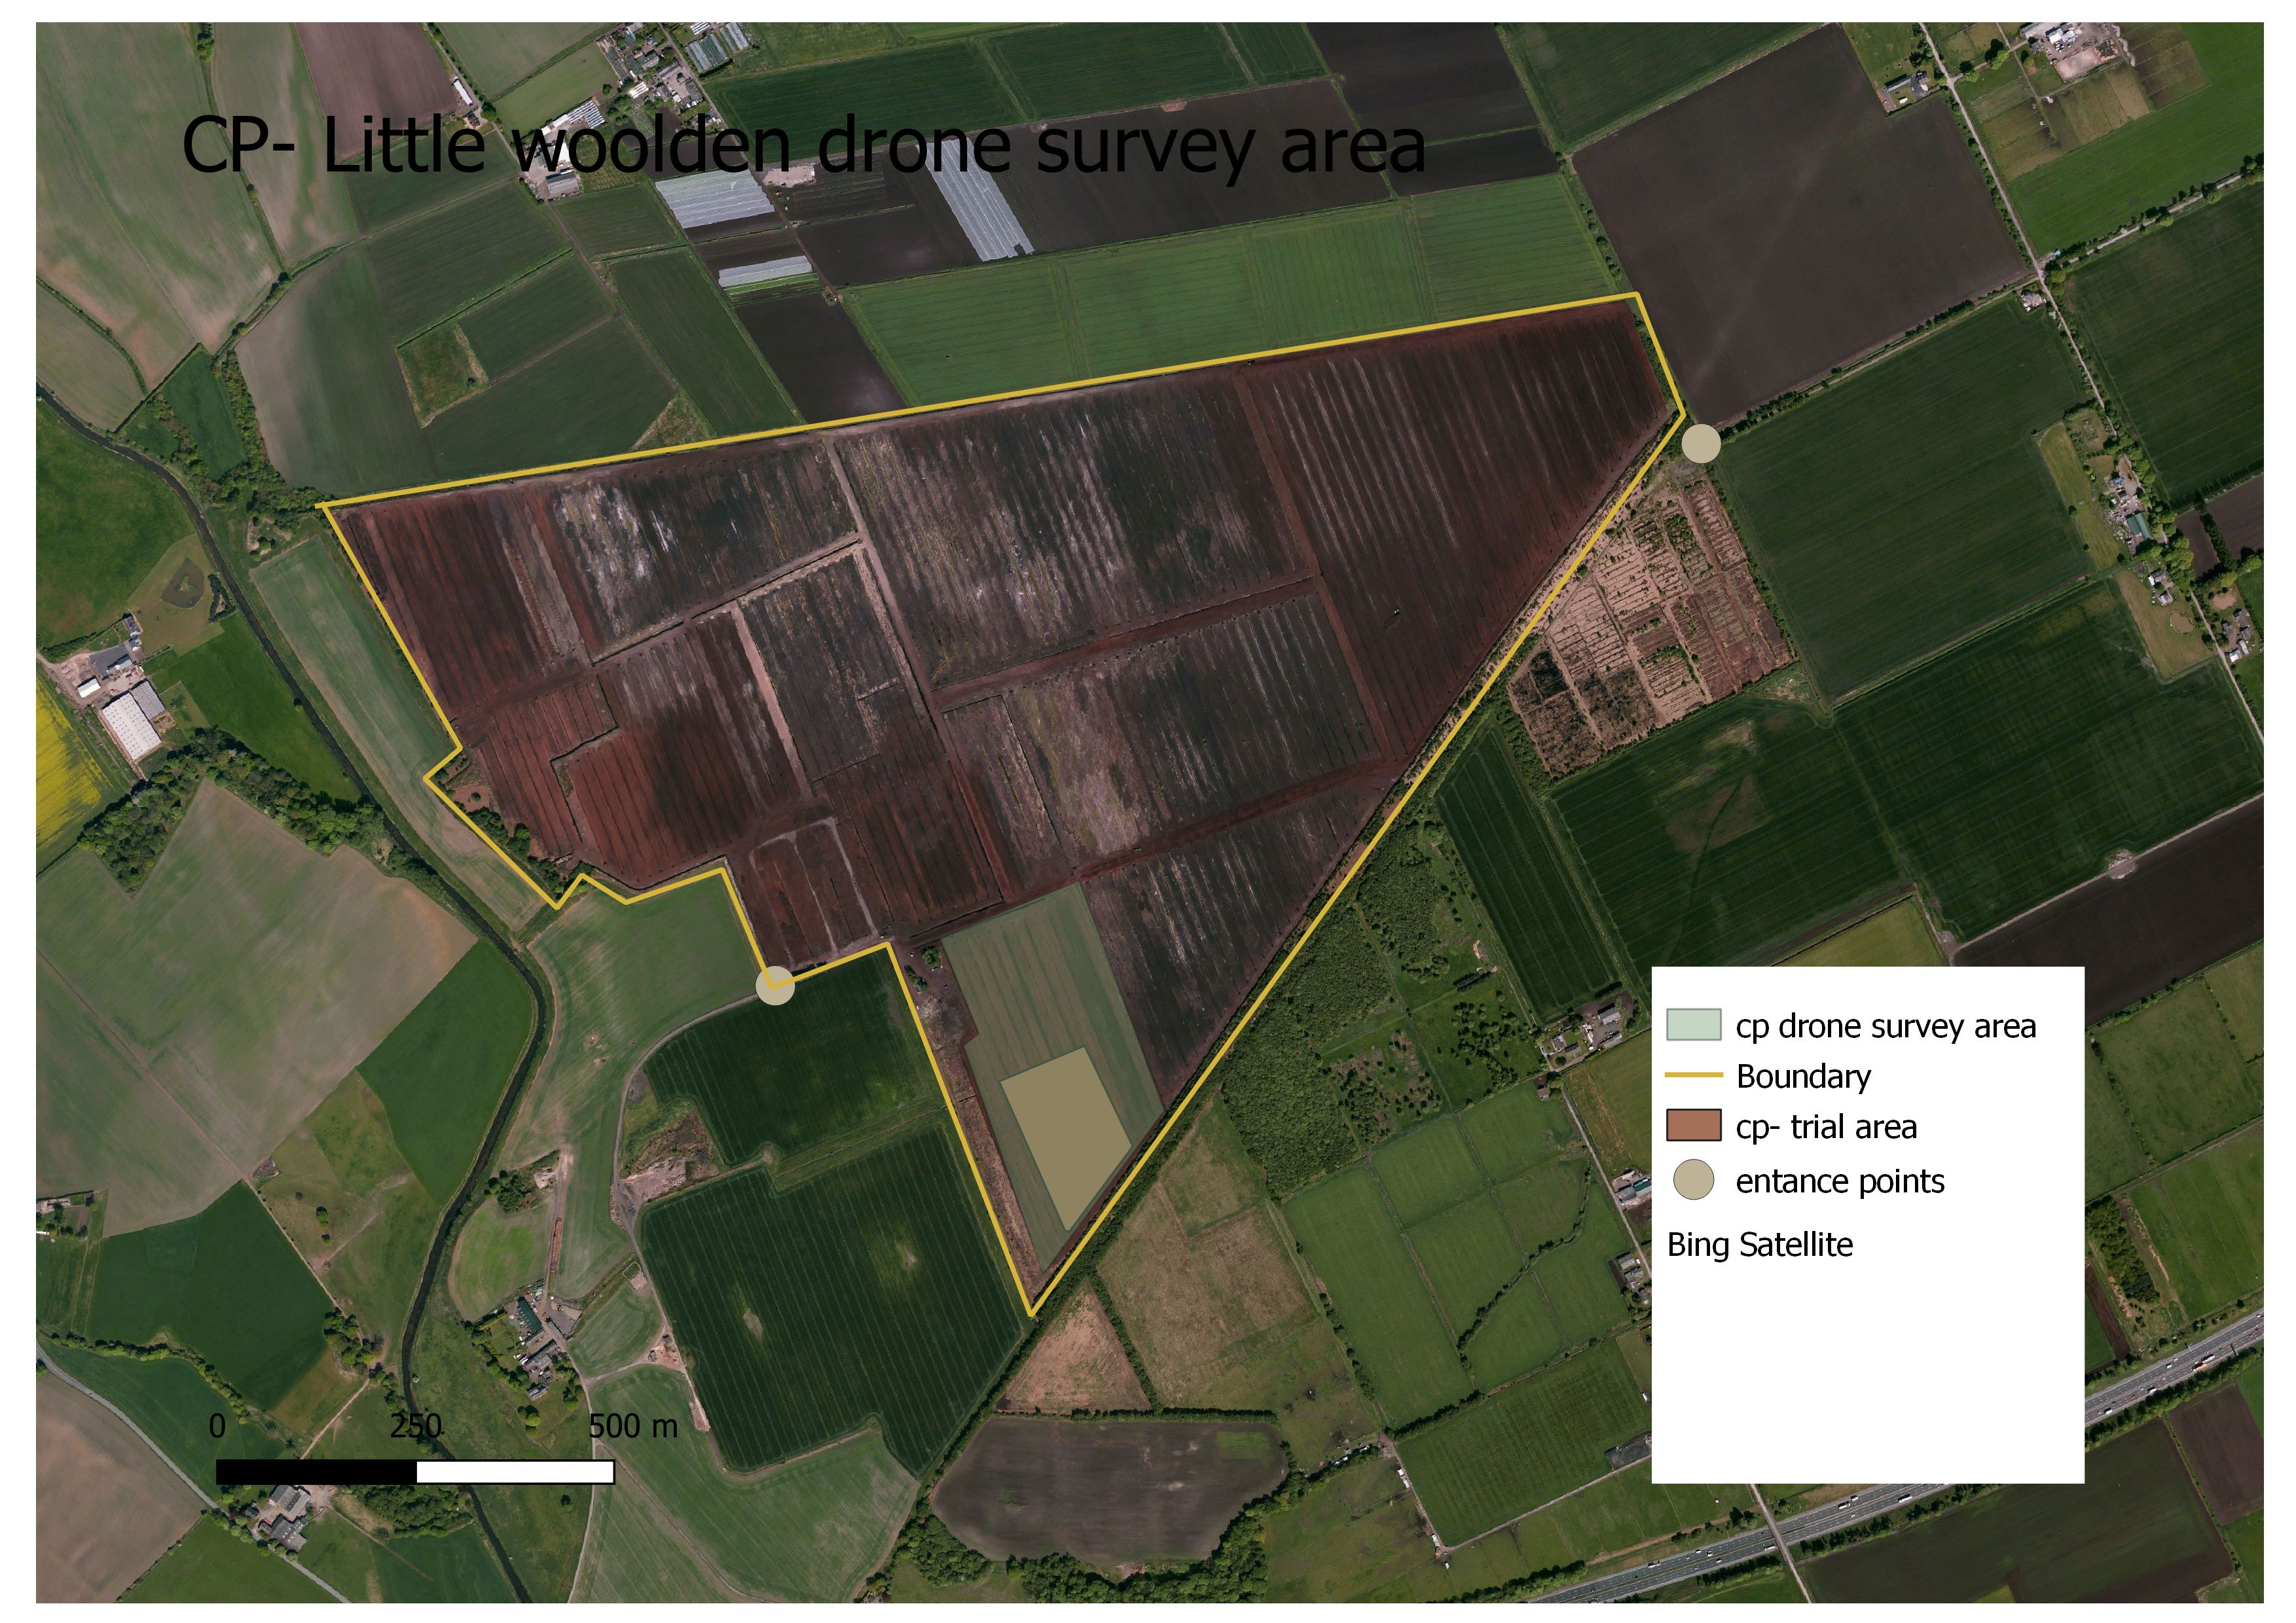
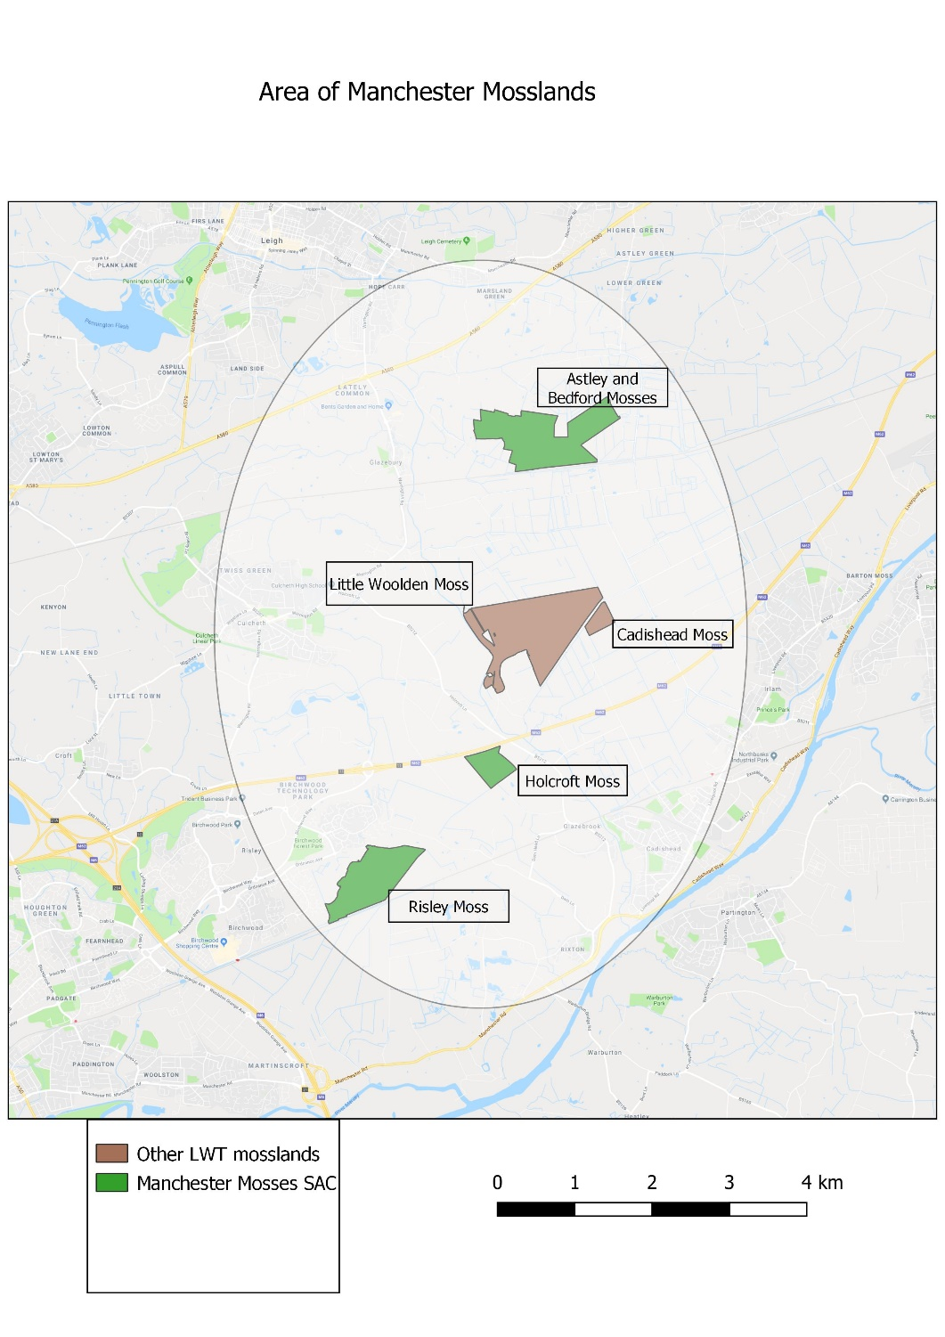
Our Pilots – Little Woolden Moss Companion Species Planting

Slide 5
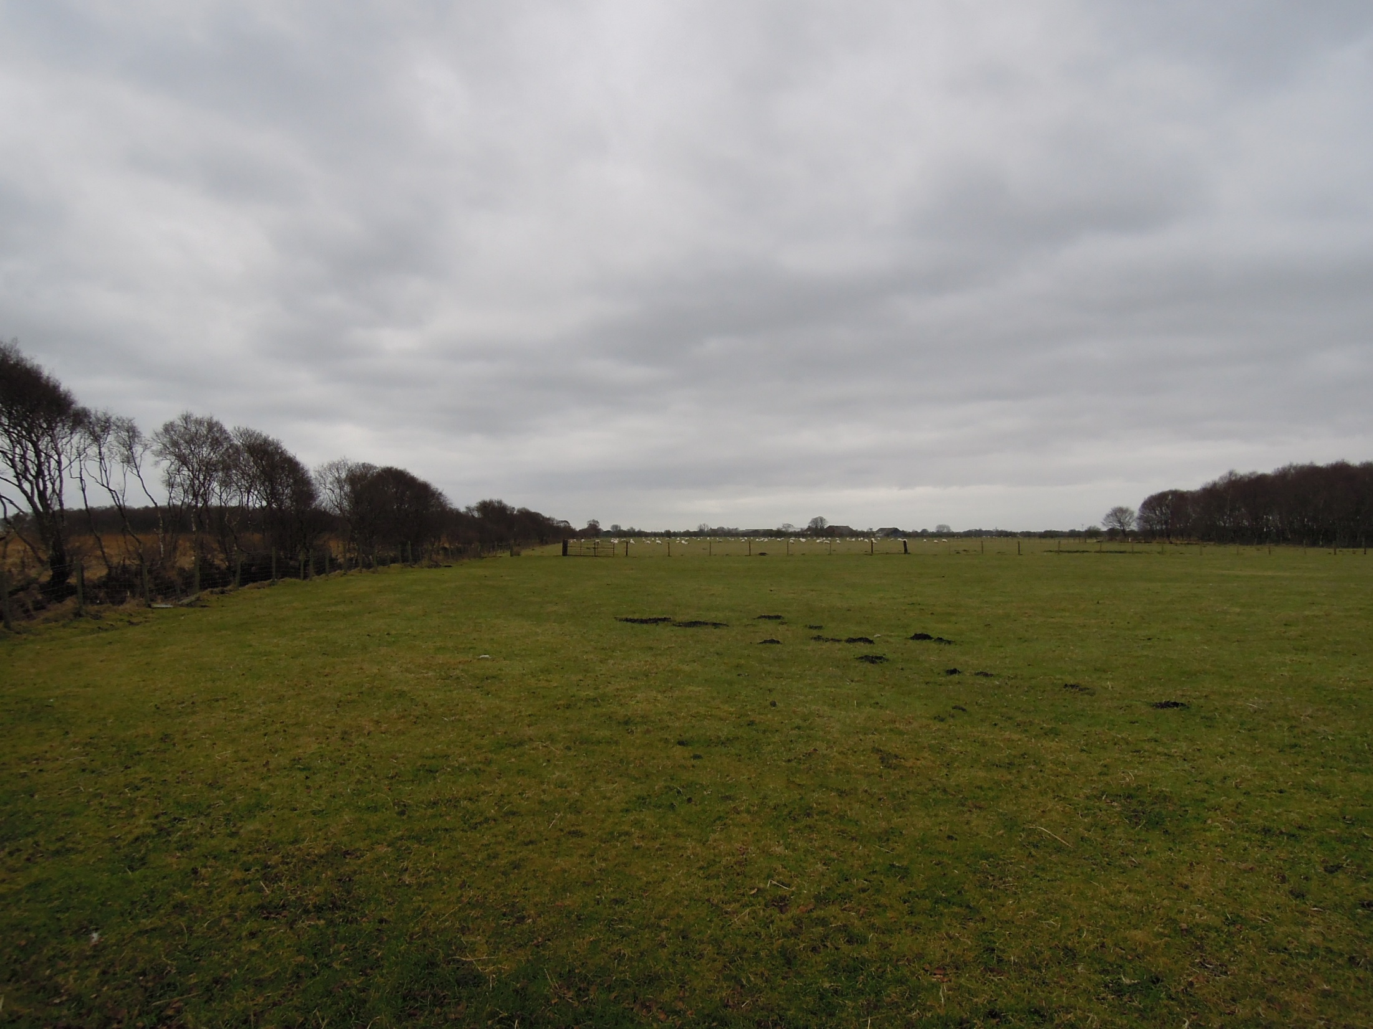
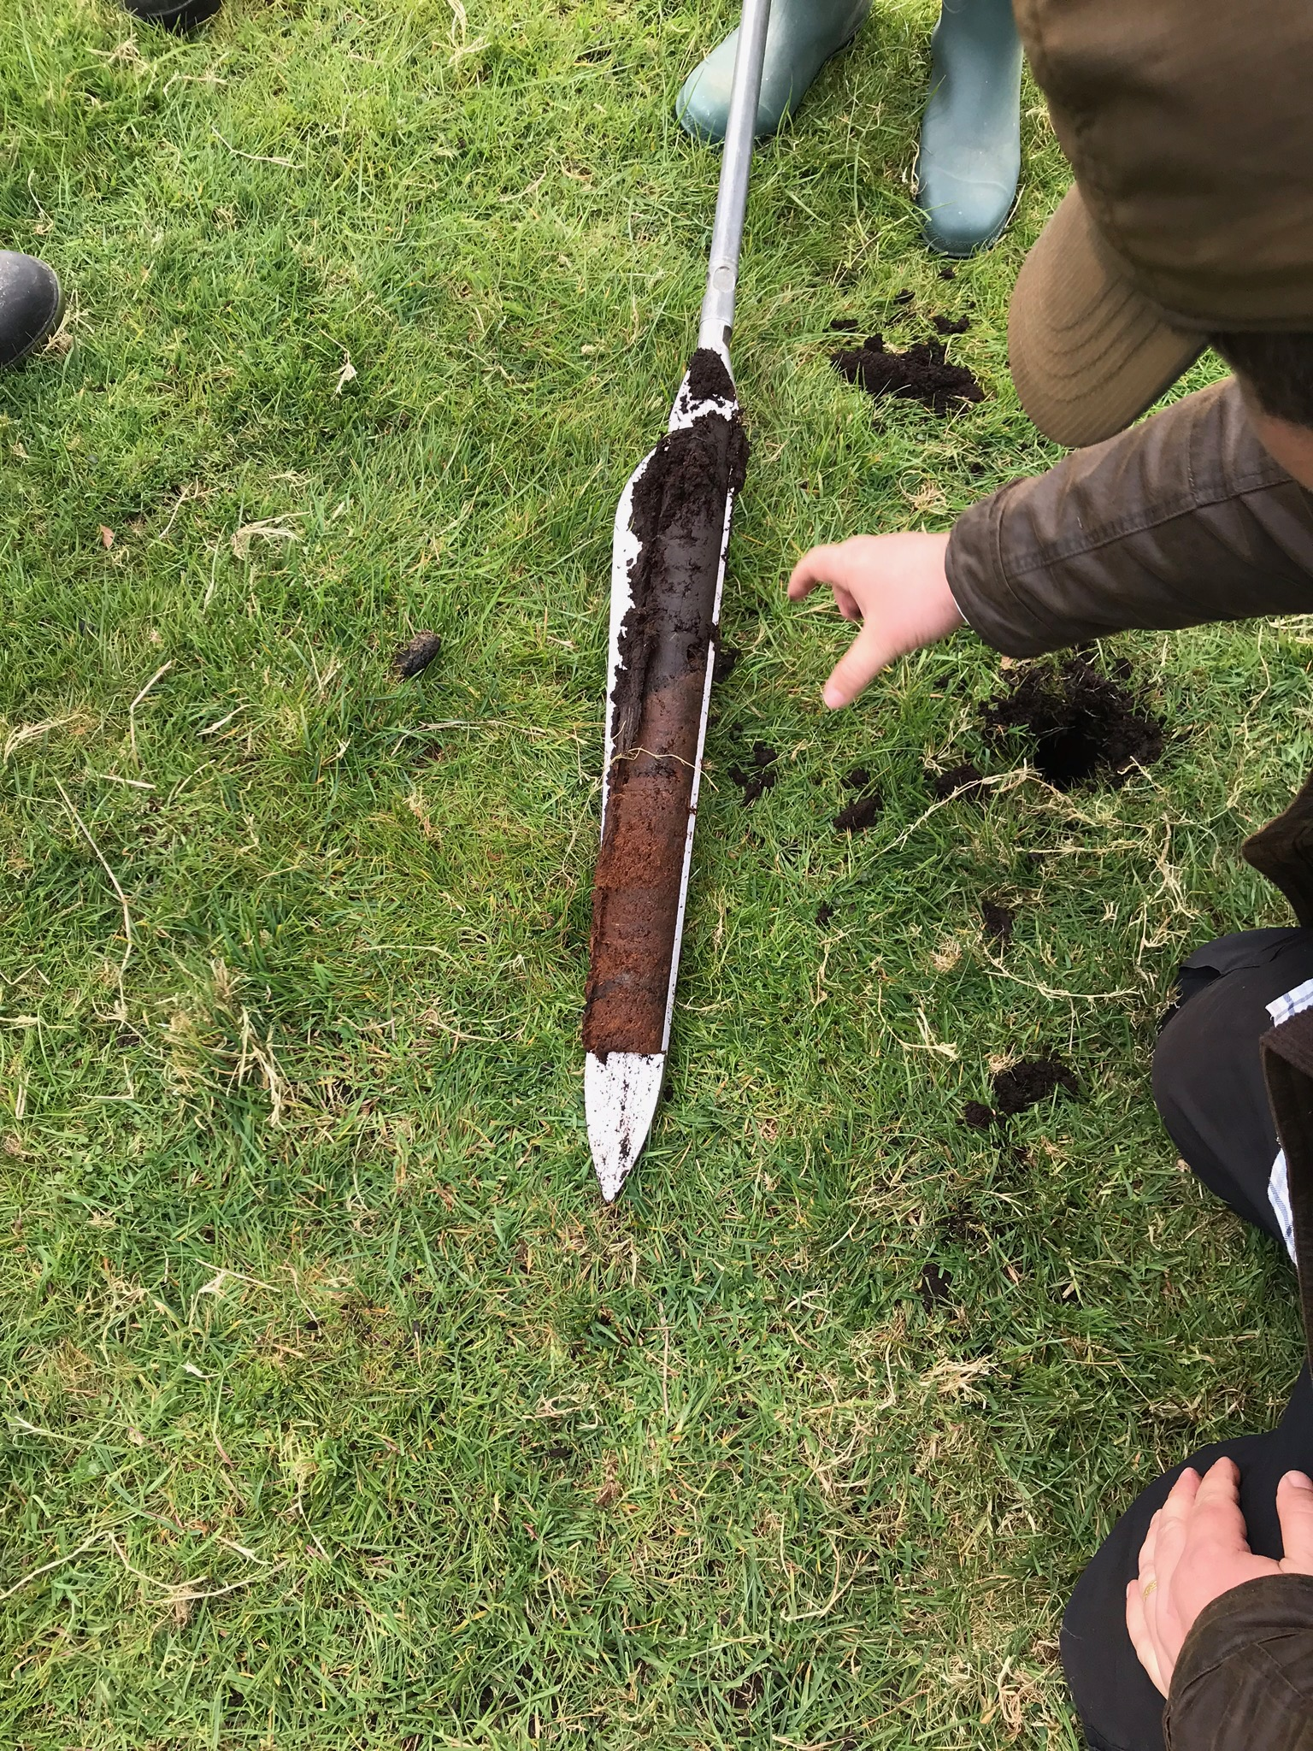
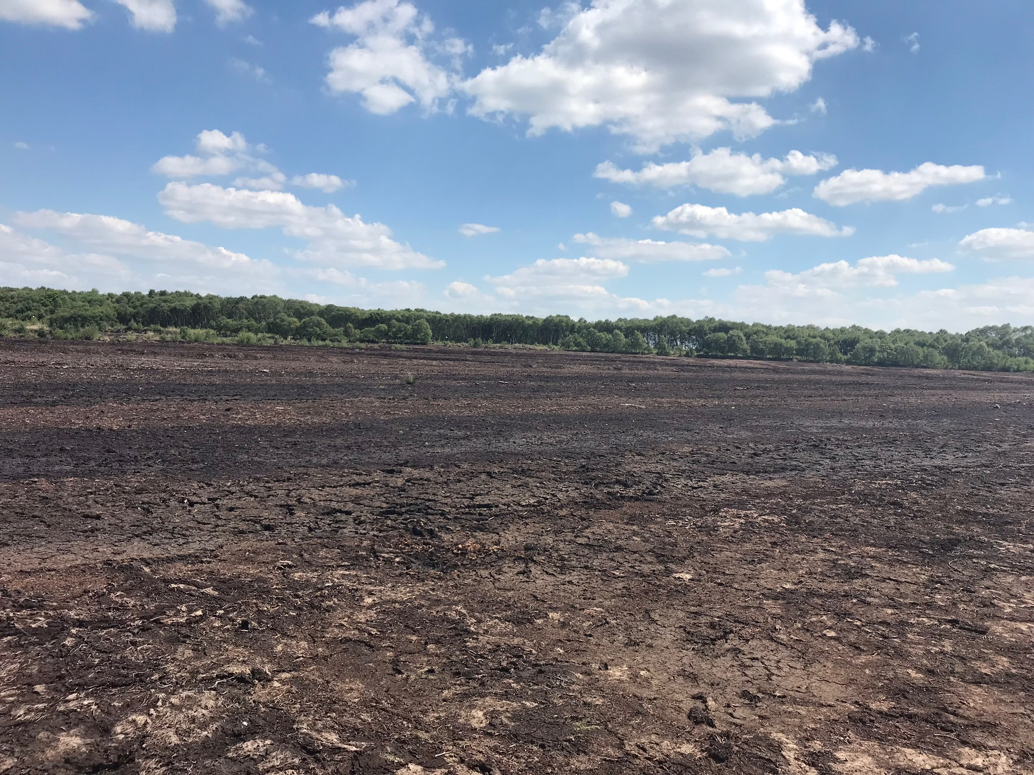
Site information
Winmarleigh Moss: 4 ha trial site adjacent to the main restoration site (89ha) – currently grazed farmland on drained lowland peat – site has had fertilizer applied to it and has been drained.
Little Woolden Moss: former peat extraction site undergoing restoration to lowland raised bog habitat, in total 107ha. Trial site of 2 ha is unrestored bare peat.

Slide 6
Restoration methods
Winmarleigh
Re-wet farmland by ditch-blocking and bund creation
Create water storage areas and irrigation means
Plant appropriate sphagnum moss species to create a “carbon farm” on farmland next to restoration site
Positive impact on restoration site
Little Woolden Moss
Trial of species planting techniques – different ways to address re-vegetation of bare peat that benefit carbon
Taking various approaches to companion species planting
Building on MMU and LWT research and methods

Slide 7
Expected results
Winmarleigh
Demonstrate improvements to the restoration site through re-wetting of this buffer land – in terms of functionality as a lowland raised bog – water table depth, carbon impacts, biodiversity quality etc
Demonstrate carbon reduction from farmland re-wetting and intensive planting of sphagnum
Demonstrate economic viability of alternative land management techniques for peat-based soils as well as benefits to society.
Little Woolden Moss
Knowledge and information on best techniques for restoring bare peat sites through species planting in terms of carbon reduction.
Demonstration of viable transferable approaches.

Slide 8
