Slide 1
Increase of the C-storage capacity of lowland peatlands by creating peat pits (WP I5)
Wiebe Borren, Ph.D.
Hydrologist, Natuurmonumenten

Slide 2

Natuurmonumenten
Largest non-governmental nature conservation organization in the Netherlands
Managing 150,000 hectares, spread over 363 sites
700,000 members
700 employees and 10,000 volunteers
Our team in the Care-Peat project:
Local nature management team of De Wieden
Specialists from the central departments
Project management and communication team
Support from Care-Peat partners
Arnoud Popping
Bea Claessens
Broer Blaauwbroek
Gidion Kok
John Tukker
Paul Vertegaal
Renate Huybrechts
Saskia Lara
Wiebe Borren

Slide 3
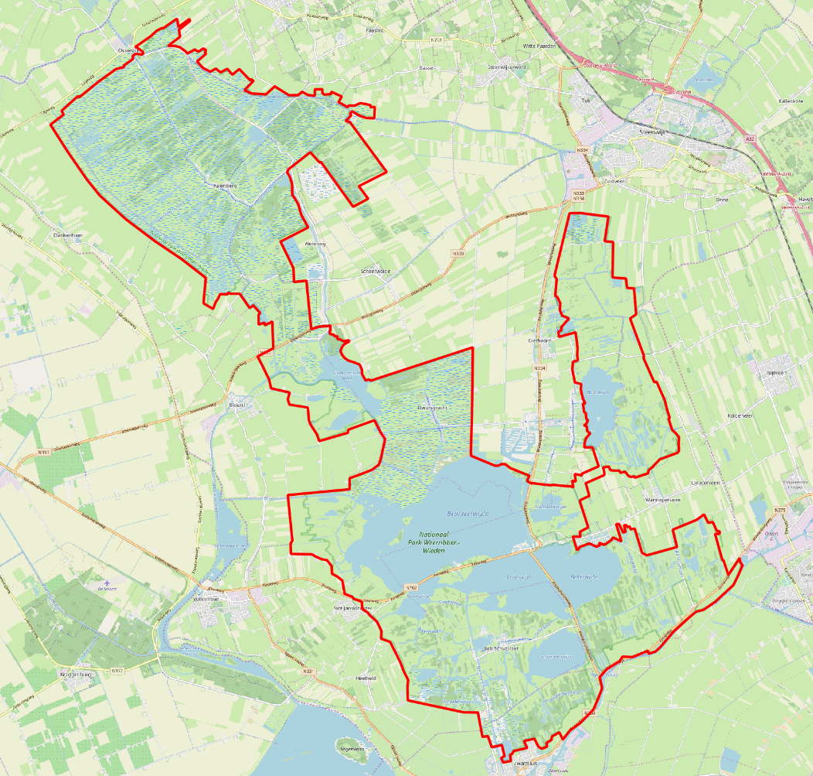
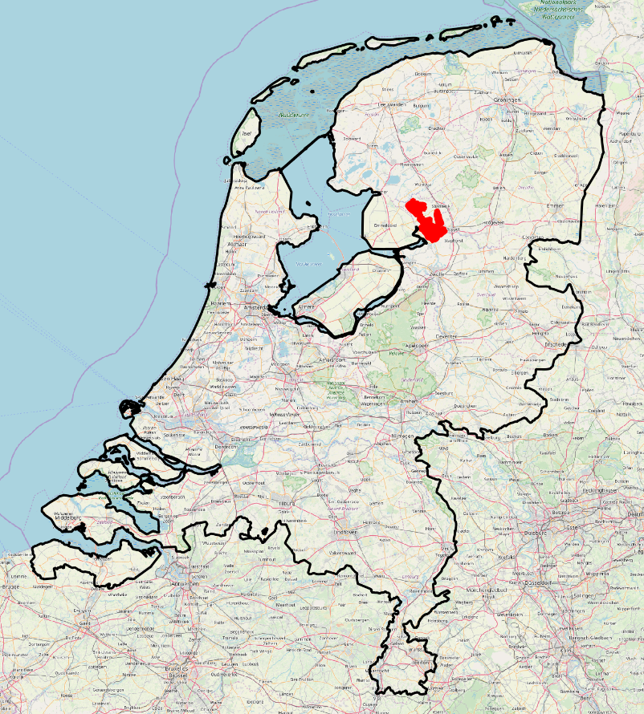
Pilot site “De Wieden”
Part of National Park “De Wieden & Weerribben” (9,000 hectares)
Natura 2000
Lowland peatland system
Care-Peat pilot site
Weerribben
De Wieden

Slide 4
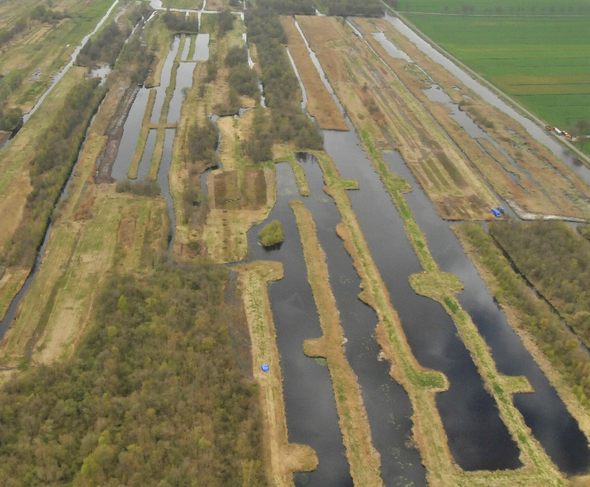
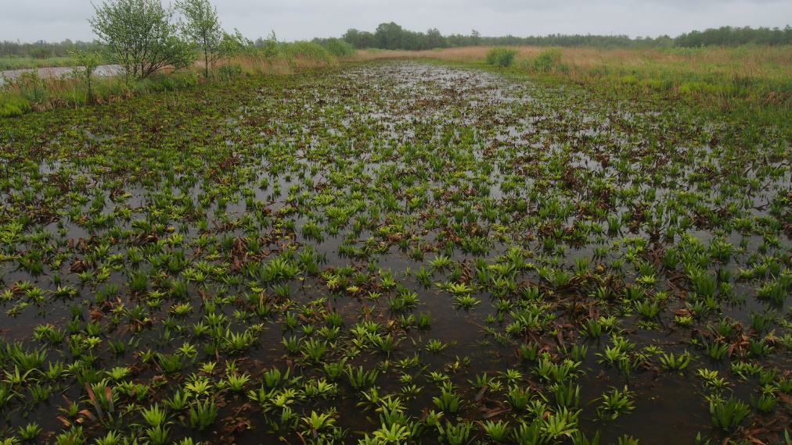
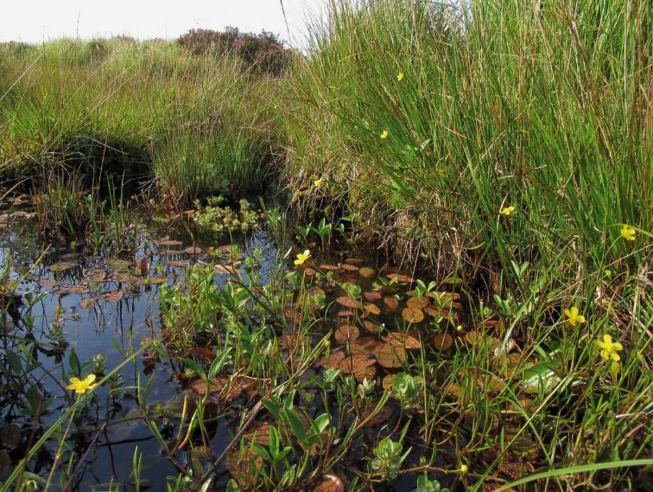
Situation
Peat pits, fens, lakes, reed lands, marshes, shrubs, forests
Quaking bogs
Transitional fens
Terrestrialising fens

Slide 5
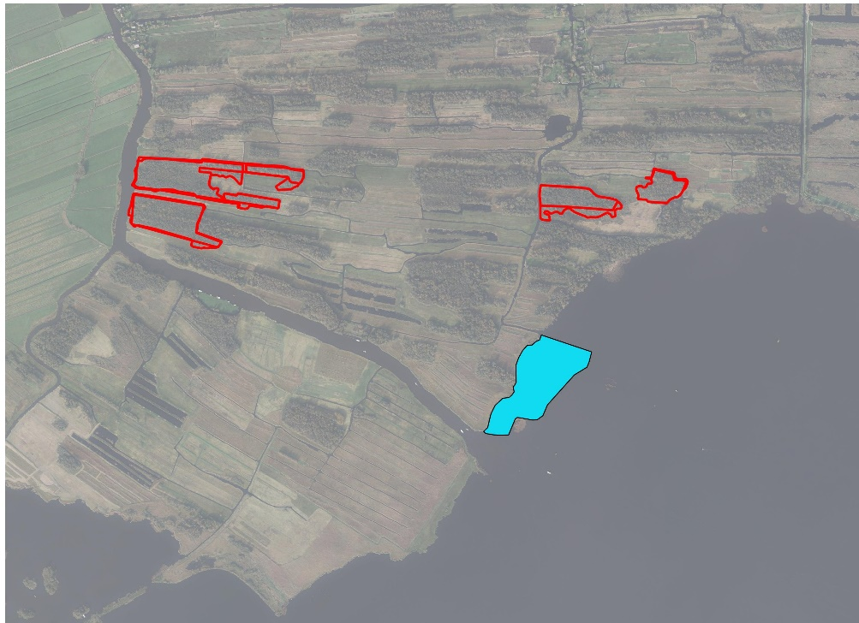
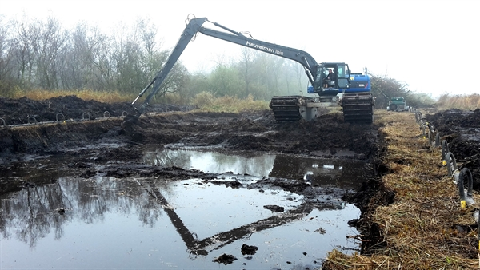
Restoration method
Present peatlands have a zero or negative C-balance (peat growth has stopped) and a suboptimal biodiversity
Creation of peat pits to re-start terrestrialisation
  50-80 cm of peat will be excavated
Anaerobic transport of peat material and creation of foreshores
– Peat will be stored just below the water surface
Peat pits
Foreshore

Slide 6
Expected results
On site:
CO₂ neutral transport and application of dredged peat material
Terrestrialisation in new peat pits → CO₂ sequestration
Vegetation development on new foreshores → accumulation of organic material and probably peat formation → CO₂ sequestration
Increased biodiversity
At project level:
Demonstration of innovative method to increase C-storage capacity in lowland peatlands
Applicability to other sites in Europe

