Slide 1









NUI Galway Pilot and Irish Partners

Slide 2
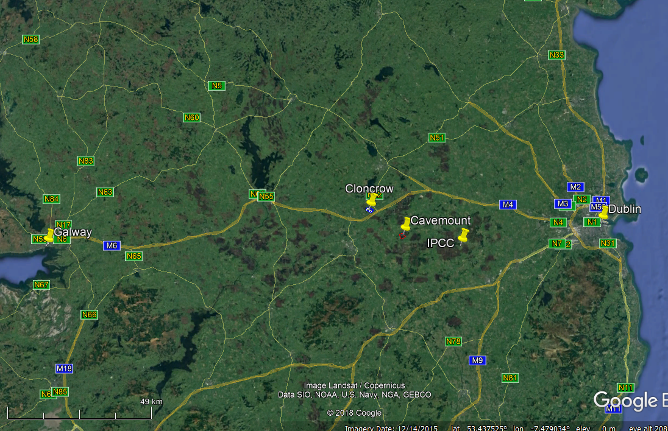
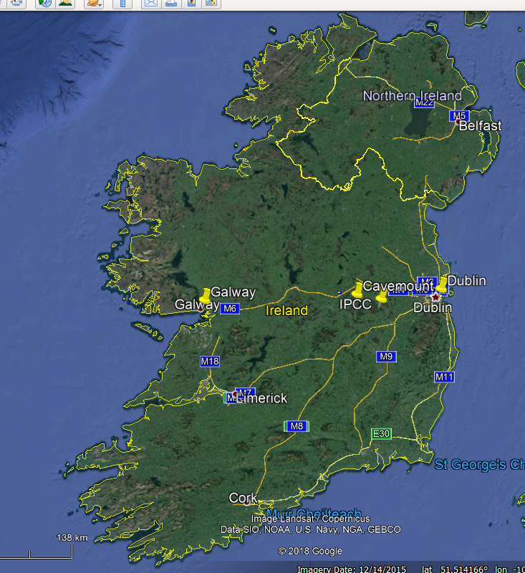
Pilot Location: Cloncrow
Bord na Mona site (Cavemount).
Dublin airport to Cloncrow ~1hr by car
Koptekst

Slide 3
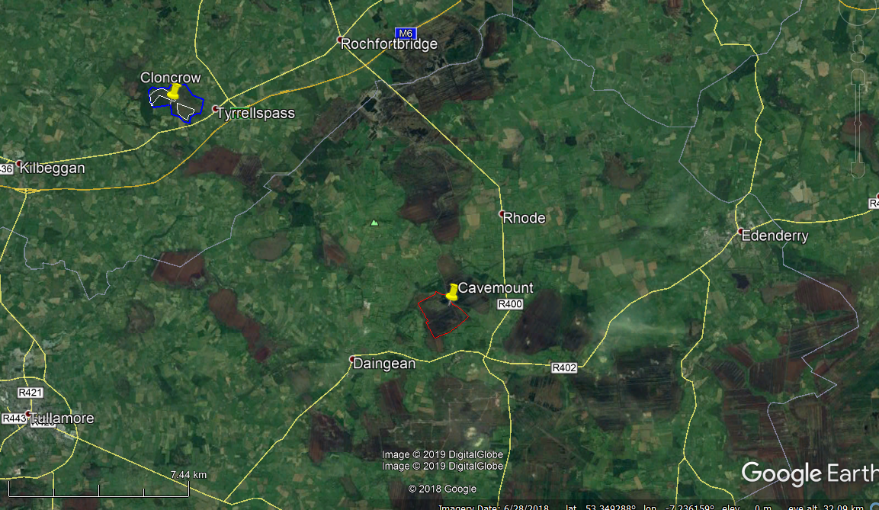
Pilot (Cloncrow),
Bord na Mona site (Cavemount).
NB: extent of degraded bog (C-potential!)

Slide 4
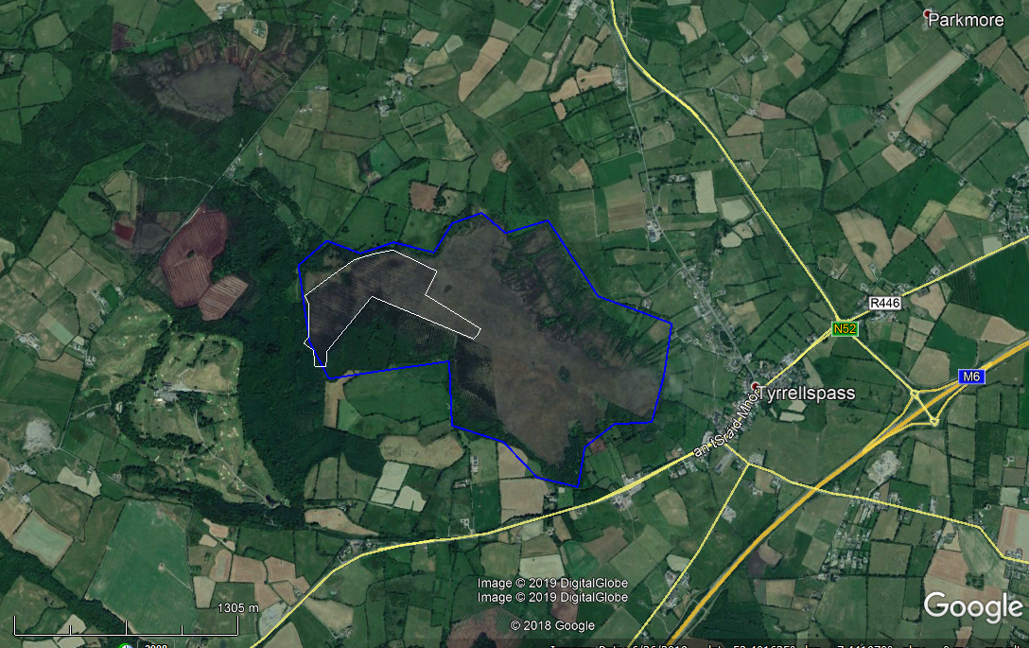
Pilot: Cloncrow NHA,
Entire bog ~200 ha (blue)
Pilot site of ~26ha (white)
Active community group in Tyrellspass

Slide 5
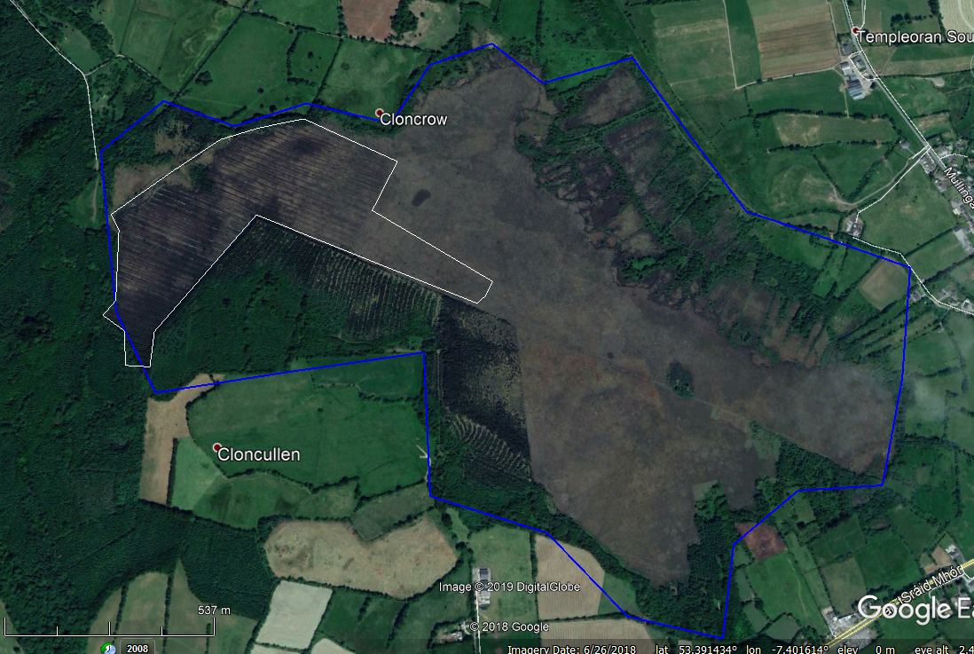
Pilot site.
Drain blocking and monitoring with sphagnum transfer.
Private cutaway. Potential landowner involvement
High Bog - Donor area
Coillte (State) Forestry
Potential involvement

Slide 6
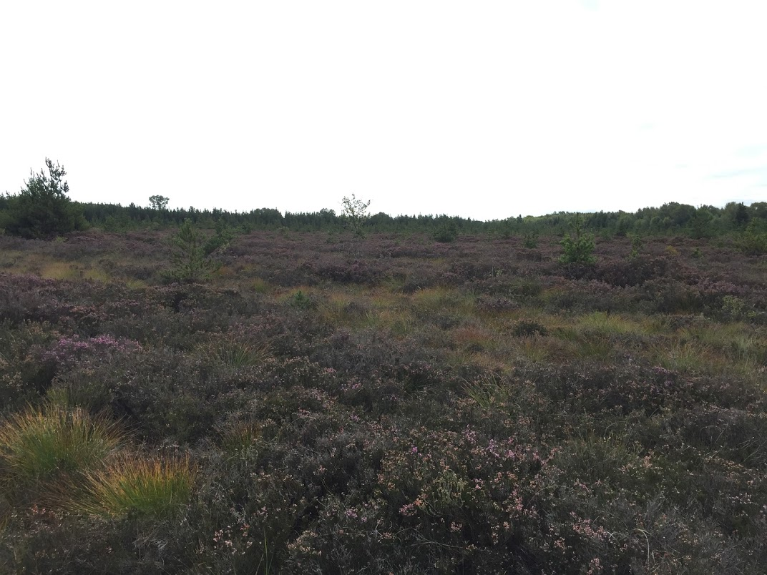
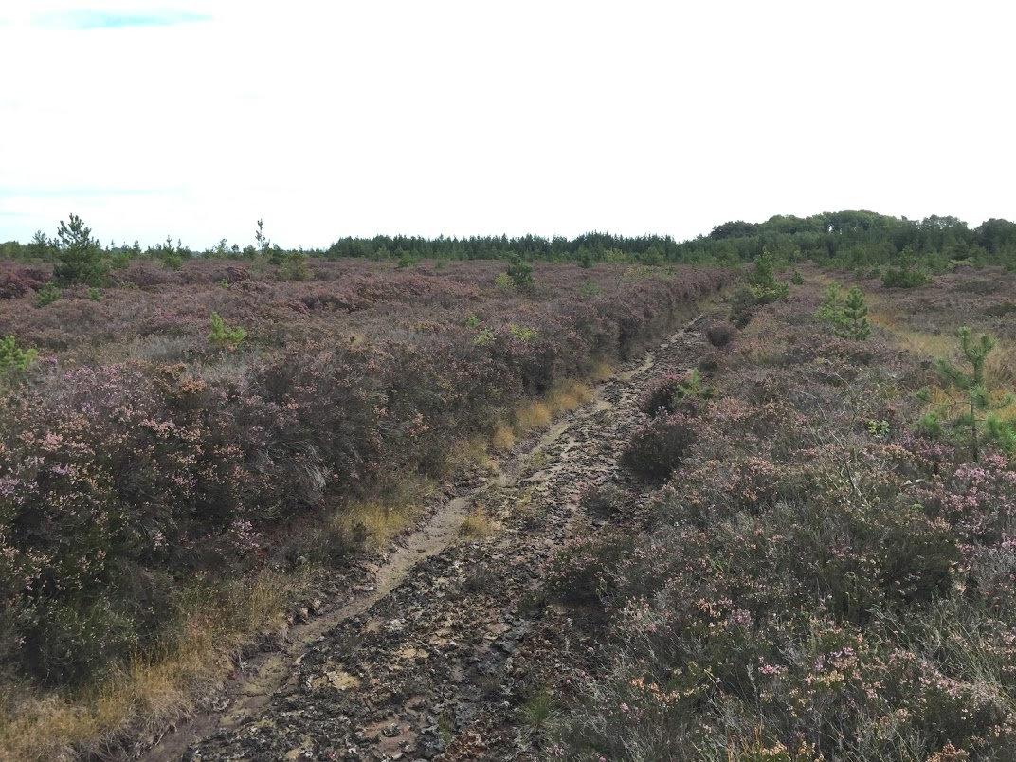
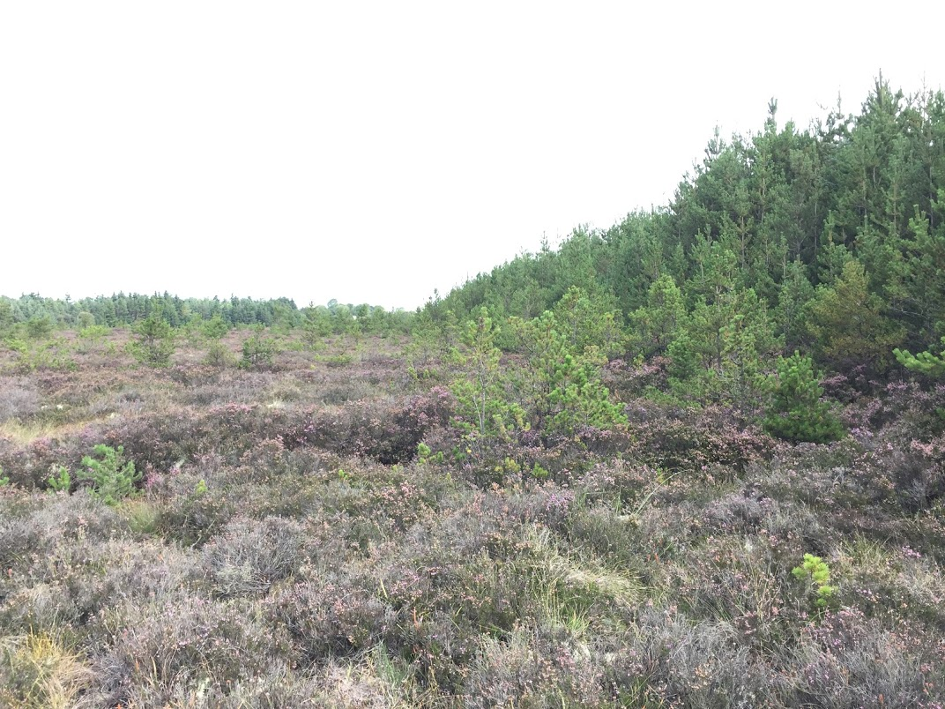
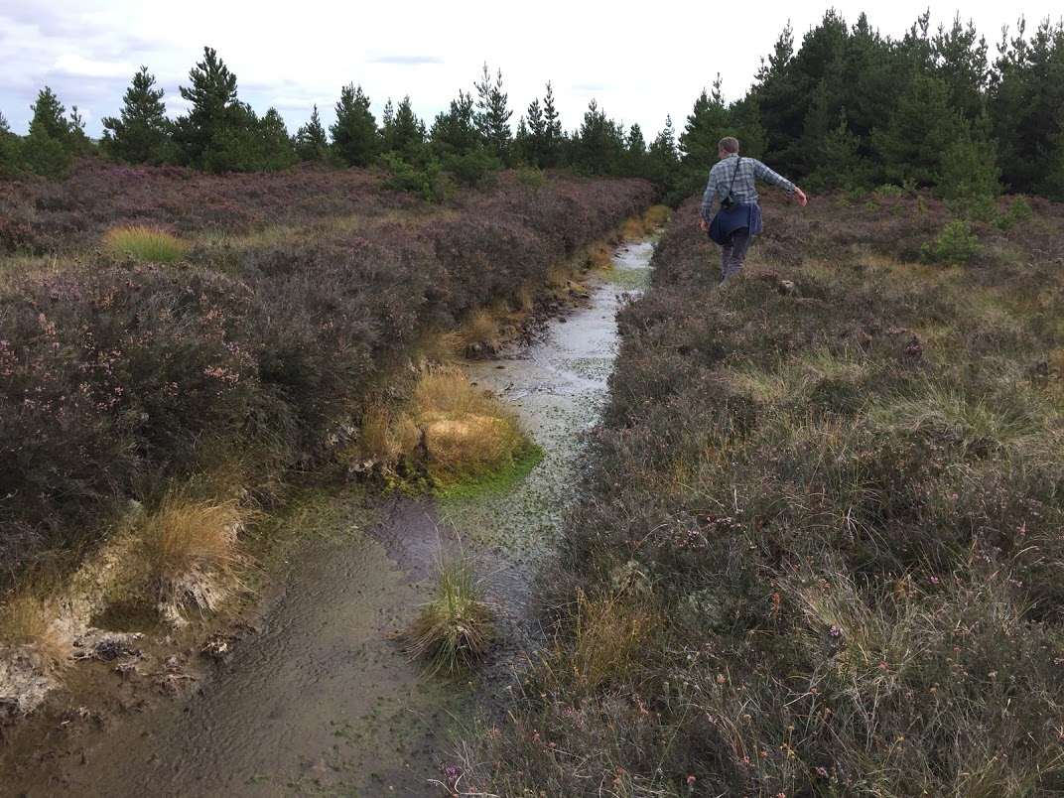
Pilot Site

Slide 7

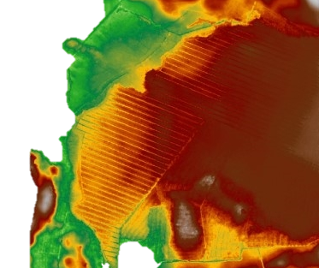
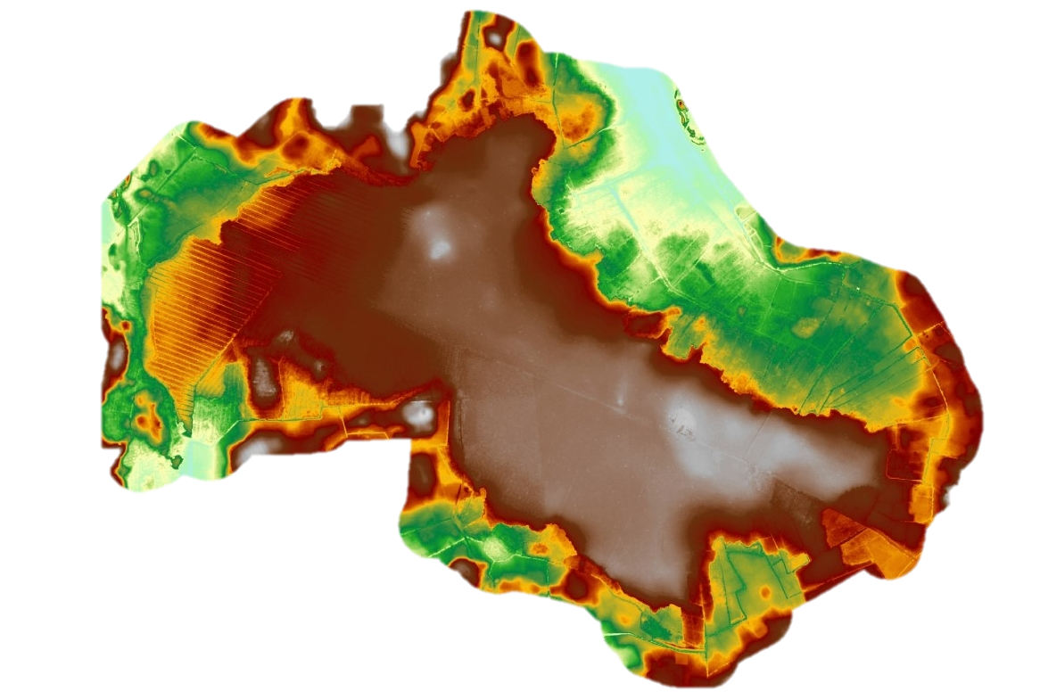
Investment WP I4
Cloncrow Bog
Total Bog: ~200ha | Pilot: 26 ha
Owned by NPWS with state and private landownership:
Condition: Extensive Private cutaway, plus afforestation
Goals:
  Block drains in a 26ha pilot
  Instrument: Piezometers, env. Monitoring (soil temp, watertable, local rainfall & temp)
  Sphagnum transfer trials with cooperation with IPCC and community group ETHOS.
  Engage landowners in N.E. section for socio-economic or other trials
Image source: RPSGroup

Slide 8
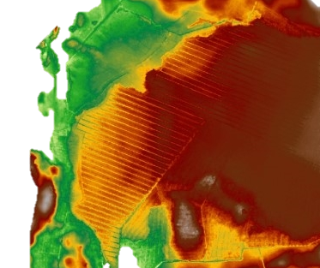

Investment WP I4
Cloncrow Bog
Pilot Timelines:
Activity | Date
Final Status Report & Initial Conditions | Jul-19
Joint Restoration Plan | Sep-19
Restoration Works | 20->21
Demonstrations | Jun-21
Spahgnum transfer workshop | Nov-21
Final Report | Jan-22
Image source: RPSGroup

Slide 9
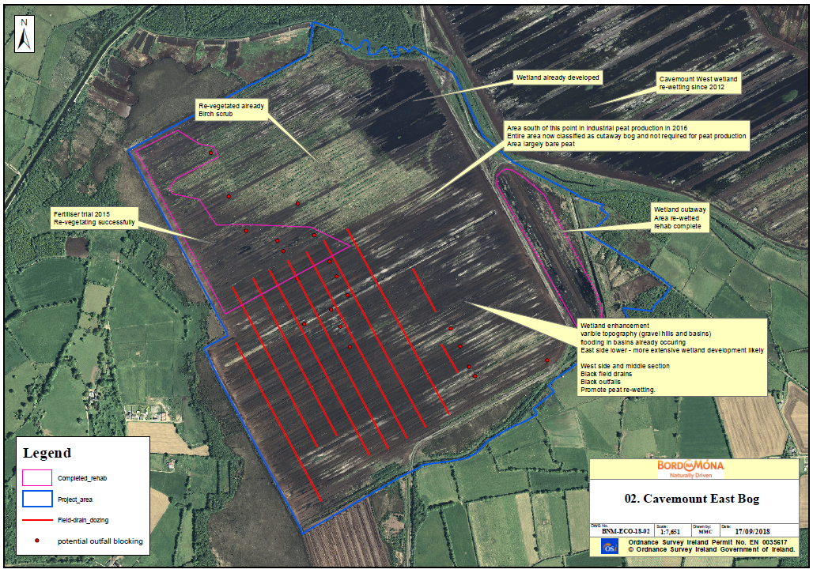
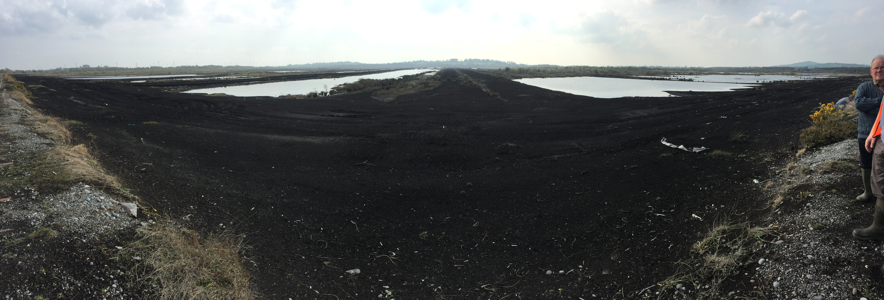
Sub-Investment WP I4 – 503 ha
Cavemount Bog
‘Associate’ pilot ~200ha (blue outline):
Former industrial bog
Needed to link main pilot to industrial emissions in same period, and we need monitoring at such sites.
BnM is interested in other PP pilots for potential use in their rehabilitation.

