Slide 1






La Guette Pilot and French (CNRS) Partners
Care-peat project – WP I2 – Investment
February 2019 – June 2021

Slide 2
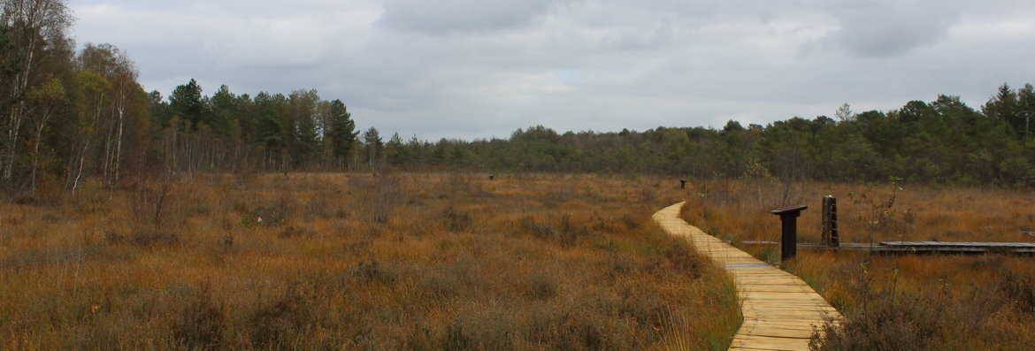
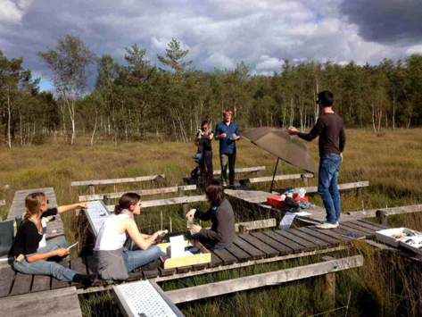
Validation of a hydrological and Sphagnum restoration and C-storage method in La Guette peatland by upscaling a previous small-scale experiment
La Guette peatland

Slide 3
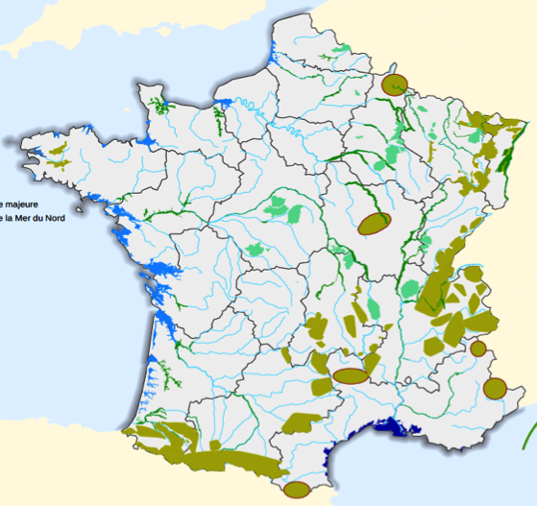

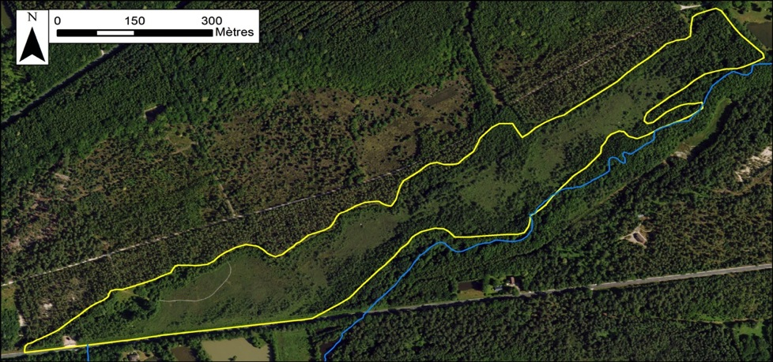
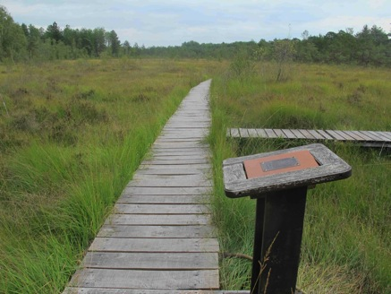
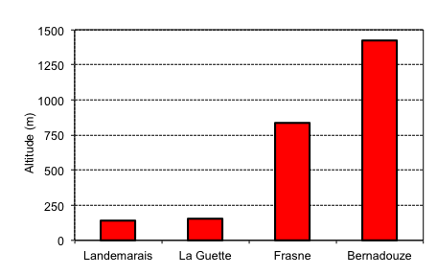
La Guette peatland: central part of France, 25ha, 180m a.s.l. as part of the French Peatland Observatory
Owner: Neuvy/Barangeon city council / Manager: Community Villages & Forests
http://www.sno-tourbieres.cnrs.fr
Altitudinal gradient : 150 à 1500 m
1: Landemarais peatland
2: La Guette peatland
3: Frasne peatland
4: Bernadouze peatland

Slide 4

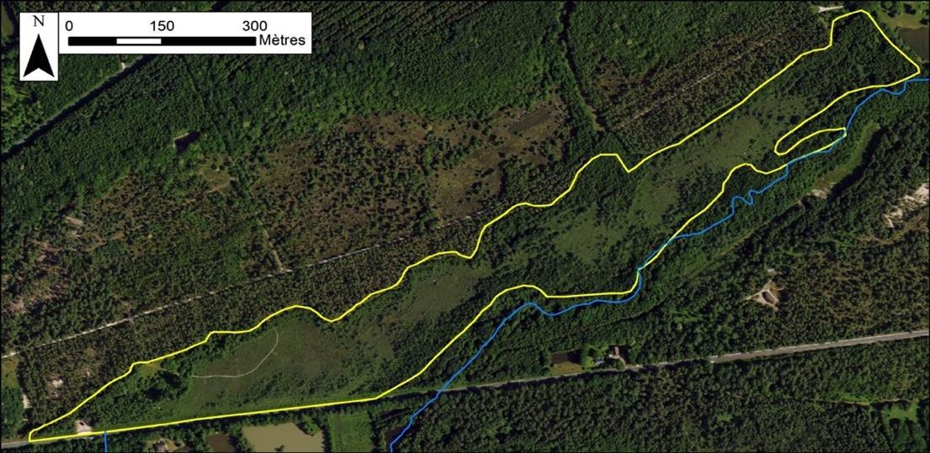

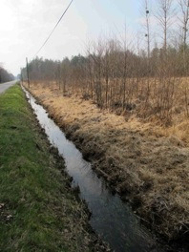
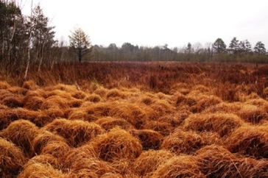
Hydrological disturbance affected the plant cover…
2 hydrological sub-systems
2: La Guette peatland
UP
DOWN
Hydrological restoration
• The site is characterised by 2 hydrological sub-systems
Road ditch
• Originally, the vegetation is mainly Sphagnum mosses…
• … but for the last 30 years, the site was invaded by Molinia and Betula spp caused by a road ditch which accelerates the peatland drainage
• Source of C in 2013 and 2014 (D’Angelo et al.)

Slide 5
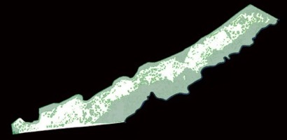
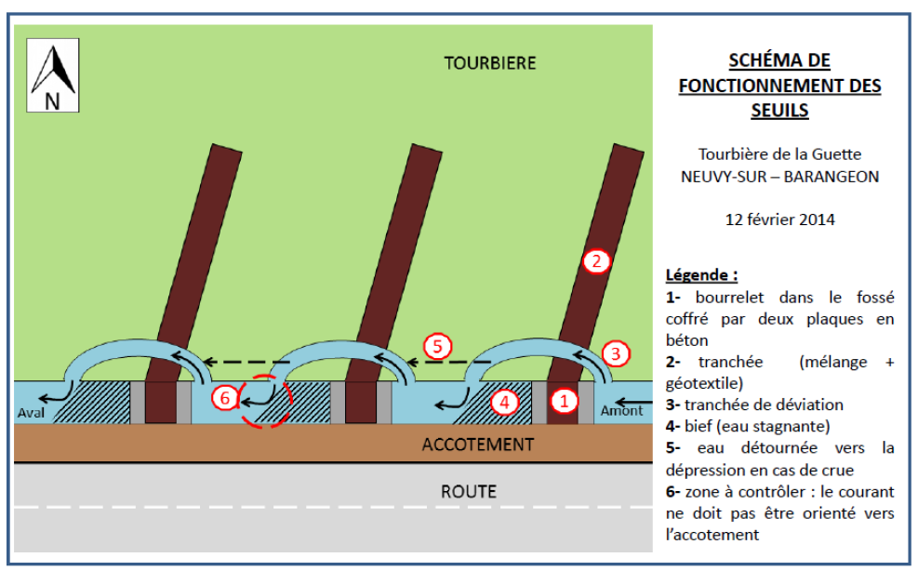
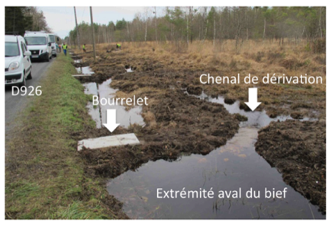
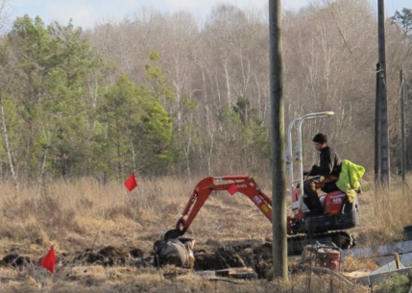
Restoration works_______________________________________________________
• Hydrological restoration in the downstream sub-system (upstream as a control):
To raise the water table depth and promote the soil rewetting
To reduce water table fluctuations
• Set up of of trenches dug in the peat soil and filled with sand and bentonite
• conversion of the straight ditch into meanders to slow down water flow
THE PEATLAND
10m
outlet
THE DITCH
D926 ROAD

Slide 6
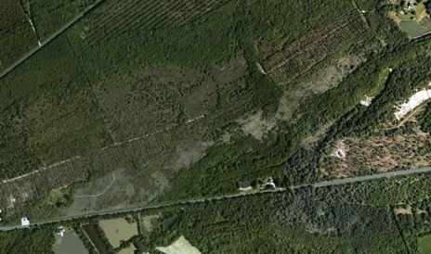
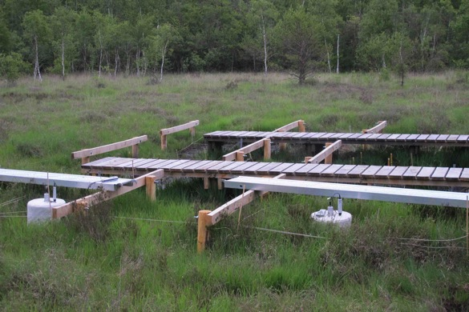
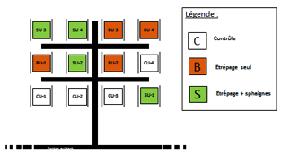
Sphagnum experiments__________________________________________
• Set up of 2 experimental stations (in Downstream and Upstream)
Experimental Stations
Experiments started in February 2014
• In each station, 3 treatments: (i) control (intact plots), (ii) bare peat (removal of vegetation and first 5 cm of peat), and (iii) Sphagnum treatment (bare peat with Sphagnum capitula spread on the surface)
• Each treatment in 4 replicates
One of the two experimental Stations
2 m
6

Slide 7
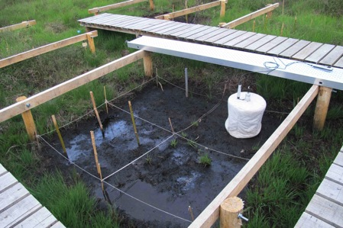
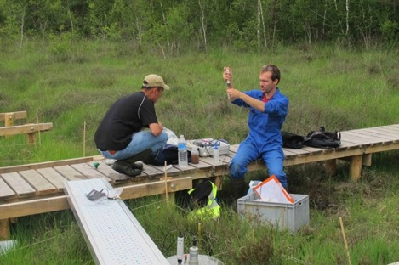
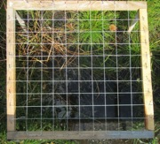
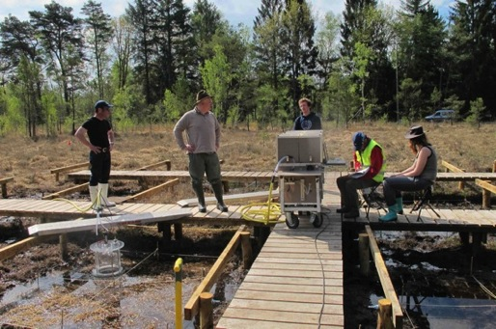
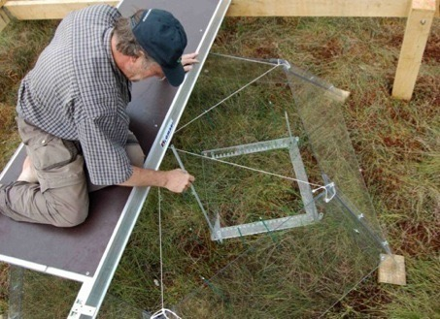
The monitored environmental variables_______________________________
In each station (12 plots), we measured monthly at the pick biomass:
- CO₂ and CH₄ fluxes with a closed static chamber (Vaisala probe for CO₂ and a portable IR laser absorption spectrometer for CH₄);
- Plant species abundance => a 50-50 cm gridded frame placed above a marked subplot.
- Water table level and water chemistry: monitored in the whole site.
2m
CO₂, CH₄
Hydro
2m
Végétation
Vegetation

Slide 8
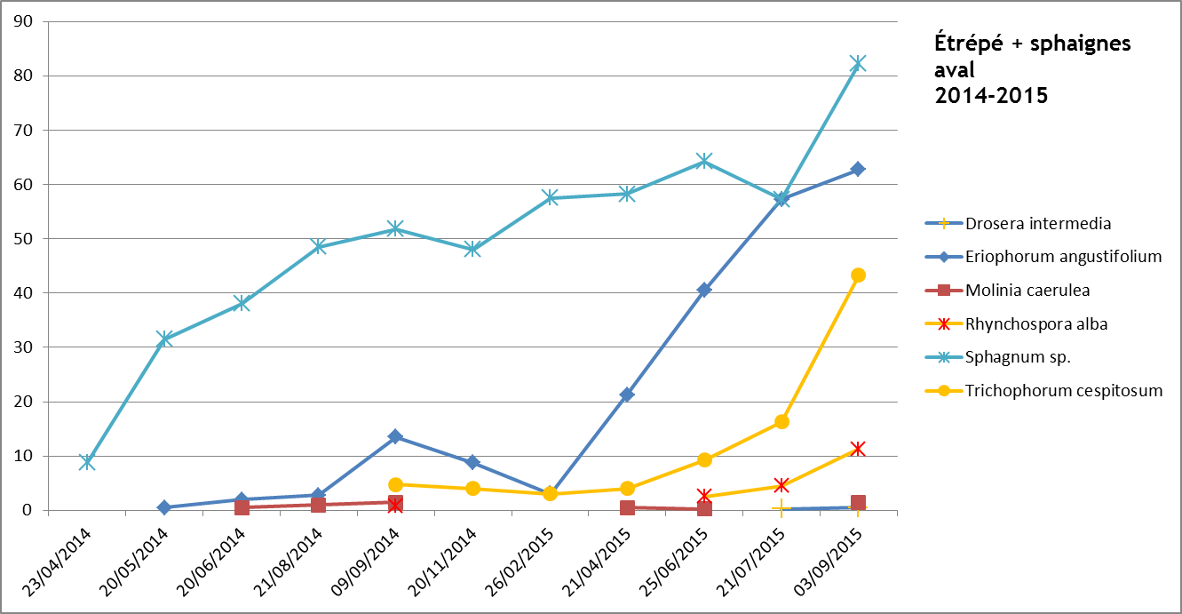
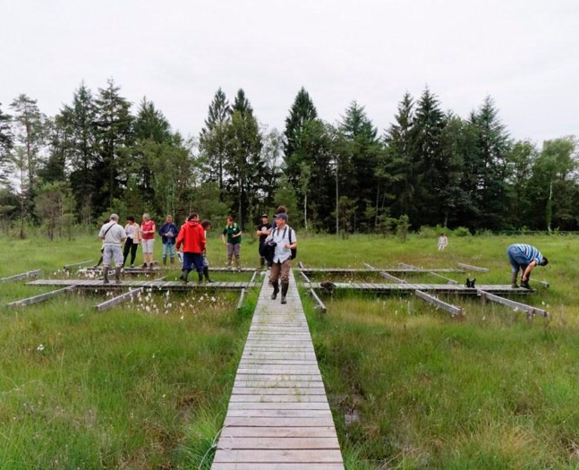
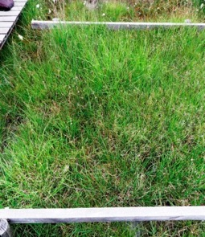
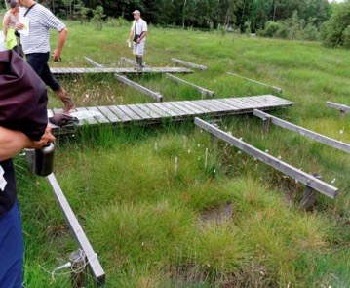
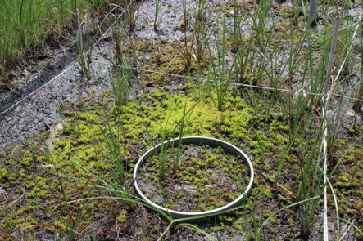
Sphagnum experiments__________________________________________
After 2 years…
Sphagnum mosses
Eriophorum angustifolium
C
Control
B
Bare peat by striping
S
Striping + Sphagnum
In July 2016
In April 2016

Slide 9
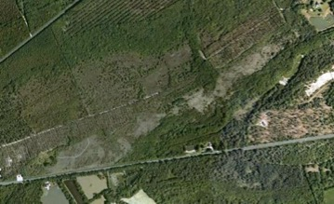
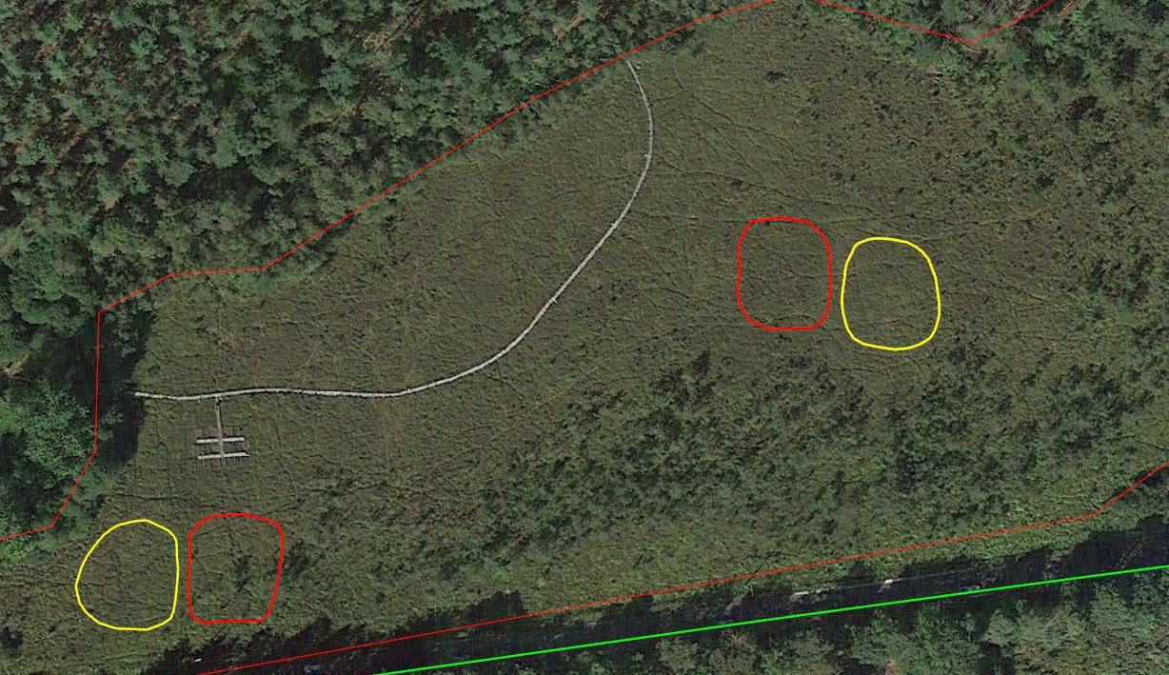
Within Care-Peat project, upscaling of previous Sphagnum experiments
Fine scale experimental stations
Automatic piezometer
Sphagnum plot #2
Control plot #2
• The restoration works made in 2 parts of the pilot to take into account the variation of the WTD, a key factor to the successful development of Sphagnum species
• Surface: total of 4 plots of 600 m² each – 2 control plots (total of 1200 m²) paired to 2 Sphagnum plots (total of 1200 m²)
Sphagnum plot #1
Control plot #1

Slide 10
Upscaling of previous Sphagnum experiments within Care-Peat project
Coordinator: CNRS – ISTO, FR
February 2019 to June 2021
• ACTIVITY I2.1 / Procedures to prepare the restoration works February 2019 to March 2020
DI2.1.1: Report of the preliminary site visit : ISTO together with the site manager (CCVF) and the Dpt Council (CD18) visited the site and decided of the exact areas of the experiment => March 2019
D12.1.2: Map drawing of the experimental plots => April 2019
DI2.1.3: Jointly refined restoration plan => Sept 2019?
DI2.1.4: Reports of the administrative procedures necessary to get permissions for the works (Regional Biodiversity agency, Regional Science Council Natural Heritage, the DREAL) => Oct 2019
DI2.1.5: Tendering procedures and final choice of the contractors (describe the work and post an offer in the market to select the company) => Dec 2019
DI2.1.6.: Report of the collection of Sphagnum => March 2020

Slide 11
• ACTIVITY I2.2 / Realisation of the pilot March 2020 to April 2020
DI2.2.1: Report of the spreading of Sphagnum: ~0.25 kg of fresh Sphagnum green parts per m² will be spread over the plot. A control zone will be associated to each plot => April 2020
DI2.2.2: Reports on walkboard construction to avoid trampling of the soil => April 2020
• ACTIVITY I2.3 / Activation of the transfer knowledge April 2020 to June 2021
DI2.3.1: Writing a technical note => allowing replication to other sites => June 2021

Slide 12
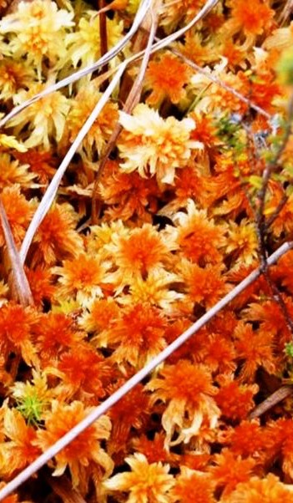
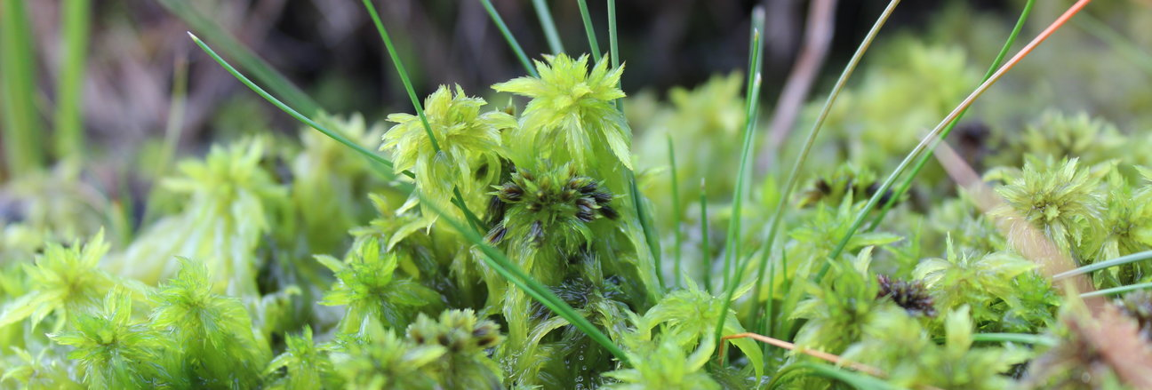
Thank you!

Slide 13
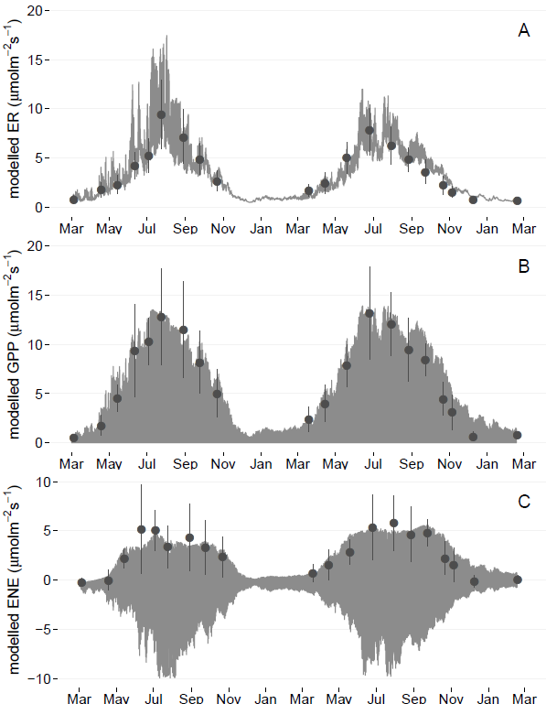
C budget = source functioning______________________________________________
Monitoring for 2 years of CO₂, CH₄ and DOC… 20 plots randomly distributed in the peatland
SOURCE functioning
Ecosystem Respiration
2013
Peatland
- 301
ER
1240
957
GPP
CH4
10
DOC
8
Gross Primary Production
gC m⁻² yr⁻¹
2014
ER
Peatland
- 138
1281
1184
GPP
CH4
24
DOC
Net Ecosystem Exchange
16

Slide 14
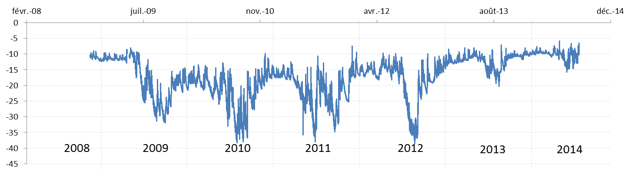

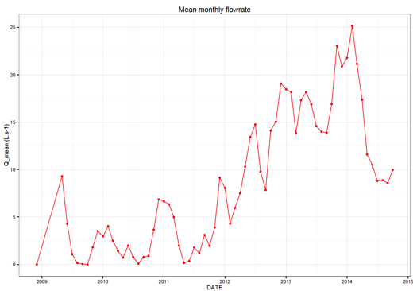
Hydrological disturbances__________________________________________
=> Frequent lowering / high fluctuations of groundwater table level
WTD (cm)
=> Rise of water flow at the peatland outlet
(month average)
Q mean (L s⁻¹
20
10
0
2009
2010
2011
2012
2013
2014

