Slide 1

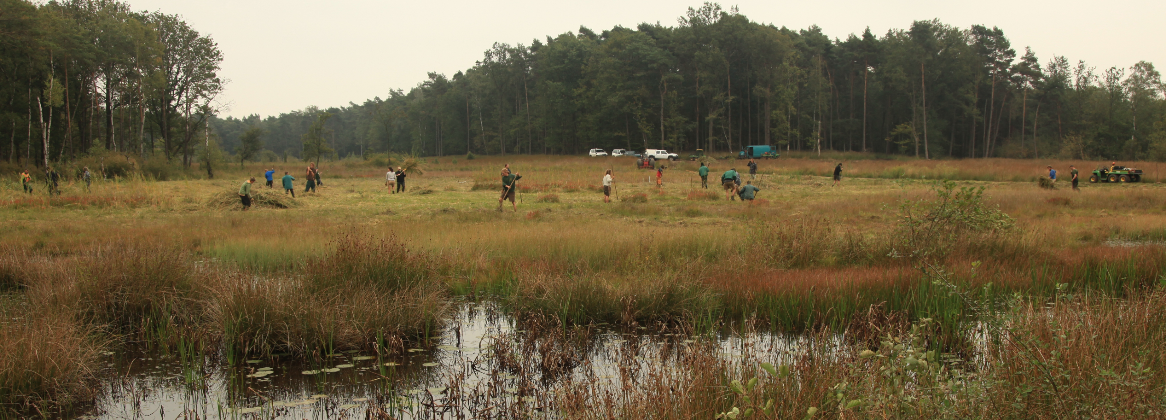
‘Natuurpunt’
as nature conservation organisation
NGO – volunteer organisation
Largest private nature managing organisation in Flanders
100.000 families as member – 6.000 volunteers
480 professionals (300 field workers)
Financing by subsidies, gifts, sponsoring and own revenues (membership)
Besides nature management also :
  research, policy, education, recreation and events, volunteer support, …
Management of 22.500 ha of nature reserve (1,66% of Flanders)
‘ANB’ is natural partner in the government:
  Flemish government ‘Agency for Nature and Forests’

Slide 2
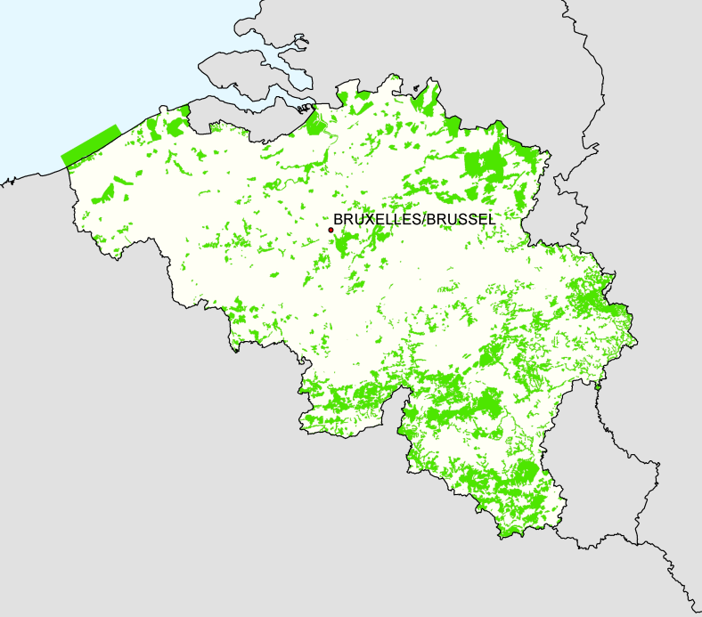
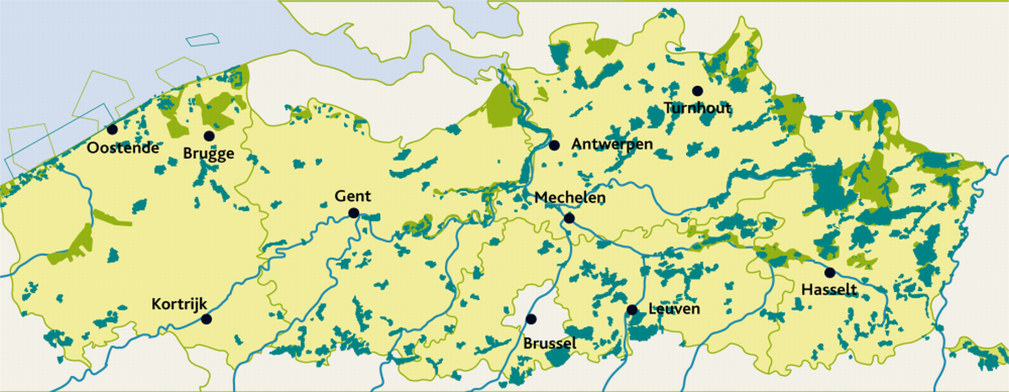
Vallei van de Zwarte Beek
Zwarte Beek

Slide 3
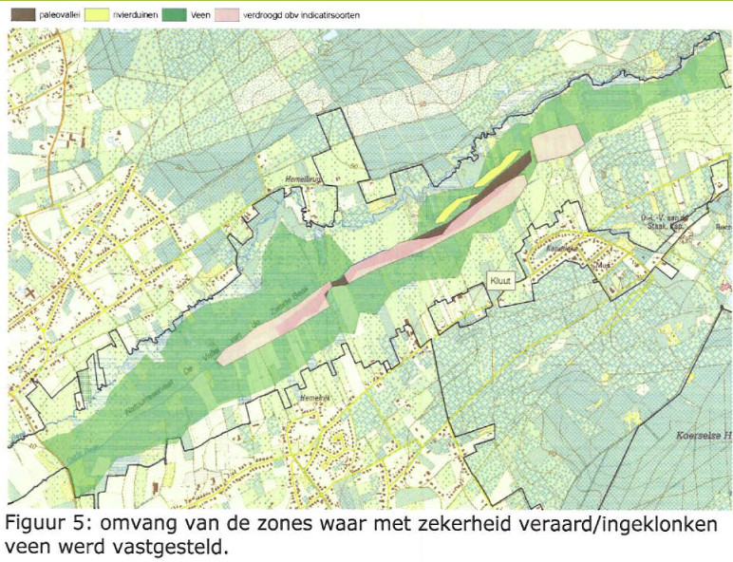
Peat layer

Slide 4
WP I1 – Pilot NP
Vallei van de Zwarte Beek
° Hydrology measurement network
° Ecological restoration
  -Stakeholder involvement and consulting
    (water managers, landowners)
  -Restoration measures
    (closing up ditches, removing scrub)
° Adaptive management (sustainabality)
  -Purchase of wetland track combination
  -Manual workers team
  -Experimenting with management techniques for conservation of sites

Slide 5
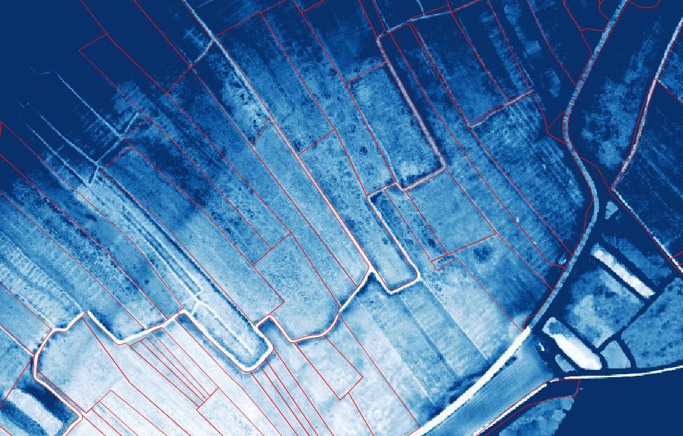

Slide 6
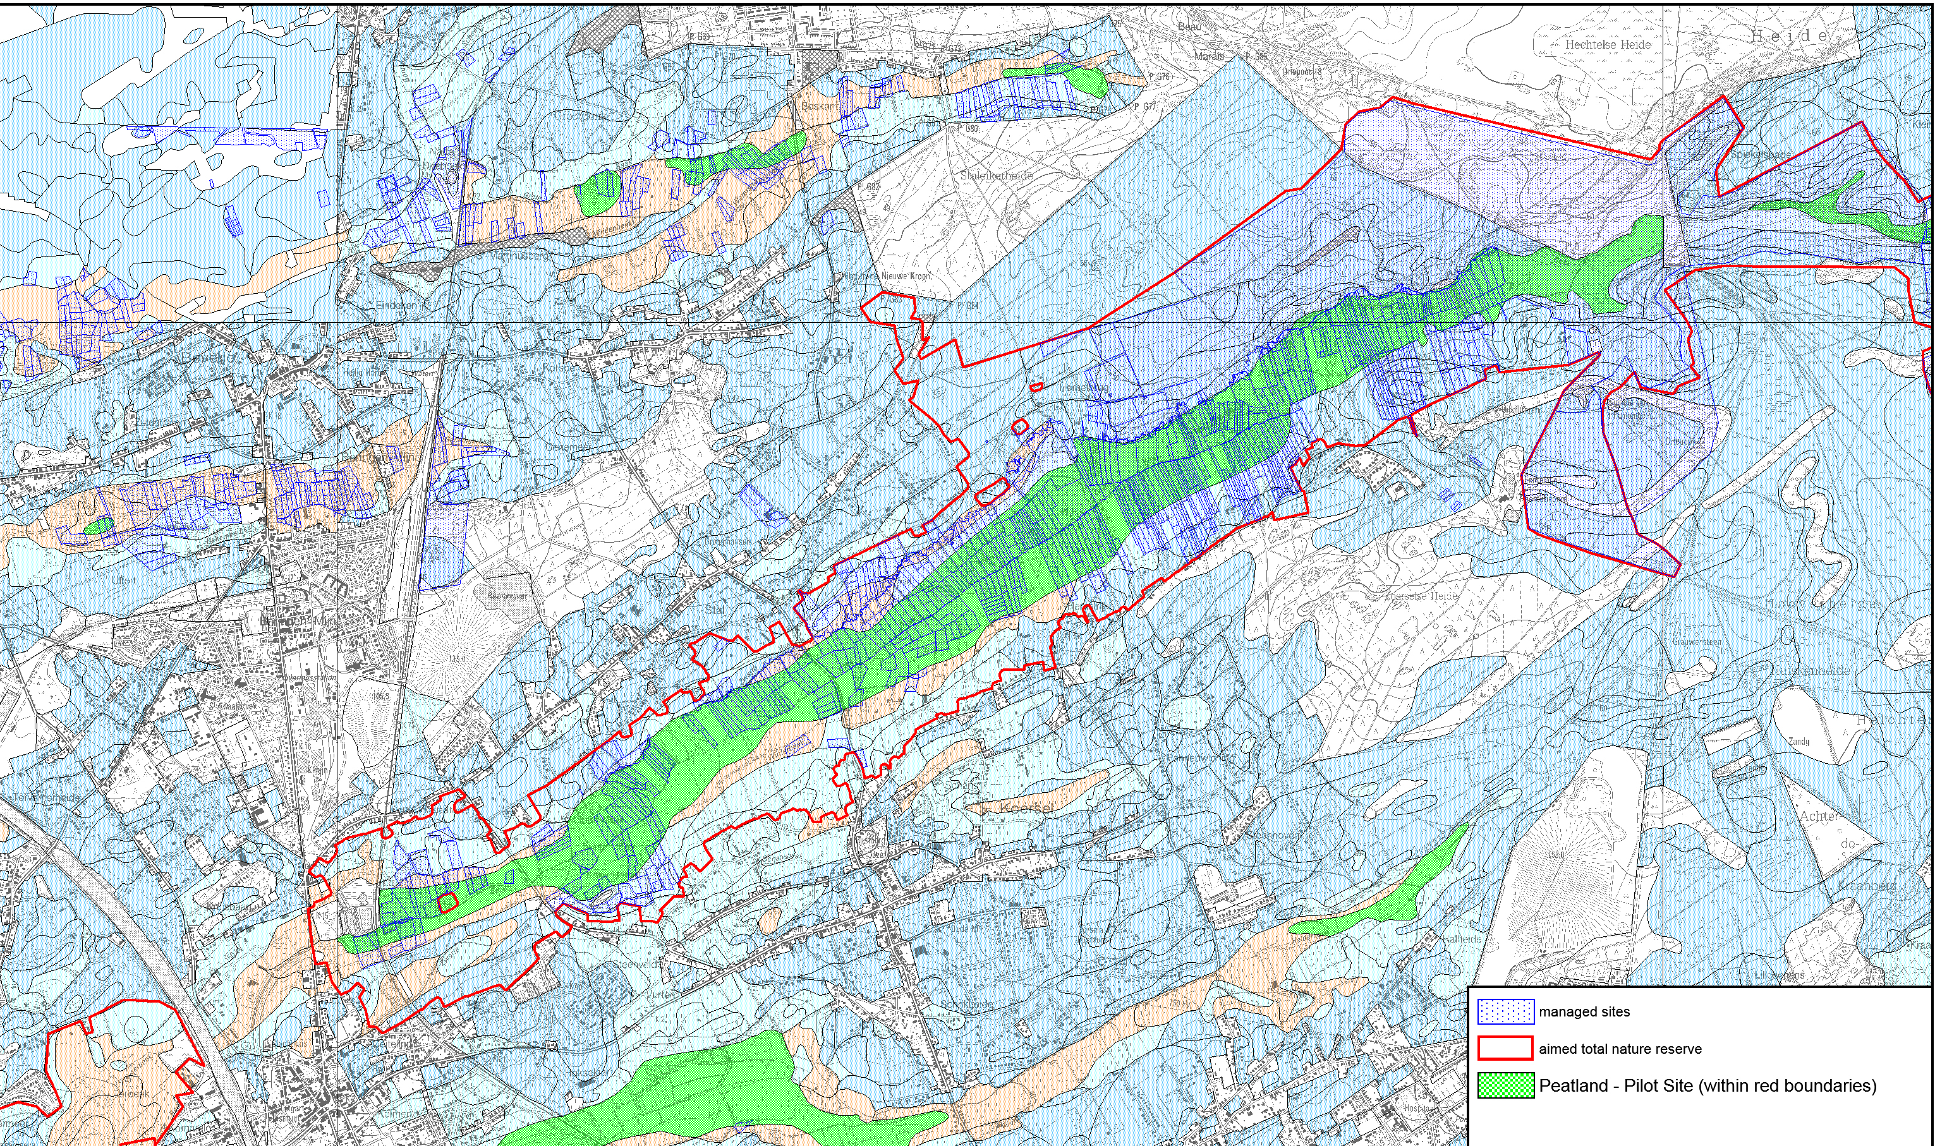

Slide 7
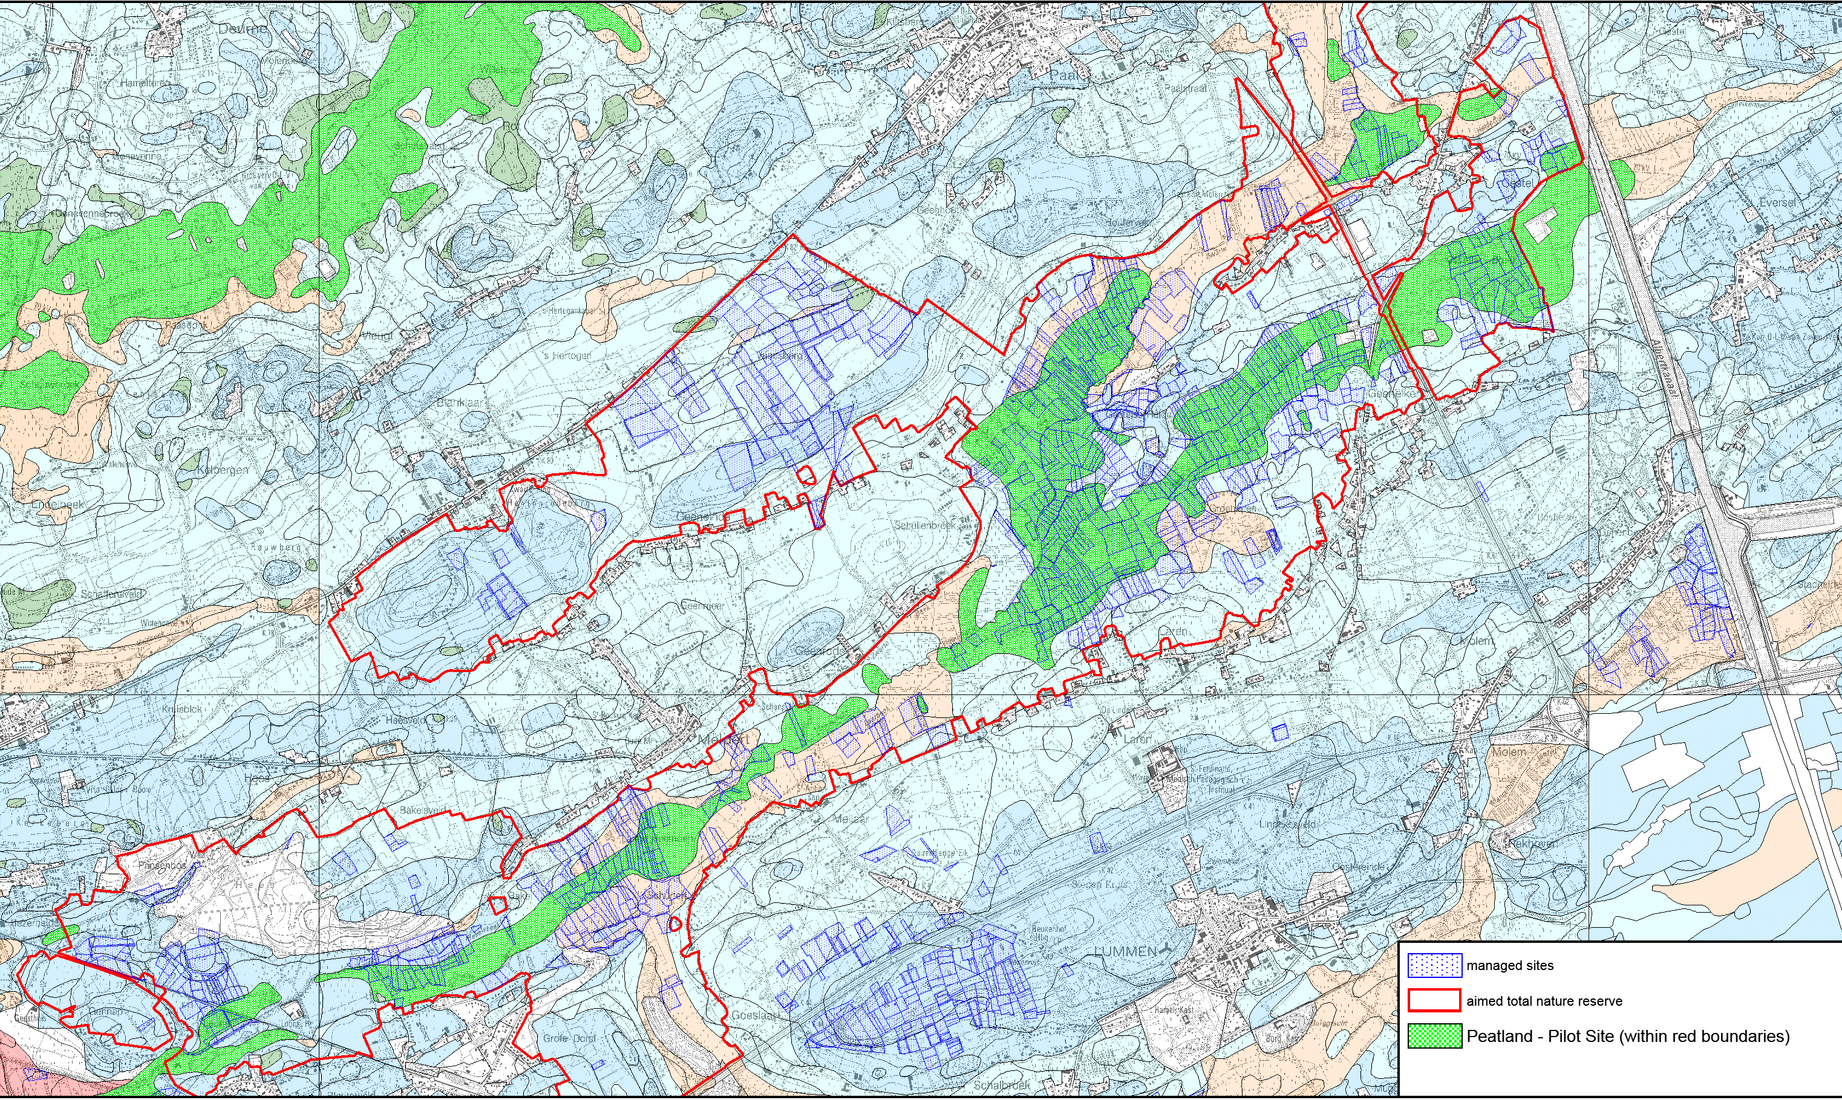

Slide 8
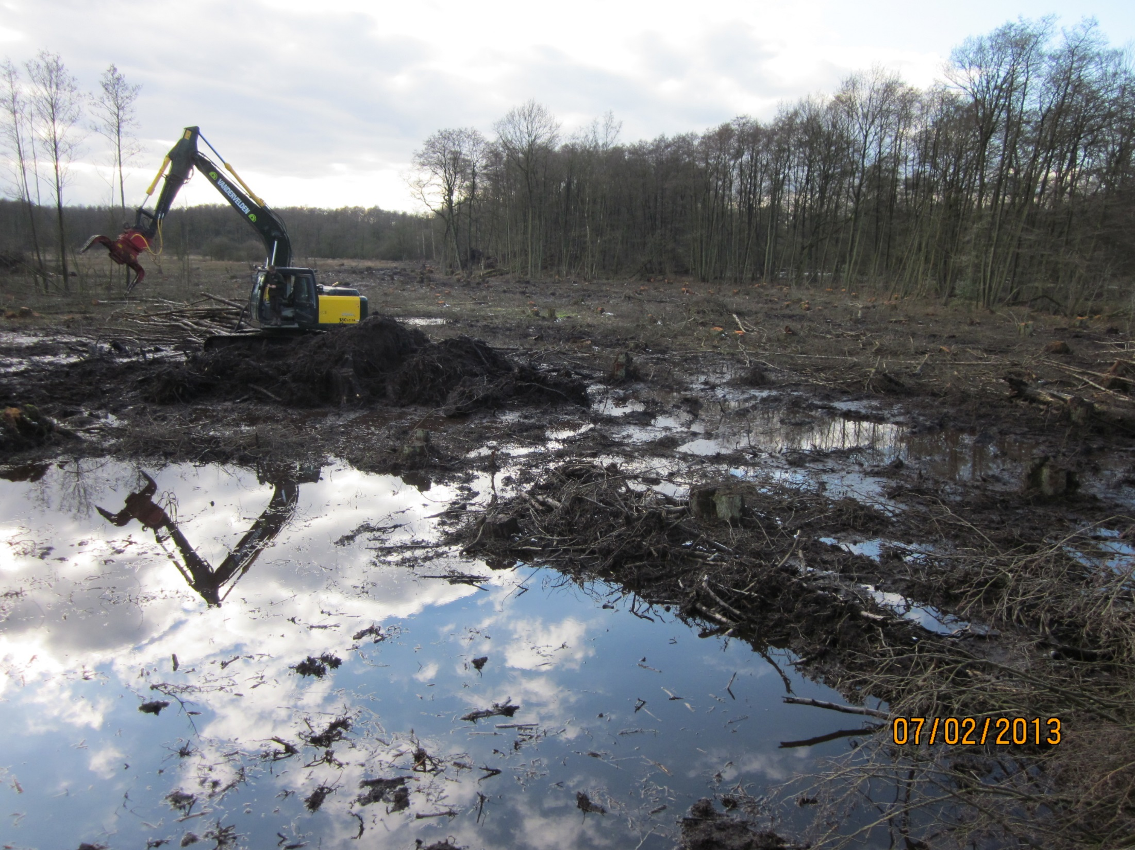
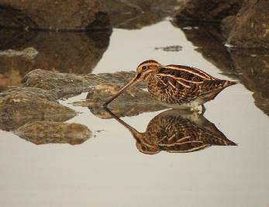

Slide 10
WP I1 – Pilot NP
Results
° 250 ha restored peatland (within 750ha peatland)
-max CO² loss reduction
° Adaptive management
  -Replicable and transferable
  to other sites in Europe
for other goals (eg. Paliduculture)
° Win-win: increase in biodiversity

Slide 11
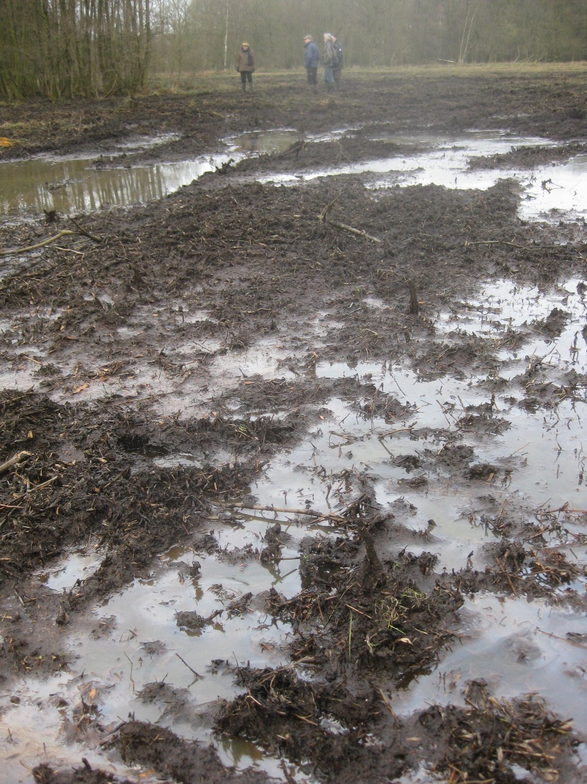
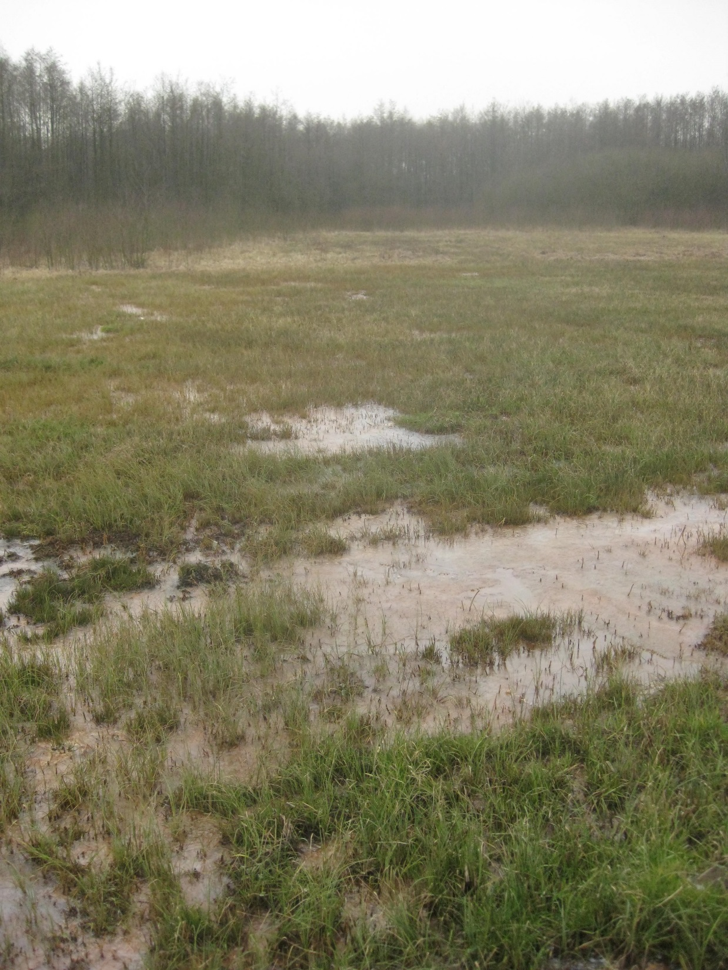
Biotoop voor de Snip

