Slide 1
Eurosite & Care-Peat
Jelke Brandehof, Communications and Membership Officer
12 June 2019, Care-Peat Start Conference, Manchester

Slide 2
A network for natural site managers
Eurosite’s Vision:
“A Europe where nature is cared for, protected, restored and valued by all.”
Eurosite’s Mission:
“Providing opportunities for practitioners to network and exchange experience on practical site management.” (since 1989)
Eurosite’s Objectives:
Networking for Europe’s Nature
A Gold Standard for Information
Advocacy for Site Based Management
in short…

Slide 3
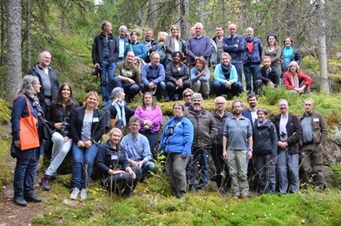
The Eurosite network:
55 members 31 + 24
20 countries across Europe
Governmental and non-governmental organisations and individuals
Natura 2000 sites and other natural areas
3 staff members, based in the Netherlands

Slide 4
Twinning: our DNA
1987 – the European Natural Sites Twinning Programme – 33 sites across Europe. 1989 – Eurosite established.
The aim of Twinning: To strengthen links between natural sites with similar habitats and similar problems to solve and to encourage the sharing of information about site management for nature conservation
Thematic Twinning & Peatland restoration: Collaboration on a specific theme and involvement of various stakeholder types

Slide 5
Work Package Long Term
Set up a permanent transnational peatland nature conservation management group within Eurosite
Set up 4 regional platforms for peatland conservation and restoration
Set up a transnational scientific research group peatland restoration and C-sequestration
Develop module on peatland management as a part of the Eurosite Management Planning Guidance Portal
Involve private landowners who own peatlands or might be affected by restoration measures

Slide 6
Thematic Twinning: Peatland Restoration Working Group - WPLT
Discuss peatland restoration work
Share the group’s expertise on peatland research, monitoring, outreach
Discuss LIFE projects (what worked/working, what didn’t/isn’t, lesson learned)
Look for synergy, replicability and transferability opportunities
Look for promotional opportunities of each other’s events, et cetera
Look for opportunities to have site visits and exchanges
Look for new funding opportunities
11 July 11:00

