Slide 1

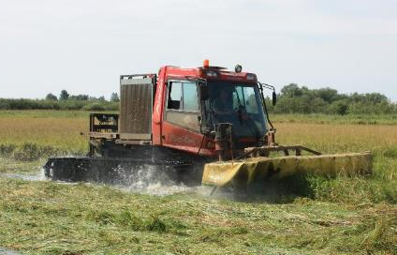
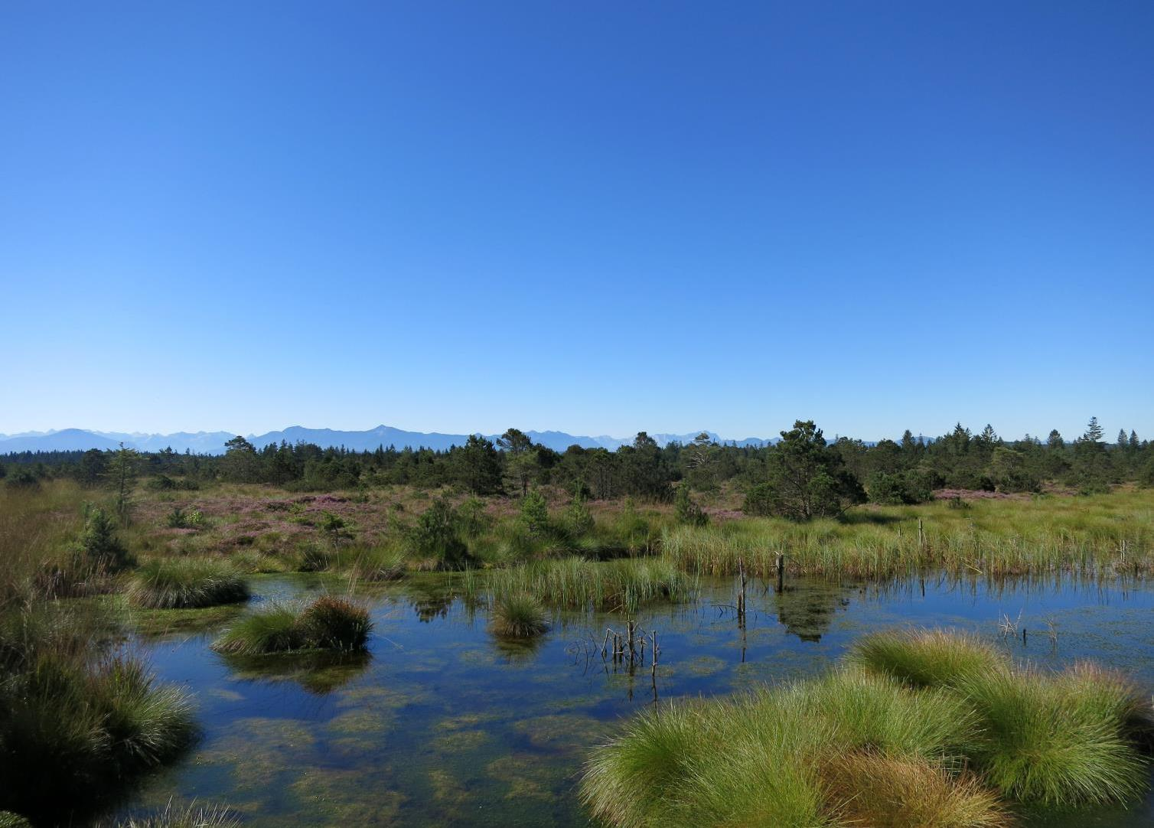
Importance of Peatlands for the climate and ecosystem services
Examples from the Baltic Sea Region
Interreg Care-Peat Start Conference
12th June 2019 – Manchester Metropolitan University
Jan Peters, Michael Succow Foundation
C. Schröder
J.Peters

Slide 2
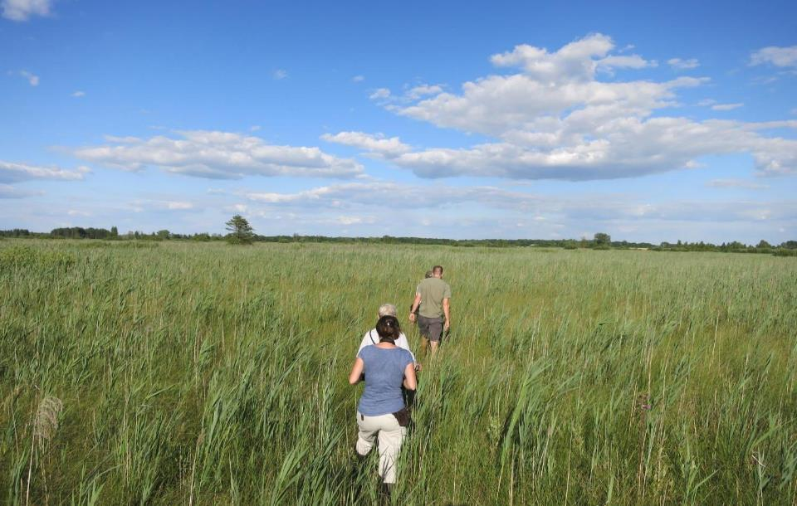
Paris has made the world simple: we have one common goal!
Poland

Slide 3
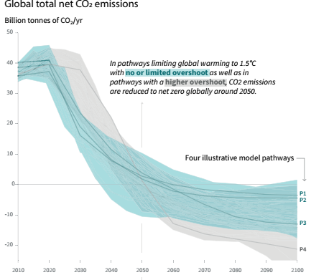
< 2º → 0 emissions by 2050: me, you, we:
no more excuses
→ The longer we wait, the faster we must reduce
IPCC 2018 SR15

Slide 4
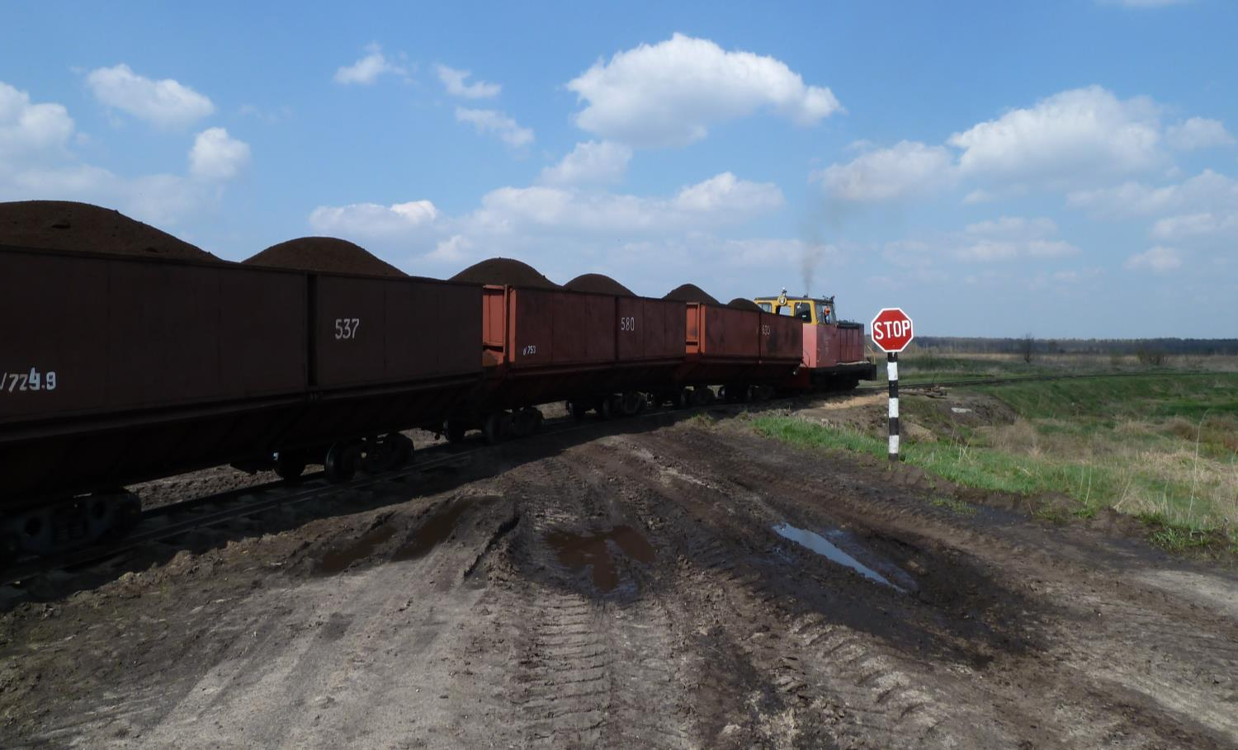
→ breaking radically with routines from the past, also with respect to peatlands
Belarus
4

Slide 5
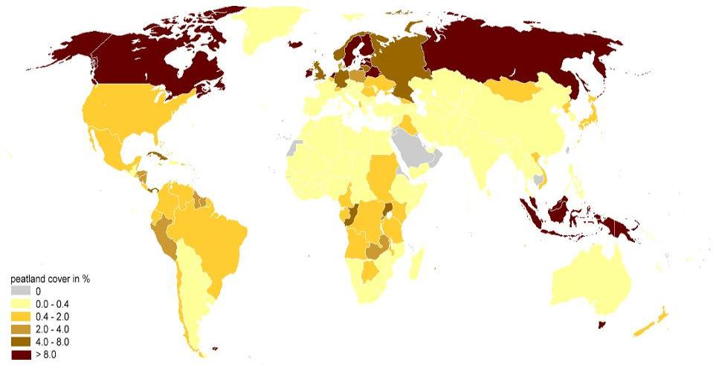
Peatlands are found in almost every country and very diverse.
Worldwide: 4 million km²
Joosten 2009

Slide 6
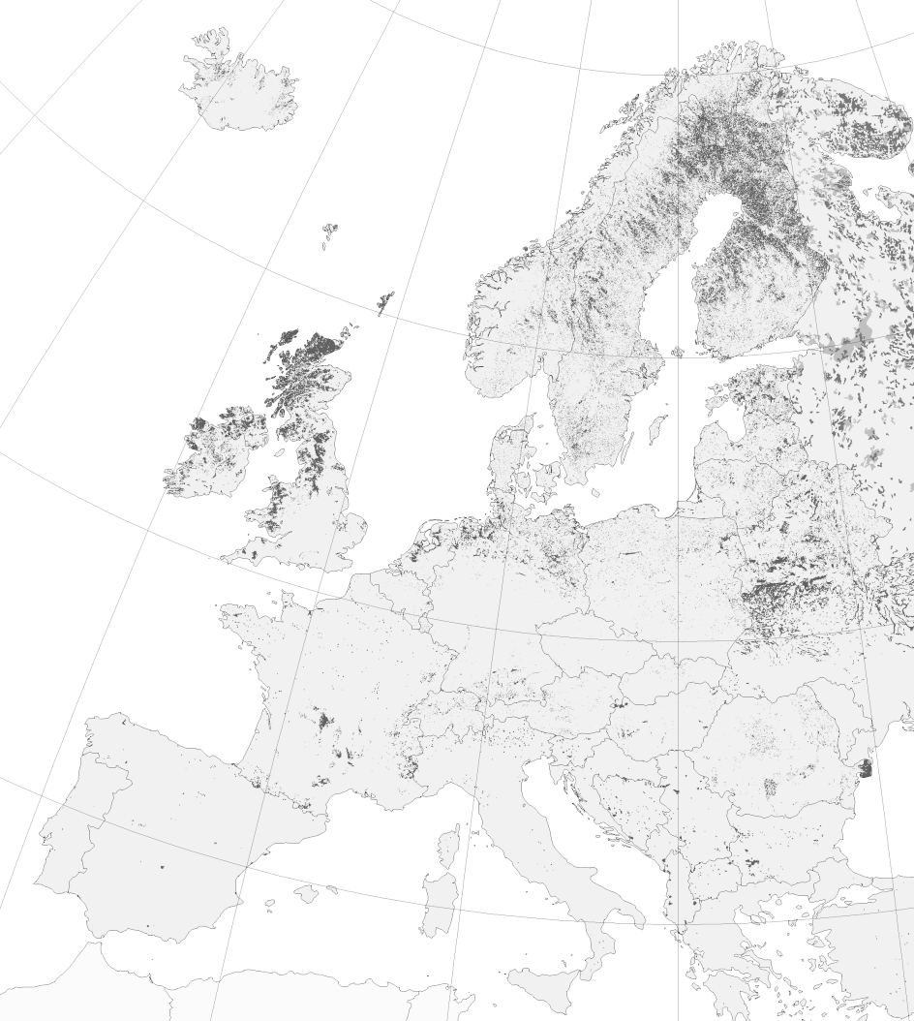
…in almost every EU Member State:
345,000 km²
Tanneberger et al. 2017
6

Slide 7
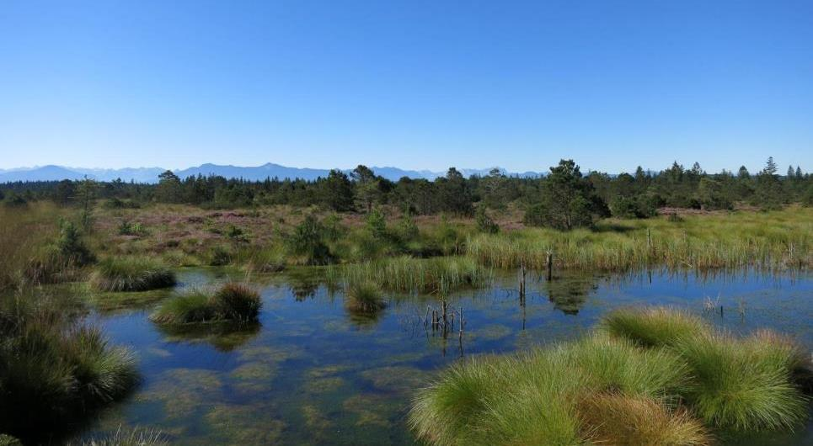
Living peatlands are climate neutral:
Globally: CO₂ sink balanced by CH₄ source
CO₂
CH₄
7

Slide 8
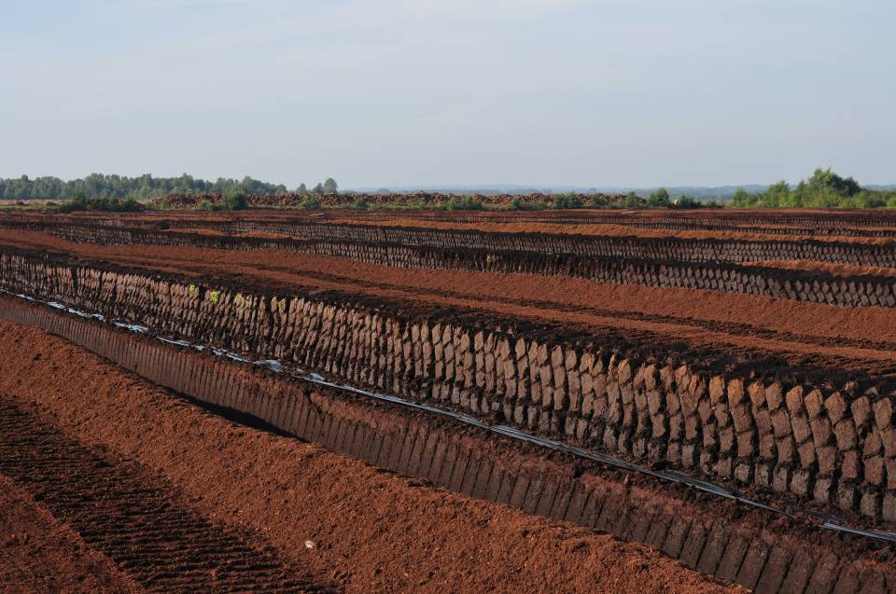
While covering only 3% of the World’s land area, peatlands contain >500 Gigaton of carbon.
Germany

Slide 9

i.e. twice the carbon stock of the world’s total forest biomass
Sabah

Slide 10
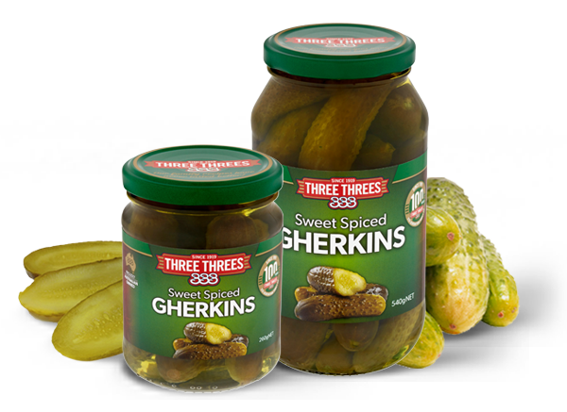
Peat is like gherkins: when you remove the conserving water, the organic matter rots away

Slide 11
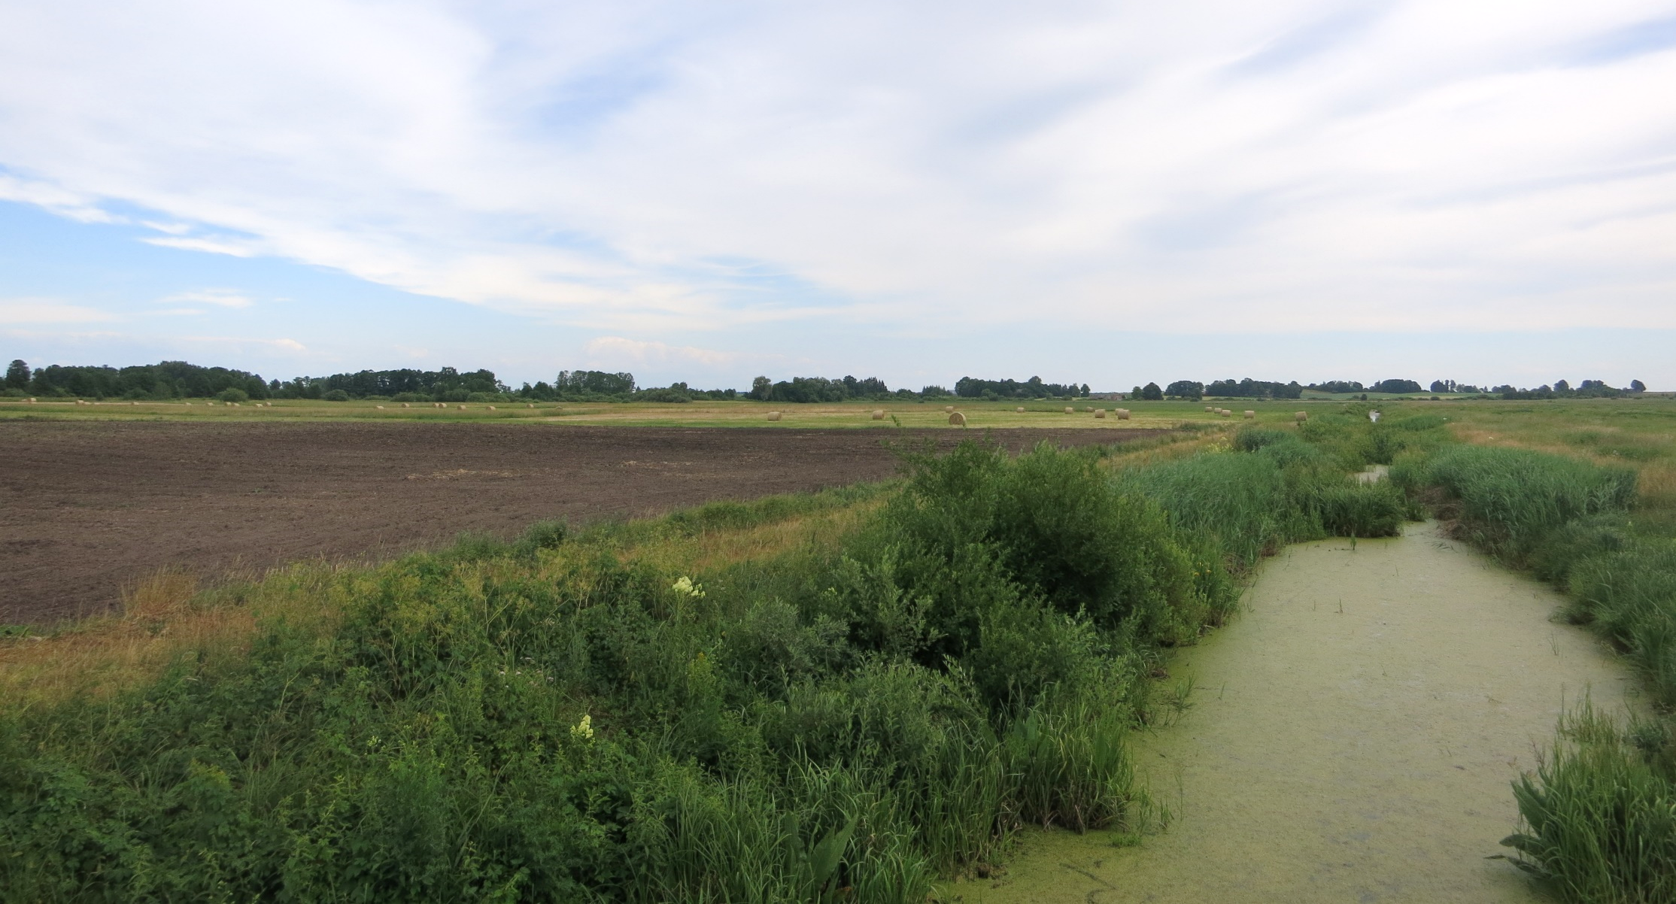
By drainage peat is oxidized
→ GHG released + soil subsidence
CO₂
N₂O
Subsidence
CH₄
Notes:
Foto Landwirtschaft
Soil degradation, subsidence

Slide 12
Deeper water table → more greenhouse gas emissions
-10 cm drainage = 5 t CO₂eq.

Slide 13
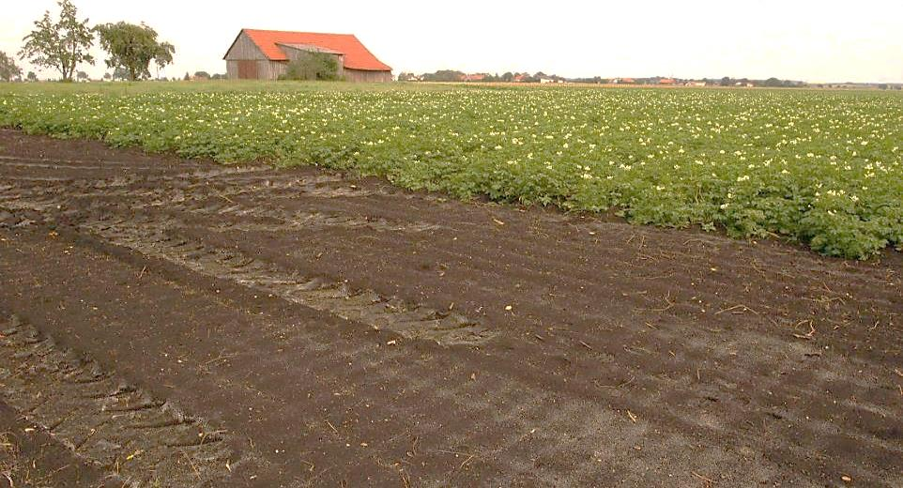
A potato field on peat in Europe emits 37 t CO₂e /ha/yr
= 185.000 km with middle class car…
Germany

Slide 14
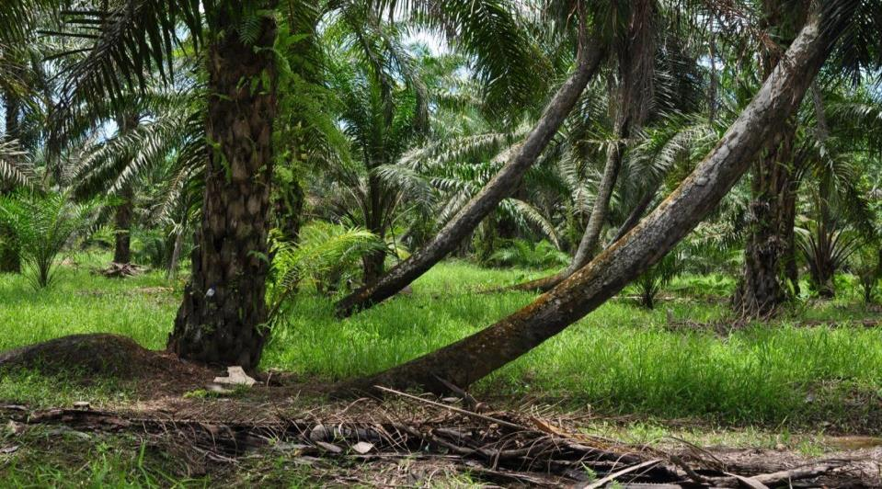
Oil palm on peat in the tropics emits 60 t CO₂e /ha/yr
= 300.000 km by car: every hectare, every year
Malaysia

Slide 15
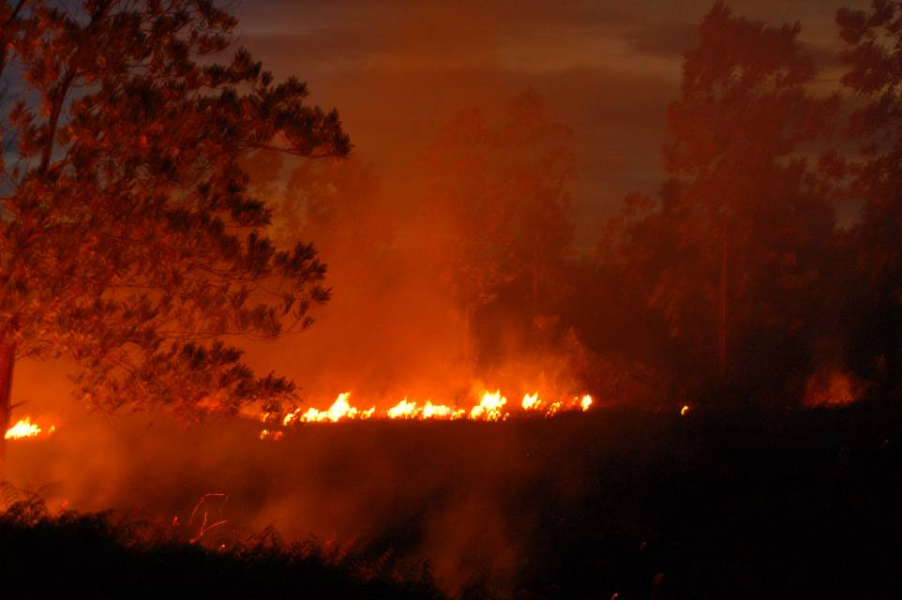
  Globally, drained peatlands emit 2 Gt CO₂e /yr,
  i.e. 0.4 % of the land produces 5% of all global emissions
And in some years much more…
Indonesia

Slide 16
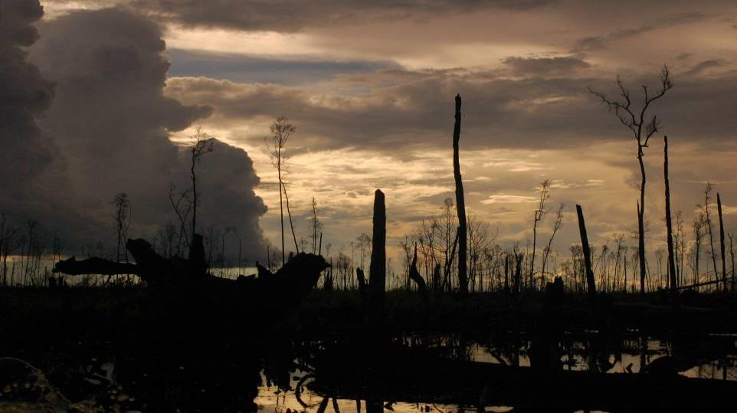
  Indonesia leads the list of global top emitters, also without the enormous peatland fires…
Indonesia

Slide 17
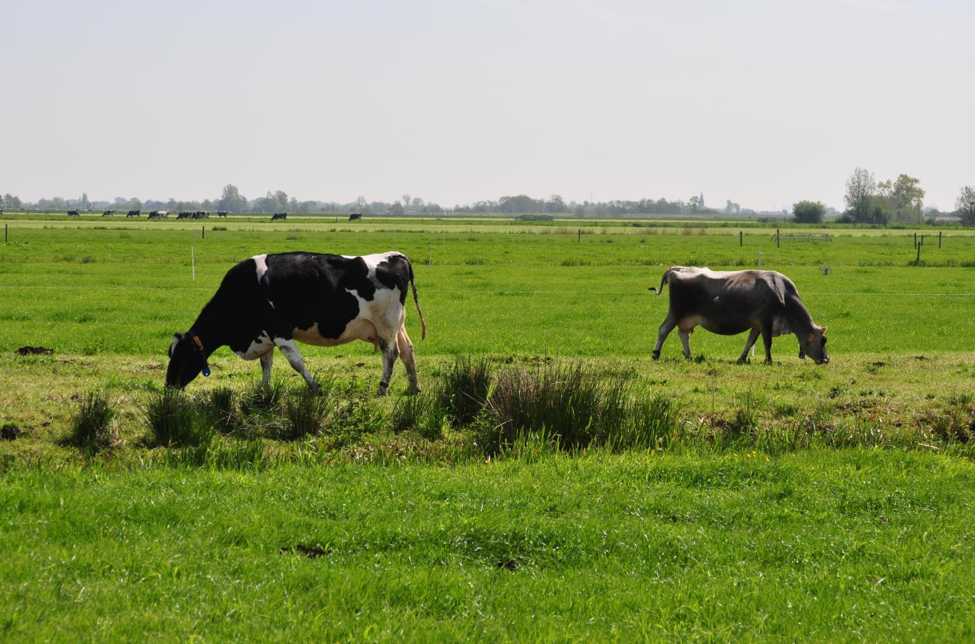
  But the European Union is a good second …
Netherlands

Slide 18
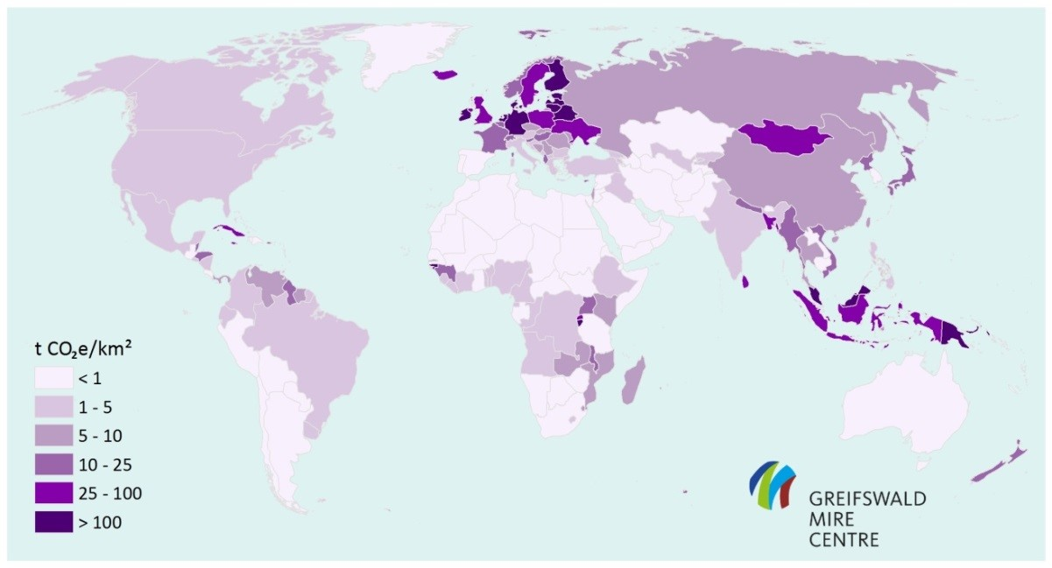
Peatlands emissions per land area (tCO₂e/km²): highest urgency for national land use policies

Slide 19
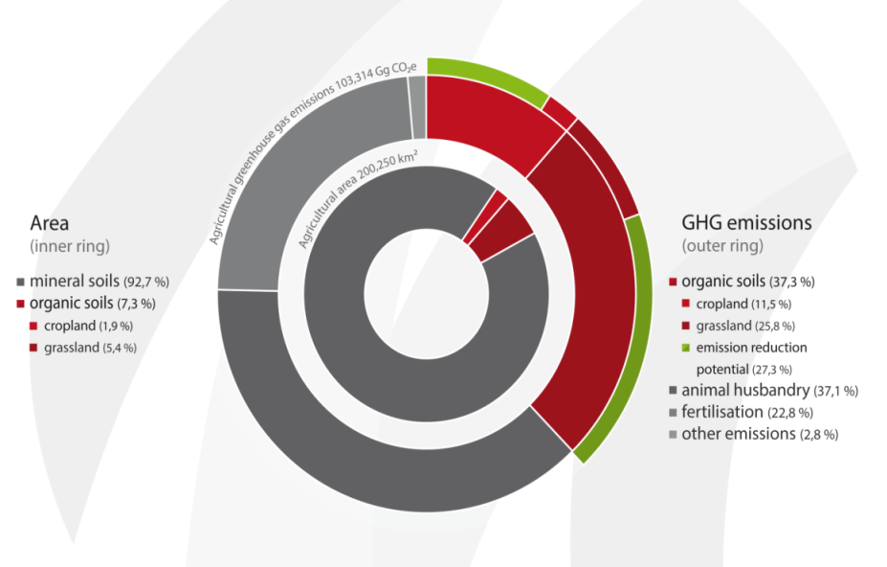

Agriculture in Germany: 7% of land
causes 37% of emissions

Slide 20
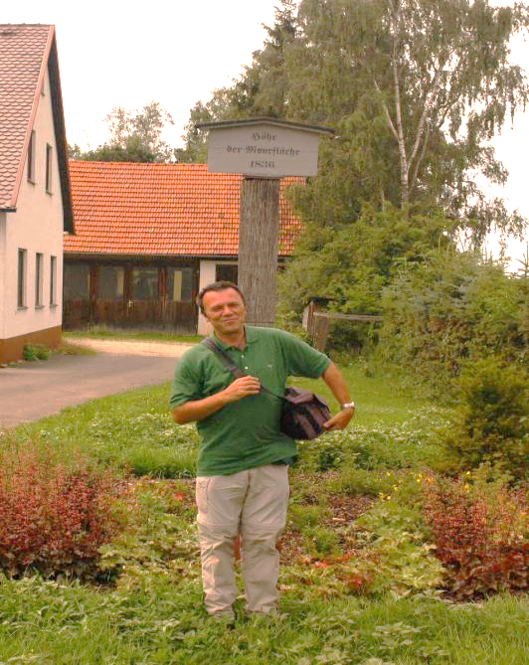
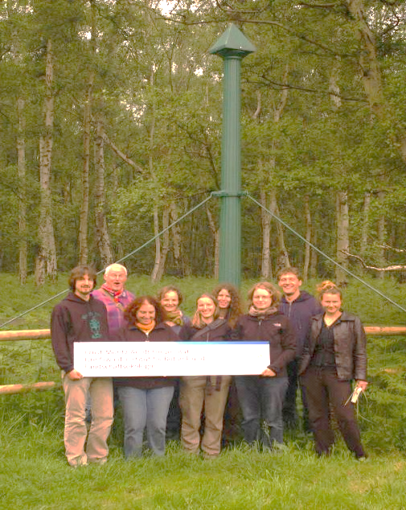
Drainage→ subsidence (loss of height): 1-2 cm annually
former land surface
Bavaria: 3 m loss since 1836
UK: 4 m loss since 1870

Slide 21
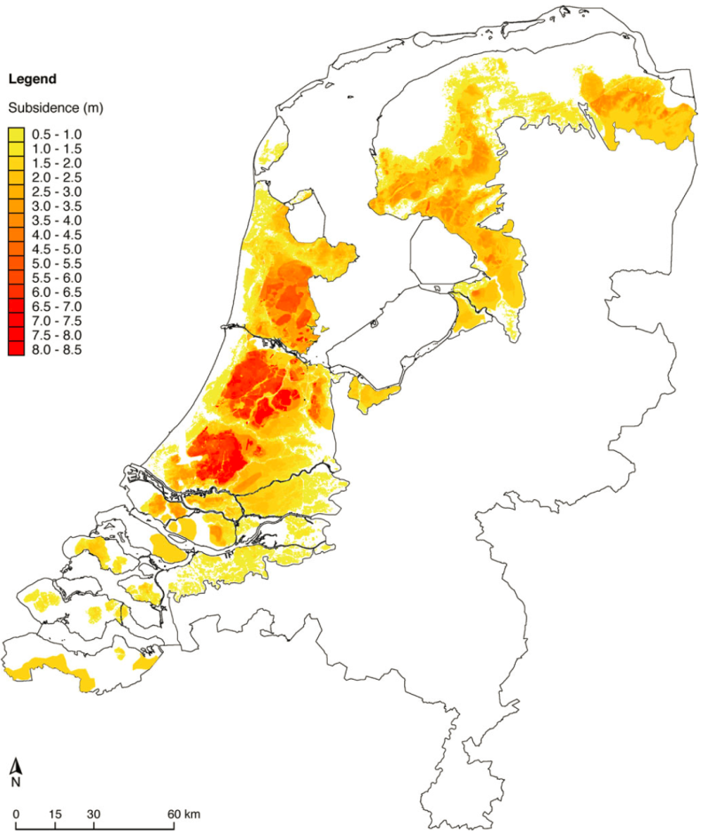
…Nether-lands: bogged down by 1000 yr of peatland drainage and subsidence
8 m subsidence

Slide 22
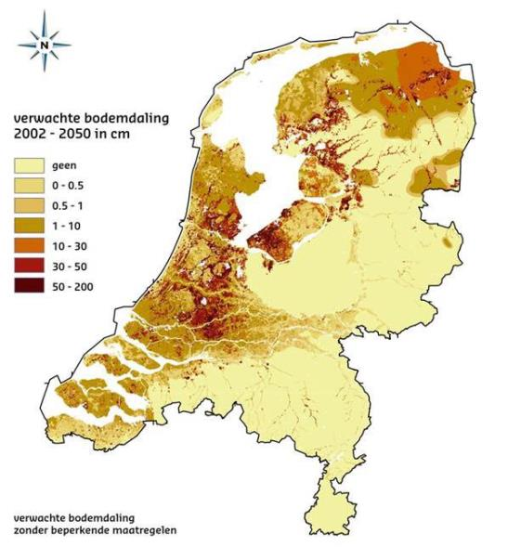
…and subsidence continues…
In
tropics
subsidence
5 times faster!

Slide 23
Whereas the sea level rises, we bog the peatlands down….
start of drainage
height
Subsiding peatland surface
Tidal range
Rising sea level
time

Slide 24
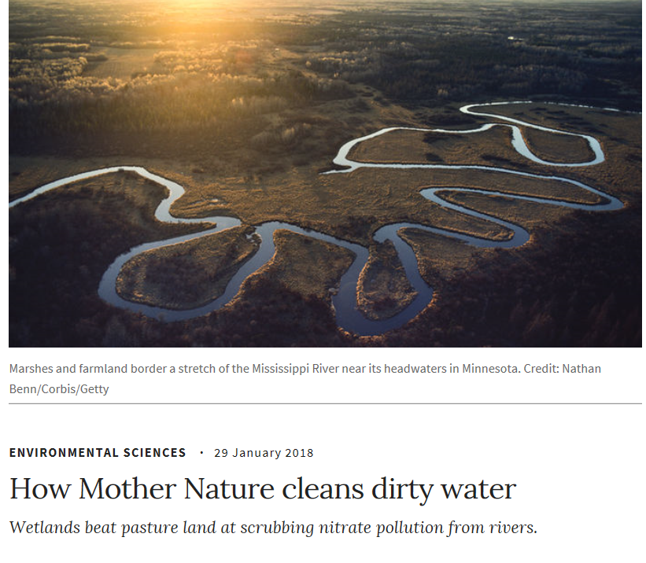
„Kidneys of the landscape“: Nutrients
Balance of nutrients in peatlands dependent on their status (natural, drained, rewetted, managed,...)
Wet peatlands as Wetland Buffer Zones
  Sedimentation, reduction,
  sequestration
  Export of nutrients by harvesting
  biomass
  Elimination – Denitrification
  Carbon sink

Slide 25
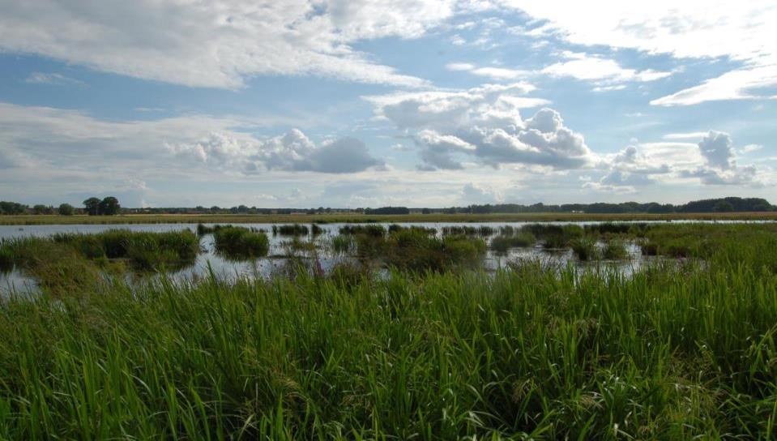
Rewetting solves most of the problems
Germany

Slide 26
< 2º → 0 emissions by 2050: me, you, we:
no more excuses
→ The longer we wait, the faster we must reduce
IPCC 2018 SR15

Slide 27
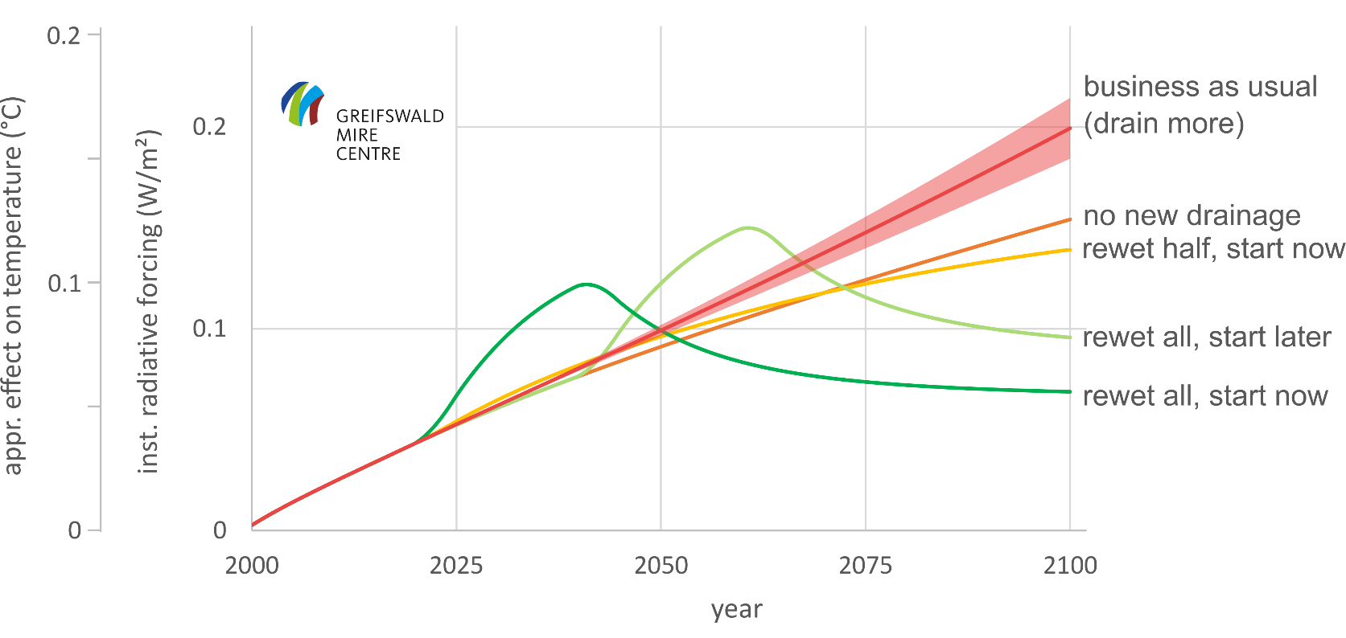
Rewetting
source: GMC Global Peatland Database, graph & calculations: J Couwenberg & A Günther

Slide 28
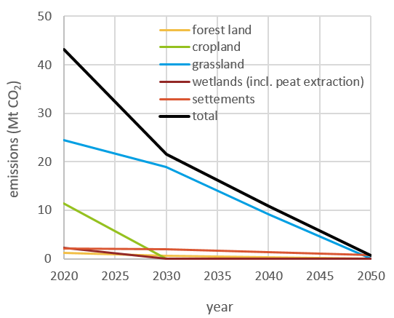
Transformation pathway for Germany
Notes:
Diese Abb. Zeigt die CO2 Emissionen aus den Moorböden. Die schwarze Kurve zeigt die Abnahme bis 2050 nach dem dargestellten Szenario.

Slide 29
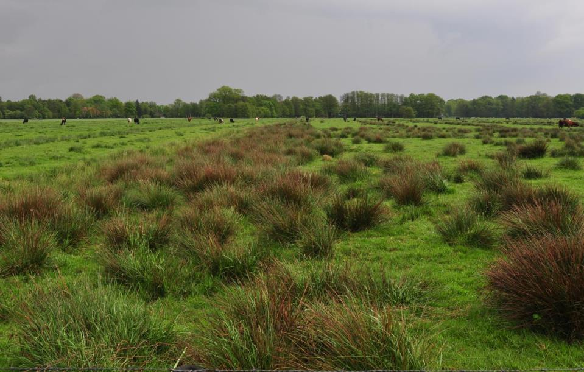
But we cannot flood all 500,000 km² of drained peatland worldwide and take them out of production
Lower Saxony

Slide 30
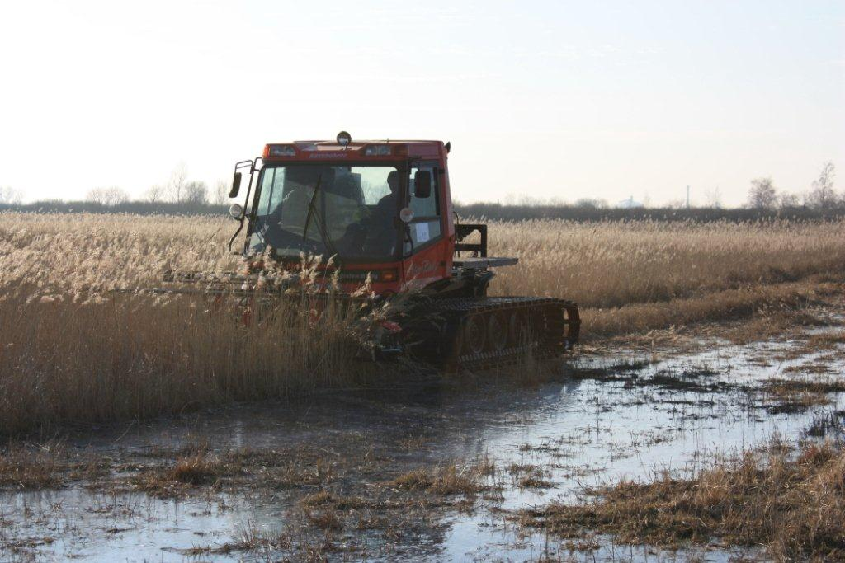
We must solve the drainage problems while maintaining production: i.e. with paludiculture
Mecklenburg-West Pomerania

Slide 31
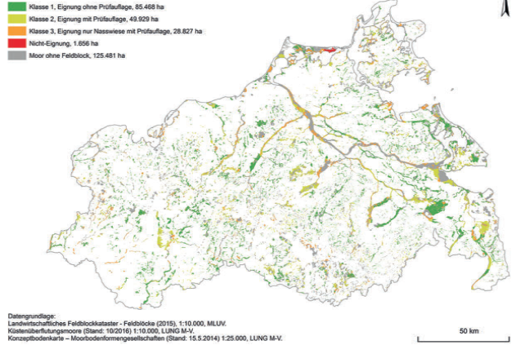

Paludiculture Strategies
Clear delineation of potential areas
Involvement of all stakeholders
Baltic states:
(in prep.)
German Federal State MV:
Notes:
Agricultural administration initiated paludiculture land classification in 2017

Slide 32













Development of sustainable peatland management
by restoration and paludiculture for nutrient retention
in the Neman river catchment
(DESIRE)
Period: 01/2019 – 06/2021
Partners in LT, PL, RUS, D, (BY)
Notes:
Baltic Env Forum Lithuania

Slide 33



Thanks for your attention!
Jan Peters
Michael Succow Foundation, Partner in the GMC
Peatlands & Climate Change
jan.peters@succow-stiftung.de
Follow us on Twitter:
@greifswaldmoor

