Slide 1
Reducing greenhouse gas emissions and creating a sustainable economy
Creating A New Approach to Peatland Ecosystems
Manchester, 12th June 2019
Notes:
Creating a New Approach to Peatland Ecosystems – What does this mean?

Slide 2
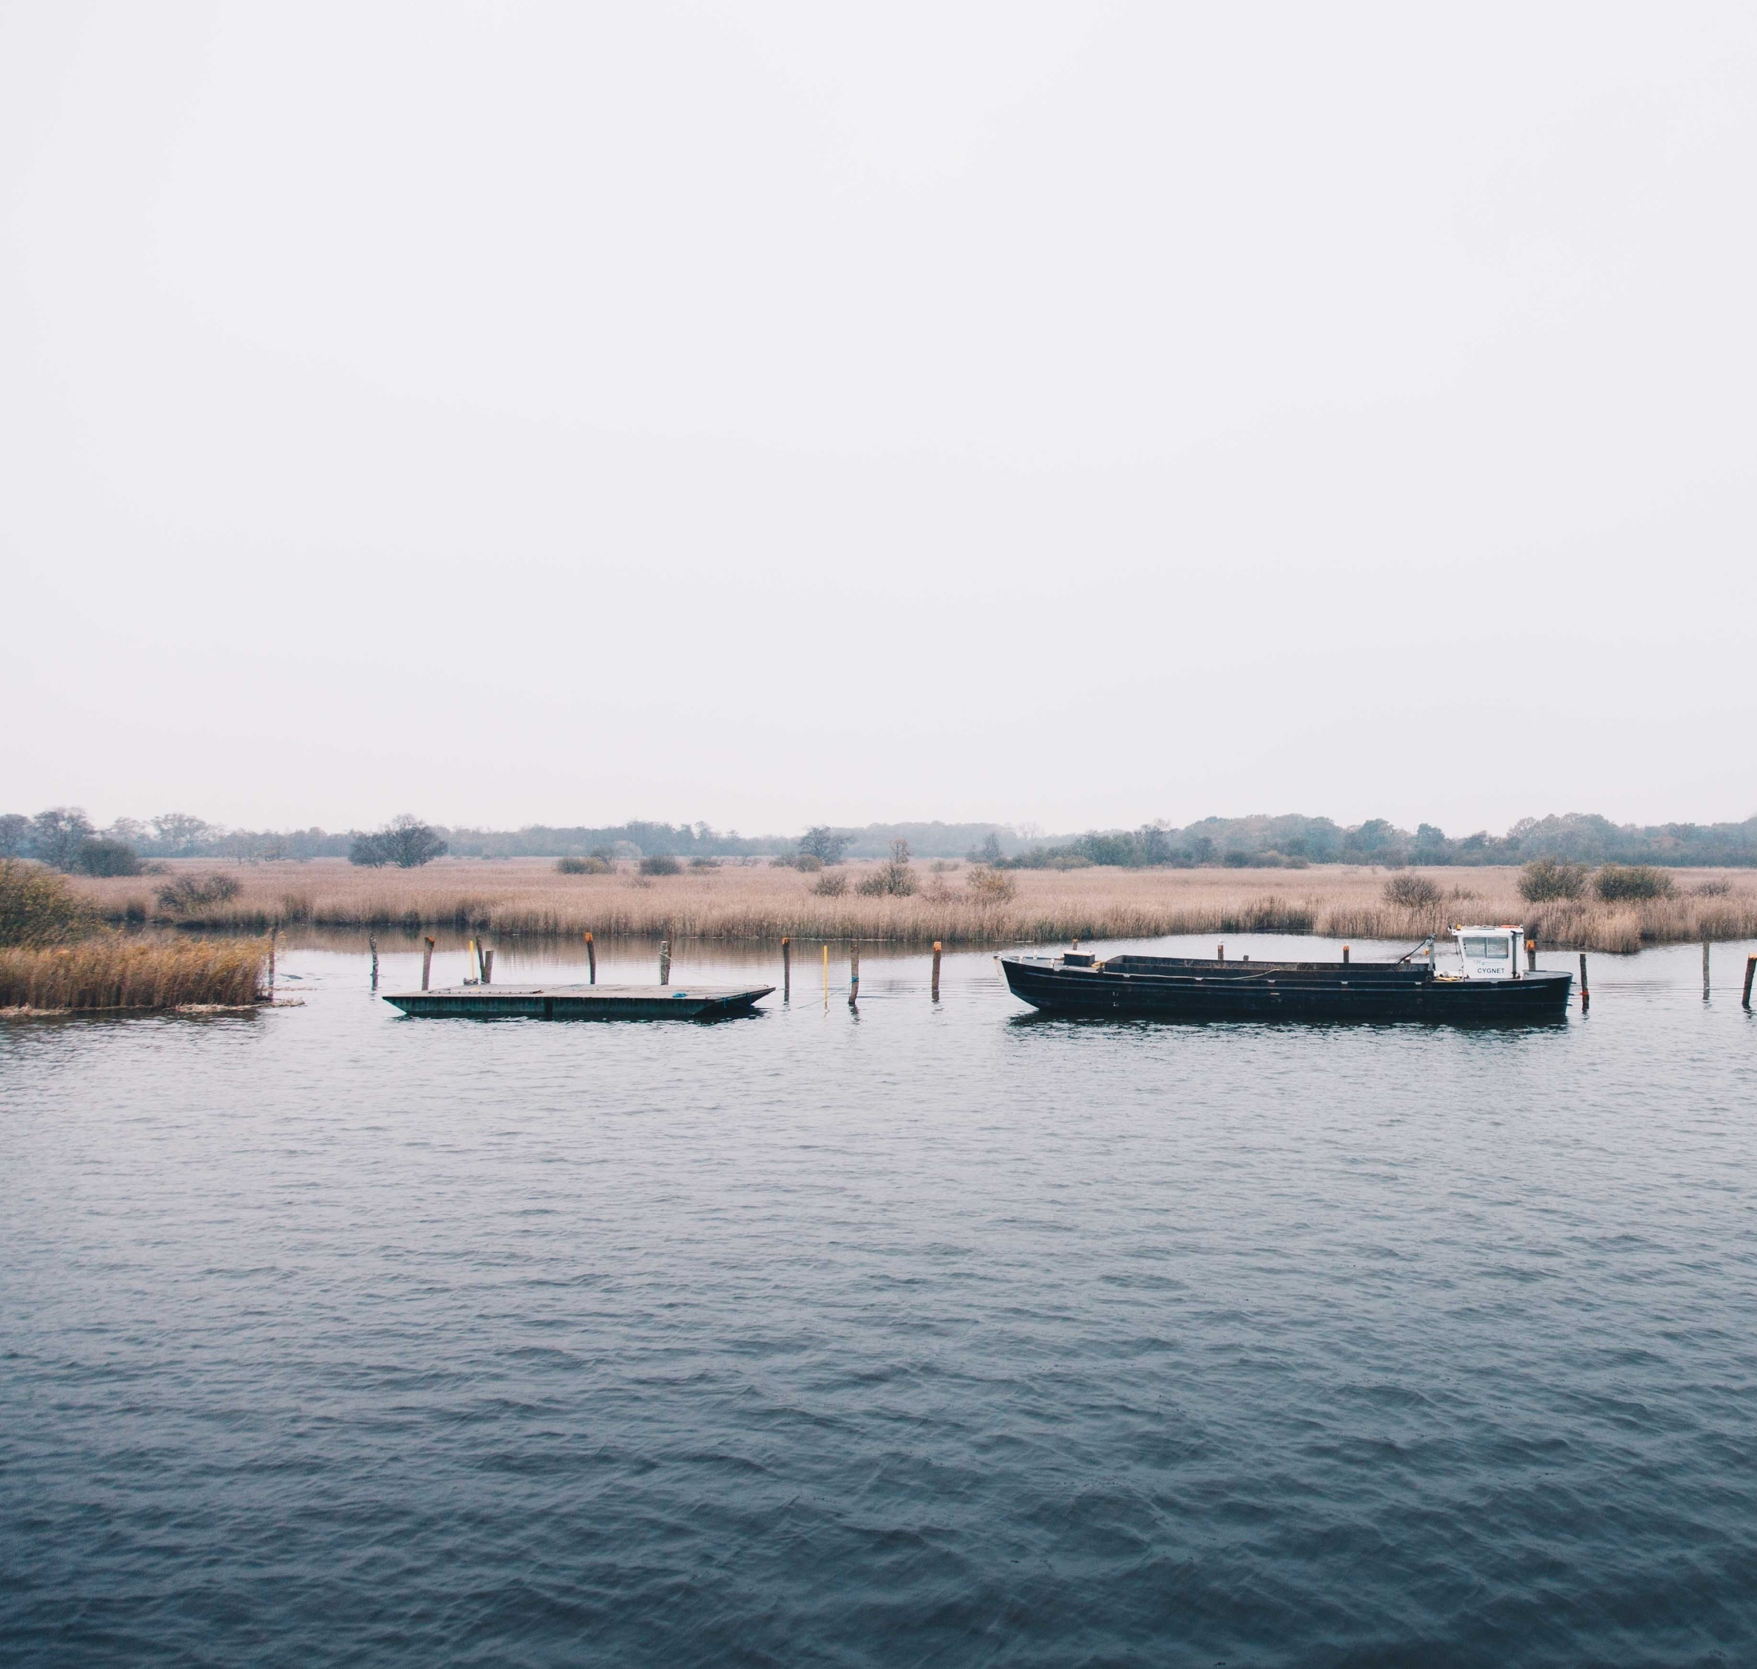
CANAPE
> 90ha of restoration
3 lakes restored
1640 tonnes of CO2 savings per year
Demonstrating sustainable peatland products
Notes:
The Broads Authority is leading the CANAPE Project with 14 organisations across 5 countries.
CANAPE is a wide ranging project, we are working with a budget of 5.45 million, 50% funded by the ERDF through the Interreg North Sea Region Programme. BA share is about 1.5 Million
The underlying theme is better management of peat in the wetland ecosystems of the North Sea Area.
168 000 cubic metres of water storage.
We want the public to change, farmers to change, conservators to change, and our experience is on the practical hands on delivery. Demonstrating that this can be done. We are not a research project, our organisations do not have the capacity for frontline research.
Focus on Northwest Europe peat, fens, bogs, rivers and lakes. Lowland Peat.
Very much the focus is on delivery, what can we do as land management organisations looking at is how to go beyond this, how to start pushing a wider change in how the wetlands are managed.

Slide 3
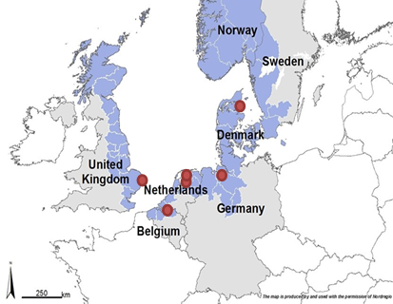
Our locations
Notes:
Total partnership of 14 organisations, 5 countries. The Key partners are Natuurpunt (BE), Hunze en Aas (NL), VHL (NL), Landkries Deipholz (DE), DNA (DK). Shown within the area of the North Sea Region Programme.

Slide 4
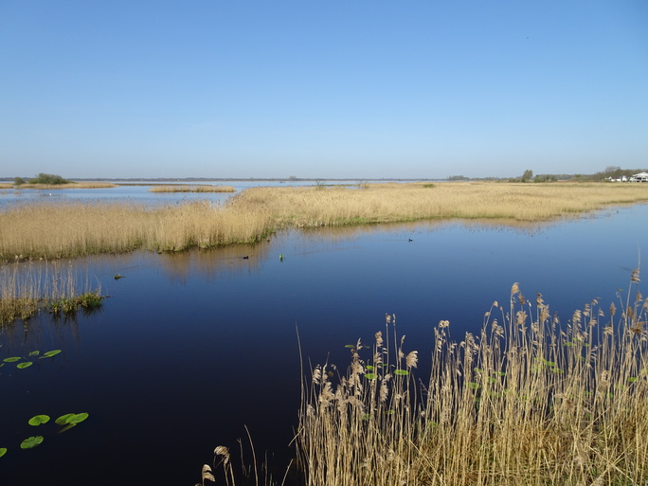
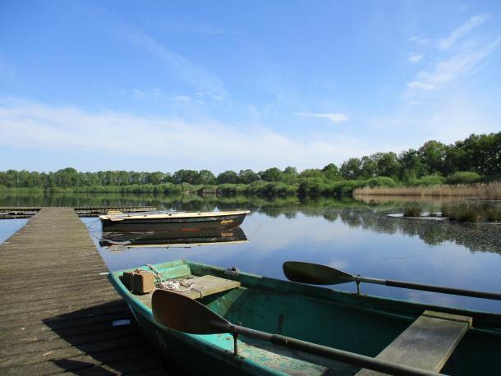
Our locations
4 Lakes
Hickling Broad
Zuidlaardermeer
Holter Meer
De Leijan
Notes:
Broadly speaking we are working across 8 sites, although we have a number of other areas we will have some impact on.
Hickling Broad – UK – will be spoken about more
ZL – NL
HM – DE
De Leijan
Talk a bit about what is being done at each lake – Zuidlaardermeer restoration measures, Holter Meer is being designed using PC Lake. This is a Dutch water authority method for mathematically modelling Shallow lakes.
Developing the learning has already led to a BA spin off project called “Tipping the Balance” using the modelling to inform flipping the state of some of the currently Eutrophic Broads Lakes. This would be the first use in England (previously only used in Scotland) – could be major climate benefits of restoring plant life to the broads.
Managing for better water quality whilst still providing the area for recreation.
The basic test is you should be able to see the bottom – these are all shallow systems, if you can’t see the plants something is wrong.

Slide 5
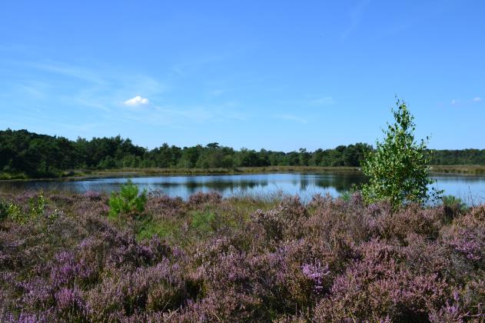
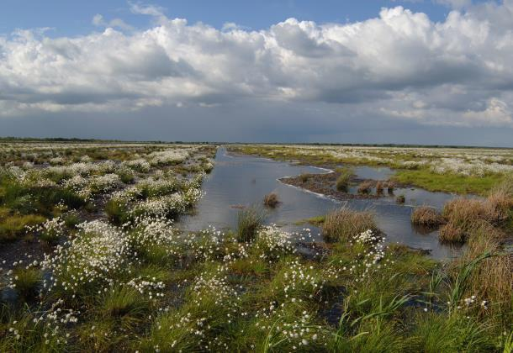
Our locations
4 Bogs
De Nol
Lille Vildmose
Store Vildmose
Barver Moor
Notes:
De Nol – BE
Lille Vildmose – DK
Store Vildmose – DK
Barver More – DE
(Pictured – De Nol and Lille Vildmose)
NB: De Nol is heathy bog.

Slide 6
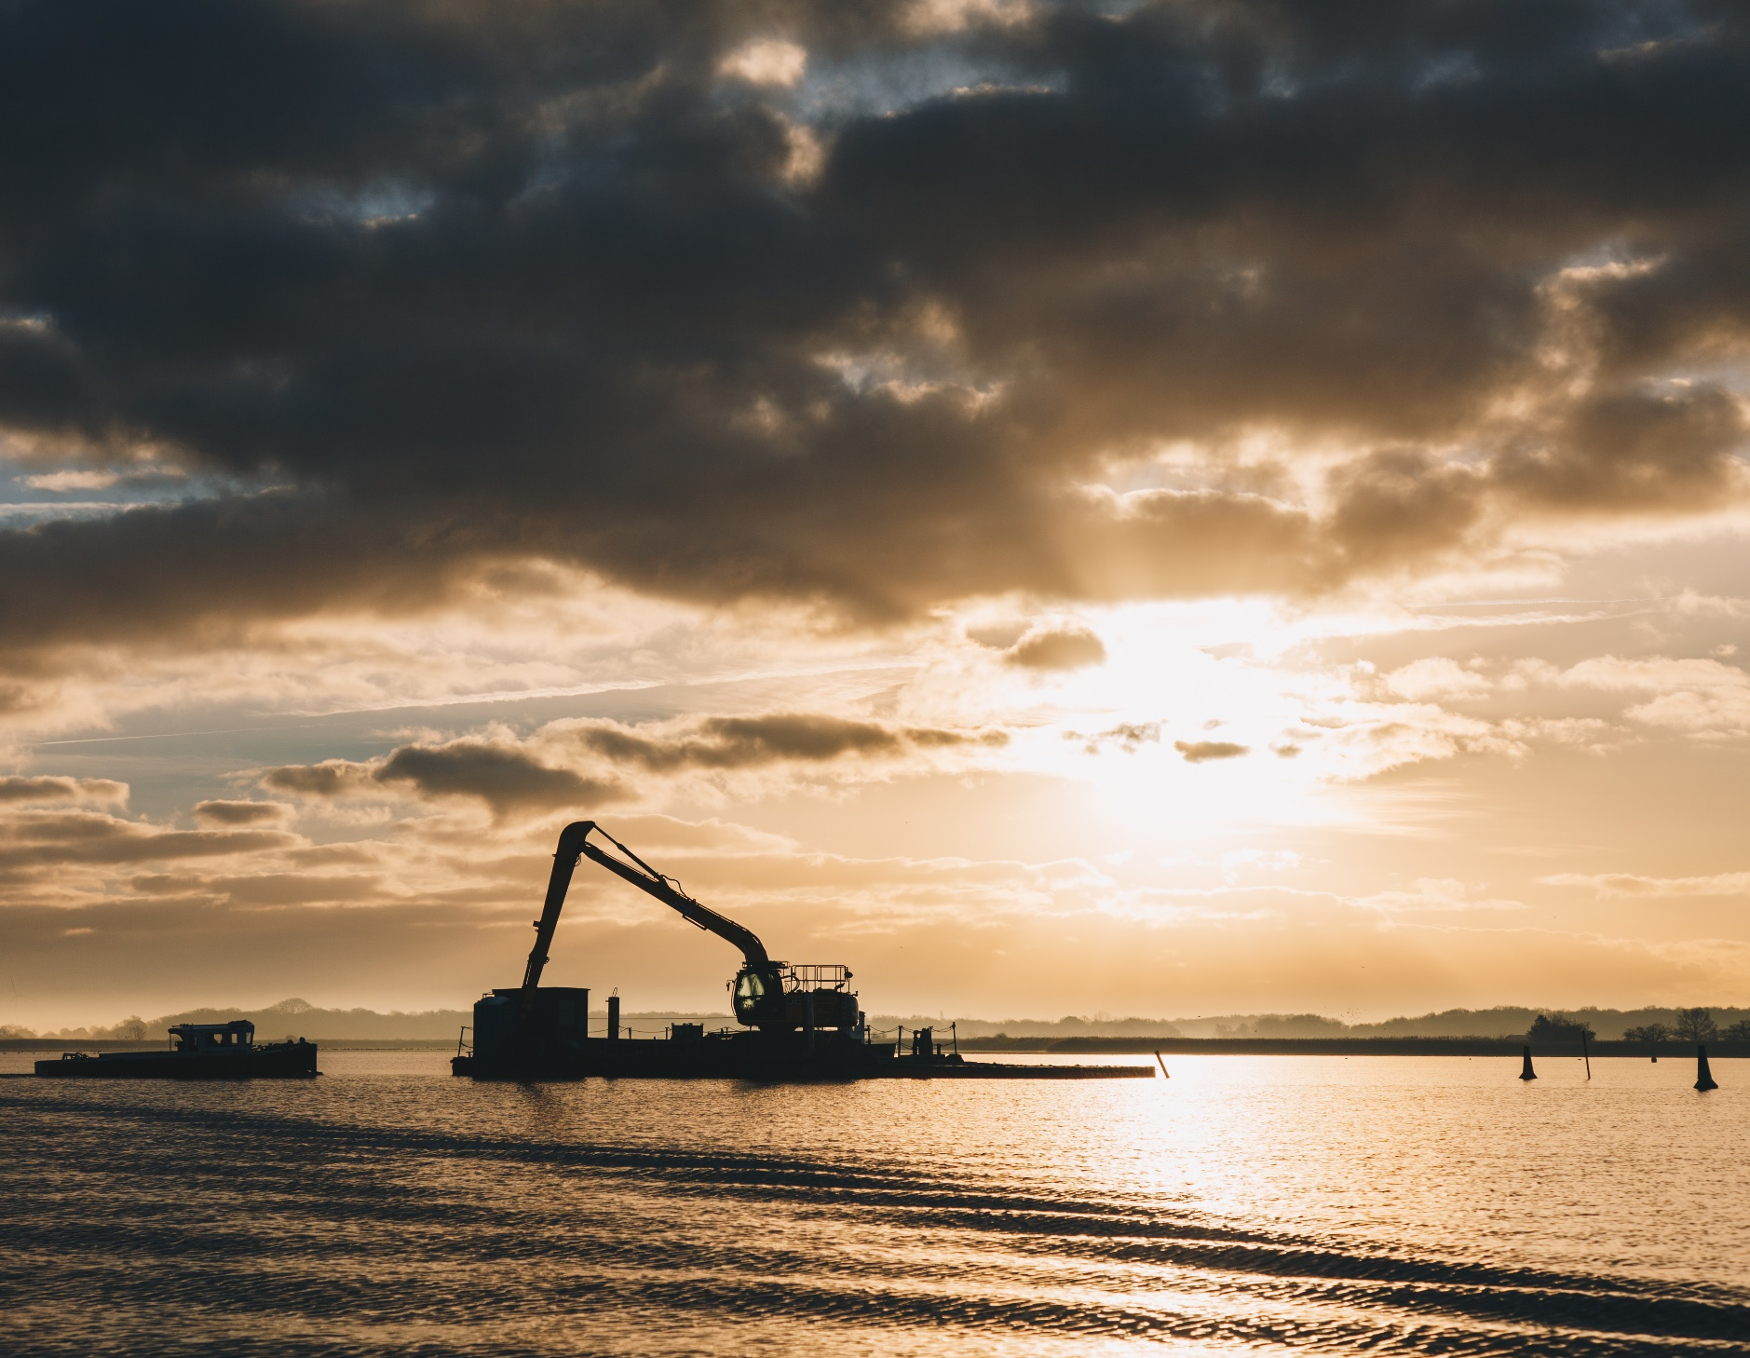
WP3 – Create Resilient & Integrated peatland systems
Hickling Broad
1 ha Reedswamp creation
19,000 m3 of sediment dredged from channels
Creation of still water “refuge” area
Notes:
Work within the National Nature Reserve managed by Norfolk Wildlife Trust
Describe Hickling – for those that are not familiar with the setting 600ha/6km2
– as the navigation authority the BA has the responsibility to dredge the marked channel and keep it open for navigation.
This leaves a large amount of peaty sediment to dispose of – can be spread on fields but needs a suitably adjacent field.
– Potential to result in substantial carbon release.

Slide 7
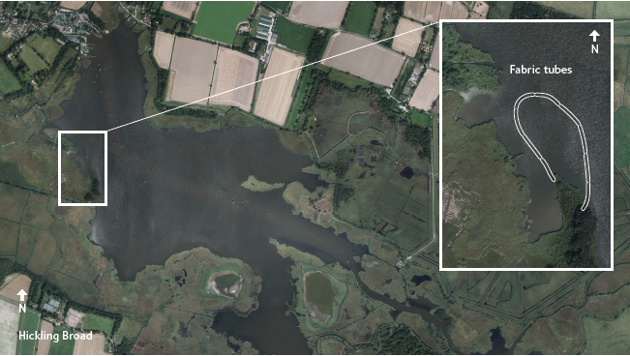
WP3 – Create Resilient & Integrated peatland systems
Notes:
Dug for peat and gravel, forms the boundary of 3 historic parishes that all had peat cutting rights. Back then the river flowed differently, now it is the head of the Thurne river seen in the right hand bottom corner.
Alternative method of sediment disposal – we are building a new peninsula.
Historic aerial pictures from 1946 and 1988 show that there used to be reedbed in this area, however it has eroded away. So this is a restoration of previously existing lands.
Constructed using 9 geotextile tubes
Will create a sheltered area behind the area, which will hopefully allow stoneworts to establish
Should imrpove over all water quality with extra filtration, and less suspended sediment from boat propellers.
Aerial Shot of the Broad, showing our plans in the context of the waterway. Total area 600ha.

Slide 8
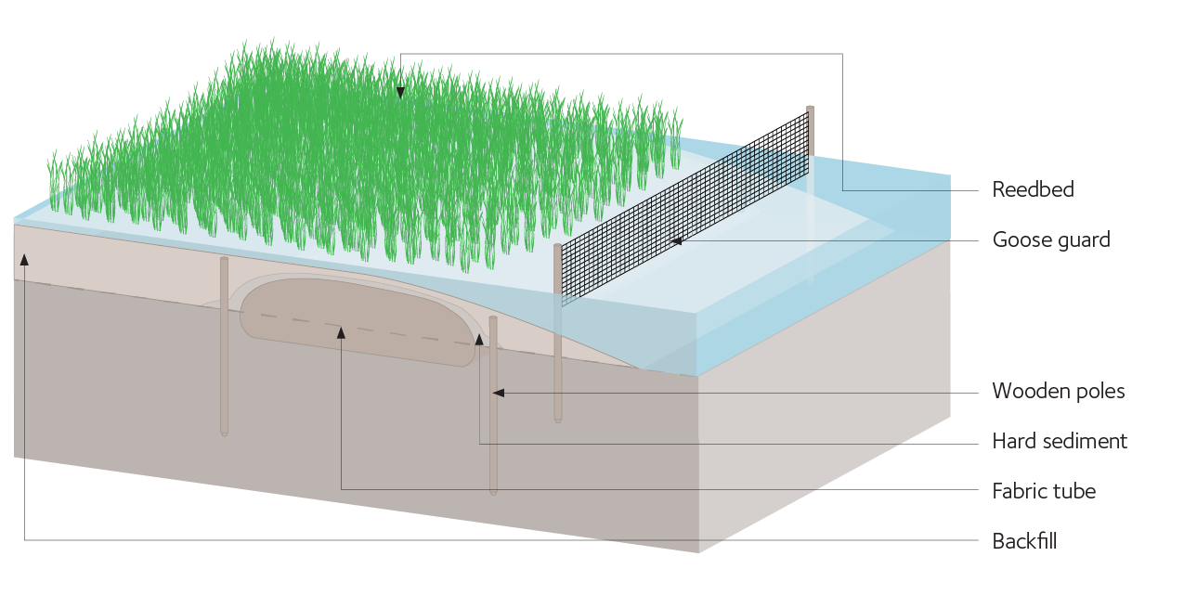
WP3 – Create Resilient & Integrated peatland systems
Notes:
Simple engineering diagram – this shows the cut away of what it will eventually look like.

Slide 9
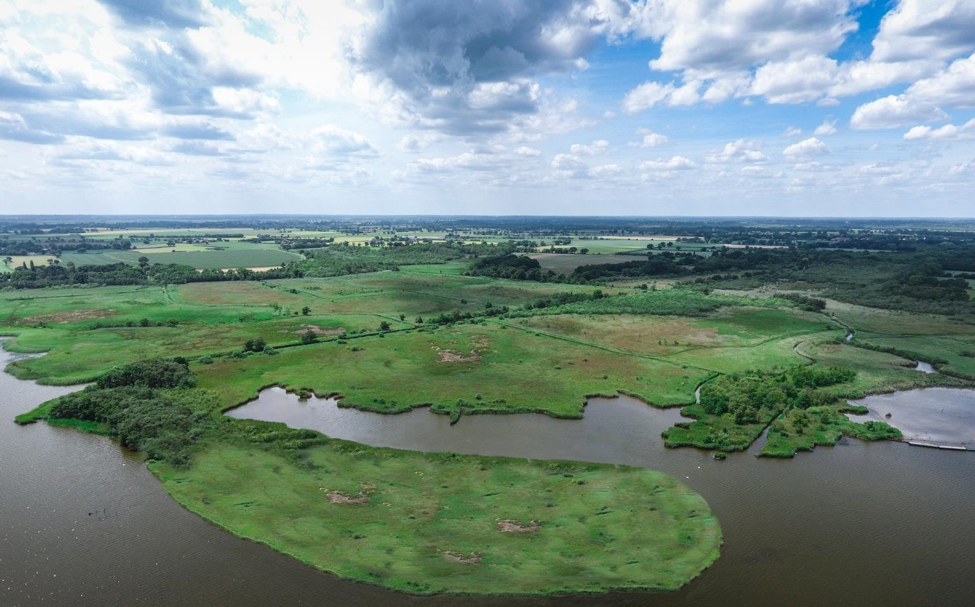
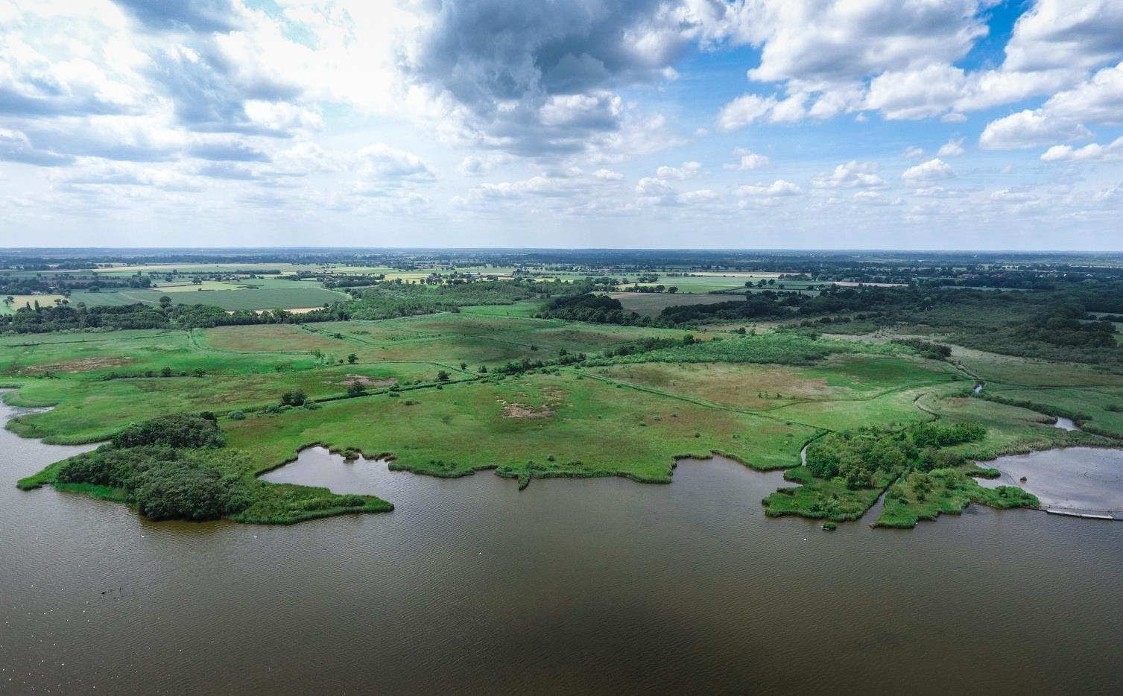
Notes:
Based on aerials taken in the Summer of 2018 – with a photoshop showing our eventual ambition.
This is looking Southwest away from the site, showing the slight rise to the fields that are outside the fen margin, and the network of drainage ditches and dykes cut into the fen. The area is 120m from headland to headland, to give an idea of scale.

Slide 10
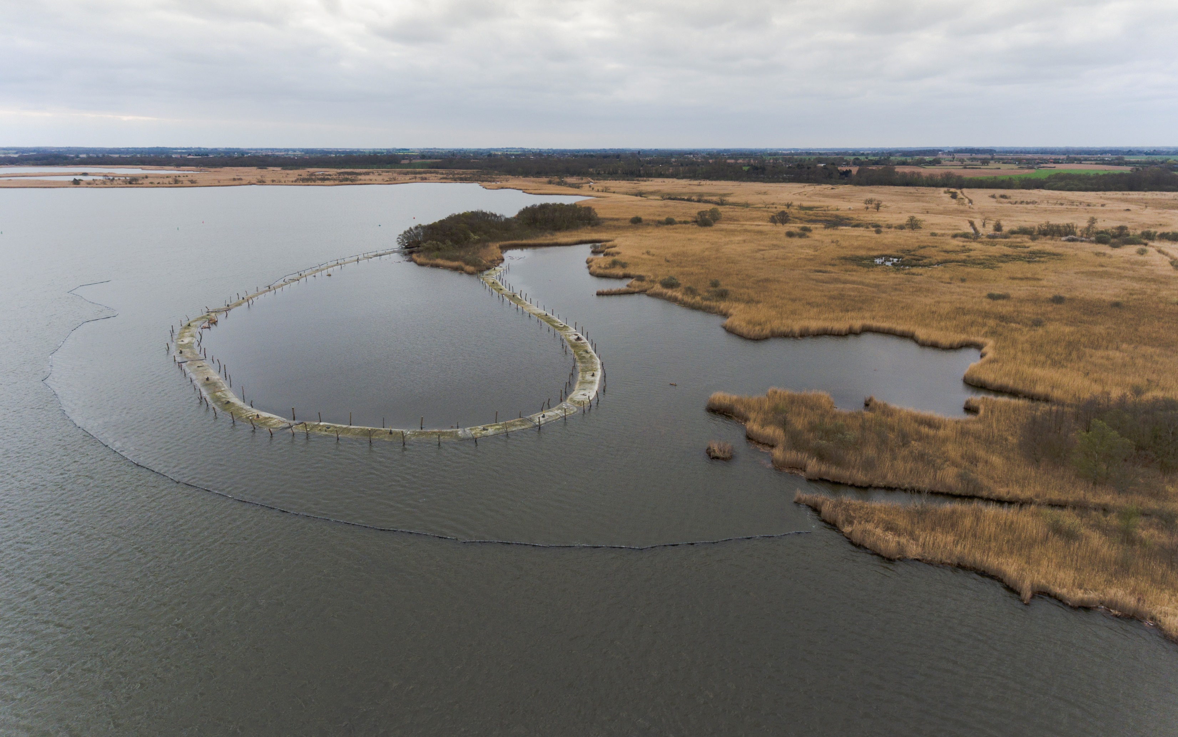
Notes:
11th of April 2019 – Looking Southeast
Construction work has halted at the end of March to ensure that we are not working when the water temperature is above 8 degrees to avoid risks of Prymnesium blooms.
This has already created the still water refuge on the far side, as time goes on further windbreak will be added with reeds growing on the top of the tubes to further guard.
The material of the tubes is designed to allow plant roots to grow through them.
Approximately 1ha included in the area

Slide 11
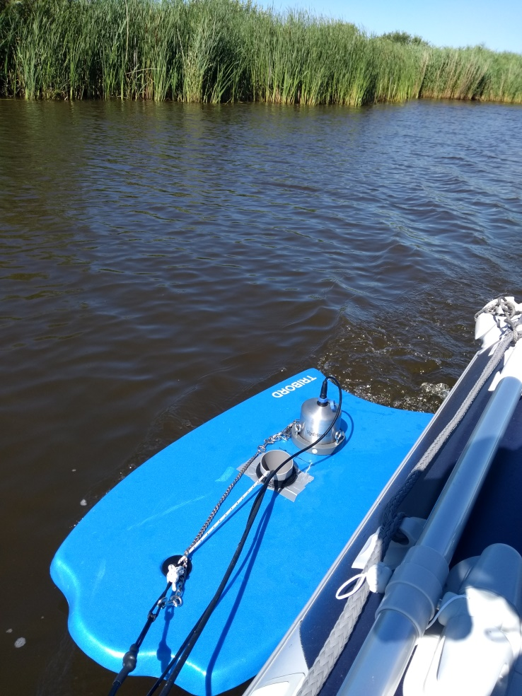
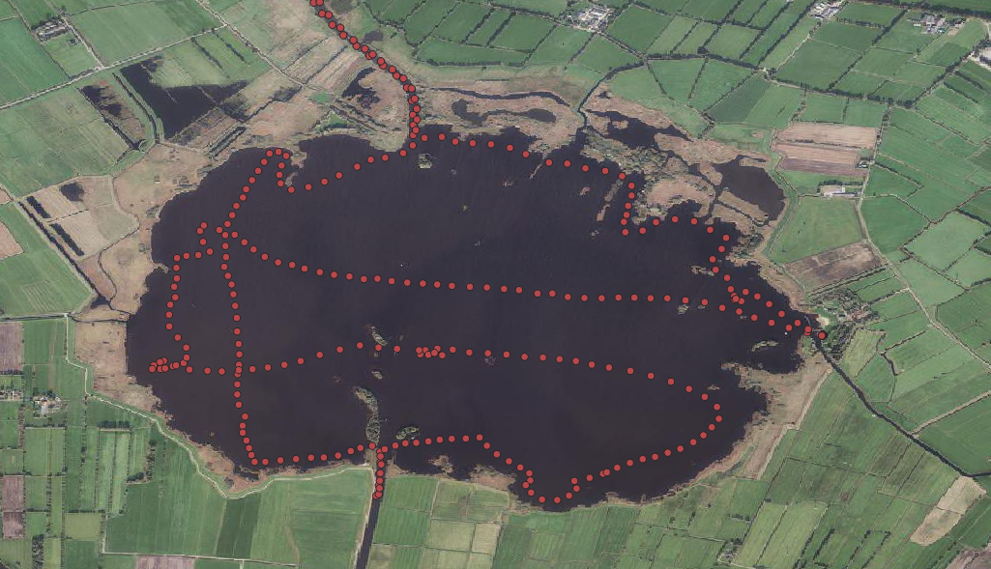
WP3 – Create Resilient & Integrated peatland systems
WP3 – Create Resilient & Integrated peatland systems
Notes:
Moving on to work being carried out by our partner Van Hall Laurenstein University in the Netherlands.
They are working on a project on Lake de Leijan, comparing spatial water quality with fish tracking data, to understand better the ways the water is behaving.
They are building a spatial map of water quality using a Water quality Sonde, mounted on a floatation device, and towing it around the lake. Working to develop better software and tools for this work.
This will be linked to work being done by the local angling association to tag and track fish, helping them understand how fish respond best to the water quality. Local anglers are taking part in tracking work as a citizen science.

Slide 12
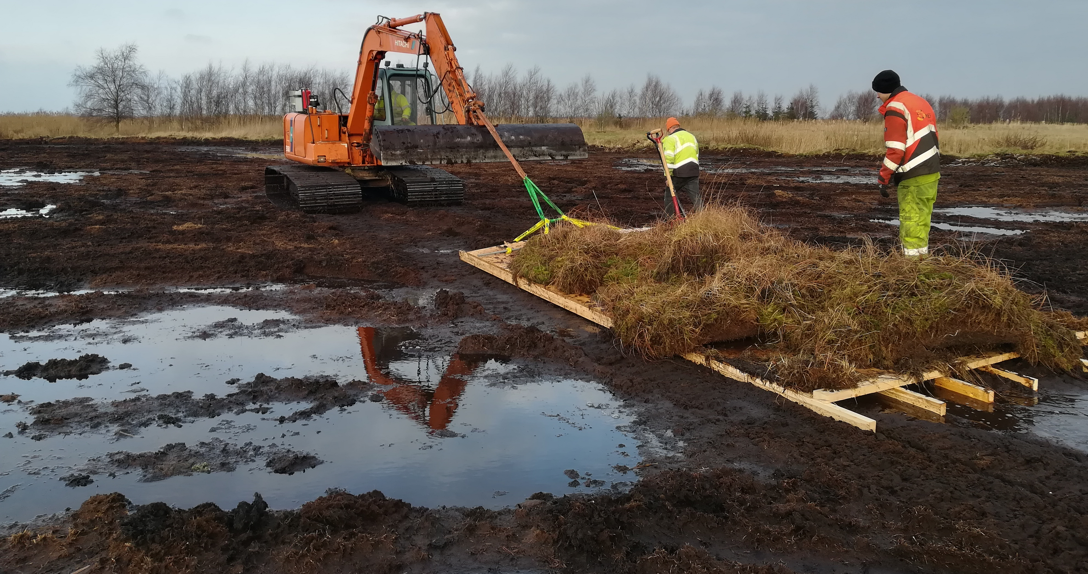
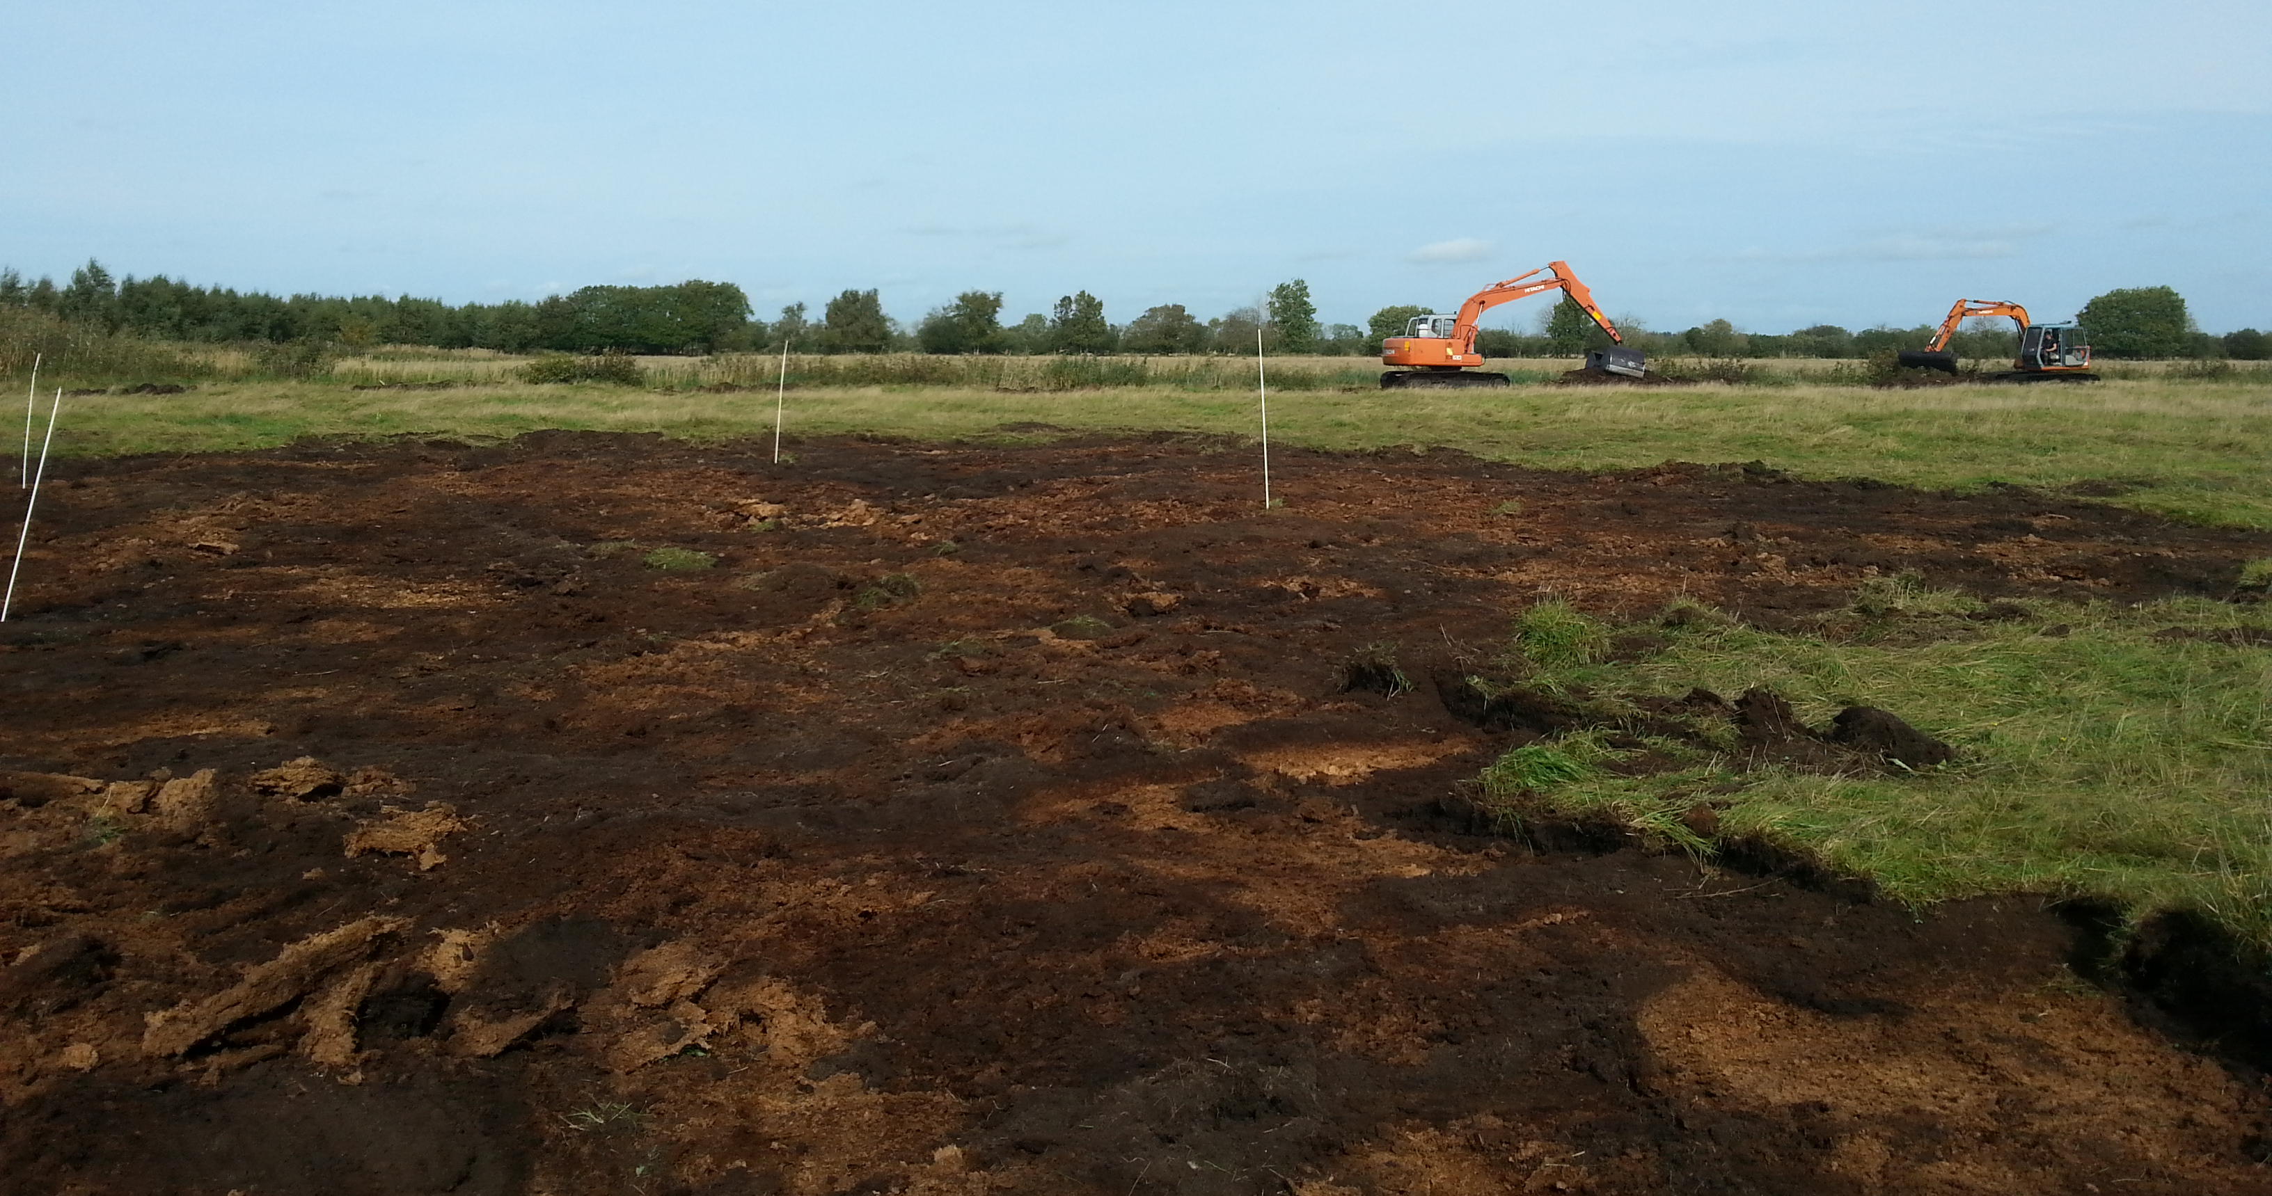
WP3 – Create Resilient & Integrated peatland systems
Notes:
This is Lille Vildmose in Denmark – our partners have begun their work on bog restoration with removing the mineralised top soil. The objective is to have an additional 2-3ha of rewetted bog within the RAMSAR area. First bog in Denmark to have the RAMSAR dedication recongising international climate importance.
Removal of the top 30cm of topsoil is necessary to reseed the sphagnum, and also because the hydrology of the area does not allow this area to have its water level to that point without flooding the surrounding roads. There is an inevitable carbon loss from that, but should be offset somewhat by faster resubmerging with water. Also avoids the methane spike that is known to sometimes occur with stripped soil.

Slide 13
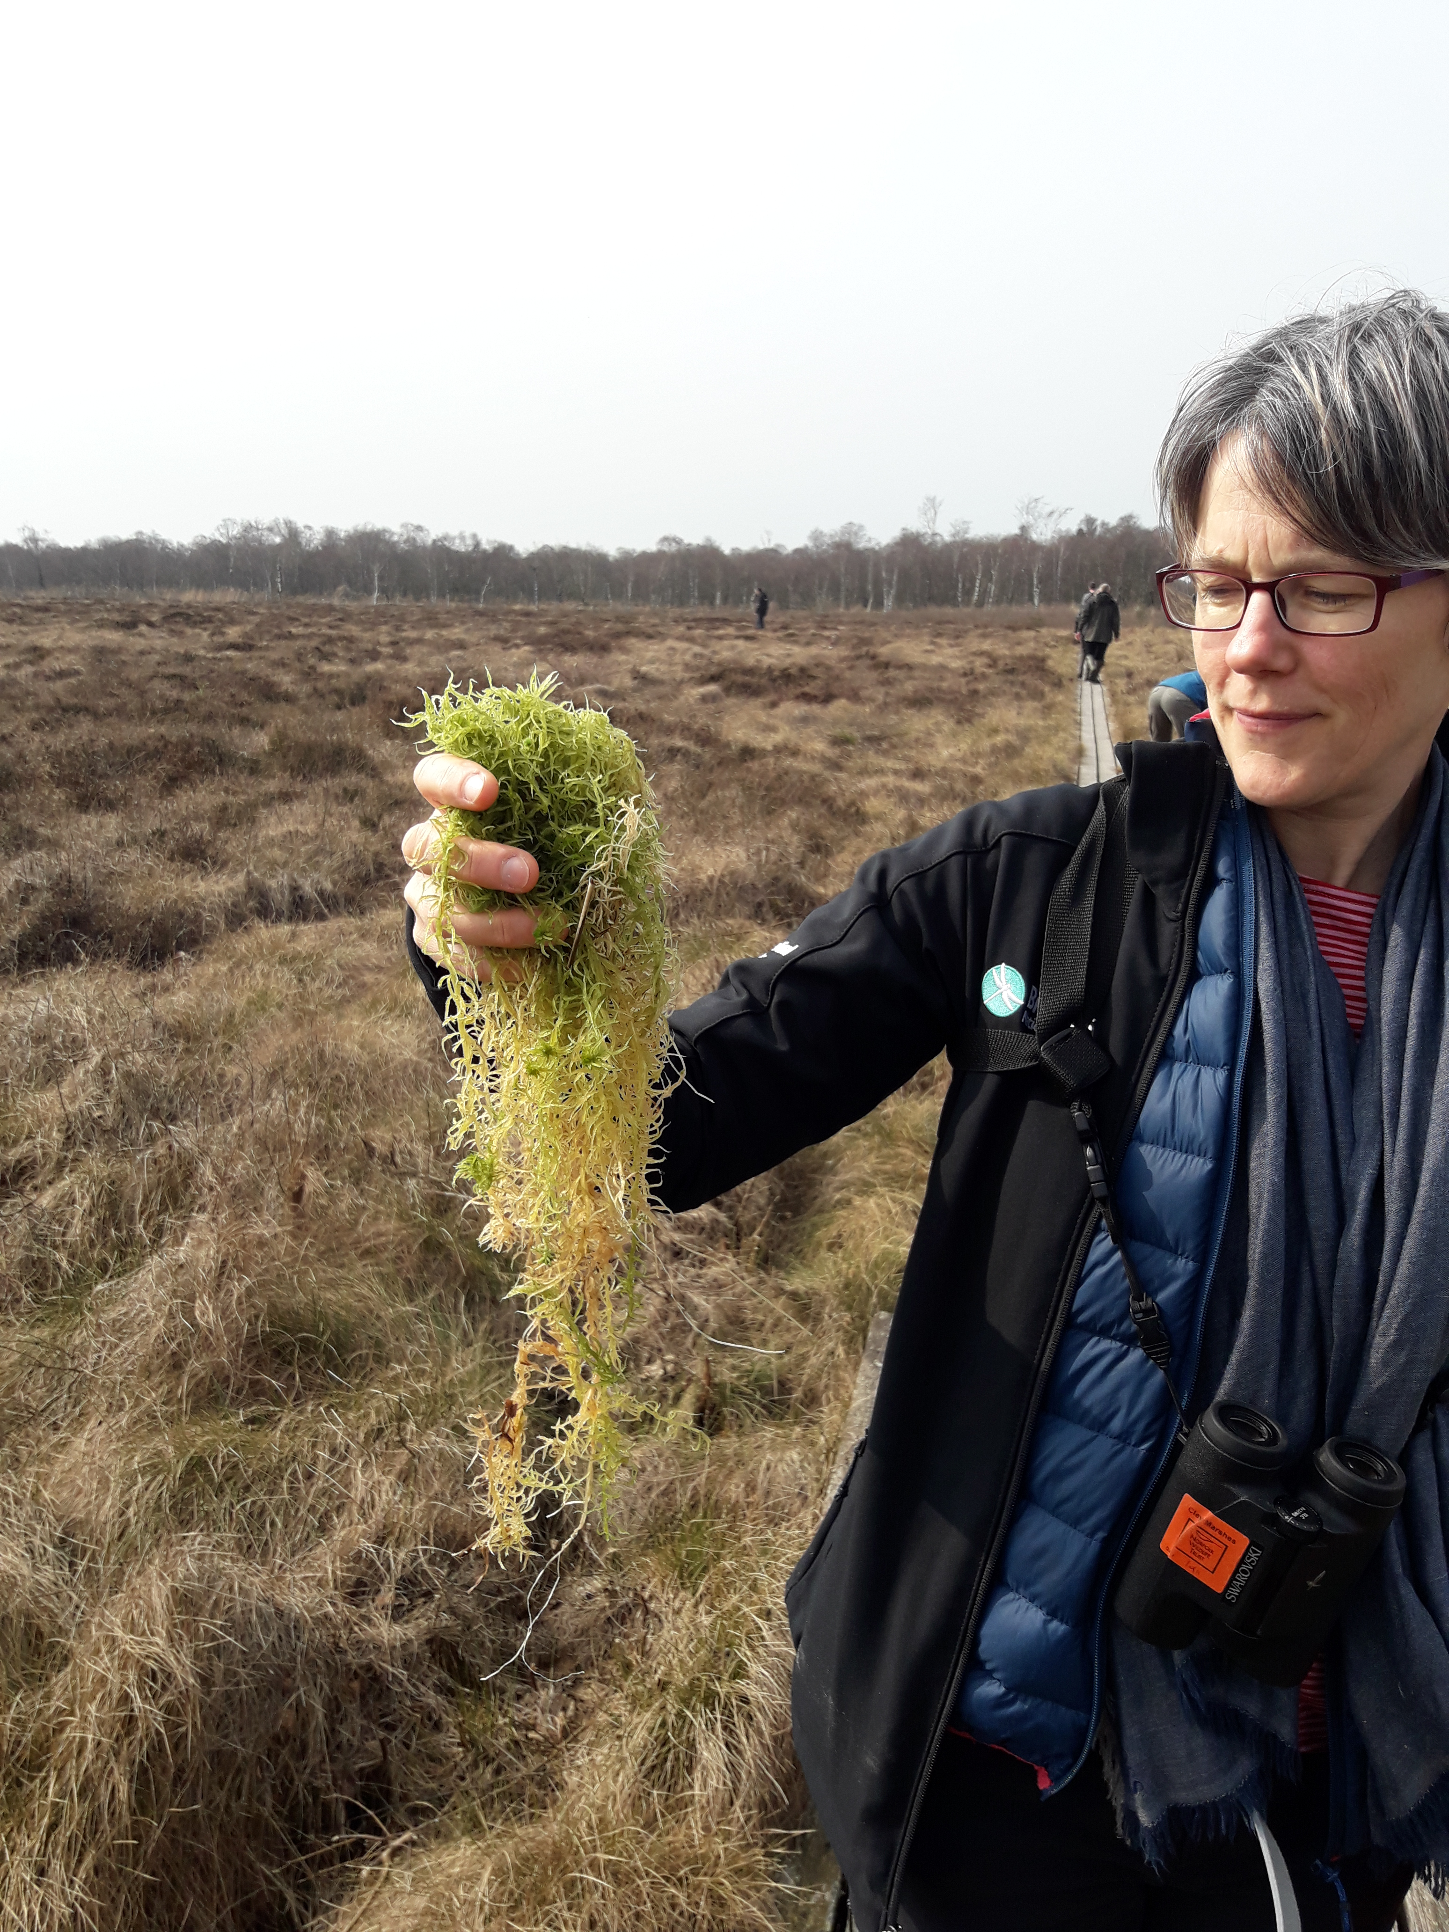
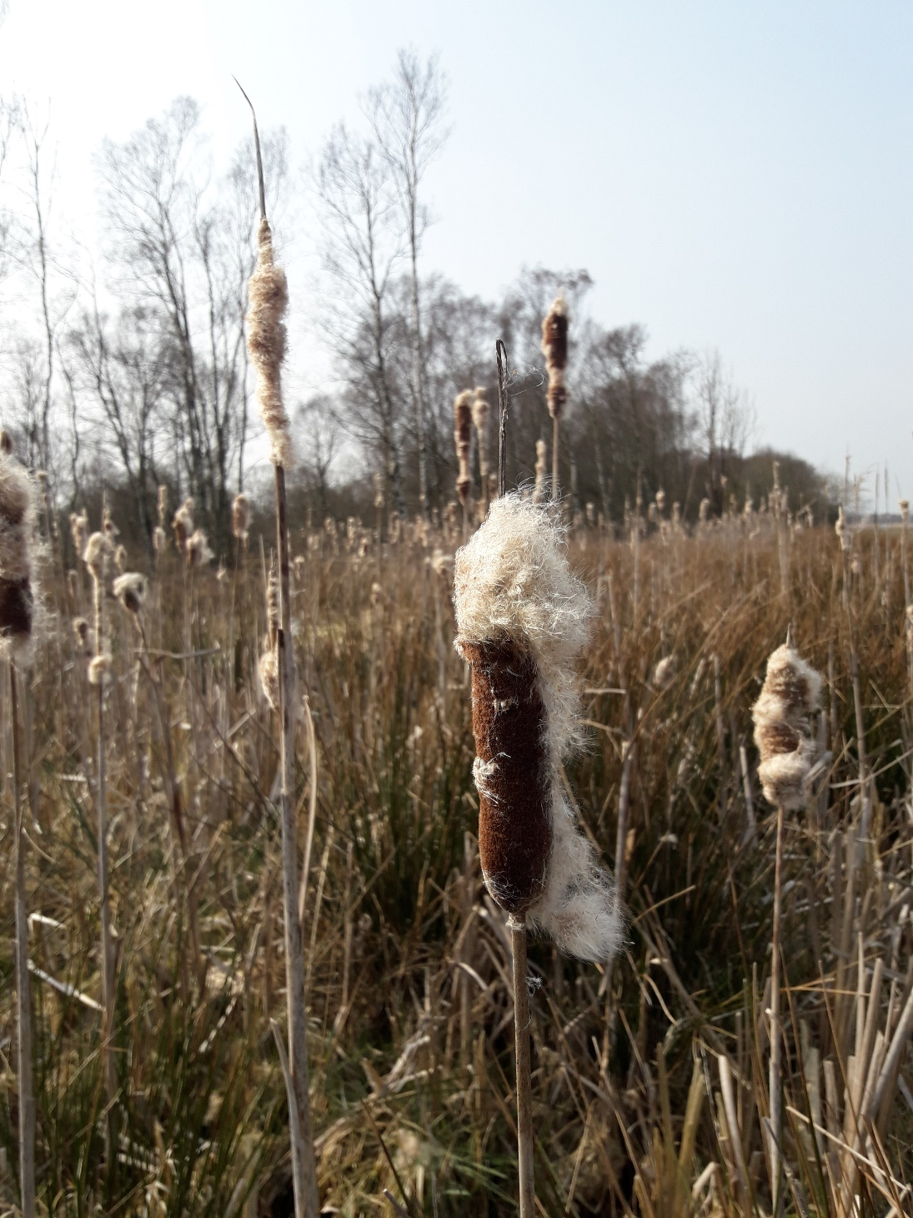
WP4 – A sustainable & Marketable Future for peatlands
Notes:
Paludiculture – the project is not going to be able to break new ground in this area as a research basis – this is about demonstration. The technology exists, we want people to use it, so the projects are market focused, towards getting people to grow. In each of our respective regions trying to raise awareness, among the farming community, and the political community, and the wider public . Looking at where we are, the products are there, the demand and funding now needs to come onboard.
Looking at the recently published UK peatland inventory – their best case scenario, the stretch scenario, is that by 2050 we achieve 35% reduction in UK peatland emissions. That leaves around 4% of UK current emissions just through drained peat in a year that we are supposed to be carbon neutral. Their standard scenario is only 18% reduction – assuming all current policies and aspirations are fulfilled.
In the UK, arable and intensive grassland are the largest per unit emitters. Arable is about 1/3rd of UK emissions, despite being only about 7% of the peatland in the UK. Big opportunity to cut emissions. Sphagnum Moss farming – sphagnum Mosses
Alternatively, our partners in Denmark are exploring the option of Typha, based on work done by the GMC in Germany. The Typha has the advantage of being possible to grow on nutrient rich soils. It has many potential uses, initial experiments have focused on its capacity to work as an insulation Board. Other possibly uses include as a food crop, and a growing media mix.
Underlying problem – there is no subsidy for this – this is not regarded as agriculture under the European Common Agricultural Policy. No subsidy, no profit in comparison to other agriculture. Drained land + cows = subsidy – even though not viable in economic sense and definitely not in a climate sense.

Slide 14
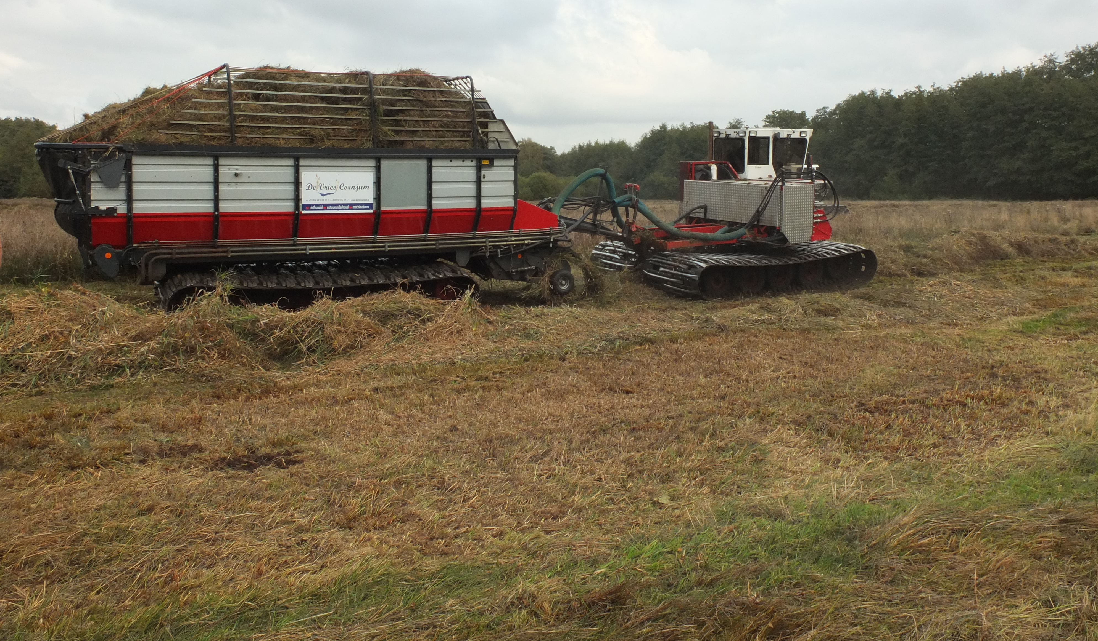
WP4 – A sustainable & Marketable Future for peatlands
Notes:
Picture from Natuurpunt – that is a lot of grass to deal with. – Katrien will perhaps be better able to present the work that has been done previously with Grasgoed.
Our next challenge is also about making an add-on revenue stream from our conservation work. This is not about agriculture, but the huge quantities of green waste we produce each year.

Slide 15
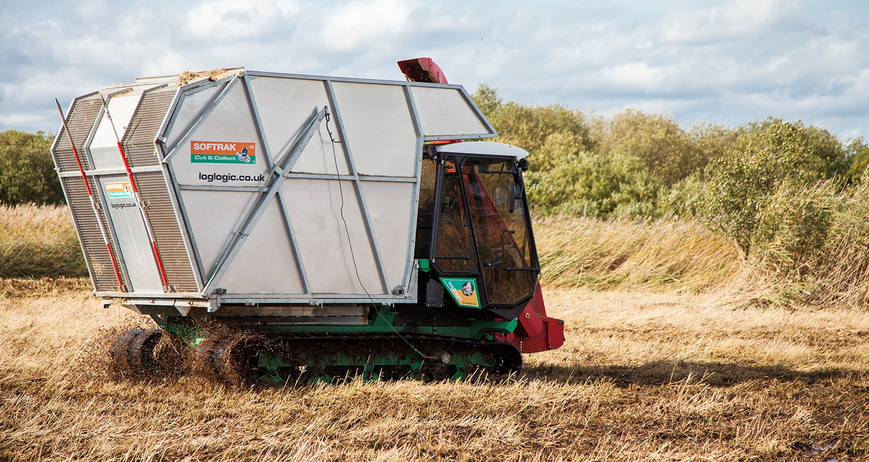
WP4 – A sustainable & Marketable Future for peatlands
Notes:
Broads Authority operates in a similar environment cutting reed. Actually own the same machines as Natuurpunt.
Phragmites Reeds – Another big area of challenge for us as an authority is dealing with reed offcuts. Fenland management requires cutting of the beds, we use the pictured softrack cutter (pictured) for this purpose. Again, we simply have heaps of material building up, or end up burning it.
Possible uses as a biofuel – has been explored but without meaningful subsidy the economics of this simply do not add up. This is the underlying problem of all paludi.

Slide 16
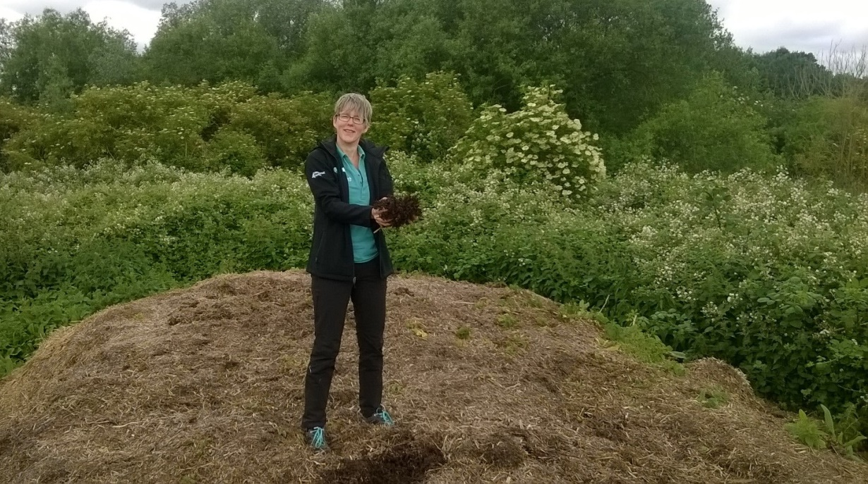
WP4 – A sustainable & Marketable Future for peatlands
Notes:
See pictured, not very attractive pile of material on the edge of a wetland site, however it has excellent potential as a compost/soil improver. Initial trials will be with agriculture for bulk use, future trials with customers in supermarkets as an alternative to the current peat based substrates.
First trials are with a local farming co-operative, also in a wildflower area we manage. Aim to determine the amount of improvement it makes to the soil, and use the data to have other farmers interested. Potential also to use it for retail depending on quality – this is the challenging point.
Another option for the reed (depending on how and when it is cut) is to turn some of it to Biochar – a very active project we have just started.

Slide 17
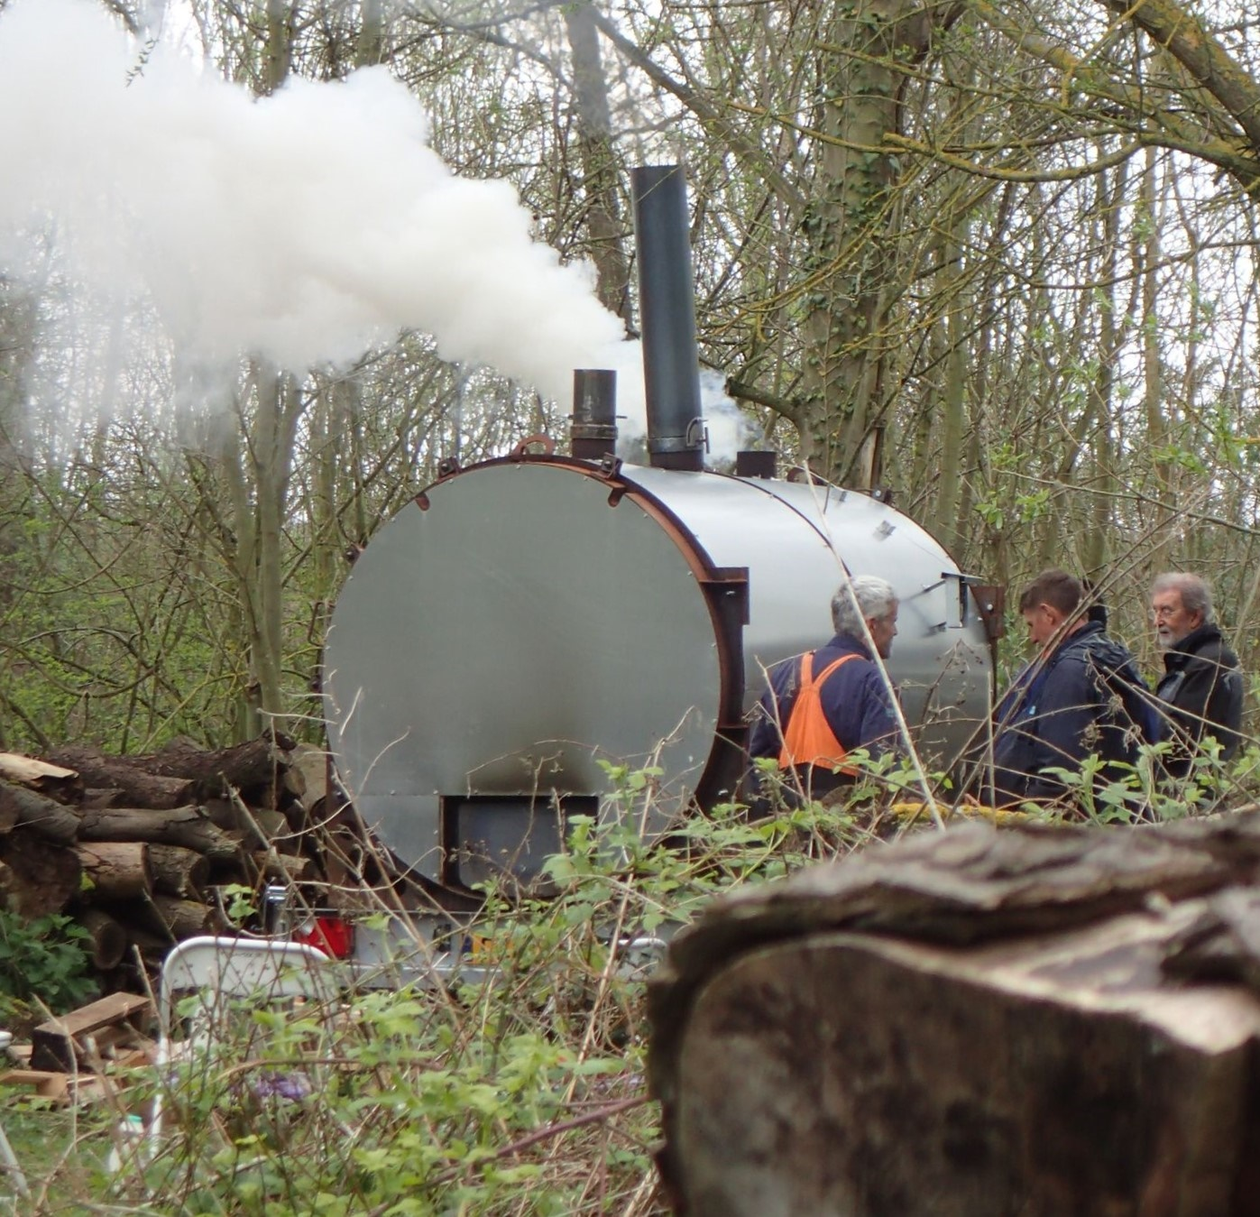
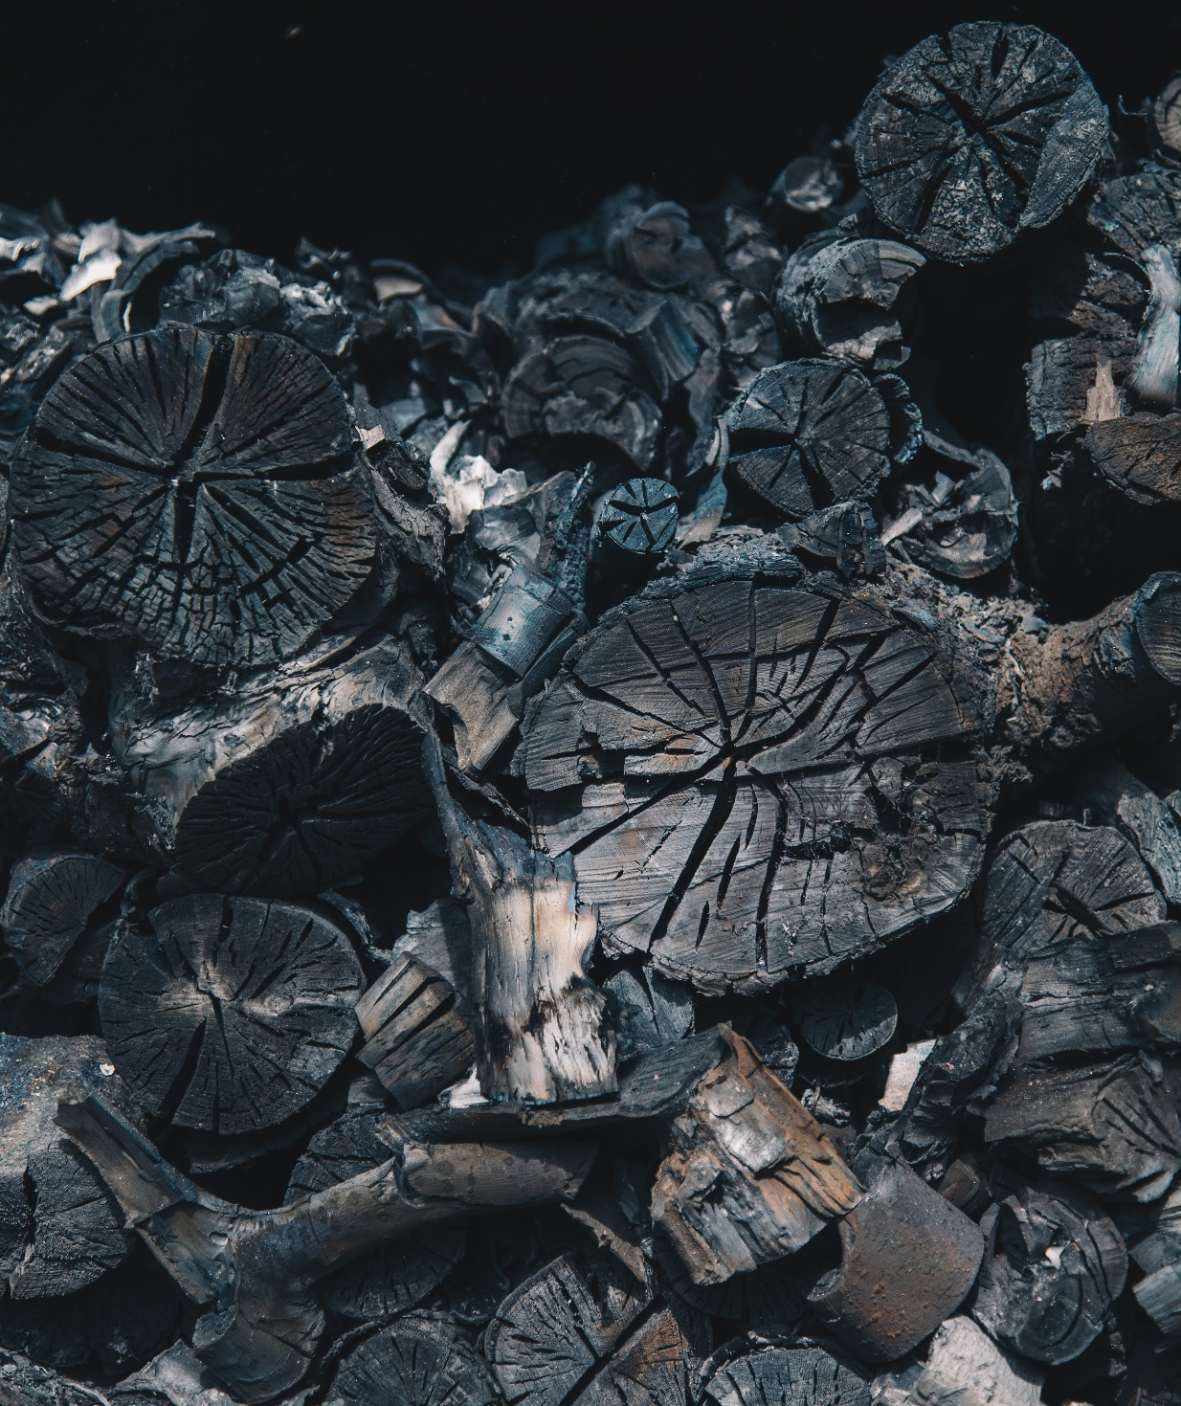
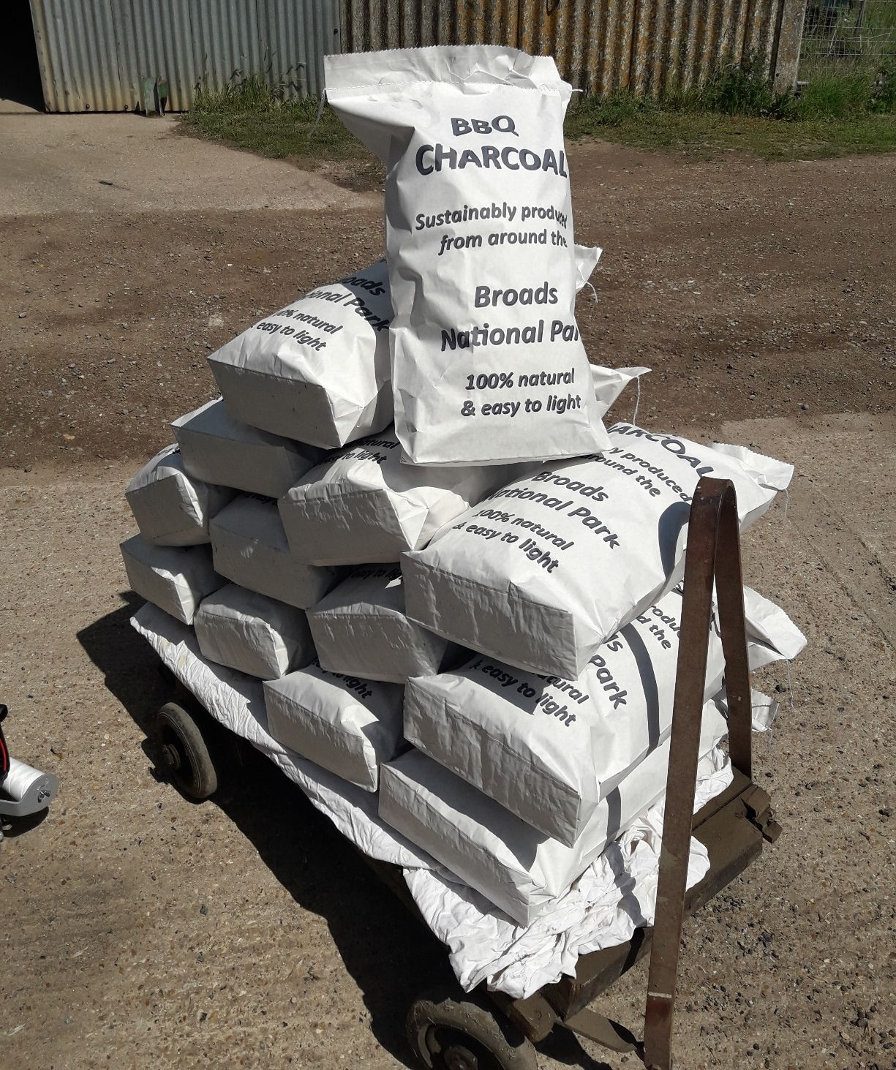
WP4 – A sustainable & Marketable Future for peatlands
Notes:
Conservation needs requires a largescale removal of wood, at the moment a lot of this is burned on site. We cannot sell this material due to regulations for firewood, low demand, and poor access.
This creates pollution, and creates potential publicity issues for some organisations with the sensitive issue of moor burning for grouse shooting.
SO we have purchased a Charcoal Retort to trial creation of sustainable charcoal in the Broads – first burns took place in April.
In the Broads there is an opportunity to develop local charcoal manufacture. Pictured is a part of the process of manufacturing charcoal, the syngas flaring from our burner to drive the pyrolysis process.

Slide 18
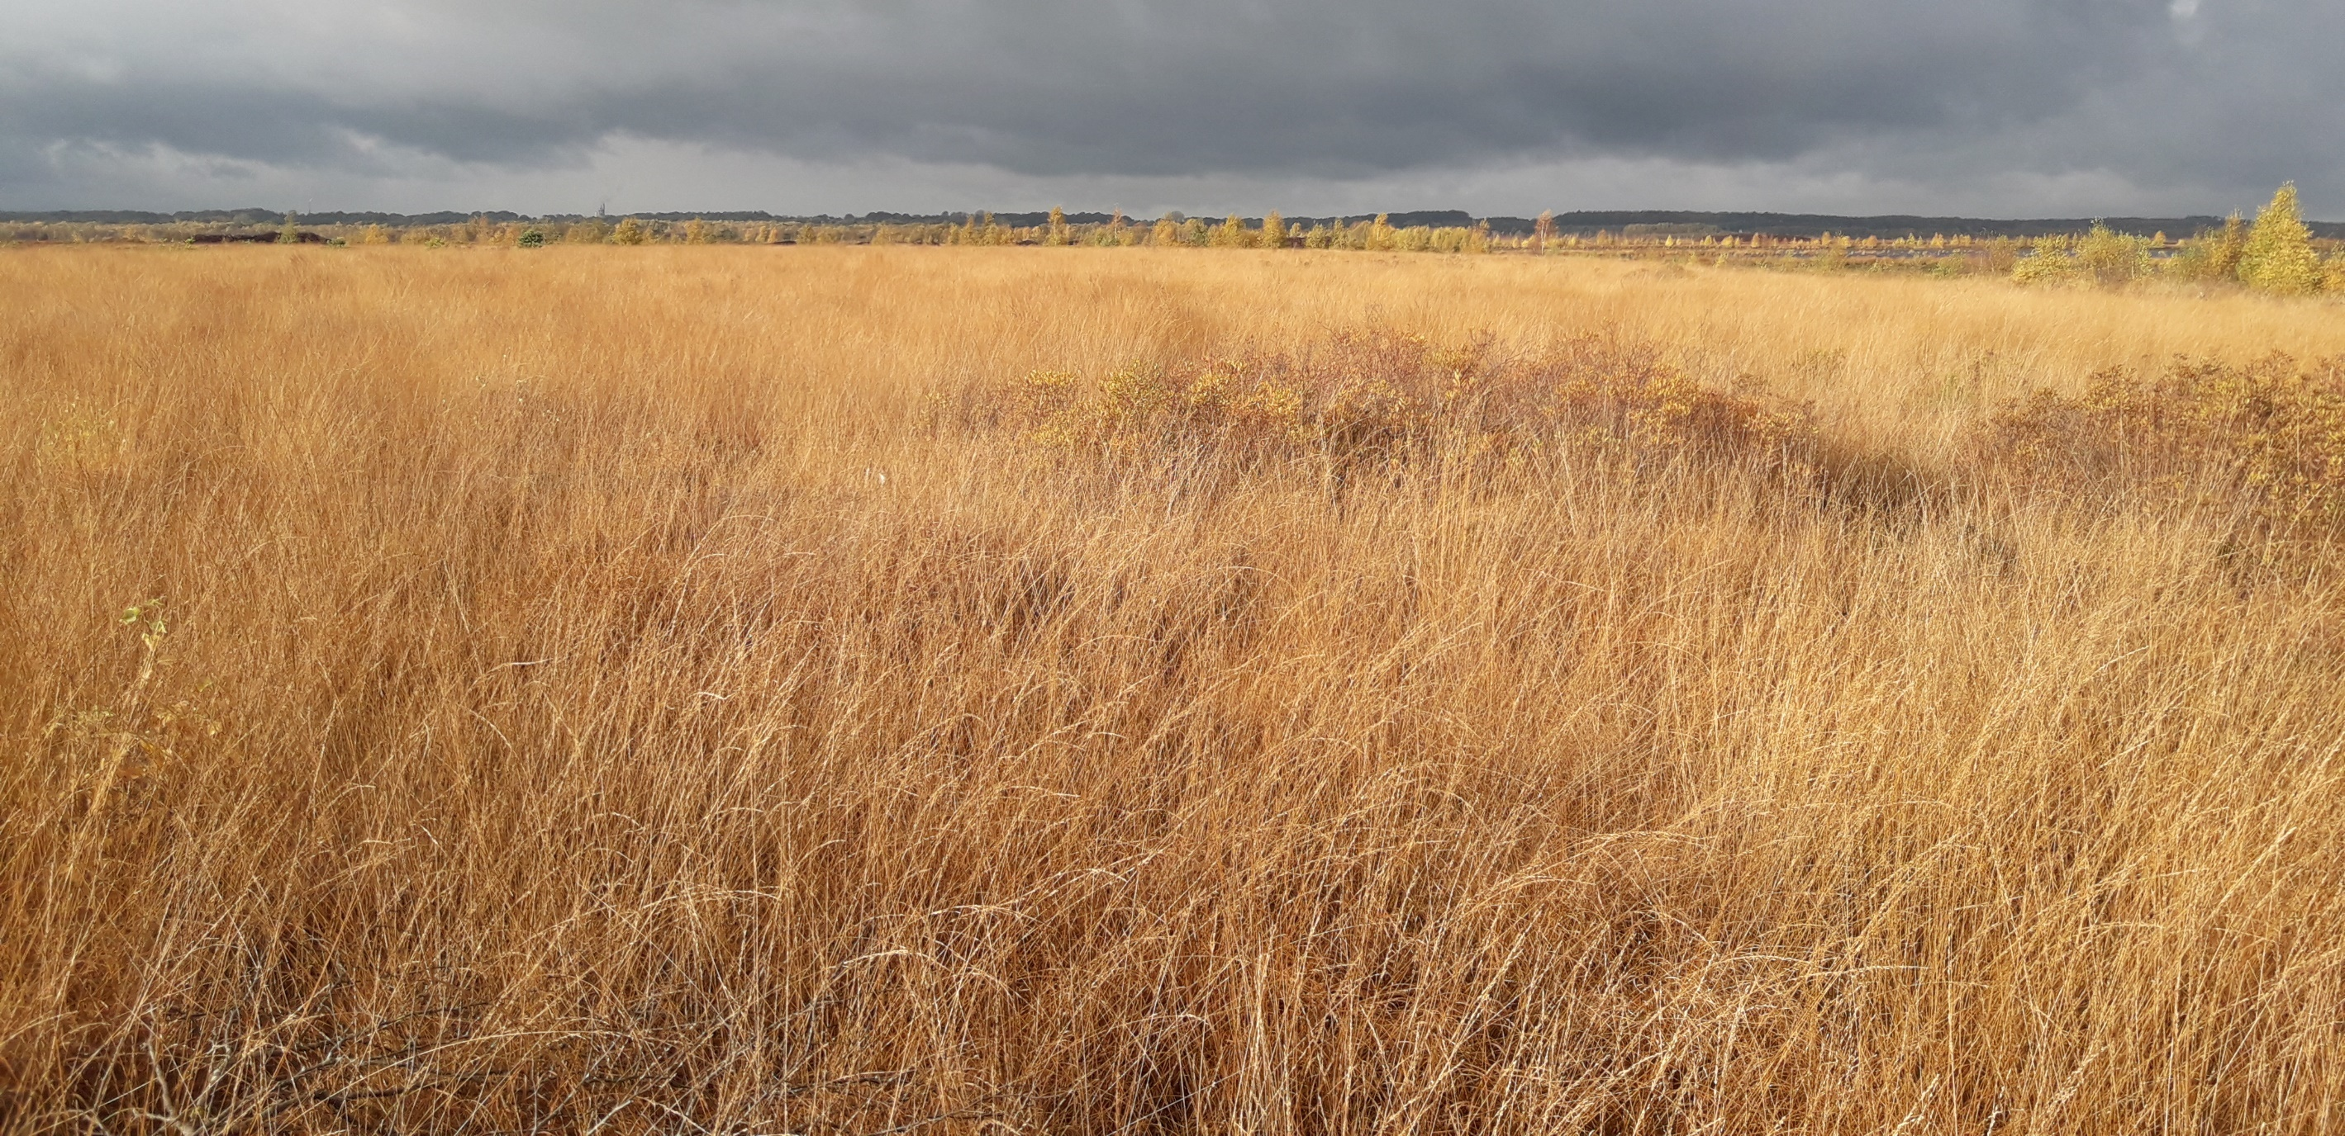
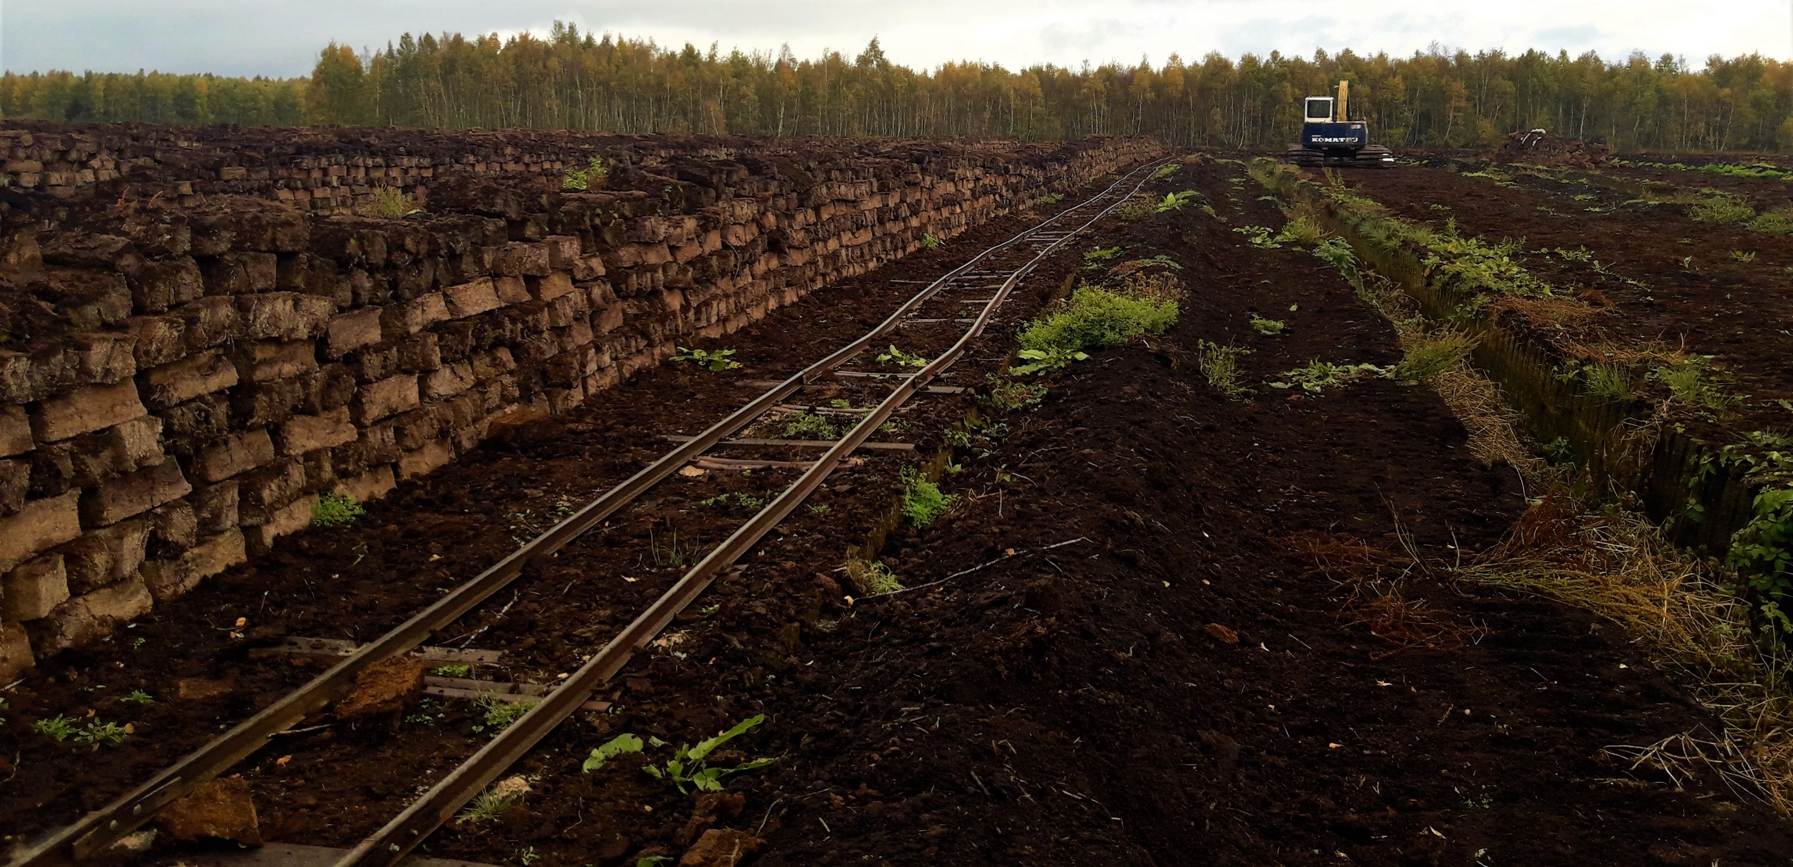
Public Understanding
Notes:
We want the public to begin to value and understand this type of landscape – there is insufficient awareness of the following process.
Too much of this happening – peat cutting – and at a wider scale general drainage for agriculture. Often this happened centuries ago.
Public perception is missing. People buy grow bags and compost, unaware that it is turning the above it this.
Paludiculture – how to stop peat degradation at a wider level. Working on nature reserves and rewilding is one thing, but there are huge areas of wetlands under agricultural management at the moment were there is a serious issue of carbon loss and subsidence.
The other challenge, looking at the wider catchment, and the important climate effects, is what to grow on wet ground. Rewilding is controversial as it is understood as taking productive land and making it less productive. So what productive use can we offer to growers to maintain the ecosystem services?

Slide 19
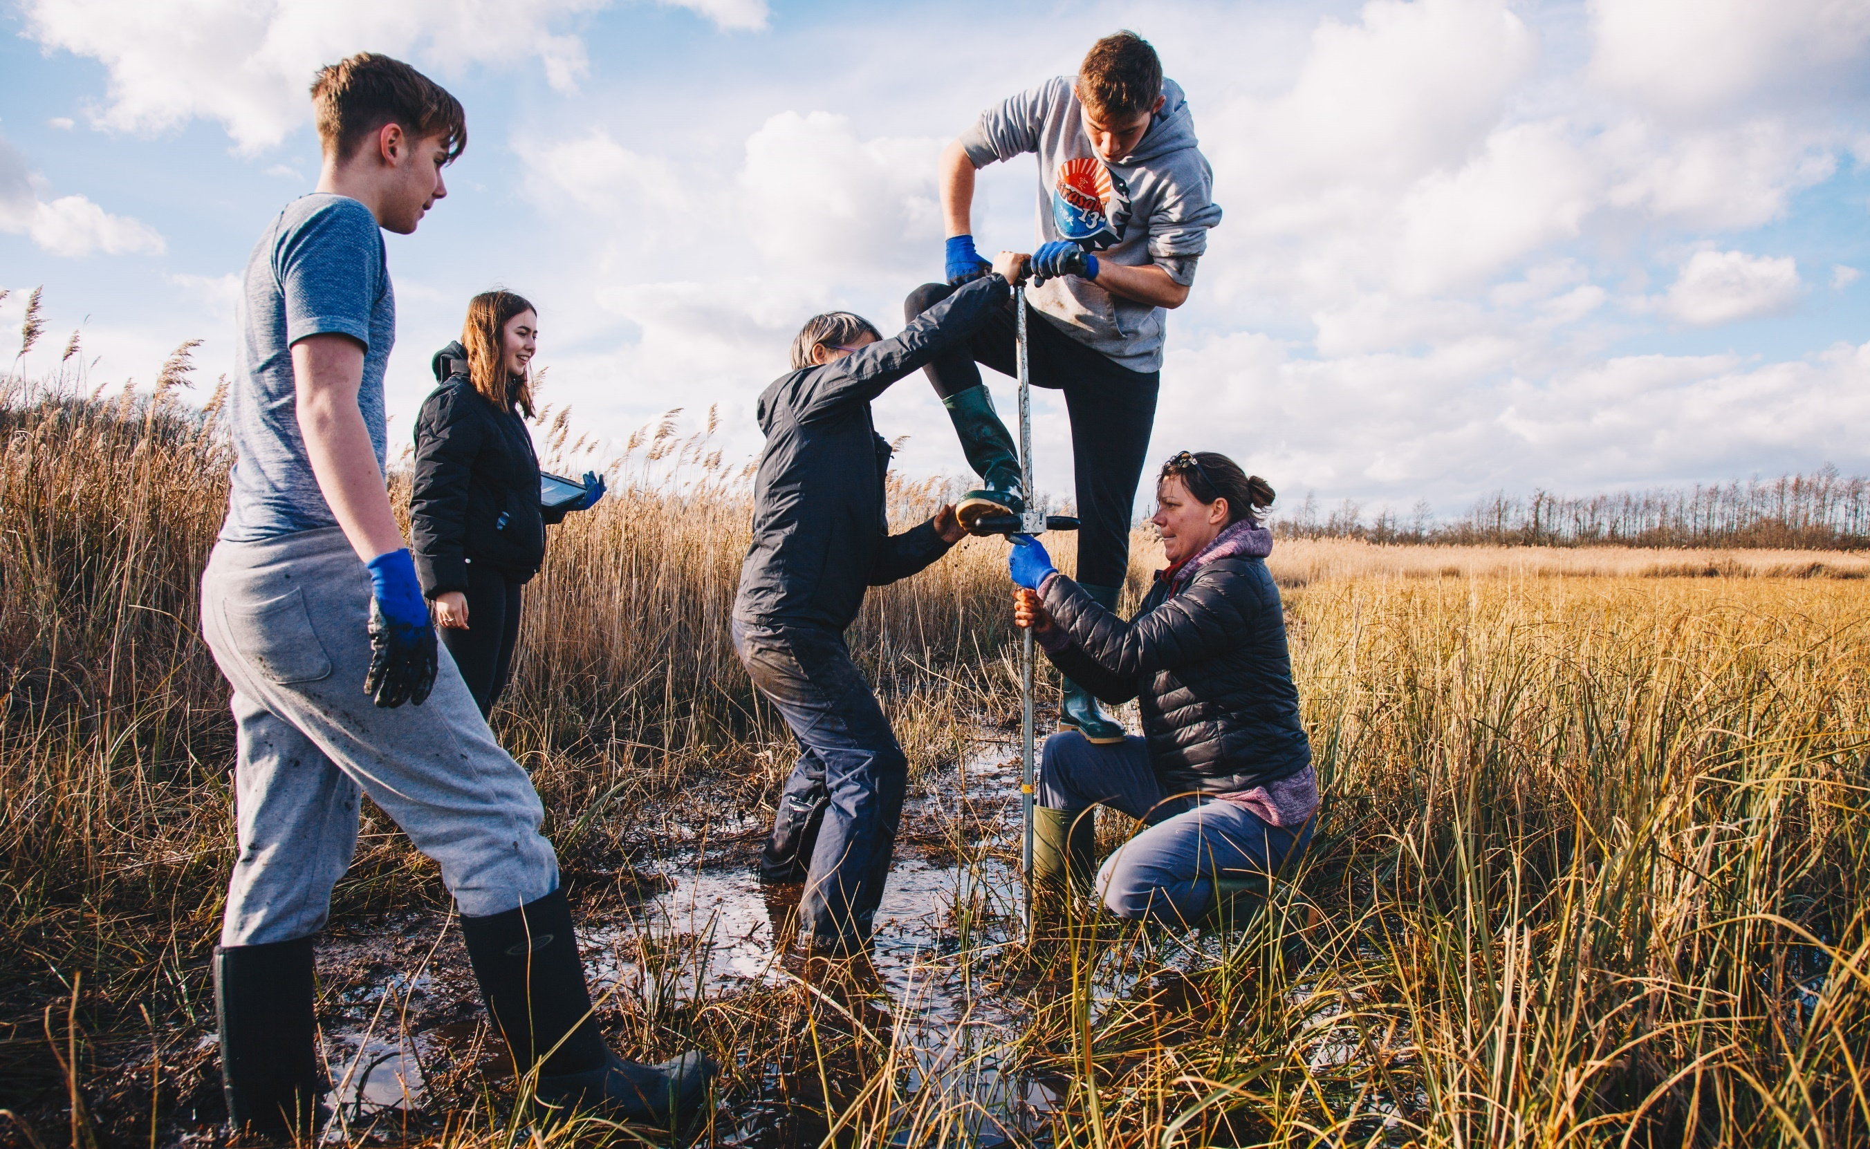
Public Understanding
Notes:
The sustainable future for peatlands – finding this balance of economy and conservation, finding a way to get people to recognise the resource for what it is, rather than an inconvenience to be got out of the way.
We want the public to appreciate wetlands for what they give, so part of this is citizen science as a method of engagement. Using students to help us build the message. Students need fresh air, regular walks in the countryside, and good contact with nature so we are giving them the chance to carry out research for us on our wetland sites. Peat coring is an important part of understanding the Broads, there is a real excitement in discovering the recent geological history, a real living sense of the age and power of these areas.

Slide 20
What are we trying to change?
Terrestrial Peatlands are wetter
You can see the bottom of our peatland lakes
Policy Makers are more supportive of rewetting peatland
Public understanding and appreciation of peatlands has increased
Notes:
Anyone who has sat through the UK government approved project management training (PRINCE 2) will know that they key defining part of a project is that it must change something.

Slide 21
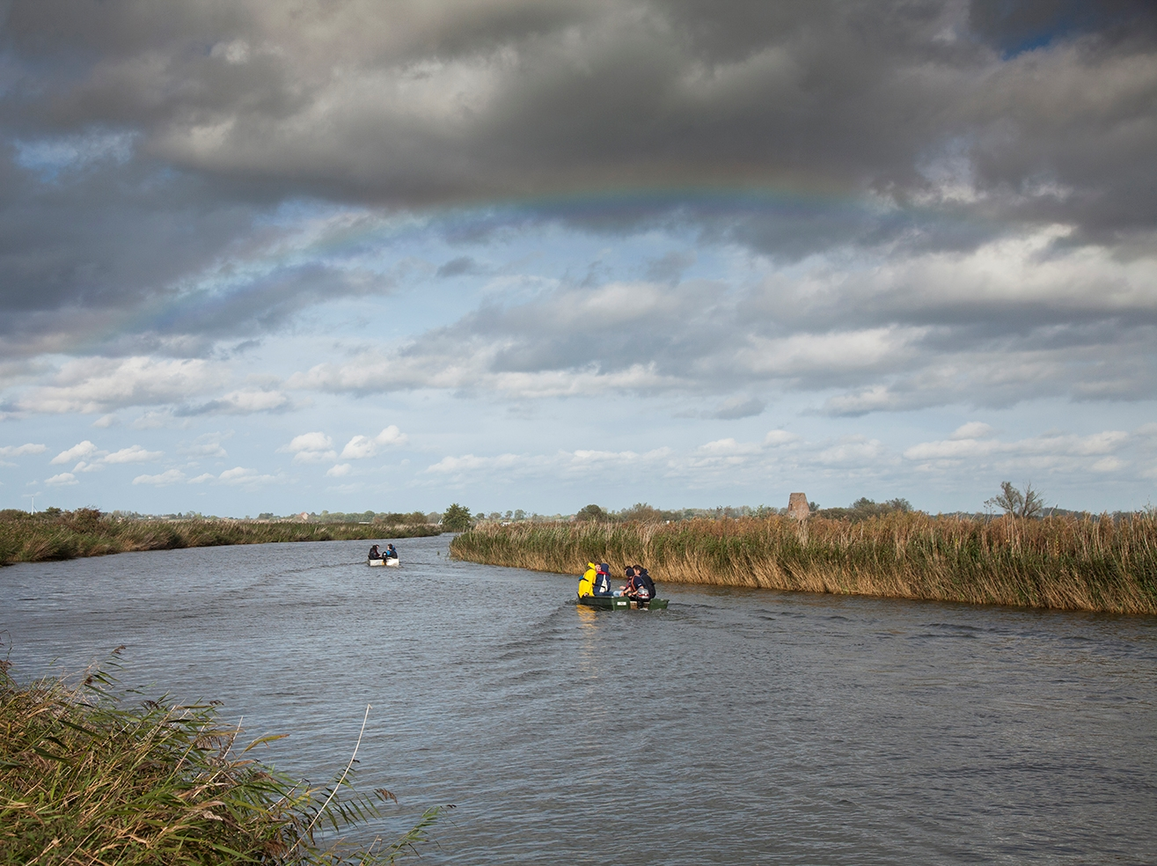
Thank you for listening
www.northsearegion.eu/CANAPE
Notes:
Website is below – please ensure to sign up to our newsletter (possible on the landing page)

