Slide 1


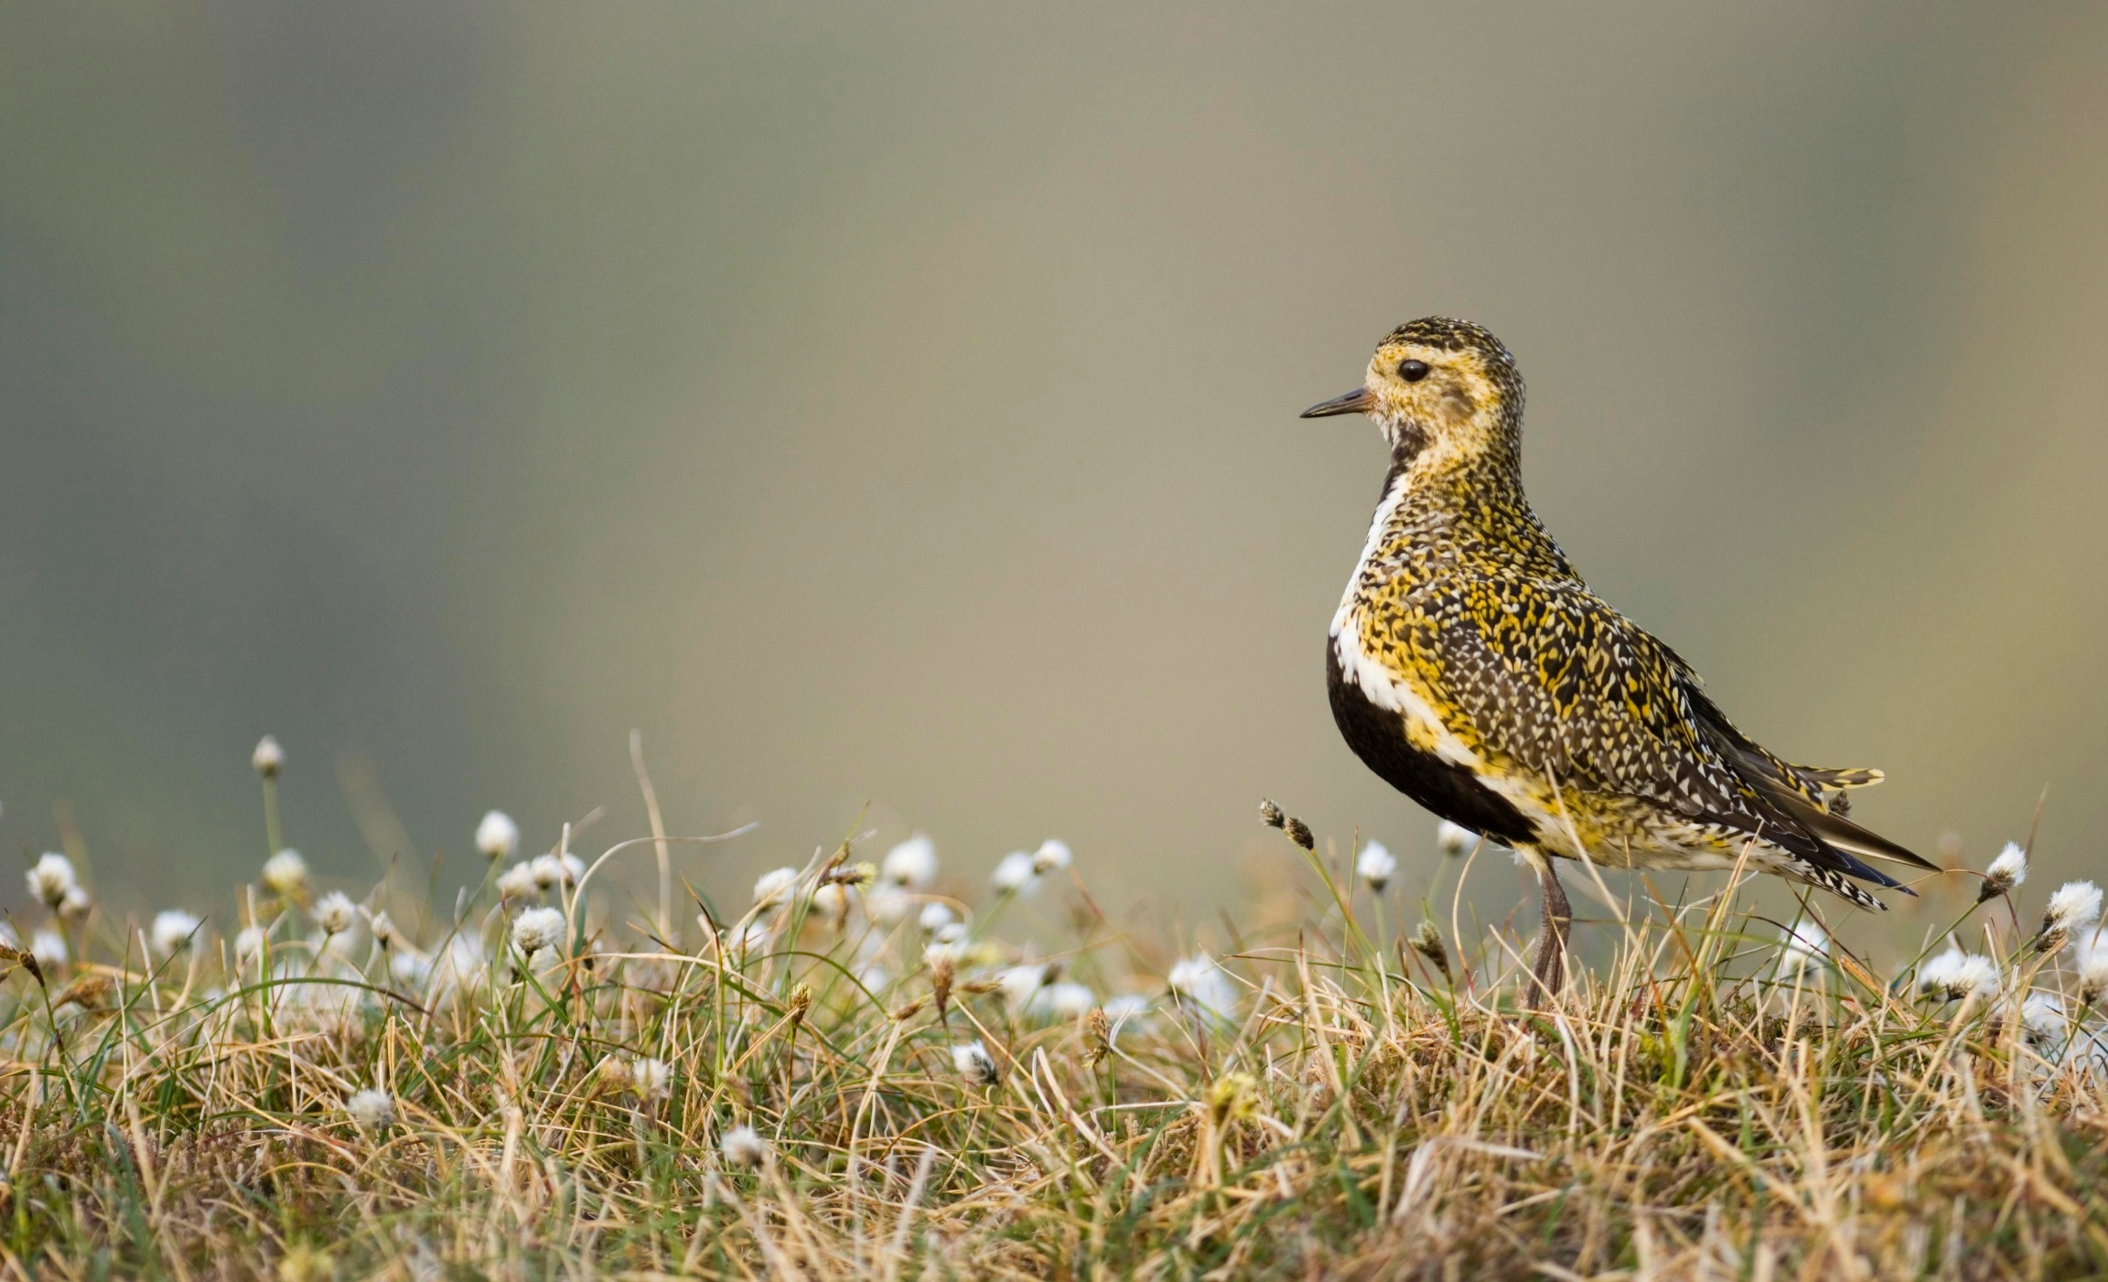
PEATLAND CODE:
AN OPPORTUNITY?
Generate a new funding stream
Create a lasting legacy for future generations
Contribute to tackling climate change and habitat loss

Slide 2
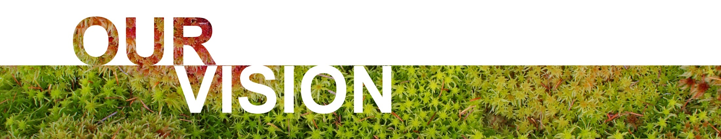


The IUCN UK Peatland Programme has a vision for healthy, wildlife-rich peatlands in the UK, that provide multiple benefits for people.
The value of our peatlands is better understood and prioritised for restoration and conservation.
Bring together scientists, practitioners, land managers and policy makers and all those who can help to deliver strategic peatland goals.
Provide guidance and promote good practice for peatland management that is underpinned by scientific consensus and monitoring, and is responsive to new evidence.
Notes:
Who we are and our vision for UK Peatlands
Value: UK Strategy creating shared value. Advocate for funding. Public awareness and communications.
Strong peatlands: Nurture partnerships. Build links.
Knowledge exchange: Good practice guidance. Showcase. Policy advice. Share scientific evidence to develop and further understanding.

Slide 3

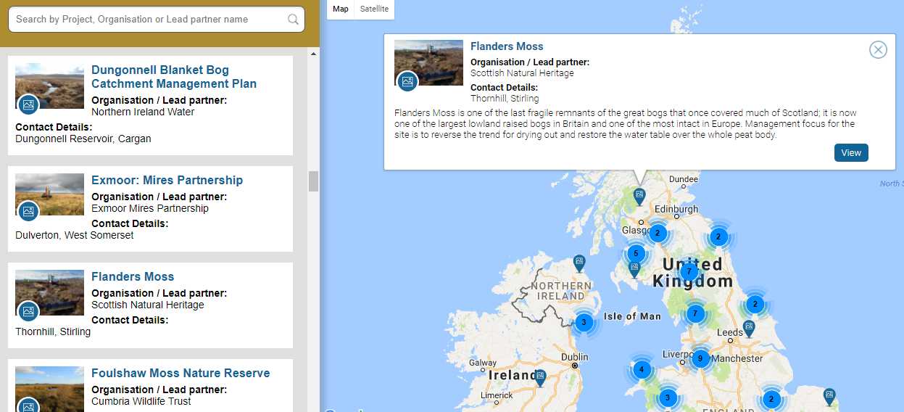

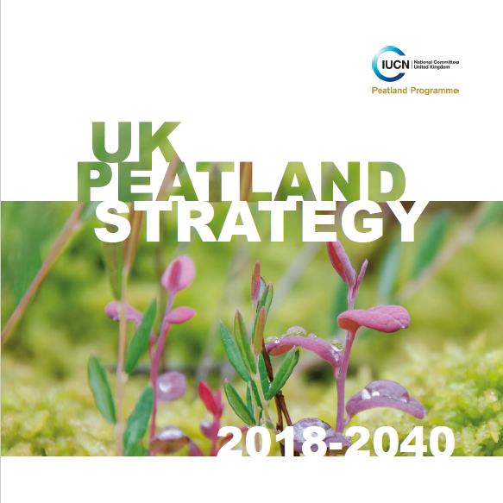
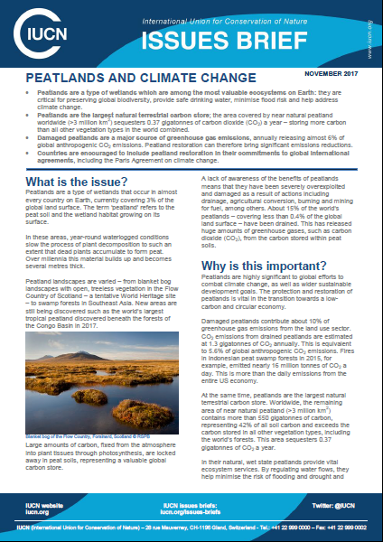

Notes:
Examples of some of our work
Peatland Project Map
UK Peatland Strategy
Briefings for policy, technical information and support for events e.g. IUCN brief produced for the COP
Commission of Inquiry and 2018 update
Peatland Code development and administration

Slide 4

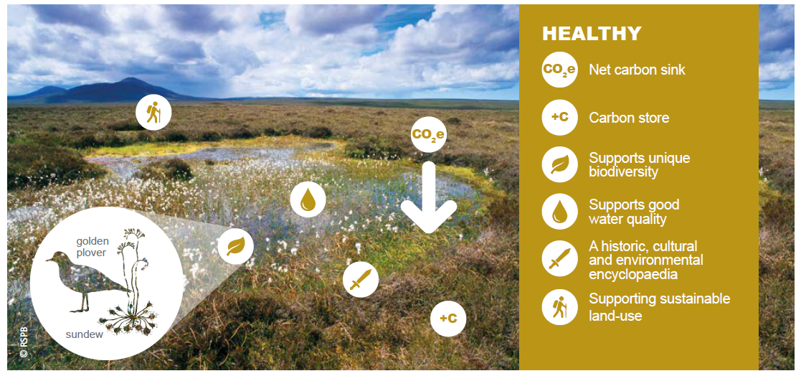
ECOSYSTEM SERVICES IN A HEALTHY PEATLAND

Slide 5
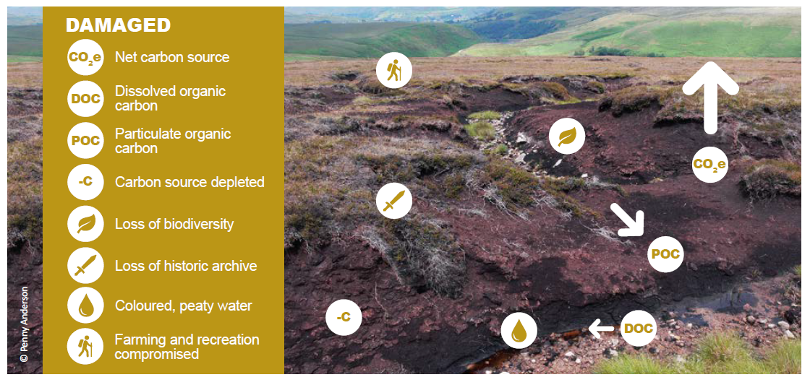
ECOSYSTEM SERVICES IN A DAMAGED PEATLAND

Slide 6
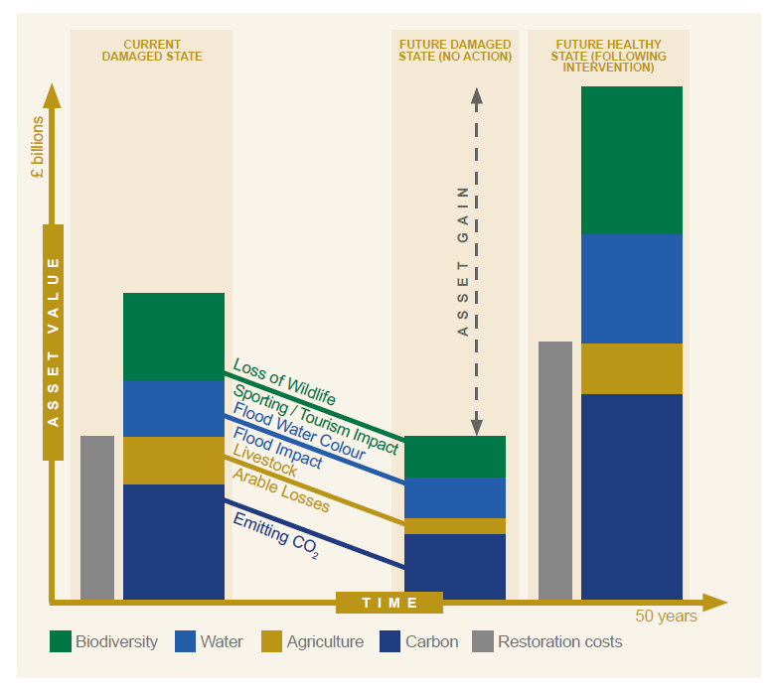
PEATLAND NATURAL CAPITAL
Leaving peatlands in a damaged state imposes a HUGE cost on future generations.

Slide 7

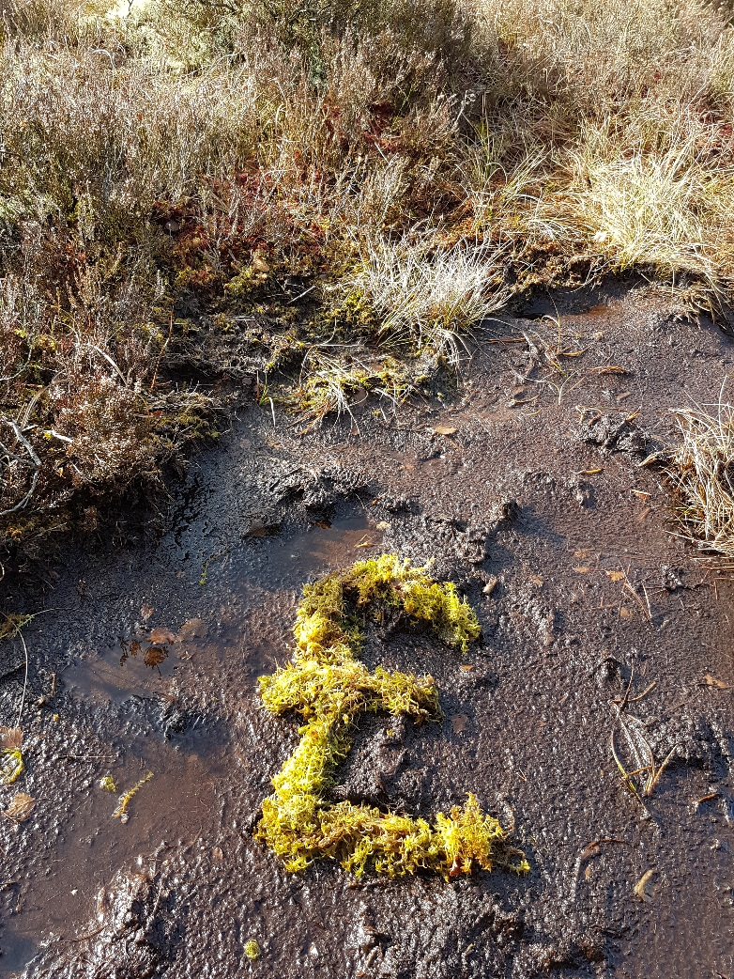
HOW DO WE FUND THE RESTORATION REQUIRED?
Public funding via grants and agri-environment payments?
Private finance via ‘Payments for Ecosystem Service’ (PES) mechanisms?
Blended finance initiatives?

Slide 8
PAYMENTS FOR ECOSYSTEM SERVICES
Payments to the managers of land in exchange for the provision of specified ecosystem services
Over and above what would otherwise be provided – ‘Additional’
A voluntary transaction
A market based mechanism
Services
Beneficiaries
Payment
Providers

Slide 9
BARRIERS to PES
How do we market an intangible product(s)?
How do we acquire ‘up front’ funding - benefits accrue over time?
How do we quantify the ecosystem service benefits?
How do we present the ecosystem service benefits for sale - bundled or layered?
How do we ensure that the ecosystem service benefits provided are additional?

Slide 10






MARKETING A ‘PRODUCT’
How do traditional, tangible products convey a message about quality, providence etc.?

Slide 11

PEATLAND CODE
A voluntary certification standard
to…
attract private funding for peatland restoration projects in exchange for climate benefits
by…
providing assurance to buyers

Slide 12
BARRIERS to PES
How do we market an intangible product(s)?
How do we acquire ‘up front’ funding - benefits accrue over time?
How do we quantify the ecosystem service benefits?
How do we present the ecosystem service benefits for sale - bundled or layered?
How do we ensure that the ecosystem service benefits provided are additional?

Slide 13
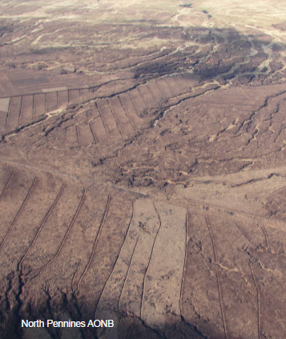
ELIGIBILITY CRITERIA
Blanket Bog or Raised Bog
Minimum 50cm peat
Actively Eroding or Drained
Re-Profiling, Re-vegetating, Re-wetting
30 years minimum project duration
Additional

Slide 14
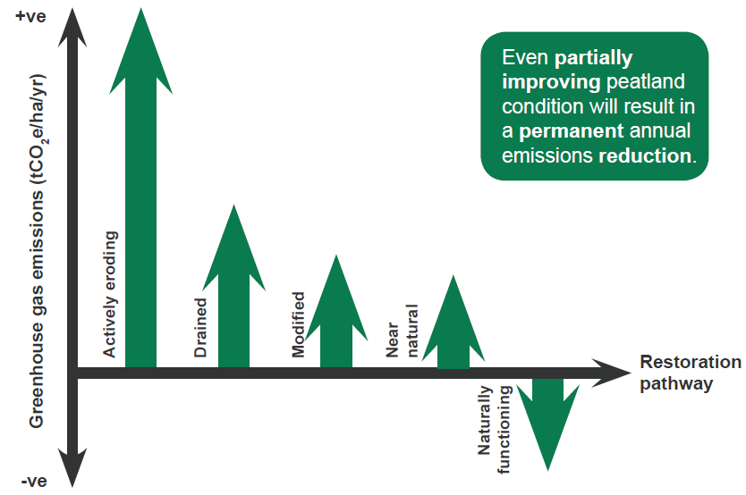
RESTICTIONS ON GHG BENEFIT CLAIMS

Slide 15
FIND OUT MORE
Web: www.iucn-uk-peatlandprogramme.org
Email: jillian.hoy@iucn.org.uk

