Slide 1
Peatland Restoration – a marathon not a sprint
Dr Dave Chandler
Science Programme Manager – Moors for the Future Partnership
12th June 2019

Slide 2
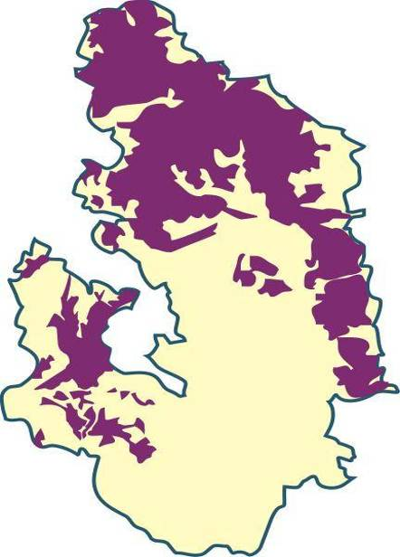
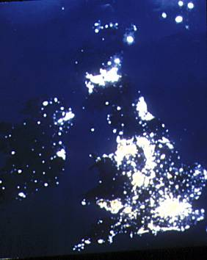
A brief history of the uplands

Slide 3
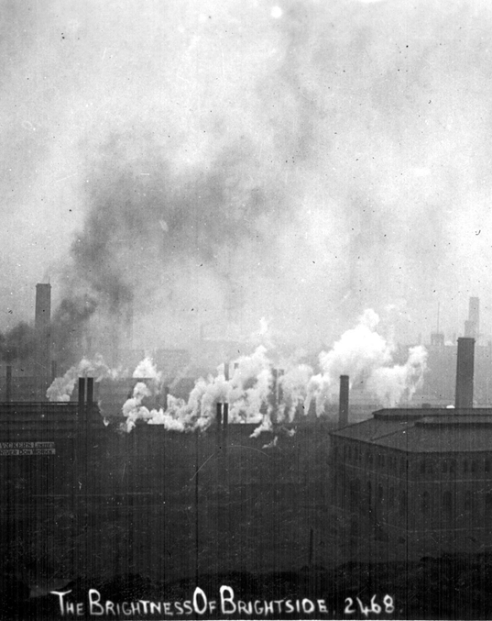
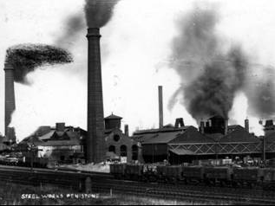
A brief history of the uplands

Slide 4
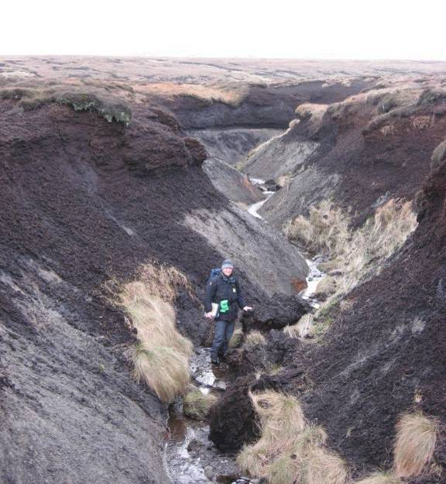
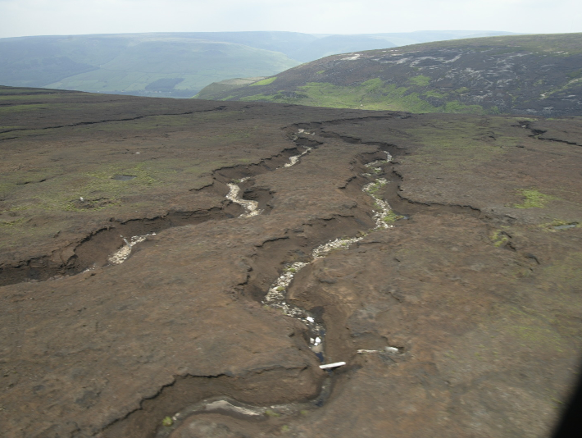
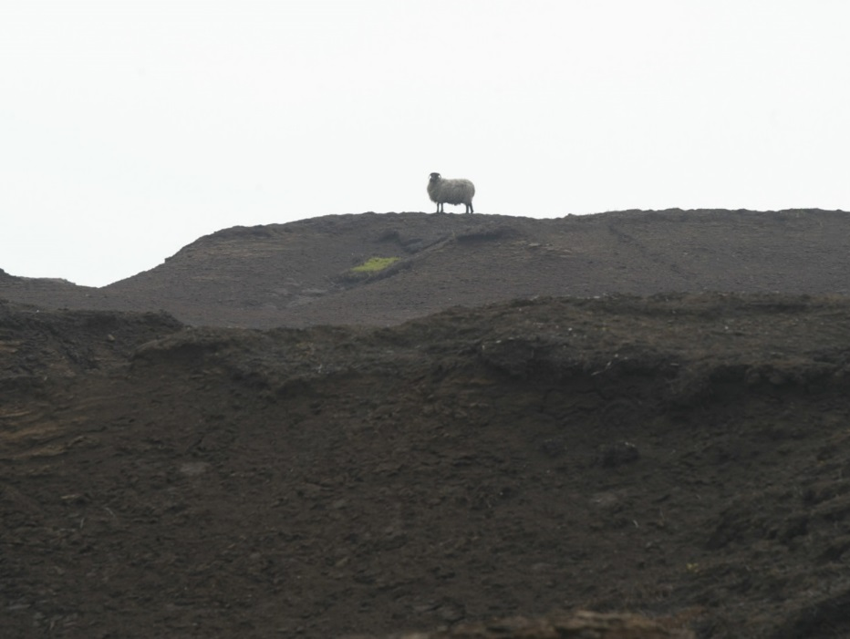
A brief history of the uplands

Slide 5
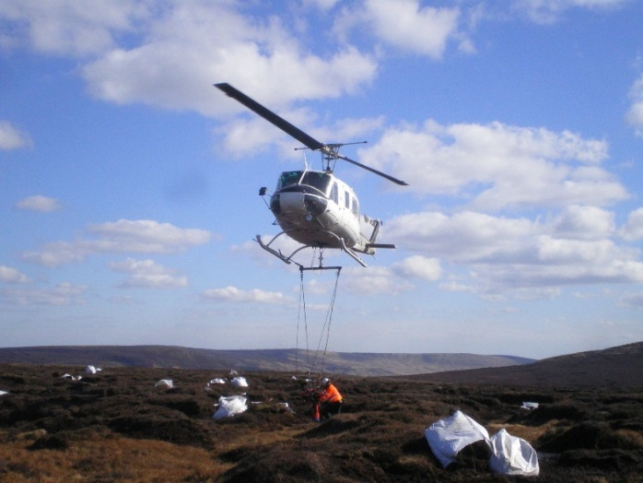
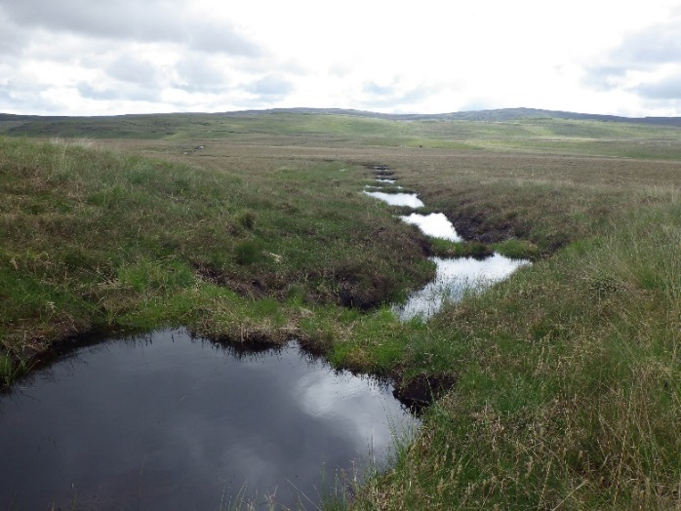
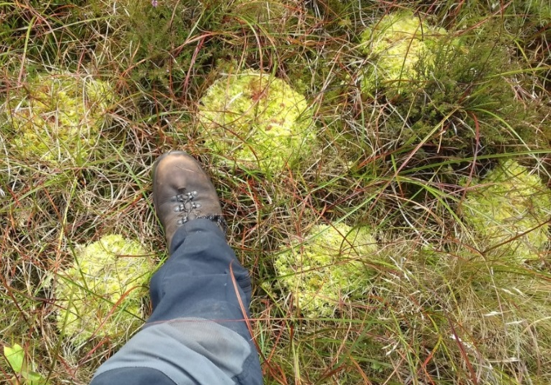
The work of Moors for the Future Partnership

Slide 6
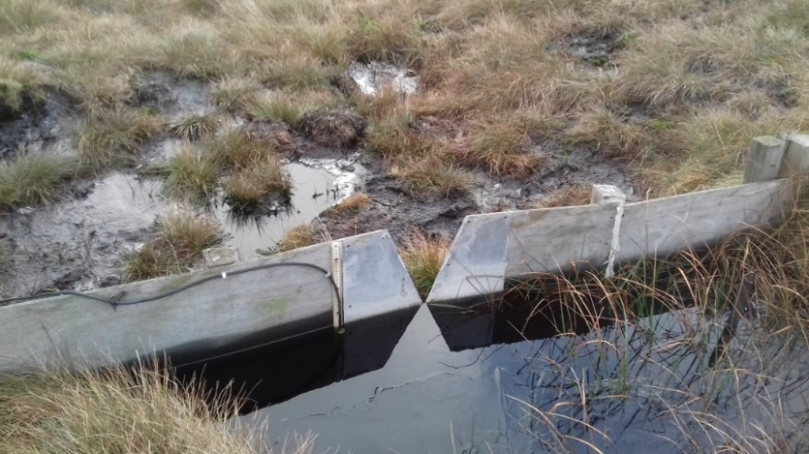
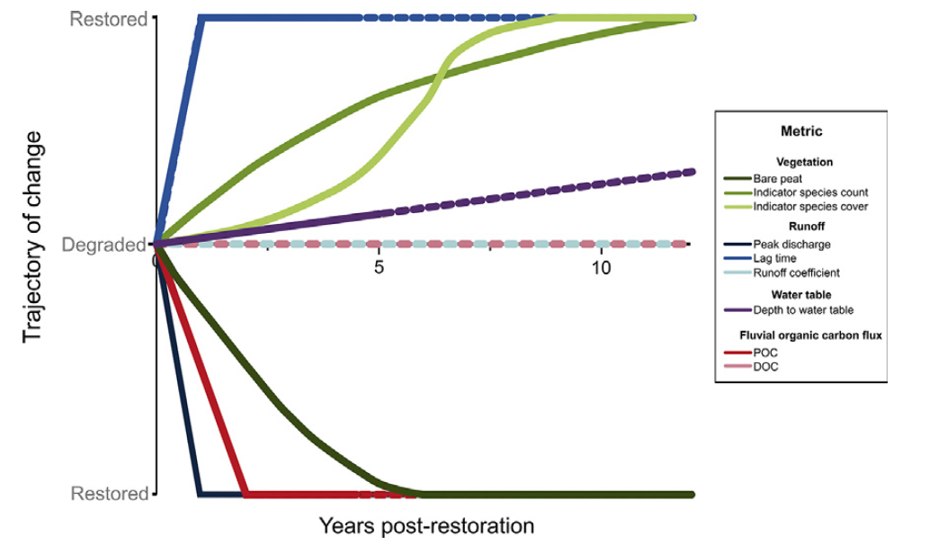
The work of Moors for the Future Partnership

Slide 7
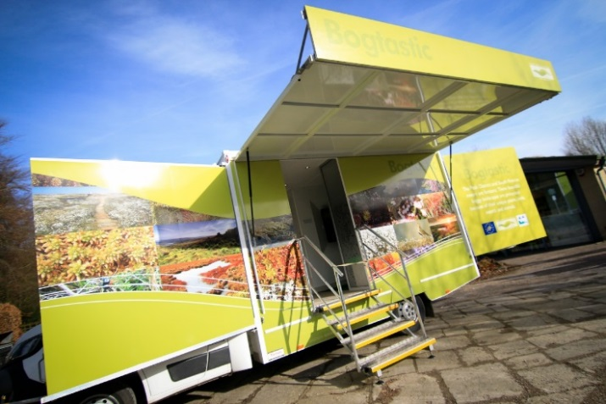
The work of Moors for the Future Partnership

Slide 8
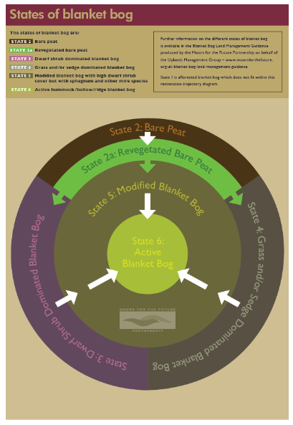
The work of Moors for the Future Partnership

Slide 9
Why work in partnership?
Partners include regulators, private companies, charities, landowner groups… WIDE range of interests
Peak District National Park Authority are the lead partner/coordinating partner
Common vision
Synergistic benefits
The Moorland Association

Slide 10
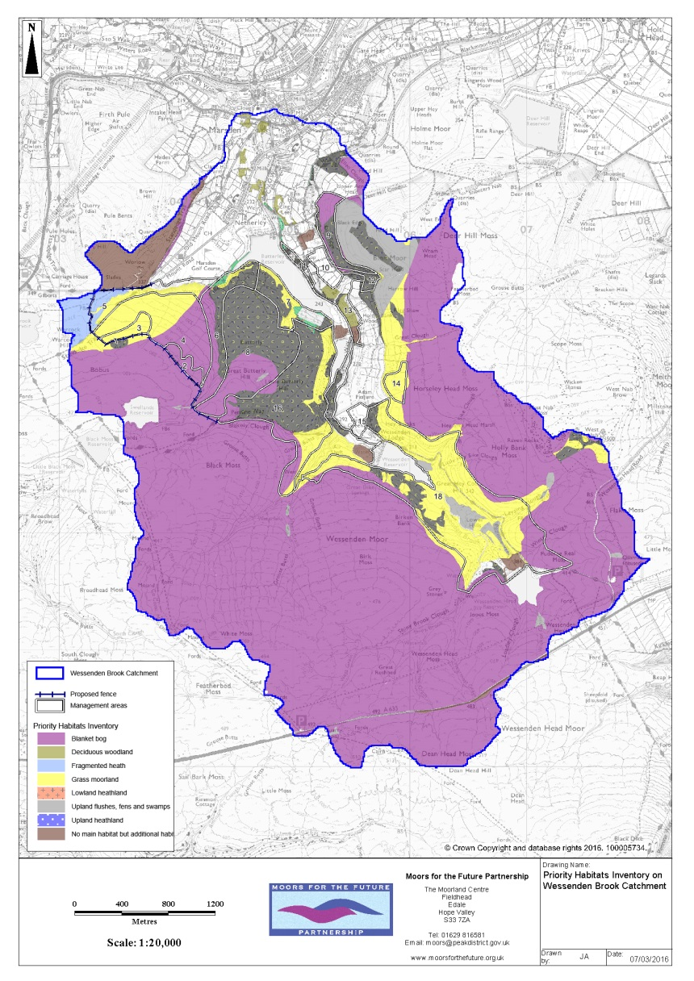
Why work in partnership?
Wessenden valley moors example
Benefits come from the whole landscape
Different habitats
Not related to land ownership
Different reasons for land management
Private landowners
National Trust
Yorkshire Water
9 projects between 2003 and 2021

Slide 11
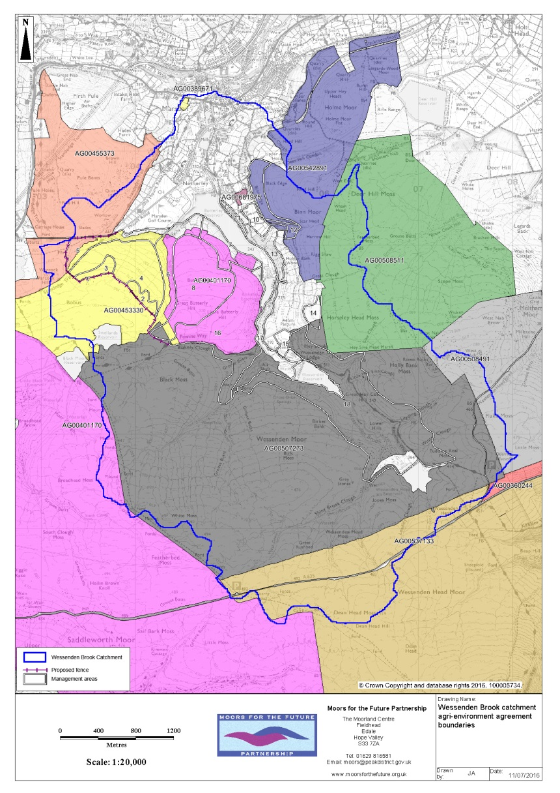
Why work in partnership?
Wessenden valley moors example
Benefits come from the whole landscape
Different habitats
Not related to land ownership
Different reasons for land management
Private landowners
National Trust
Yorkshire Water
9 projects between 2003 and 2021

Slide 12
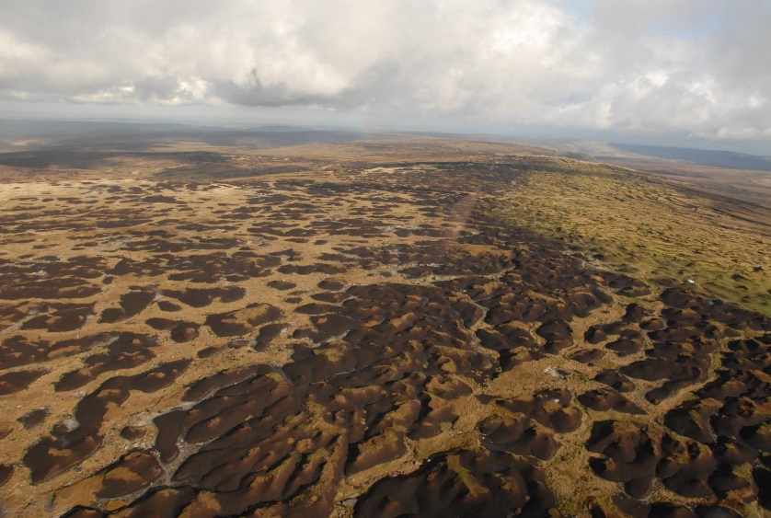
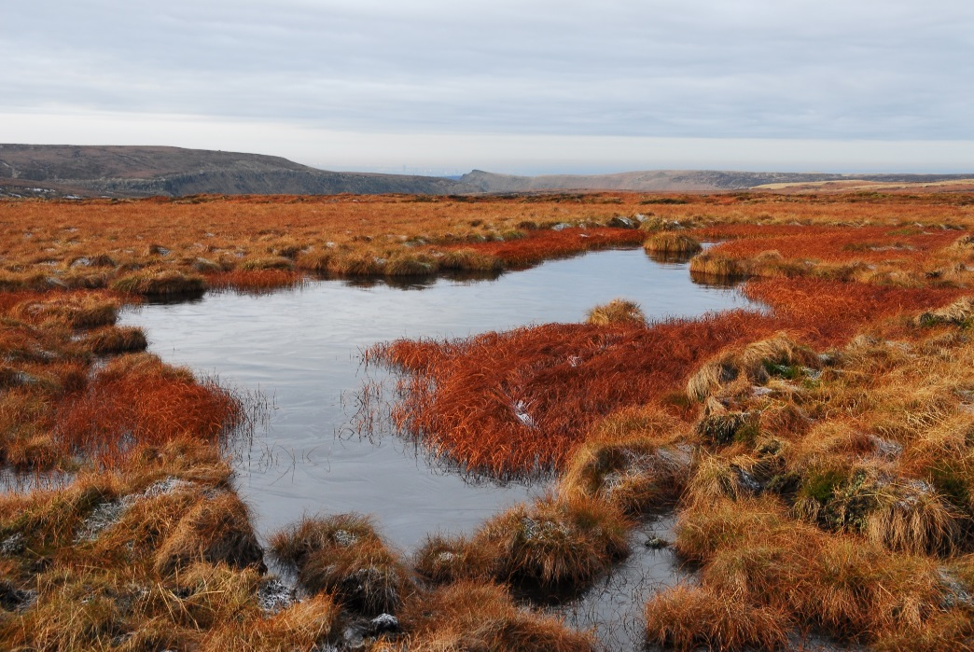
Benefits of Partnership working
Complementary interests – shared vision
Adaptability within restoration:
Biodiversity
Water quality
Water flow (NFM)
Carbon
Visitors
Countryside stewardship
Multiple sources of funding and knowledge
Cross-Boundary working (physical, administrative, and topical)

Slide 13
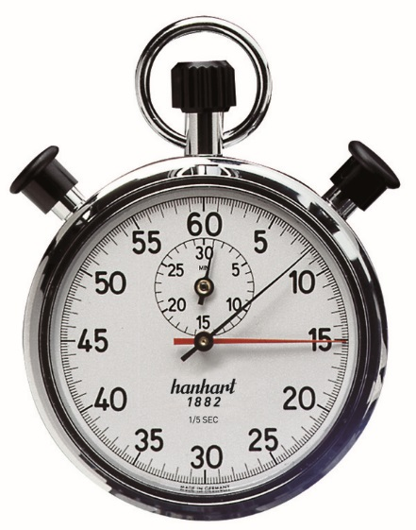
Challenges in partnership working
It’s not easy
Philosophical difference of opinion
Multiple partners, multiple reporting mechanisms
Clients or colleagues?
Decision making timescales

Slide 14
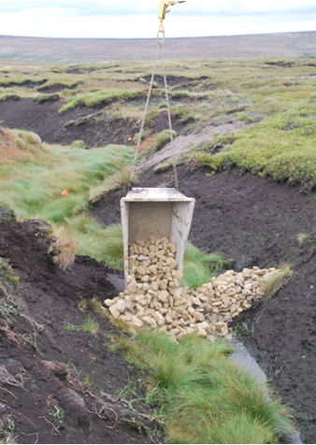
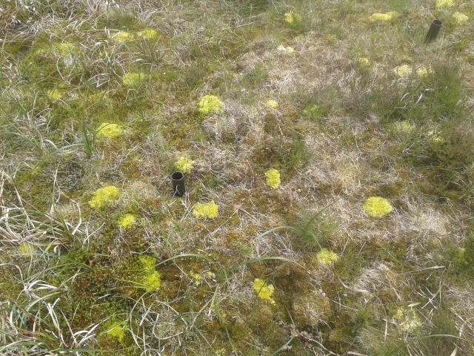
Benefits of Partnership working - an example
MoorLIFE2020 - €16M project
Aiming to restore degraded blanket bog, and address wildfire issues throughout SAC.
Funded by the EU LIFE programme, Severn-Trent Water, United Utilities, and Yorkshire Water.
Delivered by the MFFP staff team, Pennine Prospects, National Trust, and RSPB.
Delivering restoration, research and monitoring, and communications and engagement on behalf of all partners.

Slide 15
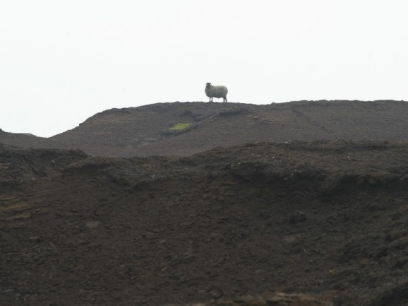
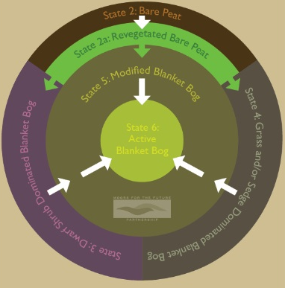
Partnership working in summary
Shared vision
Pooled/shared resources
Adaptability is key for long term partnership survival
There will be conflicts of interest – find the common ground
It’s not easy, but it’s worth it

