Slide 1
Internet as place: Policy, practice, and research in e-mental health for Scotland
Dr Diane Rasmussen Pennington FHEA FRSA
Lecturer in Information Science and Course Director
Digital Health and Wellness Research Group
Strathclyde iSchool Research Group (SiSRG)
diane.pennington@strath.ac.uk / @infogamerist
Place-Based Approaches to E-mental Health Seminar
24 May 2018

Slide 2
How can we improve Europe's mental health using the power of technology? A video from eMen
https://www.youtube.com/watch?time_continue=1&v=GFlaB1YFkAg

Slide 3
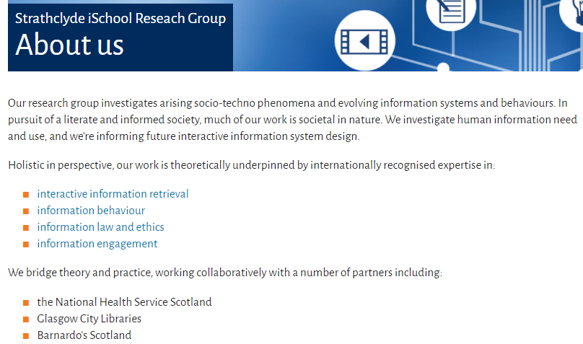
What is information science?

Slide 4
Lead, Information Engagement area

Slide 5
E-mental health – What’s available? What help is out there? How can they find it?

Slide 6
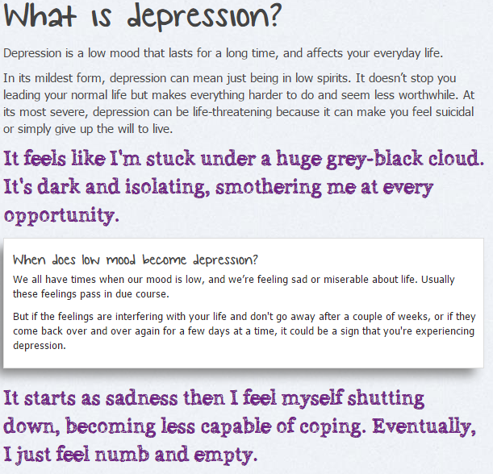
A page of text
http://www.mind.org.uk/information-support/types-of-mental-health-problems/depression/#.V_zm8ugrKUl

Slide 7
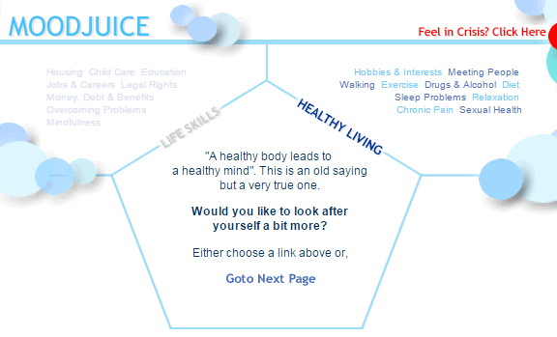
Quizzes to evaluate issues/severity
http://www.moodjuice.scot.nhs.uk/mildmoderate/home2.asp

Slide 8
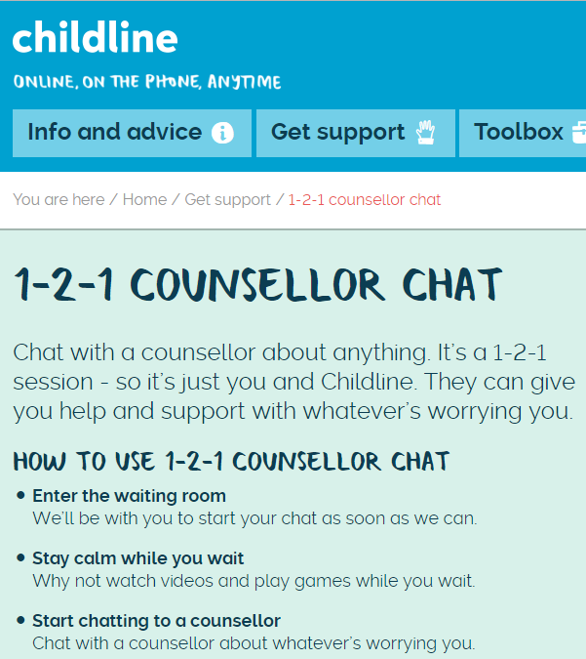
Online chat with a counsellor
https://www.childline.org.uk/get-support/1-2-1-counsellor-chat/

Slide 9
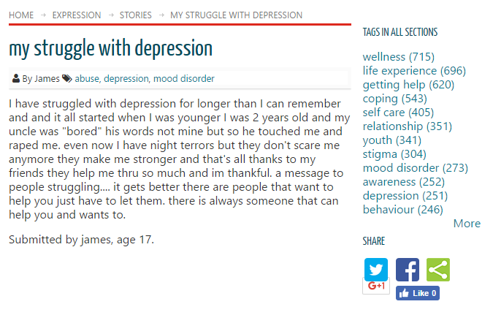
Personal stories
https://mindyourmind.ca/expression/stories/my-struggle-depression

Slide 10
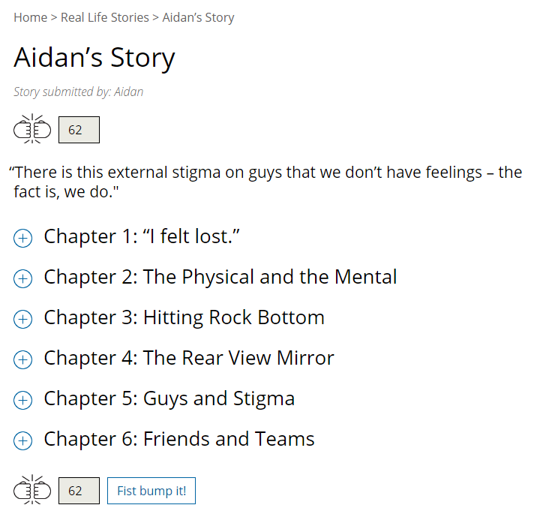
Personal stories (with interactions?)
http://www.brotalk.ca/Real-Life-Stories/Aidans-Story

Slide 11
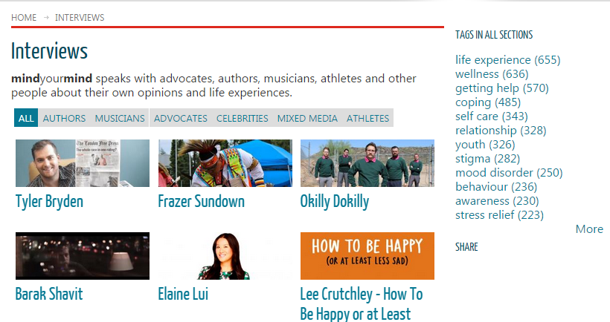
Videos featuring others who have “been there”
http://mindyourmind.ca/interviews

Slide 12
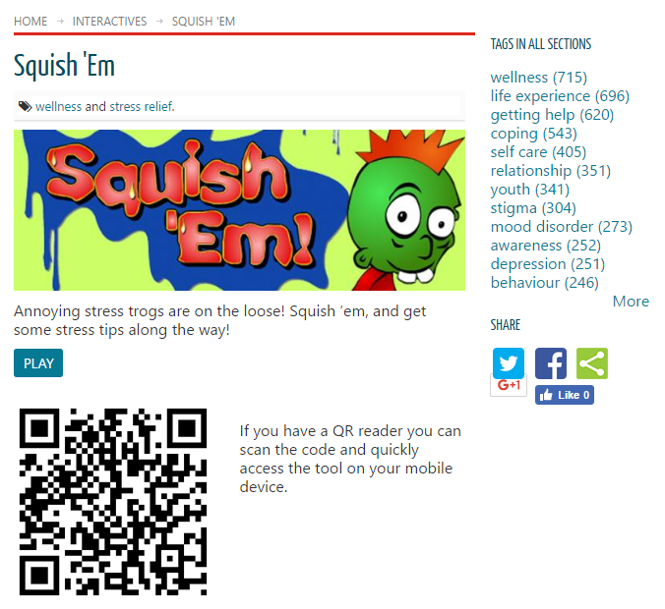
Interactives/games
https://mindyourmind.ca/interactives/squish-em

Slide 13
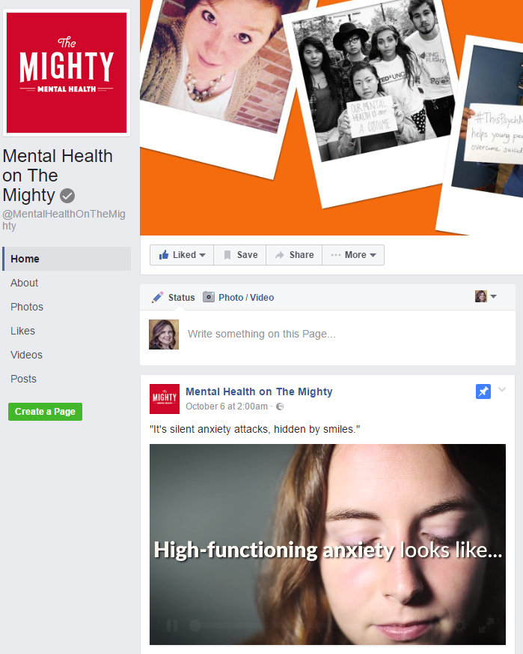
Social media awareness
https://www.facebook.com/MentalHealthOnTheMighty

Slide 14
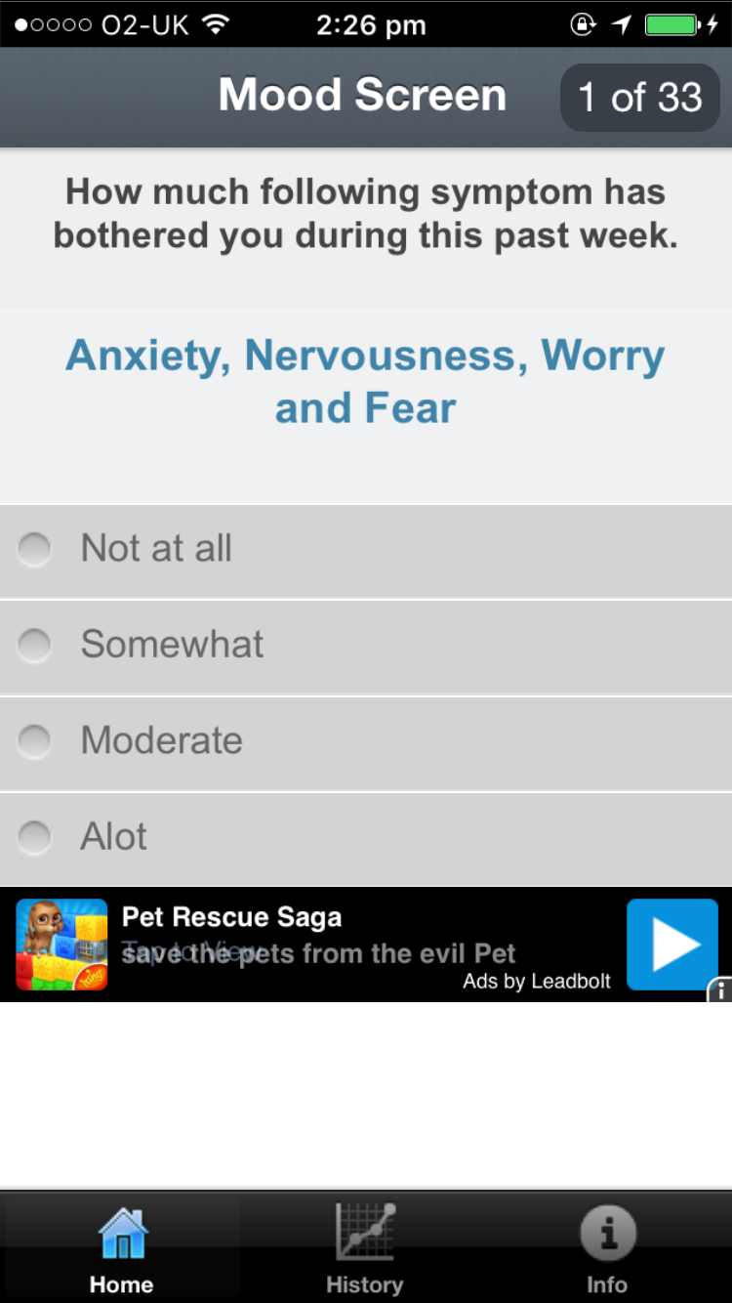
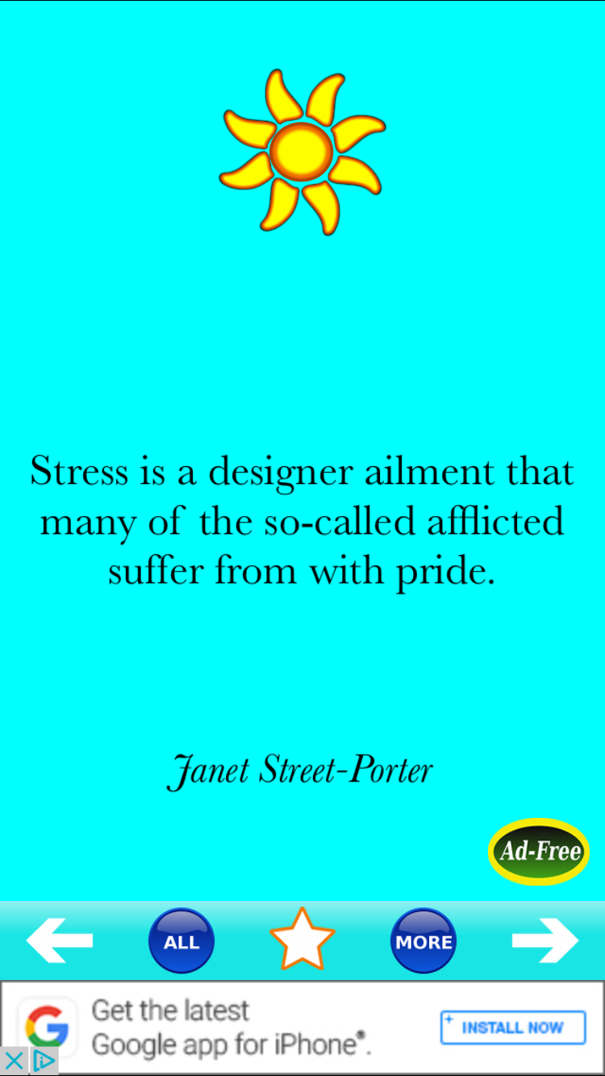
Apps (mood tracking, meditation, inspiration)

Slide 15
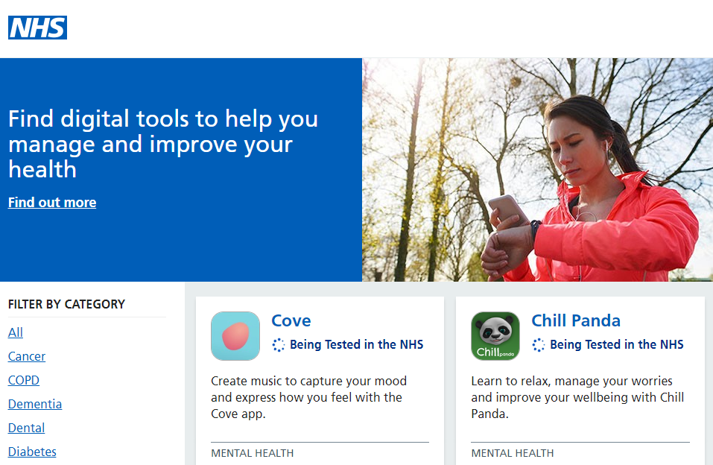

Slide 16
Online Cognitive Behavioural Therapy (CBT)

Slide 17
Online communities and self-help

Slide 18
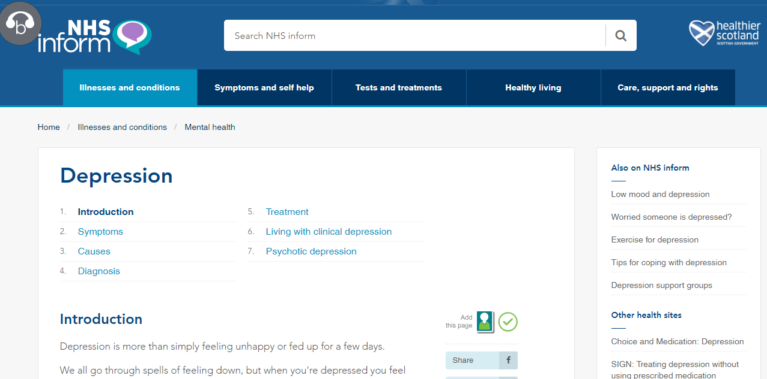
Authoritative resources

Slide 19
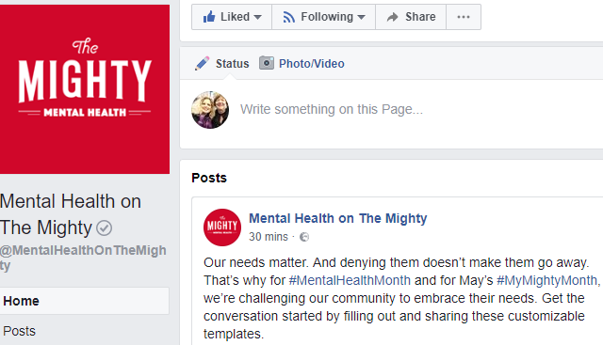
Social media; anti-stigma campaigns

Slide 20
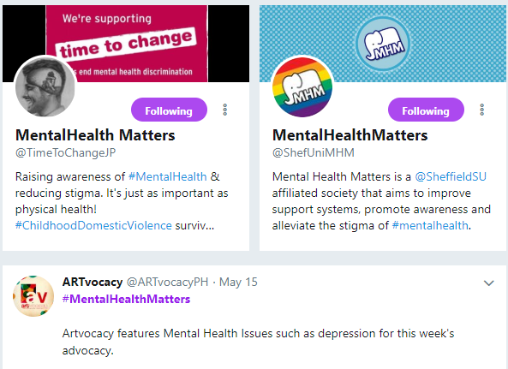
Social media; anti-stigma campaigns

Slide 21
A growing evidence base for youth (citations available on request)
It can help!
ICBT similar to face-to-face CBT
Text alerts for motivation
Games for mental health literacy?
Decision aids may be helpful, but little parental consent
Apps decreased self-harm (but little evidence for apps overall)
Chat with counsellors seems effective
Must be simple, interactive, supportive, not necessarily social media
Turn to online for help; family/friends next; tend to avoid professional services
Online help preferred, but need help finding it
Services should increase feelings of power and connection
Concerns about anonymity, privacy, security

Slide 22
Young people’s needs from mental health mobile technologies
Safety: confidentiality, cyberbullying, stigma
Engagement
Functionality
Social interaction
Promoting awareness
Accessibility
Gender
Young people in control
Kenny, R., Dooley, B., & Fitzgerald, A. (2016). Developing mental health mobile apps: Exploring adolescents’ perspectives. Health Informatics Journal, 22(2), 265-275.

Slide 23
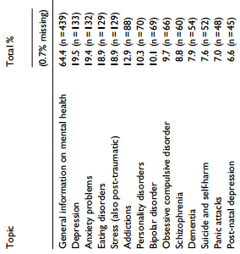
University students’ e-mental health use
Women more than men
78% did not trust what they found
13% had used e-mental health (forums, chat)
Advantages:
Easy to get
Lots of info
Private
Disadvantages:
Unreliable info
Don’t know who wrote info
Medical advice more reliable
Montagni, I., et al. (2016). Spanish students’ use of the Internet for mental health information and support seeking. Health Informatics Journal, 22(2), 333-354.

Slide 24
E-mental health for older people and people with dementia (PwD)
iPads/tablets most successful
Potential for PwD to increase social health and social participation with information and communication technologies (ICTs)
PwD difficulty with transferring pencil and paper-based skills, such as cognitive tests, to a device?
Integrative care in primary care: connect MH professionals, GPs, patients, etc. to share information, leading patients to self-manage and increase self-efficacy
Wearable sensors potential

Slide 25
Results of my work so far in youth mental health

Slide 26
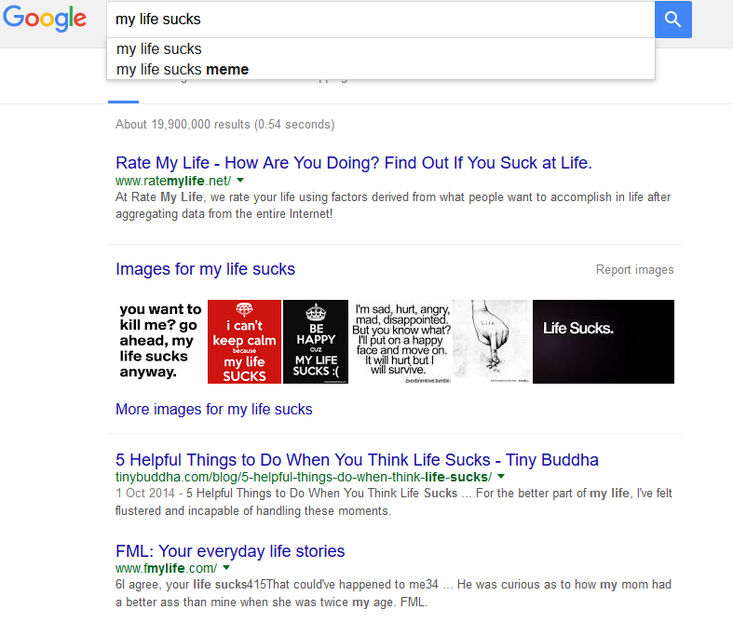
Start with Google, using their terms

Slide 27
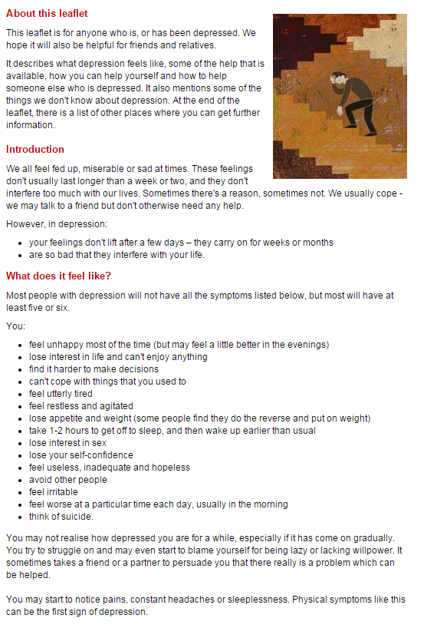
Not too much text
http://www.rcpsych.ac.uk/healthadvice/problemsdisorders/depression.aspx

Slide 28
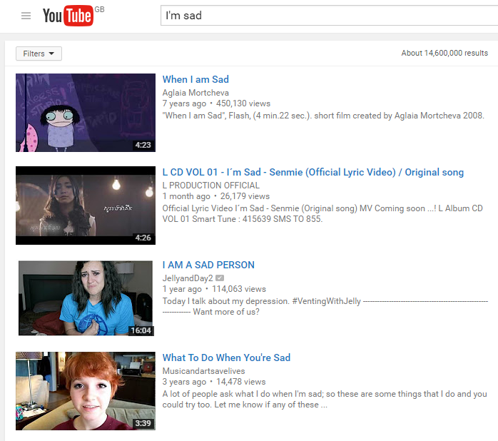
Videos!

Slide 29
Interactive, not static
Discussion forums
Respect confidentiality
Quizzes, but not if topic is “too serious”
Chatting/texting with a trusted counsellor
Chatting/texting is better than phone
Games must hold their interest

Slide 30
Other results
They do not know what is available
Poor health literacy
Disagreements on judging credibility
Trust issues are prominent

Slide 31
Methods of engagement: How did we find this out?

Slide 32
mindyourmind’s definition of “youth engagement” – and conflicting worlds
“Young people who are engaged affectively, cognitively and behaviourally participate fully and become co-creators with adults as partners. They are loyal, invested and because of this will be more likely to talk to their peers about their involvement. Interactions and communications are delivered in a manner that reflects a young person’s world view and incorporates pillars of youth culture in the delivery and presentation.”
Icebreakers, favourite bands and websites, making name tags, food, comfortable social settings
Result: “Let’s just say I hugged the phone.”

Slide 33
Meet them “where they are”
Recruit through social media, school contacts, prior relationships
Online surveys to start
WordPress/asynchronous groups
Google Hangouts groups
School nurses/counsellors as contacts
Youth advisory steering group
Search sessions with interviews

Slide 34
“How do you find a good movie?”
YouTube Find an exciting movie.
SoundCloud Find a sad song.
Flickr Find a beautiful picture.
Google Play Store Find a calming app.
Wikipedia What makes people angry about Brexit?

Slide 35
Finding solutions to advance digital health for addressing unmet needs in relation to self-harming behaviours

Slide 36
…through socially-oriented, equal inclusion of stakeholders
Social Innovation Labs/co-production approach to the incubation of creative ideas and solutions
Young people with “lived experience”, parents, families will all contribute equally
“Hackathons”
Interviews, surveys
Project Steering Group

Slide 37
Meanwhile in Scotland…

Slide 38
Place-based approaches
Geographic context is important, and so is the use of knowledge in policy intervention
The uniqueness of a place is an advantage; one size doesn’t fit all
Requires local groups and higher-level groups working together to develop the place and everyone makes contributions
“Place-based policies are the best way to tackle the persistent underutilisation of potential and reducing persistent social exclusion” in Europe (Barca et al, 2012, p. 139)

Slide 39
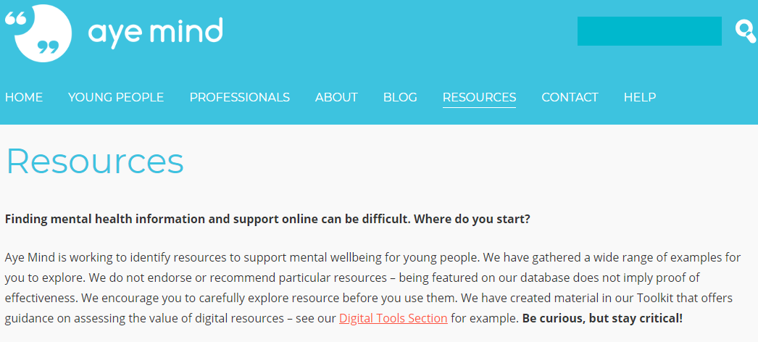
‘Places’ for ‘the good stuff’
http://ayemind.com/resource-map/

Slide 40
Does this look familiar? Factors in the ‘digital divide’

Slide 41
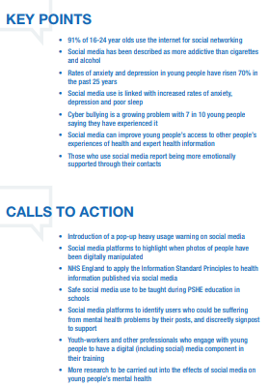
Royal Society of Public Health: #StatusOfMind report

Slide 42
Digital Mental Health Cooperative Report: Areas for Innovation (NHS 24, GSA, et al., 2017)
Literature review: Good evidence for phone and video delivery, safety of Internet interventions when with humans, moderated peer support
Public labs in Elgin (recognise need, transport in rural locations, range of resources or none)
Invited labs in Moray and Perth (bad past experiences with the system)
‘Simple Signposting’ to help people navigate services and recovery

Slide 43
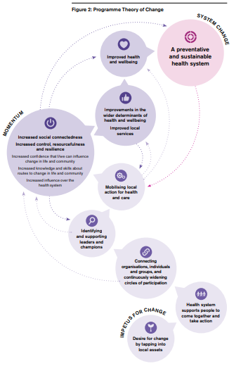
Health as a Social Movement: Theory into Practice (RSA, NHS England, New Economics Foundation, 2018)
(It’s complicated, but possible!)

Slide 44
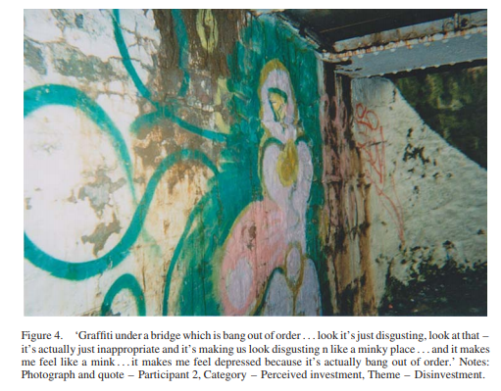
Disadvantage is a determinant of poor mental well-being
Aberdeen

Slide 45
And Glasgow
‘… if you go into a different area with somebody that you might consider your friend, but then you go into their place they could just turn round and punch you. I know people that has happened to before.’

Slide 46
Health and Social Care Delivery Plan, December 2016
Integration: ‘… older people … a package of assessment, treatment, rehabilitation, and support in the community … could better serve their needs.’
Digital: ‘Empowering people to more actively manage their own health means changing and investing in new technologies and services…’
‘People will have access to more and more effective services across the health system to support mental health … as important as physical health.’
Online CBT by 2018

Slide 47
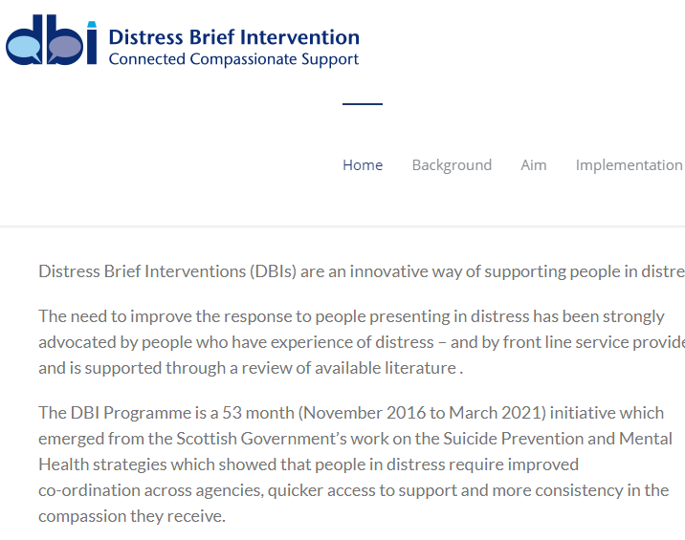
Making it Easier: A Health Literacy Action Plan for Scotland, 2017-2025
Embed mental health literacy in DBI:

Slide 48
Making it Easier: A Health Literacy Action Plan for Scotland, 2017-2025
‘NHS Inform as “go-to” source of online information

Slide 49
Making it Easier: A Health Literacy Action Plan for Scotland, 2017-2025
Information intermediary role, especially for the disadvantaged – librarians, family nurses, social workers…
Digital tools for self-management as well as decision making for people and their practitioners
(BUT, there are other literacies needed first/in addition to health, leading to barriers: information, computer, media, digital)

Slide 50
Scotland’s National Dementia Strategy 2017-2020
Commitment 11: ‘We will implement the Technology Charter for People in Scotland with Dementia, ensuring that everyone with a diagnosis of dementia and those who care for them are aware of, and have access to, a range of proven technologies to enable people living with dementia to live safely and independently…’

Slide 51
From the Charter:

Slide 52
Mental Health Strategy, 2017-2020
Action 25: ‘Develop more accessible psychological self-help resources and support national rollout of computerised CBT [cognitive behavioural therapy] with NHS 24, by 2018.’
Connecting rural communities to decrease isolation
Other opportunities also exist through peer support, digital tools and better use of electronic information because these offer huge potential for widening access, supporting co-production and self-management.’
Digital Health and Care Strategy will ‘connect the needs of mental health services and users into digital infrastructure investments that are being mapped out for health and community care over the next 5 years and beyond.’

Slide 53
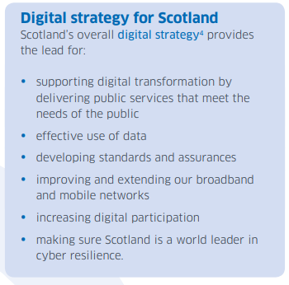
Scotland’s Digital Health and Care Strategy (Digital Health and Care Scotland, 2018)

Slide 54
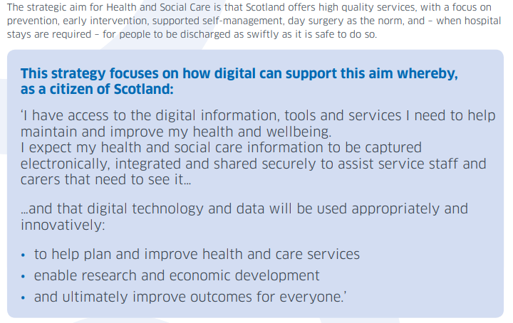
Scotland’s Digital Health and Care Strategy (Digital Health and Care Scotland, 2018)

Slide 55
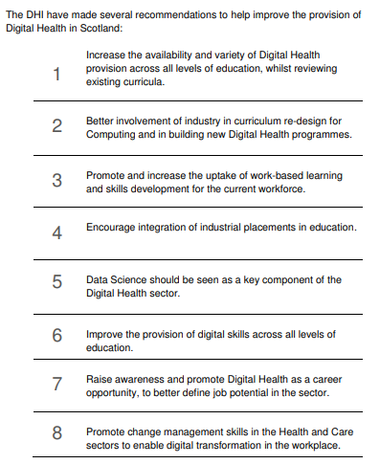
Review and Analysis of the Digital Health Sector and Skills for Scotland (DHI & Skills Development Scotland, 2018)

Slide 56
Internet as place?
Significance of ‘place’ cannot be ignored
Blending of the ‘virtual’ and ‘real’
Take advantage of integration focus
What we need in Stornoway is not the same as what we need in Glasgow… but how different are they exactly?
How can each of us contribute, individually and collectively, within our authorities and institutions, to help Scotland meet their ambitious e-mental health challenges and goals?

Slide 57
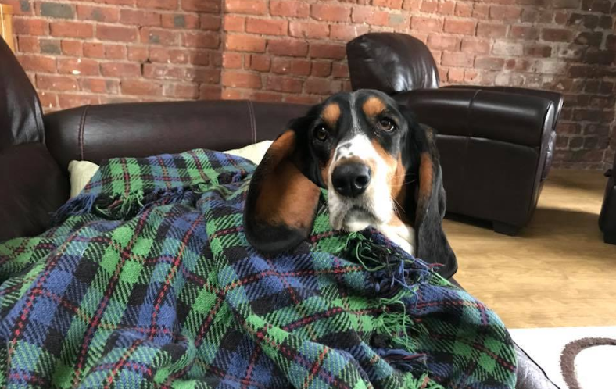
Thank you!

