Slide 1



Aye Mind – digital mental health collaboration with young people -
- an adaptable approach useful for
schools, colleges and other settings
Dr Trevor Lakey, Health Improvement and Inequalities Manager –
Mental Health, Alcohol and Drugs, NHS Greater Glasgow and Clyde
@ayemind99

Slide 2

Opening questions
Quick scan of the range of settings that colleagues are working in…
What are your experiences, examples of both the positive opportunities for digital mental health and wellbeing and some of the negatives / downsides that need to be addressed?
How do you currently keep up-to-date with the changing landscape, opportunities and issues?
Would you say your organisation supports you well for this task?

Slide 3
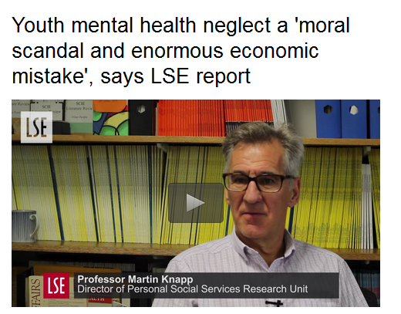
The case for action on young people’s mental health – “a moral obligation”
“Young people not only have the highest incidence and prevalence of mental illness across the lifespan, they manifest the worst service access of any age group”
British Journal of Psychiatry, 2013
Notes:
http://www.lse.ac.uk/newsAndMedia/news/archives/2016/02/Youth-mental-health.aspx

Slide 4

Scottish Youth Parliament –
Speak Your Mind
“Our Generation’s Epidemic: Young People’s Awareness and Experience of Mental Health Information, Support and Services”
SYP surveyed 1453 people aged 12-25 from all 32 of Scotland’s local authorities.
1 in 4 young people considered themselves to have experienced mental health difficulties yet 70% of those people didn’t know where to access support
Notes:
http://www.thinkpositive.scot/2016/07/syp-mental-health-report/

Slide 5
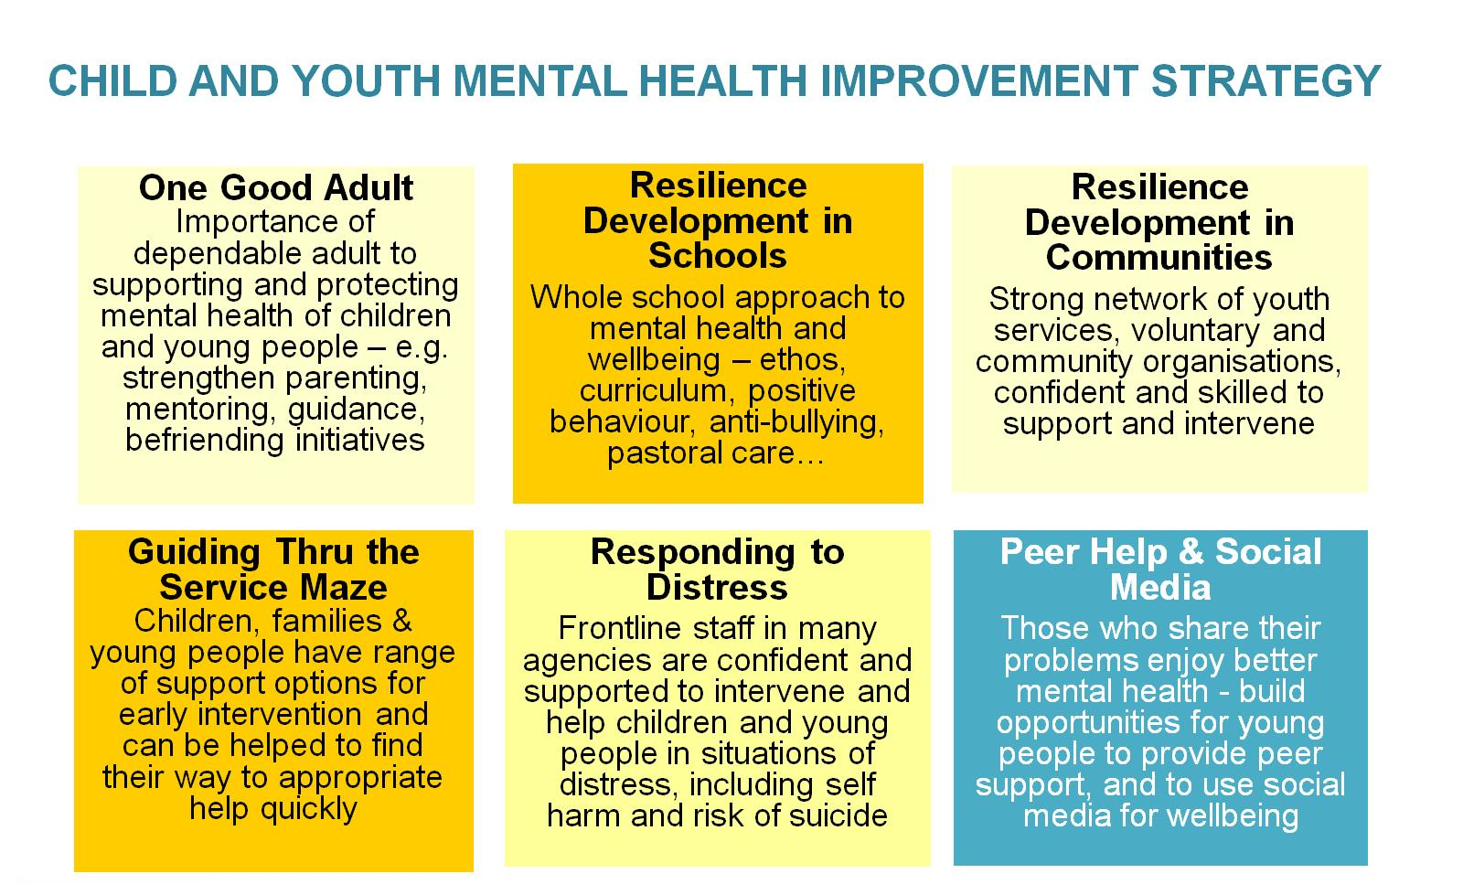
The case for action on young people’s mental health – “a moral obligation”
Greater Glasgow and Clyde

Slide 6


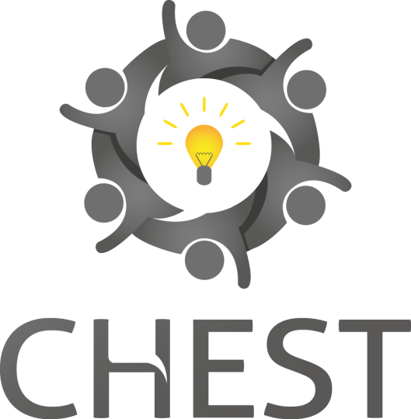


‘Digital Wellbeing Collaborative’ members and range of local youth groups and young people
Collaborative Approach…

Slide 7
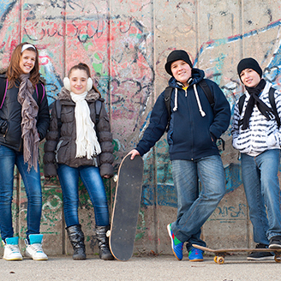
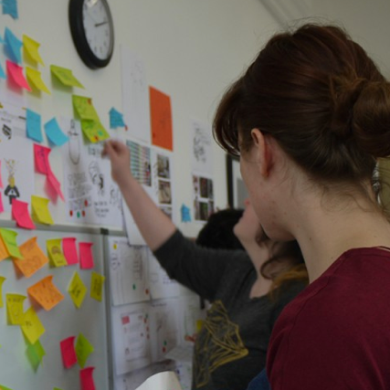
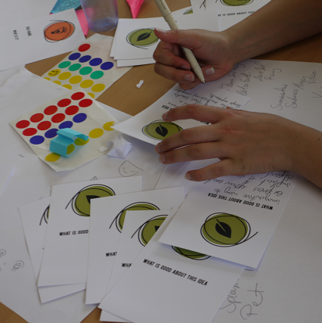
Target Groups
Young people,
13-21 years old
From diverse backgrounds and needs across Greater Glasgow and Clyde
Youth-related
workers
From youth and allied workers to clinical staff, health improvement and information staff
Service managers, planners & policy makers
Spanning health, social care, education, voluntary and private sectors

Slide 8

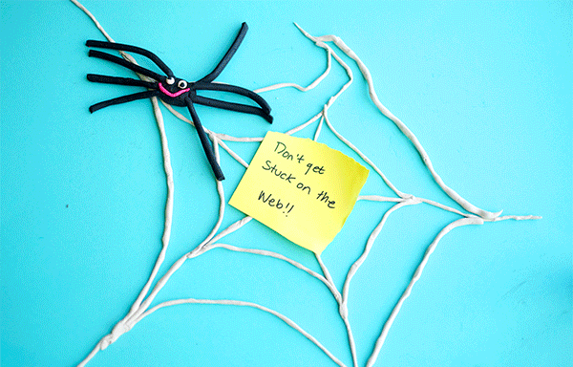
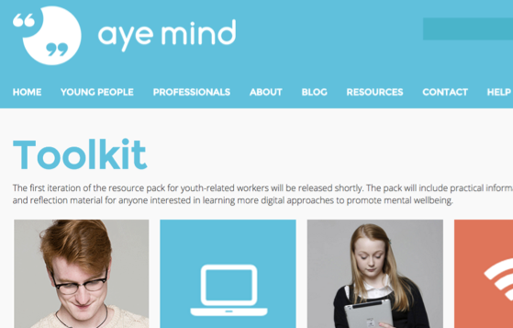
Objectives
Create a digital resource platform for young people to help promote their mental wellbeing
Create digital resources to support young people who support their peers
Create a workers’ toolkit on how to better utilise the “digital world” for wellbeing

Slide 9
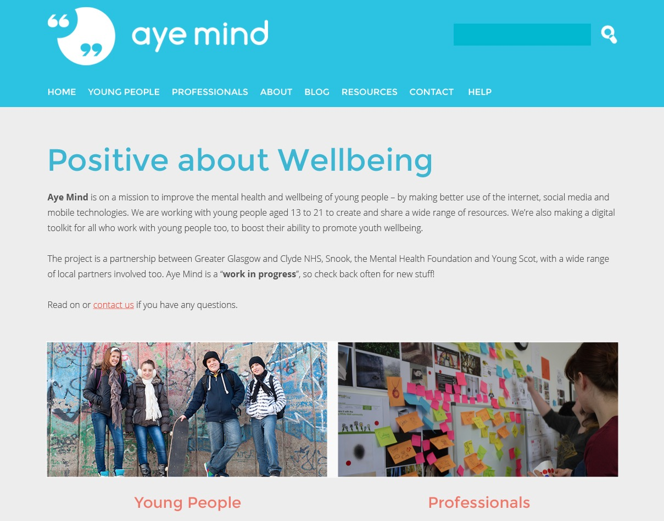

Slide 10
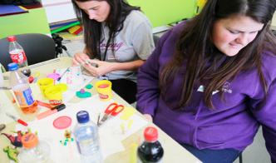
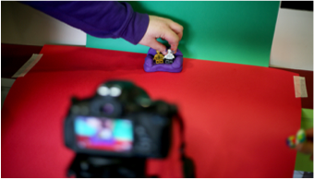
Co-production in action
- Making animated gifs to communicate on mental wellbeing issues
“serious fun”

Slide 11


Co-production in action
- Making animated gifs to communicate on mental wellbeing issues
Animated Gifs – covering range of wellbeing themes, devised entirely by young people
Gif making competition – run by Young Scot – around 80 submissions, winning Young Scot reward points
Notes:
See http://ayemind.com/support-squared-materials/ and http://ayemind.com/support-squared-gifs/ for further details of gif making

Slide 12
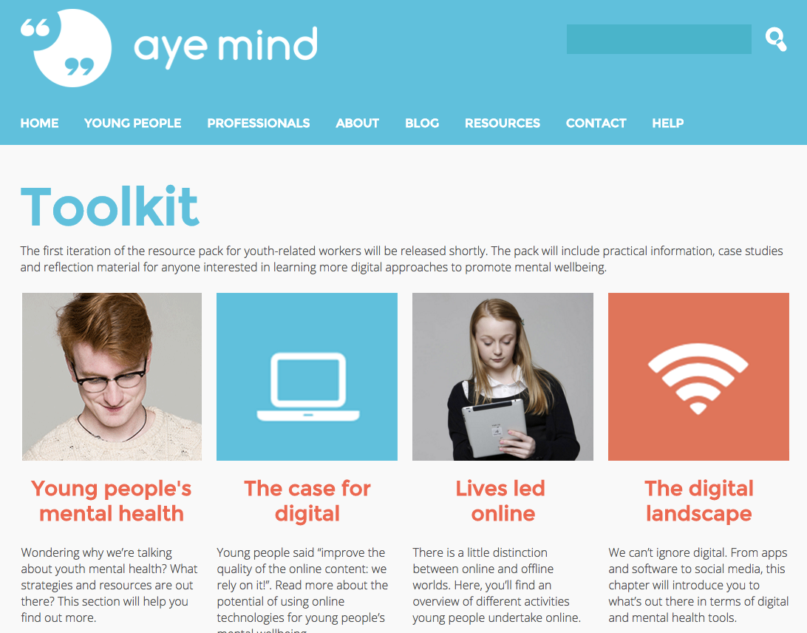
http://ayemind.com/toolkit/

Slide 13







Digital Resources for Mental Wellbeing… Much More Than Apps!
Browse or search http://ayemind.com/resource-map/
Notes:
http://ayemind.com/resource-map/

Slide 14
Support Hope and Recovery Online Network (SHaRON) is an Eating Disorders Tele Health System that connects individuals to each other and to their care providers
Benefits seen to date
Over 80% of SHaRON users agree that SHaRON
has been helpful in their recovery.
Service deploying SHaRON has transformed from 5 days a week 8 hours a day, to 24 hours, 365 days per year service, at very little additional cost
Net savings per patient (18+) per year of £4,496 for Berkshire when compared with other services in the region. This amounted to a total savings per year of £715k for Berkshire CCGs
As well as improving the quality of the service delivered to patients, considerable evidence of early discharge, with SHaRON as part of the discharge plan, and increased re-referral prevention.
Notes:
http://www.sharon.nhs.uk/ Berkshire development

Slide 15
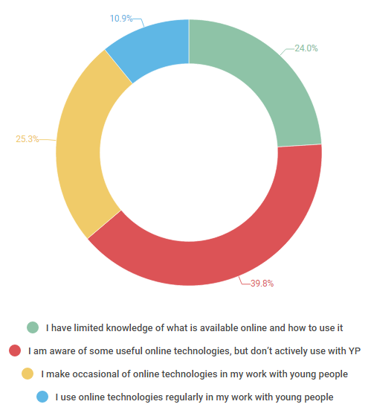
Use of online technologies to support
mental health and wellbeing for young people - from our Aye Mind Survey Monkey
“Social media is here to stay - NHS and its partners need to embrace it, and work with young people to maximise the positive potential, rather than think only of risks.”
Answered: 305 Skipped: 85

Slide 16
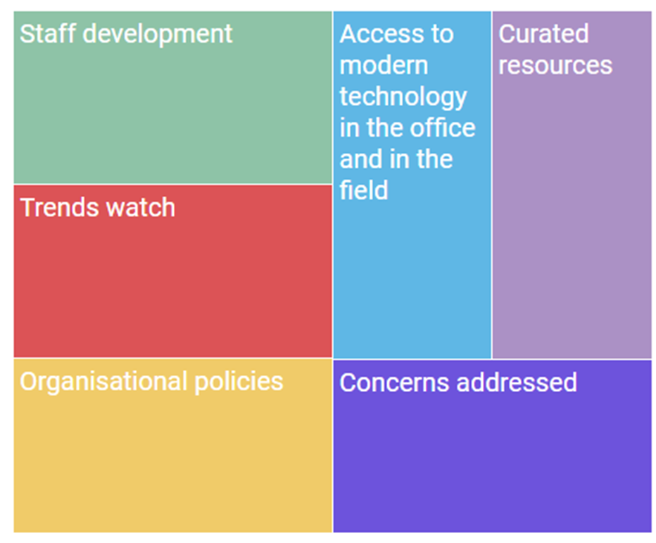
What would improve your ability to use online technologies to support young people’s mental health and wellbeing?
Staff need time to improve their ability as well as access to specific learning and skills development.
Appropriate, helpful, interesting, quality controlled, current, and free (or funded). Need more aimed at older young people, and more developed by young people
Modernised infrastructure and equipment including access to tablets, smartphones and printers
Regular briefings on the latest trends in technologies used by young people including platforms, apps and forums as well as current jargon and abbreviations.
Many policies currently limit or prohibit the use of online technologies including apps. Ensure policies contribute to protecting workers and young people e.g. safe practice, cyberbullying and confidentiality.
And accessing and contributing to the evidence base.

Slide 17

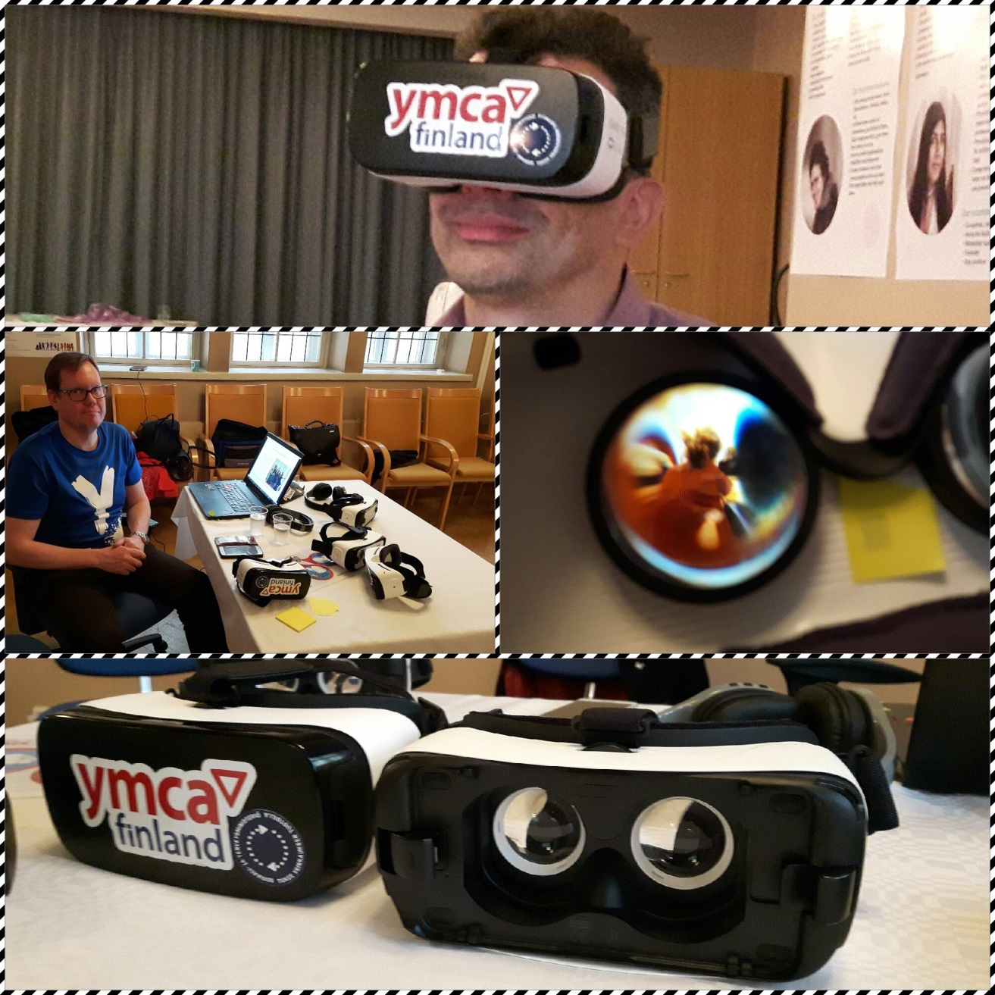
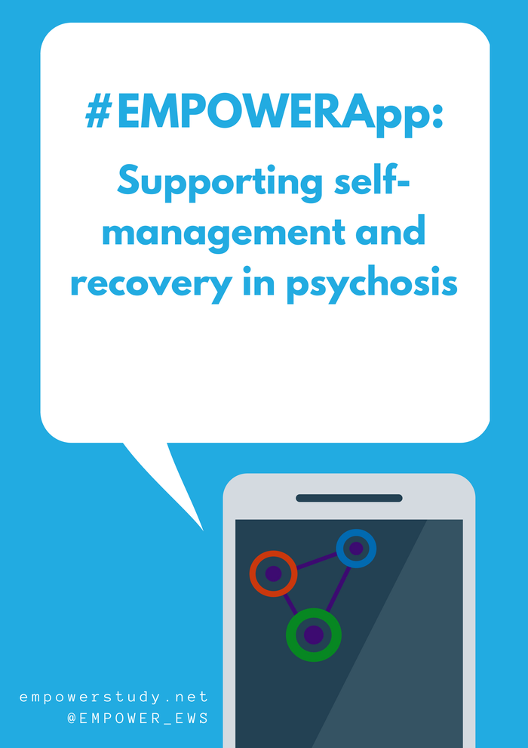

Slide 18
Youth Mental Health and the Digital World
Four strands of development work emerging from Aye Mind experiences
Digital Citizenship - Assisting young people to be confident, skilled, active, social, empathic & empowered citizens (& 5Rights)
Digital Inclusion - Focused work with vulnerable young people using creative digital methods (e.g. #notwithoutme)
Digital Wellbeing - Tools and approaches to support and encourage mental wellbeing, resilience and peer support
Digitally Enhanced Care - Specialist therapeutic and allied tools and services
Notes:
http://www.cool2talk.org/
http://ayemind.com/resource-map/
https://www.kooth.com/

Slide 19
Discussion points
What steps do organisations and workers need to take to enable effective use of digital resources and methods? How do you currently learn, keep up-to-date, innovate - what helps or inhibits this?
What opportunities for further participatory / coproduction work with young people and for engaging on wellbeing themes – any settings guidance?
How can Aye Mind and allied resources and approaches be used in mainstream work with young people and young adults?
How do we progress this agenda? Are you a “digital champion”? What steps will you take to progress digital approaches to wellbeing?

Slide 20
www.ayemind.com
@ayemind99 – Twitter
and/or @synedrum – personal account
Thank you!

