Slide 1
Loneliness and social isolation in rural communities: harnessing community and digital assets, experiences in Canada and Western Isles, Scotland’
Martin Malcolm, NHS Western Isles/
Churchill Fellow 2017

Slide 2
Background
All Ages
Over 9M adults in UK always or often lonely (Coop/RedCross)
43% of 17-15 year olds lonely (Action for Children)
Over 4000 Childline counselling sessions were for loneliness (16/17)
11% Scotland often feel lonely and 38% sometimes lonely (MHF, 2010)
Older adults:
6-13% experience chronic loneliness in UK unchanged since 1940s (Victor, 2005)
2/5th (3.9M) say TV is their main company (Age UK, 2014)
Disabled People:
Up t o 50% lonely on any given day (SENSE, 2016)
Health:
SI/Loneliness acknowledged as public health challenge >= obesity and = smoking 15 cigs./day
Loneliness increases risk of death by 29% (Holt-Lunstad, 2015)
Notes:
Why focus on SI/loneliness?
ie. those experiencing loneliness always or often, has been consistently reported among older adults at between 5-16% in UK although higher levels exist for the very old (Victor et al, 2005).

Slide 3
health impacts
To assess mechanism by which SI/loneliness impacts health
Health evidence:
SI/Loneliness acknowledged as public health challenge >= obesity and = smoking 15 cigs./day
29% greater risk of death
Care Service impacts
1.8 times more likely to visit GP
1.6 times more likely to visit A&E
1.3 times more likely to have emergency admission
3.5 times more likely to enter residential care
Notes:
Better inform interventions
Key role for communities in solutions if to be sustainable
Investigate whether particular role for technology particularly in its ability to get round difficulties of remoteness and dispersed pops..

Slide 4
Evidence: Loneliness/SI: Health Impacts
Mental Health:
3.4 times more likely to have depression
1.9 times more likely to develop dementia within15 years
Double risk of alzheimer’s disease
Also anxiety, schizophrenia & suicide links
Physical Health:
2-3 times more likely to be physically inactive
  = 7% > risk diabetes
  = 8% > risk stroke
  =14% > risk CHD (via raised bp /cholesterol levels; lower survival)
Disability (physical functioning eg. daily living tasks)
Cancer survival
Notes:
In terms of specific health conditions:
Dementia and Alzheimer’s Disease (Tilvis et al, 2004; UK Alzheimer’s Society, 2013; Wilson et al., 2007)
64% increase risk of clinical dementia (Holwerda et al, 2012)
Doubles risk of Alzheimer’s disease
Anxiety (Anderson & Harvey, 1988)
Schizophrenia (DeNiro, 1995; Neeleman & Power, 1994)
Suicide (Heinrich, 2005; Bancroft et al 1976; Birtchnell & Alarcon; 1971; Nordentoft & Rubin, 1993),
CHD & CVD conditions (Heikkinen, et al, 2002; Ort-Gomer et al, 1988; Herlitz et al, 1998; Sorkin et al, 2002).
Infectious Disease (Pressman et al, 2005; Steptoe et al, 2004)
Disability (Perisinotto et al 2012; McLaughlin et al 2012)
Cancer - conditions eg. breast cancer (Fox et al, 1994)
- Cancer survivors (Rokach, 2000; Boer et al, 1998)

Slide 5
Objectives
To consider particular challenges for SI/Loneliness for remote/rural communities
To identify approaches harnessing community/digital assets to socially connect remote/rural communities - Canada
To test community/digital approaches in overcoming Remote/Rural challenges in Western Isles
Notes:
Better inform interventions
Key role for communities in solutions if to be sustainable
Investigate whether particular role for technology particularly in its ability to get round difficulties of remoteness and dispersed pops..

Slide 6
Objective 1: SI/Loneliness Challenges in Remote/Rural areas - Western Isles
Geographic
Demographic
Social
Lifestyle
Notes:
There are particular challenges facing remote/rural areas such as Western Isles in Scotland in terms of loneliness/SI and health impacts
Can be grouped into following areas that present key risk factors for loneliness/SI:

Slide 7
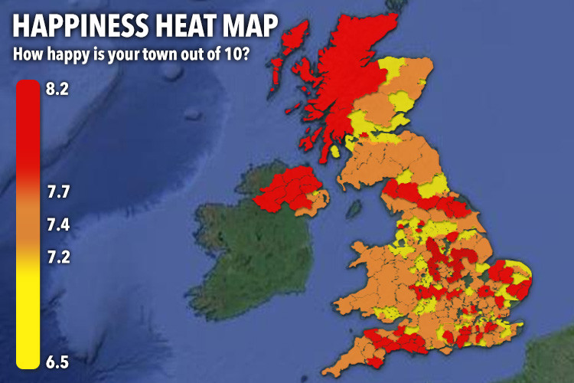
SI/loneliness in the
Western Isles?
Notes:
For WI:
On face of it not a problem in WI and much of Scotland - Apparently WI is happiest place in UK –
BUT we saw earlier loneliness (sense of belonging) is decreasing across UK but relatively more so in places like WI.
So we really don’t know

Slide 8
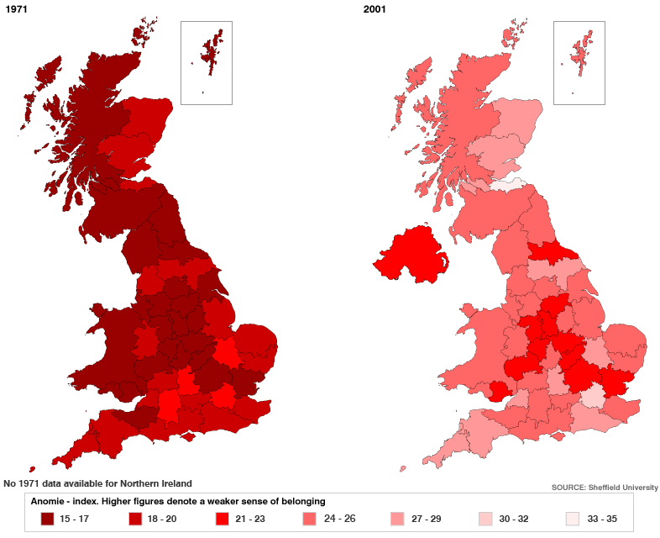
UK Map of Loneliness
Notes:
Looking at geographical variations in UK and over time:
Suggests worsening generally but particularly across Scotland/Wales, North
Actually sense of belonging as no data captured across UK
BUT as proxy measure shows much of UK losing sense of belonging even in highlands/islands communities!

Slide 9
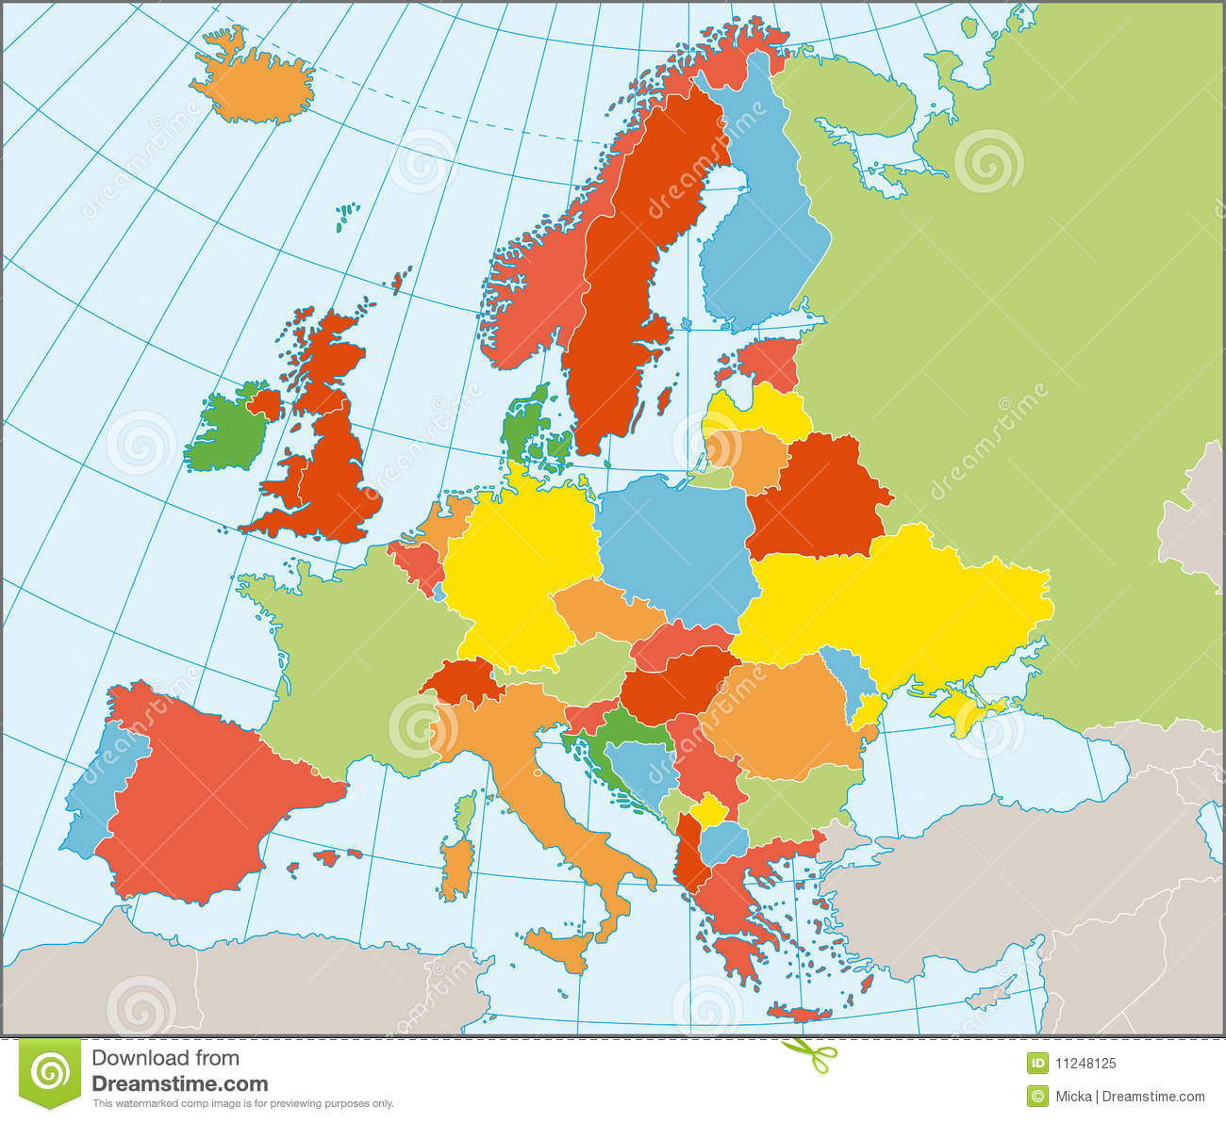
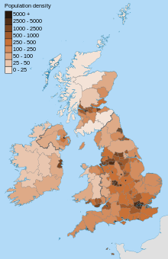
Objective2: Remote/Rural Challenges-Geography
Remoteness Sparsity
Notes:
This means
Physically Remote –from rest of Scotland and UK and.....further afield
AND sparsely populated:
Lowest pop. density in UK <25persons/km2

Slide 10
Challenges: Socio-demographic
Persons Living Alone – Western Isles/ Scotland
Notes:
Looking at socio-demographic challenge
2 Key trends:
1) Ageing population and we know Age is one of biggest risk factors for loneliness/SI
In Scottish terms WI has highest % of 65+ and projected to increase to 40% of pop.
2) Living Alone another key social factor – WI above Scottish level and set to widen
Note: These figures are equal to the number of people in the age group projected to live in a 'one adult' household, divided by the projected population of that age and gender (including those living in communal establishments).
This table only includes people aged 16 and over.
challenges
Increased LE but static HLE
Increasing demand on health and social care services
Greater LTCs
Ageing informal carers

Slide 11
Challenges: Social
% Population 65+ and living alone, EU NUTS level 3 regions
% Single-person households, EU NUTS level 3 regions
Notes:
AND SET to increase with WI outstripping Scotland
In European terms among highest areas presently 2011 30-35% with only Northern Scandinavia and some Baltic states higher

Slide 12




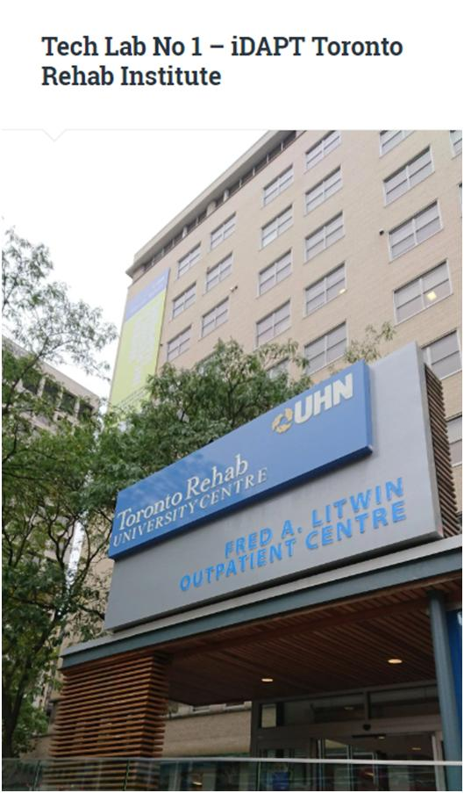
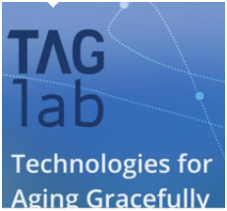



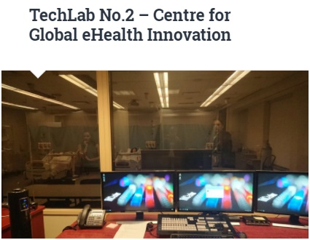
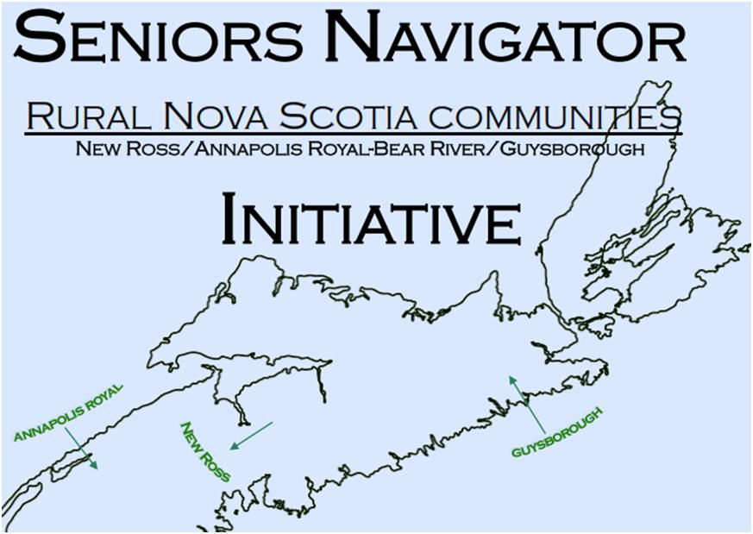


Objectives 2: Community/Digital approaches – Canada Churchill Fellowship Study
Technology for Active Participation
in Society (WP4)
Rural Communities
Notes:
So that the evidence and challenges for WI/Scotland generally –
Third objective was to review solutions in Canada where similar remote/rural challenges exist
2 areas of focus
Social Digital innovations
Rural Communities (esp. for use of digital)
NOW a few examples of projects where we seek to tackle and all harness to varying degrees the potential role of technology

Slide 13
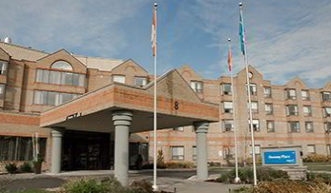
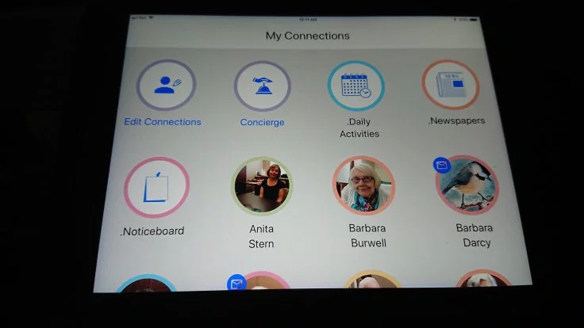
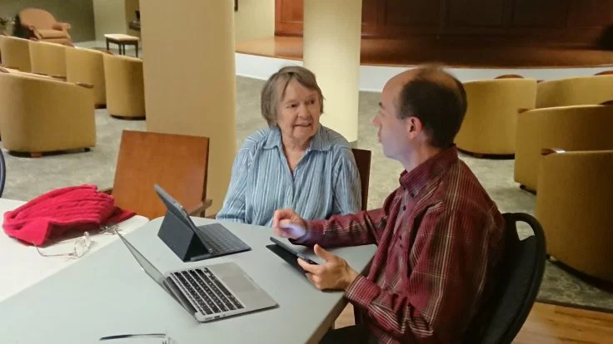
InTouch – Socially Connecting Seniors Home residents
CONNECT-TECH InTouch Project – TagLab
Notes:
Partnership between TagLab (toronto Uni) and Donway Place, Seniors Home

Slide 14
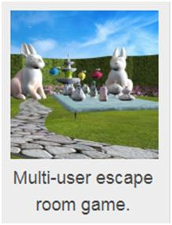

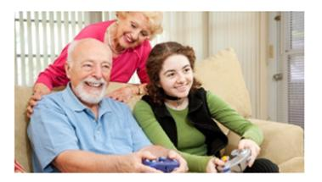
CONNECT-PLAY - SFU
Aging Well: Can digital games help older people (2012-2016)
Digital Games for older people:
Tic Tac Quiz
Solitaire Quiz
Escape Room Game
Knowledge development/ Educational
Social connections
Cognitive exercise
Coplaying
Digital skills
Fun/enjoyment
Dr. David Kaufman is a professor and researcher at Simon Fraser University and co-lead of an AGE-WELL research theme on Technology for Active Participation in Society.
Notes:
Other area was project led by SFU to explore social role of digital gaming among older adults
Found benefits in terms of:
learning (cognitive)
social connectedness (co-playing, collaboration)
Digital skills and acceptance
general enjoyment (wellbeing)
survey of over 1000 seniors was conducted about their digital and non-digital gameplay. This is being followed up with a series of interventions in seniors' facilities, community centres and private homes to investigate the potential of using various digital games to provide cognitive and social-emotional benefits to older adults
Solitaire Quiz, the first in a series of AGE-WELL-supported digital games for older adults, was developed by Dr. Sauvé’s team in collaboration with Dr. Kaufman. It is now available online in English and French at Android and Apple stores and through Facebook. Tic Tac Quiz is being field tested and will be available soon. An online escape room game will be field tested this fall and launched early in 2018.
Familiar games to an older audience, Solitaire Quiz and Tic Tac Quiz also feature customizable quizzes on a variety of topics, such as nutrition and healthy living. The escape room is a collaborative game that requires two players to talk and work together to solve the puzzle and escape.
Play, Learn, Connect: older adults expriences with multiplayer, educational, digital bingo game:
The results of this study showed significant improvement in players' scores for knowledge, social connectedness, and attitudes toward digital games from the pretest to the posttest. The interview data confirmed these increases and provided insights on the importance of learning, social connectedness, coplaying, and general enjoyment from playing a digital educational game

Slide 15

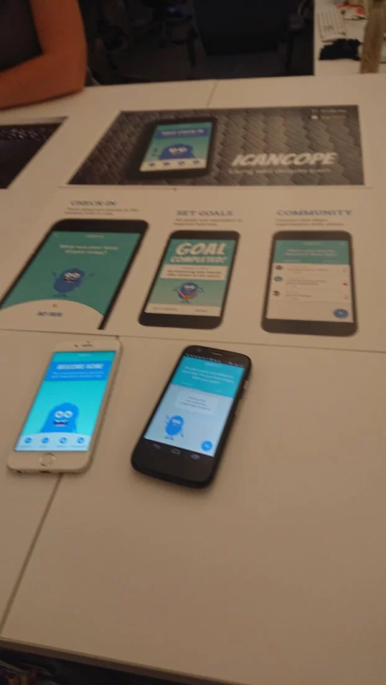
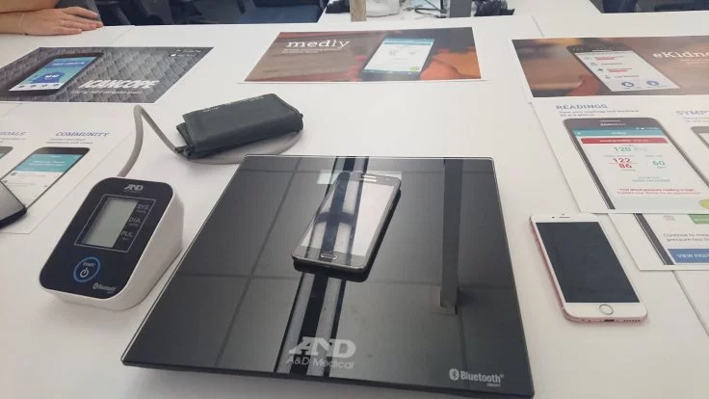



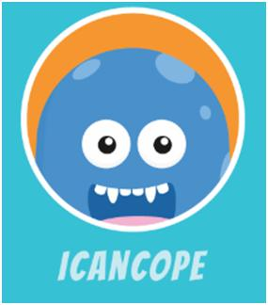
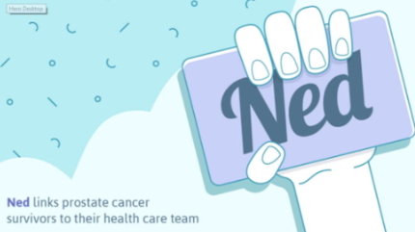
Socially Supporting People with LTCs
Notes:
Persons with LTCs are a key group where SI/loneliness can impact – so found in no. of digital apps developed for condition management a strong social support element
e.g.
ICanCop – chronic pain for young adults/adolescents
iPeer2Peer – peer support for teenagers with LTCs via young adult mentoring on VC
Teens taking charge – onlines self-management with strong social support element
Medly – multiple chronic condition support – again strong community social support element
ICanCope – support with chronic pain for young adults/adolescents – socially connecting element/support The app will help AYA to track pain, sleep, mood, activities, and exercise and socially supportive/connecting element – via Community and Goal Setting with help of other AYA with pain to meet goals.
iPeer2Peer - Peer support could help meet this need. Providing face-to-face peer support using the Internet
The iPeer2Peer Program matches teenagers with chronic disease with a young adult mentor who has learned to manage their disease. The teenagers and their mentors speak on Skype video calls ten times for 20 to 30 minutes over three months. The iPeer2Peer Program is new and different because it uses technology that many teenagers are already familiar with and makes education and support more accessible to young people with chronic disease.
Teens taking charge online self-management program – includes
focus on helping youth gain skills for independence and transitioning to adulthood and after/adult health care;
(b) include interactive comprehensive cognitive-behavioural methods to promote self-management skills; and
(c) provide opportunities for meaningful social support or interaction with health care providers (health coaches, “Ask An Expert” feature).

Slide 16
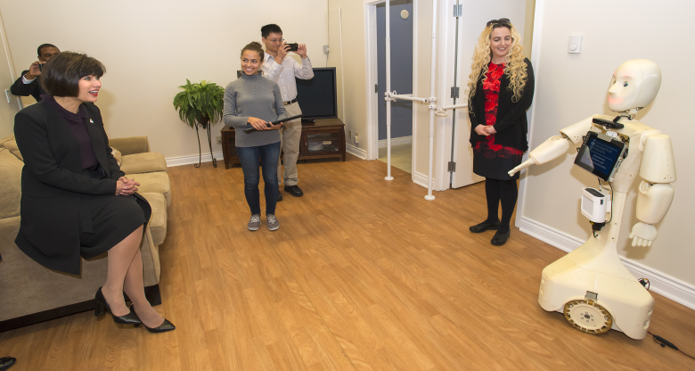
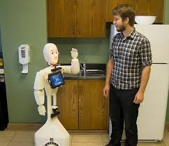

Socially assistive robotics – Robot Social intelligence?
Socially intelligent robots for human-robot interactions (HRI) inc.
Providing reminders
health monitoring
social &cognitive training interventions
Key characteristics:
automated real-time affect (emotion/mood/attitude)
detection & classification of:
  body language,
  paralanguage
  facial expressions
display appropriate emotion-based behaviours
Notes:
ASB Lab – Toronto
AT momement largely lab/research trials
with social functionalities and behavioural norms to engage humans in natural assistive interactions inc.
for social human-robot interaction (HRI) scenarios need to be socially intelligent based – Toronto university

Slide 17
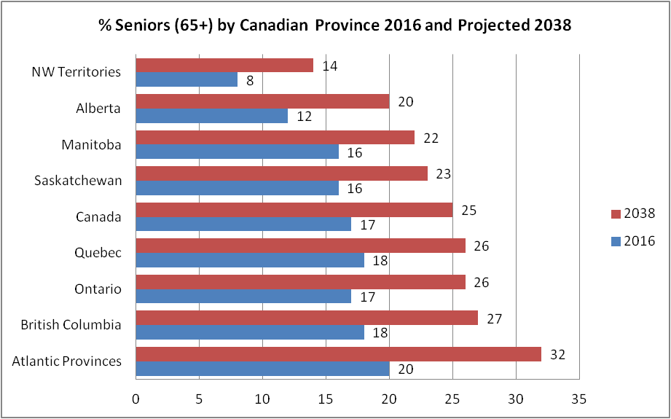
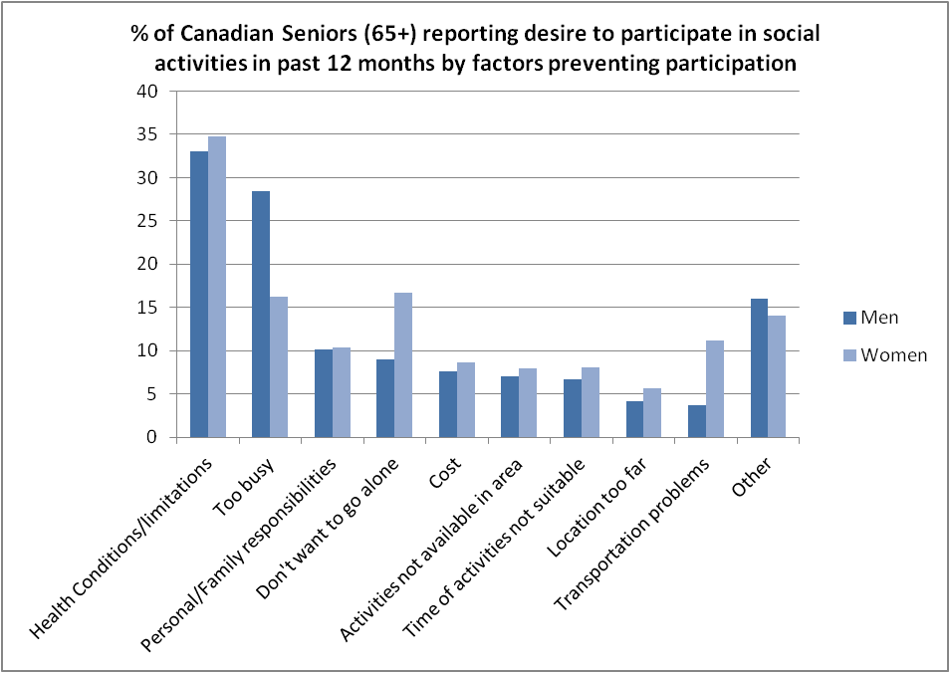
Canada – Ageing and Social Isolation

Slide 18
Rural Communities
Prince Edward Island
Rural Nova Scotia
Northern BC
Rural Ontario
Key factors
Accessibility
Ease of use
Tech Support
Facilitation of content
Personalised

Slide 19


Prince Edward Island/ Nova Scotia @NS
SHIFT – NS Action Plan for Aging Population
Key Commitment: Support Social Connections
Increase affordable access to recreational facilities
Encourage older adults to participate in public policy development
Invest in community internet/digital literacy upskilling
Assist persons with disability to remain in home
Digital Initiatives:
Seniors Navigator Project – ICT assistance
PEI Party Line – community telephone contact/chat program
  Social chat
  Programmed talks/discussions e.g. Stress awareness, 50+Memories
Seniors College – inc. technology classes taught by seniors for seniors
Seniors Safe@Home Program – adaptations to home
‘Empowering Seniors through Technology’ Program – trainers in rural
locations across Nova Scotia

Slide 20
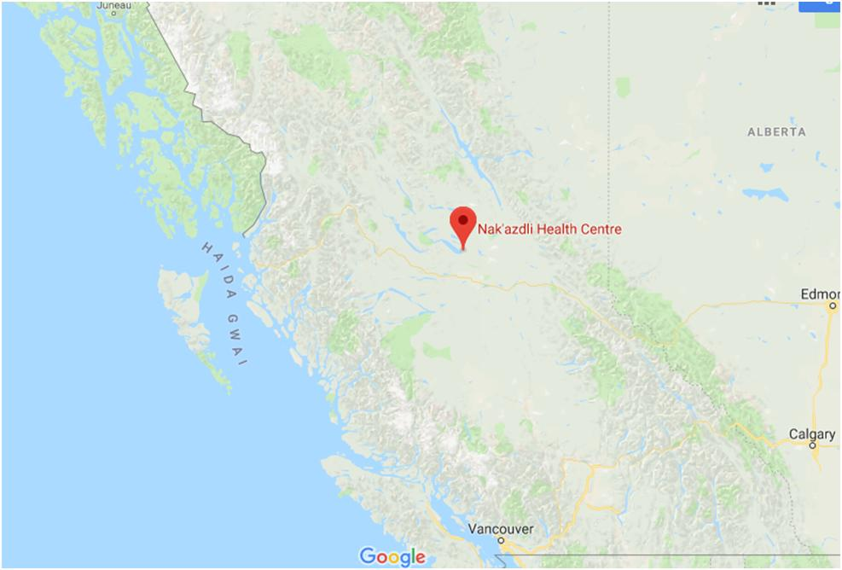
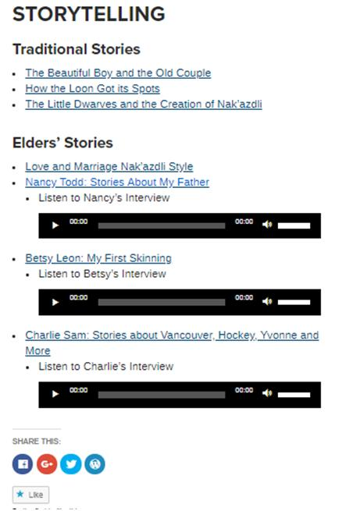
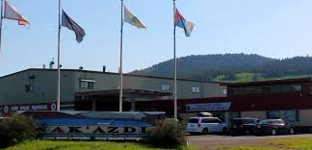
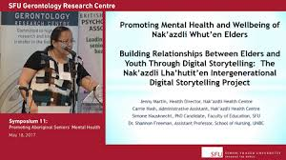
Northern BC- Intergenerational Digital Storytelling – First Nations Lha’hutit’en Project
Notes:
Building Relationships between Elders and Youth Through Digital Storytelling: The Nak’azdli Lha’hutit’en Intergenerational Digital Story Telling Project
Combines digital and intergenerational approaches
Elementary school pupils and elders groups
Objectives:
Preserve Nak’azdkli culture, history and traditions
Build intergenerational relationships
Engage elders in meaningful ways
Design: 10 sessions
Focus groups and community showcase event:
The Nak’azdli Band is in need of a means to strengthen intergenerational linkages between elders and youth to preserve cultural wisdom held by the elders for future generations. Under the direction of the Nak’azdli Health Centre, a Nak’azdli elder’s survey was conducted in the spring of 2016. This survey identified that sharing cultural knowledge and traditions was a priority for Nak’azdli Elders. This is understandable as elders cope with adapting to a fast-changing society and the loss of elders in death. Our team agreed to introduce a digital storytelling workshop using technology as a means to facilitate knowledge-sharing between elders and youths. This pilot workshop involves Nak’albun Elementary School students and Nak’azdli Elders. The project’s intended outcome is to integrate digital storytelling into the school curriculum and support elders working with youths in a meaningful way to bridge the intergenerational divide and preserve their culture and lived experiences.

Slide 21
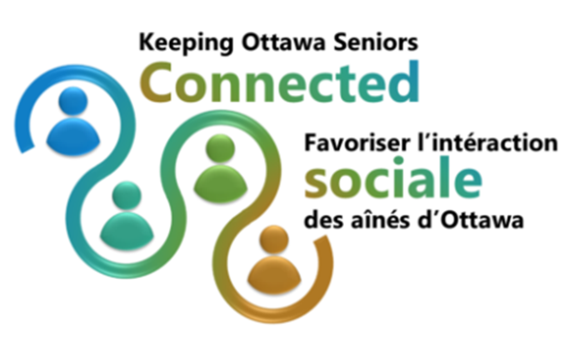
Rural Ottawa - digital
Social Connections:
Seniors Centre Without Walls
Keeping Ottawa Seniors Connected
Rural Ottawa Resource Centre – Community Helpers training programme – 8 modules inc. Loneliness/SI and digital resources
Community Engagement/Participation:
Ottawa CivicTech – communities/policy/technologists combine for civic good projects
Tech4Good Ottawa (NetSquared community): Connecting People and Technology – e.g. Random Hacks of kindness events ; Digital storytelling workshops ; Podcasting/Blogging training
Notes:
Examples of Community projects/initiatives where technology has role in socially connecting people
1) More low level simple tech initiatives where social mediao even telephone used to connect people – importantly: facilitated/structured/training support
Seniors centre without walls – 55+isolated seniors – fun/educational/Health&wellness seminars from home – conference call/facilitated – webex? http://thegoodcompanions.ca/programs-services/seniors-centre-without-walls/
KOSC – Social Isolation impact plan aided by Innoweave Social Innovation specialists
- http://kosc.ca/project-partners/pan-canadian-projects/
Rural Ottawa Centre - Community Helpers prog.inc. modules on loneliness/SI and tech support
- https://www.wocrc.ca/seniors-and-adults-physical-disability/community-helpers
2) More tech-based with digital cos. With social impact aims joing up with communities in initiatives – problem solving
Ottawa Civic Tech –
http://ottawacivictech.ca/
NetSquared Groups – ottawa
https://www.techsoupcanada.ca/en/community/netsquared

Slide 22



Objectives 3:
Social Support Innovation Projects – Western Isles
To develop new ways to support vulnerable older people (dementia/frail older people) to live longer in their homes in sparsely populated areas of N. Europe
To stimulate transformation in older people’s services, enabling people to live well, safely and independently in their own homes, supported by a modernised infrastructure for healthy ageing
To create innovative, effective & transferable digital solutions and supporting services to prevent and reduce social isolation and associated health issues among at risk older people in remote communities.
Notes:
So that the evidence and challenges for WI/Scotland generally –
NOW a few examples of projects where we seek to tackle and all harness to varying degrees the potential role of technology
Remoage

Slide 23
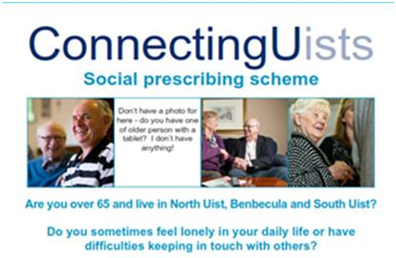
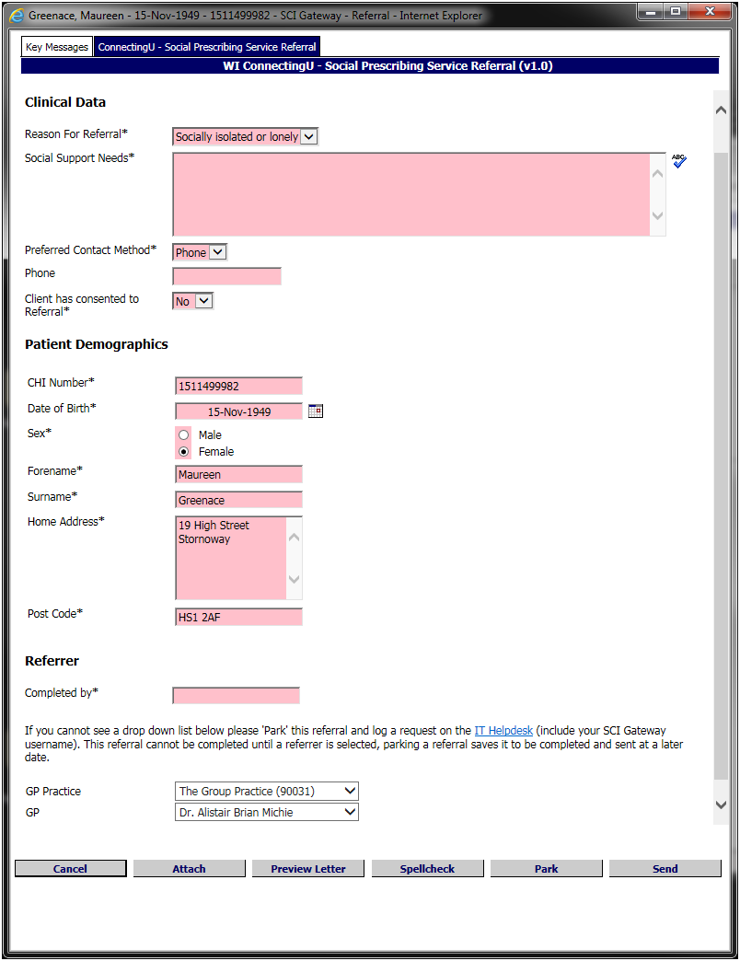
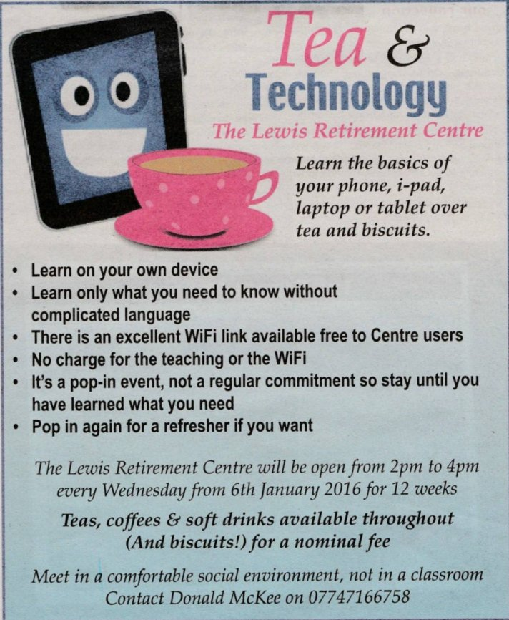
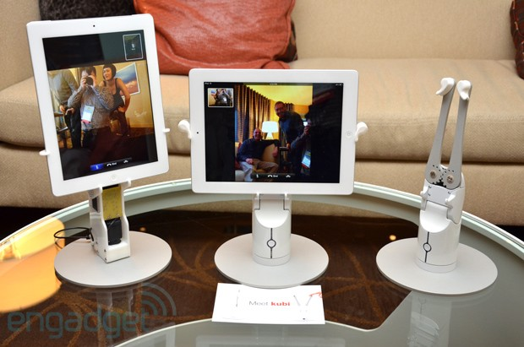
Remoage:ConnectingUists Service-
Digital Elements
Electronic Referrals
Tech training/support
Digital prescription/ access
ConnectingUists
Notes:
Protocol iteslf – simple to encourage referrals – pulls in CHI – unique patient ID from GP systems
With Option to pull through clinical/medication data from primary care system if required – not currently.
a)Process enabler:
Referral process integrated into existing Primary Care IT systems –via electronic protocols
b)Suppot to Patient/Carers:
Digital Community Assets register – linking Social Navigator and clients with Social Providers
Supported access/training to social support ICT services via Independent Living Outreach Centres
eg. Double/ iPad devices for social connections.

Slide 24
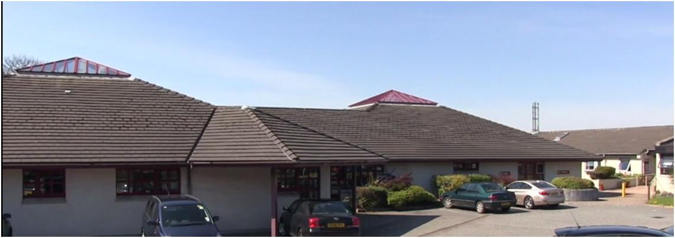
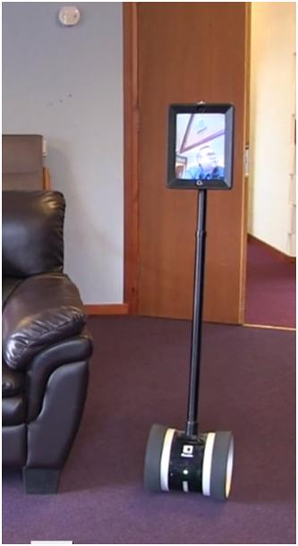
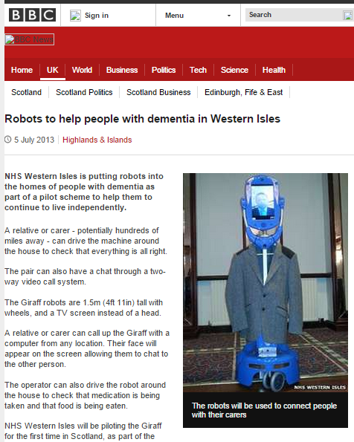


Remoage Centre for Independent Living
https://vimeo.com/167817734
Notes:
https://vimeo.com/167817734

Slide 25
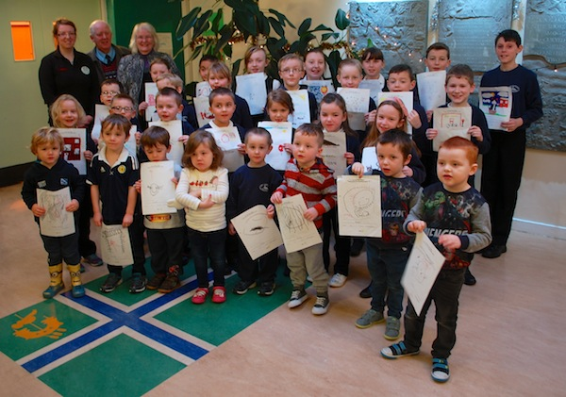
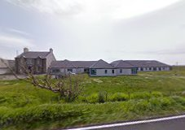

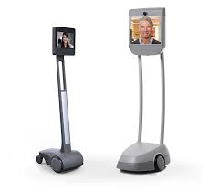
Remoage Intergenerational Project
Sacred Heart Care Home
Iochdar Primary School
Notes:
Remoage IG project – connecting school children/care home residents via activities/Gaelic language using latest tech eg. BEAM, DOUBLE

Slide 26

Community Navigator Service:
2500 Well Being plan
Digital services:
    a)Home Health Monitoring (Florence):
    LTC management (CHD,Diabetes, COPD)
    Keeping in Touch - Social Support
    bi)Video Enabled Care (VEC):
    Primary Care VEC – VC units in satellite GP Surgeries
    Secondary Care VEC – VC units in OP clinics to mainland services
    bii)Video Enabled Social Support (VESS)-
    Digital Storytelling Intergenerational Project
    Keeping in Touch VC – social support
    c)Digital H&WB apps
    Apps on prescription – sleep/CBT/Exercise
    Social support – i2iHub?
Notes:
mPower project crossborder service Ireland-Scotland – 5 year project with 11 sites supported by national partners
Deployment sites:
N. Ireland: Western and Southern Health and Social Care Trust areas
Ireland: border counties Cavan, Monaghan, Louth, Donegal, Sligo, Leitrim
Scotland: Ayrshire and Arran, Dumfries & Galloway and Western Isles
Other Partners:
NHS24 (Lead Partner)
CAWT (Operational Lead)
SCVO (Engagement/Community Asset Mapping)
UHI (evaluation)
Has 2 strands:
First is Community Navigator service...
Identify older people 65+ at risk
Offer Link role between isolated patient, referring professionals and social providers
Well-Being Plans (target=2500)
Personalised action plan focusing on individual goals and priorities.
Positive recognition of what the individual can do for themselves, their skills, access to resources and community supports.
Roadmaps to quality of life enhancement.
Opportunities for eHealth interventions.

Slide 27

Remote Rural i2iHub
Client
Assessment & Planning
iPlan
iSolutions
Remote Monitoring
Network Analysis-
Sensors: visitors/Phone calls/ Social Media
Social Navigator
Digital Support
Older Person
Sleep/ BP monitors
Isolation
Physiological
iNeighboursiBfriend
iPlay
iConnect
iKnow
PA –fitbit
Meds(sensor)
Alcohol/ smoking survey
Behaviours
Notes:
Older Person at the centre services surrounding them in terms of Social Navigator and Digitial support to enable access and use of the Remote i2iHub itself
i2iHub comprises 3 elements:
1)i2i Remote Assessment/Planning via:
iNavigator linking service
iConnector digital skills service
iPlan interactive social & digital client support plans
2)i2i Remote Monitoring of Social Isolation and Support impacts
via a range of i2iHub connected devices/client survey feedback
Following categories:
Social Isolation itself (eg. via door visitor sensors, telephone usage sensors, social media activity reporting)
Health Risks: a) Physiological eg. sleep pattern (device), BP (device)
b) Behavioural eg. Physical Activity (fitbit), smoking/alcohol (via smartexting survey), Meds compliance (sensor)
3) iSolutions themselves– digital interventions (activated via client iPlans)
iNeighbours private community network and asset map
iBfriend online befriending service
iPlay older adult digital gaming and storytelling
iConnect VC/chat service inc. intergenerational component
iKnow remote digital knowledgebase on iSolutions
Others? Eg. lifestyle support

Slide 28







Rural i2iHub
iSolutions – digital interventions (activated via client iPlans)
      iNeighbours private community network and asset map
      iBfriend online befriending service
      iPlay older adult digital gaming and storytelling
      iConnect VC/chat service inc. intergenerational component
      iKnow remote digital knowledgebase on iSolutions
      Others? Eg. lifestyle support
Notes:
Bit more detail on the sorts of iSolutions that will be activated via the rural i2iHub

Slide 29
Ideas for Future Collaborative Project?
Low Mood/Psycho-social Digital Solutions
Remote/Rural Mental Health Solutions
Martin Malcolm
Head Public Health Intelligence
NHS Western Isles
T: 01851708037/55
E: martin.malcolm@nhs.net
Blog: https://i2isearch.wordpress.com

