Slide 1
Notes:
Who I am and my role in mPower
Partnership and funding for mPower
Scope to look at what works best for our local communities

Slide 2
Introduction
mPower team in place in the Western Isles from November 2017 – 2 posts
Objective for NHSWI: to enable those living in our rural communities take the steps needed to live well, safely and independently in their own homes and care in the community.
Exploring a range of solutions and innovations including: Walking Groups, Community Group activities, Attend Anywhere, Florence.
Looking to the future, technology classes, apps, support sites ongoing programmes across communities.
Notes:
Information on Community Navigator/Implementation Lead roles
How referrals are made and received, our current plans for working with individuals
Research carried out to date, building relationships learning about what is already available e.g. Florence/Attend Anywhere – ways of keeping in touch
Continuously how we can make a difference, gaps and how we can fill them e.g. technology use

Slide 3
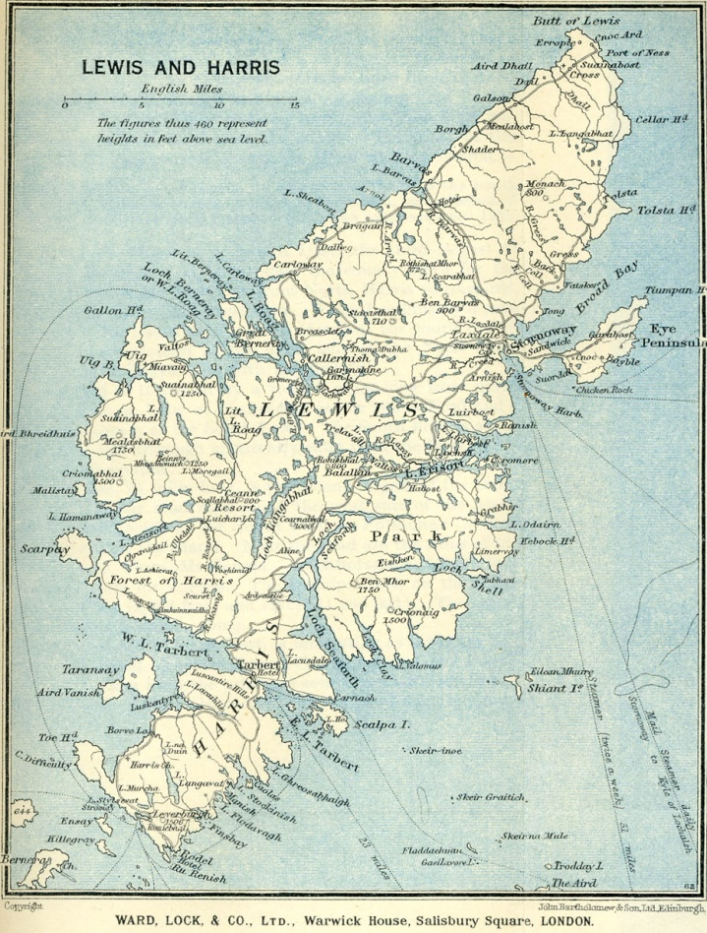
Notes:
What considerations to take into account:
Transport Links
Time taken to travel between Stornoway and furthest points in Lewis and Harris, serving as many as possible – how can we do this effectively and in the ‘right way’

Slide 4
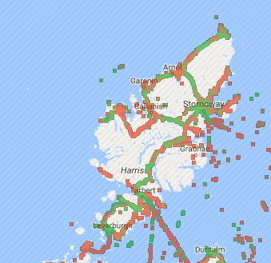
Notes:
Considering use of technology e.g. Florence – Connectivity
A muddled picture – lots involved, continuously changing landscape
Do our users have mobile phones/what assets?

Slide 5
Flo is not an app.
Flo is a web based clinical interface that collects data from patients via their mobile phone.
Florence
Notes:
One quick solution we are putting in place is Florence:
Cheap
No Need for extra equipment
Most people have a mobile phone

Slide 6
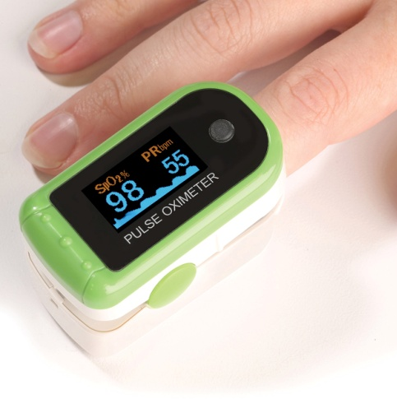
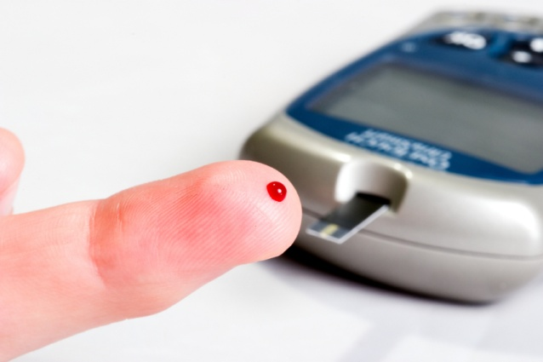
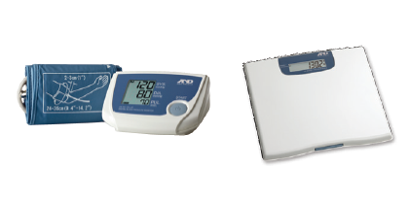
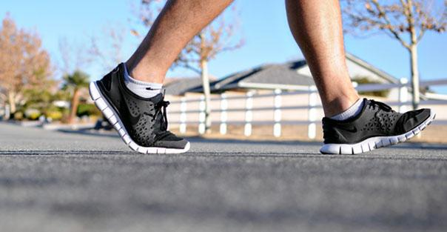
Florence
Data currently being monitored remotely using Flo:
Blood Pressure &
Weight
Heart Rate & Blood Oxygen
Blood Glucose
Exercise Tracking & Weight
Medication Compliance
Symptom Management
Notes:
Used widely for Medication reminders, we have found in most of our community meetings that at least one person in the room has heard of or used Florence

Slide 7
Florence
Thinking Differently
Notes:
We are not clinicians but considering the functionality of Florence felt it could be a powerful tool to keep in touch with our Service Users, mainly one way traffic but people appreciate the contact – feedback from our group visits

Slide 8
Day 1- 8.00am
Week 1- 8.00am
Week 2- 8.00am
FLORENCE :
“Hello, thanks for joining mPower! Your aim is to live well, safely and independently. You may also be focusing on self management of a Long Term Condition.”
FLORENCE:
“Good morning! Remember, aim to achieve the goals in your Action Plan agreed with your Community Navigator Lorna. Best wishes, Flo.”
FLORENCE:
“Hello, it's Flo. How did you get on achieving your goals last week on a scale of 1-10 (1=not well,10=very well).Contact Lorna if you're having any difficulty.”
Week 4- 8.00am
Week 3- 8.00am
FLORENCE:
“Hi, it's Flo. Did you know there's a wide range of health information on the NHS Inform website including symptoms & medicines.
FLORENCE:
“Good morning! Remember, aim to achieve the goals in your Action Plan agreed with your Community Navigator Lorna. Best wishes, Flo.”
Notes:
Initial set of scripts designed to follow progress of Action Plan which complements Community Navigator activity of telephone calls and visits.

Slide 9
What Next?
Florence
Notes:
Development of Florence scripts to include shared interest groups/location groups
Development of Attend Anywhere as a tool to keep in touch visually as well as exploring to support community groups to connect with those in their community as well as potentially connecting to their clinician.

