Slide 1
Enhancing Interpersonal
Connections via Digital

Slide 2
Enhancing Interpersonal Connections via digital
Fiona Duffy, Consultant Clinical Psychologist, NHS Lothian CAMHS Eating Disorder Development Team
Sarah Taylor, Research Nurse, NHS Lothian CAMHS Eating Disorder Development Team
Fiona.duffy@nhslothian.scot.nhs.uk

Slide 3
NHS Lothian CAMHS, in partnership with Beat, secured a TEC Grant from the Scottish Government in 2017
Main aim of project is to use digital technology to enhance the knowledge and skills of parents and carers supporting a young person (aged 12-25)

Slide 4
An online resource for Parents and Carers of Young People with an Eating Disorder
@CaredScotland

Slide 5
The Scottish Government Mental Health Strategy 2017 - 2027
Action 22:
“Support development of a digital tool to support young people with eating disorders”

Slide 6
Eating Disorders in Young People
Eating disorders are most likely to develop in adolescence with young people between 14-25 years most at risk
Intervening early is key to support full recovery from Anorexia Nervosa, before the eating disorder becomes entrenched
Eating disorders account for nearly a quarter of all psychiatric child and adolescent inpatient admissions and have the longest length of stay of any psychiatric disorder.

Slide 7
Parents and Carers
Strongest evidence based for Anorexia Nervosa in adolescents is Family Based Treatment with NICE (2017) also recommending FBT for Bulimia Nervosa in teenagers
Parents and carers are seen to be a major part of the treatment team and key to supporting their loved one’s recovery
Majority of young people with eating disorders are treated in community settings

Slide 8
Impact of Eating Disorders on Parents and Carers
Parents and carers experience increased anxiety, depression and caregiver burden including financial burden exacerbated by sense of isolation
Carers have identified a need for reliable information about how to help their loved one recover from the illness and psycho education has been shown to reduce distress in caregivers.

Slide 9
Impact of Eating Disorders on Parents and Carers
Existing interventions mostly involve self-help books, or group workshop formats with many aligned with long term adult treatment, require attendance at specific times e.g. timed online or face to face workshops; or involve costly online packages.
Our aim was to increase freely available and easily accessible psychological self-help resources for parents and carers of a young person with an eating disorder.

Slide 10
Previous Experience Shaping this Project
Previous Burdett Trust Grant developing online platform for training for professionals on eating disorders and transitions in partnership with Beat, National Eating Disorder Charity https://training.b-eat.co.uk
Partnership delivery of online peer support for young people with eating disorders across Lothian
Development of online cognitive behavioral therapy package for young people with anxiety and depression.

Slide 11
Lessons Learned
Importance of partnership working
- Service Users
- Third sector organisations with social media presence
Tech companies with previous experience in health
Considering sustainability and ownership of materials
Don’t reinvent the wheel
Don’t assume you know what other people want or need
Google analytics is your best friend (alongside a clear evaluation strategy!)

Slide 12
Online resource for parents and carers within the first few weeks of treatment
Aligned with evidence based treatment
Developed in partnership with service users
Designed to support knowledge and skill development quickly and to enhance carer self efficacy (the extent or strength of one's belief in one's own ability to complete tasks and reach goals) to support health based changes

Slide 13
www.caredscotland.co.uk

Slide 14
Online Support
Peer-delivered health promotion provides an alternative/addition to top-down, professionally-led models of health
It is perceived that by sharing key characteristics, peers may be more credible sources of information than traditional health educators and that they may be particularly helpful in reaching ‘at risk’ young people
Young people have been found to seek help from the internet at the same rate as they seek help from mental health professionals

Slide 15
Online Support
E-mental health can provide
Anonymous, easily accessible service
Convenient
Time efficient
Specific advantages to certain groups due to social barriers such as lack of anonymity, shame, and stigma and reduced appearance pressures

Slide 16
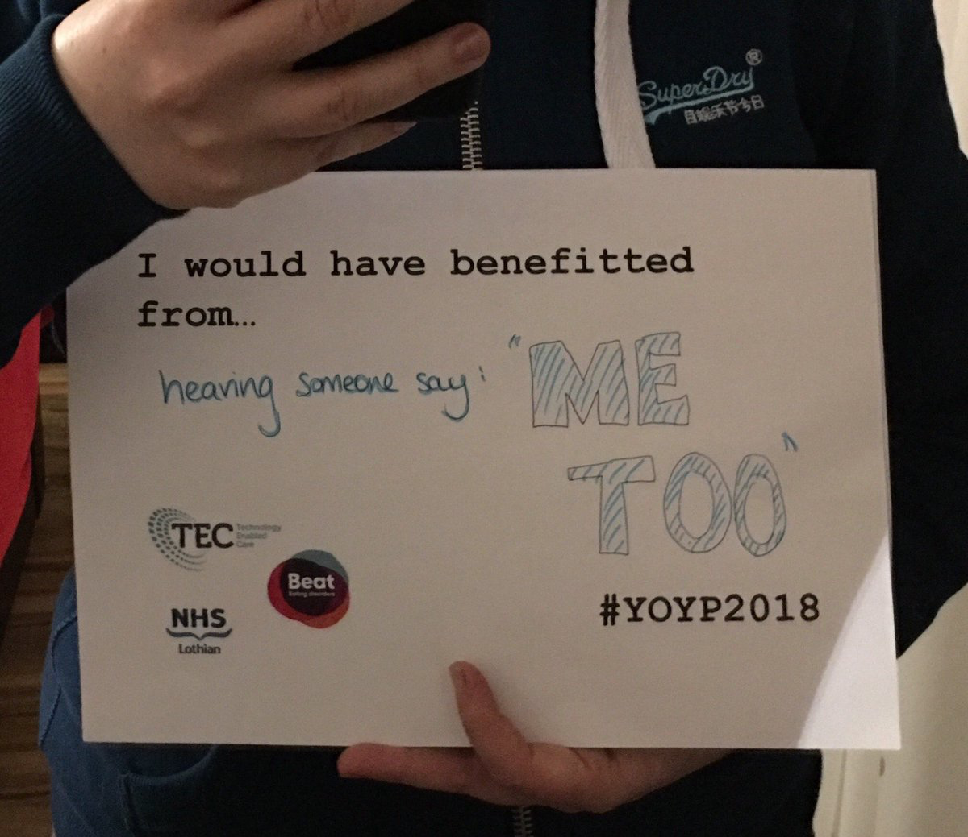
Online Support

Slide 17
Online Support
Notes:
https://www.caredscotland.co.uk/entry-recovery/pushing-for-recovery-and-the-impact-on-relationships/#
https://www.caredscotland.co.uk/entry-skills/skills-2-2/# (traps)

Slide 18
Online Support

Slide 19
Online Support
The online peers support consists of BEAT volunteer befrienders providing 1-3 emails per week to young people aged up to 25 years with eating disorders and/or parents and carer’s.
All volunteers are formally trained by BEAT and email communication is moderated to make sure it is helpful and safe

Slide 20
As part of a previous partnership project with BEAT and NHS Lothian CAMHS, all eating disorder services in Lothian were listed on BEAT’s online “helpfinder” tool: https://helpfinder.beateatingdisorders.org.uk
Goal was to provide outreach to engage with Scottish eating disorder services to develop up to date national listings

Slide 21
HelpFinder

Slide 22
Impact so far
66 Scottish Eating Disorder Services now listed on Beat’s Help finder – increase of 288% from initial listings in October 2017
28 active pairs in or have completed online support (8 parent and carers and 21 young people)
Majority users are female caring for, or themselves have, a diagnosis of anorexia (78%) bulimia, binge eating disorder and atypical eating disorder
Length of disorder from under 1 year to over 10 years.
Average of 2.35 emails exchanges a week per person

Slide 23
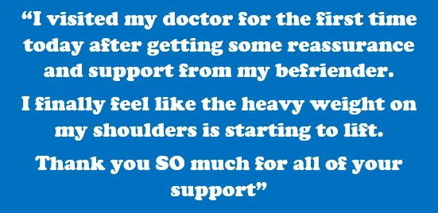

Slide 24
www.caredscotland.co.uk

Slide 25
Over 1200 individuals accessed the online platform within 10 weeks
Return Rate of 15% - expecting to rise following launch
81% from UK, 10% US, 10% Australia
Seven out of the top 10 cities accessing it are Scottish

Slide 27
User Feedback first 10 weeks
Mean usefulness: 8.45/10
Mean relevance: 7.54/10
Mean helpfulness of videos: 7.18/10
Mean learned something new: 7.27/10

Slide 28
Parent &Carer Feedback
“I am finding this very useful and am making a lot of notes to get a good understanding of how to help my daughter.”
“I’ve felt in the dark with the support we’ve had from our CAMHS. And having to wait for my questions to be answered takes it toll. It’s good to have somewhere to go where I can get immediate information.”
“I wish I'd had this resource when my daughter was first diagnosed. It is a really clear one stop shop for information and support”
“I already have recommended this to a fellow carer, and also asked my family to go onto here to help understand my daughter better”

Slide 29
Parent &Carer Feedback
“I found the videos particularly useful, especially those from parents. It has been quite a relief to know that others have felt the same as I currently do.”
“I feel like I’m looking in the mirror when listening to the parents speaking. It’s such a relief to not feel so “unique”.
“More from the videos. They have helped to explain things that professionals don't (and can't really) go into detail with (such as unexpected behaviours at meal times and the anger from my daughter which very much caught me off-guard)”
“I would recommend this although I have felt overwhelmed by all of the information and things that are likely still to come. It is helpful to feel prepared”
Notes:
Play a video here? https://www.caredscotland.co.uk/entry-recovery/pushing-for-recovery-and-the-impact-on-relationships/# (constance)
https://www.caredscotland.co.uk/entry-skills/skills-2-2/# (traps) (parents? – long~~)

Slide 30
Blips along the way!
NHS social media
Need more support to help clinicians adhere to NHS policies and procedures but not inhibit innovation and e-health developments
Need for key contacts in IT, communications etc.

Slide 31
Reflection on Digital Health
Doesn’t have to be “instead of” - helpful to be aligned with routine care to enhance it
Young people supporting promotion and sustainability
Has potential to support vulnerable people into services
Significantly greater reach to more people, geographical distance and isolated individuals.
Can make your own care more efficient
Has to be service user led
The voice of a service user can be more powerful, and insightful, than a health care providers

Slide 32
With Thanks to!
NHS Lothian CAMHS parents and carers
Beat Young Ambassadors
CAPS Independent Advocacy
Range of parents, carers and professionals for reviewing the resource prior to launch
Technology Enabled Care Grant Scheme
Scottish Government

Slide 33
Contacts
Peer Support & HelpFinder
Cared
https://helpfinder.beateatingdisorders.org.uk/scotland-online-peer-support
www.caredscotland.co.uk
@CaredScotland #caredscotland
caredscotland@nhslothian.scot.nhs.uk
@BeatED_Scotland
teced@beateatingdsisorders.org.uk
sarah..taylor@nhslothian.scot.nhs.uk
fiona.duffy@nhslothian.scot.nhs.uk

