Slide 1
Answering the ‘so what’ question
Nigel Henderson, Chief Executive,
Penumbra

Slide 2
About Penumbra
Started in 1985
Significant provider of community mental health services
400+ staff
1600+ people using our services each week
Innovative
Recovery focused
Person centred

Slide 3
Transformations
Services Service
Care Worker Coach/Mentor
Patient Active Citizen
Outputs Outcomes
Maintenance Recovery

Slide 4
Recovery
Recovery isn’t waiting for the storm to pass….
It’s learning to dance in the rain…..
Notes:
I.ROC seeks to measure personal recovery. There are different definitions of recovery – this one was used by someone with a lived experience – it emphasises that personal recovery relates to wellbeing and e.g. realising potential. Recovery doesn’t mean being happy all the time but being ok with experiencing different emotions, it isn’t about being free from disability or ageing or other factors that have an impact on our wellbeing but it is about living a full life in spite of any challenges that are faced.

Slide 5
Focus on wellbeing
+ve
Wellbeing
-ve
+ve
Mental Health
-ve

Slide 6
Our journey
Created a framework
Explored how we might measure personal recovery
Tested and retested various prototypes with people we support
Set up a KTP with Abertay University
Gradually refined, researched and developed I.ROC between 2010-2012
Began our digital journey in 2015

Slide 7
Factors Affecting Wellbeing
Early Life: {Genetics, Experiences, Trauma, Education}
Mental Health: {Illness, Confidence, Resourcefulness, Connectedness, Hopefulness,}
Physical Health: {Illness, Pain, Diet, Addiction, Fitness}
Situation: {Home, Personal Safety, Poverty, Debt, Inequality, Opportunity, Gender}
Notes:
In developing measure of recovery it is helpful to think of the factors that are known to affect wellbeing. These can be summarised as above.
These factors were used to create the HOPE Framework – the framework developed by penumbra to focus on wellbeing and recovery and that forms the structure of I.ROC.

Slide 8
Framework for Wellbeing
Notes:
HOPE Framework = 4 areas of HOPE – all relevant to wellbeing and recovery.

Slide 9
Measuring Recovery
4 areas of HOPE
6 point scale
picture of recovery
12 indicators of wellbeing
Notes:
I.ROC uses the 4 areas of the HOPE Framework as its basis. It then has 12 indicators of wellbeing which were originally identified by people who use Penumbra services and Penumbra practitioners. There are 12 questions, 1 for each indicator, and then a six point scale is used to measure recovery. The first time I.ROC is completed it provides 12 baseline scores ( the darker inner area ). These scores are recorded and can be plotted on an I.ROC graph to provide the baseline measurement. This can also tell you what are the areas that are having the most impact on the wellbeing and recovery for the person completing I.ROC. When I.ROC is completed at a later date – the difference can be measured based on the current scores vs the baseline scores previously provided i.e the picture of recovery.

Slide 10
Testing process
Test | Method
Relevant | Literature Review.
Comprehensive | Literature Review and Focus Groups.
Valid | Study by Abertay University and published results.
Reliable | Study by Abertay University and published results.
Notes:
We have been assessing the reliability and validity of I.ROC over the past 4 ½ years to make sure that you can be confident in why you are using it and what it is telling you.

Slide 11
Validation Results
Scoring
4
0
BASIS-32
1
I.ROC
6
r = 0.7
p < 0.001
Scoring
1
RAS
5
r = -0.55
p < 0.001
1
I.ROC
6
Notes:
Almost 200 people who use Penumbra’s services participated in the next step of the validation, in which they were asked to complete I.ROC alongside two other questionnaires.
The Recovery Assessment Scale (RAS) was one of the first questionnaires developed to measure personal recovery. It has been rigorously tested and has since been used in just about every validation of new recovery measures. It is an American questionnaire consisting of 41 questions which work on a similar scale to I.ROC such that a score of 1 is the furthest away from recovery and 5 is the closest to personal recovery. Because I.ROC and RAS use a similar scoring system, we expected to see a positive correlation between the two measures. We therefore expected people scoring low on I.ROC to score low on RAS and people scoring high on RAS to score high on I.ROC.
BASIS-32 is a clinical outcomes measures which is used on a mandatory basis in parts of Australia and New Zealand. Whilst it is not technically a recovery measure, it does describe itself a measure of personally assessed outcomes and is the sort of tool which, left to their own devices, would most likely be implemented by the Scottish Government and the NHS. Being a clinical measure, its scoring works in the opposite way. A score of 0 represents no deficits and is therefore the closest to ‘recovery’. A score of 4 represents the greatest number of deficits/difficulty and therefore is the furthest away from recovery. Because of this we expected to see a negative correlation between BASIS-32 and I.ROC such that people scoring low on I.ROC would score high on BASIS-32 and people scoring low on BASIS-32 would score high on I.ROC.
And this is exactly what we found.

Slide 12
Questionnaire Preference
Questionnaire Preference
I.ROC
Notes:
We also asked people which questionnaire they preferred. Because, if I.ROC correlates well with other measures that have already been through rigorous testing, why use I.ROC rather than these other tools? Luckily for us, people significantly preferred completing I.ROC to either BASIS-32 or RAS. When asked why, they said that it was shorter, easier, made more sense and was more relevant to their concept of recovery.

Slide 13
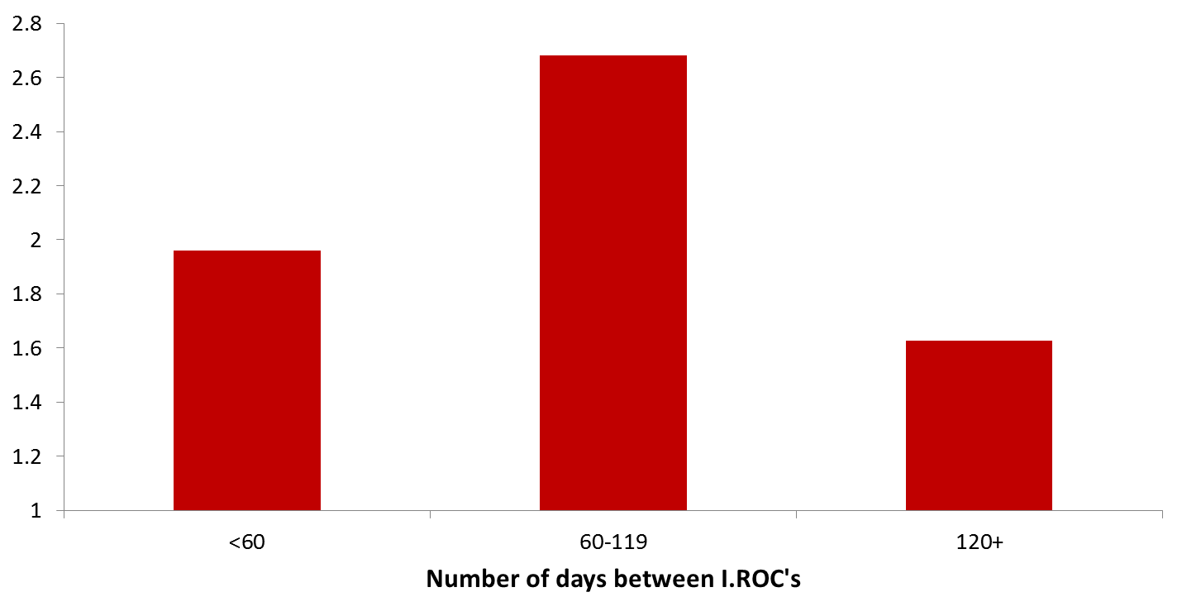
Review Frequency
Change in scores over time
* p <0.05
*
Notes:
So when we looked, we saw that the first time point at which there was a significant change in people’s scores was 3 months. This was a good finding for us of course, as this is the time that you are asked to review I.ROC. It does not mean that for each individual this will be appropriate, and we are aware that for some services this may not be the optimum, but for Penumbra as a whole, 3 months is the best time at which to repeat I.ROC.

Slide 14
I.ROC

Slide 15
I.ROC in Penumbra
Now in use across relevant Penumbra services
Over 12,000 people have used I.ROC in Penumbra since 2012
Offers a dynamic personal outcomes focused process for staff and the people we support
Data gathered enables us to focus on particular areas for service development

Slide 16
‘Going digital’ with I.ROC Wellbeing

Slide 17
I.ROC Client Management

Slide 18
I.ROC Client Management

Slide 19
I.ROC Digital

Slide 20
I.ROC Reports

Slide 21
I.ROC Reports

Slide 22
Measuring Impact

Slide 23
Variables

Slide 24
Demonstrating Impact

Slide 25
www.irocwellbeing.com
For the person who wants to:
√ Identify factors that impact own wellbeing
√ Define personal outcomes
√ Shape and manage own recovery
√ Develop strategies of self-management
For the Practitioner who wants to have
√ Clarity of purpose
√ Support tools and resources
√ Confidence of approach
√ Ability to measure “distance travelled” of person

Slide 26
The benefits of using I.ROCwellbeing are:
A secure and reliable system to store detailed personal, demographic and recovery data for each client in one place.
Access the system securely anywhere, on almost any device, PC, tablet and smartphone.
Easy for practitioners to update client records and upload further documents to the account.
Complete I•ROCs online or
via mobile APP (online or offline).

Slide 27
benefits cont/
Access HOPE Toolkit and recovery resources online.
Generate comprehensive client, service and organisation outcome reports quickly and easily.
Access comprehensive eLearning modules about I•ROC wellbeing and recovery approach.
Create unlimited accounts per service - with unlimited storage.

Slide 28
Who’s using I.ROCwellbeing
People in: UK
USA
Australia
Netherlands
Belgium
Spain
Chile

Slide 29
And….
Work/research underway with new partners in:
Finland
Australia
Netherlands
Czech Republic
China

Slide 30
Settings where I.ROC is in use
Hospital wards
Forensic unit
Rehabilitation units
Step down services
ARBD services
Ex-offender services
Community services
Recovery Colleges
Supported Housing

Slide 31
New developments
Y.ROC
eLearning modules
Extended HOPE toolkit

Slide 32
Contact Details
Nigel Henderson
e:nigel.henderson@penumbra.org.uk
twitter: @sogalo

