Slide 1


“How e-mental health can be used in the criminal justice system, and in particular in prisons”
Workshop, May 24, 2018
Dr Pauline Whelan, Co-Director CAMHS.Digital
Centre for Women’s Mental Health / Division of Informatics, Imaging and Data Science
Greater Manchester Mental Health Trust / University of Manchester
Dr Kerry Gutridge, Project Manager, Centre for Women’s Mental Health, Forensic Research

Slide 2
Outline for the Workshop
Introductions
e-Mental Health and Health Informatics Research
Self-Harm and Prison Context
Small Group Tasks
General Discussion

Slide 3
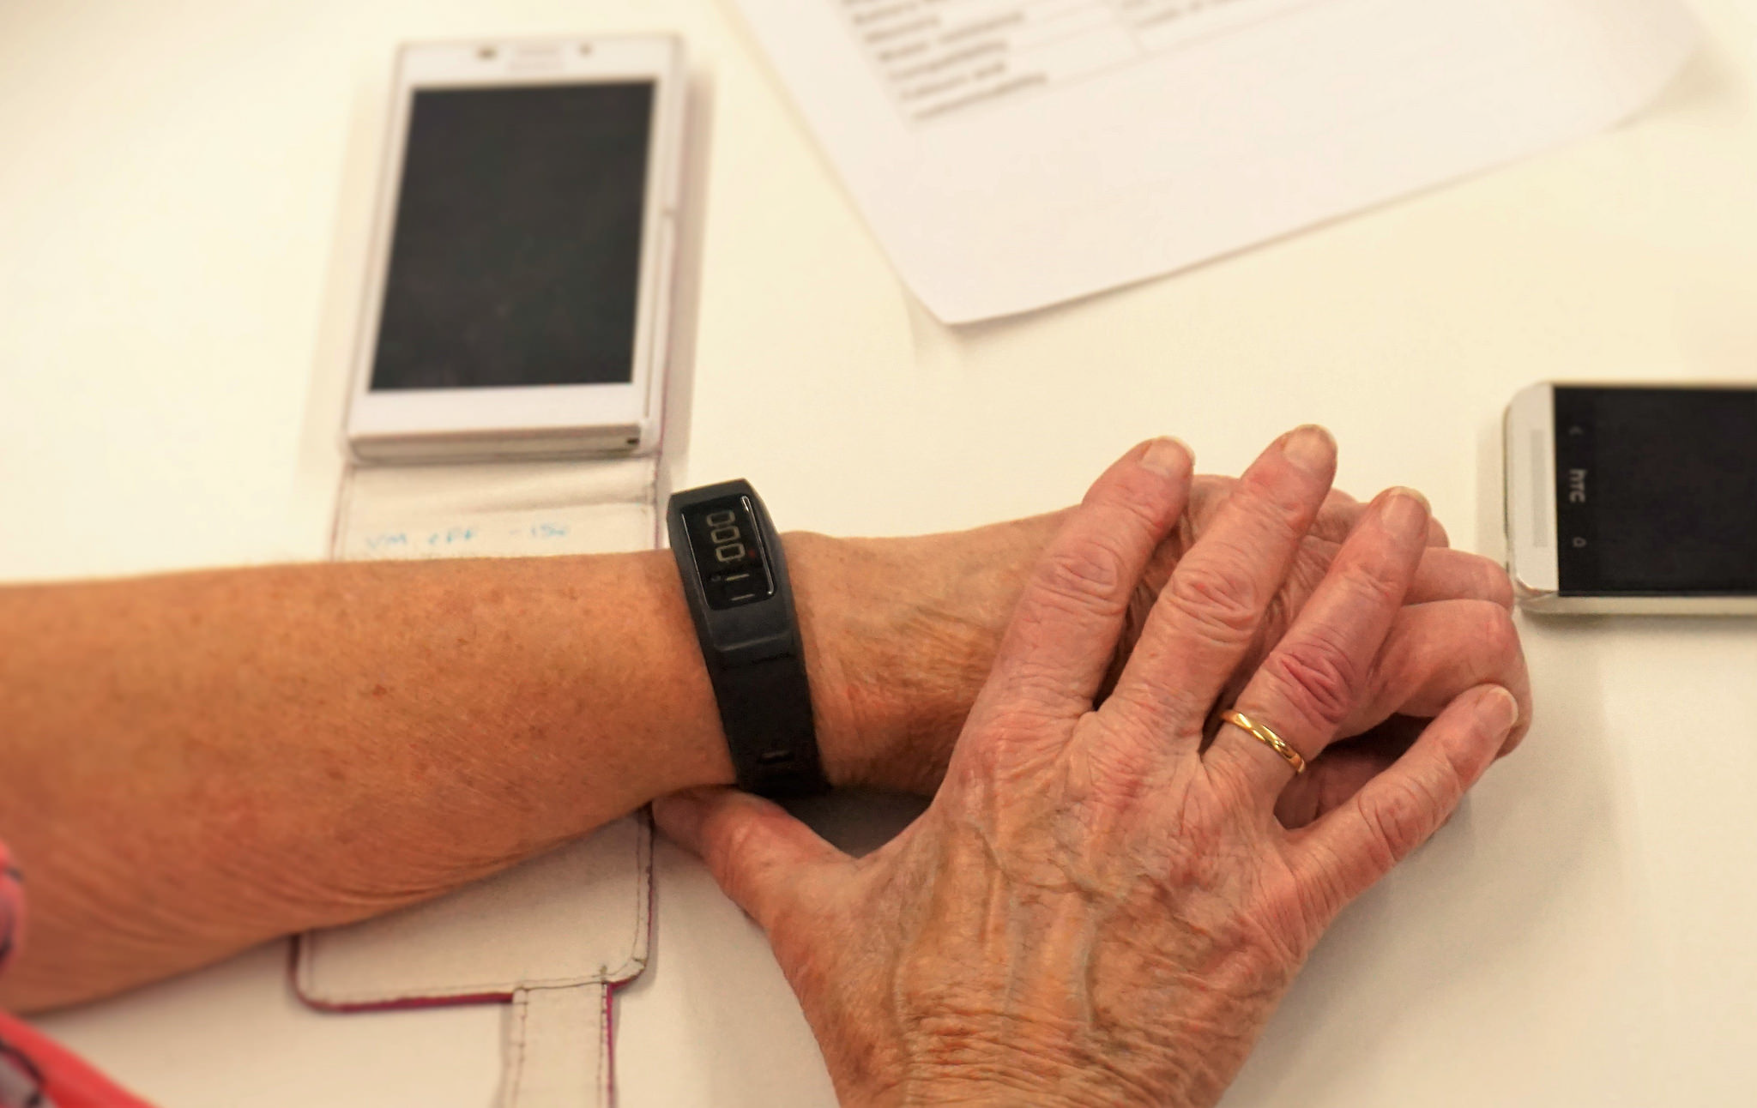
Introduction
Applies mobile and web technologies to health informatics research
Using agile technologies to co-produce digital platforms
Work as part of an integrated project research team
Embed digital solutions into routine care across a wide variety of contexts
Start from a strong theoretical base
Co-produce flexible digital solutions
Aim to embed technology in routine care

Slide 4
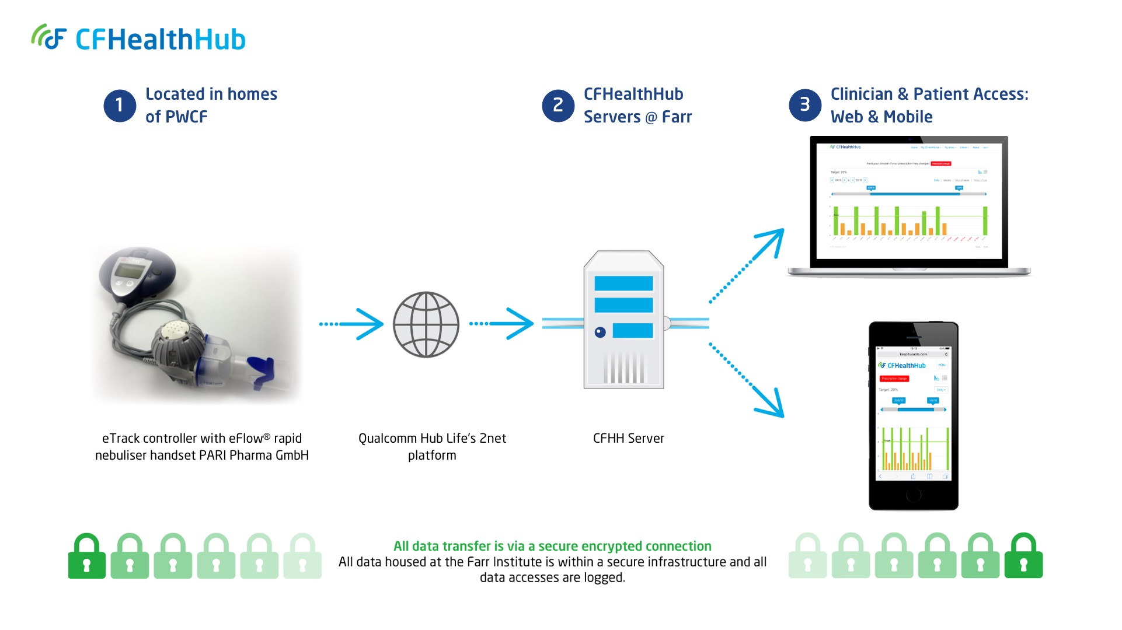
e-Mental Health / e-Solutions?
AI/Machine learning
Big Data
Data Linkage
Behavioural Nudges
Medical Device Integration
mHealth
eHealth
Patient-facing
Clinician-facing

Slide 5
Health Professionals, ClinTouch, 2010
They said
We found
Few users own and use a mobile
Users won’t be interested
They’ll lose or sell the handset
It will make users paranoid
It will be too complicated
It will take too long to complete
They will stop using it
Responses won’t resemble interview data
85% do.
80% agreed
1/44 lost handset
2/44 discontinued for this reason
36/44 completed >33% of 36
Average 70 seconds
81% completed a week
Very high correlations on key items

Slide 6
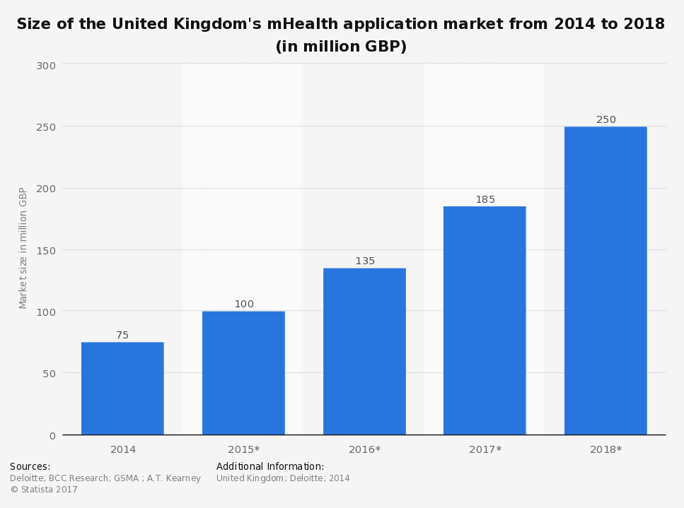

The Context
Notes:
Focuses on health in mobile and tablet computing; pervasive and ubiquitous computing, including wearable devices
Benefits – ubiquitous data capture (‘big data’); enables self-management so reduces cost on services; patient empowerment (involving patients in their own care and treatment plans); giving clinicians access to real-time data; big data allows analysis of population health

Slide 7
Ethics in the time of technology:
http://www.affectech.org/2018/05/ethics-in-the-time-of-technology/

Slide 8
e-Mental Health
ICT for mental health purposes
Public expectations increasing
Technical capabilities (mobile Health, wearables, data science & Big Data, Artificial Intelligence, Machine learning, Linking datasets…)
Peer support, self-management enabled interventions
Ability for real-time monitoring and intervention delivery
Enhanced clinical monitoring
Resource challenges – scalable, wide roll-out at low cost

Slide 9
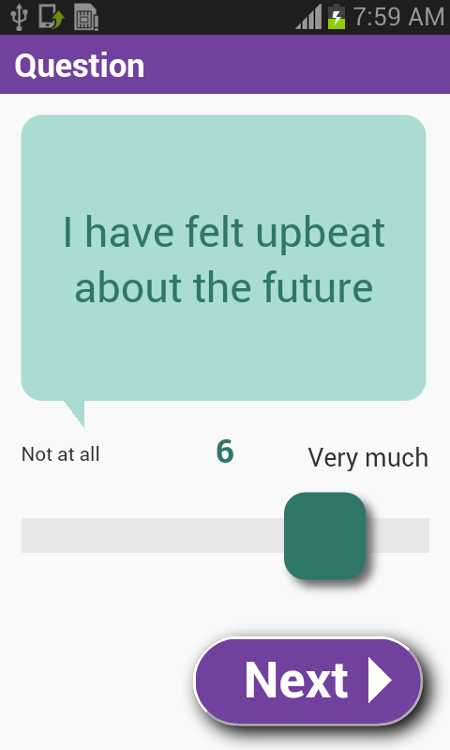

ClinTouch – Problem One - Clinician
I wish I knew how my patient was really feeling between clinic appointments
  Symptom reporting intermittent and unreliable, difficult to get an accurate account of patient’s health

Slide 10
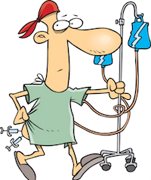
ClinTouch – Problem Two - Patient
Service users reported feelings of disengagement from their care planning
I wish I could be more involved in my own care and treatment planning

Slide 11

ClinTouch – Problem Three – Clinician, Patient & NHS
  Late detection of worsening symptoms increases risk of relapse
  Cost of unscheduled hospital admissions high – both for patient and for the NHS
  Early intervention is key

Slide 12
Self-harm in women’s prisons
Self-harm in women is a complex behaviour associated with a history of trauma (triggered by acute distress) and carries increased suicide risk (Hawton et al., 2014; Marzano et al., 2010).
Most women in prison have extensive victimisation histories, often describing multiple traumas (Moloney et al., 2009).
Of 3,901 women prisoners in England/Wales (Ministry of Justice, 2018), at any one time, approximately 30% self-harm.
Notes:
Because every year ~9000 women pass through prison [14], this means that evidence-based interventions have the potential to benefit several thousand women annually.
This is base on staff time not other costs and does not factor in the costs associated with suicide
Reduced self-harm thoughts and acts would alleviate huge demands on diminishing prison staff/resources, supporting NHS in-reach and ACCT.
Professionals who manage people who self-harm have been shown to experience a range of difficult emotions that have the potential to damage their own psychological wellbeing [22]. Prison staff who work with women who self-harm may experience feelings of powerlessness and struggle to cope with the impact of self-harm incidents [22].
Based on one prison’s estimates, self-harm costs the NHS £31,285 per week across the Women’s Estate.

Slide 13
Self-harm in women’s prisons
There is a pressing need to develop and evaluate evidence-based interventions.
Although various interventions are used in prison to treat women who self-harm, a systematic review, conducted by the University of Manchester, identified the need for all such interventions to be robustly tested and based on clear evidence of benefit.
Preliminary consultation with prison staff, revealed concerns that there has been too little focus on self-harm prevention, as opposed to treatment.
Notes:
(pre-publication, available on request).

Slide 14
Self-harm in women’s prisons
Reception into the prison is a high-risk period when a disproportionate amount of self-harm occurs (Prison Reform Trust, 2015; Shaw et al., 2004).
When women are in their cells boredom and a lack of purposeful activity can be a risk factor for self-harm (Marzano et al., 2011).
Moreover, women in their cells may have limited access to other prison-based support mechanisms such as listeners.

Slide 15
eHealth for women in prison
eHealth self-management interventions are particularly suited to forensic populations who may have restricted access to the self-help mechanisms they would typically use in the community and have low literacy.
eHealth which emphasises self-care has the potential to empower women and provide them with skills they can use in prison and continue to use through the gate.
Using eHealth technology will ensure that women in prison are familiar with technological advances, enabling more seamless reintegration into the community (Van De Steene & Knight, 2017).

Slide 16
Self-harm and Prison Context
Small Group Discussion 1:
How might mobile health help address self-harm in a prison context?

Slide 17
Designing a self-harm app
Exercises to distract people from self-harm
Advice on self-comforting behaviour
Exercises to encourage relaxation and build resilience
User developed content e.g. voiceovers, accounts of their experiences, artwork or poetry
Signposting to sources of immediate and long term help.

Slide 18
mHealth Challenges in a Prison Context
Small Group Discussion 2:
What kinds of problems might we encounter deploying e-Mental Health in prison contexts?

Slide 19
Problems in a Prison Context
Access to mobiles/laptops for people in prison
Restricted access to internet services for data transfer
Signal strength to access the internet
Restricted devices – access to people in prison to co-develop the app
‘Big data’ but small sample sizes
Long lead times to gain access
Public and media pressure
Notes:
Devices:
limited set of features (video/audio -> development complexity increases vs limited set of features, usability compromise)

Slide 20
mHealth – General Issues
Socio-technical challenges of mHealth
Reuse/extend existing platforms
Data security – data capture, data storage, data transfer
Regulatory frameworks – MHRA and medical devices directive
Think PPI from the start
Managing requirements during co-production phases
Building ‘device agnostic’ systems & Interoperability
Cost
User Interface Design & Usability (Personalisation)

Slide 21
Thank You
ClinTouch was funded by two Medical Research Council Developmental Clinical Studies grants 2010-12, 2012-15.
NIHR: CFHealthHub is funded by the National Institute for Health Research (NIHR) under its Programme Grants for Applied Research Programme (Grant Reference Number RP-PG-1212-20015). The views expressed are those of the author(s) and not necessarily those of the NHS, the NIHR or the Department of Health.

Slide 22
References
•Hawton, K., Linsell, L., Adeniji, T., Sariaslan, A. & Fazel, S. (2014). Self-Harm in Prisons in England and Wales: An Epidemiological Study of Prevalence, Risk Factors, Clustering, and Subsequent Suicide. [Research Support, Non-U.S. Gov't]. Lancet, 383(9923), 1147-1154.
•MarzanoL., FazelS., RivlinA. & HawtonK. (2010). Psychiatric Disorders in Women Prisoners who have engaged in Near-Lethal Self-Harm: Case-Control Study. British Journal of Psychiatry, 197, 219–26.
•Marzano, L., Fazel, S., Rivlin, A. & Hawton, K. (2011). Near-lethal self-harm in women prisoners: contributing factors and psychological processes. The Journal of Forensic Psychiatry & Psychology, 22(6), 863-884.
•Ministry of Justice. (2018). Population bulletin: weekly 16 March 2018.London: Ministry of Justice.
•Moloney, K., van den Bergh, B. et al. (2009). Women in Prison: The Central Issues of Gender Characteristics and Trauma History. Public Health, 23(6): 426-430.
•Prison Reform Trust. (2015). Bromley Briefings Prison Factfile: August 2015. Prison Reform Trust: London.
•Shaw, J., Baker, D., Hunt, I.M., Moloney, A. & Appleby, L. (2004). Suicide by prisoners: National Clinical Survey. British Journal of Psychiatry, 184(3), 263-267.
•Van De Steene, S. & Knight, V. (2017). Digital transformation for prisons: Developing a needs-based strategy. Probation Journal, 64(3), 256-268.

